Slide 1






Polycythemia
Objectives:
-To understand the meaning of myeloproliferative neoplasm (MPN) and its clinical presentation.
-To differentiate between primary and secondary polycythemia.
-To obtain an overview about primary myelofibrosis and essential thrombocythemia.
-To appreciate the importance of genetic abnormalities (clonality) in these hematological neoplasms and the idea of targeted therapy.
Important.
Extra.
Notes
References:
436 girls & boys’ slides
435 teamwork slides
Editing file
Do you have any suggestions? Please contact us!
@haematology436 E-mail: Haematology436@gmail.com
or simply use this form

Slide 2

Myeloid Neoplasm
Myeloproliferative neoplasms (MPN)
Myelodysplastic syndromes (MDS)
acute myeloid leukemia (AML)
MDS/MPN
Classification:- تكملة للتقسيم في محاضرة الكرونيك لوكيميا ولا يناقضه
Polycythemia vera (PV)
Essential Thrombocythemia
Primary myelofibrosis
BCR-ABL Must be –ve
Positive BCR-ABL1 is a characteristic feature of chronic myeloid leukemia (CML)
That is why in any myeloproliferative disease the BCR-ABL1 must be negative
قبل بدايتك في المحاضرة ننصحك بمشاهدة هذا الفيديو من عمل التيم فيه شرح عام للمحاضرة ممكن يسهل عليك
Myeloproliferative neoplasm (MPN) features:
Cytosis.
Organomegaly (mainly splenomegaly).
High uric acid. Because of increased turnover of these cells - may cause gout
Hypercellular bone marrow.
Clonal evolution.
Progression to acute leukemia ,mainly (Acute Myeloid Leukemia).
Myeloproliferative neoplasm (MPN) is a group of interacting diseases where bone marrow stem cells are affected (by an acquired abnormality) which result in increase proliferation
It can affect any cell lineage:
When red cells’ precursor is affected ← polycythemia Vera
When platelets are affected ← essential thrombocytosis
When all three lineages are affected← primary myelofibrosis

Slide 3
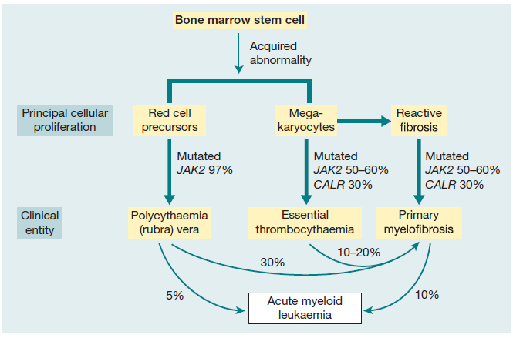
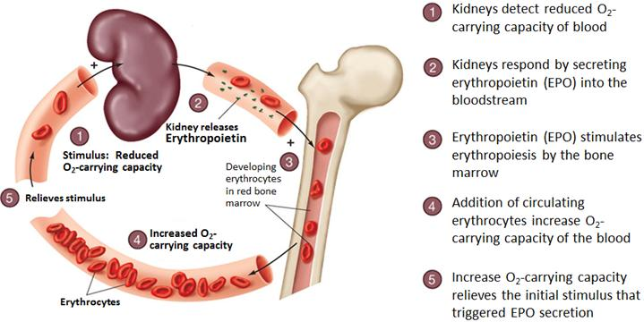
EXTRA IMPORTANT
ارجع للصورة بعد ما تخلص المحاضرة، النسب مهمة، مشروحة في مقطع الفيديو في السلايد الثاني
Relationship between the three myeloproliferative diseases. They may all arise by somatic mutation in the pluripotential stem and progenitor cells. Many transitional cases occur showing features of two conditions and, in other cases, the disease transforms during its course from one of these diseases to another or to acute myeloid leukaemia. The three diseases, polycythaemia rubra vera, essential thrombocythaemia and primary myelofibrosis, are characterized by JAK2 or CALR mutation in a varying proportion of cases.
Polycythemia
In Greek, “too many cells in the blood.”.
Absolute increase in total body red cell volume (or mass).
Manifests itself as a raised hemoglobin or packed cell volume (PCV), maybe masked by other disorders like iron deficiency.
Almost always, accompanied with JAK2 mutation.
Regulation of Erythropoiesis by erythropoietin: مشروحة في الفيديو

Slide 4
Calcification of polycythemia. Important! مشروحة في الفيديو
normal
normal
normal
Relative or pseudo or stress
Polycythemia
absolute
Secondary polycythemia
absolute Polycythemia
Vera
Decreased plasma volume due to severe dehydration RBCs mass in NOT increased but in comparison to the decreased plasma the RBCs are a lot
Increased RBC mass due to high EPO (erythropoietin​) :
1-COPD, Sleep apnea, (smoking most common)
2-High altitude
3-High affinity HB (hard release of oxygen to tissue leading to more O2 demand)
4-Renal disease
5- EPO secreting tumor (Parathyroid adenoma)
Increased RBC mass due to malignant proliferation
2ry polycythemia: Any cause that interrupt with EPO production or affect kidneys may cause more RBCs and this is not a clonal disease
Polycythemia vera:
It is a type of MPN characterized by increased red blood cell production independent of the mechanisms that normally regulate erythropoiesis (intrinsic proliferation and anti-apoptotic).
Diagnostic features of polycythemia vera:
HB >16.5g/dl in men, 16.0g/dl in women. (raised Hb).
Hypercellular bone marrow (pan-myelosis all myelo cell lineages may be increased).
JAK2 mutation in >95% of cases.
No increase in serum erythropoietin level. Because it is not the cause.
Clinical feature of polycythemia vera :
1-Increased blood viscosity due to increase the number of RBCs related to plasma.
Hypertension
Headache, dizziness, visual disturbances & paresthesia
pruritus.
2- Thrombosis
Deep vein thrombosis
Myocardial infarction
Mesenteric, portal or splenic vein thrombosis
3-Splenomegaly in 70% most important feature due to Extra destruction of RBCs in the spleen, because of its high number
4-Hepatomegaly in 40%

Slide 5
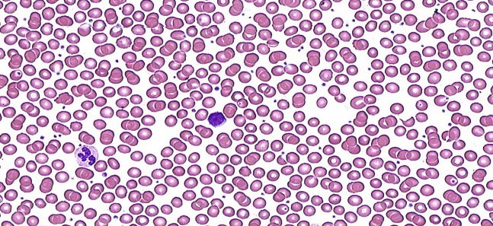
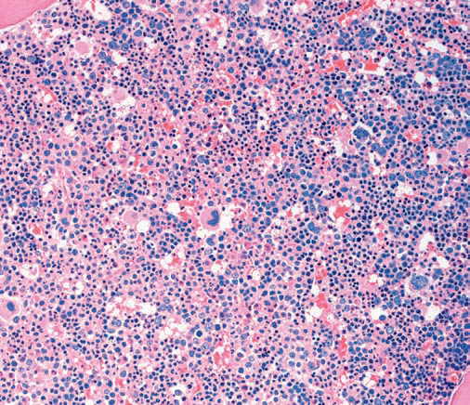
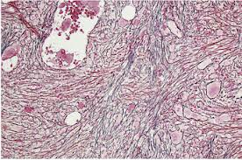
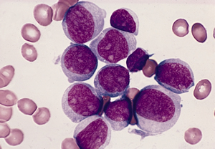
When do we say that this patient has PV? Important!
When he has 3 Major criteria or First 2 Major and the Minor criteria.
Major criteria
1. Hb> 16.5 g/dl in men or Hb>16.0 g/dl in women
Or Hematocrit > 49% in men or >48% in women
Or Increased Red Cells Mass (RCM).
2. Bone Marrow biopsy shows (panmyelosis).
3. Presence of JAK2V617 or JAK2 exon12 Mutation.
Minor criteria
Subnormal serum erythropoietin level.
Investigations of polycythemia vera :
CBC:
*RBC: increased *Hb: increased
*WBC&PLT (platelets) :mildly increased (usually).
Blood smear:
Excess of normocytic normochromic RBC.
± Leukocytosis &thrombocytosis.
Bone marrow
Hypercellular.
Predominant erythroid precursors.
± Increased megakaryocytes & myeloid precursors.
Blasts AL transformation
Complication and treatment of polycythemia vera:
Treatment: Not important
Venesectiont+ Aspirin to prevent thrombosis
± Myelo-suppressive drugs (hydroxyurea) it’s a chemotherapy
Complications:
10-15 years
20-30%
5-10%
Myelofibrosis
Acute leukemia

Slide 6
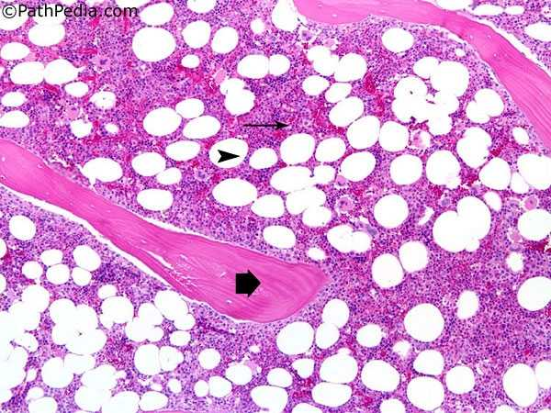
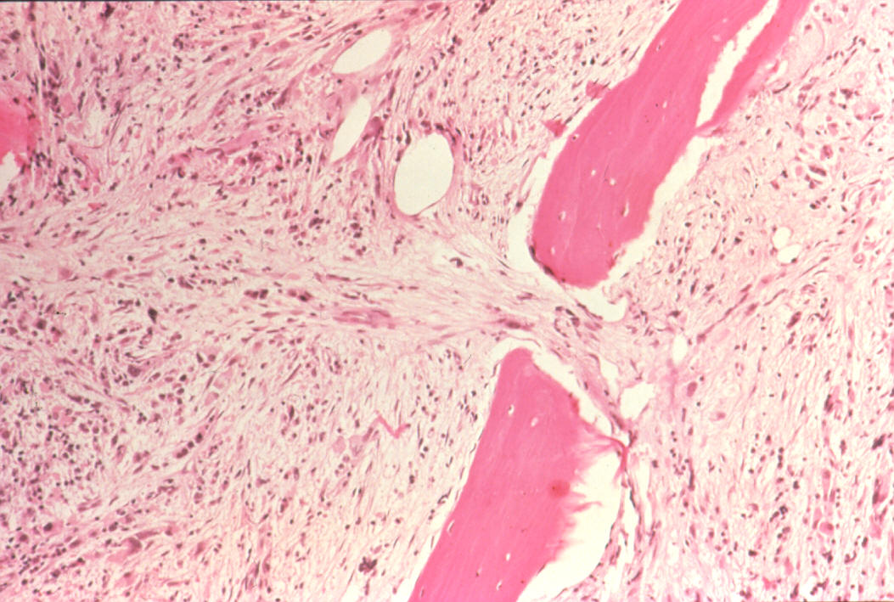
Primary myelofibrosis
It is a clonal MPN characterized by a proliferation of megakaryocytes & granulocytes in the bone marrow that associated with deposition of fibrous connective tissue and extramedullary hematopoiesis
Clinical feature of primary myelofibrosis :
Anemia
Leukoerythroblastic blood picture. Due to bone marrow stress from fibrosis
Massive splenomegaly. (The bone marrow is filled with fibrosis so extramedullary hematopoiesis is required and splenomegally is massive because the spleen not only filter but also makes new cells so even bigger than in polycythemia Vera or Essential thrombocythemia)
Fibrotic bone marrow.
JAK2 mutation (50%-60%).
Risk of AML transformation (10-20%).
Leukoblast
Teardrop cell
Nucleated RBC
Leukoerythroblastic blood picture. مهمة ومشروحة في الفيديو
Blast cells seen in peripheral blood because bone marrow is filled with fibrosis
Nucleated RBCs (immature) -Blast WBS -Tear drop cells
Bone marrow in myelofibrosis
Normal BM
Fibrotic BM
Stages of primary myelofibrosis :
Pre-fibrotic stage
Proliferation of megakaryocytes & granulocytes
- Leukocytosis
- Thrombocytosis
7-10 years survival
00
3-7 years survival
Fibrotic stage
Anemia
Leukopenia
Thrombocytopenia
Extramedullary hematopoiesis
AML transformation
≤1 year survival

Slide 7
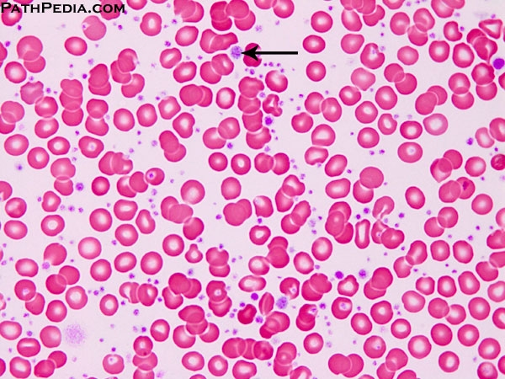
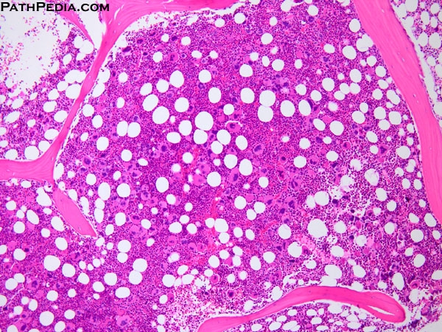
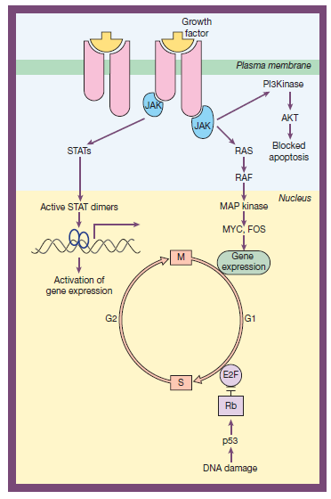
Essential Thrombocythemia
It is a MPN that involves primarily the megakaryocytic lineage and characterized by sustained thrombocytosis
Diagnostic features of Essential Thrombocythemia
Sustained thrombocytosis ≥45O×10⁹/L.
Hypercellular BM with megakaryocytic proliferation.
Exclusion of: CML, MDS, PV &PMF. (all these diseases can cause thrombocytosis so exclude them) remember CML is excluded by a negative BCR-ABL
JAK2 V617F mutation (50-60%), CARL or MPL mutations, If negative; no evidence of reactive thrombocytosis which is : Iron deficiency, splenectomy, surgery, infection ,autoimmune disease…. The causes of reactive thrombocytosis should be also excluded because they increase thrombocytes as well
Clinical presentation of essential thrombocytopenia
Asymptomatic (50%)
Thrombosis
Bleeding (defective function of platelets)
Mild splenomegaly (50%)
Mild hepatomegaly (20%)
Very indolent
(5% risk of AML transformation )
Treatment : Aspirin (to prevent thrombosis) ± Hydroxyurea
JAK2 mutation
JAK2: (Ch 9p with 26 exons), a non-receptor protein tyrosine kinase involved in signal transduction pathway.
JAK2 kinase domains structure
JH6
JH5
JH4
JH3
JH2
JH1
Negative feed back
When JAK2 get Activated it activates system called STATs by dimerizing 2 STATs Together This system will cause modulating of Gene expression To start the proliferation.

Slide 8
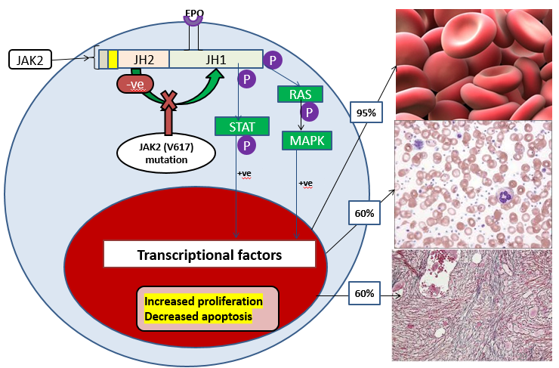
Summary
The video in slide 2 summarizes everything.

Slide 9
MCQs:
Which ONE of the following is NOT a cause of polycythemia?
A) Mutation of JAK‐2.
B) Renal disease.
C) Congenital heart disease.
D) Hemoglobin abnormality.
E) Iron overload.
Which ONE of these statements is TRUE about pseudo (stress) polycythemia?
A) It is caused by a raised red cell mass.
B) It is associated with a large spleen.
C) It is treated with hydroxycarbamide (hydroxyurea).
D) It is most common in young male adults.
What is the approximate frequency of the Val617Phe mutation in JAK2 in myeloproliferative neoplasms?
A) 99% in polycythemia vera (PV) and 50% in essential thrombocythemia (ET) and primary myelofibrosis (PM).
B) Approximately 50% in PV, ET and PM.
C) 50% in PV and 25% in ET and PM.
D) 90% in PV, rare in ET and PM.
Answers
E
D
A
Good Luck!
Team Members
Khalid Al-Husainan
Abdullah Al-Nasser
Dania AlKelabi
Team Leaders
Abdulaziz Al-Hussainy
Safa Al-Osaimi

