Slide 1
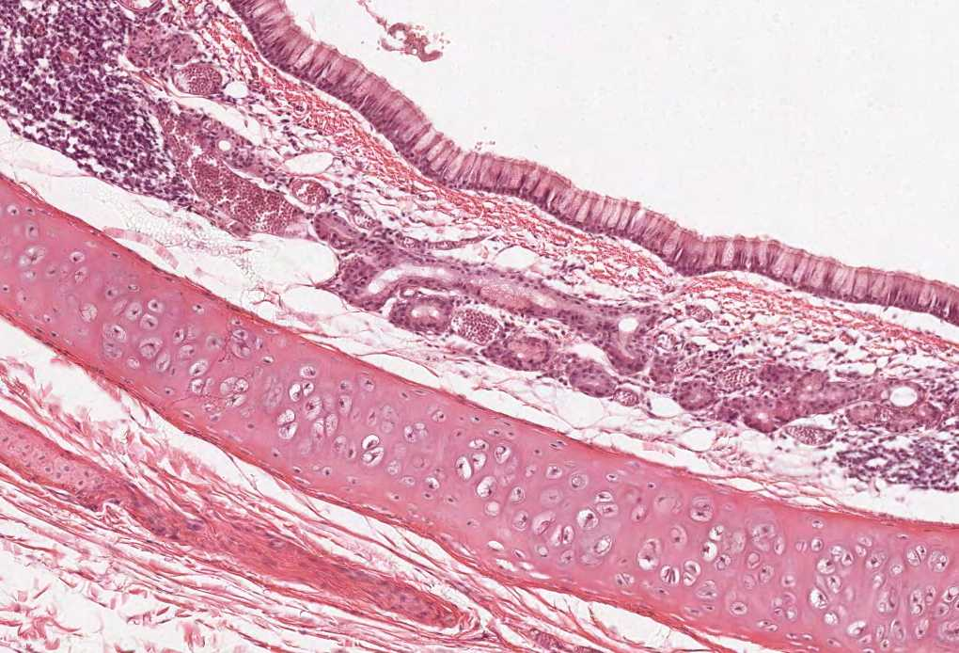
Alimentary Canal (I)
(Esophagus and Stomach)
Salivatory Glands
Color index:
Slides.. Important ..Notes ..Extra..

Slide 2
Objectives:
By the end of this lecture, the student should be able to discuss the microscopic structure in correlation with the function of the following organs:
Esophagus.
Stomach.
The GIT systems looks more like one tube with one continuous lumen with some modification in each area according to the function but the main structure is the same.
Describe the microscopic structure of the major salivary glands in correlation with function.

Slide 3
Alimentary Canal
Is the tubular portion of digestive system.
Is subdivided into:
Esophagus, stomach, small intestine (duodenum, jejunum and ileum),
and large intestine (cecum, colon, rectum, anal canal, and appendix).
General Architecture of L/M Structure of Alimentary Canal:
1- Mucosa: epithelium (lining the cavity), C.T (Lamina propria) and mucosal muscularis smooth muscle (outer longitudinal and inner circular)
2- Submucosa: submucosal plexuses (mesenteric plexuses), lymphatic nodules and immune cells
3- Muscularis externa: outer longitudinal, inner circular and between them is myenteric plexuses (neuronal layer)
4- Adventitia OR serosa: Most of the esophagus has adventitia as its last layer cause most of it located in the thoracic cavity and there is no peritoneum there. The rest of esophagus has serosa.
Serosa
3ps:
1-plurea around lungs
2-precardiun around heart
3-peritoneum(serosa) around abdominal cavity
So it depends on the organ whatever it covers by Adventitia or serosa

Slide 4
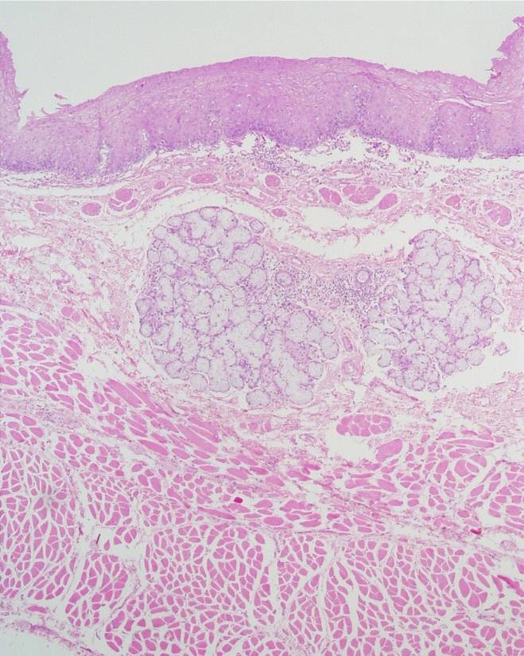
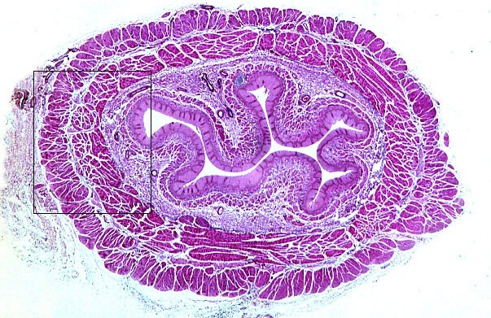
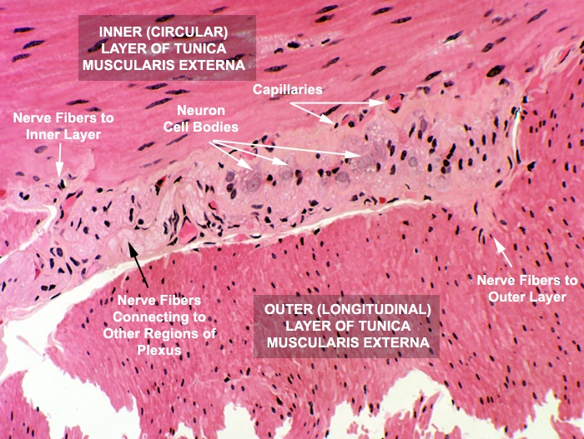
1- Esophagus: Four concentric layers:
1-Mucosa: has folds to increase the surface area | 2-Submucosa
Epithelial Lining: Non-Keratinized Stratified Squamous Epithelium. Lamina propria: Loose areolar C.T. with mucosal esophageal glands (secretion of mucus) in the upper and lower ends. Muscularis mucosae: Few layers of smooth muscle fibers. | Loose areolar C.T. containing blood vessels, nerves, submucosal esophageal glands (secretion of mucus). Meissner’s plexus of nerve fibers and nerve cells.
3-Muscularis Externa: | 4-Serosa or Adventitia
Two muscle layers: 1- Inner circular layer. 2- Outer longitudinal layer. Upper 1/3: Both layers are skeletal M. Middle 1/3: Inner layer is smooth muscle Outer layer is skeletal M. Lower 1/3: Both layers are smooth M. Auerbach’s (myenteric) plexus in between the 2 layers Upper 1/3rd: Skeletal = voluntary | Adventitia: is loose areolar C.T. not covered by mesothelium. Serosa: is loose areolar C.T. covered by mesothelium (simple squamous epithelium) in the abdominal part of the esophagus.
Or Serosa

Slide 5
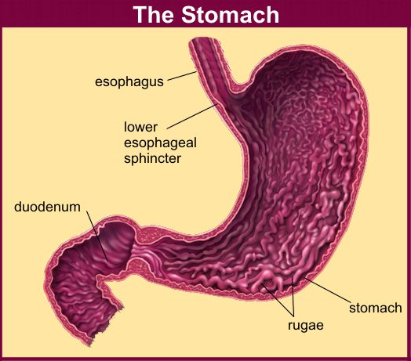
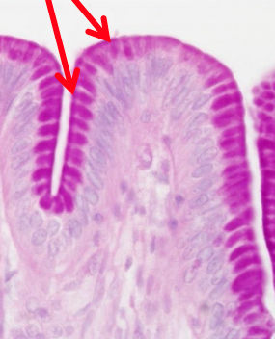
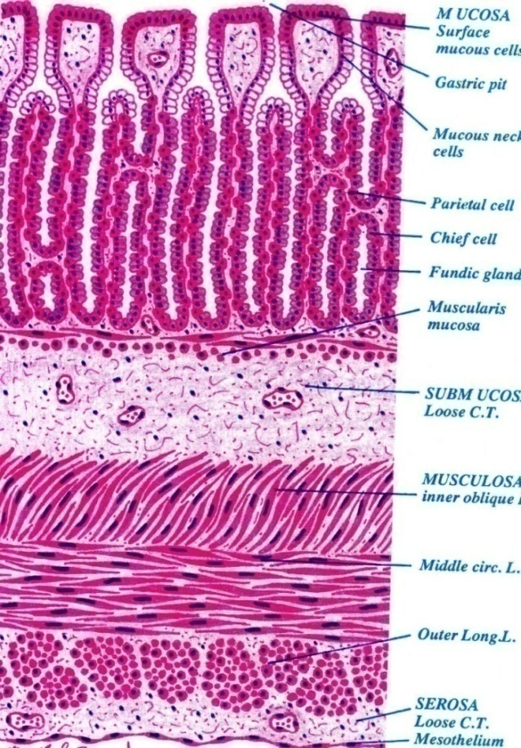
2- Stomach (Fundus and Body)
It has 4 regions: cardia, fundus, body and pylorus.
Mucosa has folds, known as rugae that disappear in the distended stomach.
1-Mucosa: | 2-Submucosa
Is invaded by fundic glands. Surface epithelium: is simple columnar mucus-secreting cells. The mucus protects the cells from the acidic lumen. PAS(stain): any cell that contain mucous will get colorized by this stain. Lamina propria: C.T. invaded by numerous fundic glands with lymphoid elements. Muscularis mucosae: 2 layers of smooth muscle fibers. | Connective tissue containing blood vessels, nerves, and Meissner’s plexus. NO submucosal glands.
3-Muscularis Externa: | 4-Serosa
Three smooth muscle layers: Inner oblique. Middle circular. Outer longitudinal. Auerbach’s (myenteric) plexus. | C.T. covered by mesothelium.
Lower esophageal sphincter:
فايدتها تمنع الاكل يرجع لما تكون وضعيه الجسم بالعكس ولكن عالعموم هي مو عضله قويه

Slide 6
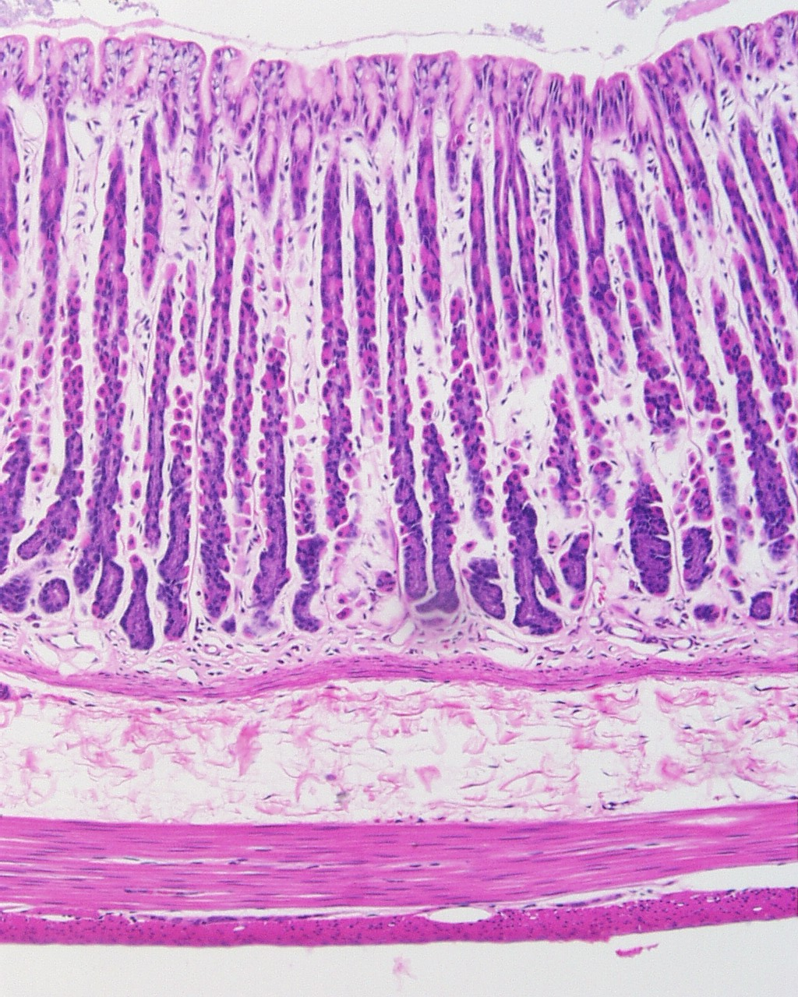
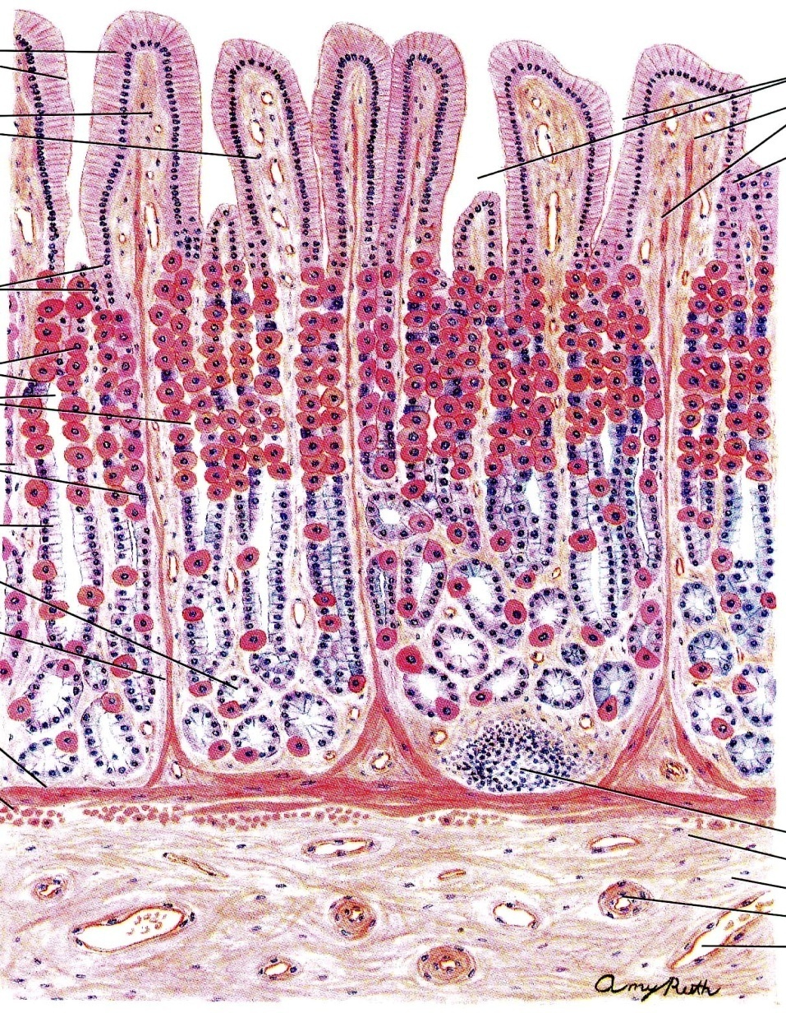
Mucosa of Fundus of Stomach
Fundic Glands
1. Lumen
2. Surface columnar epithelium.
3. Pits of fundic glands.
4. Fundic glands.
5. Lamina propria.
6. Muscularis mucosae
Fundic glands have:
Short pits: one fourth of mucosa. حفرة
Simple branched tubular glands.
Are rich in parietal & chief cells.
Composed of 5 cell types:
1. Parietal (oxyntic) cells.
2. Peptic (chief) cells.
3. Mucous neck cells.
4. Enteroendocrine (EE, DNES) cells.
5. Stem cells.
2
1
3
4
5
6

Slide 7
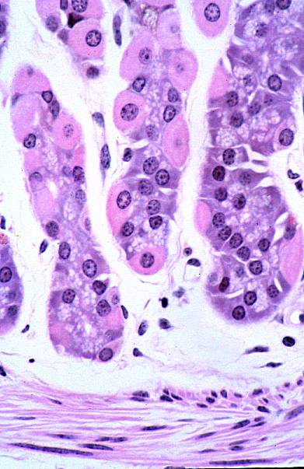
Fundic Glands
**
1. Parietal (oxyntic) cells:** Shape: pyramidal or polygonal. Nucleus: central, round. Cytoplasm: Deeply acidophilic (pink color), rich in SER and mitochondria (40% of the cell volume). C-shaped intracellular canaliculus. Function: its villi secrete HCl and gastric intrinsic factor that helps absorption of vitamin B12. Parietal - why? Bc this type of cells do not reach the lumen of the stomach Oxyntic - why? Bc it’s acid forming cells | 2. Peptic (chief) cells: The predominant cell type. Columnar cells. Nucleus: basal, round. Cytoplasm: basophilic with apical secretory granules. Function: Secrete pepsinogen (inactive form), when activated it'll digest proteins. Proteins always appears under the microscope as basophilic.
3- Mucous neck cells: secrete mucus. | 4- Stem cells: regenerative cells. the normal cells age = around 4 days then it will renew by stem cells
5- Enteroendocrine (EE) (DNES) cells: Enterochromaffin (EC) cells: secrete hormones (e.g. serotonin, endorphin). hormones are secreted basally near C.T--to blood vessels –then circulate in blood

Slide 8
Fundic gland (extra)

Slide 9
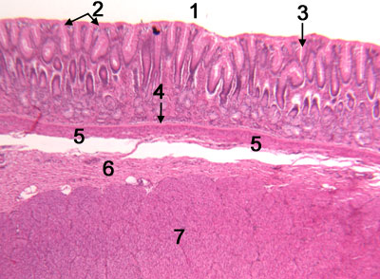
Pylorus of Stomach
Mucosa: Is invaded by pyloric glands. The surface epithelium is simple columnar mucus-secreting cells.
2. Submucosa: Connective tissue containing blood vessels, nerves, and Meissner’s plexus. NO glands.
3. Muscularis Externa: Two smooth muscle layers: 1- Inner circular: is very thick because it will form sphincter 2- Outer longitudinal. Auerbach’s plexus
4. Serosa: C.T. covered by mesothelium
Lumen
Surface epithelium
Pits of pyloric glands
Lamina propria
Muscularis mucosae
Submucosa
Muscularis externa

Slide 10
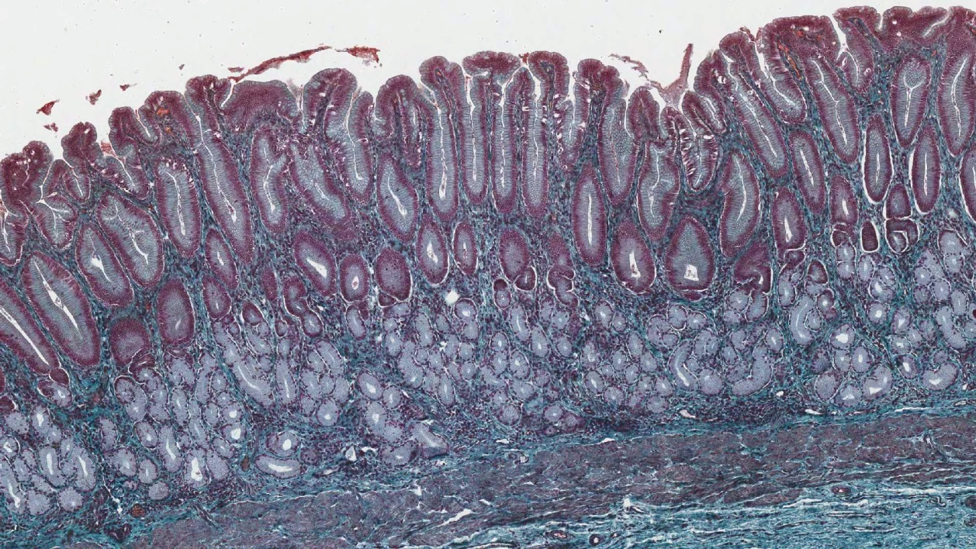
Pyloric Glands
Their pits are deep {about half the length of mucosa}.
They are branched and convoluted {many cross sections}.
Cells of pyloric glands:
1. Mucous neck cells (Mucus secreting cells): The predominant cells. Secrete mucus Neck cells are alkaline to neutralized the acidic chime, because chime is going from stomach (acid) to intestine (basic), also that’s why there are a few parietal cells, because we do not need acid anymore. | 2. EE cells: EC cells G cells D cells A cells
3. Stem cells.
4. Parietal cells: few.
5. No peptic cells.

Slide 11
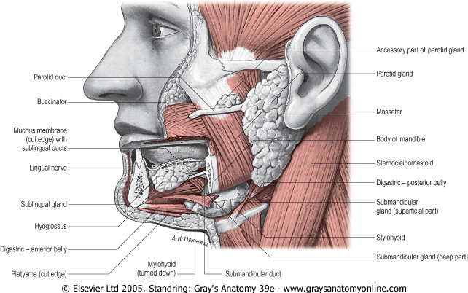
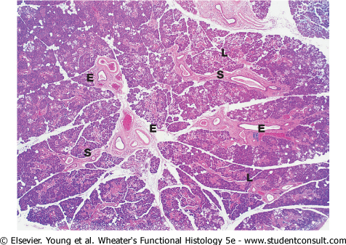
Salivary Glands
There are 2 main types:
The general structures:
A- Major Salivary Glands: (Large and paired structures)
1- Parotid.
2- Submandibular.
3- Sublingual.
B- Minor Salivary Glands: (Under the mucus membrane of
the oral cavity)
- Labial (lips) , Lingual (tongue) , Buccal (cheek) , Palatine (Palate)
- Produce 5% of salivary output.
A- Stroma: )Supporting elements (
C.T. capsule.
C.T. septa dividing the glands into lobes and lobules.
Background reticular C.T
B- Parenchyma: (Functional elements)
Acini. Secretion into the duct
Duct system. (Since it’s an exocrine gland, so it must have a duct system).

Slide 12
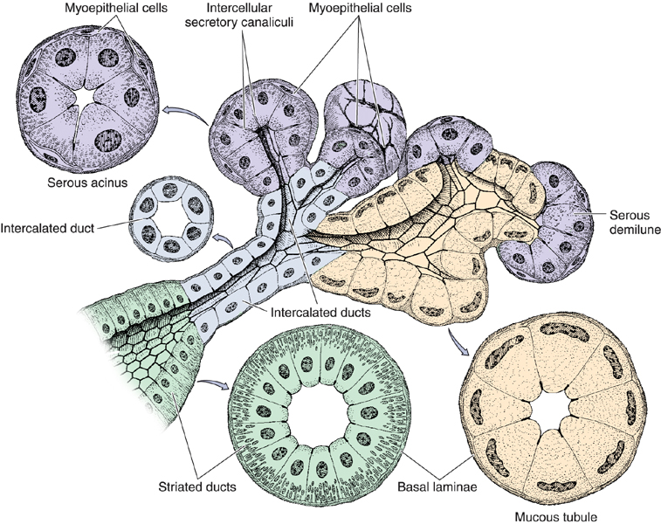
Types of Salivary Acini:
Serous Acini:
Contain only serous cells.
Small, spherical, and with a narrow lumen.
Secrete serous secretion rich in enzymes, such as amylase and lysozyme (Lysozyme is a defensive enzyme which lysis bacteria cell wall)
Mucous Acini :
Contain only mucous cells.
Larger, more tubular, and with a wider lumen.
Secrete mucous secretion.
Mucoserous (Mixed) Acini:
Mucous acini with a cap of serous cells (serous demilunes).
Demilunes مثل شكل الهلال

Slide 13
Cells of Salivary Acini:
1. Serous cells
- Pyramidal in shape.
- Nuclei are round and basal.
- Cytoplasm:
Deeply basophilic (due to numerous RER), with apical acidophilic secretory granules (rich in salivary amylase).
3. Myoepithelial cells (basket cells):
(Epithelial cells which modified to perform the function of contraction)
- Contractile cells that embrace the basal aspect of the acini.
- Their contraction releases the secretion into the duct system.
2. Mucous cells
- Pyramidal or cuboidal.
- Nuclei are flattened and basal. (Because the cell is distended with mucus)
- Cytoplasm:
Pale basophilic and vacuolated (foamy) (due to dissolved mucinogen secretory granules).

Slide 14
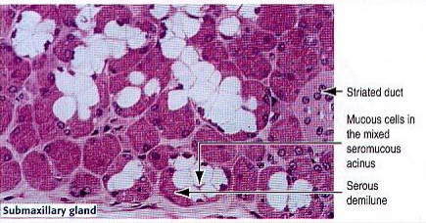
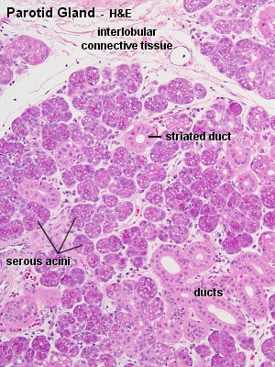
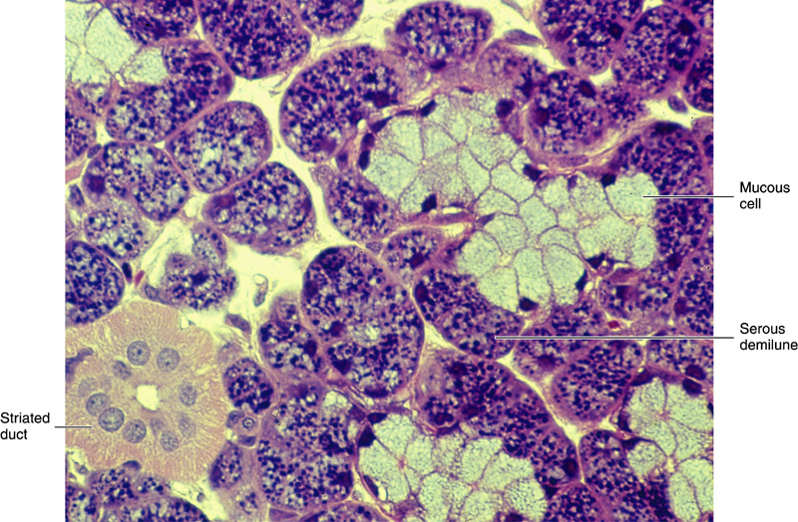
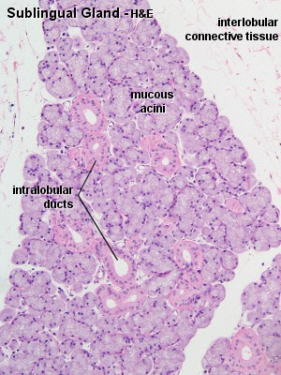
Major Salivary Glands
Parotid | Submandibular | Sublingual
The Largest salivary Gland | Intermediate in size | The Smallest Salivary Gland
Produces 30% of salivary output | Produces 60% of salivary output | Produces 5% of salivary output.
Purely serous | Mixed but mostly serous (90%). | Mixed but mostly mucous
Prominent intralobular ducts. Secretion rich in: Amylase, Lactoferrin, Lysozyme, secretory IgA | Mucous acini are capped by serous demilunes

Slide 15
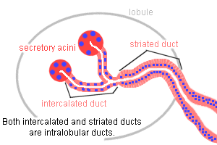
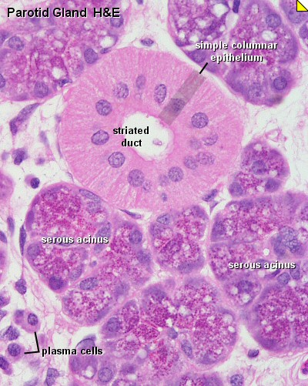
Duct System of Salivary Gland
Intralobular Ducts (prominent) inside the lublue | Interlobular Ducts outside the lobule | Main Duct opens in oral cavity
A) Intercalated Dutcs inside the acini: Lined by small cuboidal cells B) Striated Ducts formed by 2 intercalated ducts: Lined by low columnar cells | Lined by simple columnar epithelium | lined by stratified columnar epithelium which becomes stratified squamous (nonkeratinized) in the distal end near the opening in oral caivty
The main duct

Slide 16
MCQs
1- Meissner’s plexus of nerve fibers and nerve cells are found in:
A-mucosa of esophagus.
B-submucosa of esophagus.
C-Serosa of esophagus.
7- Pyloric Glands are:
A- branched.
B-convoluted.
C-both a&b.
8- Which one of the following is a major salivary gland?
A-Labial
B-Buccal
C-Sublingual
D-Lingual
9- Which of the following glands produce the most output of saliva?
A-Parotid
B-Submadibular
C-Sublingual
D-Buccal
10- Amylase & lysozyme produced by?
A-Serous acini
B-Mucous acini
C-Mixed acini
D- Basket cells
11-Function of basket cells is contractile and help to releases the secretion into the duct system
A-true B-false
12- Which of the following is a feature of mucous cells salivary acini
A-Pyramidal in shape B-flattened and basal nuclei
C-pale basophilic (cytoplasm) D-All above
2- There are…………. in Muscularis Externa of esophagus:
A-Auerbach’s (myenteric) plexus.
B-submucosal glands.
C-Meissner’s plexus.
3- Which of the following is a characteristic of Submucosa of the stomach:
A-NO submucosal glands.
B-circular smooth muscle.
C-by numerous fundic glands.
1-b
2-a
3-a
4-b
5-c
6-b
7-c
8-C
9-b
10-a
11-a
12-d
4- Fundic glands are composed of:
A- Dendritic cells.
B-Peptic (chief) cells.
c-goblet cells.
5- Parietal (oxyntic) cell nucleus is:
A-basal, round.
B-oval-elongated.
C-central, round.
6- Peptic (chief) cell cytoplasm is:
A-acidophilic.
B-basophilic.
C-none of the above.

Slide 17
Thank you & good luck
- Histology team
Done by:
Amal AlQarni
Allulu Alsulayhim
Do’aa Walid
Shahad AlAnzan
We’am Babaier
Ahmed Badahdah
Mutasem Alhasani
Omar Turkistani
Nawaf Aldarweesh
Mohammed Khojah
Team leaders:
Rana Barasain
Faisal Alrabaii
References:
Females’ and Males’ slides.
Doctors’ notes

