Slide 1
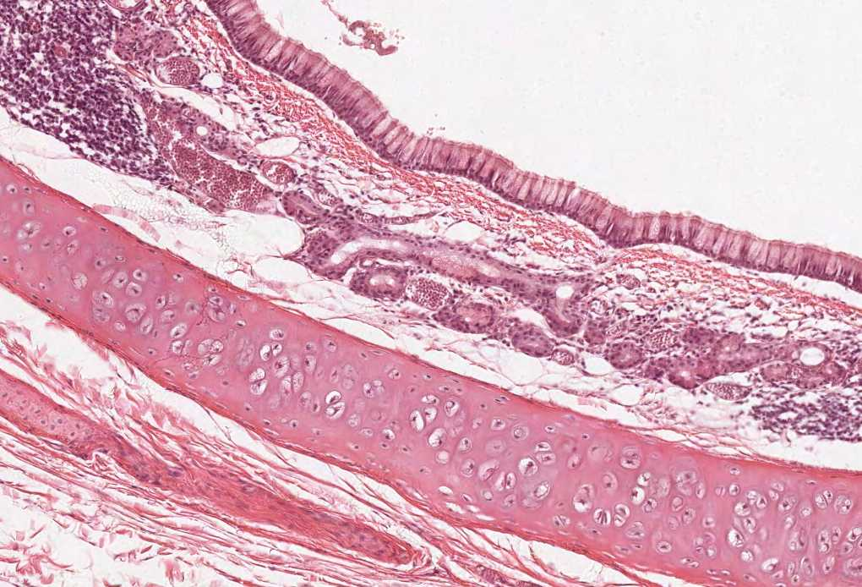


Biliary Passages & Pancreas
Color index:
Slides.. Important ..Notes ..Extra..

Slide 2
Objectives :
The student should be able to identify & describe the histological features of:
Intrahepatic biliary passages.
Extrahepatic bile ducts.
Gall bladder.
Exocrine pancreas

Slide 3
Doctor’s explanation:
The liver is composed of hepatic lobules (column like): they are the unit of the liver, there are corners between them which are called the portal area or tract. These columns are hepatocytes (liver cells) arranged to form grey like columns. تخيلوها زي الشمس كذا بالنص فيه دائرة وطالع منها اشعاعات، الاشعاعات هذي هي خلايا الكبد.
The bile salts are formed in the liver, and stored in the gall bladder. It acts on the duodenum through billiary passages. They’re used to digest fat.
The bile canaliculi is formed by the membrane of the adjacent hepatocytes. (doesn’t have its own membrane) so if there is a defect in the tight junctions > jaundice
The bile ductules are very important pathologically.
Interlobular bile duct is lined by simple cuboidal epithelium, they end in the right and left hepatic duct which form common hepatic duct that fuses with the cystic duct.
To understand the difference between inter and intralobular:
https://en.wikipedia.org/wiki/Intralobular_duct (leading directly from acinus to interlobular duct)
https://en.wikipedia.org/wiki/Interlobular_duct (connects more than one lobule)

Slide 4
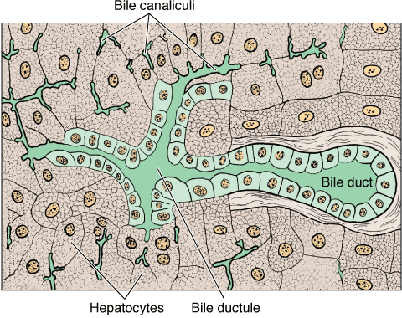
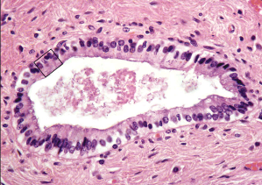
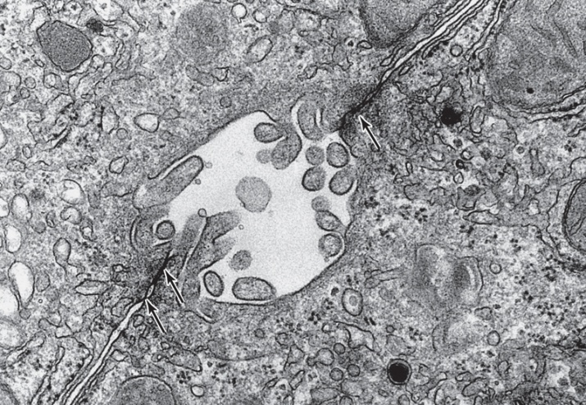
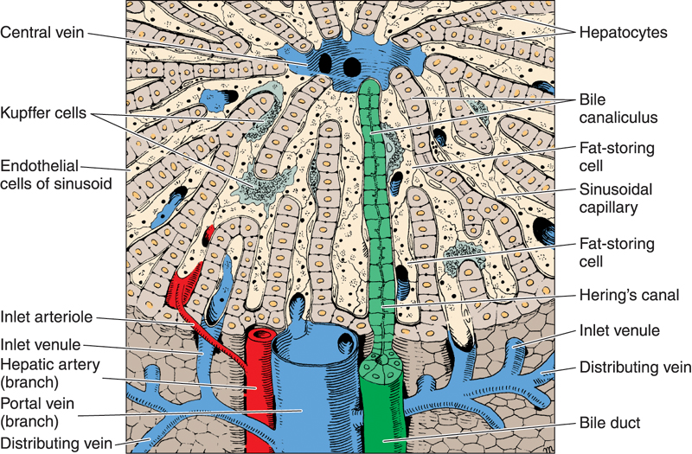
Biliary Passages
A. Intrahepatic passages:
3- Interlobular bile ducts. | 2-Bile ductules (canals of Hering). | 1-Bile canaliculi.
Are in the portal areas. Lined by simple cuboidal epithelium (becomes simple columnar epithelium near the porta hepatis). Interlobular bile ducts merge to form larger ducts, which eventually unite to form the right and left hepatic ducts. | Near the peripheral portal areas, bile canaliculi empty into bile ductules composed of cuboidal epithelial cells called cholangiocytes. After a short distance, these ductules collect and end in the interlobular bile ducts in the portal areas. | Narrow channels located between hepatocytes, limited only by the cell membranes of 2 hepatocytes. They are the first portions of the bile duct system. Microvilli project from the hepatocyte into the bile canaliculi, thus increasing the surface area. Tight junctions between the cell membranes of the 2 hepatocytes prevent leakage of bile.

Slide 5
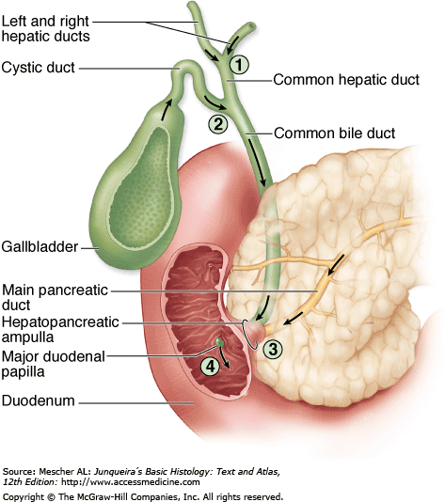
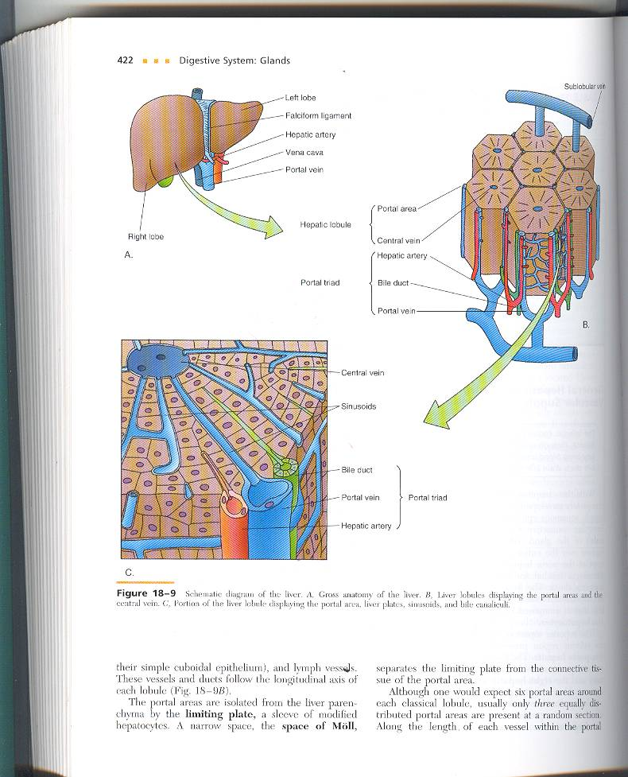
Biliary Passages, Cont…
B-Extrahepatic passages
6-Common bile duct. | 5-Common hepatic duct. | 4-Right & left Hepatic ducts.
Common hepatic duct
Formed by union of the right & left hepatic ducts. It joins the cystic duct, arising from the gallbladder, forming the common bile duct. Similar in structure to the wall of gall bladder and other extrahepatic bile ducts. Mucosa: Epithelium: Simple columnar. Lamina propria. Muscularis: bundles of smooth muscle fibers in all directions. Adventitia. Why adventitia? Because it is present under the liver Same structure of gall bladder

Slide 6
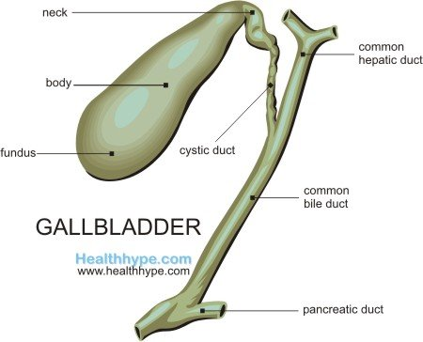
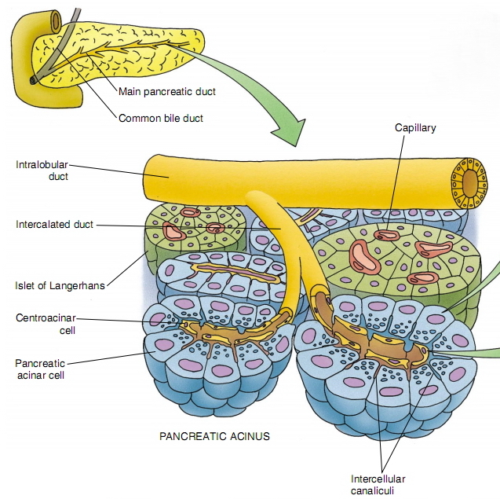
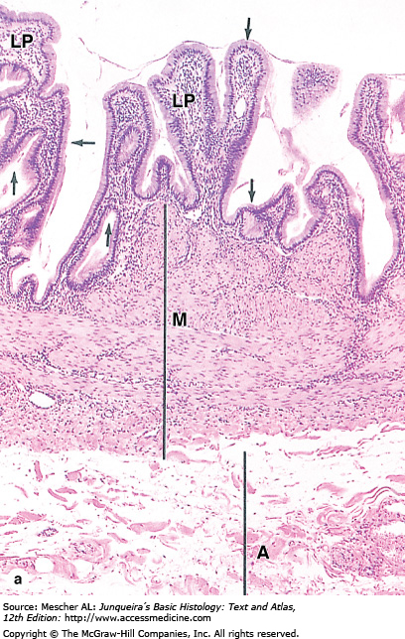
Gall Bladder Pancreas
A saclike structure that stores, concentrates and releases bile.
Its wall is formed of:
Stroma: Capsule, septa & reticular fibers.
Parenchyma: Pancreas is a mixed gland:
extra
Mucosa: highly folded. Simple columnar epithelium. Lamina propria: contains mucous glands in the neck of gall bladder.
Muscularis:: bundles of smooth muscle fibers oriented in all directions.
Serosa or adventitia. Serosa > fundus Adventitia > body
Exocrine part (acini & ducts): produces digestive pancreatic enzymes. | Endocrine part (islets of Langerhans): produces hormones.
Why adventitia or serosa? Because part of the gall bladder is present in the abdomen but most of it is adventitia because it is present under the liver. *this is very important in the exam
The neck of the bladder is the only place that has a lot of glands
Muscularis: for squeezing كأنها تصب

Slide 7
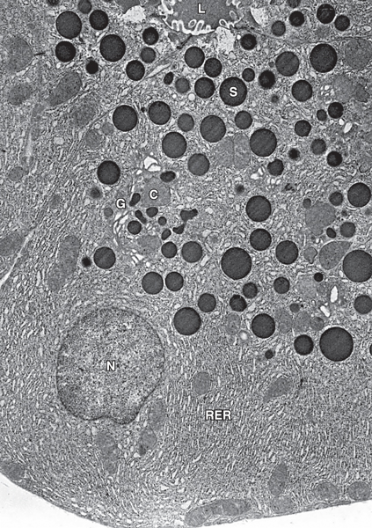
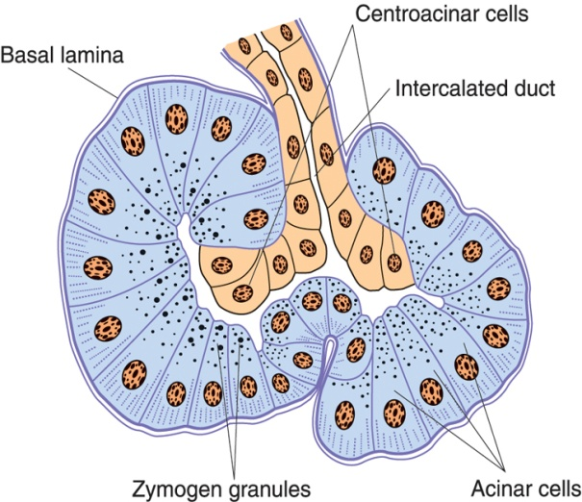
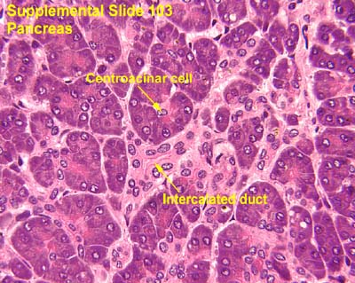
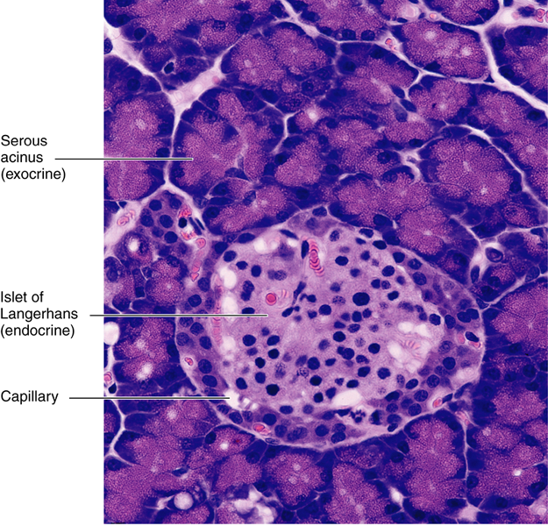
Exocrine Pancreas
Pancreatic Acini: | Duct System:
They are serous acini: secreting a thin fluid rich in digestive pancreatic enzymes. The Acinar cells: rosette shape Pyramidal in shape. Nuclei are basal. Cytoplasm: Basal part Basophilic (due to abundant rER) to secrete proteins Apical part Acidophilic (due to secretory granules). No Myoepithelial Cells around the acini. | Centroacinar cells: simple cuboidal Their nuclei appear in the center of the acini. They represent the beginning of the ducts. First ductal cells, have serous secretions like parotid. Intercalated ducts (low cuboidal). Intralobular ducts (NOT prominent). Interlobular ducts. Inter = between Main pancreatic duct.

Slide 8
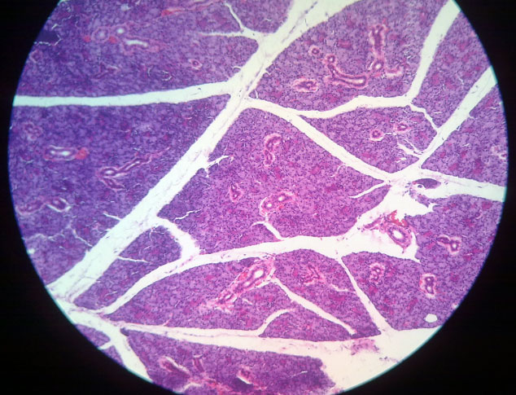
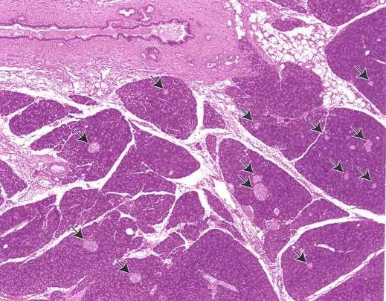
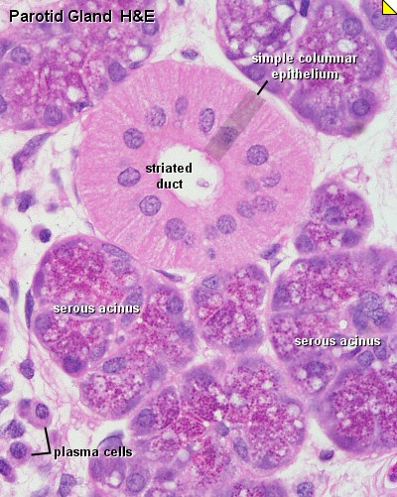
We differentiated between Pancreas and Parotid gland by:
1-islet of Langerhans
2-intralobular dusts (very prominent in parotid gland, not seen in pancreas)
Here in pancreas the intralobular ducts are not prominent
Intralobular duct
Islet of Langerhans
Parotid Gland
Pancreas

Slide 9
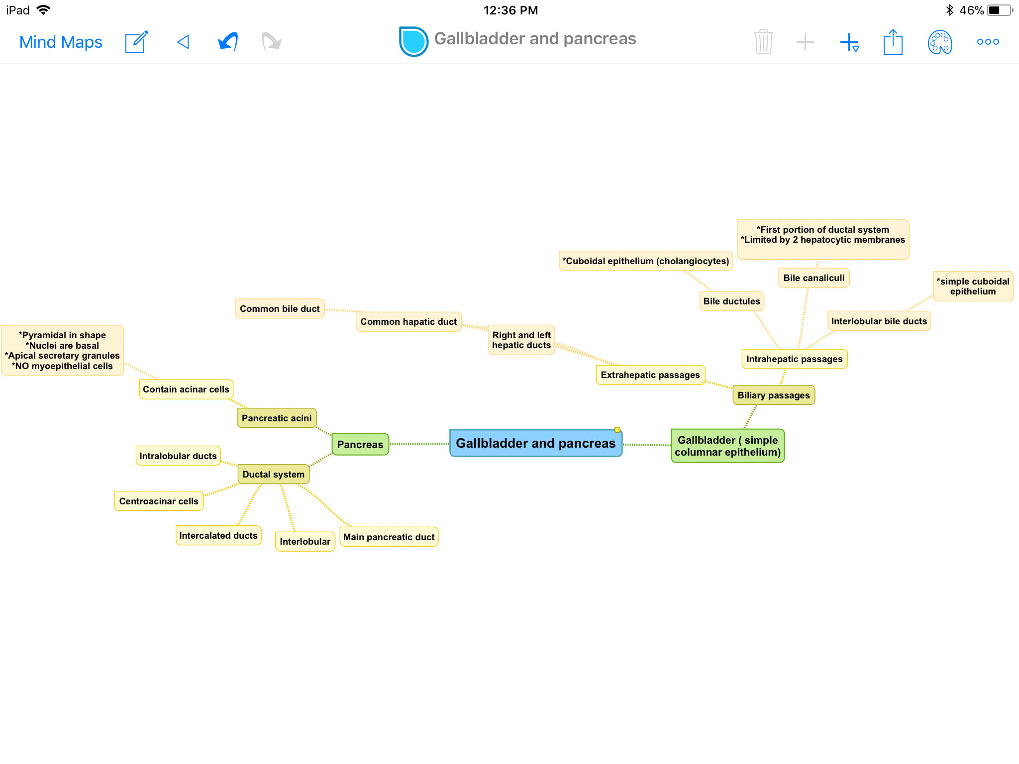

Slide 10

MCQs
1\They are Narrow channels located between hepatocytes:
A-Interlobular bile ducts
B-Bile canaliculi
C-canals of Hering.
5\The mucosa of gallbladder contains:
A-simple cuboidal epithelium.
B-smooth muscle fibers.
C-glands in the neck.
2\the function of Tight junctions between the cell membranes of the 2 hepatocytes :
A-prevent leakage of bile
B-increase surface area.
C-increase the size of hepatocytes.
6\what is characteristic of Pancreatic Acini:
A-represents the beginning of the ducts.
B-secretes digestive pancreatic enzymes.
C-none of the above.
3\cholangiocytes are:
A-cuboidal epithelial cells.
B-squamous epithelial cells.
C-Columnar epithelial cells.
1-b
2-a
3-a
4-b
5-c
6-b
4\Interlobular bile ducts merge to form larger ducts, which unite to form:
A- Common hepatic duct.
B-the right and left hepatic ducts.
c-Common bile duct.

Slide 11



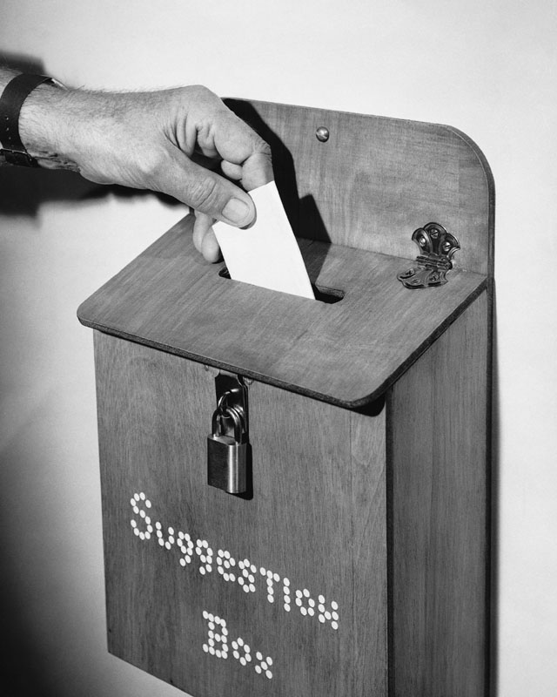
Thank you & good luck
- Histology team
Done by:
Amal AlQarni
Do’aa Walid
Heba AlNasser
We’am Babaier
Shahad AlAnzan
Team leaders:
Rana Barasain
Faisal Alrabaii
References:
Females’ and Males’ slides.
Doctors’ notes

