Slide 1
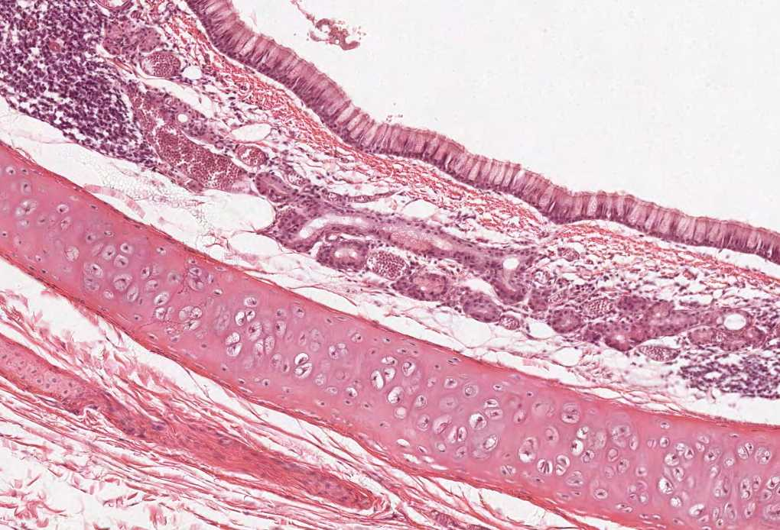
SMALL & LARGE INTESTINES
Color index:
Slides.. Important ..Notes ..Extra..

Slide 2
Objectives :
By the end of this lecture, the student should be able to discuss the microscopic structure in correlation with the function of the following structures :
Duodenum
Jejunum
Ileum
Colon
Appendix
Definitions:
Plicae circulares: transverse/horizontal folds of mucosa and submucosa.
Crypts of Lieberkuhn: invaginations of epithelium into the lamina propria between the villi to form glands.

Slide 3
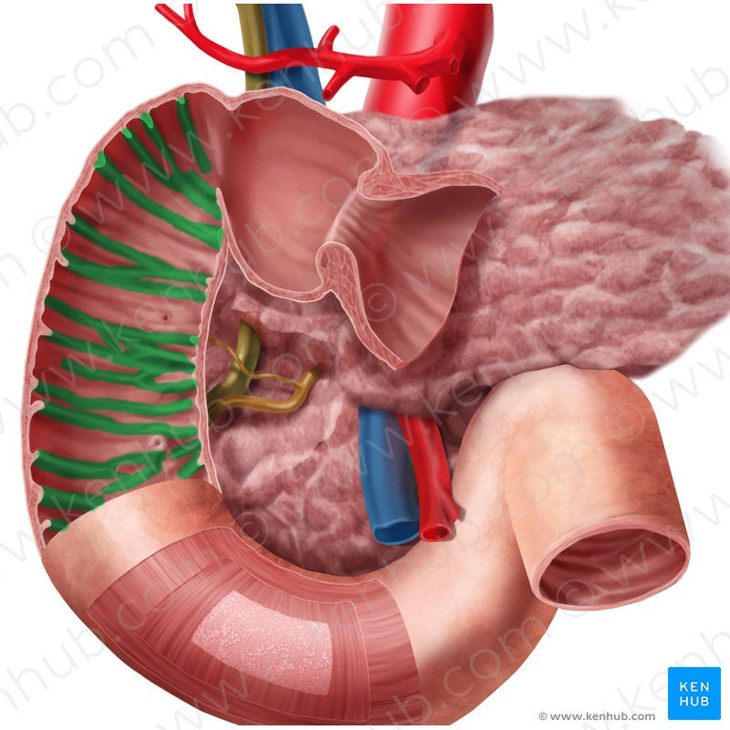
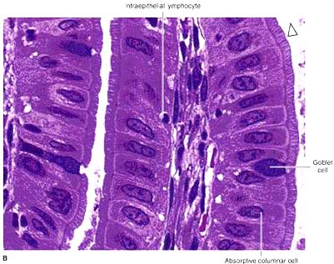
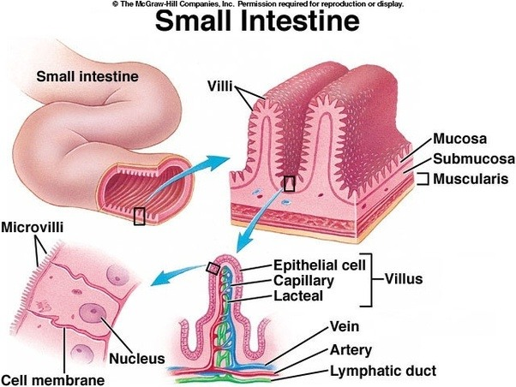
SMALL INTESTINE
To increase surface area the mucosa has:
Plicae circulares (circular folds): Permanent folds of the mucosa and submucosa. (Increase the rate of absorption 3-2 times)
Villi. (Increase the rate of absorption 10 times)
Intestinal crypts (crypts of Lieberkühn). Secretes intestinal juice (includes enzymes)
Microvilli (Brush border). (Increase the rate of absorption 20 times)

Slide 4
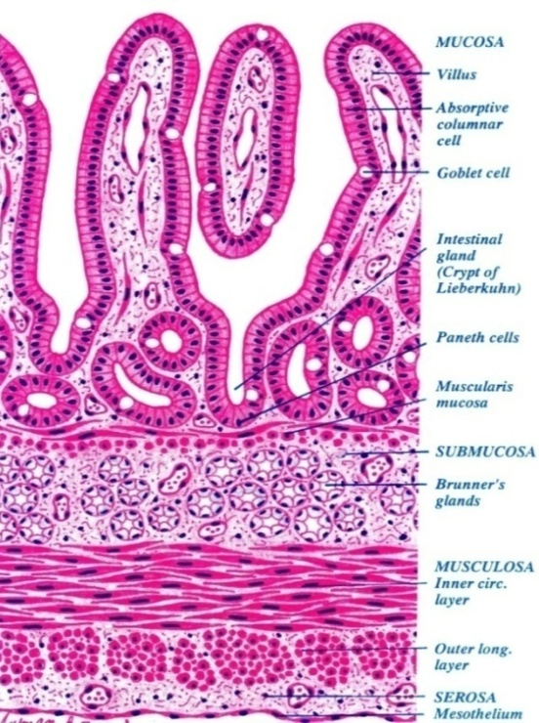
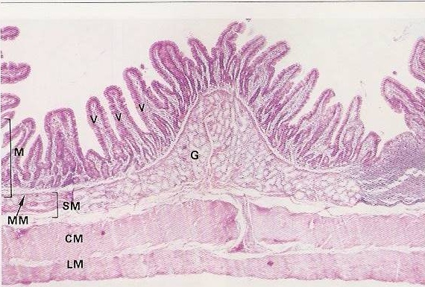
Wall of the duodenum
All parts of the small intestine has the same features of the 4 layers except some differences will be discussed later on. Other than that it’s all the same.
:1- Mucosa
2- Submucosa:
3-Muscularis externa:
Shows villi and crypts.
A- Epithelium: simple columnar epithelium with few goblet cells. ( the goblet cells gradually increase)
B- Lamina propria: loose areolar C.T.
C- Muscularis mucosae: 2 layers of smooth muscle cells.
Connective tissue containing blood vessels & nerves.
Contains Brunner’s glands (secrete mucus). ( in the first inch of the upper part of the duodenum)
2 smooth muscle layers:
4. Serosa or Adventitia:
1- Inner circular layer.
2- Outer longitudinal layer.
Duodenum is invested by a serosa or adventitia.

Slide 5
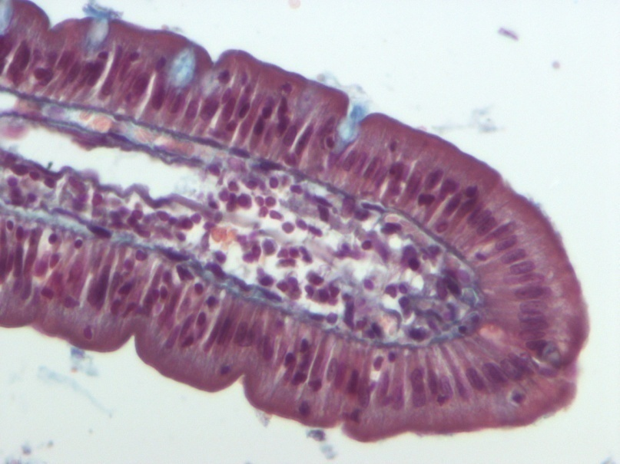
Intestinal villi
Intestinal villi: Each Villus is a finger-like projection of small intestinal mucosa and it is formed of:
I-Central core of loose areolar C.T. : | containing: Lymphocytes, Plasma cells, Fibroblasts, Smooth muscle cells, Capillary loops, Lacteal (blindly ending lymphatic channels). Important in absorption of fat droplets
II- Villus- covering epithelium
Loose areolar CT with lymphocytes as the lamina propria
Cells Covering the Villi:
1-Surface columnar absorptive cells:
-They have brush border (microvilli). (Increase the rate of absorption 20 times)
-They are covered with thick glycocalx that has digestive enzymes.
-They have Junction complex (tight, adhering and desmosome junctions).
2-Goblet cells: Increase toward the ileum.
3-Enteroendocrine (EE) cells (DNES cells).
4-M cells (Membrane or Microfold epithelial cells).

Slide 6
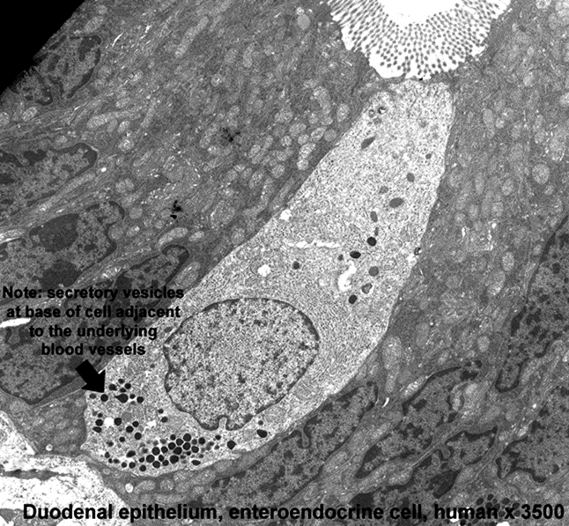
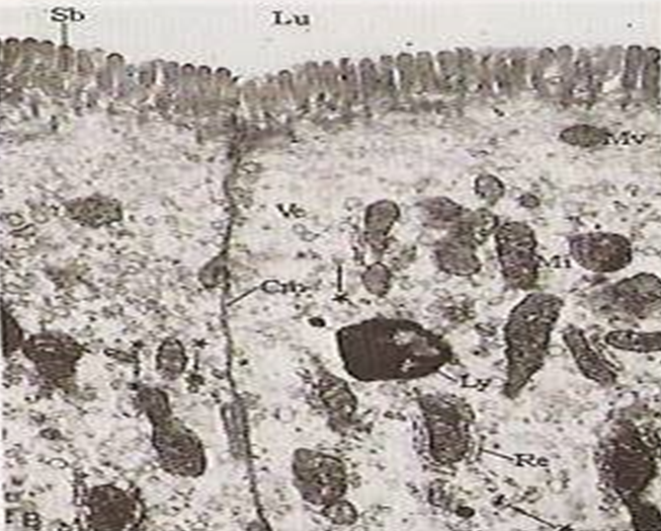
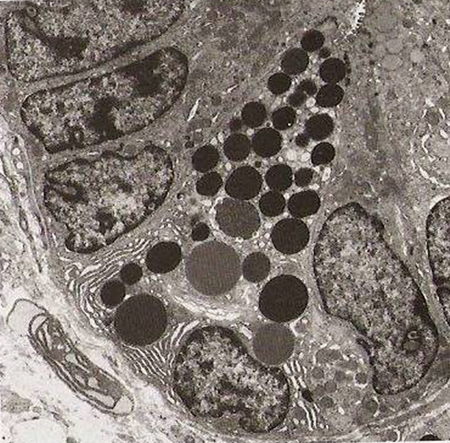
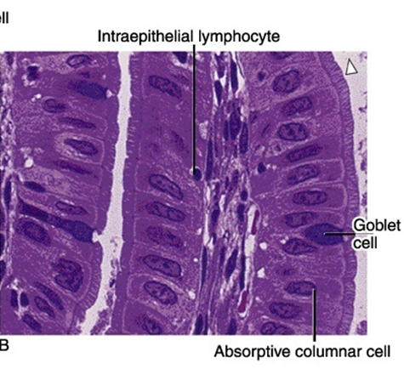
Intestinal Glands (Crypts)
EE (DNES) cells
Simple tubular glands that open between villi.
Composed of 5 cell types:
Columnar absorptive cells.
Goblet cells: secrete mucus.
Enteroendocrine (EE) (DNES) cells: secrete hormones.
Paneth cells: secrete Lysozyme (antibacterial). are found in the base of the crypts. That’s why small intestine has no bacteria
*Stem cells: are regenerative cells. are found in the base of the crypts. *Important for MCQs
- Stem cells and paneth cells are special for the crypts
EC cells: secrete endorphin and serotonin.
S cells: secrete secretin.
D cells: secrete somatostatin.
A cells: secrete glucagon.
Mo cells: secrete motilin. Regulates motility
CCK-PZ cells: secrete cholecystokinin (pancreozymin).
Hormonal secreting cells are found on the base ‘near to vessels on C.T.’
Columnar Absorptive cells
Paneth cell
- They are mainly found within the intestinal epithelium overlying lymphatic nodules of lamina propria.
- Each is a dome-shaped cell (or specialized squamous cell) with a basal concavity that contains intraepithelial lymphocytes and macrophages.
- They phagocytose and transport antigens present in the intestinal lumen to the underlying lymphoid tissue cells to initiate the immune response to these antigens leading to the
secretion of IgA.
1, 2, 3 are also found in cells covering the villi.

Slide 7
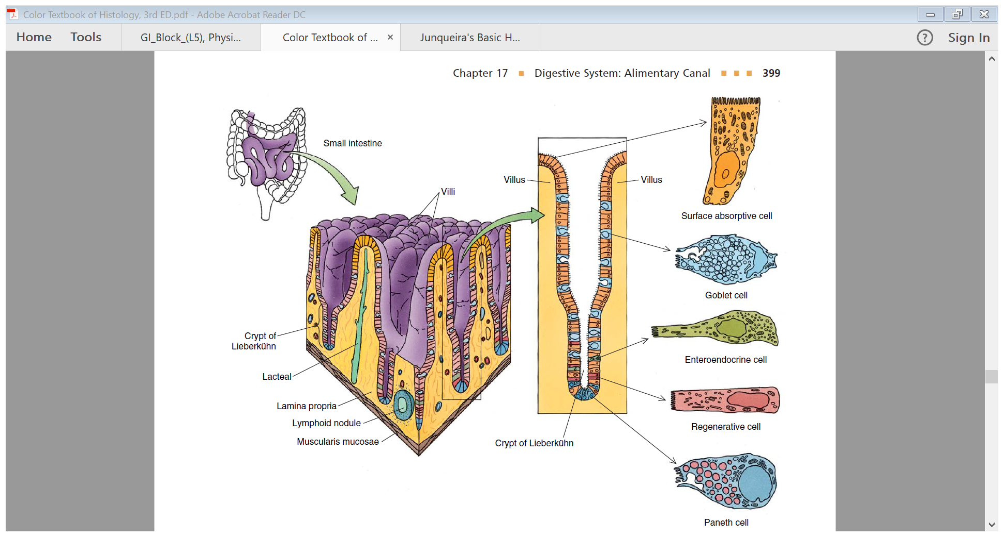
Intestinal Glands ( crypts )

Slide 8
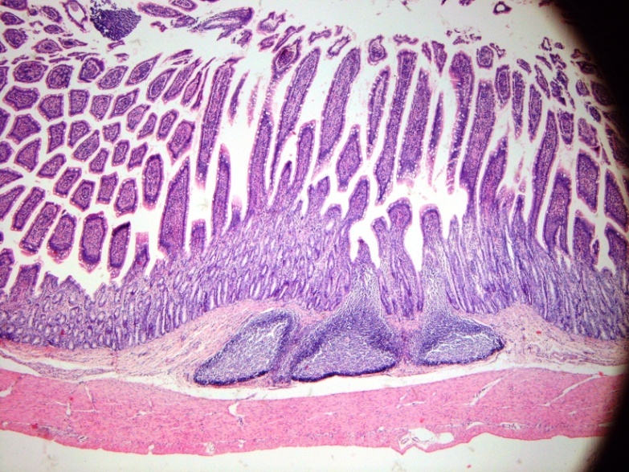
Regional differences of small intestine
How to differentiate between them?
The duodenum → Brunner’s glands
The ileum → Peyer's patches
The jejunum → By exclusion of the other 2 parts.
Duodenum:
Jejunum:
Ileum:
Its submucosa has Brunner’s glands.
has neither Brunner’s glands nor Peyer’s patches.
Its lamina propria, opposite the attachment of the mesentery, has lymphoid nodules (Peyer's patches) that extend to the submucosa. (Anti-mesenteric area)
It is invested by serosa or adventitia
It is invested by serosa.
It is invested by serosa.
Secretes alkaline mucous
Brunner’s glands
Peyer's patches

Slide 9
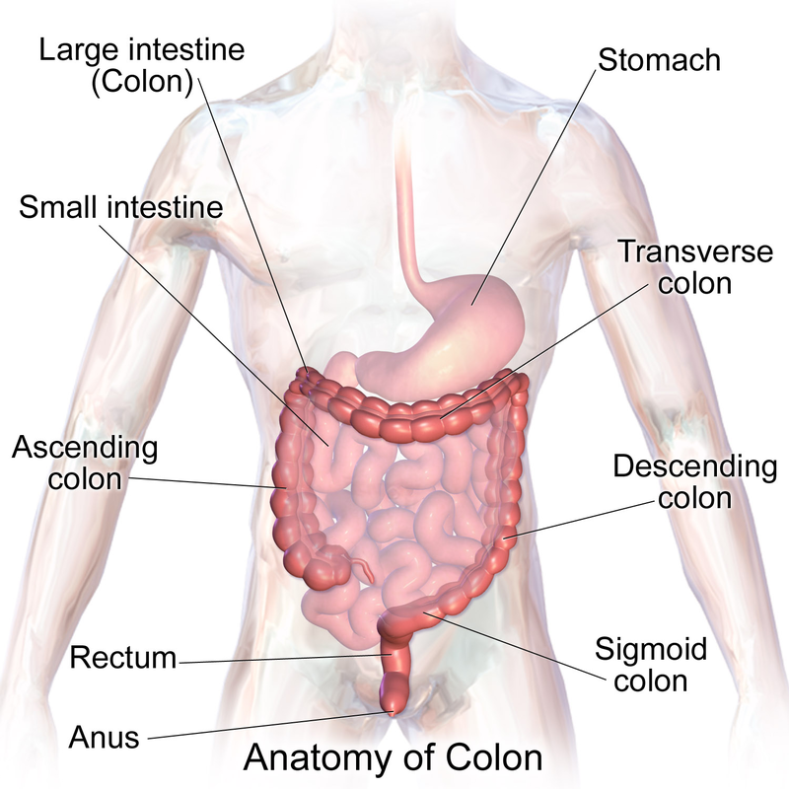
Large intestine
Divided anatomically into:
Appendix
Cecum: right side
Anal canal
Colon
Rectum
ascending
transverse
descending
sigmoid

Slide 10
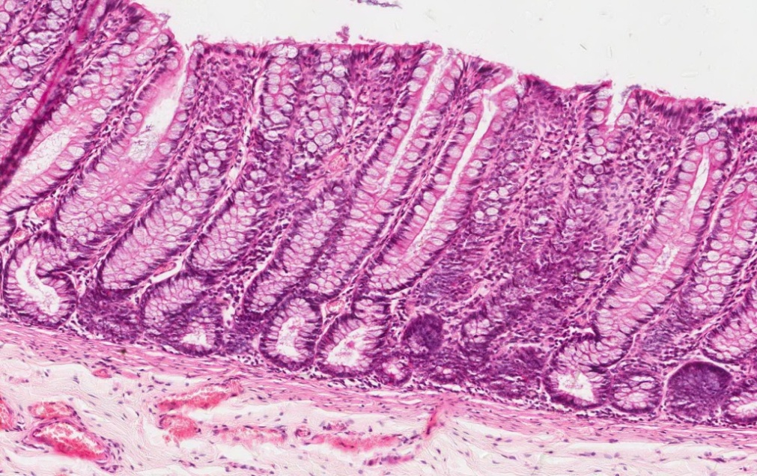
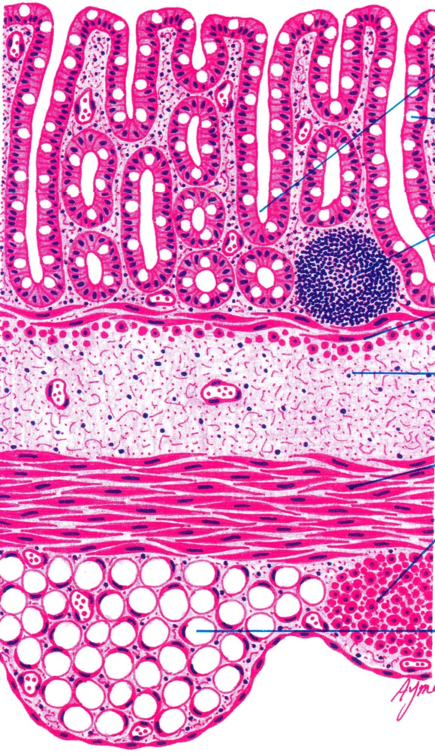
Wall of Colon
1- Mucosa the mucosa is thinner than that of small int.
Shows only crypts (NO villi) Epithelium: Simple columnar epithelium with numerous goblet cells. (more numerous goblet cells than small intestine, and increase near the rectum) Lamina propria: C.T containing numerous crypts. ( Glands ) Cells of the crypts are the same as in small intestine but WITHOUT Paneth cells. Lymphatic nodules (solitary): frequent. The ileum starts in the antibacterial process with having peyer’s patches, and bacteria really appear in the colon. Muscularis mucosae: 2 layers of smooth muscle.
2- Submuosa
NO glands. Meissner’s nerve plexus.
3- Muscularis Externa:
Inner circular & outer longitudinal smooth muscle layers. The outer longitudinal layer is not continuous but in the form of 3 ribbons (teniae coli). Auerbach’s nerve plexus.
Serosa:
C.T. covered by mesothelium. Has fat-filled pouches ( pendolous masses) called appendices epiploicae.
القلاندز بس موجودة بالـ (esophagus + duodenum)

Slide 11
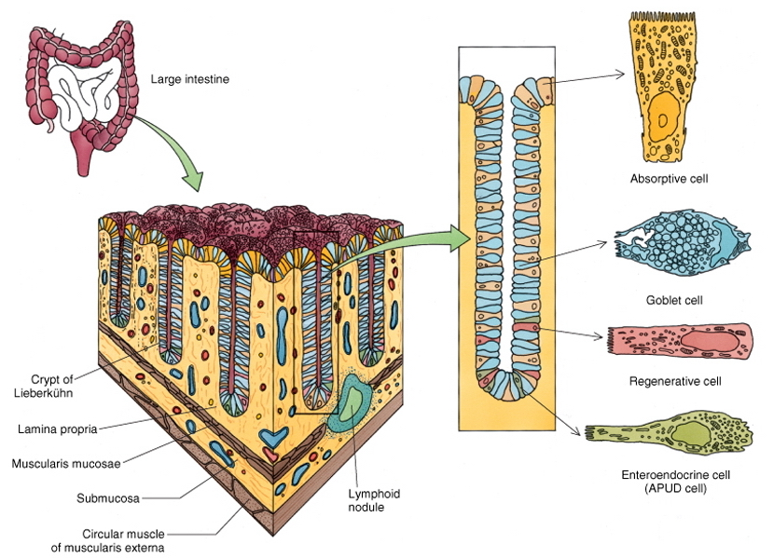
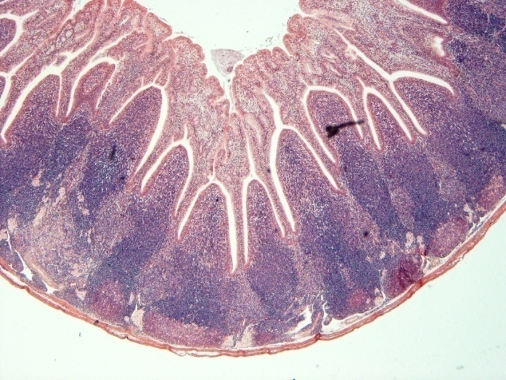
Intestinal Crypts of Colon
Vermiform Appendix
Cells lining the crypts are:
1. Surface columnar absorptive cells.
2. Goblet cells.
3. Enteroendocrine cells.
4. Stem cells.
5- M-cells.
Similar to the colon, but with much smaller diameter, shallow crypts, more lymphoid nodules (aggregated lymphoid nodules, all around, in lamina propria and extending into submucosa), Few goblet cells and more EE (DNES) cells.
Muscularis mucosae:
Not continuous.
Muscularis externa:
No teniae coli. (continuous, no 3 ribbons)
Serosa: no appendices epiploicae (fat)
The only difference between here and small intestine is here there is no paneth cell.
In crypts: Goblet cells less than the colon
It is mainly an immune organ.

Slide 12
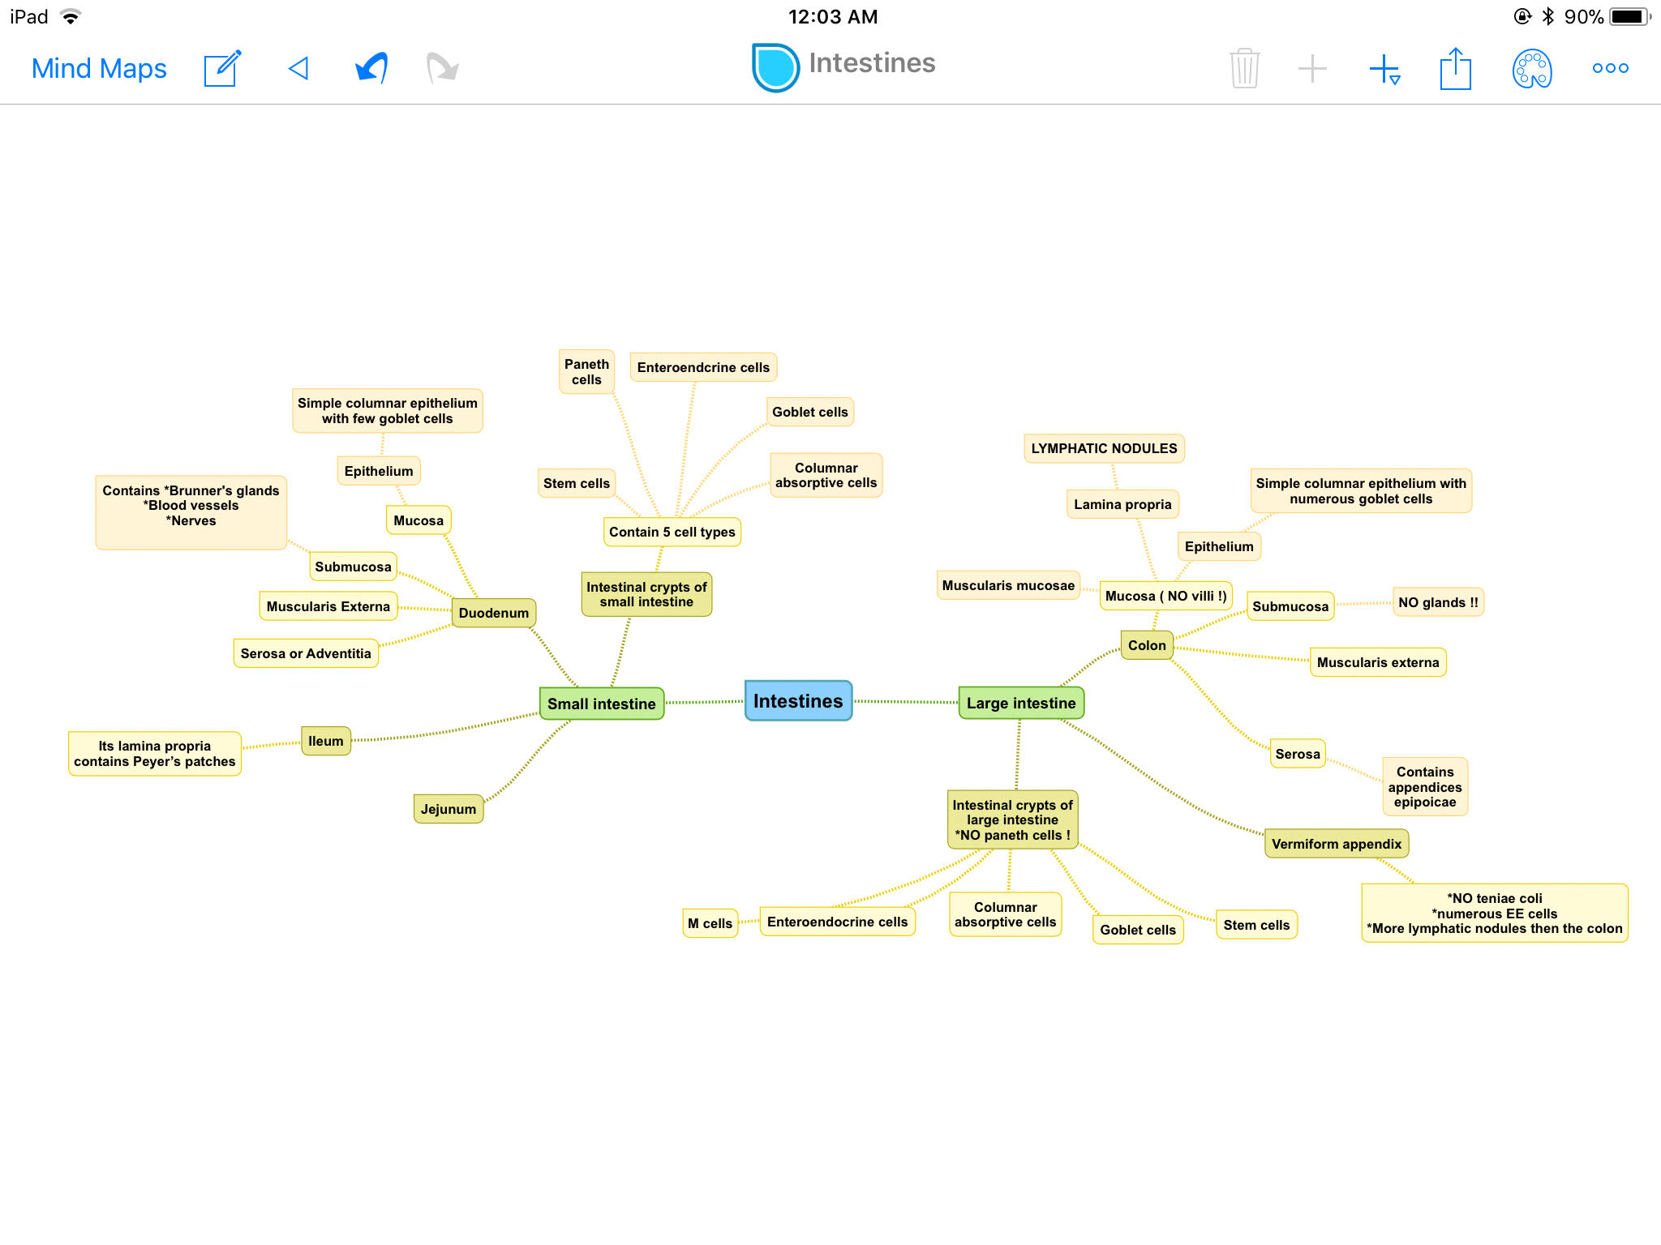

Slide 13
MCQs
1- Brunner’s glands are found in which of following ?
A-Colon
B- Duodenum
C-Jejunum
D- Ileum
7-Which one of these layers contains fat-filled pouches called appendices epiploicae?
Mucosa
Submucosa
Muscularis externa
Serosa
2- Brunner’s glands are found in which of following layers ?
A-Mucosa
B-Submucosa
C-Muscularis mucosae
D-Serosa.
8- Muscularis mucosae in Vermiform appendix are?
Continuous
non continuous
not formed
contain M cells
3-Peyer’s patches may found in Jejunum ?
a-true
B-false
1-B
2-B
3-B
4-D
5-A
6-C
7-D
8-B
9-A
10-
11-
12-
4- A cells and D cells secrete?
A-Secretin and Motilin
B-Endorphin and Glucagon
C-CKK and somatostatin
D-Glucagon and somatostatin
9-Lymphatic nodules (solitary) are found in which layer of the Colon?
A-Mucosa
B-Submucosa
C-Serosa
D-Muscularis externa
5- Which cell of the following secretes antibacterial material?
A- Paneth cells
B-Enteroendocrine
C-Stem cells
D-Goblet cells
6)-Which cell of the following secretes IgA and transports antigens in intestinal lumen to the lymphoid tissue?
S cells
Mo cells
M cells
EC cells

Slide 14
Thank you & good luck
- Histology team
Done by:
Ahmed Badahdah
Mutasem Alhasani
Omar Turkistani
Nawaf Aldarweesh
Mohammed Khojah
Shahad AlAnzan
Team leaders:
Rana Barasain
Faisal Alrabaii
References:
Females’ and Males’ slides.
Doctors’ notes

