Slide 1
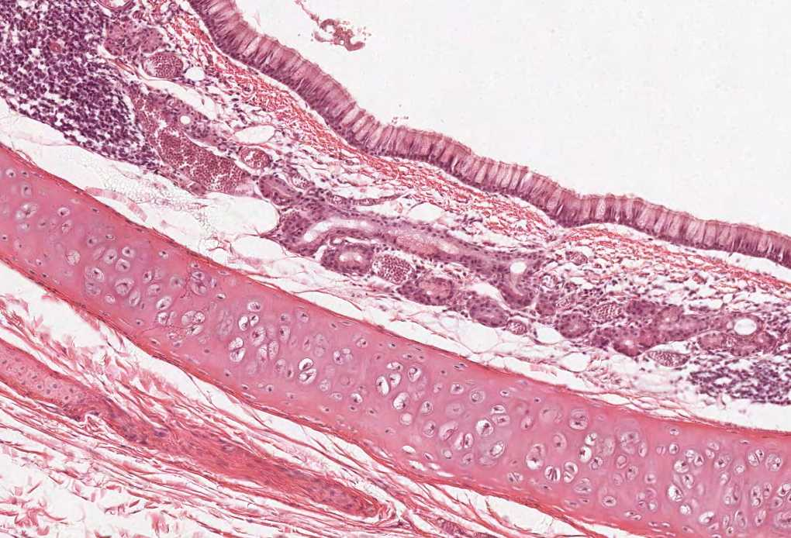
LIVER & SPLEEN
Color index:
Slides.. Important ..Notes ..Extra..

Slide 2
Objectives:
By the end of this lecture, the student should be able to describe:
1. The histological structure of liver with special emphasis on:
Classical hepatic (liver) lobule.
Hepatocytes.
Portal tract (portal area).
Hepatic (liver) blood sinusoids.
Space of Disse (perisinusoidal space of Disse)
Bile canalculi.
2. The histological structure of spleen with special emphasis on:
White pulp.
Red Pulp.

Slide 3
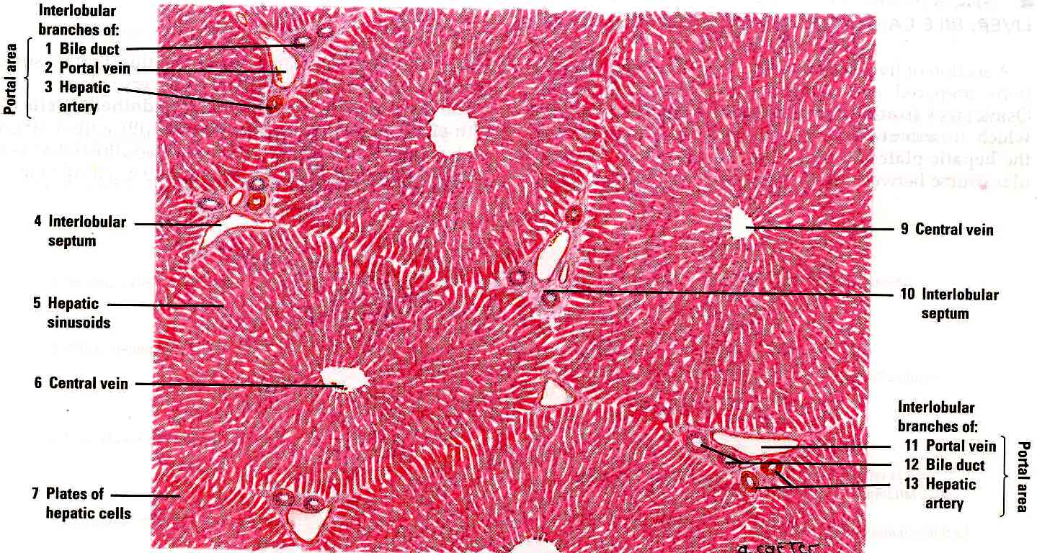
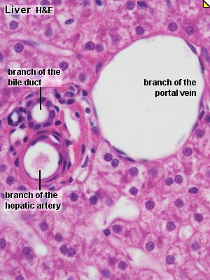
LIVER
2-Parenchyma; Classical liver (hepatic) lobules | 1-Stroma; mainly C.T, but not in humans.
It is formed of a polygonal mass of liver tissue, bounded by interlobular septa with portal areas at the periphery & central (centrolobular) vein in the center. Central vein: surrounded by hepatocytes | a- Capsule: Glisson’s Capsule. b- Septa (absent in human) & Portal areas (Portal tracts) Portal area: surrounded by other structures. c- Network of reticular fibers.

Slide 4
LIVER
Contents of the Classic Liver Lobule:
the rows of hepatocytes should be next to each other; remember canaliculi
1- Anastomosing plates of hepatocytes.
2- Liver blood sinusoids (hepatic blood sinusoids): between the plates.
3- Spaces of Disse (perisinusoidal spaces of Disse) between the hepatocytes and sinusoids
4- Central vein.
5- Bile canaliculi.
Borders of the Classical Liver Lobule
1- Septa: C.T. septa (e.g. in pigs).
2- Portal areas (Portal tracts):
Are located in the corners of the classical hepatic lobule (usually 3 in No.).
Contents of portal area:
a- C.T.
b- Bile ducts (interlobular bile ducts).
c- Venule (Branch of portal vein).
d- Arteriole (Branch of hepatic artery).
Hepatic artery: surrounded by smooth muscles while the bile duct is not.

Slide 5
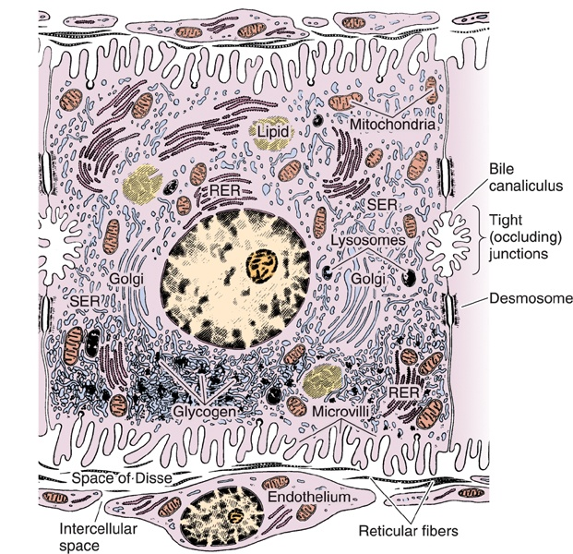
Hepatocytes (LM)
IMPORTANT: *the hepatocytes have two surfaces: one facing another hepatocyte, the other facing the sinusoids *Are grouped in interconnected plates. *Liver sinusoids are located in the spaces between these plates.
Shape: polyhedral
Nucleus: 1 or 2, vesicular with prominent nucleoli.
Cytoplasm: acidophilic.
Organelles: 1- Mitochondria: ++++ 2- ER (sER & rER): abundant. 3- Golgi complex. 4- Lysosomes. 5- Peroxisomes.
Inclusions (Deposits): 1- Glycogen 2- Lipid (few droplets). 3- Lipofuscin (old age)
The area facing the hepatocyte has tight junctions which increase surface area and desmosomes to fix these junctions in place.
The area facing the sinusoids have microvilli for absorption and secretion of metabolites to/from the hepatocytes, but these microvilli do not reach the blood.

Slide 6
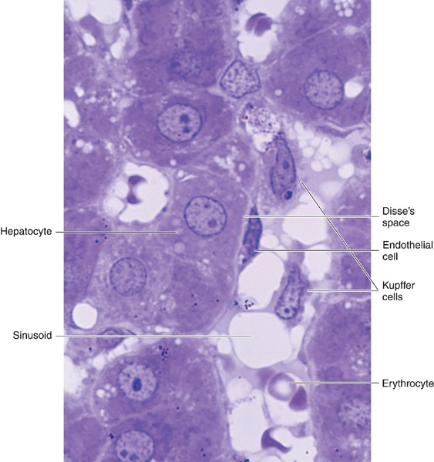
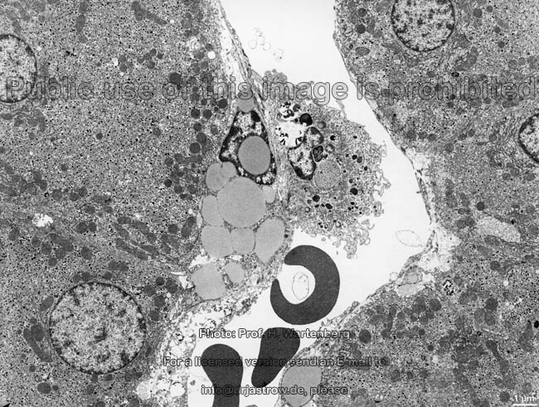
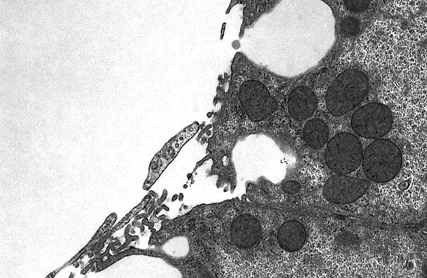
Liver Blood Sinusoids
Space of Disse (Perisinusoidal Space)
(1) Endothelial Cells:
Fenestrated & discontinuous → free passage of plasma.
Basal lamina is absent.
(2) Kupffer Cells: produce lysosomes
Are macrophages.
Are found on the luminal surface of the endothelial cells.
Function: phagocytosis.
Contents:
1- Fat-storing cells (Ito cells) (Hepatic stellate cells):
contain vitamin A-rich lipid.
form reticulin.
2- Reticular fibers: formed by reticulin
(type III collagen). Normally present in small amounts, an increase = liver fibrosis
3- Plasma of blood. NOT cells! , cells found in the blood are NOT filtered !
4- Microvilli of hepatocytes.

Slide 7
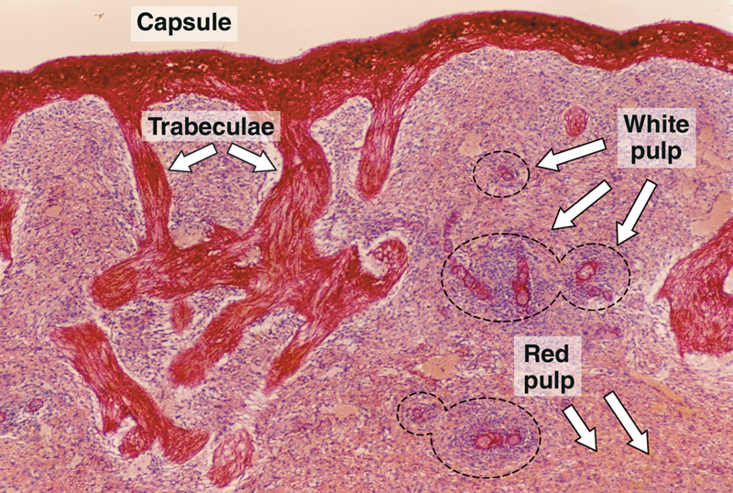
Spleen
Stroma of Spleen | Parenchyma of Spleen
1- Capsule: Is covered by visceral layer of peritoneum; mesothelium. Is formed of fibromuscular C.T. (Dense fibrous C.T. + smooth muscle cells). Muscles for contraction in case of loss of blood 2- Trabeculae: Are irregular, incomplete, divide the spleen into intercommunicating compartments (lobules). 3- Reticular C.T. | White pulp. Red pulp (around white pulp) N.B. to differentiate the spleen from the lymph nodes No cortex, No medulla, No afferent lymphatic vessel.

Slide 8
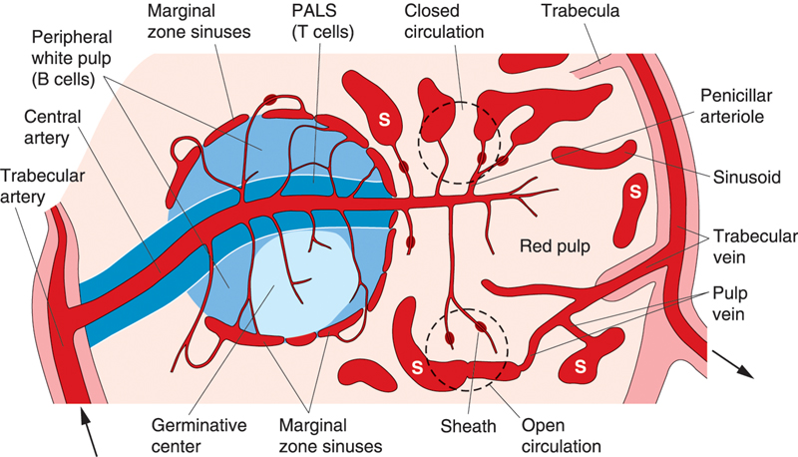
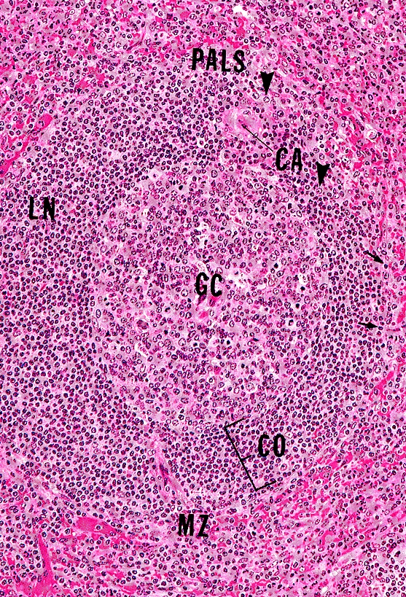
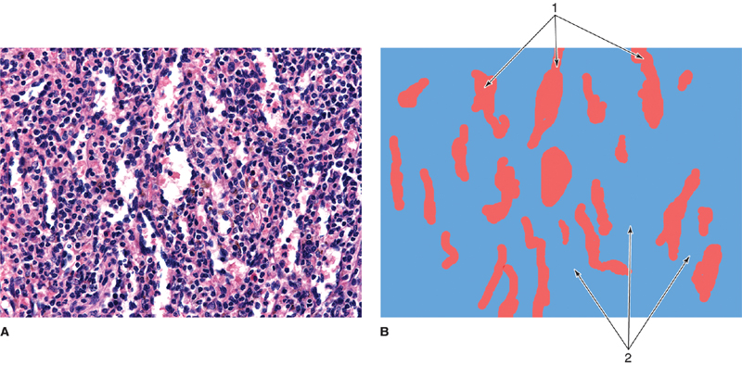
Parenchyma of Spleen
Cells of parenchyma of Spleen
(A) White Pulp | (B) Red pulp
Periarterial lymphatic sheaths (PALS): housing T lymphocytes. Lymphoid follicles (with germinal centers): housing B lymphocytes. N.B. Both 1&2 have the acentrically located central artery (central arteriole) (follicular arteriole). | Splenic (pulp) cords: Extravasated blood cells, plasma cells, macrophages & reticular cells and fibers. Splenic blood sinusoids: Surrounded by the pulp Are lined with elongated fusiform endothelial cells with large intercellular spaces & supported by discontinuous, circular basement membrane.
Lymphocytes B + T
Plasma cells.
Macrophages for the filtration of blood
Blood elements (RBCs, leucocytes and blood platelets).
Splenic Microcirculation
IMPORTANT: The PALS (blue area surrounding the artery) have T-Cells PURELY

Slide 9
MCQs
1\ Glisson’s Capsules are found in:
A-parenchyma.
B-stroma.
C-Both A&B.
5\Fat-storing cells in liver are called:
a.Endothelial cells.
b.kupffer cells
c.Ito cells.
2\ the shape of hepatocyte is:
a.polyhedral.
b.spherical.
c.spiral.
6\ Which of the following is part of the
spleen’s Parenchyma?
a. Cortex.
b. Red Pulp.
c. Medulla.
3\ What is the space between the liver sinusoids
and the hepatocytes called?
a. Space of Disse.
b. Space of Mall.
c. Vacuole.
7\one of The differences between the spleen and the lymph nodes is:
a.spleen has no white pulp.
b.Spleen has cortex.
c.Spleen has No medulla.
4\what is the function of Kupffer Cells:
a.Regeneration.
b.Phagocytosis.
c.nutrtion.
1-b
2-a
3-a
4-b
5-c
6-b
7-c

Slide 10
Thank you & good luck
- Histology team
Done by:
Amal AlQarni
Do’aa AlWalid
Heba AlNasser
Shahad AlAnzan
We’am Babaier
Team leaders:
Rana Barasain
Faisal Alrabaii
References:
Females’ and Males’ slides.
Doctors’ notes

