Slide 1


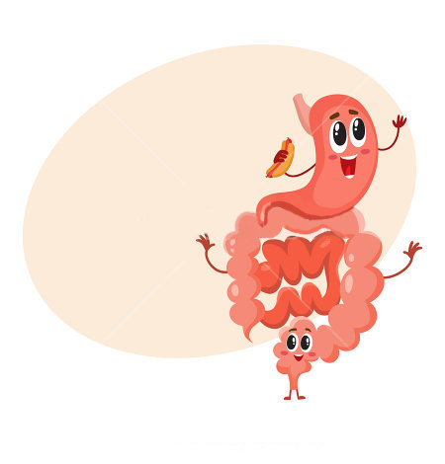


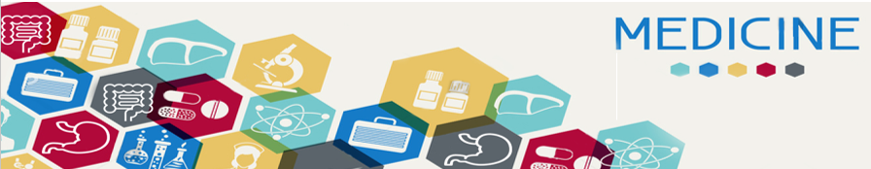
Nutrition Education
Color code
Important
doctor notes
Notes/extra explanation
By the end of the lecture you should able to:
Define nutrition education.
Recognize the importance of nutrition education.
Understand methode used in nutrition education.

Slide 2
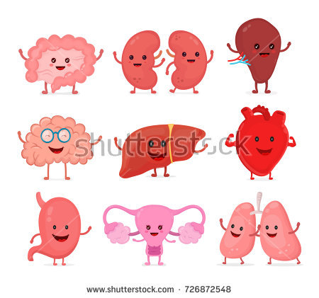
Definition of nutrition education.
It’s the science of teaching the individual how to practice proper and correct nutrition in terms of:
1-Knowing the proper nutrition rules. (Why we need them to be nutrition sufficient)
2- knowing benefit of each nutrient.
3- more attention to quality and quantity of foods. (Of course when we talk about food they're not all bad and they're not all good so we need to balance quantity and quality)
Nutrition: The process by which the human intakes food for growth, energy, and replacement of tissues(Why after operations we tell them to eat well) ; its successive stages include digestion, absorption, metabolism, and excretion
Food: Any substance taken into the body that will help to meet the body needs for energy, maintenance and growth.( food is the substance but nutrition is better )
Nutrition requirements: The quantities (Requirements are based on the quantities) of each nutrient which met the human body needs to prevent nutrients deficiency diseases.
Contribution differs between countries
(In general it's between countries and could be in the same country with different communities)

Slide 3
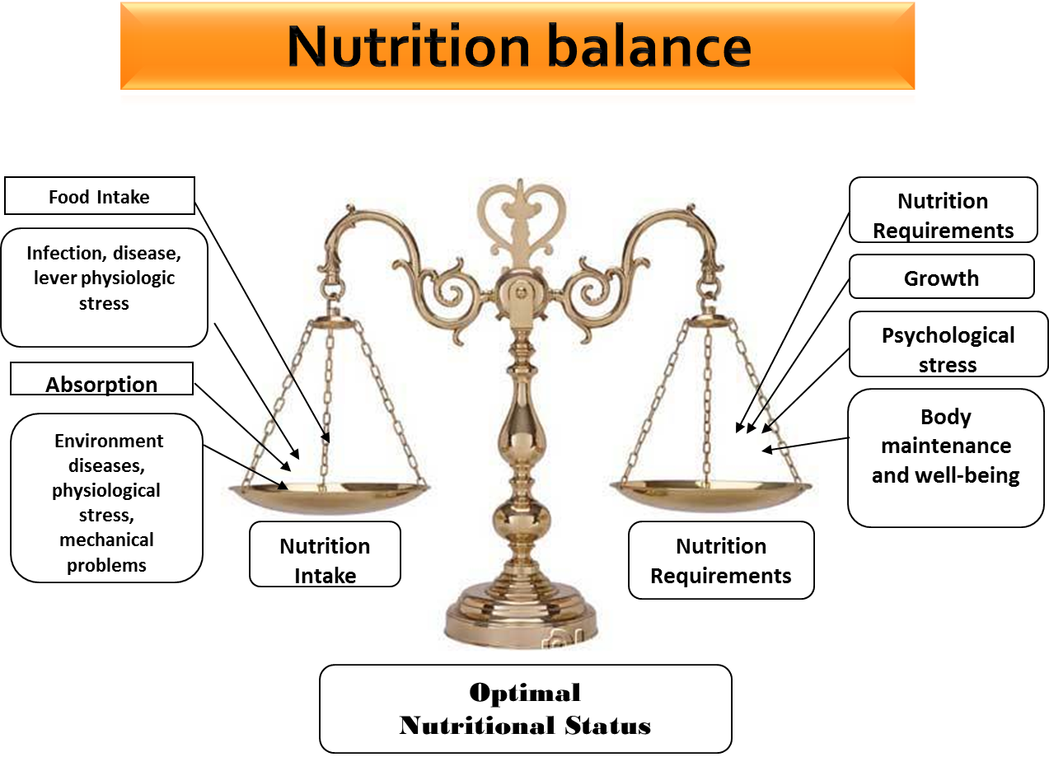
Ignorance
Disease
Poverty
Any imbalance will lead to malnutrition
Malnutrition
Malnutrition :Could happen in developed countries (like UK and US) and in poor countries (liked in Africa) but the nature of malnutrition is different. In poor countries, Malnutrition is because they don't have enough food but sometimes you have enough food but you aren't consuming it in the right way and that's mean Ignorance . Also sometimes you don't have proper education so you are not able to consume it the right way.
Diseases: could cause malnutrition ( specially GI diseases ) , and malnutrition could cause diseases
Could affect the physiology of the body and you will need more nutrients
For example babies in growth spurt they will need to be fed more than the other days and even normal growth needs nutrition

Slide 4
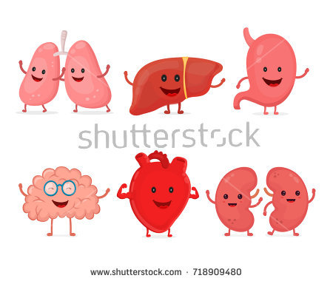
Importance of Nutrition education:
So we need to teach them
Man doesn’t have instinct nor inherit knowledge that leads him to know
the effect of different foods on health.
there is consensus that people’s food choices, dietary practices, and
physical activities behaviors influence health. (If we target these three
main factors, we going to be able to control people's health)
increased risk of chronic diseases. (We know that most of chronic diseases exist
because of (these 3 main factors) so if we target them we will be able to target
diseases. We target all of these by education.)
nutrition education can increase the motivation, skills, and opportunities for
people to engage in health promoting actions. (I can attract you on these
topics and how you educate people in nutrition and I use you in the education
and you will be a role model)
Aim of nutrition education:
To increase people’s ability to know
the following facts:من ناحية
appearanceيعني كيف ؟ انا under weight فايبي يرتفع واذا كان سمين يبي ينزل فا appearance مهم
The relationship between the body growth, qualities of and appearance (Depends on) , and the types of food they eat.
Increased diversification in the food they eat, and enjoy its taste. (It's out there they just have to make the effort to know it and to do it)
Planning and preparing of meals rich in nutrients. (We give them healthy alternatives and tell them how to make healthy and delicious out of these to attract them. لان فيه انواع مانعرفها زي الكينوا فلما نقدمها لهم نعلمهم كيف يستيفيدون منها
The natural resources of food.
Assessment of their nutritional behaviors and beliefs.(We need them to see how healthy food reflect on there lives and behaviors )
Appreciating the importance of the standard of living improving programs.(Of course they have to work on themselves and on there standards of living . يعني ما نروح لاحد فقير ونقوله وشو الاكل الصحي الموجود ونتوقع منه انه يطبق على طول عشان كذا لازم نفكر اول شي هذولا الناس مين عشان نساعدهم يوصلون ستاندردز معينه عشان يتبنون هذا )

Slide 5
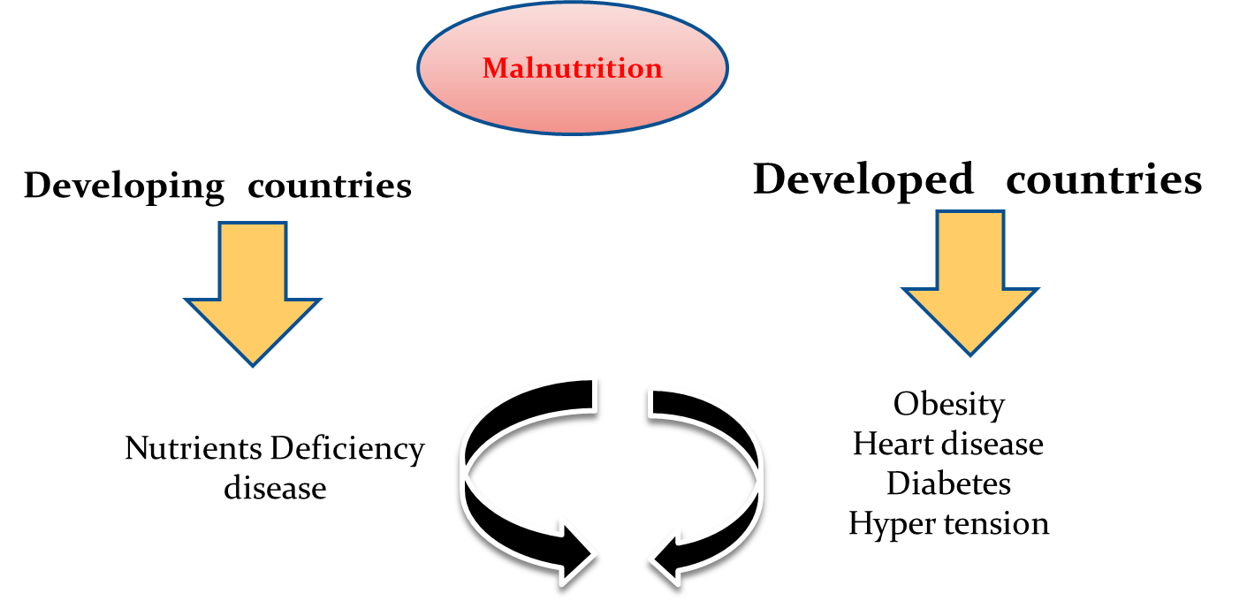
Factors affected on human's food consumptions:
1-The healthy body and disease.
2-Psychological factors: (Some people when they feel stress they buy a package of ice cream and start eating)
3-Food habits. (Of course each culture has their own eating habits اكل) مثلا عندنا بالسعوديه ما فيه رز ما فيه اكل وما فيه لحمه حمرا ما فيه )
7-Political conditions. (مثلا الدوله المجاوره صارت مشاكل بينا وبينهم فمعد تصدرلنا خيار وحنا ماننتج خيار اذا هذا الشيء بياثر على غذاءنا ) 8-Social conditions
13-Geographical characteristic. 15-Religious occasions (لما يجي العيد وناكل لحمه وكبده او حتى كبده نيه)
4-Economic levels.) Rich people they tend to eat healthier than poor people because it's more available for them, but sometimes it's available but you don't use it so It's only one factor that works together with the other factors عشان نعرف وش وضع هذا الكميونتي او وضع هذولا الناس
5-Education level.) It's easier for me to target educated people and convince them to eat healthier than less educated people 6-Religious beliefs) Religion is always part of culture. التمر على سبيل المثال حنا نستخدمه لانه من السنه بس طريقه استخدامنا له مثلا نحطه كل شوي مع القهوه ونحطه مع الحلى ونستخدمه بطريقه مختلفه لكن الباكقراوند حقنا هو الدين
When we develop a program to education people about nutrition we keep in mind that there are differences between people. So I have to solve the main problem to be able to target them the same way as I target other people
We have to understand that for people to adopt certain ways of
eating or preparing food, depends on :
9-Form and offering way of food ) I can offer you rice without oil and I can offer you rice full of oil and full of meat. I can't offer you coffee without dates because it is a cultural way of offering coffee ( 10-Media ) The way they present food is sexy and we can use this way to attract you to eat healthy or unhealthy(
11-Travel & Tourism (The first thing you think about when you travel is restaurants)
12-Labor Migration (For example in UK, the most common dish is Curry which is Indian dish

Slide 6
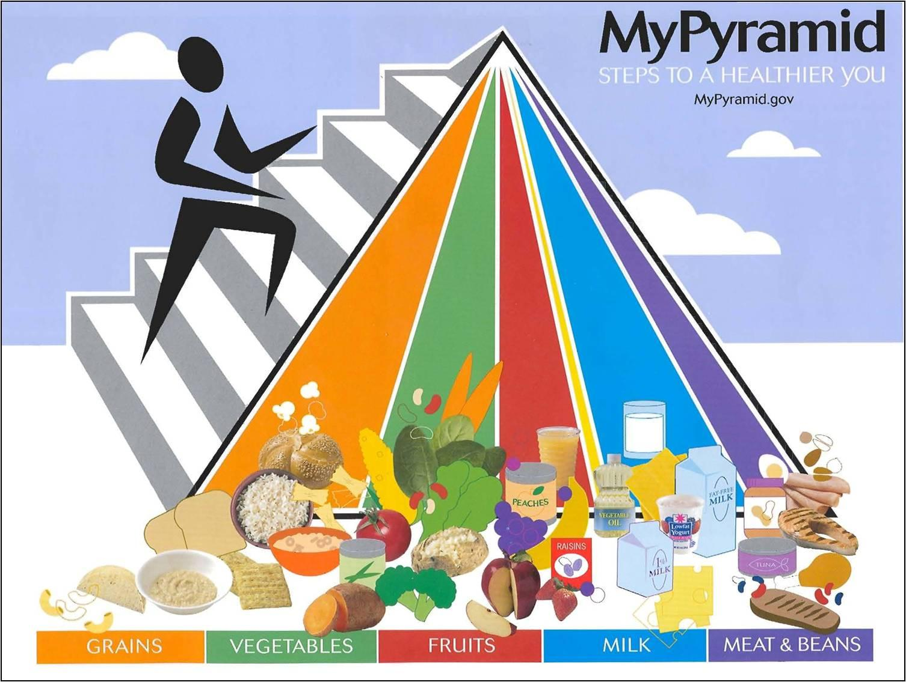
Nutrition education strategy: We can apply this in any educational program to change people's life style
Encouraging the targeted categories to consume Balanced diets according to the: Of course when I make program here in Saudi Arabia It's going to be different when I make it in UK or in China because they have internal differences we have to keep in mind to encourage people to adopt the way I'm planning to tell them
available sources انا ايش عندي وايش الميزانيه ومين هم الناس وهل يستخدمون انترنت او لا
Renew the dishes Make them more healthy and teach them how to cook their dishes healthier
Local food and eating habits
The presenting ways
The best preparing Methods
Suitable food هذولا ياكلون سوشي فاسوي لهم سوشي صحي اكثر وهذولا ياكلون كبسه اخلي كبستهم صحيه
To Meet the needs. يعني اعرف السعوديين مستحيل يستغنون عن الرز فخلاص استخدمه اذا يحتاجون الرز اعطيهم اياه بطريقه صحيه
changing the eating habits through nutrition education:
Food habits affect food consumption pattern.
Requirements:
Diffusion Of Innovations : Spread of innovations / (new ideas).
الموضوع يبدأ بفكر ممكن بالبدايه نطنشها لكن مع الوقت تبدا تكبر بمخ الناس مع الانتشار وممكن نطبق
Communication process: Methods of conveying thought and
feeling, it describes interactions between individuals and
groups as well on between various media and people. [one of the best methods] نبدا نتكلم عن الموضوع اكثر ونحلل فيه اكثر يعني يصير في كلام مع الناس وانتراكشن وليس مجرد فكره والناس تتكلم عنها لازم نبدأ نوضحها ونتكلم عنها اكثر
Source (sender): nutrition educator. The most important requirement in education is communication process
Channel: presentations, lectures………….media عن طريق ممكن اننا نسوي برزنتيشن او نستخدم الميديا على حسب الفئه المستهدفه مثلا المراهقين استهدفهم من السنابشات او الامهات من الواتس اب
Message: simple (eat more vegetables and fruits) لازم كلامك مفهوم وبسيط عشان يفهما وتقدر تتأكد انو وصلت المعلومة فاعشان كذا قلنا education level للشخص اللي قدامك مهم
Complex (how to get your child to eat healthful)
Audience (receiver): individual, group or public.
Carbs in the base and it's biggest because the serving of carbs you need is more than any serving of food groups

Slide 7
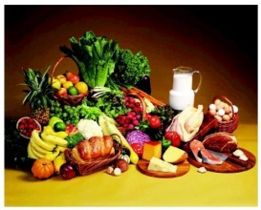
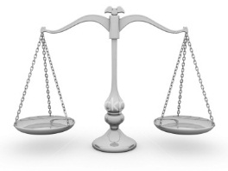

Vegetables are naturally low in fat and calories and provide
dietary fiber, potassium, Vitamin A, Vitamin C
•Fruits are sources of many essential nutrients including: potassium;
dietary fiber, vitamin C, and folate.
•Whole grain are sources of Dietary fiber, B vitamins and (Except
b12 because its source is the animals) Minerals – iron, magnesium and
selenium.
•Proteins are sources of B vitamins, vitamin E, iron, zinc, and magnesium and
Omega-3 fatty acids which are found in seafood.
•Oils are sources of energy and improve brain function like olive oil, corn oil, …
A Healthier Diet is ..
Adequate: provides enough energy, nutrients, fiber, and vitamins to support a person’s health. (Quantity = adequate)
Varied: to eat many different types of foods each day.
Balanced: contains the right combinations of foods to provide the proper balance of nutrients.
Moderate: contains the right amounts of foods for maintaining proper weight – neither too much nor too little food.

Slide 8
Adoption of Idea:
Awareness:Recognizing innovative for the first time
Interest: Collection of information available about the idea as much as possible, and more knowledge about characteristic , as a result of generating motivation to learn more about this new idea. لما يكون في فكره في ناس يسمعوها وما يهتمون وفي ناس يرجعون يقرون عنها اكثر ويجمعون معلومات وفي ناس تجذبهم الفكره
يشوف اذا جذبت انتباهه الفكرة
Decision & evaluation: The adopter take decision continuing to collect more information about the idea or to quit , as well as begin to assess the information which obtained according to the present situation and future prospects for decision to adopt it , or leave it. If someone decides to buy an iPhone for example there will be a decision (to buy it) and evaluation (is it good or bad for them, how do they feel and is it
Trial: In this stage the individual try to apply the new ideas in small area , to esteem the benefits of this new ideas. مثلا انا قطعت الكاربز من الطحين بس واحس اني احسن وصحيه اكثر بعدها اقرر
Adoption: After recognizing and after convicting the benefits of the new ideas the person will adopt these new ideas يعني صار لايف ستايل يستمر فيه
Steps of social change
Innovation : Create or develop a new idea
Diffusion : Delivery of new ideas through certain channels to members of the social system Contribute a better translation. ما تصير مجرد اشاعه او فكره اصير انا اقولها في التلفزيون او الجرايد وازرعها شوي شوي
Results : Are those changes that occur within the social system due to the spread of these new ideas between its parts, and thus change has become a monument to connect.
هنا يقصدون ان لازم تكون عندك فكره جديده بعدين طريقه توصلها فيها ومين الي بيسمعون وأخيرا ايش النتائج اللي طلعت معاك

Slide 9
Classes of adopters:يستخدمها في public health زي برامج التغذية والتدخين وهذي ما تصير كل وحده لحالها في
هذا الوقت مثلافي ناس قاعدين يتحولون من انفويتور الى ارلي ادوبترز وفي ناس لسه قاعده تصير انوفيتورز
Innovators: (the first individuals to adopt innovation) حوالي ١٥٪‏ تعجبهم هذي الفكره الجديده اللي محد يعرف عنها شي لسا فيقرو عنها اكثر او اللي ابتكر الفكره في مجموعه من الناس
Early adopters: (Second category of individuals who adopt innovation)
After searching some of them will like the idea and then they will start
adopting it so you call them early adopters اول من تبنى الفكره
Early majority: (adopt innovation after a variable degree of time)
بعدها الفكره تصير جزء من حياتهم وهنا يصيرون ايرلي
ميجورتي اللي هم مجموعه من الناس اللي عجبتهم فكره قطع الكاربز وبدو يطبقوها بحياتهم بشكل حقيقي
Late majority: (adopt innovation after the majority of society adopted the innovation as they have a high degree of skepticism “doubt”.
هذي العمليه وحصلو على النتائج الايجابيه مثلا انا شفت وحده من صاحباتي مرت بكل هذي المراحل بعدين صار لايف ستايل لها وانا شفت النتيجه مثلا نحفت وصار شكلها حلو اجي على طول اقرا عن الموضوع سريع سريع واصير على طول ليت مجورتي او مو من اول من سمعها اخذها انتظر وقت بعدين اخذها
Laggards: (the last to adopt innovation, show little or no leadership)
والمجتمع ما يخلو من الفئه اللي الفكره ما راح تجذبهم ابدا وما راح يتبنون اي شي مثلا في ناس للحين ما يستخدمون الايفون رغم الغزو او هذول الناس مترددين
Criteria which affect on diffusion of innovation:
Relative advantage of the new idea.
Complexity (easy in understanding and applying)
Compatibility (suitability) .
Results observe-ability احاول اوضح النتائج لهم
Societies characteristic , and thinking pattern .
Coast of the new ideas. كل ما كانت مكلفه كل ما كان
اصعب انهم يطبقوها فلازم اوفر لهم بدائل عشان تسهل التطبيق
Education levels
Socio-economic levels.
Civilizing (modernizing ) and cultural practices of the societies. مثل في السعوديه في شريحه كبيره ما زالو
ترادشنال وما تبحث عن التجديد فالطريقه ا
للي اوصلهم فيه مختلفه وممكن ما اقدر اوصلهم اقدر اوصل
Customs and traditions prevailing in the community. مثلا
قطعت عنهم التمر لازم اوفر لهم بديل وما اصعب عليهم الموضوع واروح

Slide 10
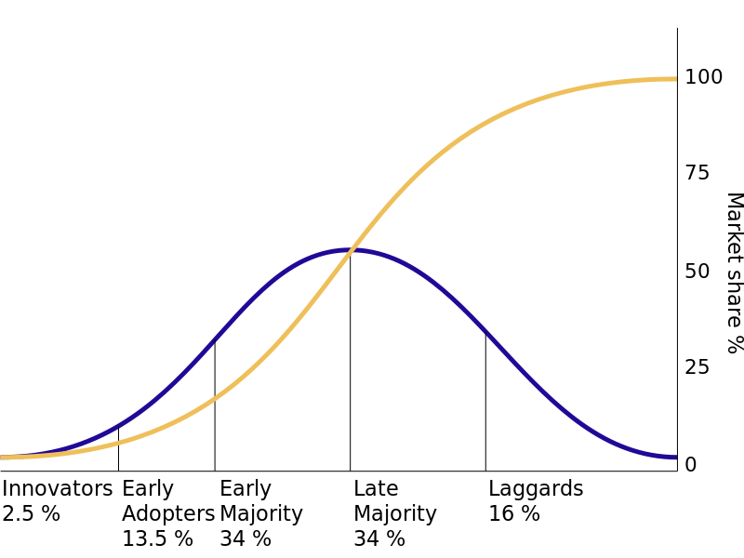
Classes of Adopters
تقريبا اكثر الناس يا يكونون early majority or late majority

Slide 11
Choosing the channels of nutrition education
1.Newspapers and publications.
2. The radio.
3. Television.
4. Space stations.
5. Telephone and fax.
6. Internet.
لازم اعرف هذا الكميونتي وش يصلح له اكثر شي عشان اقدر اوصله
Techniques:
ways that the educator will delivering the massages to the reserve (target groups)
1.lecture 2. seminars. 3. symposium . 4. role play
5. Discussion groups مثل انا استخدمت انستقرام فتطلع لي الافكار حقت الطبخ الصحي فلما ارجع للبيت من الدوام وافتح الثلاج وادور اسهل شي اللي هو الخبز مثلا مع جبن او زبده فول سوداني وهذي اشياء مع الوقت تسمن ، فكان تجيني اشياء بالانستقرام بطريقه اني اجهز اكل بحيث انه لما اجوع القا هلثي فود ، فالطريقه اللي وصلو لي فيها هي الانستقرام

Slide 13
Questions:
Q1:Which one of the following consider as nutritional strategy;
A-media B-available sources C-food habits D-non of them
Q2:Media is one of important factors that effects the food consumption ?
A-true B-false
Q3:any substance taken into body that help to meet the body needs for energy , maintenance and growth?
A-nutritional strategy B-food habits C-food D-innovation
Q4:The balance between the nutritional requirement and intake is called nutritional education?
A-true B-false
Q5:in developing country the malnutrition is due to?
A-obesity B-diabetis C-heart disease D-no enough food
Q6:the cause of malnutrition?
A-ignorance B-poverty C-disease D-all
1-B 2-A 3-C 4-B 5-D 6-D

Slide 14

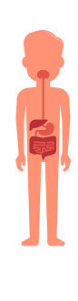
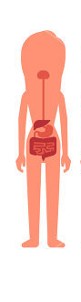




Leaders : Jawaher alkhayyal , naif alziyadi
TEAM MEMBERS:
Ebtisam almutairi
Reem alshathri
Monera alayuni
Aroob alhuthail
Anwar alajmi
Njoud alenezy
Feedback
References :
Girls & Boys slides
medicine436@gmail.com
@medicine436
recommended video:

