Slide 1
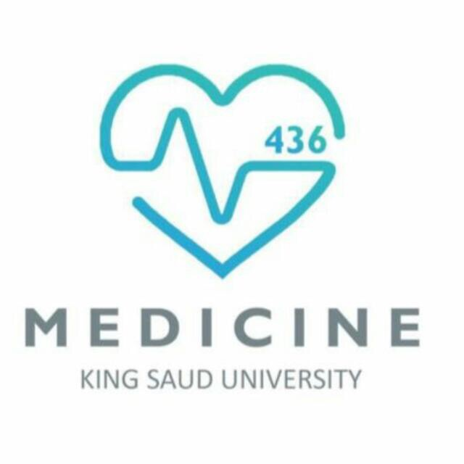
c
Pathophysiology Of Ascites In Cirrhosis
To acquire knowledge, one must; study
but to acquire wisdom, one must observe.
Marilyn Vos Savant
Color code
Important
doctor notes
Notes/extra explanation
وقل ربِّ زدني علماً (20 طه آية 114).

Slide 2
تقدير وشكر الى كافة أعضاء فريق medicine نشكر لكم جهدكم وتميزكم
عبدالكريم الحربي
مساعد النويصر
فارس النفيسة
أسيل السليماني
ابتسام المطيري
منيرة العيوني
عروب الهذيل
انوار العجمي
نجود العنزي
زينه الكاف
ريما الشايع
بشرى قوقندي
ندى الصومالي
لمى التميمي
حنين باشيخ
الاء العقيل
شهد العنزان
قادة فريق : جواهر الخيال & نايف الزيادي
Medicine

Slide 3
Objectives:
c
By the end of the lecture you should able to:
Understand mechanism of portal hypertension
Understand basic pathophysiologic steps in the development of ascites secondary to cirrhosis.
Causes of PHT
Approach of ascites
Correlate the anatomic and pathophysiologic changes with clinical manifestations.
Understand the basic steps in evaluation of patients with ascites

Slide 4
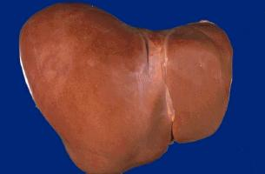
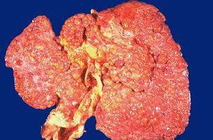
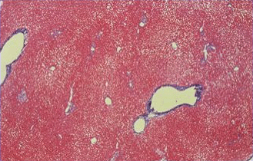
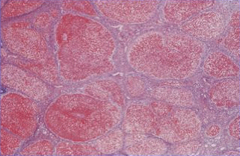
Cirrhosis
Late stage of chronic liver inflammation and fibrosis, in which liver parenchyma is distorted and replaced by fibrous tissue and regenerating nodules.
Causes of Cirrhosis
c
We should look for the color and surface if its smooth or nodular also normal hepatocyte and the appetance of hepatocyte fibrosis
Commmonest | Other causes
Viral (HBV+-HDV,HCV) | Autoimmune (AIH, PBC, PSC)
NASH non alcoholic steatoHepatitis | Metabolic & Hereditary WD, A1AT, HH
ASH Alcoholic steatoHepatitis | Vascular BCS, HF
Obesity | Biliary SC
 | Drugs
NORMAL LIVER
CIRRHOTIC LIVER

Slide 5
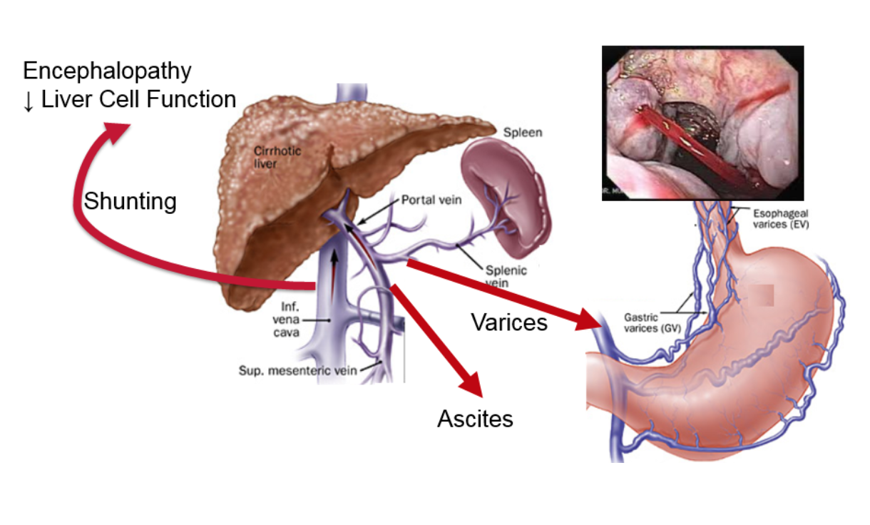
c

Slide 6
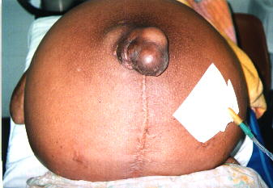
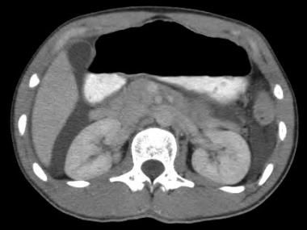
Ascites
The pathologic accumulation of fluid in the peritoneal cavity.
It is the most common complication of cirrhosis. " Normally there is no fluid in the peritoneal cavity in men but it might be liitle amount in women"
Ascites:
Cirrhosis 85% the most common cause is cirrhosis
Other causes 15 %
The development of ascites is the final consequence of a series of anatomic, pathophysiologic, and biochemical abnormalities occurring in patients with cirrhosis.
The formation of ascites is governed by the same principles as edema formation at other sites: net capillary permeability and the hydraulic and oncotic pressure gradients.
c
Accumulation of fluid

Slide 7
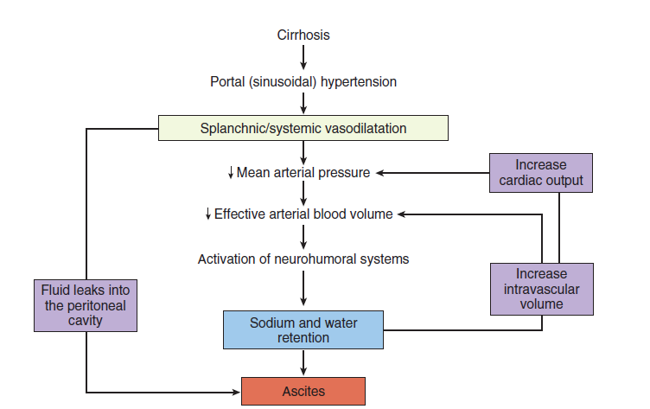
Important slide**
PORTAL HYPERTENSION
The development of portal hypertension (PHT) is the first step toward fluid retention in the setting of cirrhosis.
Patients with cirrhosis but without PHT do not develop ascites or edema.
A portal pressure >12 mmHg appears to be required for fluid retention 2 main mechanisms involved in portal hypertension:Portal hypertension usually 8 to 10 mmHg
1- Mechanical (due to structural changes in the liver with fibrosis and regenerative nodules)
2- Hemdynamic (circulatory, vascular, functional, and biochemical abnormalities)
c

Slide 8
Vasodilation(VD)
Portal hypertension leads to VD
Mechanisms of vasodilation:
Increase production of nitric oxide (NO), which is the primary
mediator of VD in cirrhosis (for splanchnic and peripheral vasodilation).
Increased levels of other circulating VDs. (Glucagon, vasoactive
intestinal peptide(VIP), prostacyclin.
production of these VDs may be stimulated by endotoxins or other bacterial products
VD initially develops in the arterial splanchnic circulation (i.e., the mesenteric arteries).
Subsequently, vasodilation develops in the arterial systemic circulation.
c
in systemic vessels, the NO is increased, as results of splanchnic vasodilation.

Slide 9
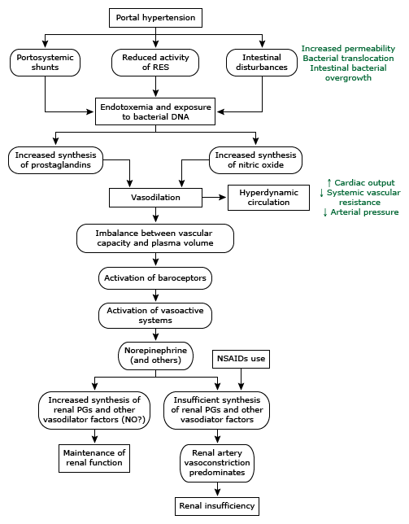
c
Hyperdynamic circulation
Systemic consequences to VD
reduction in systemic vascular resistance (SVR)
reduction in mean arterial pressure (MAP)
increase in cardiac output
→hyperdynamic circulation
Usually patients with cirrhosis and ascites have hyperdynamic
circulation.
CONSEQUENCES OF VASODILATION
Activation of endogenous vasoconstrictors Increase intravascular volume
Sodium and water retention
Increase renal vasoconstriction. Increase in renin

Slide 10
VD→ The reduction in pressure (or stretch) at the carotid and renal baroreceptors production of VDs may be stimulated bu endotoxins or other bacterial products" important
→ activation of the sodium-retaining neurohumoral mechanisms
(in an attempt to restore perfusion pressure to normal
renin-angiotensin-aldosterone system
sympathetic nervous system
antidiuretic hormone (vasopressin).
The net effect is avoid sodium and water retention
Sodium retention impaired sodium excretion
Water retention
Initially water excretion is normal in patients with cirrhosis before the development of ascites and then becomes increasingly impaired as the liver disease progresses. (Increase ADH)
Activation of endogenous vasoconstrictor agents
c
Important slide**
Thus, patients with cirrhosis and ascites usually demonstrate urinary sodium retention, increased total body sodium, and dilutional hyponatremia.
Renal vasoconstriction
VC → renal hypoperfusion→ decrease GFR→(in some patient hepatorenal
syndrome)This excess retained blood volume is thought to leak-out(filtered)
(extravasate) directly from both the liver surface, and the mesenteric vessels.
due to:
increased hydrostatics pressure
Increase vascular wall permeability
concurrently decreased oncotic (osmotic) pressure (hypoalbuminemia)
hypoalbuminemia cause decrease in omcotic pressure
always in ascites look for the underlying cause first before treatment"

Slide 11
Important slide**
Abnormalities in patients with cirrhosis and ascites
c
Circulatory | Vascular | Functional | Biochemical
Reduced systemic vascular resistance | Splanchnic vasodilation | Activation of systemic vasodilator factors | Sodium retention
Reduced arterial pressure | Renal artery vasoconstriction | Activation of systemic vasoconstrictor factors | Water retention
Increased heart rate | Pulmonary vasodilation | Activation of renal vasodilator factors | Increased systemic nitric oxide
Increased cardiac index |  | Reduced glomerular filtration rate | Increased systemic prostaglandins
Increased plasma volume |  |  | Increased renal nitric oxide and prostaglandins
Reduced renal blood flow
Increased portal blood flow

Slide 12
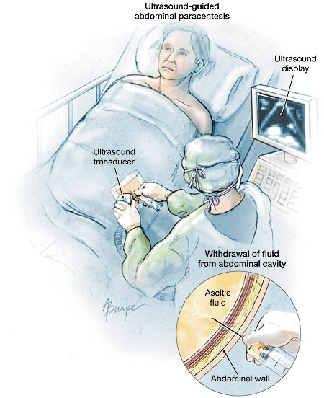
c
Any new ascites should be tapped and analyzed!
history: check if he has progressive abdomenal distention, jaundice, lower limb adema.
Clinically there will be extention and shifting.

Slide 13
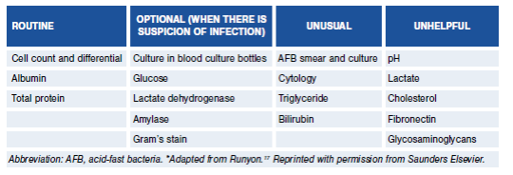
c
Ascitic Fluid Analysis
Measure SAAG
From serum, if its high=portal hyper tension ,
if decresed=malegnancy
High SAAG ( mainly liver ) Low SAAG ( other causes )
SAAG is more sensitive to fluid the idea is measure the serum & ascitic albumin

Slide 14
Serum-to-Ascites Albumin Gradient (SAAG)
c
High SAAG ≥1.1 g/dL
Cirrhosis
Heart failure/constrictive pericarditis
Alcoholic hepatitis
Budd chiari
Massive hepatic metastases
Low SAAG <1.1 g/dL
Peritoneal carcinomatosis
Peritoneal tuberculosis
Secondary peritonitis
Pancreatitis
Serositis
Nephrotic syndrome
Initial treatment of ascites
1. Dietary sodium restriction : Limiting sodium intake to 88 meq (2000 mg) per day
2. Diuretics (most successful therapeutic regimen is the combination of Spironolactone and Furosemide) Monitor electrolytes and kidney function
3. Discontinue non-steroidal anti-inflammatory drugs . avoid all hepatotoxic drugs.
4. Rx of underlying cause
5. Evaluation for liver transplantation. if the patient didnt respond to the treatment, he should have liver transplantation.

Slide 15
c
Take home message
Ascites is the most common liver cirrhosis complication.
Development of ascites indicates advanced stage of liver disease and poorer prognosis.
Development of ascites is complex process.
Portal hypertension is first step in ascites development in patient with cirrhosis.
Portal hypertension and possible bacterial toxin trigger VDs.
VD with activation of secondary mechanisms;
renin-angiotensin-aldosterone system
sympathetic nervous system
antidiuretic hormone (vasopressin).
LEADS TO SALT AND WATER RESTENTION and Increase plasma volume
All these with hypoalbuminemia and increase vascular permeability lead to fluid extravasation.

Slide 16
Cirrhosis
Late stage of chronic liver inflammation and fibrosis, in which liver parenchyma is distorted and replaced by fibrous tissue and regenerating nodules.
Causes of Cirrhosis
Ascites
The pathologic accumulation of fluid in the peritoneal cavity
It is the most common complication of cirrhosis
Ascites:
Cirrhosis 85%
Other causes 15 %
The development of ascites is the final consequence of a series of anatomic, pathophysiologic, and biochemical abnormalities occurring in patients with cirrhosis.
The formation of ascites is governed by the same principles as edema formation at other sites: net capillary permeability and the hydraulic and oncotic pressure gradients.
PORTAL HYPERTENSION
The development of portal hypertension (PHT) is the first step toward fluid retention in the setting of cirrhosis.
Patients with cirrhosis but without PHT do not develop ascites or edema
A portal pressure >12 mmHg appears to be required for fluid retention
2 main mechanisms involved in portal hypertension:
1- Mechanical (due to structural changes in the liver with fibrosis and regenerative nodules)
2- Hemdynamic (circulatory, vascular, functional, and biochemical abnormalities)
Vasodilation(VD)
Portal hypertension leads to VD
Mechanisms of vasodilation:
Increase production of nitric oxide (NO), which is the primary mediator of VD in cirrhosis (for splanchnic and peripheral vasodilation).
Increased levels of other circulating VDs. (Glucagon, vasoactive intestinal peptide(VIP), prostacyclin.
production of these VDs may be stimulated by endotoxins or other bacterial products
VD initially develops in the arterial splanchnic circulation (i.e., the mesenteric arteries).
Subsequently, vasodilation develops in the arterial systemic circulation.
Hyperdynamic circulation
Systemic consequences to VD
reduction in systemic vascular resistance (SVR)
reduction in mean arterial pressure (MAP)
increase in cardiac output
→hyperdynamic circulation
Usually patients with cirrhosis and ascites have hyperdynamic circulation.
Commonest
Viral
(HBV+- HDV, HCV)
NASH
ASH
Other causes
Autoimmune
(AIH, PBC, PSC)
Metabolic & Hereditary
WD, A1AT, HH
Vascular
BCS, HF
Biliary
SC
Drugs

Slide 17
CONSEQUENCES OF VASODILATION
Activation of endogenous vasoconstrictors
Sodium and water retention
Increase renal vasoconstriction.
Activation of endogenous vasoconstrictor agents
VD→ The reduction in pressure (or stretch) at the carotid and renal baroreceptors → activation of the sodium-retaining neurohumoral mechanisms (in an attempt to restore perfusion pressure to normal
renin-angiotensin-aldosterone system
sympathetic nervous system
antidiuretic hormone (vasopressin).
The net effect is avid sodium and water retention
Sodium retention
impaired sodium excretion
Water retention
Initially water excretion is normal in patients with cirrhosis before the development of ascites and then becomes increasingly impaired as the liver disease progresses. (Increase ADH)
Thus, patients with cirrhosis and ascites usually demonstrate urinary sodium retention, increased total body sodium, and dilutional hyponatremia.
Renal vasoconstriction —
VC → renal hypoperfusion→ decrease GFR→(in some patient hepatorenal syndrome)
This excess retained blood volume is thought to leak-out (filtered) (extravasate) directly from both the liver surface, and the mesenteric vessels.
due to:
increased hydrostatics pressure
Increase vascular wall permeability
concurrently decreased oncotic (osmotic) pressure (hypoalbuminemia)
Serum-to-Ascites Albumin Gradient (SAAG)
Initial treatment of ascites
1. Dietary sodium restriction
Limiting sodium intake to 88 meq (2000 mg) per day
2. Diuretics (most successful therapeutic regimen is the combination of Spironolactone and Furosemide)
Monitor electrolytes and kidney function
3. Discontinue non-steroidal anti-inflammatory drugs
4. Rx of underlying cause
5. Evaluation for liver transplantation
High SAAG ≥1.1 g/dL
Cirrhosis
Heart failure/constrictive pericarditis
Alcoholic hepatitis
Budd chiari
Massive hepatic metastases
Low SAAG <1.1 g/dL
Peritoneal carcinomatosis
Peritoneal tuberculosis
Secondary peritonitis
Pancreatitis
Serositis
Nephrotic syndrome

Slide 18
MCQs
c
Q1 - What’s the main cause for ascites?
A.Live cirrhosis
B.Hepatitis
C.Heart failure
D.Viral hepatitis B
Q2 - The first step toward fluid retention in
the setting of cirrhosis is:
A.Vasodilation
B.Activation of endogenous vasoconstrictor agents
C.Portal hypertension
D.Hyperdynamic circulation
Q3 - The primary mediator of vasodilatation
in cirrhosis is :
A.VIP
B.nitric oxide (NO)
C.Prostaglandin
D.ADH
Q4 – Which one of the following is a systemic consequences to vasodilatation
A.Hyperdynamic circulation
B.Vomiting
C.Headach
D.Sodium and water retention
Q5 - Which of the following is a consequence of vasodilatation?
A.Activation of endogenous vasoconstrictors
B.Sodium and water retention
C.Increase renal vasoconstriction.
D.A,B&C
Q6 – Which one of the following isn’t biochemical change in ascites:
A.Increased systemic nitric oxide
B.Increased systemic prostaglandin
C.Reduced glomerular filtration rate
D.Sodium water retention
Answers:
1-A
2-C
3-B
4-A
5-D
6-C

Slide 19
Leaders : Jawaher Alkhayyal & Naif Alziyadi
c
TEAM MEMBERS:
•Abdulkarim alharbi
•Mosaed Alnowaiser
•Fares Alnafisah
Bushra Kokandi
Ebtisam Almutairi
Nada Alsomali
Aseel Alsulimani
Feedback
References : boys and girls slides.
Medicine436@gmail.com
@medicine436
Please check our editing file https://docs.google.com/presentation/d/1-ToRZ75K6Bva-_wmwUUdohnVPlDvh368MvwfT0XmbXw

