Slide 1
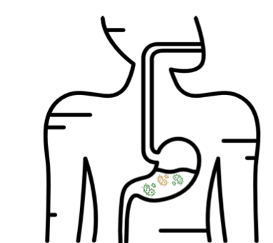
Review File

Slide 2
H pyolri
6 slides

Slide 3
Peptic ulcer
Definition | Is an ulcer defined as mucosal erosions(≥ 0.5cm) associated with the over usage of NSAIDs , alcohol , smoking , helicobacter pylori .
Location | •Peptic ulcer is created in an acidic area​ (very painful). •More Peptic ulcers are arise in duodenum ​than stomach (duodenum less acidic)
Complication | •4% of stomach ulcer can turn to be malignant tumor. •Duodenal ulcers are generally benign.​ •(Multiple biopsies are needed to exclude cancer)
Signs and symptoms | •​Abdominal pain, epigastric with severity relating to meal time (3 hours after meal with gastric ulcer). “Before the meal may indicates duodenum ulcer” •Bloating and abdominal fullness. •Nausea​ and​ vomiting.​ • Loss of appetite and weight loss​. •Haematemesis (vomiting of blood) due to gastric or esophagus damage. •Melena (foul-smelling & dark brown feces due to oxidized hemoglobin iron). •Rarely, Gastric or duodenal perforation leading to acute peritonitis.(extremely painful require urgent surgery )

Slide 4
Helicobacter Pylori
Helicobacter pylori (formerly known as Campylobacter.pylori or C.pyloridis) is found closely associated with gastric mucosa and causes chronic active gastritis, gastric and duodenal ulcer (Peptic ulcer) and could develop adenocarcinoma and Gastric mucosa-associated lymphoid tissue (MALT) lymphoma.
Poor sanitary conditions contribute to high rates
Over 80% of individuals infected with the bacterium are asymptomatic.
transmission:
Person to person (oral to oral or fecal-oral)​ route.
Transmission occur mainly within families or community.
Fecal-oralroute of infection occur by ingestion contaminated food or water due poor hygiene.
Using same spoons, forks and tooth brushes and kissing children mouth to mouth increases​ oral-oral route of infection.
Gastric antrum is the most favoured site.
Genoum :
H pylori contain 40kb-long Cag pathogenicity island (PAI) with over 40 pathogenetic genes.
Asymptomatic patients carry H.pylori strains lacking the Cag pathogenesity island (PAI).

Slide 5
Pathogenesis ( important )
•To colonize the stomach, H pylori must survive acidity.
•Using flagella, H pylori moves through stomach lumen and drill into the mucoid lining of stomach.
•Produces adhesions that binds to the epithelial cells.
•Produces large amounts of urease enzyme that break down urea into co2 +ammonia.
•This in-turn neutalizes gastric acid.
•Ammonia is toxic to epithelial cells along with proteases, vacA protein and phospholipases produced by H pylori and could damage epithelial cells.
•Colonization of stomach or duodenum results in chronic gastritis (inflammation of stomach lining).
•Inflammation stimulate more production of gastric acid ,This leads to gastric and duodenal ulcers, atrophy and later cancer.
•CagA protein was found to contribute to peptic ulcer.
•Free radical production in the gastric lining due to H pylori increases host cell mutation*.
•H pylori induces the production of TNF-α and Interleukin 6 that leads to host cells mutation.
•CagA: cytotoxin- associated gene A
•CagA is thought to be directly injected into the gastric epithelium and interferes with cell cycle progression and oncogenic function
•H. pylori that express functional VacA and CagA proteins possess greater pathogenic potential

Slide 6
Laboratory characteristics :
Culture: | •On blood or chocolate agar based medium in a moist microaerophilic * atmosphere.
Biochemical reactions: | •catalase-positive •oxidase- positive •strongly urease-positive. Hallmark of the species is production of urease enzyme: -Urease breaks urea down to Co2+NH3 -Amonia is a strong base -Urease helps H. pylori survive strongly acidic stomach conditions. •Very fragile (a point of importance when referring samples to the lab).
small, Gram negative spiral rods bacilli , motile by flagella .
Strictly Microaerophilic

Slide 7
Diagnosis : Checking for dyspeptic patients for H pylori.
Non-invasive methods: -First choice “Commonly used” | •Serology (Blood antibody) tests - poor accuracy
 | •Stool antigen test. “very specific (Reliable but may there cross react with other bacteria”
 | •Carbon urea breath test (C14 or C13 ).- (very specific but very expensive)
Invasive methods (most reliable), on biopsy: “Commonly used” | •Histological examination of biopsy specimens of gastric/duodenal mucosa take at endoscopy. (Very reliable, The gold standard )
 | •Rapid urease test (CLO-test ®) .
 | •Endoscopy followed by culturing the bacteria.- Culturing the bacteria.
 | •Molecular methods (e.g. PCR)

Slide 8
Treatment
Clarithromycin Triple therapies (first line): | Bismuth Quadruple Therapies (second line):
•PPI b.d. (twice a day) + clarithromycin + amoxicillin or metrodiazole for 14 days. | •PPI b.d. + bismuth subsalicylate/subcitrate + nitroimidazole + tetracycline for 10 - 14 days. – Can be used as salvage therapy if primary therapy with the Clarithromycin triple therapy fails .
Another option for salvage: levofloxacin + amoxicillin + PPI
Post Treatment Testing : After identification and treatment, eradication should be proven using: •Urea breath test •Fecal (stool) antigen test •Biopsy based testing ( usually not used)

Slide 9
Viral gastroenteritis
2 slides

Slide 10
Gastroeneritis
Definition | It is inflammation of the gastrointestinal tract which involves both stomach and small intestine and leading to acute diarrhea and vomiting
Causes | 1-Infectious (viruses ) 2- non-infectious ( allergy,drugs,chemical)
Epidemiology | ● common in poor hygiene, overcrowding and poverty. Age: infants and young childern ● Transmission: Fecal-oral route . ● Season: Winter months. ● Endemic infection: group A Rotavirus and Adenovirus 40,41 in children ● Epidemic infection : Norovirus (most common cause of non-bacterial outbreak )
Clinical features | ● Short incubation period. ● diarrhea , vomiting , fever and abdominal cramps . ● complication: dehydration . Winter vomiting disease: vomiting > diarrhea - calicivirus
Lab diagnosis | Mainly detection of viral antigen in stool by ELISA (microscopy and culture aren’t significant )
Treatment | Treatment : rehydration Prevention : sanitation and no vaccines except for rotavirus

Slide 11
 | Rotavirus most common | Adenovirus | Calicivirus | Astrovirus
Description All of them are Icosahedral & non-enveloped | -11 segment Ds RNA -Double-layered with Wheel-Like Structure -It has 7 groups [A-G]: -group A is the most common | - ds DNA - the only virus with a fiber protruding from the capsid (important for Attachment) -Classification: 1-Adenoviruses 2-Enteric adenoviruses: (40&41 serotypes , Fastidious , subgenus F) | - ss RNA , +ve polarity. -Two types: 1-Typical caliciviruses (Sapovirus) : small rounded structured 2-Norovirus”norrwalk virus” | - ss RNA ,+ve polarity
Epidemiology | -Fecal-oral route transmission. -endemic |  | Norovirus: -Faecal-oral route (water-shellfish) Responsible for non- bacterial outbreaks
Clinical features | 1- infants&young children: watery non-bloody diarrhea,vomiting and fever 2- adult ;asymptomatic 3-immunocompromised : chronic diarrhae | Longer incubation period, less severe and prolonged period than rotavirus | Norovirus: Common symptom in children is vomiting Common symptom in adult is diarrhea | -Mild gastroenteritis. -Outbreak of diarrhea affect children less than 5 year
Diagnosis | -ELISA :most used -Immunochromatography + LA -PCR: more sensitive but expensive | Antigen detection in stool by( ELISA Or Immunochromatography Technology)
Management | Treatment :rehydration Prevention :Oral live attenuated vaccine (RotaTeg) | Treatment >rehydration , Prevention>sanitation

Slide 12
Intestinal helminthis
8 slides

Slide 13
1-Enterobius vermicularis
•infects only human. •Children are more often evolved than adults , it tends to occur in groups living together •Adult worms live in large intestine, are mainly located in lumen of cecum and the female migrate to rectum to deposits her eggs on perianal skin. •Direct human to human infection occurs mainly by swallowing the eggs. -autoinfection occurs by contamination of the fingers.
Pathology: | •Main clinical presentation pruritus and occurs more often during the night, persistent itching may lead to inflammation. •Infected children may suffer from emotional disturbance because of lack of sleep, loss of weight and loss of concentration and enuresis. •Ectopic enterobiasis occurs in infected adult female when invade vulva and vagina
Diagnosis: | the eggs are not usually found in feces .The best method is by taking an anal swab or by using CELLULOSE ADHESIVE TAPE, the examination should be done before defecation or bathing.
Treatment: | Albandazole

Slide 14
2-Ascaris lumbricoides (roundworm)
General | •the commonest human helminthes infection all over the world. •HUMAN is the only definitive host. (live as adult ) •Infection by fecal-oral rout •The largest intestinal NEMATODE of human , which is normally located in the small intestine. | •Found in jejunum and upper part of ileum. •Feed on semi digested food. Causes malnutrition •Needs soil area to be in the infective stage -infective stage in embryonated eggs -Diagnostic stage is Unfertilized eggs
Pathogenicity
1-Migrating LARVA : Ascaris pneumonia (Loeffler”s syndrome) | 2-Adult WORM: The worm consumes proteins and vitamins from host’s diet and leads to malnutrition. Can cause intussusception, intestinal ulcers and in massive infection can cause intestinal obstruction.
Diagnosis |  | Treatment
•eggs in stool. (unfertilized) •larvae in sputum. •adult may pass with stool. “in heavy infection” |  | Albendazole

Slide 15
3-Trichuris trichiura (Whipworm)
General | • World wide •Infect only human by fecal-oral rout •It coexists with Ascaris because of similar requirement( the eggs to be embryonated egg infective stage it needs to be 3 weeks in the soil). •Adult live in large intestine especially caecum and appendix -in heavy infection the whole length of large intestine affected.
Pathology and Symptoms | •light infection : asymptomatic •heavy infection :abdominal pain ,bloody diarrhea. Rectal prolapsed why? because it live in the large intestine in children is a common complication.
Diagnosis | egg in stool characterized by its barrel shape with mucoid plugs at each pole .
Treatment | Albendazole. “for all helminths”

Slide 16
4-Hook worms :Ancylostoma dudenale (in the middle east) &Necator americanus( in US)
General | •Its buccal capsule (mouth) lined with hard hooks, triangular cutting plates and anticoagulant glands. •Infection by penetrating the skin •Needs soil such as the previous but enter the circulation by barefoot •There are no specific symptoms or signs of hookworm infection, but they give rise to a combination of intestinal inflammation and progressive iron-deficiency anemia and protein deficiency
Pathology& clinical picture | olarvae: •At the site of entry of larvae intense itching(ground itch) and dermatitis. •Migration phase: cough with bloody sputum, pneumonitis and bronchitis but less sever than Ascaris, eosinophilia urticaria. | oAdult worm: -low worm burden (INFECTION): no symptoms. -Moderate to heavy burden: Anemia: due to withdrawal of blood by parasites and hemorrhage from puncture sites lead to sever anemia = microcytic hypo chromic anemia or iron-deficiency anemia
Diagnosis | Eggs in stools.
Treatment | Albendazol

Slide 17
5-Strongyloides stercoralis
General | •fatal dissemination in immuno-compromised host. Epically HIV patient • It is smallest pathogenic nematodes •adult live in mucous membrane of duodenum jejunum rarely mucous membrane of bronchus. •AUTOINFECTION IS VERY IMPORTANT CRITERIA •Infection by penetrating the skin
Pathology and clinical picture | •Cuteneous little reaction on penetration, sever dermatitis at perianal region in case of external autoinfection. •Migration :pneumonitis during larval migration. . •Intestinal: inflammation of upper intestinal mucosa, diarrhea, upper abdominal pain in the epigastria colicky in nature. •Disseminated strongyloidiasis : in patient with immunodeficiency ,uncontrolled diarrhea –granulomatus changes –necrosis--perforation—peritonitis - death.
Diagnosis | NO EGG IN DIAGNOSIS, rhabditiform larvae diagnostic stage in: -Stool examination -Duodenal aspirate Treatment: Albendazol
The parasite shows 3 different modes of development:
Direct development: The rhabiditiform larva pass from stool and become directly a Filariform larva if the environment of the soil is suitable
Indirect development : in external environment Rh. larva becomes free living adults, produce eggs ,rhabiditiform larva (diagnostic stage) and Filariform larva (Infective stage).
AUTOINFECTION: mainly in immunocompromised patients
Internal :when the rhabiditiform larva become a filariform larva in the intestine and penetrate the intestine
External : fecal contamination of skin –Rh larva > filariform penetrates the skin

Slide 18
Common Tapeworm Infections:
TAPEWORM: | Taenia saginata | Taenia solium - ADULT | Taenia solium- LARVA (cysticercus cellulosae) | Hymenolepis nana | Echinochoccus granulosus
DISEASE: | taeniasis | taeniasis | Cysticercosis | hymenolepiais | hydatid disease
Taenia saginata
General | • one of the cestodes •CATTLE become infected by ingesting grass contaminated with eggs or gravid segments (womb filled with eggs) which passed from human faeces. In the cattle the onchosphere hatches out go to circulation and transformed to cysticercus stage in the muscle known as CYSTICERCUS BOVIS. •Man become infected by eating undercooked or improperly cooked beef which contain cyst, the adult worm lives in small intestine of man passing eggs and gravid proglottids to the environment •The majority of cases are Asymptomatic ,some patients have vague intestinal discomfort, vomiting and diarrhea.
Diagnosis | by demonstration of eggs and gravid segments in the stool of human
Treatment | Albendazole.

Slide 19
Taenia solium:
the human can infected in 2 ways:
1-eating food contaminated with eggs or gravid segment will cause cystocercosis in man.
2-man can be infected by eating undercooked pig meet containing the cystocircosis in pig meat will lead to infection and having the adult worm.
Hymenolepis nana: ( you should know ONLY that it is one of the cestodes and infect human and rats)
Echinococcus granulousus:
•E. granulosus requires two host types:
1.definitive host of this parasite are: dogs
2.intermediate host are: most commonly sheep, cattle, and Humans
•DOG become infected by eating sheep,cattle muscle having hydated cyct which become in the intestine of the DOG as an adult and start releasing eggs which gets excreted in the faces .
Human become infected by ingestion of Echinococcus Granulosus eggs, usually by hand-to-mouth contact with infected dog feces. The ingested eggs migrate to the various body tissues, and produce hydatid cysts. The life cycle is terminated at this point Symptoms vary, depending on the location of the cyst in tissues. Although cysts may form in many areas of the body, the lung and the liver are most commonly affected. One serious complication of hydatid cyst disease is the risk of anaphylactic shock, following rupture of the cyst.

Slide 20
Hydatid cyst
General | •hydatid cyst, which may reach large size and causes compression .
Diagnosis | •Radiological examination: (CT), (MRI) and ultrasound •Serological examination: to detect specific antibodies ELIZA,CFT. •Casoni`s test: it is an intradermal test used to detect immediate hypersensitivity in hydatid disease. •Microscopical examination: •Hydatid fluid may be withdrawn by the fine needle aspiration and examined under the microscope for scolices or hooklets.THIS IS DANGEROUS PROCEDURE.
Treatment of Tapeworms
•Intestinal stages: Praziquantel •Tissue stages ( Hydatid , cysticersosis): Depends on clinical condition : Surgical and/or Albendazole

Slide 21
Intestinal protozoa
5 slides

Slide 22
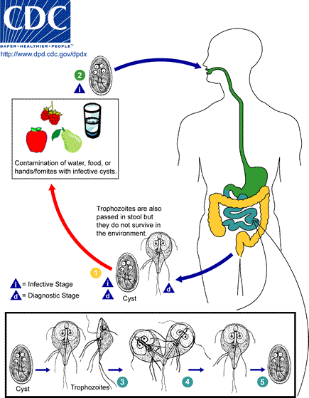
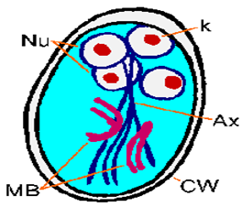
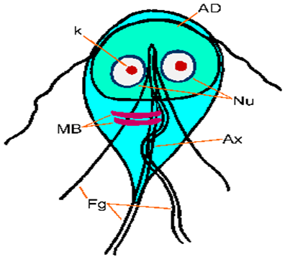
Giardia Lamblia (has 2 stages )
Life cycle | Ingestion of food containing cyst →intestine→ trophozoite → comes out in the stool cyst or trophozite → only cyst can live in outside environment
Stages | Characteristics | Notes
Cyst | - Infective stage -Diagnostic stage | •why is it an infective stage ?Because it can resist the acidity of the stomach •Multi-nucleated
Trophozite | -Replicative stage -Diagnostic stage | •Die in the stomach because of high acidity
Giardiasis
Clinical Picture | •The parasite mostly asymptomatic or can produce a wide range of gastrointestinal symptoms especially in children. •Symptomatic Infections: ‒Typical picture: IP 1-2 wks followed by diarrhea, vomiting & flatulence for about 6 wks, ‒Atypical: Severe diarrhea, malabsorption (especially in children) and cholecystitis.
Laboratory diagnosis | •Stools examination: ‒Microscopy for cysts or trophozoits why? Because diagnostic stage are both ‒Detection of Giardia antigens in stools •Examination of duodenal contents: trophozoites because the pathogenesis and inflammation due to trophozoid but the infective stage is cyst
Chemotherapy | Drug of choice: Metronidazole

Slide 23
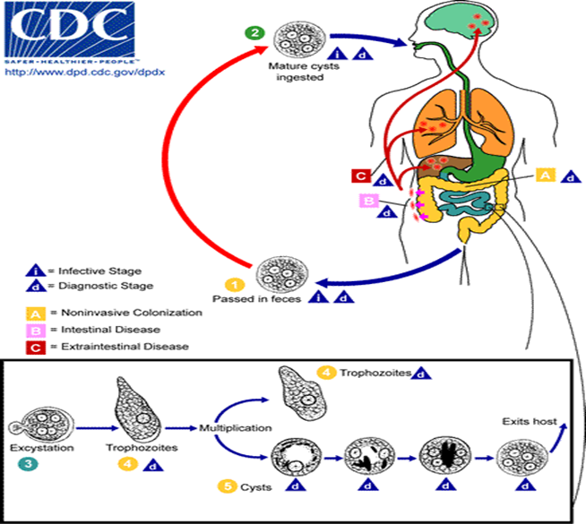
Entamoeba Histolytica
Characteristics | - Ameba is protozoa, unicellular and it can move by pseudopodia - seen more often in tropical countries with poor sanitary conditions. It is a waterborne infection. - There are 6 species of Entamoeba: (important) 1.E.histolytic:Amoebae that are pathogenic and invasive. 3. E.hartmanni 5. E.gingivalis 2.E.dispar:The nonpathogenic, non invasive form. 4. E.coli 6. E.polecki
Mode of infection | (faecal-oral route): -Water, food -Not a zoonosis (only human)
IP | can be from few days to few weeks depending on the infective dose.
Clinical Outcome | - Asymptomatic Carrier:Remain in a good health but produce cysts in the stool -symptomatic Intestinal: (amoebic dysentery) Extra-intestinal: make amoebic abscess in the liver ,brain ,and lung
stages | Cyst: - infective stage - diagnostic stage -The infective dose can be as little as 1 cyst. -Resist the harsh conditions “acidity of the stomach” of the environment | Trophozoite: - vegetative stage - must encyst to survive in the environment. -It is a fragile structure.

Slide 24
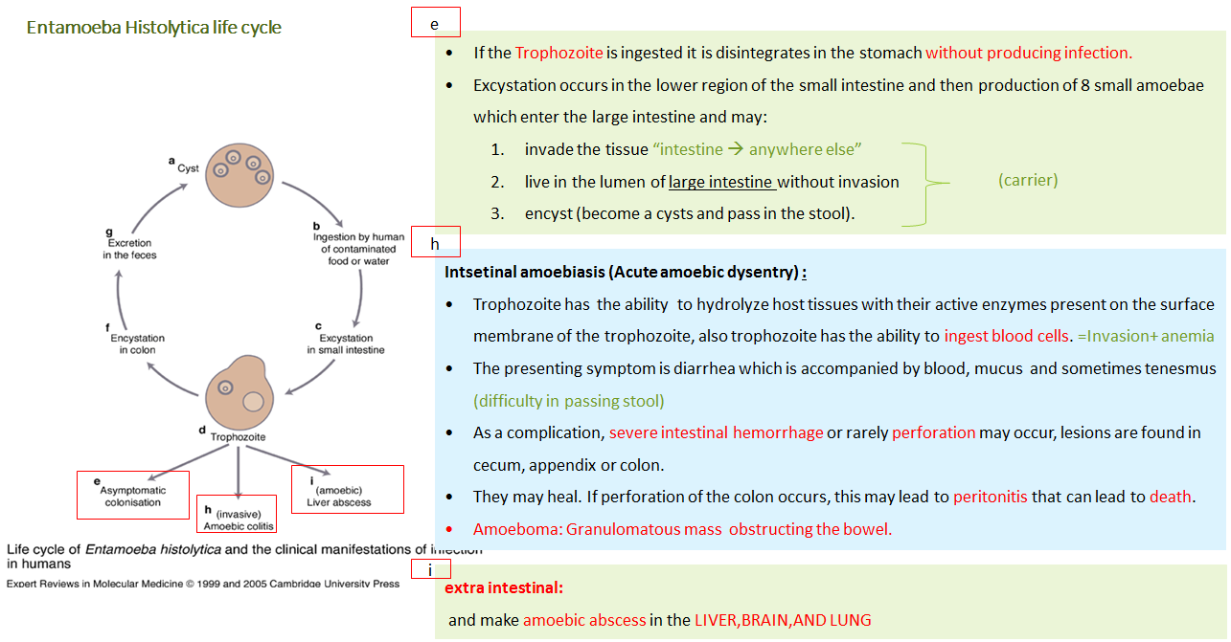

Slide 25
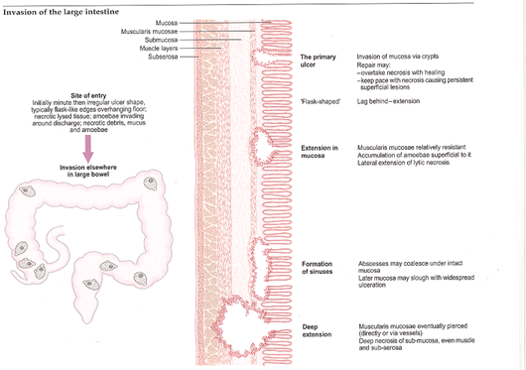
Entamoeba Histolytica con.
Pathology | In the large intestine the ameba may cause ulcers or deep ulcers and form a sinus
Amoebiasis:you have to distinguish between the diagnosis of intestinal and extra intestinal
Amoebiasis | Main drugs for treatment | Laboratory Diagnosis of Amoebiasis
Intestinal | Symptomatic (cysts and trophozoites): metronidazole | Stools examination : •Wet mount (cysts and trophozoites) •Concentration methods (only cysts) Serology (mainly for invasive infections): IHA , ELISA
Extra-intestinal | Metronidazole | Serology: IHA , ELISA Microscopy of tissues or fluids radiological: x-ray and CT scan

Slide 26
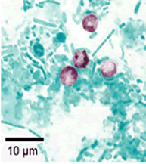
Cryptosporidium Parvum
Charactaristics | •Usually nit pathogenic but turned to be in immunocompromised patients epically AIDS •Infection is caused by ingestion of sporulated oocysts transmitted by the faecal-oral rout •In immunocompromised patients, such as those with AIDS infection may not be self-limiting leading to dehydration an sever cases can lead to death “can be fatal”
diagnosis | STAIN : cryptosporidium oocyst in faces by ziehl-neelsen stain
Treatment | •Self-limited in immunocompetent patients •In AIDS patients we give treatment
Cryptosporidium, acid-fast stain

Slide 27
Normal flora
13 slide

Slide 28
Acute diarrheal illness and food poisoning:
Introduction:
•Acute diarrheal illness is one of the most common problems evaluated by clinicians. •A major cause of morbidity and mortality world wide. •Most of healthy people have mild illness but other might develop serious squeals so it is important to identify those individuals who require early treatment.
Definition of diarrhea:
•Stool weight in excess of 200 gm/day or 3 or more loose or watery stools/day •Acute < 14 days •Alteration in normal bowel movement characterized by decreased consistency and increased frequency •Less than 14 days in duration
Etiology:
•Viral the majority: 70-80% of infectious diarrhea (In children) in developed countries •Bacterial: 10-20% of infectious diarrhea but responsible for most cases of severe diarrhea •Protozoan: less than 10% (and may be complicated)

Slide 29
Classifications
1. Infectious diarrhea: viral (Causes watery diarrhea) or Bacterial organism ( Campylobcator, Shigella,Solmonella,Yersinea, vibrio Cholera and E.coli). 2. Food poisoning: Staphylococcus aureus (their toxin is preformed thus their poisoning effect is quick (, Clostridium perfringens, Bacillus spp.) the incubation period of these 3 bcateria is Quick= 6 hours- half a day( 3. Traveler diarrhea: (can cause watery diarrhea) Enterotoxogenic (no invasion by the bacteria thus no pus ,and no fever because there is no inflammation) E-coli (incubation period 1-3 days and this is true for most of the diarrheal disease) 4. Antibiotic associated diarrhea: Clostridium difficile

Slide 30
Clinical Presentation and Pathogenic Mechanism
1-Enterotoxin mediated: Here the bacteria is dead but they already released their poison | 2-Invasive: Here the bacteria are alive and the fight and release their poisons
•Lack of pus in the stool (no gut invasion) •Lack of fever (because no inflammation) •Rapid onset preformed toxin<12 hour •Small intestine are affected •Vomiting ,non-bloody diarrhea, abdominal cramp •Vibrio cholerae, Staphylococcus aureus, Clostridium perfringens and Bacillus cereus All of these produce toxin which usually affect the small intestine and cause some abdominal cramp, nausea, vomiting and watery diarrhea, there is no invasion •Other viral and some parasitic infection can produce toxin but more common is via bacteria. | •Pus and blood in the stool •Fever due to inflammation •Shigella, and Endameba histolytica (very important) •Affect colonic mucosal surface of the bowel invasive mechanism à large intestine is usually affected For enterotoxin mechanism à small intestine is usually affected •Sometime Solmonella spp, Campylobacter, some E-coli EHEC , Yersinia and Clostridium difficile •Extension to lymph nodes •Incubation period 1-3 days •E.histolytica 1-3 wk •Dysentery syndrome- gross blood and mucous with stool in small amounts after severe suprapubic pain , the pain is releaved after defection ends. (ممكن نسألكم عنها في الاختبار) •EHEC bloody diarrhea •If the cause is shigella we call it bacillus dysentery And if the cause is ameba histolytica we call amebic dysentery

Slide 31
Campylobacter | •Gram negative curved ( spiral or s-shape ) bacilli . •world wide infection ,more common among children •Common species : C.jejuni (the most common), C. coli, C fetus.
Family | Campylobacraceae -Genus arcobacter
Epidemiology: | Source: poultry, birds, dog , cat, →water, milk, meat, person to person can occur
Clinically | •IP: 2-6 days •Lower abdominal pain , watery or dysenteric diarrhea with pus and blood. fever in some patients, bloody diarrhea, Nausea and vomiting are rare •Self limiting 2-6 Day •Chronic carrier outbreaks uncommon. Complications: May lead to autoimmune disease like Guillain- Barrie’ syndrome* (neurologic disease characterize by paralysis) and extra-intestinal infections eg. Reactive arthritis ,bacteremia ,lung infection and others frequently preceded by C.jejuni infection.
Laboratory diagnosis | •Transport media Cary Blair Because it may die quickly if it does not transported to the lab •Culture on CAMPY BAP media contain antibiotics •Incubate in microaerophilic atmosphere (5%)O₂ ,(10%)CO₂ ,(85%)N at 42°C except C.fetus 37°C •Identification: Gram stain/culture biochemical/Serology
treatment | •Only severe cases but usually is self limiting disease and no need for treatment. •Ciprofloxacin, Erythromycin or Tetracycline

Slide 32
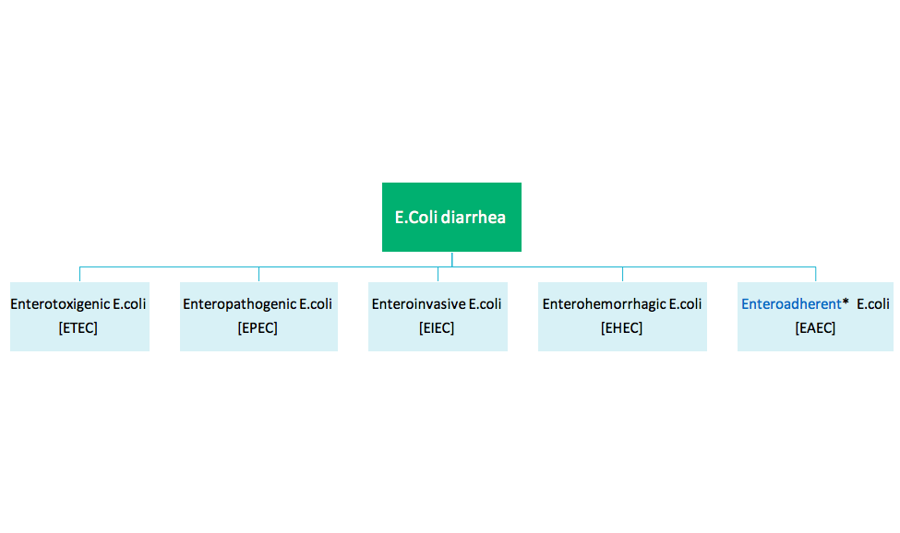
TOXIN TYPE | TOXIN PRODUCING BACTERIA
Neurotoxin Food poisoning | Staph aureus
 | Bacillus cereus
enterotoxin | Enterotoxigenic E.coli
 | Clostridium perfringens
cytotoxin | Shigella dysenteriae type I
 | Clostridium perfringens
 | E. histolytica

Slide 33
 | Enterotoxigenic E.coli | Enteroinvasive E.coli
The diseases | Major cause of traveler's diarrhea in infant and adult in developing countries from contaminated food and water | Produce dysentery (Penetration, invasion and distraction), Common in children
Infective doses | High : 10⁶-10¹⁰ | 10⁶
Symptoms | watery diarrhea, abdominal cramps and some time vomiting | Fever, severe abdominal cramps, malaise and watery diarrhea
toxins | Has heat-labile toxin (LT) and heat-stable toxin (ST) each has two fragment (A and B). No invasion or inflammation, LT leads to accumulation of CGMP, which lead to hyper secretion of fluid with no cellular injury | -
diagnosis | No routine diagnostic method. | Diagnosis Sereny* test and DNA probes.
Other info | Self limiting - | -Similar to Shigella spp (Non motile, LNF) -transmition: Fecal oral route

Slide 34
Enterohemrrhagic E.coli ( very important) The most dangerous one and most common one
The diseases | O157H7 and Non O157H7 Hemorrhagic diarrhea, colitis and hemolytic uremic syndrome (HUS)=↓Platelet count, hemolytic anemia and kidney failure.
Prevalence | Fetal disease in young and elderly persons in nursing homes.
symptoms | Bloody diarrhea, low grade fever and stool has no leucocytes
toxins | Cytotoxin =vertoxin І and vertoxin ІІ Similar to Stx₁ (shigotoxin I&II).
Diagnosis | Diagnosis by culture on SMAC (sorbitol MacConkey agar cefixime), MUG test , Vertoxin detection by immunological test or PCR.
Other info | -Undercooked hamburgers it was known as hamburger’s disease, unpasteurized dairy products, apple cider, cookie dough happen to help the bacteria. -E.coli other than 0157H7 can cause HUS.

Slide 35
 | Enteroadherent E.coli Enteroaggregative Ecoli | Enteropathogenic E.coli
The diseases | Pediatric Diarrheal Disease. | Causes Infantile diarrhea ( bottle fed infants)
symptoms | Produce mucoid, Watery diarrhea, vomiting, dehydration and abdominal pain. | Low grade fever, malaise, vomiting and watery diarrhea
Other info | -produce Aggregative stacked bricked (like blocks), adherence to surface of intestinal epithelial cells. -resolve after 2 weeks or more | -Outbreak in hospital nurseries and day-care centers -Stool mucous but no blood. -Disrupt microvilli and intestinal absorptive function.

Slide 36
Yersinia enterocolitica
The diseases | Mesenteric lymphadenitis in children and septicemia in immunocompramised hosts
symptoms | Presented with enteritis, arthritis and erythema nodosum Systemic manifestation not GIT only
Prevalence | Common in Europe, USA, Canada and cat, dog, swine (chitterlings)
Characteristics | Survive cold temperatures and associated with transfusion of packed red blood cells.
Diagnosis | Growth at 25°c-30°c media Cefsulodin-Igrasan-Novabiacin (CIN)
Other info | Generalize infection in adult and children 1-5 yrs usually mild but in old children adult mimic appendicitis In saudi arabia it can be misdiagnosed with appendicitis

Slide 37
Clostridium difficile
The diseases | The most common cause of Antibiotic associated diarrhea, ( ampicillin, cephalosporins & clindamycin à is the most common one). Antibiotic use for the last 8 weeks ( community acquired= outpatient) or hospital stay for at least 3 days ( hospital acquired=inpatient). So the duration is very important.
Transmission | Transmit from person to person via Fecal-Oral route.
symptoms | Patient Presents with fever, leukocytosis, abdominal pain and diarrhea
toxins | Produce toxin A ( enterotoxic & cytotoxic effects ) and B (cytotoxic which more serious) that can bind to surface epithelial cell receptors leading to inflammation mucosal injury and diarrhea
Histological findings | Pseudomembrane With endoscopy we can see it can result (neutrophils, fibrin, and cellular debris in the colonic mucosa) and toxic megacolon.
Diagnosis* | direct toxin detection from stool by (EIA)
Treatment | Metronidazole ± oral Vancomycin and supportive treatment.
Other info | -Have been cultured from in animate hospital surfaces. -causes Disruption of the indigenous bacterial flora of the colon

Slide 38
Type | Organism | Incubation Period | Source Risk factors | Clinical | Diagnosis | Treatment
Infectious diarrhea Invasive Dysentery Blood+mucous | Shigella gram-negative rods | 1-3 Days | Contaminated Food or water with human excreta | Small amount of stool with blood and mucous and lower abdominal pain ( trismus) | Culture on selective media | Ciprofloxacin
 | Entamoeba histolytica | 1-3 wks |  |  | Microscopy | Metronidazole
 | EIEC gram-negative rods | 1-3 Days |  |  | Culture and toxin detection | Ciprofloxacin

Slide 39
Type | Organism | Incubation Period | Source Risk factors | Clinical | Diagnosis | Treatment
Food Poisoning Watery (preformed toxin) | Staphylococcus aureus | 1-6 hour | Contaminated food from human flora | Vomiting then watery diarrhea | Culture and toxin detection | Observation and supportive treatment
 | Clostridium perfringens | 8 to 16 hours | Food contaminated with Soil
 | bacillus cereus spore forming aerobic Gram pos bacilli | 8 to 16 hours | 8 to 16 hours
Travelers | ETEC | 1-3 Days | Travel | Watery diarrhea | Culture Toxin detection | ciprofloxacin
Antibiotics Associated | Clostridium Difficile | 1-3 Days | Antibiotics use patientà patient | Bloody diarrhea Toxin A and B | Toxin detection PCR | Metronidazole +/- Vancomycin

Slide 40
Type | Organism | Incubation Period | Source Risk factors | Clinical | Diagnosis | Treatment
Infectious diarrhea Non-invasive Watery +/-blood | Salmonella gram-negative rods | 1-3 Days | S.typhi and S.para Human Others reptiles and snakes | Watery+/-Blood | S.typhi and S.para typhià typhoid Others watery diarrhea | Ampicillin or ciprofluxaci or metronidazole or trimethoprim sulfa
 | campylobacter jejuni small, curved, gram-negative rods | 1-3 Days | poultry | Watery+/-Blood | Special media at 42 º C at microaerophilic condition | Erythromycin
 | EHEC | 1-3 Days | beef | Watery then bloody diarrhea Renal failure | Culture and toxin detection
 | Vibrio cholera Comma-shape gram-negative rods | 1-3 Days | Salt water | Rice water |  | Ciprofloxacin Doxycycline
 | Yersinia Gram Neg bacilli | 1-3 Days | Pork intestine | Pseudo appendicitis | Cold enrichment 25-30ºC CIN (Yersinia) | Gentamycin
 | Listeria Monocytogenes Gram pos bacilli | 2-3 wks | unpasteurized dairy products | Meningitis in neonate and old Abortion |  | Ampicillin

Slide 41
Salmonella and shieglla
1 slide

Slide 42
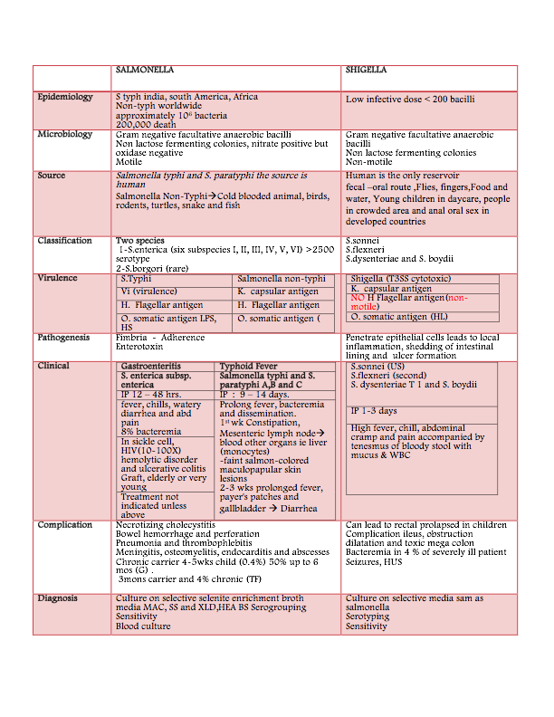

Slide 43
Cholera
4 slides

Slide 44
Cholera
Overview | •Cholera is a life-threatening intestinal infection (small intestine) that causes severe secretory diarrhea. •Caused by vibrio cholera which is a comma- shaped gram-negative rods. • Produce a non-invasive enterotoxin (a non-invasive diarrheal disease) which leads to outbreak and epidemic. •It is a Water-borne illness caused by ingesting of water/food, Grows in salt and fresh water.( during war ,hurricanes,etc)
Epidemiology | •V. cholera O1 ( till now) and O139 ( in asia only ) serogroup1 organisms are the causes of epidemic cholera. Seven major outbreaks. •Each year 3-5 millions cases result in 100,000 deaths. •A major epidemic disease. • Common in India, Sub-Saharan Africa & Southern Asia but Very rare in industrialized countries. • It is a leading cause of death in Africa.
Risk factors | •People with low gastric acid are more susceptible (Children and Elderly). •O blood type (O>> B > A > AB).

Slide 45
Transmission
•Transmitted by fecal-oral route (Strictly Human transmitted) → Resulting diarrhea makes it easy for bacteria to spread in unsanitary conditions causing epidemics. •​Undercooked-shellfish.
Infectivity
•Period of infectivity during acute stage till recovery ( end one to three wks) •Infected person can produce up to 20 L of 10⁹ CFU/ml /day Has high infectious dose NOT like Shigella , Due to harsh environment of the intestine i.e. temperature and stomach acidity and Bile salts, organic acids in the intestine •Infectious dose 10⁶-10¹¹ colony-forming units
•Gram stain (curve Gram Negative bacilli) •Culture on thiosulfate citrate bile sucrose (TCBS) agar-yellow colonies

Slide 46
Clinical manifestation:
•Incubation period: Ranges from a few hours to 5 days (range 1-3 days).
•Depending on gastric acidity and initial infectious dose
•75% are asymptomatic
Mild disease (20%) | Severe symptoms (2-5% ) Cholera Gravis
● Vomiting ● Cramps ● Watery diarrhea (1 L/hour), consisting of: ➔ flecks of white mucus (rice water stool) with a fishy odor | •Rapid loss of body fluids(6L/H) → hypovolemic shock(Severe metabolic acidosis due to inadequate O) and electrolytes imbalance(↓ Ca ++ and K can lead to ileus, muscle pain and spasm, and even tetany) → multi organ failure (Cardiac and renal). • Sunken eyes , and ↓skin turgor ( tenting) , cold and clammy . • Anuric and lactic acidosis ( Kussmual breathing ). • Hypoglycemia leads to seizure or comma. • Cardiac and Renal failure. • Aspiration pneumonia (from vomiting).
Without treatment, death in 18 hours-several days. | ● Mortality 50-60% without treatment within 12 hours or less ● Mortality <1% with rehydration

Slide 47
Treatment
•Basically rehydration and antimicrobial therapy. •Oral Rehydration Salt (ORS) by WHO and UNICEF ( in mild cases ) •Azithromycin single-dose is often the preferred therapy especially in children. •Or Ciprofloxacin Or Tetracycline, Doxycycline
 | Killed Whole-cell Vaccines | Live Attenuated Vaccines
Adult | 50% protection for 6 months | 60% protection for 2 years
children aged 2-5 | < 25% protection | protection rapidly declines after 6 months
Doses | Multiple doses | 3 doses
Side effects | -------------------- | Mild diarrhea, abdominal cramping

Slide 48
Schistosomiasis
8 slides

Slide 49
General information about schisotosoma:
Genus of trematodes, Schistosoma, commonly known as blood-flukes )الدم في تمشي ,) • are parasitic flat-worms responsible for a highly significant group of infections in humans termed schistosomiasis. • Schistosomiasis is considered by the World Health Organization as the seacond most socioeconomically devastating parasitic disease, (after malaria), with hundreds of millions infected worldwide. • Adult flatworms parasitize blood capillaries of either : depending on the infecting species 1. Mesenteries (Schistosoma mansoni )in GIT, blood in stool 2. plexus of the bladder (Schistosoma haematobium) in bladder , blood in the urine

Slide 50
Schistosomiasis
Types | Schisotosma mansoni | Schisotosma haematobium
Life cycle | the eggs of the human-infected with S.mansoni & S.japonicum are passed in the feces/stool. | the eggs are passed during micturition from host infected with S.haematobium and passed mainly in urine.
 | water > miracidium hatches out of the egg > snail > develops to cercaria > penetrate the skin of the human > transformed into a schisosomula inside the host tissues migrates to the lung and then moves via circulation through the left side of the heart then it develops into a sexually mature adult > finds its way into:
 | Into the portal circulation (S.mansoni and S.japonicum) worms mature in the mesenteric veins of the portal circulation (here where the adult stay). | worms generally remain in the systemic circulation and mature in the blood vessels of the vesical and venous plexus.

Slide 51
Types | Schisotosoma mansoni | Schisotosoma haematobium
Diagnostic stage | Eggs in feces | Eggs in urine
Infective stage | Cercaria : then transformed into a schistosomulae inside the host tissues. Cercaria lose tails during penetrating
Pathology | The EGG is the main cause of pathology in schistosomiasis. Many eggs become stranded in the tissues or are carried by the blood stream to other organs mainly the LIVER. The host reaction to the eggs may vary from small granulomas to extensive fibrosis .The extent of damage is generally related to the number of eggs present in the tissues.
Pathogenicity of Schistosomiasis | Cercarial dermatitis: at the site of entry of cercaria. Toxic Metabolites: schistosomulae in the circulation veins may cause anaphylactic reaction ,fever Terminal spined eggs : may erode blood vessels and cause hemorrhages. Schistosome eggs, deposited in the tissues, act as foreign protein ,cause irritation leading to cell infiltration and connective tissue hyperplasia ,egg granuloma around each egg (cell mediated immunity) .
Schistosoma dermatitis | or "swimmers itch” occurs when skin is penetrated by a free-swimming, fork-tailed infective cercaria. The dermatitis often develops 24 hours after exposure and last for 2 to 3 days and then spontaneously disappears.

Slide 52
Developing schistosome in liver:
S. mansoni & S. japonicum located mainly in mesenteric vein and its branches
The worm discharges EGGS ,the eggs travel in 2 directions :
1-Other eggs find their way into the lumen of the bowel and appear in the faeces
1-Some flow with blood stream in the portal circulation and enter the LIVER*.
again some of these eggs find their way through the liver tissue and enter the systemic circulation to another organ such as brain
Most of these eggs are trapped in the liver and give rise to pathology ,fibrosis of the liver caused from eggs settled in the liver may produce portal hypertension (very very important!!), which may lead to hepatomegaly ,splenomegaly esophageal varices, hemorrhoids and ascites.
*Three parasite manly effect the liver 1-schistosoma 2-E-histolytica (abscess) 3-echiococuss granulosus

Slide 53
S. haematobium
the worm is located in the vesical venous plexus surrounding the urinary bladder. > Many eggs are trapped in the wall of the bladder where they may give rise to calcification and granuloma formation in the wall of the bladder which may lead to cancer > obstruction of ureter > no urine > kidney failure.
>Constriction of the orifice of the ureter may produce kidney damage , hydronephrosis and cancer of the bladder.
Types | Schisotosoma mansoni =portal hypertension | Schisotosoma haematobium
Lead to | Intestinal schistosomiasis | Urinary schistosomiasis
Egg deposition and extrusion | -Dysentery (blood and mucus in stools) -Hepatomegaly splenomegaly | -painless haematuria -Inflammation of bladder and burning micturition
Dx Microscopical: | Examination of stool | Examination of urine
Dx Immunological: | Serological tests CFT,ELIZA.
Dx indirect | Radiological, endoscopy. | Radiological, cystoscopy.
Treatment | Drug of choice for schistosomiasis is Praziquantel

Slide 54
Fasciola hepatica=biliary obstruction
Hosts | Definitive host: sheep ,cattle ,goat and man. | Intermediate host: snails.
Infective stages | Metacercaria :ingested with contaminated grasses. “if the person didn’t eat the grasses contaminated with Metacercaria he will not get infected, If the person eat rot cattle liver infected with Fasciola it will be false infection and only pass eggs in stool” Do not confuse with cercaria in schistosomiasis
DIAGNOSTIC STAGE: | Eggs pass in stool or in the duodenal aspirate
Pathology and clinical picture | 1- True infection : occur when man accidentally ingests water plant (watercress) contaminated with metacercaria , the adult worm can causes mainly biliary colic with biliary obstruction (very important) , jaundice, generalised abdominal pain ,cholisistietis and cholithiasis.
 | 2- False infection is when eggs are eaten in infected animal liver and passed in stools. (false infection will not lead to liver infection only we can detect eggs in stool after eating rot cattle liver infected with Fasciola Hepatica so we can find the eggs in stool but patient is not infected.)
Treatment | Triclabendazole

Slide 55
Life-cycle of Fasciola hepatica LIVER FLUKE
METACERCARIA ,excyst in the duodenum ,migrate through intestinal wall to the liver and settle in the biliary tract, Then grow into adult worm, And liberate eggs in bile , throw bile eggs reach the intestine and then passed in stool. *So it is vey important to know that: If a patient has Fasciola hepatica, he will develop BILLIARY OBSTRUCTION. If a patient has Schistosoma, he will develop PORTAL HYPERTENSION.
Egg of Fasciola hepatica can be seen in true patient's stool or in false infection.
Liver parasitic infection : 1- E.histylotica > liver abcess 2-S.mansoni > portal hypertention
3- E.granulosa > hydatid cyst
In Fasciola hepatica : biliary obstruction jaundice
In S.mansoni : portal hypertension and periportal fibrosis

Slide 56
Trypanosomiasis
4 slides

Slide 57
Trypanosomiasis
There are two types of trypanosomiasis that affect humans, they are divided according to their geographical location :
Trypanosome life cycle:

Slide 61
Leishmaniasis
3 slides

Slide 62
Leishmania Parasites and Diseases
There are three 3 main form of Lishmaniassis each caused by a different species :
SPECIES | Disease
Leishmania tropica*, Leishmania major* Leishmania aethiopica, Leishmania mexicana | Cutaneous leishmaniasis Affects the skin only
Leishmania braziliensis | Mucocutaneous leishmaniasis In the areas containing mucous membrane
Leishmania donovani*, Leishmania infantum* Leishmania chagasi. | Visceral leishmaniasis Internal
* Endemic in Saudi Arabia
The life cycle of Leishmania: Lishmania spp survive within the macrophages in the human body as intracellular parasites cell mediated immunity determines the host response to infection and clinical manifestations of the disease. The disease is more severe in immunocompromised patients.
Route of transmission : via the bite of infected blood –sucking Sandflies.

Slide 63
Clinical types of cutaneous leishmaniasis
known as (oriental sore):Oriental sore is classical self-limited ulcer. يتشافى لحاله اذا كانت الاميونتي له سليمه من قبل
Common types
Leishmania major: | Leishmania tropica:
human and Zoonotic cutaneous leishmaniasis (dogs,rodents): wet lesions with severe reaction. ممكن تجي من الانسان للحيوان والعكس \ ممكن من الحيوان للحيوان \ من الانسان للانسان | Anthroponotic (human only) cutaneous leishmaniasis: Dry lesions with minimal ulceration. From human to human only
This starts as a painless papule at the site of Sand fly bite, generally the face, which enlarges. The lesion ulcerates after a few months with an indurated margin.
these known as (wet-type-lesion) which heal slowly. Which takes more time than dry lesions. | In some cases the ulcer remains dry and heals readily (dry-type-lesion).
Uncommon types
Diffuse cutaneous leishmaniasis (DCL): | Leishmaniasis recidiva (lupoid leishmaniasis):
-Caused by L. aethiopica, | Severe immunological reaction to leishmania antigen

Slide 64
Muco - cutaneous leishmaniasis. Caused by: L. braziliensis. يجي في جنوب أمريكا - In the nasopharyngeal area. The lesion may become ulcerative after many months and then extend into the naso- pharyngeal mucous membrane. Secondary infection is very common with destruction of the nasal cartilage and the facial bone.
For cutaneous & muco-cutaneous leishmaniasis:
Diagnosis
The parasite can be isolated from the ,argin of the ulcer. | Smear: Giemsa stain-microscopy for LD bodies (amastigotes) in the macrophages. | Biopsy: microscopy for LD bodies in the macrophages, or culture in NNN medium for finding promastigotes.
NNN medium ( is specific for leishmania). We culture the macrophages which have amastigotes inside them in NNN medium and look for promastigotes
Visceral leishmaniasis (Kala-azar) endemic in saudi arabia
they involve lymph nodes and bone marrow + transmuted by sand-fly
1-Leishmania infantum mainly affect children 2-Leishmania donovani mainly affects adults
Symptoms | generally are: fever ,malaise, weight loss with splenomegaly,hepatomegaly,anaemia, leucopenia and sweating. Hepato-splenomegally can be seen because of the hyperplasia of the lymphoid –macrophage system.
Diagnosis: | 1- Parasitological diagnosis: A. Specimen: Bone marrow aspirate (the golden standard) / Splenic aspirate / Lymph node / Tissue biopsy. B. culture in NNN medium
Bone marrow to demonstrate (LD bodies ) amastigotes in macrophages.in the medium it will be promastigotes.
Hepatosplenomegaly Found in: • schistosoma • visceral leishmania

Slide 65
Malaria
2 slides

Slide 66
Malaria is the most important of all tropical parasitic disease ,causes death and debility and is endemic throughout the tropics and subtropics. The main symptoms and signs are periodic fever, headache ,anorexia and anemia Five species of malaria infect humans: Plasmodium falciparum ,Plasmodium vivax ,Plasmodium ovale ,Plasmodium malariae ,Plasmodium knowlesi
Epidemiology | Asexual stage: Mosquito inject sporozoite to human→enter the liver→the liver relese merozoite→enter the RBC (ring stage) and cause the main pathology which is blood heamolysis and anemia •Mosquito inject sporozoite to human (infective stage) •Mosquito suck gametocytes from human Sexual stage: male and female Gametocyte are taken up from the blood of an infected human by biting mosquito .Further sexual development takes place in the mosquito gut to produce SPOROZOITES. Transmission: mainly from mosquito to human
Pathogenesis | The main pathology of malaria is the infection of the RBCs (hemolysis of RBCs) •Hemolysis of Red Blood Cells : with release of metabolites and pigments from Malaria parasite. •Plugging of capillaries by parasitized erythrocytes :In cerebral malaria there is sequestration of parasites in central nervous system capillaries. The most one that do that is PLASMODIUM FALCIPARUM
Clinical signs and symptoms (Malarial Paroxysm) | 1- cold stage : feeling of intense cold and vigorous shivering 2- hot stage : intense heat and dry burning skin 3- sweating stage : profuse sweating

Slide 67
Clinical Picture | 1- ACUTE Disease: Non-severe Acute Febrile disease→Severe malaria e.g. Cerebral Malaria (by falciparum )→DEATH 2- CHRONIC Disease : Chronic Asymptomatic Infection →Anemia→Developmental Disorders;Transfusions; Death Infection During Pregnancy→Placental Malaria→Low Birth weight→Increased Infant Mortality
Severe Complications | Severe malaria is defined as symptomatic malaria in a patient with P. falciparum with one or more of the following complications: 1.Cerebral malaria (unrousable coma not attributable to other causes). 2.Generalized convulsions 3.Hypo glycaemia and pulmonary edema in pregnancy can lead to abortion* 4.Acute renal failure (blackwater fever) 5.Tropical splenomegaly. Clinical Picture of severe malaria : Haemoglobinuria associated with malaria Acute renal failure (“blackwater fever”) is uncommon and malarial haemoglobinuria usually presents in adults as severe disease with anemia and renal failure.
Diagnosis | 1: Light microscopy the gold standard : We have (a) thick film (b) thin film to check for 1.Parasite density 2.Species diagnosis 3.Monitoring response to treatment 2: Rapid diagnostic tests (RDTs).Serological Rapid diagnostic tests detect malaria antigens.
YOU MUST KNOW THAT !! •sexual host (Definitive host)=mosquitos •Intermediate host=human

Slide 68
Hepatitis A ,E
10 SLIDES

Slide 69
Characteristics: | oFamily of Picornaviridae. oGenus: Hepatovirus. oVirion non-enveloped and consist of: 1.Icosahedral capsid. 2.Positive sense ss-RNA. | Other names for hepatitis a virus: oShort incubation hepatitis (Hepatitis E virus is longer) o Infectious hepatitis o Epidemic hepatitis
Epidemiology
Distribution: | Worldwide, endemic in tropical countries Due to poor hygiene
Transmission: | •Fecal-oral route [major route] :Contaminated food &water Like eating infected shellfish harvested in the fecal contaminated order or uncooked food like salad |  | •Sexual contact (homosexual men) •Blood transfusion (very rarely)
Age: | •In developing countries; children The most aﬀected group of age due to poor hygiene |  | •In developed countries; young adults
Manifestations | Acute infection Hepatitis: •Asymptomatic & anicteric infection is common • Symptomatic illness increases with age •Incubation period=2-6 Weeks •Two Phases: 1- Pre-icteric phase: fever, fatigue ,nausea, vomiting, & RUQP (right upper quadrant pain) 2- Icteric phase: dark urine, pale stool, jaundice

Slide 70
Pathogenesis: | The virus enters the body by ingestion of contaminated food. It replicates in the intestine (epithelium), and then spread to the liver where it multiplies in hepatocytes. Cell mediated immunity à Damage of virus-infected hepatocytes à increase ALT, AST & Bilirubin
Managment
Treatment: | Supportive therapy
Prevention: | Sanitation & hygiene measures
 | HIG (human immunoglobulin): Given before or within 2 Weeks of exposure (shorter immunity) -Indication: travellers, unvaccinated, exposed patients.
 | Vaccine: inactivated (longer immunity), Given IM in two doses ->1 Y of age -Indication: Patients at high risk of infection and severe disease
Lab Diagnosis | Serology: •Detection of anti-HAV IgM àCurrent infection •Detection of Anti-HAV IgG à Previous infection OR Immunity
Prognosis | •Self-limited disease* •Fulminant hepatitis à rare Severe necrotic infection of Lever lead to liver failure •Mortality rate ~ 0.1 - 0.3% •No chronicity or malignancy changes

Slide 71
Characteristics: | •Family of Hepeviridae. •Genus: Hepevirus. | •Virion non-enveloped and consist of: •Icosahedral capsid. •Positive sense ss-RNA.
Epidemiology
Distribution: | Outbreak of water-borne & sporadic cases of viral hepatitis
Transmission: | 1.Water-borne The main route 2.Zoonotic (from animals) food borne. (from pork) |  |  | 3. Blood-borne Rare 4. Perinatal From pregnant mother to her baby
Age: | •Age; young adults

Slide 72
Clinical features:
Similar to HAV infection with exceptions: • Longer incubation period =4-8 weeks •Acute and Chronic hepatitis, cirrhosis, but not hepatocellular carcinoma (HCC) |  | • Fulminant disease • Mortality rate ~10 times > HAV / ~ 1-3% / [20% in pregnancy]
Lab diagnosis: | ELISA à Anti-HE IgM
Treatment: | •Not specific In immunocompetent
Prevention: | •Sanitation & hygiene measures •No Immunoglobulin •No vaccine

Slide 73
EBV
Characteristics: | •It is lymphotropic*. | •It has oncogenic properties; (Burkitt’s lymphoma, Nasopharyngeal carcinoma)
Epidemiology
Distribution: | worldwide
Transmission: | 1-slaiva (kissing disease) |  | 2-blood(rare)
Age: | •socio-economic state(SE): 1-Low SE : early childhood (developing countries) 2-High SE : adolsence (developed countries)

Slide 74
Clinical features:
1-immunocompetive host: •Asymptomatic Usually •Infectious mononucleosis [or glandular fever] •Mainly in teenagers & young adults •IP = 4-7 weeks •Fever, pharyngitis, malaise, hepatosplenomegaly & abnormal LFT, hepatitis. •Complications: (acute air way obstruction, splenic rupture, CNS inf) Rare |  |  | 2-immunocompremised host: (HIV) • Lymphoproliferative disease ( LD) • Oral hairy leukoplakia (OHL) •
Lab diagnosis: | Hematology: • increased WBC • Lymphocytosis (atypical lymphocytes) | Serology: 1- Non-specific AB test : -Heterophile Abs +ve -Paul-Bunnell or -monospot test |  | 2- EBV-specific AB test: IgM Abs to EBV capsid antigen
Treatment: | Antiviral drug is not effective in IMN
Prevention: | no vaccine

Slide 75
CMV
Special features: | -Its replication cycle is longer. -Infected cell enlarged with multinucleated.[cyto=cell, megalo=big](change in cell ) -Resistant to acyclovir. -Latent in monocyte, lymphocyte & other
Distribution: | worldwide
Transmission: | •Early in life: Transplacental From pregnant mother to her baby causing a congenital infection- Birth canal - Breast milk •Young children: saliva •Later in life: sexual contact, Blood transfusion & organ transplant.
1-Acquired Infection: a)Immunocompetent host: Asymptomatic - Self-limited illness – Hepatitis - Infectious mononucleosis like syndrome [Heterophile AB is –ve] b)Immunocompromised host : Encephalitis , Retinitis , Pneumonia - Hepatitis, Esophagitis, Colitis. 2- Congenital Infections

Slide 76
Lab diagnosis: | Histology: Intranuclear inclusion bodies [Owl’s –eye] | Culture: •In human fibroblast 1-4 wks à CPE (very slow growing disease) •Shell Vial Assay à 1-3 days | Serology : 1-AB : à IgM: current infection à IgG: previous exposure 2-Ag: à CMV pp65 Ag by IFA | PCR
Treatment: | •Ganciclovir : is effective in the treatment of severe CMV inf. •Foscarnet: the 2nd drug of choice •
Prevention: | • Screening • Organ donors • Organ recipient • Blood donors •Leukocyte-depleted blood. •Prophylaxis: Ganciclovir, CMVIG. •No vaccine.

Slide 77
Arthropod –borne Viruses (Arboviruses)
Yellow Fever virus (because of jaundice)
Jungle Yellow Fever

Slide 78
Diagnosis
-Reference Lab -Lab Methods: A- Isolation (Gold standard) B -IgM-Ab - ELISA, IF: (most used) C - Arbovirus RNA by RT-PCR
Prevention
1-Vector Control: •Elimination of vector breading sites •Using insecticides •Avoidance contact with vectors 2-Vaccines: •Yellow Fever vaccine (LAV, one dose /10 yrs) • is recommended for travelers

Slide 79
Hepatitis B,C,D and G
8 SLIDES

Slide 80
•Hepatitis B viruses is an enveloped, dsDNA virus, and is the major member of the Hepadanavirus family
•Hepatitis B virus, resist either, low pH, moderate heating
1.HBV consists of an outer envelope lipoprotein like ID (HBsAg) protects the whole virus which surrounds €
2.€ an inner core of nucleocapsid protein HBcAg protects the DNA+ enzymes which surrounds €
3.€the viral DNA and DNA polymerase and Reverse Transcriptase enzyme.
•HBeAg is a component of core gene product and indicate ACTIVE VIRAL REPLICATION if it’s found in the serum it
indicates that the virus is active , when it’s negative it might infects the individuals 10% but when it’s positive it infects individuals 50%.
•the integrated viral DNA been found in hepatocellular carcinoma it could be the cause .
•There are 8 genotype (A-H),genotype D is dominant in Saudi Arabia. Each one of them is sensitive toward different
treatments .
.
The serum of infected individual contains 3 types of hepatitis B Particles :
A.Large number of small spherical free HBsAg Particles.
B.Some of these HBsAg particles are linked together to form filament .
C.The complete HBV particles (Dane* particles)

Slide 81
Transmission | 1.Parentally: 1.Direct exposure to infected blood or body fluids (e.g. sweat , saliva , tears especially if there is HBeAgin serum) (e.g. receiving blood from infected donor). 2.Using contaminated or not adequately sterilized tools in surgical or cosmetic practice(dental, tattooing, body piercing). 3.Sharing contaminated needles drug abuser , razors لاثم جحلاب , or tooth brushes. 1.Sexually : The virus is present in blood and body fluids. By having sexual contacts with infected person ,virus is present in semen and vaginal secretion (homosexual) 3.Perinatally (from mother to baby): 1.Infected mothers can transmit HBV to their babies mostly during delivery. 2.Breastfeeding is also way of perinatal transmission 3.through placenta (vertical transmission)
Risk factors | •Intravenously drug users. •Hemodialysis patients. •Patients receiving clotting factors. No more to be found due to good screening •Individuals with multiple sexual partners and homosexuals the highest percentage is for homosexuals •Health care workers with frequent blood contact. •Individuals who exposed to tattooing, body piercing or cupping .هماجحلا

Slide 82
An-icteric hepatitis: (no jaundice) | fever, malaise , anorexia, rash, nausea, vomiting and high upper quadrant abdominal pain with raised liver enzyme.
Icteric hepatitis (with jaundice) | about 25% of the patient become icteric Jaundice with raised bilirubin, dark bile containing urine and pale stools
CLINICAL OUTCOME
A) About 90 % of infected adults will develop acute hepatitis B infection and recover completely.
B)progress to chronic hepatitis B: chronicity is more in children ✓less than 9 % of the infected adult ✓90% of infected infants مهنم هوذخو مهدنع ناك مهتاهما ✓20% of infected children = 1-18 y
C) < 1 % may develop fulminant hepatitis B, characterized by massive liver necrosis, liver failure and death.

Slide 83
Types | Description | Serological Profile
HBV DNA | Marker of infection | the 1st marker that appears in circulation , 34 week after infection.
HBsAg surface antigen Marker of infection |  | is the 2nd marker that appears in the blood and persists up to 6 month then disappear .
Hepatitis B e antigen (HBeAg) Present in all body fluids | Marker of active virus replication , the patient is highly infectious , the virus is present in all body fluids | HBeAg is the 3rd maker that appears in circulation and disappears before the disappearance of HBsAg it indicate active viral replication
Antibody to hepatitis B core (Anti-HBc) It might last forever | Marker of exposure to hepatitis B infection . | Anti-HBc Ab is the 1st antibody that appears in the blood and and usually persists for several years.
Antibody to hepatitis B e antigen (Anti-HBe) Means it is less infectious | Marker of low infectivity The patient is less infection | with the disappearance of HBeAg and appearance of anti- HBe Ab whish usually persists for several weeks to several months.
Antibody to hepatitis B surface antigen(Anti-HBs) It might last forever | Marker of immunity. | is the last marker that appears in the blood, It appears few weeks after disappearance of HBsAg and persists for several years, It indicates immunity to hepatitis B infection .

Slide 84
Lab diagnosis | detection of HBsAg in the blood. . Positive results must be repeated in duplicate . Repeatedly reactive results must be confirmed by neutralization test
Vaccine | •The vaccine is administered in three doses at 0,1, & 6 months. •The vaccine is safe and protective
Prevention and Control: | Pre-exposure prophylaxis: ميلسلا صخشلل ✓Active vaccination only given to all newborn, children or adult. ✓Recombinant hepatitis B vaccine: ✓It is prepared by cloning HBsAg in yeast cells. ✓The vaccine is given in 3 IM injection at 0-1-6 months and booster dose after 5 years. | Post exposure prophylaxis: ✓Persons exposed to needle prick or infant born to +ve HBsAg mother should immediately receive both: Active vaccine and hepatitis B specific immunoglobulin must be both .

Slide 85
HEPATITIS C
Classification & structure | ●Consists of an outer envelope icosahedral core and linear positive polarity ss-RNA gemone. ●There are 6 major genotypes (1 – 6), genotype 4 is the dominant in Saudi patients.
Transmission | Similar to HBV: Parenterally - Sexually - From mother to child perinatally
markers | 1.Hepatitis C virus – RNA : Is the first marker that appears in the serum, it appears as early as 2-3 weeks after exposure , It is a marker of infection 2.Ig G Antibody to hepatitis C: Antibodies to hepatitis C virus is the last marker that appears in the serum , usually appear 50 days after exposure long window period. This Ab present in both Acute or chronic patient or immune.
ACUTE HEPATITIS | •Many HCV infection are asymptomatic •If symptomatic: ✓Symptom: jaundice, fatigue & nausea. ✓Elevated serum ALT (usually greater than 10 folds). ✓Presence of anti-HCV (-ve in 30-40%) in early stages of disease. ✓HCV-RNA is +ve even before the onset of symptoms.
CHRONIC HEPATITS | •Defined as the presence of anti-HCV & elevated serum level of ALT for >6 ms. •Almost all patients with chronic hepatitis C have the genome HC RNA in serum. •Usually asymptomatic, but if symptom present it’s usually mild, non-specific & intermittent.

Slide 86
Risk factor to develop cancer: | Men - Alcohol consumption - Age above 40 years. - Patient with cirrhosis - Infection with HCV for more than 20 to 40 years.
Lab diagnosis | By detection of : 1.Serology to look for anti-HC if posstive we have to do it in duplicate 2.Then we will do confirmatory test RIBA and PCR to detect the HC RNA
vaccine | No vaccine available to hepatitis C.
Treatment | 1.combined therapy using: Pegylated alpha interferon and ribavirin . 2.For follow up the patient during treatment we have to do qualitative PCR and follow up his liver enzyme.

Slide 87
Hepatitis D virus ( delta virus)
Structure & Characteristics | -It is a defective virus another name, that cannot replicate by its own . -It requires a helper virus is HBV (HBV provides the free HBsAg particles to be used as an envelope ) -Composed of small ss-RNA genome. -It’s either 1-co-infection with HBV 2- super infection after HBV
Hepatitis G virus Usually occurs as co-infection with HCV, HBV and HIV.
Structure & Characteristics | - Enveloped, ss-RNA with positive polarity.
Transmission | Parenterally, sexual and from mother to child transmission have been reported.
Causes | mild acute and chronic hepatitis infection.

Slide 88
Shrooq Alsomali
Rema Albarrak
Amal Alshaibi
Wejdan Alzaid
Ebtisam Almutairi
Shoag Alahmari
Reema Albarrak

