Slide 1
LECTURE: Helicobacter Pylori
Editing File
Important
Doctor’s notes
Extra explanation
Only F or only M
"لا حول ولا قوة إلا بالله العلي العظيم" وتقال هذه الجملة إذا داهم الإنسان أمر عظيم لا يستطيعه ، أو يصعب عليه القيام به .

Slide 2
OBJECTIVES:
Explain the various gastric and duodenal diseases caused by H.pylori.
Discuss the epidemiology and transmission of H.pylori.
Describe the pathophysiology of H.pylori inside the stomach and duodenum.
Define peptic ulcer disease and assess its distribution among patients.
Indicate the signs and symptoms of associated disease.
Discuss the impact of the discovery of H.pylori on the change of diagnosis and management of peptic ulcer.
Describe laboratory characteristics of H. pylori, its identification and diagnosis.
Discuss preventative methods used for H. pylori infection.
Describe the management and treatment regiments used for eradication of H. pylori.

Slide 3
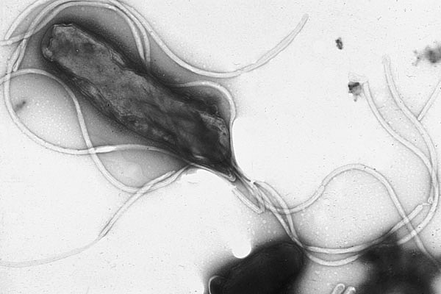
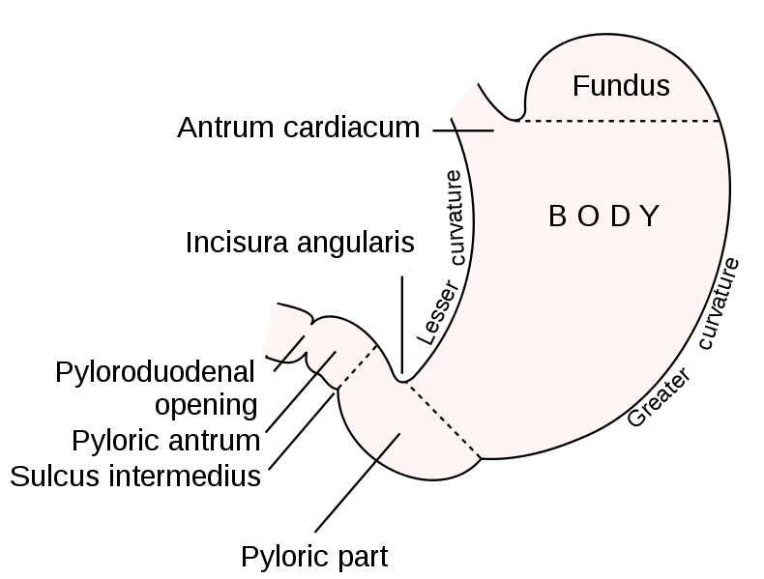
Peptic ulcer disease
Definition | Is an ulcer defined as mucosal erosions(≥ 0.5cm) associated with the over usage of NSAIDs , alcohol , smoking , helicobacter pylori .
Location | Peptic ulcer is created in an acidic area​ (very painful). More Peptic ulcers are arise in duodenum ​than stomach (duodenum less acidic)
Complication | 4% of stomach ulcer can turn to be malignant tumor. Duodenal ulcers are generally benign.​ (Multiple biopsies are needed to exclude cancer)
Signs and symptoms | ​Abdominal pain, epigastric with severity relating to meal time (3 hours after meal with gastric ulcer). “Before the meal may indicates duodenum ulcer” Bloating and abdominal fullness. Nausea​ and​ vomiting.​ Loss of appetite and weight loss​. Haematemesis (vomiting of blood) due to gastric or esophagus damage. Melena (foul-smelling & dark brown feces due to oxidized hemoglobin iron). Rarely, Gastric or duodenal perforation leading to acute peritonitis.(extremely painful require urgent surgery )

Slide 4
Helicobacter Pylori
General info. | 1983 in Perth (Australia),Warren and Marshal. Helicobacter pylori (formerly known as Campylobacter.pylori or C.pyloridis) is found closely associated with gastric mucosa and causes chronic active gastritis, gastric and duodenal ulcer (Peptic ulcer) and could develop adenocarcinoma and Gastric mucosa-associated lymphoid tissue (MALT) lymphoma. H. pylori are found in the human stomach. There is no evidence of animal-to-human transmission Discovery revolutionised the treatment of duodenal and gastric ulcers. Earned them the Nobel Prize for Medicine in 2005. Nearly 20 species of Helicobacter are now recognised.
Epidemiology
More than 50% of the world's population harbour H. pylori in their upper gastrointestinal tract Third world has more rate of infection. infections are usually acquired at childhood. Poor sanitary conditions contribute to high rates. In USA high prevalence among African-American and Hispanic population-Due to socioeconomic status Higher hygiene standards and widespread use of antibiotics behind lower rate of infection in the west. Overall frequency of H pylori infection is ​declining. Prevalence varies greatly among countries and population groups, Infection is more prevalent in developing countries. The route of transmission is unknown, although it is known individuals typically become infected in childhood. Over 80% of individuals infected with the bacterium are asymptomatic. Recently, antibiotics (metronidazole, clarithromycin) are becoming resistance to H pylori.
Only proven reservoir is the human stomach
There are some studies that suggest an animal source, however there is no evidence of animal to human transmission and H. pylori is found almost exclusively in the human stomach.

Slide 5
Transmission
•Contagious with an unknown route of transmission . •Person to person (oral to oral or fecal-oral)​ route. •Transmission occur mainly within families or community. •​Fecal-oralroute of infection occur by ingestion contaminated food or water due poor hygiene. •Using same spoons, forks and tooth brushes and kissing children mouth to mouth ​increases​ oral-oral​ route of infection. •Gastric antrum is the most favoured site. •Present in the mucus that overlies the mucosa.
Prevention
Eradication of infection will improve symptoms: Such as (dyspepsia, gastritis, peptic ulcer and cancer). Vaccination: antigens . Promising results with studying adjuvant, Determining route of immunization (oral or intramuscular). Dietary methods: (eating broccoli, cabbage, honey, and drinking green tea) Proper sanitation and clean sources of drinking water.

Slide 6
Pathogenesis: “IMPORTANT”
To colonize the stomach, H pylori must survive acidity.
Using flagella, H pylori moves through stomach lumen and drill into the mucoid lining of stomach.
Produces adhesions that binds to the epithelial cells.
Produces large amounts of urease enzyme that break down urea into co2 +ammonia.
This in-turn neutalizes gastric acid.
Ammonia is toxic to epithelial cells along with proteases, vacA protein and phospholipases produced by H pylori and could damage epithelial cells.
Colonization of stomach or duodenum results in chronic gastritis (inflammation of stomach lining).
Inflammation stimulate more production of gastric acid ,This leads to gastric and duodenal ulcers, atrophy and later cancer.
CagA protein was found to contribute to peptic ulcer.
Free radical production in the gastric lining due to H pylori increases host cell mutation*.
H pylori induces the production of TNF-α and Interleukin 6 that leads to host cells mutation.
CagA: cytotoxin- associated gene A
CagA is thought to be directly injected into the gastric epithelium and interferes with cell cycle progression and oncogenic function
H. pylori that express functional VacA and CagA proteins possess greater pathogenic potential
*Which may lead to metaplasia and finally cancer

Slide 7
Old-management : “female only”
Until recently every surgeon faced with a perforated peptic ulcer had to open the abdomen, sewing up the hole, and avoiding inflammation with cleansing abdomen cavity.
Peptic ulcer was a dangerous disease associated with high morbidity and mortality.
Gastrectomy (where part of the stomach or all is resected), is no longer used for peptic ulcer management.
The outcome of infection by H. pylori reflects an interaction between:
Strain virulence
Environmental factors
Host genotype
Genome:
H pylori consist of large diversity of strains with around 1,550 genes.
Study of H pylori is centered on trying to understand the pathogenesis of genome database.
H pylori contain 40kb-long Cag pathogenicity island (PAI) with over 40 pathogenetic genes.
Asymptomatic patients carry H.pylori strains lacking the Cag pathogenesity island (PAI).
PAI codes for cagA and it’s secretion system

Slide 8
Laboratory characteristics :
Morphology : | Fastidious in terms of growth requirements: Strictly microaerophilic Will grow in environments with increased Co2 Blood agar based medium Morphology and staining : small, Gram negative spiral rods bacilli , motile by flagella . Strictly Microaerophilic
Culture: | On blood or chocolate agar based medium in a moist microaerophilic * atmosphere. Selective medium can be used for isolation from clinical specimens. Small colonies grow after 5-7 days at 37 ̊C.
Biochemical reactions: | catalase-positive oxidase- positive strongly urease-positive. Hallmark of the species is production of urease enzyme : -Urease breaks urea down to Co2+NH3 -Amonia is a strong base -Urease helps H. pylori survive strongly acidic stomach conditions. Very fragile (a point of importance when referring samples to the lab).
Typing: To asses genetic relatedness: | A variety of nucleic acid methods have been developed, but there is no agreed typing scheme. - Generally no role in direct patient management. - Mainly useful for epidemiological studies
Serology: | IgG and IgM to Cytotoxic Associated Gene A (CagA)and (VacA) for virulence strains.
*(Need small amount of oxygen to grow) , Blood based medium like brain heart infusion (BHI, Brucella medium)

Slide 9
Diagnosis : Checking for dyspeptic patients for H pylori.
Non-invasive methods: -First choice “Commonly used” | Serology (Blood antibody) tests (IgG, IgM or IgA). - poor accuracy
 | Stool antigen test. “very specific (Reliable but may there cross react with other bacteria”
 | Carbon urea breath test (C14 or C13 ). - a urea solution labelled with C14 isotope is given to pt. The Co2 subsequently exhaled by the patient contains the C14 isotope and this is measured. A high reading indicates presence of H. Pylori. (very specific but very expensive)
Invasive methods (most reliable), on biopsy: “Commonly used” | Endoscopy followed by Histological examination. Histological examination of biopsy specimens of gastric/duodenal mucosa take at endoscopy. (Very reliable, The gold standard )
 | Rapid urease test (CLO-test ®) : based again on urease-production by the organism->NH3 production->rise in pH=>change in the colour indicator of the kit High sensitivity and specificity Prompt result.
 | Endoscopy followed by culturing the bacteria. Culturing the bacteria. Used for antibiotic resistance testing, as sensitive as the histology. Requires selective agars and incubation for growth.
 | Molecular methods (e.g. PCR)
Susceptibility Testing:
Not available in all centers.
Require growth from culture, so biopsy needed.
More recently molecular methods looking for mutations that code for resistance have been used.
Serology: Mainly IgG, IgA and IgM less useful. Cannot distinguish active from past infection
Stool antigen: detects active infection, can be used to monitor treatment. Current PPI or antibiotic use decreases sensitivity
Breath test: detects active infection, can be used to monitor treatment. Limited availability

Slide 10
Antibiotic sensitivity: In labs
In vitro¹ H.pylori is sensitive to amoxicillin, tetracycline, metronidazole, macrolides (clarithromycin).
in vivo² their efficacy is often poor due to the low pH o f the stomach, their failure to penetrate the gastric mucus and the low concentration of antibiotic obtained in the mucosa of the stomach.
Recently , Metronidazole in developing countries is becoming resistance (80-90%).
Treatment : “male only”
Clarithromycin Triple therapies (first line): | Bismuth Quadruple Therapies (second line):
PPI b.d. (twice a day) + clarithromycin + amoxicillin or metrodiazole for 14 days. | PPI b.d. + bismuth subsalicylate/subcitrate + nitroimidazole + tetracycline for 10 - 14 days. – Can be used as salvage therapy if primary therapy with the Clarithromycin triple therapy fails .
Another option for salvage: levofloxacin + amoxicillin + PPI
Post Treatment Testing : After identification and treatment, eradication should be proven using: Urea breath test Fecal (stool) antigen test Biopsy based testing ( usually not used)
1- outside the living body and in an artificial environment.
2- in the living body of a plant or animal.
Post treatment When:
4 weeks after the completion of antibiotic therapy
and after PPI therapy has been withheld for 1–2 weeks

Slide 11
Treatment : “female only”
Triple therapies | Quadruple Therapies
One-week combination of Omeprazole, Clarithromycin and Tinidazole the rate of eradication was 95%-100%. “Much better” 10 days’ combination of Ranitidine Bismuth citrate, Amoxycillin and Clarithromycin with eradication rate of no more than 75%. 10 days combination of Ranitidine Bismuth citrate, Clarithromycin and metronidazole with an eradication rate of 90%. One-week combination of Omeprazole, Amoxycillin and metronidazole the rate of eradication was 96%-( very cost effective). | 7days regimen of combination of Omeprazole, Amoxycillin , metronidazole and proton pump inhibitor (PPI) have shown to increase the eradication rate up to 98%. Unfortunately it was followed by side effects such as vaginal candidiasis in 10% of women and Pseudomembranous colitis in 11% of patients.

Slide 12
SUMMARY:
H.pylori are found in human stomach and its associated with gastric mucosa and causes chronic active gastritis, gastric and duodenal ulcer (Peptic ulcer) and could develop adenocarcinoma ( oncogenic bacteria ). Can start acute then develop to chronic. morphology Gram negative spiral bacilli , motile by flagella . Strictly Microaerophilic , catalase-positive ,oxidase- positive , strongly urease-positive. H pylori contain 40kb-long Cag pathogenicity island (PAI) with over 40 pathogenetic genes. Asymptomatic patients carry H.pylori strains lacking the Cag pathogenesity island (PAI). Diagnoses : non-invasive ( stool antigen , serology , carbon urea breath test ) Invasive ( histological examination of biopsy , rapid urease test , culturing the bacteria , pcr ) Treatment : Clarithromycin Triple therapies (first line): PPI b.d. (twice a day) + clarithromycin + amoxicillin or metrodiazole for 14 days. Bismuth Quadruple Therapies (second line): PPI b.d. + bismuth subsalicylate/subcitrate + nitroimidazole + tetracycline for 10 - 14 days. Can be used as salvage therapy if primary therapy with the Clarithromycin triple therapy fails . Another option for salvage: levofloxacin + amoxicillin + PPI Post Treatment Testing : Urea breath test , Fecal antigen test , Biopsy based testing

Slide 13
QUIZ:
Q1. H.Pylori culture in: A)Aerobic
B)Anaerobic
C)microaerophilic
Q2. H.Pylori produce urease enzyme that breaks down urea into:
A)NH3 + CO2
B)NH4 + CO2
C))NH3 +O2
3. The first line therapy for a patient with PUD :
A)Omeprazole + Clarithromycin +Tinidazole B) PPI + clarithromycin + amoxicillin C) Omeprazole + Amoxycillin + metronidazole + (PPI)
Answers : 1-C 2-A 3-B

Slide 14
THANK YOU FOR CHECKING OUR WORK, BEST OF LUCK!
Hamad Alkhudhairy
Talal alhuqayl
Shrooq Alsomali
Shatha Alghaihb
Doctors slides

