Slide 1
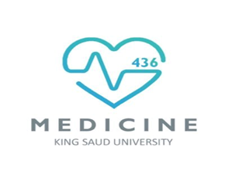
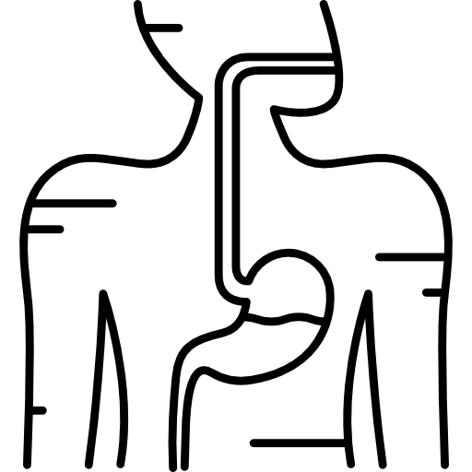
LECTURE: Leishmania
Editing File
Important
Doctor’s notes
Extra explanation
Only F or only M
"لا حول ولا قوة إلا بالله العلي العظيم" وتقال هذه الجملة إذا داهم الإنسان أمر عظيم لا يستطيعه ، أو يصعب عليه القيام به .

Slide 2
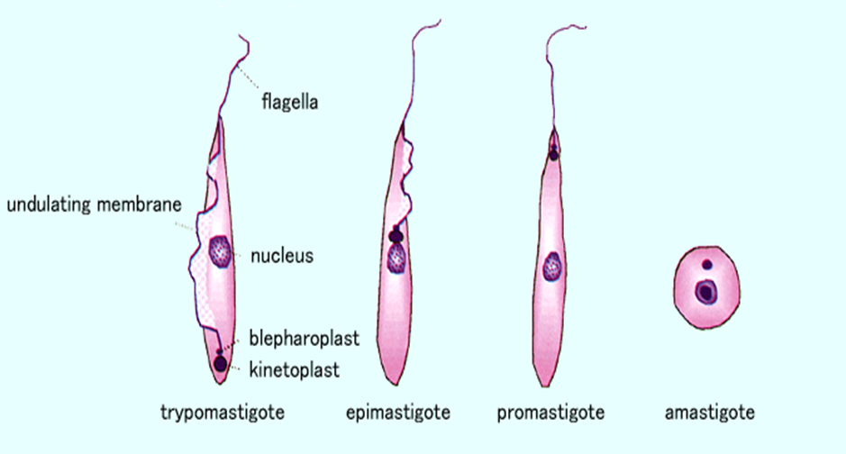
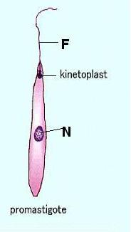
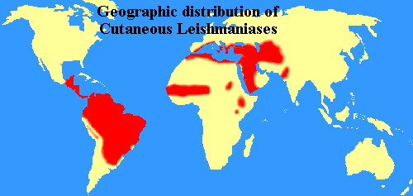
Leishmania Parasites and Diseases
There are three 3 main form of Lishmaniassis each caused by a different species :
Disease | SPECIES
Cutaneous leishmaniasis Affects the skin only | Leishmania tropica* Leishmania major* Leishmania aethiopica Leishmania mexicana
Mucocutaneous leishmaniasis In the areas containing mucous membrane | Leishmania braziliensis
Visceral leishmaniasis Internal | Leishmania donovani* Leishmania infantum* Leishmania chagasi
* Endemic in Saudi Arabia
Different stages of Haemoflagellate protozoa
Promastigotes of Leishmania
Amastigote of Leishmania

Slide 3
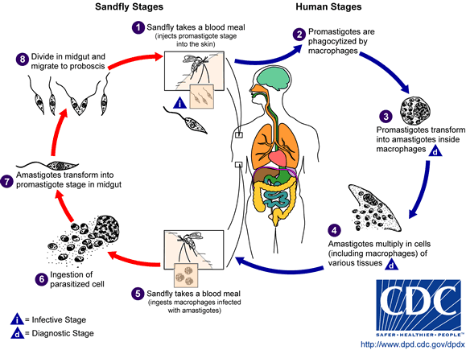
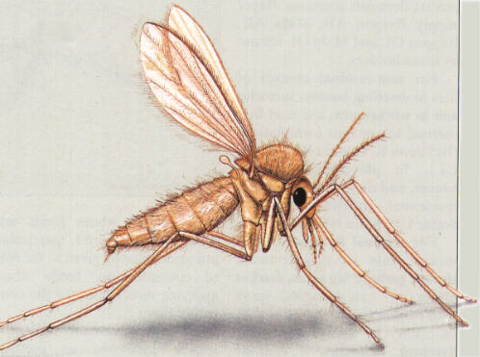
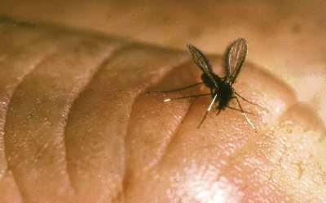
The life cycle of Leishmania:
Lishmania spp survive within the macrophages in the human body as intracellular parasites cell mediated immunity determines the host response to infection and clinical manifestations of the disease. The disease is more severe in immunocompromised patients.
Route of transmission : via the bite of infected blood –sucking Sandflies.

Slide 4
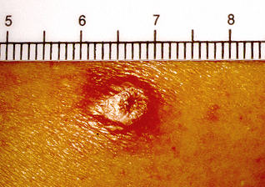
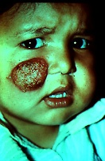
1- Clinical types of cutaneous leishmaniasis
COMMON TYPES :
known as (oriental sore) : Oriental sore is classical self-limited ulcer. يتشافى لحاله اذا كانت الاميونتي له سليمه من قبل
Leishmania major: | Leishmania tropica:
human and Zoonotic cutaneous leishmaniasis(dogs,rodents) : wet lesions with severe reaction. From human to human or from human to animal or from animal to human موجودة في الشرق الاوسط وفي السعودية | Anthroponotic (human only) cutaneous leishmaniasis: Dry lesions with minimal ulceration. From human to human only
This starts as a painless papule at the site of Sand fly bite ,generally the face ,which enlarges ,The lesion ulcerates after a few months with an indurated margin.
In some other cases the ulcer may spread with an inflammatory zone around , these known as (wet-type-lesion) which heal slowly. Which takes more time than dry lesions | In some cases the ulcer remains dry and heals readily (dry-type-lesion)
lesion of cutaneous lishmaniasis:

Slide 5
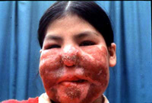
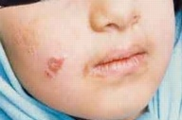
1- Clinical types of cutaneous leishmaniasis
Un COMMON TYPES :
Diffuse cutaneous leishmaniasis (DCL): | Leishmaniasis recidiva (lupoid leishmaniasis):
-Caused by L. aethiopica, diffuse nodular non-ulcerating lesions, seen in a part of Africa, people with low immunity to Leishmania antigens. -Diffuse cutaneous (DCL) , and consists of nodules and a thickening of the skin, generally without any ulceration . | Severe immunological reaction to leishmania antigen leading to persistent dry skin lesions.
Diffuse cutaneous leishmaniasis(DCL)
Leishmaniasis recidiva

Slide 6
2- Mucocutaneous leishmaniasis
In the nasopharyngeal area
The lesion starts as a pustular swelling in the mouth or on the nostrils.
The lesion may become ulcerative after many months and then extend into the naso- pharyngeal mucous membrane.
Secondary infection is very common with destruction of the nasal cartilage and the facial bone.
Caused by: L. braziliensis. يجي في جنوب أمريكا

Slide 7
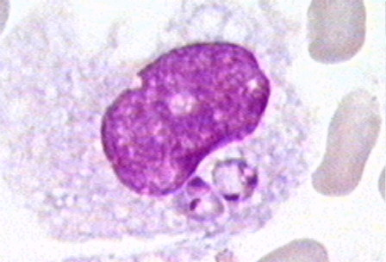
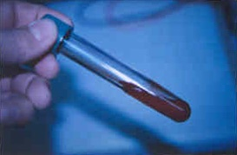
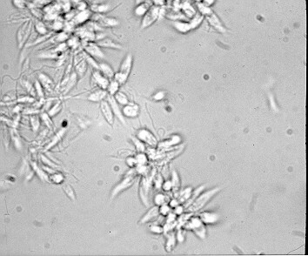
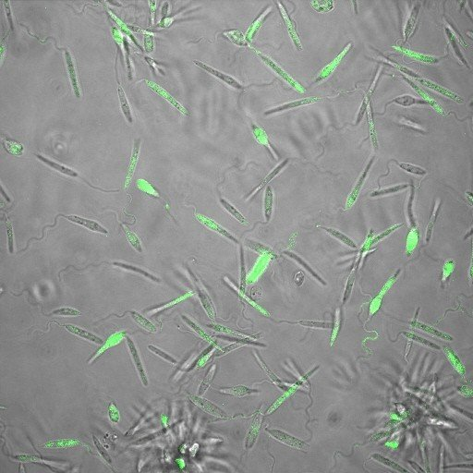
For cutaneous & muco-cutaneous leishmaniasis :
Diagnosis:
The parasite can be isolated from the margin of the ulcer. | Smear: Giemsa stain – microscopy for LD bodies (amastigotes) in the macrophages. | Biopsy: microscopy for LD bodies in the macrophages, or culture in NNN medium for finding promastigotes.
Treatment:
No treatment – self-healing lesions | Medical: Pentavalent antimony (Pentostam), Amphotericin B Antifungal drugs +/- Antibiotics for secondary bacterial infection. | Surgical: Cryosurgery Excision Curettage
NNN medium
We culture the macrophages which have amastigotes inside them in NNN medium and look for promastigotes
Amastigotes of Leishmania LD in macrophages
The diagnostic stage
Promastigotes of Leishmania
The infective stage

Slide 8
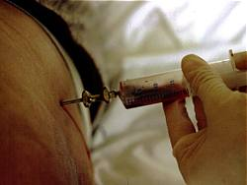
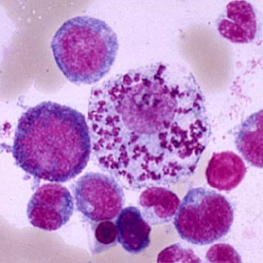
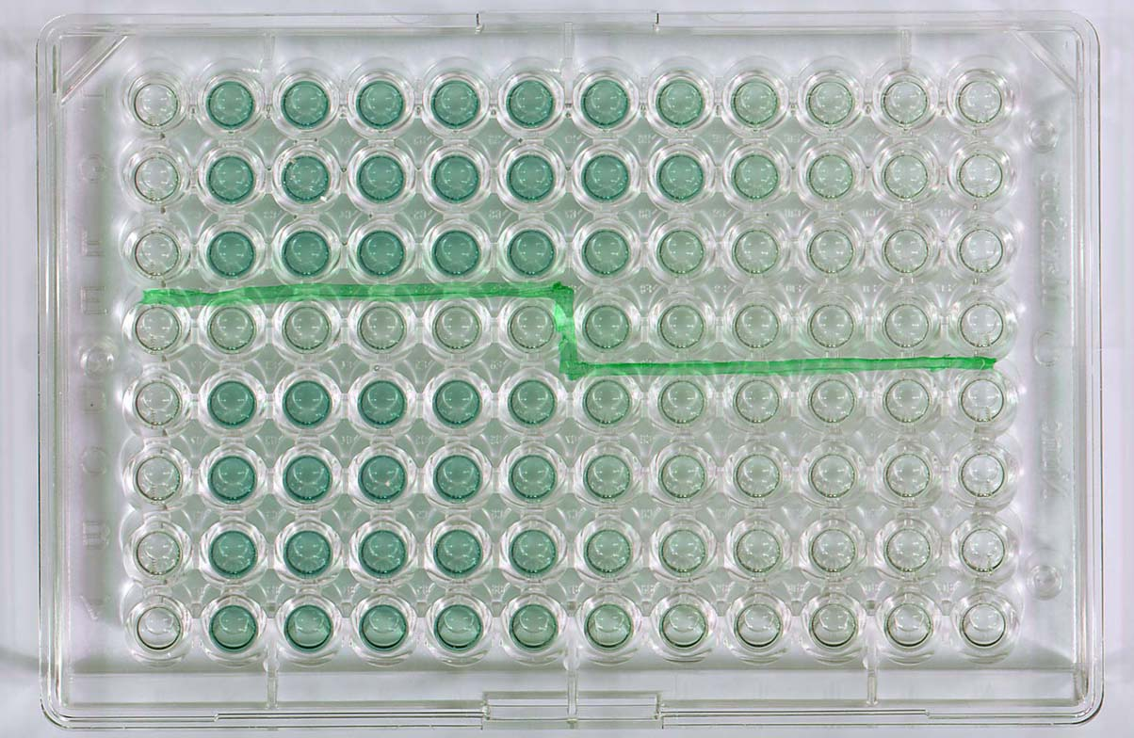
3- Visceral leishmaniasis (Kala-azar)
Both are endemic in Saudi Arabia*:
1-Leishmania infantum mainly affect children 2-Leishmania donovani mainly affects adults
incubation period: | usually 2-8 months.
Symptoms: | generally are: fever ,malaise, weight loss with splenomegaly ,hepatomegaly ,anaemia ,leucopenia and sweating .
 | Hepato-splenomegally can be seen because of the hyperplasia of the lymphoid –macrophage system.
Diagnosis: | 1- Parasitological diagnosis: Specimen: Bone marrow aspirate (the golden standard) / Splenic aspirate / Lymph node / Tissue biopsy microscopy culture in NNN medium
 | (2) Immunological Diagnosis: Specific serologic tests: Direct Agglutination Test (DAT), ELISA, IFAT Skin test (leishmanin test) for survey of populations and follow-up after treatment.
Hepatosplenomegaly
DAT test
ELISA test
Bone marrow to demonstrate (LD bodies ) amastigotes in macrophages , in the medium it will be promastigotes:
*they involve lymph nodes and bone marrow

Slide 9
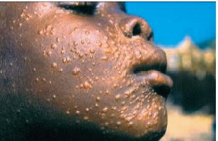
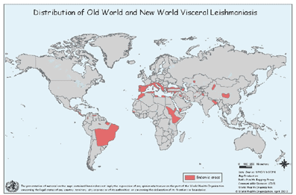
World distribution of Visceral Leishmaniasis :
Treatment of visceral leishmanisis
Recommended treatment varies in different endemic areas:
Pentavalent antimony- sodium stibogluconate (Pentostam)
Amphotericin B
Treatment of complications:
Anaemia
Bleeding
Infections etc.
Untreated disease can be fatal
After recovery it might produce a condition called post kala-azar dermal leishmaniasis (PKDL)

Slide 10
SUMMARY:
 | Leishmania
 | Cutaneous |  | Mucocutaneous | Visceral
Transmission | Diagnostic: Amastigote in macrophages Infective: Promastigote in sand fly (vector) [note: response depends on host immunity]
Pathogenesis | oriental sore = self limited ulcer (painless papule) |  | 2ry destruction of nasal cartilage and facial bone. | Kala-azar
Species | Leishmania major | Leishmania tropica | Leishmania Braziliensis | Leishmania infantum | Leishmania donovani
 | Human & zoonotic Severe Wet | Anthroponotic Minimal Dry |  | Fever, malaise, weight loss, splenomegaly, hepatomegaly, anemia, leucopenia, Post kala-azar dermal leishmaniasis Untreated may be FATAL.
 | Uncommon type: Diffuse cutaneous leishmaniasis (DCL) = L. Aethiopica Leishmaniasis recidiva
Diagnosis | Microscopy: sample from margin of ulcer and look for LD bodies (amastigote in macrophages) with GEMSA stain Culture: NNN medium for promastigote. |  |  | Microscopy: sample from BONE MARROW and look for LD bodies (amastigote in macrophages) Culture: NNN medium for promastigote. Serology: ELISA + skin test
Treatment | Medical + surgical |  |  | Treat disease and complications

Slide 11
QUIZ:
Which of the following is the infective stage of leishmaniasis ?
Trypomastigote b) Amastigote c) Promastigote
Which of the following is vector of leishmania ?
Testes fly b) Sand fly c) Triatomine
Which of the following can be seen in L. tropica infection?
Wet lesions b) minimal ulceration c) Sever reaction
Which of the following parasites cause destruction of nasal cartilage?
L. Braziliensis b) L. Major c) L. donovani
For detecting L. Tropica , ….. Is found on microscopy .
a) Trypomastigote b) Amastigote c) Promastigote
Which medium is used for diagnosing L. donovani?
NNN b) Chocolate c) MacConkey
Which of the following species of leishmania cause hepato-splenomegaly?
a) L. Braziliensis b) L. Major c) L. donovani
Which of the following is the golden standard site of aspiration when suspecting L. infantum infection?
a) Lymph node b) bone marrow c) splenic aspiration
C
B
B
A
B
A
C
B

Slide 12
THANK YOU FOR CHECKING OUR WORK, BEST OF LUCK!
Hamad Alkhudhairy
Shrooq Alsomali
Reem Alshathri
Rehab Alanazi
Jawaher Alkhayyal
Jumana Alghtani
Doctors slides

