Slide 1
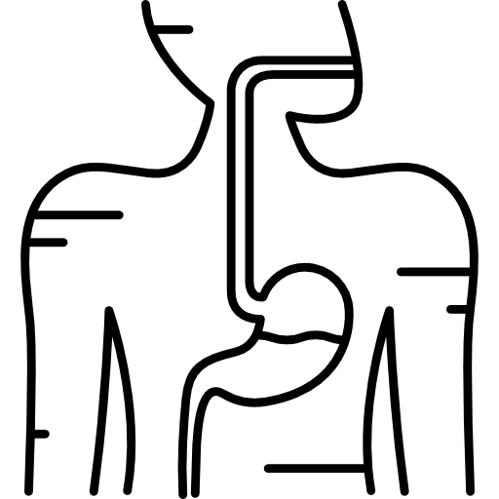
LECTURE: Viral hepatitis A , E
Editing File
Important
Doctor’s notes
Extra explanation
Only F or only M
"لا حول ولا قوة إلا بالله العلي العظيم" وتقال هذه الجملة إذا داهم الإنسان أمر عظيم لا يستطيعه ، أو يصعب عليه القيام به .

Slide 2
OBJECTIVES:
Know the classification of viruses causing hepatitis.
Viruses causing entericaly transmitted hepatitis:HAV,HEV.
Viruses that are causing hepatitis during their course of infection: Cytomegalovirus (CMV) ,Epstein-Barr
virus (EBV),Arbovirus (yellow fever virus)

Slide 3
Hepatitis:
Hepatitis: is inflammation of the liver.
Etiology:
A) Primary infection: | B) As part of generalized infection:
- Hepatitis A virus (HAV) - Hepatitis B virus (HBV). - Hepatitis C virus (HCV), was known as non-A non-B hepatitis. - Hepatitis D virus (HDV) or delta virus. - Hepatitis E virus (HEV). - Hepatitis F virus (HFV) Hepatitis F has been reported in the literature but not confirmed. - Hepatitis G virus (HGV). | (CMV, EBV, Yellow fever virus)
Viral hepatitis is divided into two large groups, based on the mode of transmission:
1– Enterically transmitted hepatitis or water-borne hepatitis | 2– Parenterally transmitted hepatitis or blood-borne hepatitis
This group includes hepatitis A and E viruses | This group includes hepatitis B, C, D & G viruses
HAV and HEV belong to diﬀerent families

Slide 4
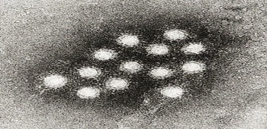
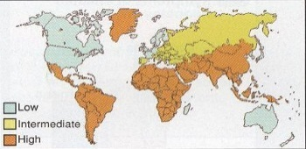
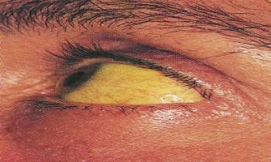
Hepatitis A Virus
Characteristics: | Family of Picornaviridae. Genus: Hepatovirus. Virion non-enveloped and consist of: Icosahedral capsid. Positive sense ss-RNA. | Other names for hepatitis a virus: Short incubation hepatitis (Hepatitis E virus is longer) Infectious hepatitis Epidemic hepatitis
Epidemiology
Distribution: | Worldwide, endemic in tropical countries Due to poor hygiene
Transmission: | Fecal-oral route [major route] :Contaminated food &water Like eating infected shellfish harvested in the fecal contaminated order or uncooked food like salad |  | Sexual contact (homosexual men) Blood transfusion (very rarely)
Age: | In developing countries; children The most aﬀected group of age due to poor hygiene |  | In developed countries; young adults
Manifestations | Acute infection Hepatitis: Asymptomatic & anicteric infection is common Symptomatic illness increases with age Incubation period=2-6 Weeks Two Phases: 1- Pre-icteric phase: fever, fatigue ,nausea, vomiting, & RUQP (right upper quadrant pain) 2- Icteric phase: dark urine, pale stool, jaundice
Virus is found in stool during incubation period + prodrome period before symptoms start to appear, and when symptoms appear the concentration of virus decline in the stool
Icteric means jaundice

Slide 5
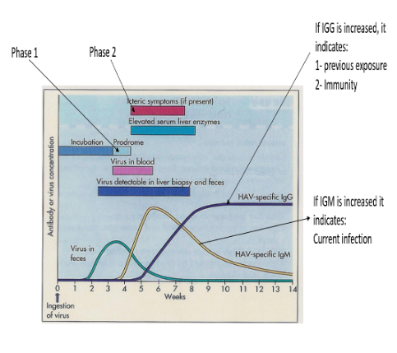
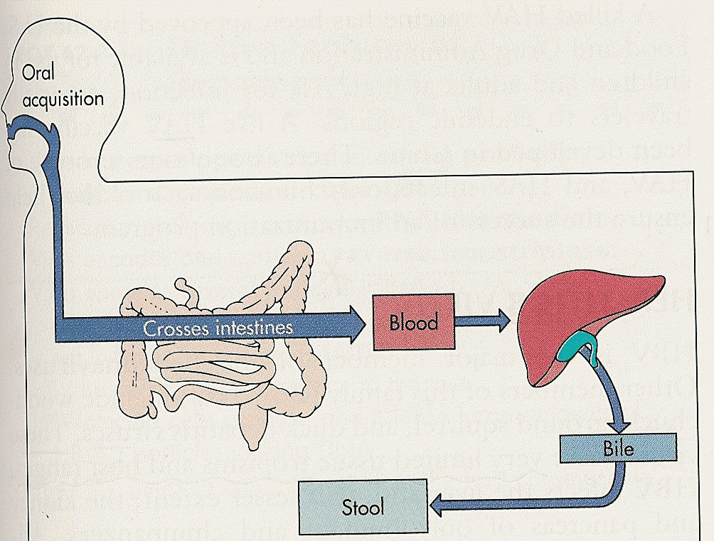
Hepatitis A Virus
Pathogenesis: | The virus enters the body by ingestion of contaminated food. It replicates in the intestine (epithelium), and then spread to the liver where it multiplies in hepatocytes. Cell mediated immunity → Damage of virus-infected hepatocytes → increase ALT, AST & Bilirubin
Managment
Treatment: | Supportive therapy
Prevention: | Sanitation & hygiene measures
 | HIG (human immunoglobulin): Given before or within 2 Weeks of exposure (shorter immunity) -Indication: travellers, unvaccinated, exposed patients.
 | Vaccine: inactivated (longer immunity), Given IM in two doses ->1 Y of age -Indication: Patients at high risk of infection and severe disease
Lab Diagnosis | Serology: Detection of anti-HAV IgM →Current infection Detection of Anti-HAV IgG → Previous infection OR Immunity
Prognosis | Self-limited disease* Fulminant hepatitis → rare Severe necrotic infection of Lever lead to liver failure Mortality rate ~ 0.1 - 0.3% No chronicity or malignancy changes
* Usually patient recovers within few weeks, however The majority of the infection are asymptomatic

Slide 6
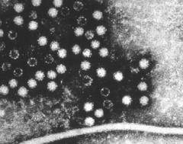
Hepatitis E virus
Characteristics: | Family of Hepeviridae. Genus: Hepevirus. | Virion non-enveloped and consist of: Icosahedral capsid. Positive sense ss-RNA.
Epidemiology
Distribution: | Outbreak of water-borne & sporadic cases of viral hepatitis
Transmission: | Water-borne The main route Zoonotic (from animals) food borne. (from pork) |  |  | 3. Blood-borne Rare 4. Perinatal From pregnant mother to her baby
Age: | Age; young adults
Clinical features:
Similar to HAV infection with exceptions: Longer incubation period =4-8 weeks Acute and Chronic hepatitis, cirrhosis, but not hepatocellular carcinoma (HCC) |  |  | Fulminant disease Mortality rate ~10 times > HAV / ~ 1-3% / [20% in pregnancy]
Lab diagnosis: | ELISA → Anti-HE IgM
Treatment: | Not specific In immunocompetent
Prevention: | Sanitation & hygiene measures No Immunoglobulin No vaccine

Slide 7
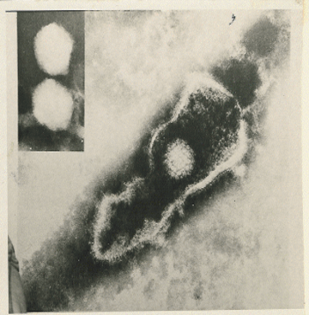
Herpesviridae:
dsDNA , Icosahedral & Enveloped Virus
1-Herpes simplex virus type-1 | HSV-1
2-Herpes simplex virus type-2 | HSV-2
3-Varicella –Zoster virus | VZV
4-Epstein-Barr virus | EBV
5-Cytomegalovirus | CMV
6-Human herpes virus type-6 | HHV-6
7-Human herpes virus type-7 | HHV-7
8-Human herpes virus type-8 | HHV-8
They cause hepatitis
Type 1-6 are mild self-limited in immunocompetent but severe in immunocompromised patients

Slide 8
Epstein–Barr Virus (EBV):
*Infect lymphocytes mainly B lymphocyte
Characteristics: | It is lymphotropic*. | It has oncogenic properties; (Burkitt’s lymphoma, Nasopharyngeal carcinoma)
Epidemiology
Distribution: | worldwide
Transmission: | 1-slaiva (kissing disease) |  | 2-blood(rare)
Age: | socio-economic state(SE): 1-Low SE : early childhood (developing countries) 2-High SE : adolsence (developed countries)
Clinical features:
1-immunocompetive host: Asymptomatic Usually Infectious mononucleosis [or glandular fever] Mainly in teenagers & young adults IP = 4-7 weeks Fever, pharyngitis, malaise, hepatosplenomegaly & abnormal LFT, hepatitis. Complications: (acute air way obstruction, splenic rupture, CNS inf) Rare |  |  |  |  | 2-immunocompremised host: (HIV) Lymphoproliferative disease ( LD) Oral hairy leukoplakia (OHL)
Lab diagnosis: | Hematology: increased WBC Lymphocytosis (atypical lymphocytes) |  |  | Serology: 1- Non-specific AB test : -Heterophile Abs +ve -Paul-Bunnell or -monospot test |  | 2- EBV-specific AB test: IgM Abs to EBV capsid antigen
Treatment: | Antiviral drug is not effective in IMN
Prevention: | no vaccine

Slide 9
Cytomegalovirus (CMV)
Special features: | -Its replication cycle is longer. -Infected cell enlarged with multinucleated.[cyto=cell, megalo=big](change in cell ) -Resistant to acyclovir. -Latent in monocyte, lymphocyte & other
Distribution: | worldwide
Transmission: | Early in life: Transplacental From pregnant mother to her baby causing a congenital infection- Birth canal - Breast milk Young children: saliva Later in life: sexual contact, Blood transfusion & organ transplant.
1-Acquired Infection: a)Immunocompetent host: Asymptomatic - Self-limited illness – Hepatitis - Infectious mononucleosis like syndrome [Heterophile AB is –ve] b)Immunocompromised host : Encephalitis , Retinitis , Pneumonia - Hepatitis, Esophagitis, Colitis. 2- Congenital Infections
The diﬀerence between infectious mononucleosis and infectious mononucleosis like syndrome is:
- the first one is caused by Epstein herpesvirus + pharyngitis + positive heterophile
- the second by cytomegalovirus + rare pharyngitis + negative heterophile

Slide 10
Cytomegalovirus (CMV)
Lab diagnosis: | Histology: Intranuclear inclusion bodies [Owl’s –eye] | Culture: In human fibroblast 1-4 wks → CPE (very slow growing disease) Shell Vial Assay → 1-3 days | Serology : 1-AB : → IgM: current infection → IgG: previous exposure 2-Ag: → CMV pp65 Ag by IFA | PCR
Treatment: | Ganciclovir : is effective in the treatment of severe CMV inf. Foscarnet: the 2nd drug of choice
Prevention: | Screening Organ donors Organ recipient Blood donors Leukocyte-depleted blood. Prophylaxis: Ganciclovir, CMVIG. No vaccine.

Slide 11
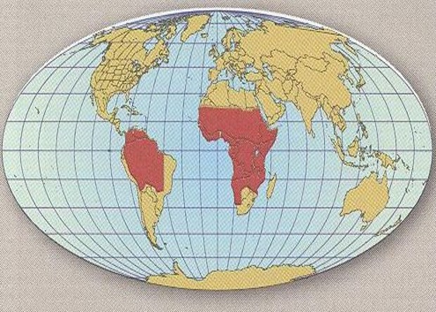
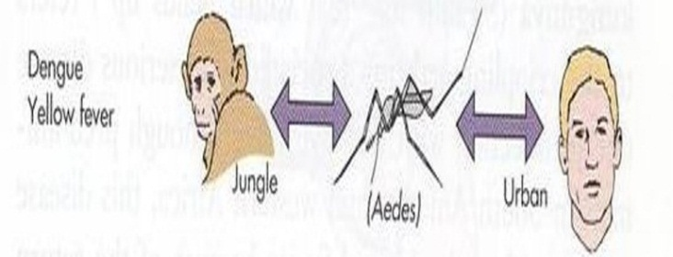
Arthropod –borne Viruses (Arboviruses) Yellow Fever virus (because of jaundice)
Family: Flaviviridae
Asymptomatic to Jaundice + Fever ± hemorrhage ± renal failure
Epidemiology
Tropical Africa & South America:
1-Jungle Yellow Fever
2-Urban Yellow Fever
Jungle Yellow Fever
Urban Yellow Fever
Vector: mosquito
Reservoir: monkeys
Accidental host: humans
It is a disease of monkeys
Vector: mosquito
Reservoir: human
It is a disease of humans

Slide 12
Arthropod –borne Viruses (Arboviruses) Yellow Fever virus (because of jaundice)
Diagnosis
-Reference Lab -Lab Methods: A- Isolation (Gold standard) B -IgM-Ab - ELISA, IF: (most used) C - Arbovirus RNA by RT-PCR
Prevention
1-Vector Control: Elimination of vector breading sites Using insecticides Avoidance contact with vectors 2-Vaccines: Yellow Fever vaccine (LAV, one dose /10 yrs) is recommended for travelers

Slide 13
THANK YOU FOR CHECKING OUR WORK, BEST OF LUCK!
Hamad Alkhudhairy
Meshal aleidi
Abdulmalik alghanam
Shrooq Alsomali
Rawan Alqahtani
Ghaida Alsaeed
Doctors slides

