Slide 1
LECTURE: Malaria
Editing File
Important
Doctor’s notes
Extra explanation
Only F or only M
"لا حول ولا قوة إلا بالله العلي العظيم" وتقال هذه الجملة إذا داهم الإنسان أمر عظيم لا يستطيعه ، أو يصعب عليه القيام به .

Slide 2
OBJECTIVES:
Know the 5 species of malaria that infect humans
Describe the life cycle of malaria, morphology and clinical picture
Compare pathogenesis of different malaria species
Know endemic countries of malaria species
Know malaria paroxysm
Know complications of malaria
Describe methods for laboratory diagnosis of malaria
Know action of anti malarial drugs in different life stages of malaria parasite

Slide 3
Malaria:
Malaria is the most important of all tropical parasitic disease ,causes death and debility and is endemic throughout the tropics and subtropics.
The main symptoms and signs are periodic fever حرارة بوقت وطريقه معينه, headache ,anorexia and anemia.
Uncomplicated malaria is defined as:
Symptomatic infection with malaria parasitemia without signs of severity and/or evidence of vital organ dysfunction.
Five species of malaria infect humans:
Plasmodium falciparum IMP
Plasmodium vivax
Plasmodium ovale
Plasmodium malariae Quartan
Plasmodium knowlesi
Plasmodium vivax, Plasmodium ovale 48h
Plasmodium malariae:72h
Plasmodium falciparum:irregular

Slide 4
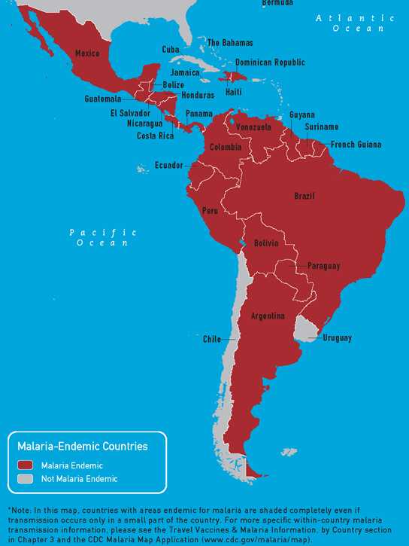
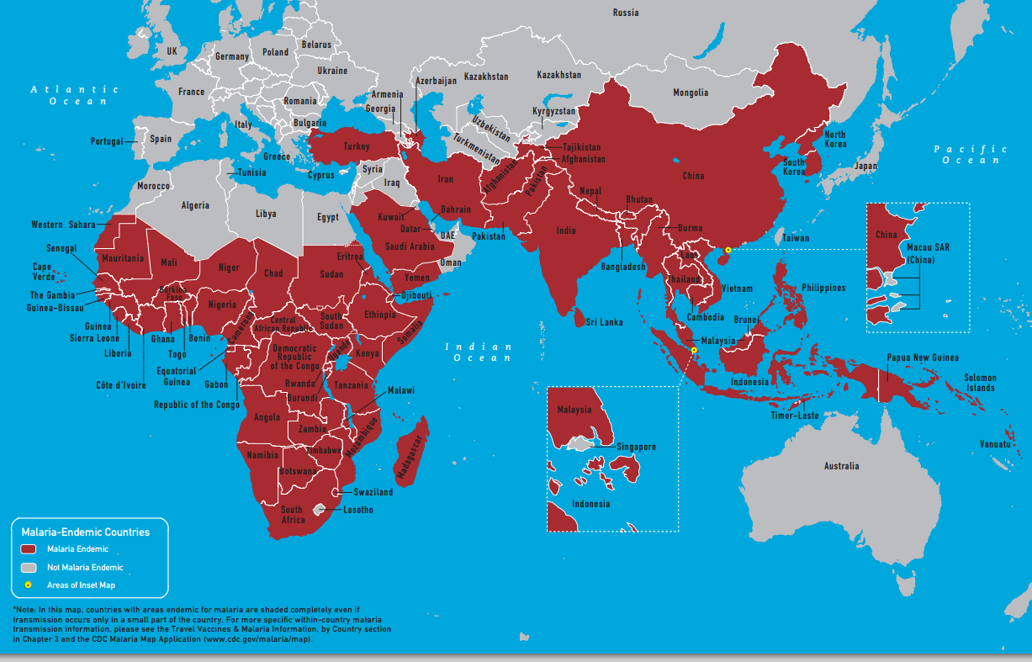
Epidemiology: IMP
Asexual stage: | Anopheles Mosquito inject sporozoite to human → enter the liver → the liver relese merozoite → enter the RBC (ring stage) and cause the main pathology which is blood heamolysis and anemia Mosquito inject sporozoite to human (infective stage) Mosquito suck gametocytes from human Some parasite develop into male + female gametocyte .
Sexual stage: | male and female Gametocyte are taken up from the blood of an infected human by biting mosquito .Further sexual development takes place in the mosquito gut to produce SPOROZOITES.
Transmission: | Human to human transmission can occur by blood transfusion vertical transmission across the placenta. mainly from mosquito to human
Endemic Countries

Slide 5
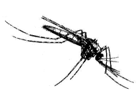
The mosquito give sporozoites and take the gametocytes and happen inside it the sexual stage
Life Cycle of Malaria
Oocyst
Sporozoites
Zygote
Stomach Wall
Salivary Gland
Sporozoites
Infective stage
Gametocytes
Pre-erythrocytic
(hepatic) cycle
Exo-erythrocytic
(hepatic) cycle
Erythrocytic
Cycle
Hypnozoites
This slide is animated

Slide 6
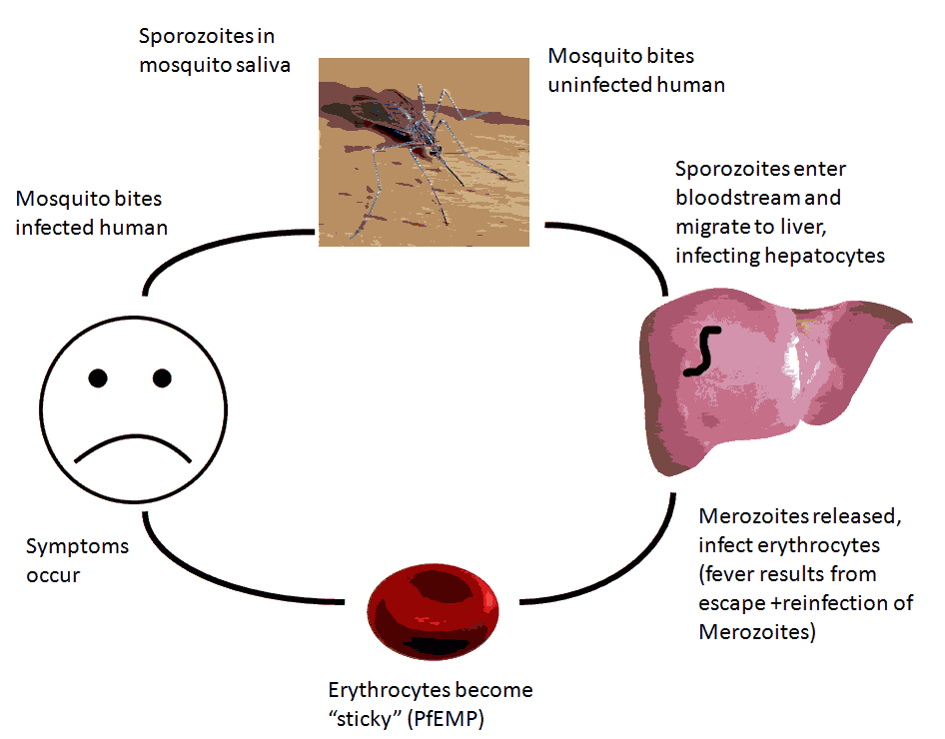
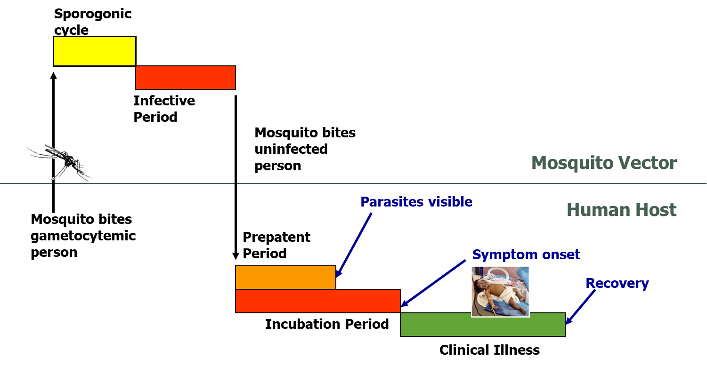
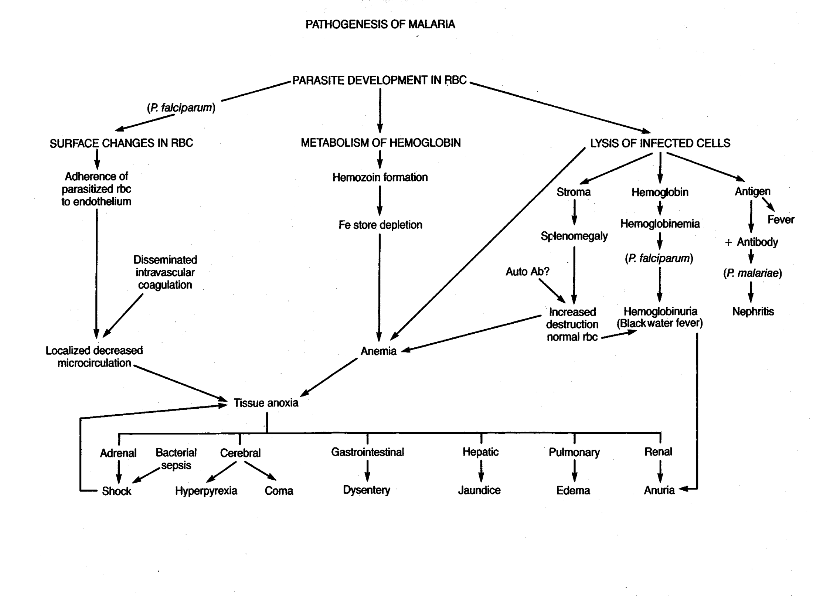
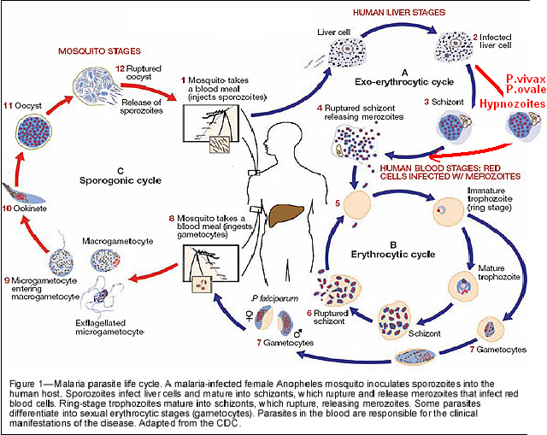
Components of the Malaria Life Cycles

Slide 7
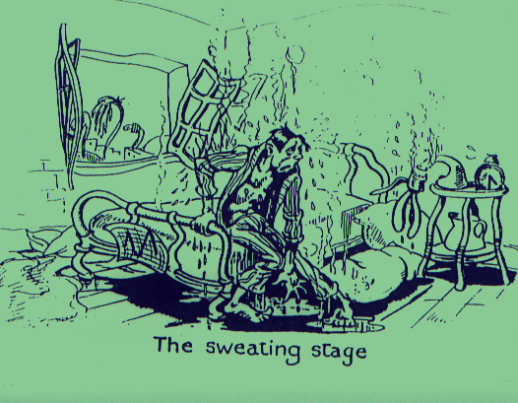
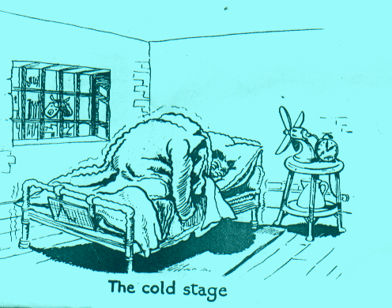
Clinical signs and symptoms of Malaria: Malarial Paroxysm
hot stage
intense heat
dry burning skin
throbbing headache
lasts 2-6 hours
Fever
Sweating
Chills
sweating stage
profuse sweating
declining temperature
exhausted and weak → sleep
lasts 2-4 hours
cold stage
feeling of intense cold
vigorous shivering
lasts 15-60 minutes

Slide 8
Pathogenesis of MALARIA:
Symptoms are due to: the main pathology of malaria is the infection of the RBCs (hemolysis of RBCs)
Hemolysis of Red Blood Cells : with release of metabolites and pigments from Malaria parasite.
Plugging of capillaries by parasitized erythrocytes :In cerebral malaria there is sequestration of parasites in central nervous system capillaries. The most one that do that is PLASMODIUM FALCIPARUM
Clinical Picture
Plasmodium falciparum can cause death
Non-severe Acute Febrile disease
Severe malaria e.g. Cerebral Malaria
DEATH
ACUTE
Disease
Chronic Asymptomatic Infection
Anemia
Developmental Disorders; Transfusions; Death
CHRONIC
Disease
Infection During Pregnancy
Placental Malaria
Low Birth weight
Increased Infant Mortality

Slide 9
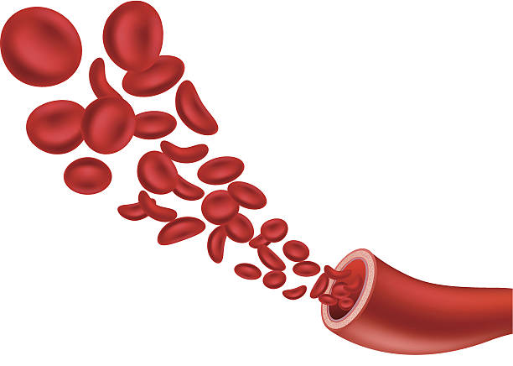
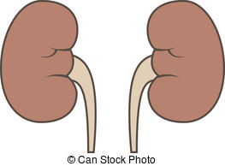
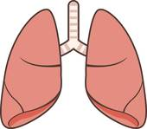
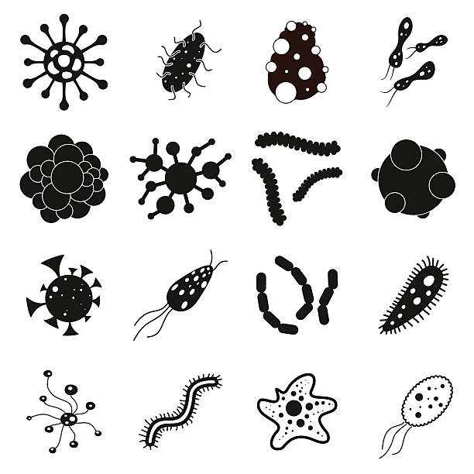
Malaria: Definition
Severe malaria is defined as symptomatic malaria in a patient with P. falciparum with one or more of the following complications:
Cerebral malaria (unrousable coma not attributable to other causes).
Generalized convulsions (> 2 episodes within 24 hours)
Severe normocytic anemia (Ht<15% or Hb < 5 g/dl)
Hypoglycaemia (blood glucose < 2.2 mmol/l or 40 mg/dl ) and pulmonary edema in pregnancy can lead to abortion ,stillbirth seen in tropical Africa.
Metabolic acidosis with respiratory distress (arterial pH < 7.35 or bicarbonate < 15 mmol/l)
Fluid and electrolyte disturbances
Acute renal failure (blackwater fever) (urine <400 ml/24 h in adults; 12 ml/kg/24 h in children)
Acute pulmonary edema and adult respiratory distress syndrome
Abnormal bleeding
Jaundice
Haemoglobinuria
Circulatory collapse, shock, septicaema (algid malaria)
Hyperparasitaemia (>10% in non-immune; >20% in semi-immune)
Tropical splenomegaly.

Slide 10
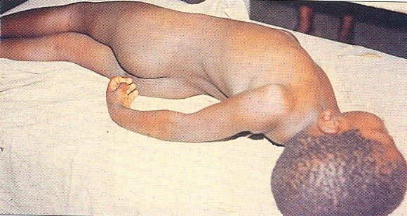
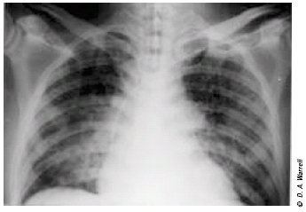
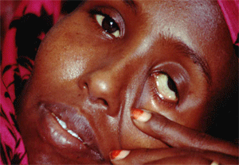
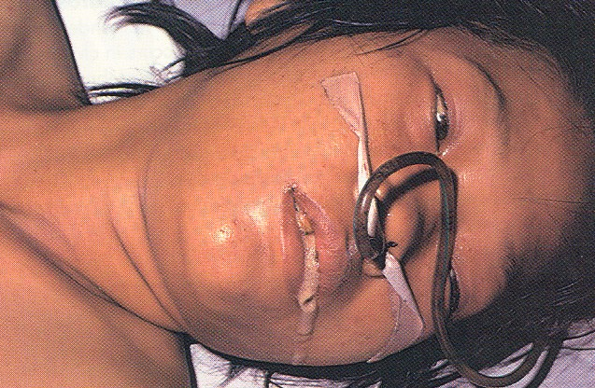
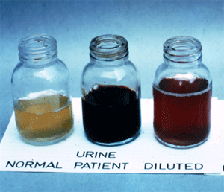
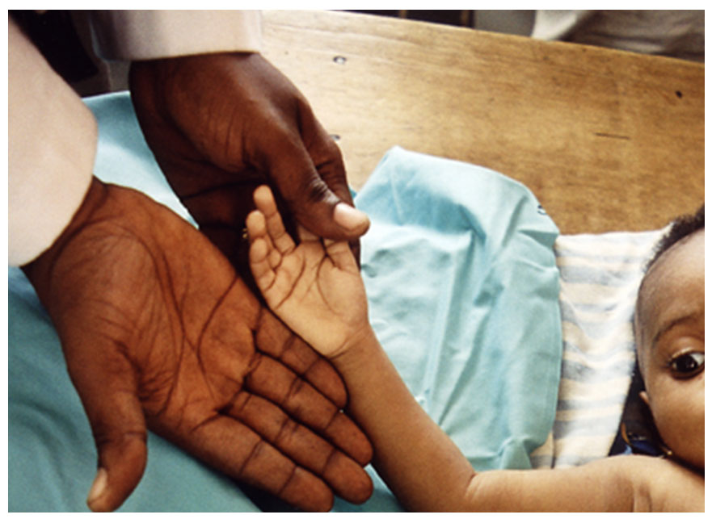
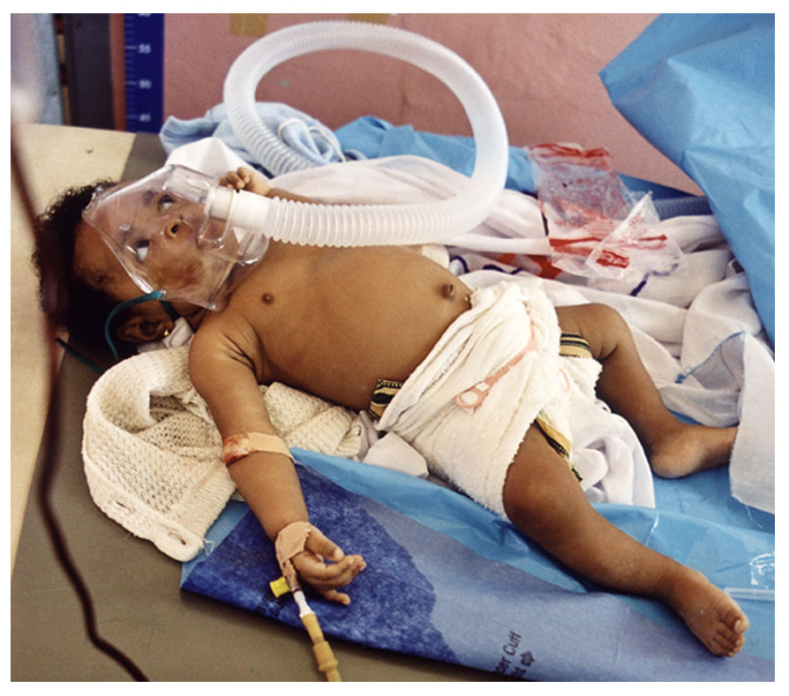
Malaria: sever Complications P. falciparum
Bc the pregnant women are immunocompromised patient
Cerebral malaria
Hypo glycaemia and pulmonary edema in pregnancy
Malarial haemoglobinuria
Cav cause coma and death
Anaemia
Clinical Picture :
Haemoglobinuria associated with malaria Acute renal failure (“blackwater fever”) is uncommon and malarial haemoglobinuria usually presents in adults as severe disease with anemia and renal failure.
Child with severe malaria anaemia and no other malaria complication
Child with severe malaria anaemia in conjunction with acidosis and respiratory distress
Acute renal failure (blackwater fever) can happened due to P. FALCIPARUM

Slide 11
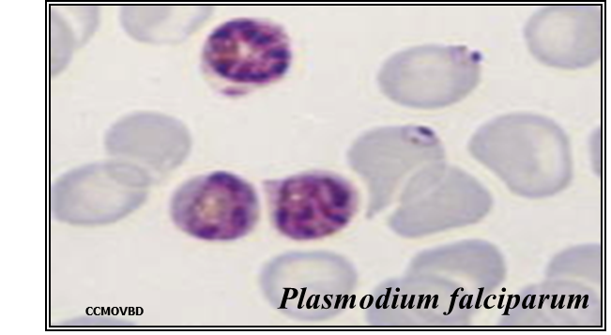
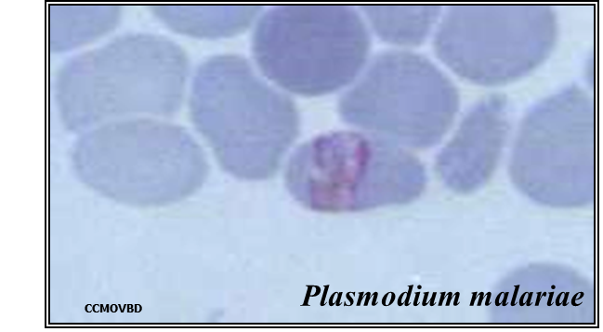
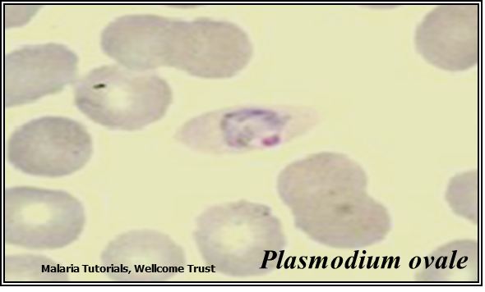
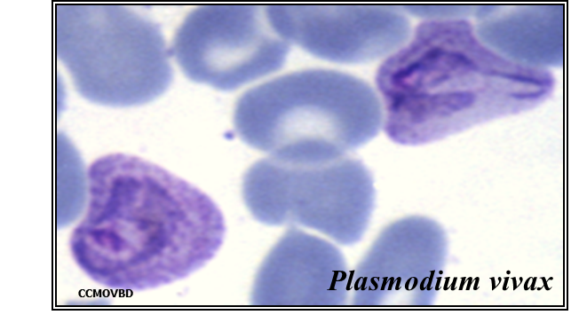
Malaria: Diagnosis
Common methods for parasitological diagnosis of malaria
The two methods common in use :
1: Light microscopy the gold standard
Microscopy is the gold standard for diagnosis of malaria
Parasite density
Species diagnosis
Monitoring response to treatment
2: Rapid diagnostic tests (RDTs).

Slide 12
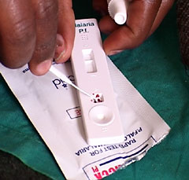
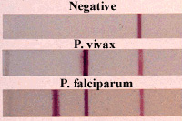
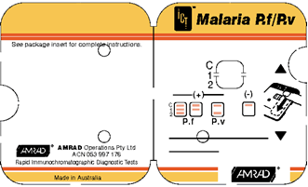
Malaria: Diagnosis
Common methods for parasitological diagnosis of malaria
The two methods common in use :
1: Light microscopy
2: Rapid diagnostic tests (RDTs).
Rapid diagnostic tests detect malaria antigens.
The product comes in a number of formats:
Plastic cassette
Card
Dipstick
Hybrid cassette-dipsticks

Slide 13
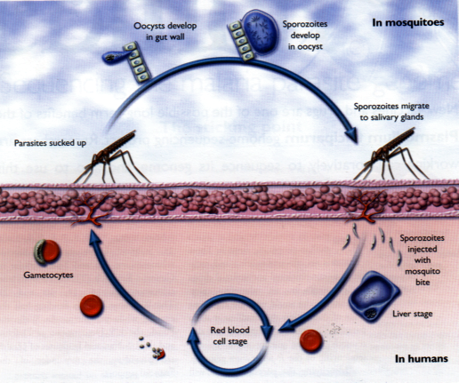
Malaria: Treatment
Action of antimalarial drug in the different life stages of the malaria parasite
Sporontocides
Primaquine
Pyrimethamine
Proguanil
Tissue Schizontocides
Primaquine
Pyrimethamine
Tetracycline
Proguanil
Gametocyide
Primaquine
Anti-relapse (P.vivax)
primaquine
Wellcome Trust (Modified)
Blood Schizontocides
Chloroquine
Sulfadoxine/Pyrimethamine
Quinine
Artemisinins

Slide 14
SUMMARY:
MALARIA
the most important of all tropical parasitic disease
Species of malaria | Plasmodium falciparum > Irregular |  |  | Plasmodium vivax. >48 h.
 | Plasmodium malariae. > 72 h. (quartan) |  |  | Plasmodium ovale. >. 48 h.
The main symptoms | 1-periodic fever 2-headache 3-anorexia 4-anemia.
Transmission | Asexual stage | sporozoites > injected by > Mosquito > enter liver cells and will become Merozoites "ring stage" > penetrate the RBC and cause the main pathology of the disease hemolysis and anemia
 | Sexual stage | male and female Gametocyte > taken up from human by mosquito > sexual development in mosquito gut > produce SPOROZOITES.
 | Others | -Human to human > blood transfusion -vertical transmission > placenta
Pathogenesis أسباب الأعراض | -Hemolysis of Red Blood Cells -Plugging of capillaries (cerebral malaria)
Clinical picture | -cold stage : Chills - hot stage: Fever - sweating stage: Sweating
Complication | - in a patient with P. falciparum | 1-Cerebral malaria مهم 2-Hypoglycaemia and pulmonary edema in pregnancy 3-renal failure , Hemoglobinuria (“blackwater fever”) 4-respiratory distress 5-anaemia مهم 6- splenomegaly.
diagnosis | 1-microscopy "gold standard" 1/Parasite density 2/Species diagnosis 3/Monitoring response to treatment 2-Rapid diagnostic tests

Slide 15
QUIZ:
Which of the following species of malaria cause a regular periodic fever?
P. Falciparum b) P. malariae c) P. vivax
Sporozoites when injected into the human skin it migrates to:
Hepatocytes b) Lymphocytes c) Intestinal wall
What is the main cause of Anemia in malaria ?
Sporozoites b) Trophozoites c) Merozoites
The sexual stage of p. vivax happens in:
Mosquito b) Human c) cattle
Chronic Asymptomatic malaria lead to:
Cerebral malaria b) placental malaria c) Anemia
The symptoms of malaria appear due to:
Migration of sporozoites to hepatocytes b) hemolysis of RBCs c) entry of sporozoites into the skin
Cerebral anemia is caused by:
P. Falciparum b) P. malariae c) P. vivax
8. Which of the following diagnostic methods used for detection of malarial antigens?
a) Light microscopy b) RDTs c) Both
B
A
C
A
C
B
A
B

Slide 16
THANK YOU FOR CHECKING OUR WORK, BEST OF LUCK!
Hamad Alkhudhairy
Shrooq Alsomali
Doctors slides

