Slide 1
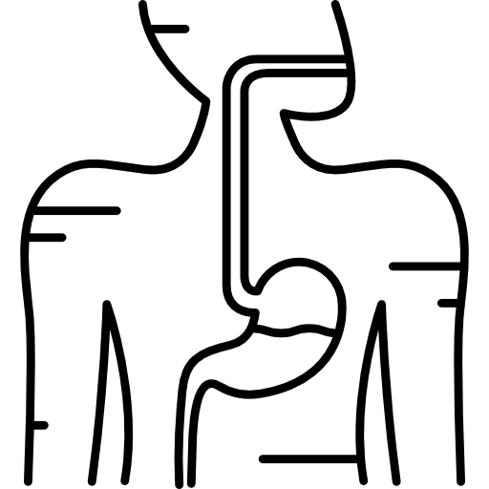
LECTURE: Viral Gastroenteritis
Editing File
Important
Doctor’s notes
Extra explanation
Only F or only M
"لا حول ولا قوة إلا بالله العلي العظيم" وتقال هذه الجملة إذا داهم الإنسان أمر عظيم لا يستطيعه ، أو يصعب عليه القيام به .

Slide 2
OBJECTIVES:
Def. of GE
Viral etiology of GE ( Structures )
Epidemiology
Clinical Features
Lab diagnosis
Treatment &Prevention (Vaccine)
Rotavirus , Adenovirus , calicivirus & Astrovirus

Slide 3
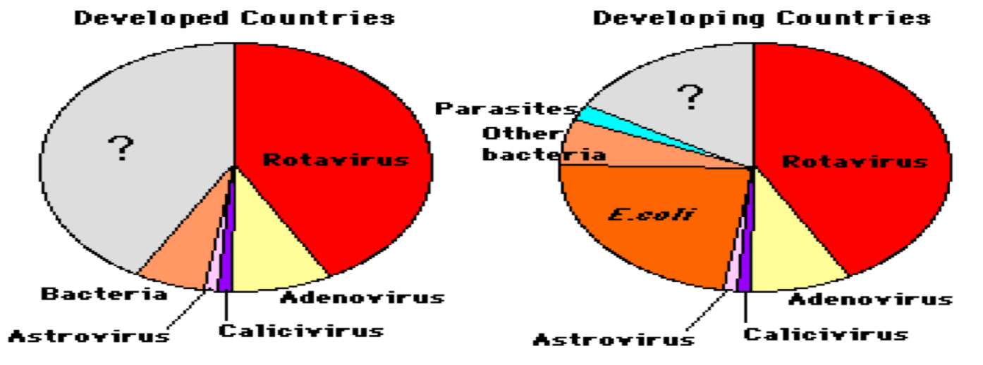
Gastroenteritis:
Definition:
It is inflammation of the gastrointestinal tract which involves both stomach and small intestine and leading to acute diarrhea and vomiting.
Viral etiology:
Rotavirus
Adenovirus 40,41 types
Calcivirus
Astrovirus
Etiologic agents in severe diarrheal illnesses requiring hygiene and rehydration of infants & young children.
Other viruses: Coronaviruses, Toroviruses, and Enteroviruses
Causes: infectious or non-infectious(side effect of some drugs or allergy)

Slide 4
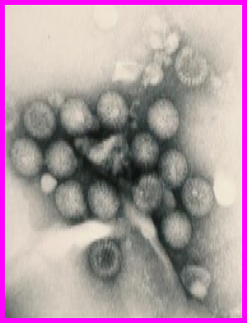
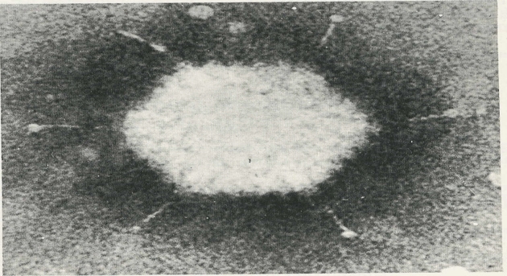
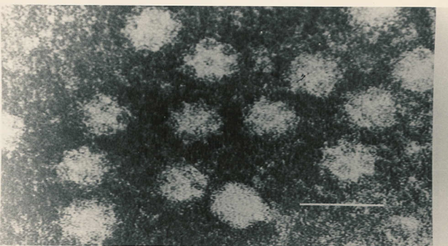
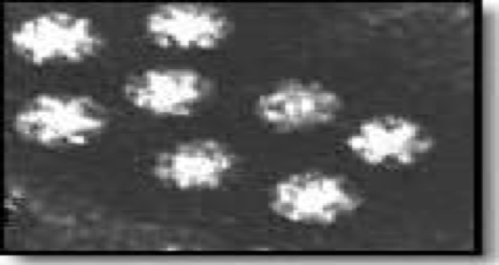
Viral Gastroenteritis:
Viral etiology:
Virus | Rotavirus MOST COMMON | Adenovirus 40,41 types 2nd common | Calicivirus | Astrovirus
Genome | dsRNA | dsDNA | ssRNA (+) | ssRNA (+)
Morphological features | Double shelled with wheel like structure | Classical icosahedral capsid with fibers | Cup like depression on its surface | 5 or 6 pointed star on its surface
Pictures:
-One of the most important exceptions in virology is that all RNA viruses composed of ss genome except rotavirus Common
-characteristics: non enveloped , Icosahedral capsule
Adeno – DNA
Rota – RNA

Slide 5
Epidemiology
Distribution: Worldwide, increased in poor hygiene, over crowding, and poverty
Age: Infants & young children more likely than older children and rarely adults
Transmission: Fecal-oral route through direct or indirect contact or contaminated surfaces
Season: Winter months
Endemic infection: Group A rotavirus & adenovirus serotype 40,41 in children
Epidemic infection: Norovirus in adults “it’s the most common of NON-bacterial outbreaks”
Clinical Features:
IP (incubation period) : Short
Dehydration (major complication) with decrease Na → Life threatening
Winter vomiting disease:
Vomiting > Diarrhea
Calicivirus (especially norovirus)
Diarrhea¹
vomiting
fever
abdominal cramps
Symptoms:
¹ Acute onset of watery non-bloody diarrhea (presence of blood is stool excludes the diagnosis of viral GE)

Slide 6
Lab Diagnosis:
Cell culture (C/C):
Not used because the sample grow poorly (Fastidious) (they require a special technique)
Electron microscopy (E.M):
Catch all tech (Can ”catch all” viruses causing GE with a single examination)
Many disadvantages² so its not used
Specific test: Immunoassay
ELISA for detection of viral Ag in stool samples. [rota , adeno , astro & caliciviruses]
Management:
Treatment: Self-limiting
Rehydration³ and supportive
Prevention: Sanitation⁴ & hygiene measures
No vaccines except for rotavirus
²Expensive , needs specialized technique , specific but not sensitive.
³Oral or IV depending on the severity
⁴Proper disposal of human feces and protection of water supply

Slide 7
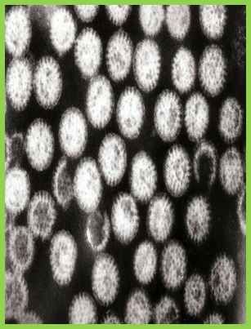
Rotavirus: (most common cause of viral GE)
Family: | Reoviridae [Respiratory & Enteric Orphan]
Description: | 11 segments ds-RNA Double-layered icosahedral capsid Non-enveloped ~ 70 nm RNA – dependent RNA polymerase⁵ 7 groups [A-G] only A-B-C affect humans- Group A → most common 95% of the cases
Epidemiology
Spread (or mode of transmission): | Fecal-oral route | Fecal-oral route through contaminated food or water
Age: | all age groups | all age groups
Symptomatic infection: | mostly in infant 6 -24 ms. | mostly in infant 6 -24 months.
Peak: | Winter months | Winter months
Infection: | Endemic | Endemic
⁵Special enzyme for transcription of mRNA for viral replication

Slide 8
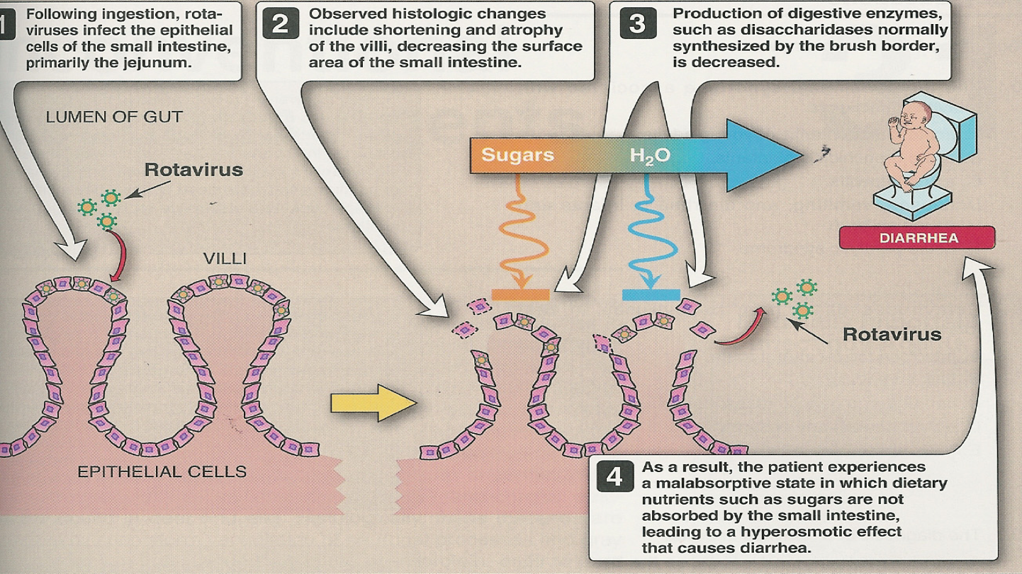
Pathogenesis:
Ingestion of Rotavirus→ affect the epithelial cells (tips of the villi , crypts are not infected) of small intestine (jejunum) →atrophy of villi and decreased production of digestive enzyme (disaccharides )→ sugars are not absorbed and accumulated in the lumen ( leads to increase water level )→diarrhea

Slide 9
Intestinal infection:
gastroenteritis or infantile GE
IP = 1-2 days
Watery, non-bloody diarrhea vomiting & fever
Dehydration
Outcomes→ vary
~1/2 of all GE cases
In developed count.
In developing count.
Deaths
Admission
Mortality is low
Mortality is significant
reported
asymptomatic
chronic diarrhea
Extra-intestinal⁶ infection:
Encephalitis
small number of cases.
Infants & young children:
Older children + adults
Low Immune hosts
Clinical Features:
⁶ In immunocompromised host

Slide 10
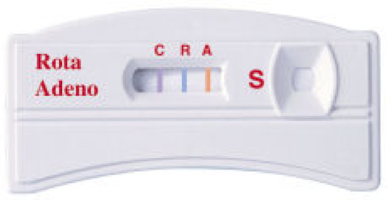
Lab Diagnosis:
Sample: stool
Immunoassay (most used):
ELISA
Immunochromatography & latex agglutination
EM
Gel electrophoresis⁷
RT-PCR⁸
Cell culture
Immunochromatography assay
Management:
Treatment: Self-limiting and rehydration
Prevention: Sanitation & hygiene measures
Vaccine: live attenuated vaccine oral
Rotashield (withdrawn)
Rotarix
RotaTeq
⁷ For typing and grouping of the virus
⁸ Reverse Transcription Polymerase Chain Reaction (Another way or typing more sensitive than gel electrophoresis)

Slide 11
Enteric Adenovirus: (second most common cause of viral GE)
Family: | Adenoviridae
Description: | Non-enveloped icosahedral capsid ds-DNA Only a virus with a fiber protruding from each of the vertices of the capsid
Fiber | Is important for: Attachment Hemagglutinin Type-specific Ag
Classification:
Adenovirus |  |  | Enteric adenoviruses
6 subgenera[A-F] / 7 subgenera[A-G] 51 serotypes / > 50 serotypes Grow in C/C |  |  | Subgenus F 40 & 41 serotypes Fastidious “dosn’t grow in cell culture”
Clinical feature:
Longer IP than rotavirus |  | Less severe than rotavirus |  | Prolonged illness than rotavirus
Diagnosis:
Ag detection in stool samples by ELISA or Immunochromatography Tech.

Slide 12
Calciviruses:
Family: | Caliciviridae [Calyx =cup]
Description: | Non-enveloped ss-RNA with +ve polarity Icosahedral capsid
Two morphologic types:
Typical caliciviruses |  | Small Rounded smooth Structured Viruses
Sapoviruses |  | Noroviruses (most common cause of non-bacterial outbreaks of GE worldwide)
Norovirus (Norwalk virus):
Epidemiology: | Fecal-oral route [water, shellfish(major source)] Outbreaks of GE in schools, camps & cruises All age groups
Clinical features: | Children: vomiting [projectile] Adults: diarrhea
Diagnosis: | Viral Ag in stool samples by ELISA

Slide 13
Astroviruses:
Family: | Astroviridae [astro= a star]
Description: | Non-enveloped ss-RNA with +ve polarity Icosahedral capsid 8 serotypes
Clinical feature:
Mild GE Outbreak of diarrhea <5 ys. (usually endemic)
Lab Diagnosis:
Ag detection in stool by ELISA

Slide 14
QUIZ:
Which of the following is the most common cause of non-bacterial endemic gastroenteritis outbreak?
A)Norovirus B)Rotavirus C)astrovirus
26y/o man with history AIDS , if infected with Rotavirus what would be the most prominent symptom (main complain) ?
A)Asymptomatic B)Gastroenteritis C)Chronic diarrhea
Which of the following has fibers protruding from its capsid?
A)Adenovirus B)Astrovirus C)Rotavirus
Which of the following viruses you can prevent it by vaccination?
A)Adenovirus B)Astrovirus C)Rotavirus
Which of the following is associated with Winter disease?
A)Adenovirus B)Calicivirus C)Rotavirus
Which one of the following is the most common cause on non-bacterial epidemic gastroenteritis outbreak?
A)Norovirus B)Rotavirus C)Adenovirus
B
C
A
C
B
A

Slide 15
SUMMARY:
Etiology | Morphological features | Genome | Epidemiology | Vaccine
1st: Rotavirus most common: GpA Most commen cause viral GE | Double-Shelled With Wheel-Like Structure | ds RNA 11 Segments | -Endemic -Infants & young children | Vaccine; LAV, oral Rotarix RotaTeq*
2nd: Enteric Adenovirus Subgenus F 40,41 types (Fastidious) | Classical Icosahedron with fibers | ds DNA | -Endemic -Less severes -Prolonged illness than rotavirus -Longer IP | -
Calicivirus (Winter vomiting disease) Noroviruses | Cup-Like depression on its surface -has Fiber (for: Attachment Type & specific ag) | ss RNA(+) | -Epidemic inf. -(its the most commen cause of nonbacterial Epidemic (Outbreaks) GE)
Astrovirus | 5 or 6-Pointed Star on its surface | ss RNA(+) | Mild GE
FOR ALL: structer: Nonenveloped, icosahedral Lab diagnosis: Immunoassay: ELISA for detection of viral Ag in stool Treatment: Rehydration Prevention: Sanitation & hygiene measures megor complication : Dehydration Transmission ; Faecal-oral route Clinical Features: Watery, nonbloody D,V & F

Slide 16
THANK YOU FOR CHECKING OUR WORK, BEST OF LUCK!
Hamad Alkhudhairy
Shrooq Alsomali
Rawan Alqahtani
Najd Altheeb
Ghada Alskait
Ghadah Almazrou
Doctors slides

