Slide 1
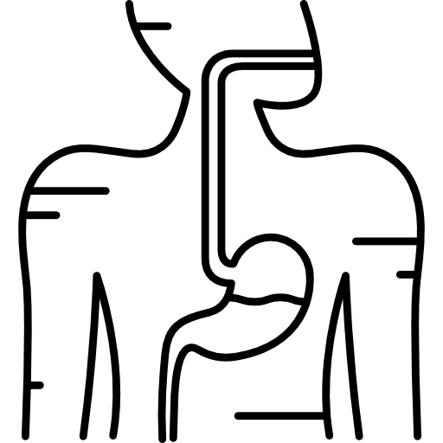
Intestinal Helminths
Editing File
Important
Doctor’s notes
Extra explanation
Only F or only M
"لا حول ولا قوة إلا بالله العلي العظيم" وتقال هذه الجملة إذا داهم الإنسان أمر عظيم لا يستطيعه ، أو يصعب عليه القيام به .

Slide 2
OBJECTIVES:
Name the 3 main groups of parasitic Helminths and their characteristic morphological features.
Know the 5 common examples of Nematodes with their scientific and common names.
Describe the life cycle of these 5 examples of Nematodes with pathology, diagnosis and treatment.
Describe the life cycle of Taenia saginata and T. solium and Hymenolepis nana
Describe the life cycle Echinococcus granulosus and diagnosis
Know treatment of Tapeworms.

Slide 3
Parasitology
PROTOZOA
HELMINTHS
Unicellular
Single cell for all functions
Multicellular (have special cells forms each system)
Specialized cells
Flat worms
Round worms (Nematodes):
- elongated
- Cylindrical
- unsegmented
1- Aoebae:
move by pseudopodia.
2- Flagellate:
move by flagella.
3- Ciliates: move by cilia
4- Apicomplexa (Sporozoa):
tissue parasites (malaria parasite)
Trematodes:
- leaf-like
- unsegmented.
Cestodes:
- tape-like
- segmented.

Slide 4
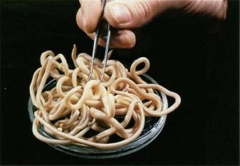
Nematodes
General features | Multicellular Elongated worm, cylindrical, unsegmented and tapering at both ends. Variable in size, measure <1 cm to about 100cm. Sex separate and male is smaller than female
Location in the human body | Intestinal nematodes Tissue nematodes
Common intestinal infections All are imprtant | Enterobius (Oxyuris) vermicularis ** (Pinworm,seatworm,threadworm) Trichuris trichiura (whipworm) Ascaris lumbricoides (roundworm) Ancylostoma duodenale & Necator americanus (hookworms) Strongyloides stercoralis****

Slide 5
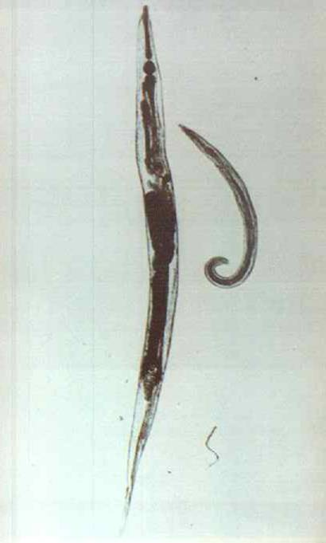
1-Enterobius vermicularis (THREAD WORM) - Enterobiais (Common names: Pin worm, seat worm)
it is a very small parasite Found all over the world but more common in temperate regions, infects only human. Children are more often evolved than adults , it tends to occur in groups living together such as families , army camps or nursery. Adult worms are mainly located in lumen of cecum and the female migrate to rectum to deposits her eggs on perianal skin. Adult worms live in the large intestine. Direct human to human infection occurs mainly by swallowing the eggs . when a child touch the anal part the eggs will be on his hand and it will spread by touch someone's hand. In addition ,autoinfection occurs by contamination of the fingers. It can be seen by naked eye as white thread ± 1cm. Male is smaller than female ± 0.5cm, with coiled end.

Slide 6
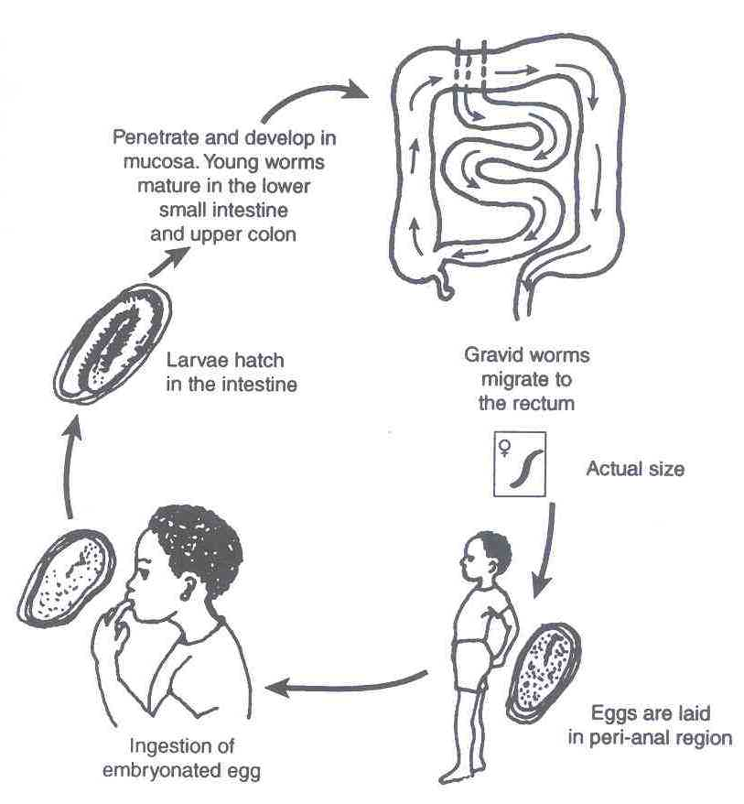
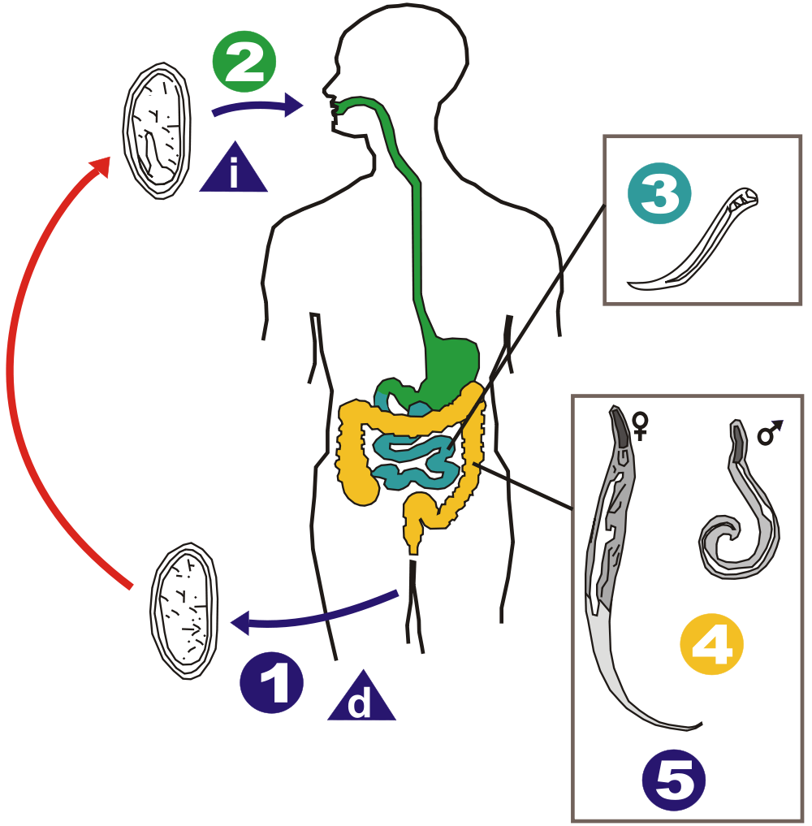
Enterobius vermicularis (Oxyuris)
Pathology | Majority of infections are asymptomatic Main clinical presentation pruritus and which can be very troublesome and occurs more often during the night, persistent itching may lead to inflammation and secondary bacterial infection of the peri-anal region. Infected children may suffer from emotional disturbance because of lack of sleep ,insomnia ,anorexia , loss of weight and loss of concentration and enuresis. Also involuntary urination and the eggs Ectopic enterobiasis occurs in infected adult female when invade vulva and vagina result in valvo-vagintis, salpingitis , also adult worm can lodged in the lumen of appendix cause appendicitis.
DIAGNOSIS | Unlike other intestinal Nematodes, the eggs are not usually found in feces .The best method is to look for them around the anus by taking an anal swab or by using CELLULOSE ADHESIVE TAPE, the examination should be done before defecation or bathing.
Treatm -ent | Albandazole , Mebendazole for whole family (it is not important but you can memorize albandazol for all )

Slide 7
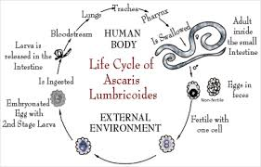
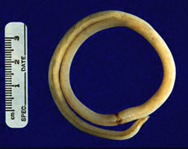
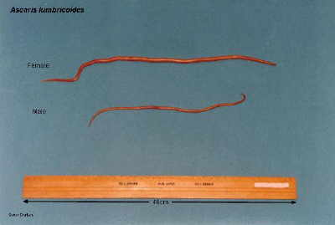
Ascaris lumbricoides (roundworm)
General | Look like spaghetti he commonest human helminthes infection all over the world. HUMAN is the only definitive host. (live as adult ) The largest intestinal NEMATODE of human , which is normally located in the small intestine. | Found in jejunum and upper part of ileum. Female ± 20 cm longer than male ± 10 cm Feed on semi digested food. Causes malnutrition Needs soil area to be in the infective stage
LIFE –CYCLE only in female | It infect only human when man ingest an fertilized egg contaminated with food or water, egg shell is dissolved by digestive juices and a Larva penetrate the wall of the duodenum to the portal circulation for (3dayes) and then from right heart into the pulmonary circulation and stay in the alveoli ,where it grow and molts for (3weeks), then Larva crawl up bronchi, trachea,larynex and pharynx and be coughed up , then swallowed ,returned to the small intestine where it mature to adults male &female ,fertilization take place producing eggs which pass in stool. Unfertilized eggs in the stool →soil area →embryonated egg →Mouth →stomach → small intestine →larva → circulation→lung→mature rich with O2 →pharynx →coughed up →swallowed→intestine→adult and mature male &female
Infective stage is embryonated egg
Diagnostic stage is unfertilized egg

Slide 8
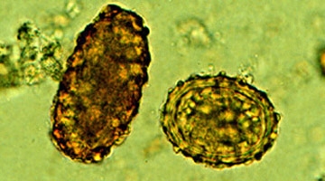
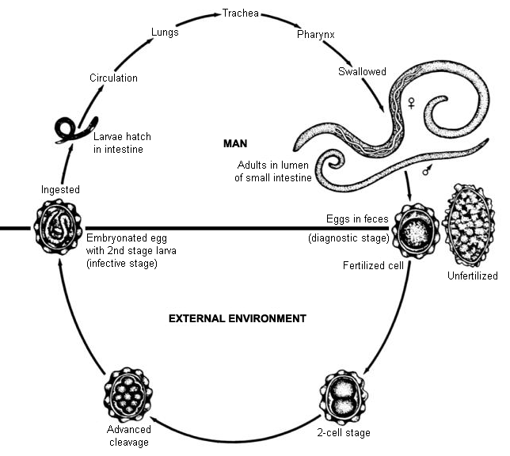
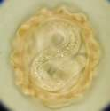
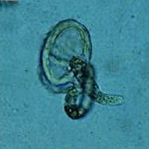
Ascaris lumbricoides life cycle
Ascaris eggs
Ascaris egg (embryonated)
Ascaris larva emerging from egg

Slide 9
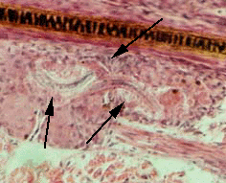
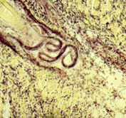
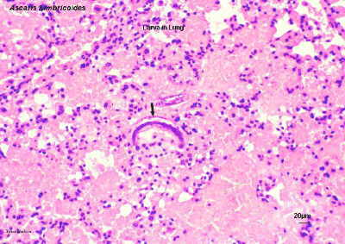
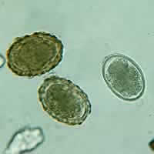
Pathogenicity female only
1-Migrating LARVA : Ascaris pneumonia (Loeffler”s syndrome) , some times LARVA reach aberrant sites like brain ,heart or spinal cord can cause unusual disturbance. |  | 2-Adult WORM: The worm consumes proteins and vitamins from host’s diet and leads to malnutrition. Because it use semi digested food Can cause intussusception (block to the intestine due to movement of the worms and it is an emergency case) , intestinal ulcers and in massive infection can cause intestinal obstruction.
Pathology:
1-Adult worm: (small intestine) Light infection : asymptomatic. Heavy infection : intestinal obstruction Migrating adult : to bile duct -jaundice |  | 2-Larvae: in lung Loeffler`s syndrome Pneumonitis and broncho-spasm, cough with bloody sputum Eosinophilia, urticaria
Diagnosis |  |  | Treatment
-eggs in stool. (unfertilized) -larvae in sputum. -adult may pass with stool. |  |  | Albendazole , Mebendazole
Loeffler`s syndrome: Larvae in lung
pneumonia, cough ,bloody sputum
Ascaris larva in lung

Slide 10
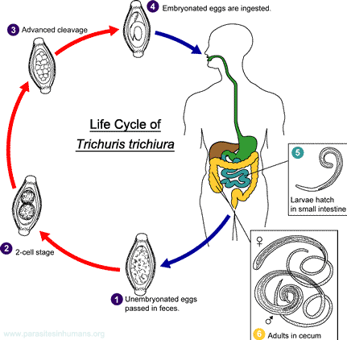
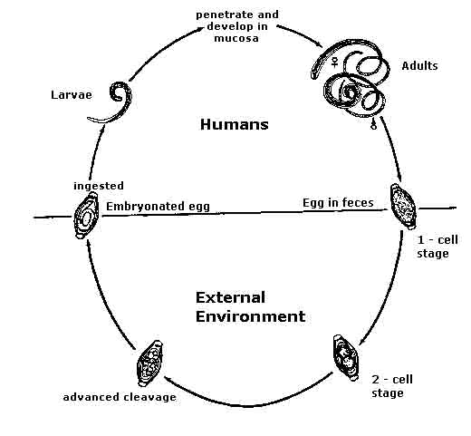
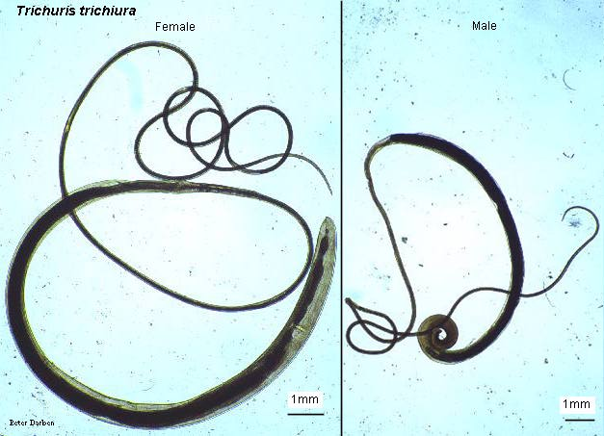
2-Trichuris trichiura (Whipworm)
Infective stage is embryonated egg
Diagnostic stage is egg in stool

Slide 11
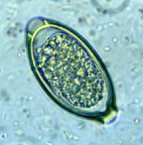
2-Trichuris trichiura (Whipworm)
General | World wide ,common in poor sanitation. Infect only human It coexists with Ascaris because of similar requirement( the eggs to be embryonated egg infective stage it needs to be 3 weeks in the soil). Adult live in large intestine especially caecum and appendix –in heavy infection the whole length of large intestine affected. Male and female worm have narrow anterior portion penetrate the intestinal mucosa
Pathology and Symptoms | light infection : asymptomatic heavy infection :abdominal pain ,bloody diarrhea Rectal prolapsed why? because it live in the large intestine in children is a common complication.
Diagnosis | egg in stool characterized by its barrel shape with mucoid plugs at each pole .
Treatment | Albendazole. (for all helminths)

Slide 12
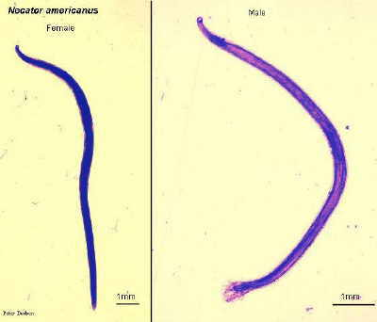
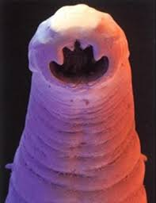
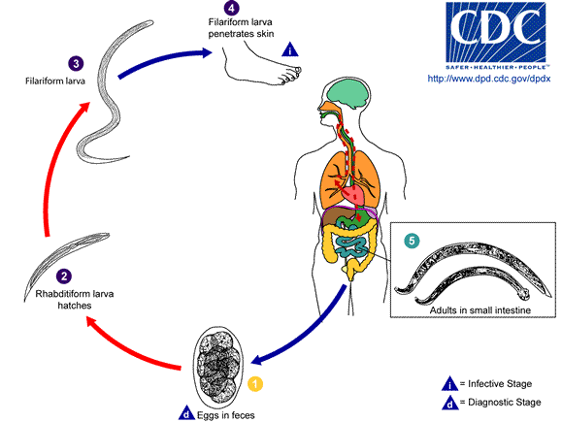
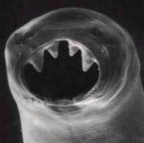
Hook worms (just remember this short name )
Ancylostoma dudenale (in the middle east) &Necator americanus( in US)
Its buccal capsule (mouth) lined with hard hooks, triangular cutting plates and anticoagulant glands.

Slide 13
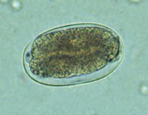
Hook worms Ancylostoma dudenale &Necator americanus
General | Needs soil such as the previous but the difference is we eat ascaris and and whipworm but hook worm inter to the circulation by barefoot Buccal cavity attached to intestinal mucosa There are no specific symptoms or signs of hookworm infection, but they give rise to a combination of intestinal inflammation and progressive iron-deficiency anemia and protein deficiency Filariform Larval (infective stage) invasion of the skin can produce a skin disease called cutaneous larva migrans also known as creeping eruption, this is commonly caused by walking barefoot through areas contaminated with fecal matter. Larva migrate through the vascular system to the lungs, and from there up the trachea, and are swallowed. They then pass down the esophagus and enter the digestive system, finishing their journey in the small intestine where the larvae mature into adult worms. They mate inside the host, females laying up to 30,000 eggs per day , which pass out in feces (diagnostic stage). The eggs need to be in soil for about one week to become FILARIFORM LARVA
Pathology& clinical picture | larvae: At the site of entry of larvae intense itching(ground itch) and dermatitis. Migration phase: cough with bloody sputum pneumonitis and bronchitis but less sever than Ascaris ,eosinophilia urticaria. | Adult worm: low worm burden (INFECTION): no symptoms. Moderate to heavy burden: Epigastric pain, vomiting , hemorrhagic enteritis. Protein loss: hypo-proteinaemia edema. Anemia: due to withdrawal of blood by parasites and hemorrhage from punctured sites lead to sever anemia = microcytic hypo chromic anemia or iron-deficiency anemia
Diagnosis | Eggs in stools.; -occult blood (+)
Treatment | Albendazol, Mebendazole

Slide 14
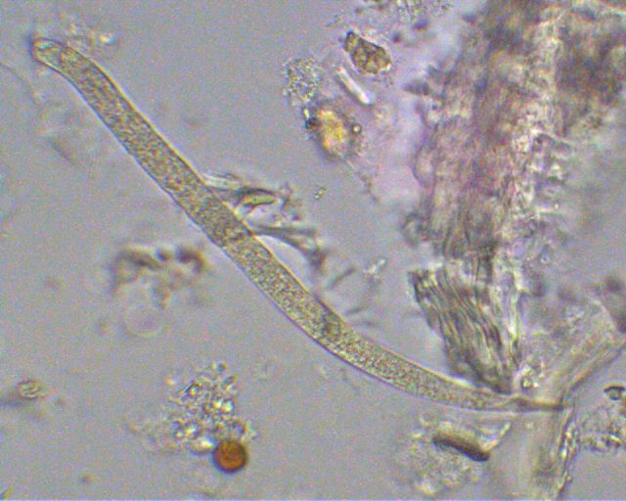
Strongyloides stercoralis
General | World wide ,common in poor sanitation. Widely distributed in tropical area at Asia, Africa & South America . fatal dissemination in immuno-compromised host. Epically HIV patient It is smallest pathogenic nematodes ± 2.5mm. adult live in mucous membrane of duodenum jejunum rarely mucous membrane of bronchus. AUTOINFECTION IS VERY IMPORTANT CRITERIA . There is external and enteral autoinfection
life cycle | The parasite shows 3 different modes of development:
 | 1-Direct development: The rhabiditiform larva pass from stool and become directly a Filariform larva if the environment of the soil is suitable. | 2-Indirect development : in external environment Rh. larva becomes free living adults, produce eggs ,rhabiditiform larva (diagnostic stage) and Filariform larva (Infective stage). |  | 3-AUTOINFECTION: mainly in immunocompromised patients Internal :when the rhabiditiform larva become a filariform larva in the intestine and penetrate the intestine External : fecal contamination of skin –Rh larva > filariform penetrates the skin
Pathology and clinical picture | Cuteneous little reaction on penetration. sever dermatitis at perianal region in case of external autoinfection. Migration :pneumonitis during larval migration. . Intestinal: inflammation of upper intestinal mucosa, diarrhea, upper abdominal pain in the epigastria colicky in nature. Disseminated strongyloidiasis : in patient with immunodeficiency ,uncontrolled diarrhea –granulomatus changes –necrosis--perforation—peritonitis death.
Diagnosis | NO EGG IN DIAGNOSIS rhabditiform larvae diagnostic stage in: -Stool examination -Duodenal aspirate |  | Treatment | Albandazole, Mebendazole

Slide 15
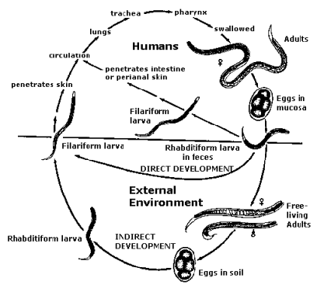
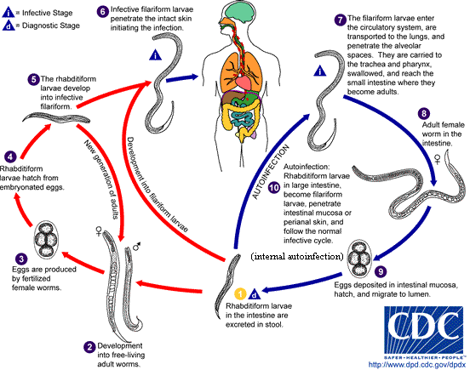
2- Strongyloides stercoralis
Direct : Rhabditiform larva in the stool→ developed directly to adult male & female→ eggs →rabidityform larva →filariform larva (infective stage) →penetrate the skin

Slide 16
Common Tapeworm Infections
DISEASE
TRANSMISSION
OF INFECTION
LOCATION OF ADULT
IN HUMANS
LOCATION
OF LARVA
IN HUMANS
CLINICAL PICTURE
LAB.
TAPEWORM
DIAGNOSIS
Taenia saginata
taeniasis
ingestion of larva in undercooked
beef
Small
Intestine
not present
vague digestive disturbances
eggs or
proglottids
in stools
Taenia solium-
taeniasis
ingestion of larva in undercooked
pork
Small
Intestine
not present
vague digestive disturbances
eggs or
proglottids
in stools
ADULT
Taenia solium-
LARVA
(cysticercus cellulosae)
Cysticercosis
ingestion of egg
not present (except in
autoinfection:
,small intestine)
sub-cutaneous
muscles
brain,eyes
depending on
locality:
from none to
epilepsy
X -ray, CT, MRI
Serology
Hymenolepis nana
hymenolepiais
ingestion of egg
Small
Intestine
Intestinal
Villi
Enteritis
diarrhoea
eggs in
stools
Echinochoccus
granulosus
hydatid disease
ingestion of egg
not present
Liver, lungs,
Bones etc
depending on
locality
X-ray,CT,US
Serology
Hydatid sand

Slide 17
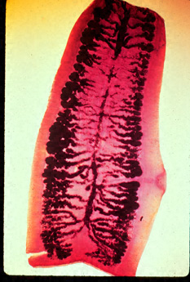
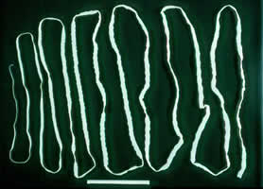
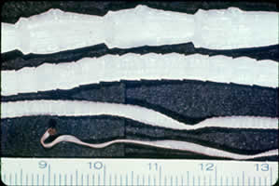
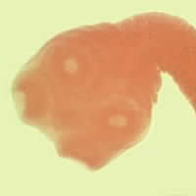
Taenia saginata
Very long but it cut into pieces in the stool while the head is inside the body and regenerate it self and increase its length

Slide 18
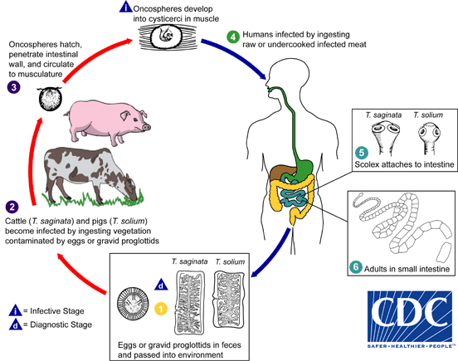
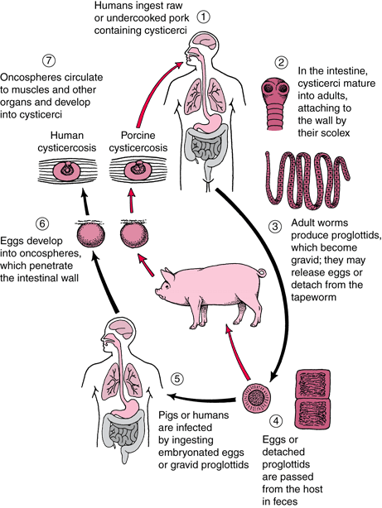
Taenia saginata
General | one of the cestodes Is an obligatory parasite of man ,the adult worm live in the SMALL INTESTINE . CATTLE become infected by ingesting grass contaminated with eggs or gravid segments (womb filled with eggs) which passed from human faeces. In the cattle the onchosphere hatches out go to circulation and transformed to cysticercus stage in the muscle known as CYSTICERCUS BOVIS. Man become infected by eating undercooked or improperly cooked beef which contain cyst , the adult worm lives in small intestine of man passing eggs and gravid proglottids to the environment. Eating the eggs only does not cause infection in taenia saginata only eating undercooked meat containing cyst another type in Europe called taenia solium causes infection by eggs and their will be cyst in the human body and it may radiate to lung or liver or brain and it is dangerous as well the pig when eat eggs of taenia solium will have cyst The majority of cases are Asymptomatic ,some patients have vague intestinal discomfort ,vomiting and diarrhea.
Life cycle of
Taenia saginata

Slide 19
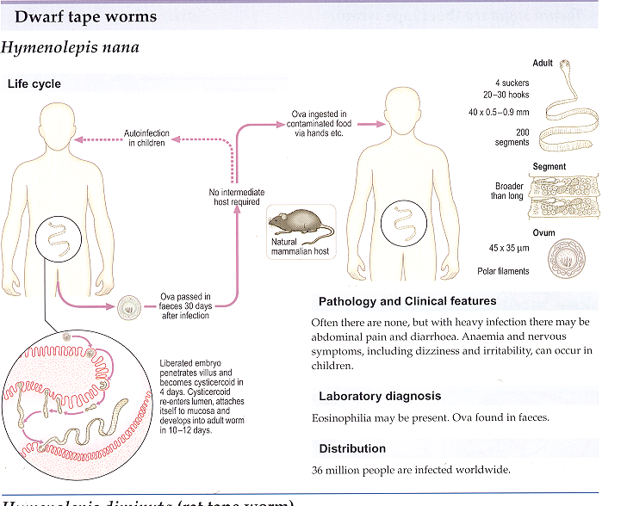
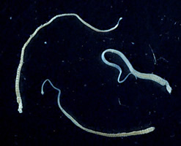
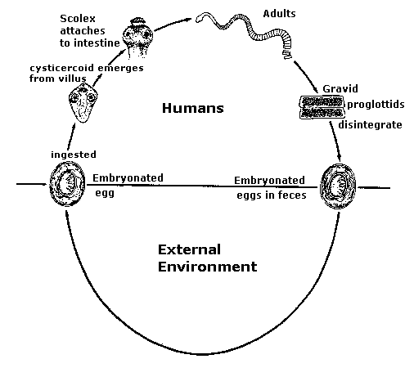
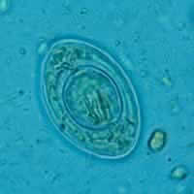
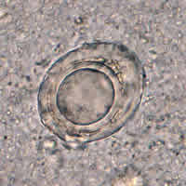
Hymenolepis nana ( you should know ONLY that it is one of the cestodes and infect human and rates)

Slide 20
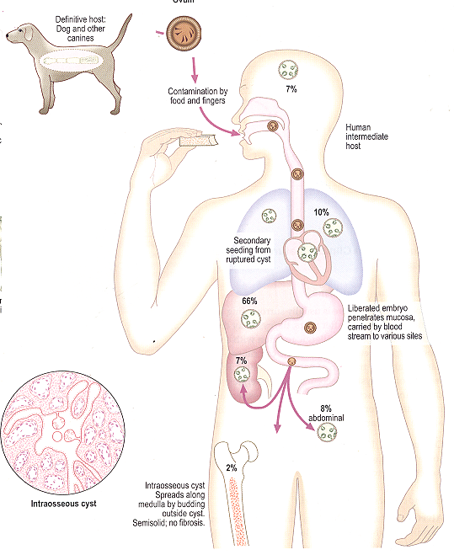
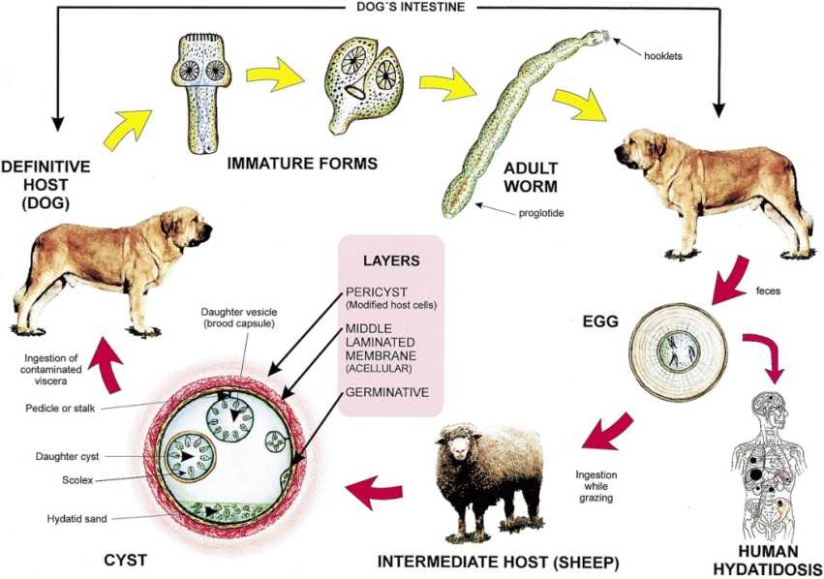
Echinococcus granulousus
Location of hydatid cyst
Echinococcus granulosus

Slide 21
Only female
Echinococcus granulousus dog & sheep (important)
Dog have adult worm→ produce eggs→if human or sheep eat a contaminated food(or grass) with the stool of the dog which have eggs → hydated cyct
If the dog eat the lamb meat (which have hydated cyst) →adult stage parasite
If the human eat the lamb meat (which have hydated cyst) → nothing will happen because human infected only by eating eggs
E. granulosus requires two host types, a definitive host and an intermediate host.
the definitive host of this parasite are dogs
The intermediate host are most commonly sheep, cattle, pigs, goats, and camels and also Humans .
E. Granulosus cyct is ingested and attaches to the mucosa of the intestines in the definitive host and there the parasite will grow into the adult stages
DOG become infected by eating sheep,cattle muscle having hydated cyct which become in the intestine of the DOG as an adult and start releasing eggs witch excreted in the faces .
Human become infected by ingestion of Echinococcus Granulosus eggs, usually by hand-to-mouth contact with infected dog feces. The ingested eggs migrate to the various body tissues, and produce hydatid cysts. The life cycle is terminated at this point Symptoms vary, depending on the location of the cyst in tissues. Although cysts may form in many areas of the body, the lung and the liver are most commonly affected. One serious complication of hydatid cyst disease is the risk of anaphylactic shock, following rupture of the cyst.
.

Slide 22
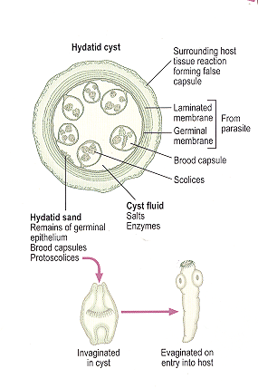
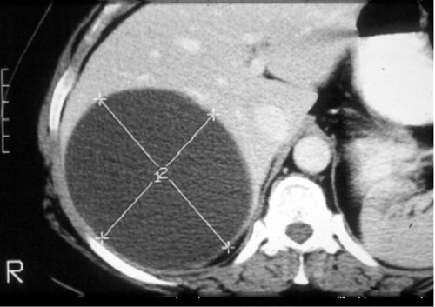
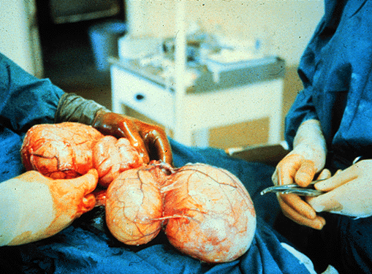
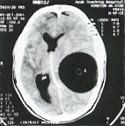
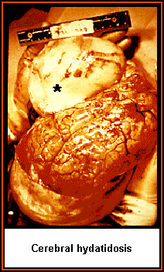
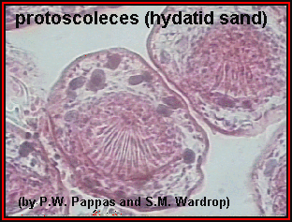
Hydatid cyst

Slide 23
Hydatid cyst
General Only female | hydatid cyst, which may reach larg size , has laminated outer layer, and an inner layer of germinal tissues from which the daughter cysts and brood capsules (smaller cysts containing several developing inverted scolices) bud. The cyst also contains loose pieces of germinal tissue and scolices. This is known as hydatid sand. In addition, there is a great deal of fluid inside the cyst
Diagnosis | Radiological examination: computed tomography (CT), magnetic resonance imaging (MRI) revealed a cystic swelling with smooth outline. Serological examination: to detect specific antibodies ELIZA,CFT. Casoni`s test: it is an intradermal test used to detect immediate hypersensitivity in hydatid disease. Microscopical examination: Hydatid fluid may be withdrawn by the fine needle aspiration and examined under the microscope for scolices or hooklets.THIS IS DANGEROUS PROCEDURE. hydatid sand Usually Radiological examination & Serological examination
Treatment of Tapeworms
Intestinal stages: Praziquantel Tissue stages ( Hydatid , cysticersosis): - Depends on clinical condition : Surgical and/or Albendazole

Slide 24
QUIZ:
Loeffler syndrome is caused by :
Ascaris larva b) Entebius larva c) Trichuris trichiura
Cellulose adhesive tape is used to diagnose which of the following?
Ascaris lumbricoides b) Enterobius vermicularis c) Trichuris Trichiura
Which of the following can give rise iron deficiency anemia?
Hookworm b) round worm c) whip worm
We diagnose Ascaris Lumbricoides by finding ….…. In stool analysis.
Emberyonic egg b) Larva C) unfertilized egg
Wich of the following Nematodes is fatal for pts. On chemotherapy?
Ascaris b) Enterobius c) Strongyloids
What do you expect to see in stool analysis of pt. with strogyloids?
Eggs b) Rhabditiform larva c) Filariform larva
7. Cattle develops Cycticercus Bovis I their muscle by ingesting which of the following ?
Taenia Saginata b) Taenia Solium c) Hymenolepis nana
Human can get hydatidosis by ingesting which of the following?
a) Taenia Saginata b) Taenia Solium c) Echinococcus granulousus
A
B
A
C
C
B
A
C

Slide 25
SUMMARY:
Helminths | Group commonly infected | location | Method of infection | Diagnosis method | Clinical signs | Extra
Enterobuis Vermicularis | In tempered region Mostly kids | Large intestine Lumen of cecum | Fecal oral Autoinfection through fingers | Cellulose adhesive tape | Pruritus ani Emotional disturbances enuresis | Females lay their eggs on anal skin
Ascaris Lumbricoides | Humans are the only host | Small intestine | Through embryonated eggs | Unfertilized eggs | Feed on semi digested food >> malabsorption | Must have soil to thrive
Trichururis truchiura | -- | Large intestine, cecum, appendix | Embryonated eggs | Eggs in stool | -- | Need soil to be fertilized
Hookworm | -- | Invades the skin | Filariform larva Walking barefoot | Eggs in stool | Iron deficiency anemia Micocytic hypochromic anemia | Has cutting plates and anticoagulant glands
Strogyloides Sterocoralis | Immunocompro-mised patients Asia, Africa, and S America | -- | Flariform larva autoinfection | Rh. Larva No eggs | -- | --

Slide 26
SUMMARY:
Tapeworms | location | Method of transmission | Infective organism | Diagnostic organism | diagnosis | treatment
Taenia saginata | Small intestine | Cattle: infected grass Humans: undercooked meat | Cysticerci in muscle | Eggs or gravid proglottidis | -- | --
Taenia Solium | Liver, brain, lungs | Eating undercooked pork | -- | -- | -- | --
Echinochoccus granulosus | -- | Infected sheep eaten by dog which spreads it to humans | -- | -- | Radiology, serology, casoni’s test, and microscopically (dangerous!) | Intestine: praziquantel Tissue: surgery and albendazole

Slide 27
THANK YOU FOR CHECKING OUR WORK, BEST OF LUCK!
Hamad Alkhudhairy
Shrooq Alsomali
Safa Alosaimi
Wejdan Alzaid
Leen Altamimi
Najd Altheeb
Jumana alghtani
Doctors slides

