Slide 1






LECTURE: Intestinal Protozoa
Editing File
Important
Doctor’s notes
Extra explanation
Only F or only M
"لا حول ولا قوة إلا بالله العلي العظيم" وتقال هذه الجملة إذا داهم الإنسان أمر عظيم لا يستطيعه ، أو يصعب عليه القيام به .

Slide 2
OBJECTIVES:
Know morphology of cysts and trophozoits of Giadia lamblia parasites
Describe life cycle of Giardia parasites
Describe Giardia trophozoits in tissue sections
Discuss the clinical picture of Giardia parasites (Typical and Atypical).
How to diagnose Giadia in the labs
Know the chemotherapy against Giardia parasites.
Summarize general features of Intestinal Entamoebae.
Know the six types of Entamoebae.
Compare between E. histolytica and E. dispar.
Describe Life cycle of E. histolytica
Discuss Pathology of E. histolytica (intestinal and extra-intestinal).
Diagnosis and treatment of Amoebae
Life cycle of Cryptosporidium and diagnosis

Slide 3
Classification Of Parasites
PROTOZOA | HELMINTHS
Unicellular Single cell for all functions | Multicellular Specialized cells
1) Amoebae: move by pseudopodia. 2) Flagellates: move by flagella. 3) Ciliates: move by cilia 4) Apicomplexa (Sporozoa) tissue parasites | Round worms (Nematodes): - elongated, cylindrical, unsegmented. Flat worms : - Trematodes: leaf-like, unsegmented. - Cestodes: tape-like, segmented.

Slide 4
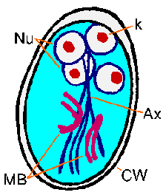
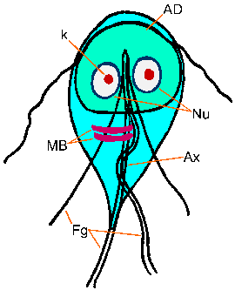
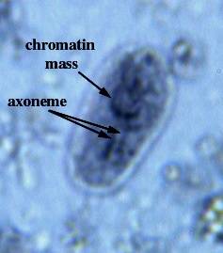
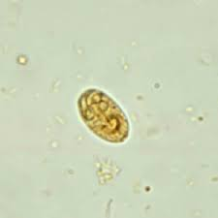
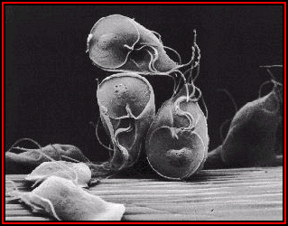
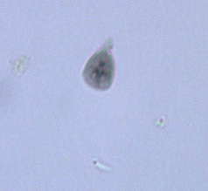
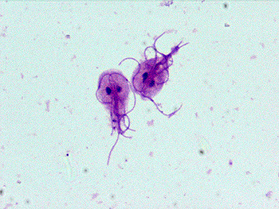
Giardia Lamblia
2 stages:
CYST
Infective stage why? Because it can resist the acidity of the stomach
Multi-nucleated
TROPHOZITE
Die in the stomach because of high acidity
Replicative stage
2 nuclei & adhesive disc
8 flagella
Diagnostic stage : both cyst and trophozite
Giardia trophozoites
(SEM)
Giardia trophozoites (light microscope)
Giardia cyst (light microscope)

Slide 5
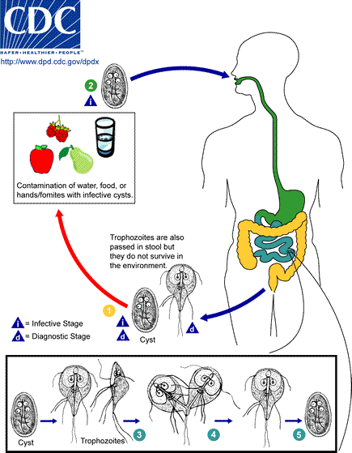
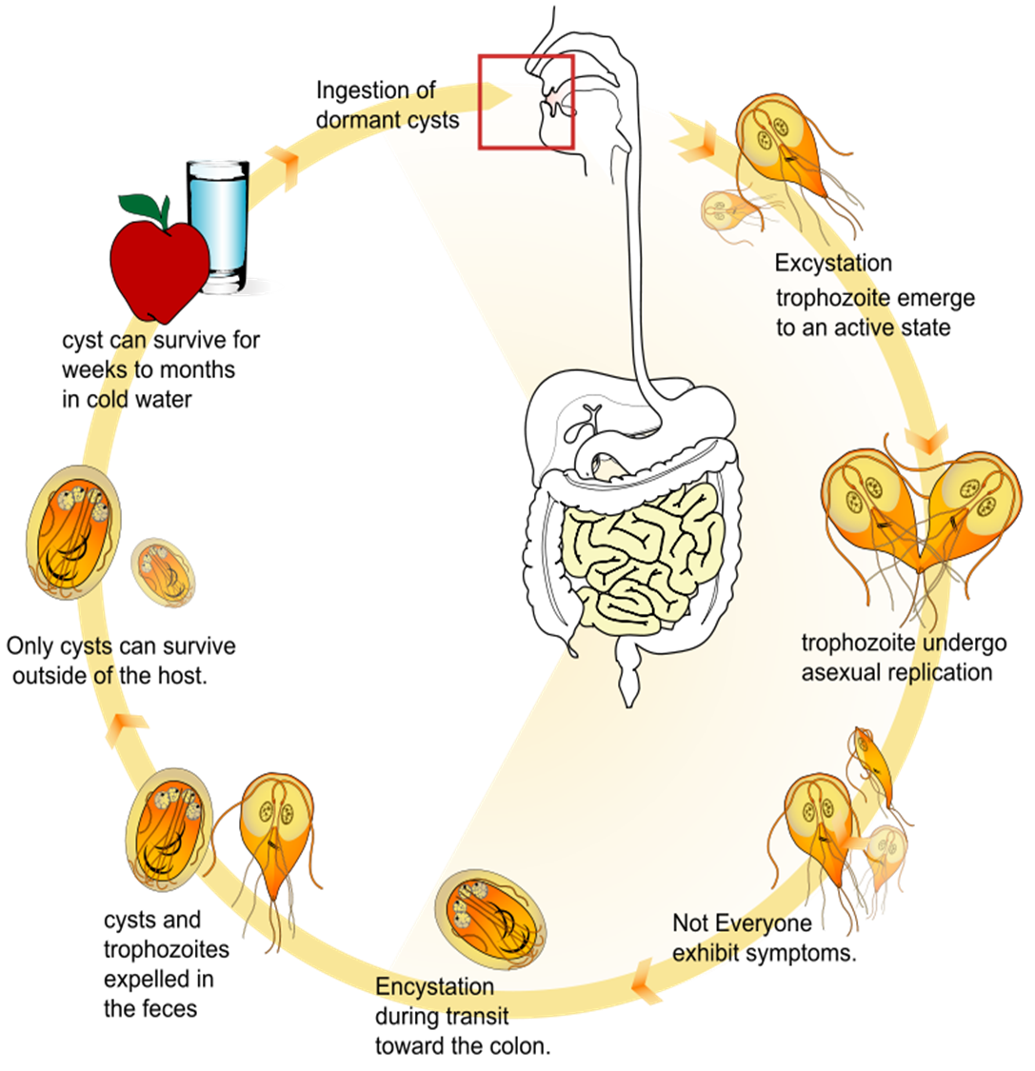
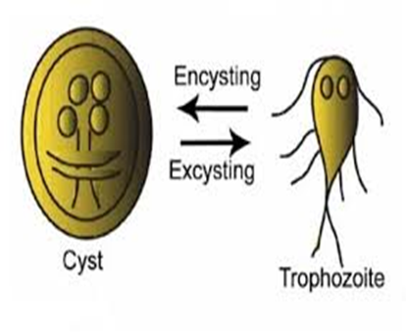
Giardia Lamblia Life Cycle
Only on the female slides
Ingestion of food containing cyst →intestine→ trophozoite → comes out in the stool cyst or trophozite → only cyst can live in outside environment

Slide 6
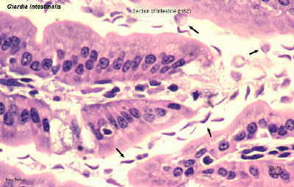
Giardiasis
Clinical Picture
The parasite mostly asymptomatic or can produce a wide range of gastrointestinal symptoms especially in children.
Symptomatic Infections:
Typical picture: IP 1-2 wks followed by diarrhea, vomiting & flatulence for about 6 wks,
Atypical: Severe diarrhea, malabsorption (especially in children) and cholecystitis.
Laboratory diagnosis
Stools examination:
Microscopy for cysts or trophozoits why? Because diagnostic stage are both
Detection of Giardia antigens in stools
Examination of duodenal contents: trophozoites
because the pathogenesis and inflammation due to trophozoid but
the infective stage is cyst
Chemotherapy
Drug of choice: Metronidazole
Giardia trophozoites in tissue section Seen by duodenal aspirate

Slide 7
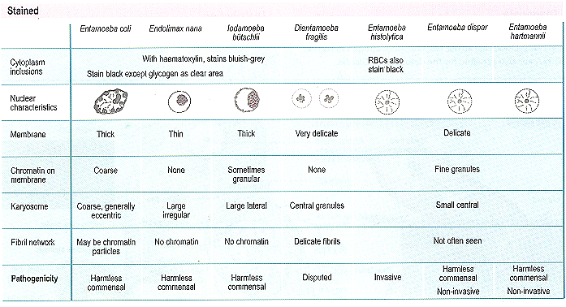
Intestinal Amoebae

Slide 8
Entamoeba Histolytica
Ameba is protozoa, unicellular and it can move by pseudopodia
500 million people are infected. 100,000 deaths per year. Worldwide distribution but is seen more often in tropical countries with poor sanitary conditions. It is a waterborne infection.
There are 6 species of Entamoeba: (important)
E.histolytic
E.dispar
E.hartmanni
E.coli
E.gingivalis
E.polecki
Entamoeba histolytica:
Amoebae that are pathogenic and invasive.
The 2 amoebae can’t be distinguish by microscopic observation.
E. dispar :
The nonpathogenic, non invasive form.

Slide 9
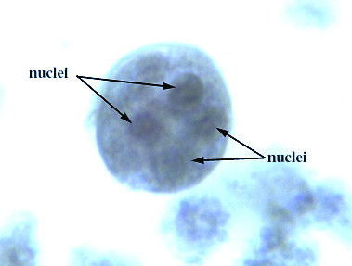
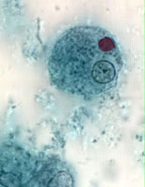
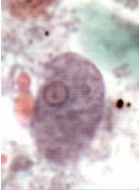
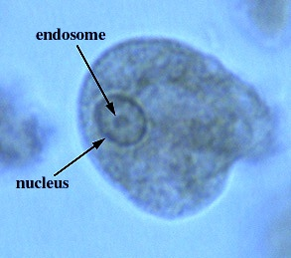

Entamoeba Histolytica
Trophozoite:
vegetative stage,
must encyst to survive in the environment.
It is a fragile structure.
Cyst:
infective stage and diagnostic as well
Resist the harsh conditions of the environment.

Slide 10
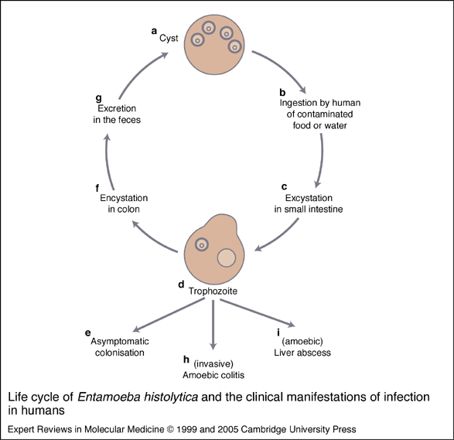
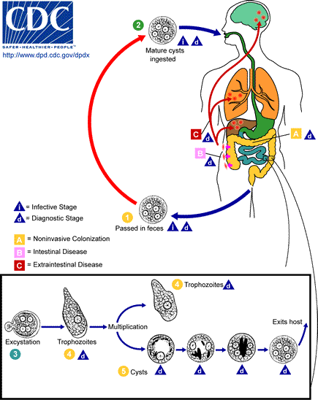
Entamoeba Histolytica
Entameba: infective and diagnostic stage are cyst
It is highly infectious even if you eat 1 cyst it will affect you
Asymptomatic colonisation: in High immunity individuals , protect himself and affect others by spread the infection

Slide 11
Entamoeba Histolytica
Mode of infection (faecal-oral route)
    Water, food
    Flies can act as vector..
    Can be sexually transmitted person to person contacts (cancel this point ! Because it is very very rare)
    Not a zoonosis
The infective dose can be as little as 1 cyst.
The incubation period can be from few days to few weeks depending on the infective dose. If the TROPHOZOITE is ingested it is disintegrates in the stomach without producing infection.
Excystation occurs in the lower region of the small intestine and then production of 8 small amoebae which enter the large intestine and may: (1) invade the tissue, (2) live in the lumen of large intestine without invasion, or (3) encyst (become a cysts and pass in the stool).
Only the Cysts can survive in the environment for weeks at appropriate temperature and humidity after excreted from stool of infected patients.
Tenia solium can make cyst in liver, lung , brain and muscle AND ameba can make 1- intestinal disease : intestinal ulcers in the large intestine 2-extraintestinal disease: radiate to liver, lung and brain

Slide 12
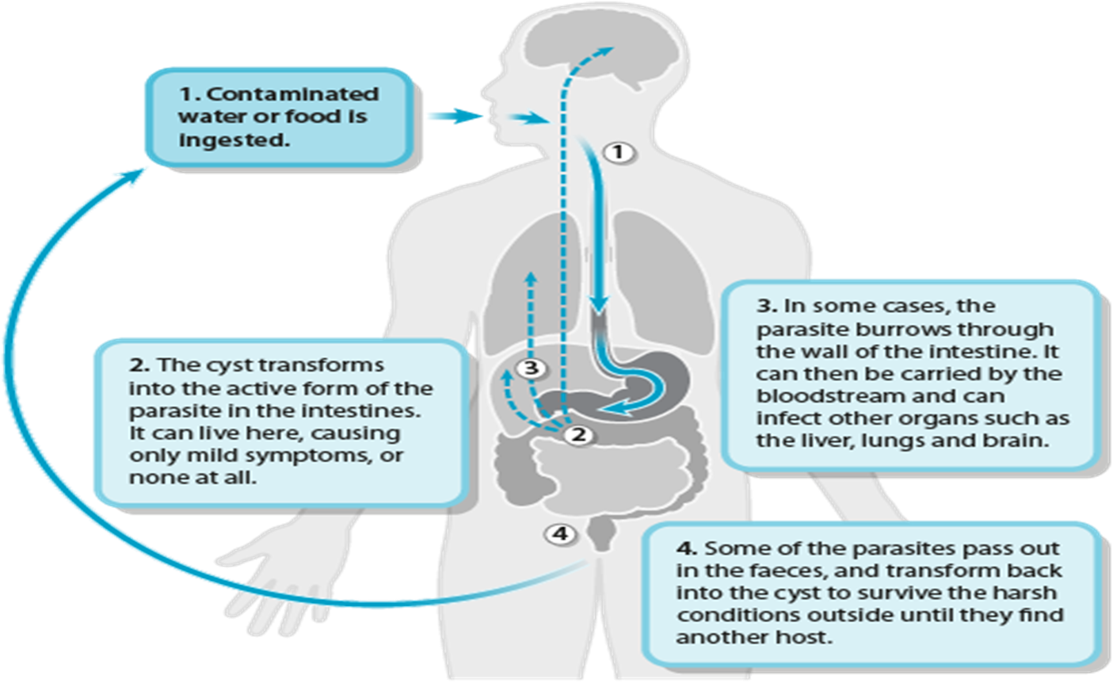
Entamoeba Histolytica
Only on the female slides
Intsetinal amoebiasis (Acute amoebic dysentry) :
Trophozoite has the ability to hydrolyze host tissues with their active enzymes present on the surface membrane of the trophozoite, also trophozoite has the ability to ingest blood cells. =Invasion+ anemia
The presenting symptom is diarrhea which is accompanied by blood, mucus and sometimes tenesmus (difficulty in passing stool)
As a complication, severe intestinal hemorrhage or rarely perforation may occur, lesions are found in cecum, appendix or colon.
They may heal. If perforation of the colon occurs, this may lead to peritonitis that can lead to death.
Amoeboma: Granulomatous mass obstructing the bowel.

Slide 13
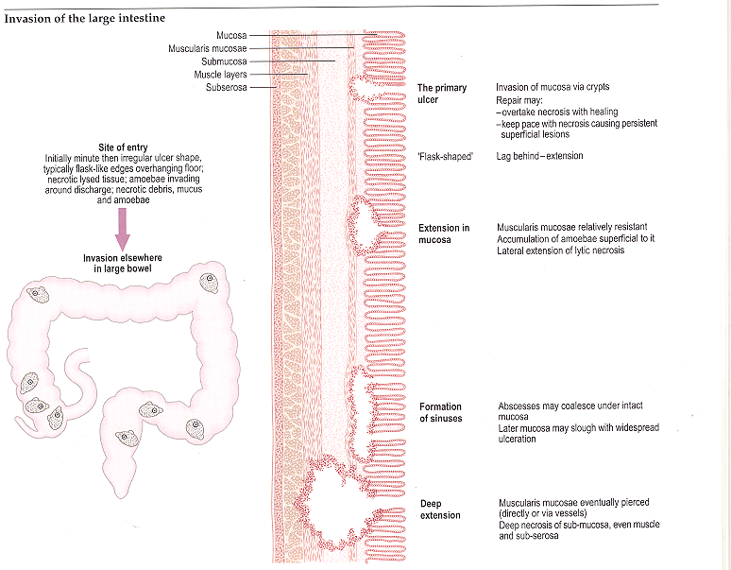
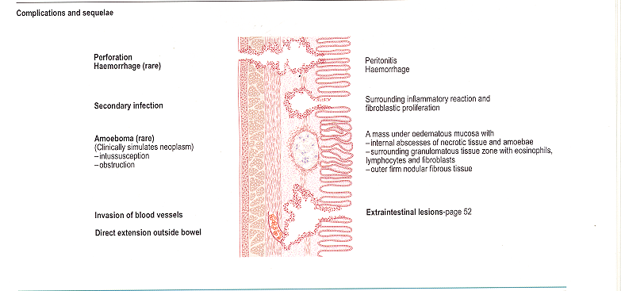
PATHOLOGY: Intestinal amoebiasis
Complications
In the large intestine the ameba may cause ulcers or deep ulcers and form a sinus

Slide 14
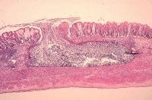
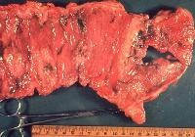
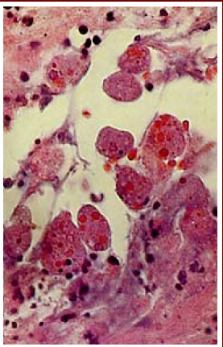
PATHOLOGY: Intestinal amoebiasis
Flask shape ulcer in large intestine
Entamoeba histolytica
E. Histolytica in mucosa.
Numerous trophozoites can be seen with ingested erythrocytes.

Slide 15
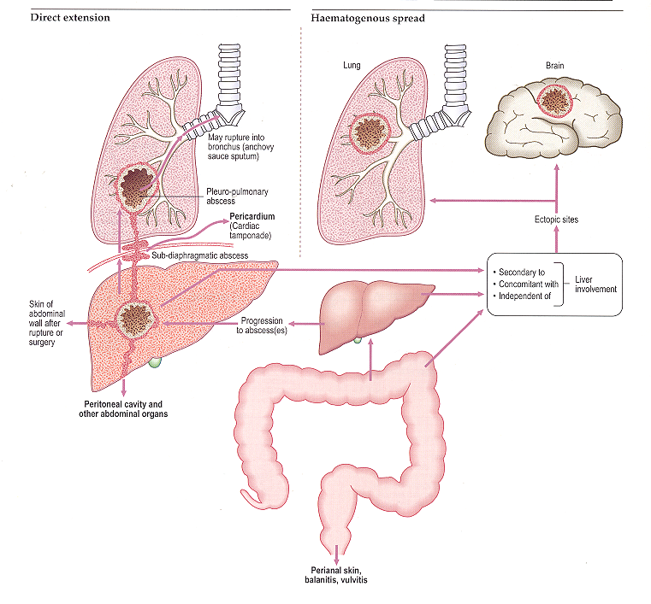
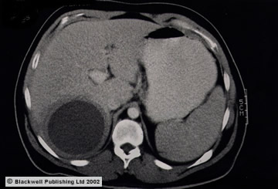

PATHOLOGY: Extra-Intestinal amoebiasis
A 30-year-old male experienced diarrhea for two weeks with fever of 39° C, nausea, vomiting, malaise and right upper abdominal pain (liver) . Physical examination revealed hepatomegaly (increase in size) 6 cm below the right costal margin. CT scan showed a single hypodense mass in the rigth lobe of 7.8 x 5.2 cm, round, with well defined borders. Serology was positive for Enamoeba histolytica at 1/512.
Amebic liver abscess was diagnosed.

Slide 16
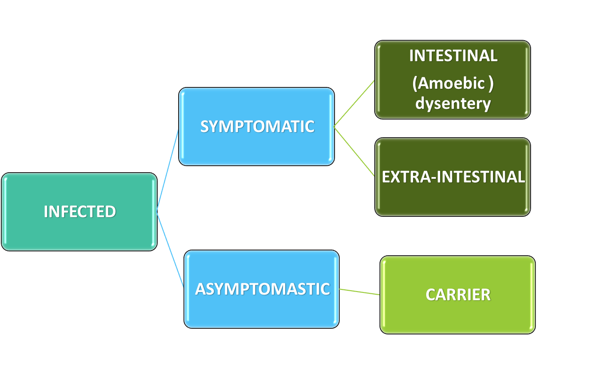
Amoebiasis: Entamoeba histolytica
Clinical Outcome:
Carrier: Remain a good health but produce cysts in the stool
 | Main drugs for treatment: | Laboratory Diagnosis of Amoebiasis
Intestinal | Asymptomatic (cysts only): diloxanide furoate (furamide) Symptomatic (cysts and trophozoites): metronidazole | Stools examination : Wet mount (cysts and trophozoites) Concentration methods (only cysts) Serology (mainly for invasive infections): IHA , ELISA
Extra-intestinal | Metronidazole | Serology: IHA , ELISA Microscopy of tissues or fluids also xray

Slide 17
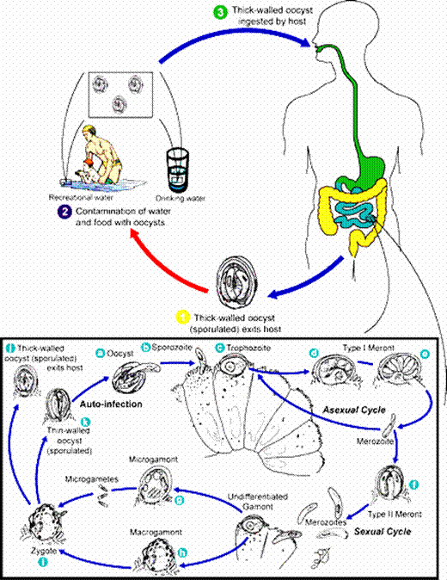
Cryptosporidium Parvum
Usually nit pathogenic but turned to be in immunocompromised patients epically AIDS
Infection is caused by ingestion of sporulated oocysts transmitted by the faecal-oral rout
Infection is generally self-limiting in immunocompetent people. In immunocompromised patients, such as those with AIDS or those undergoing immunosuppressive therapy, infection may not be self-limiting, leading to dehydration and, in severe cases, death.
Treatment
The most effective way to prevent the spread of C. parvum is to avoid contact with contaminated feces. Avoiding this contact, especially with young children, Hygiene is the most effective way to combat this difficult-to-prevent parasite
Self-limited in immunocompetent patients
In AIDS patients: paromomycin
STAIN : ziehl-neelsen stain
Female only
Female only

Slide 18
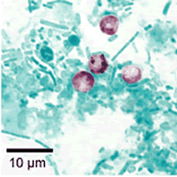
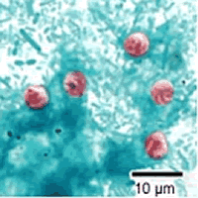
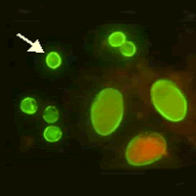
Cryptosporidium Parvum: Diagnosis
Cryptosporidium oocyt in feces by acid-fast stain
Cryptosporidium, safranin ziehl-neelsen
Crypto-Gardia FAT

Slide 19
SUMMARY:
Protozoa | Life cycle | Pathogenesis | Symptoms | Investigation and treatment
Giardia Lamblia (Unicellular, move by flagella) | Ingested food contaminated with cysts (infective stage=cyst) resists harsh environments (causes pathogenesis=trophozoites) (Diagnostic stage=Cyst+Trophozoites) | Asymptomatic or symptomatic (typical or Atypical) | Typical: IP 1-2 wks followed by diarrhea ,vomiting &flatulence for about 6 wks Atypical: Severe diarrhoea , malabsorption especially in children and cholecystitis. | Metronidazole
Entamoeba: (Unicellular, move by pseudopodia) 1- E.histolytica (pathogenic) + 5 other nonpathogenic | Waterborne infection -The infective dose can be as little as 1 cyst. -Fecal>Oral route (infective stage=Cyst) resists harsh environments (replicative stage=Trophozoites) (Diagnostic stage=Cyst) | Excystation in lower small intestines > production of amoebe in large intestine which will: 1-Invade tissue (extra-intestinal) 2-Live in lumen of Large intestines 3-Encyst Symptomatic: -Intestinal amoebiasis -Extra-intestinal amoebiasis (liver, lung, brain) Asymptomatic: Carrier | -diarrhea with blood, Mucus and sometimes Tenesmus Complication: -Severe intestinal hemorrhage or perforation -lesions in cecum , appendix, Colon>can lead to peritonitis -Granulomatous mass obstructing the bowel -Ulcer and fistulas | -intestinal: Stool examination, Serology -Extra-intestinal: Serology, microscopy of tssues or fluids Drugs: -Symptomatic intestinal+ extra-intestinal: Metronidazole
Cryptosporidium Parvum | Ingestion of oocysts by fecal-oral route | Nonpathogenic in immunocompetent, only in immunocompromised (AIDS) | infection may not be self- limiting, leading to dehydration and, in severe cases, death (in immunocompromised) | Not important

Slide 20
QUIZ:
1. Which of the following protozoa is self-limiting?
Giardia Lamblia b) Entamoeba Histolytica c) Cryptosporidium pavum
2. The infectious stage of giardia lamblia is:
Cyst b) Trophozoite d) both
3. What is the best stain used for cryptosporidium diagnosis?
a) H&E stain b) Zeihl-neelsen c) silver stain
4. Atypical symptom of giardiasis is:
Diarrhea b) Malabsorption c) Vomiting
5. Which of the following species of Entamoeba is pathogenic?
E. histolytica b) E. dispar c) E. gingiralis
6. Which of the following forms of E. histolytica can cause infection when ingested?
a) Cyst b) Trophozoite c) Both
C
A
B
B
A
A

Slide 21






THANK YOU FOR CHECKING OUR WORK, BEST OF LUCK!
Hamad Alkhudhairy
Shrooq Alsomali
Safa Alosaimi
Jawaher Abanumy
Leen Altamimi
Amal Alshaibi
Jumana Alghtani
Doctors slides

