Slide 1






LECTURE: Salmonella & shigella
Editing File
Important
Doctor’s notes
Extra explanation
Only F or only M
"لا حول ولا قوة إلا بالله العلي العظيم" وتقال هذه الجملة إذا داهم الإنسان أمر عظيم لا يستطيعه ، أو يصعب عليه القيام به .

Slide 2
Objectives :
1-Develop an algorithm using biochemical tests to
identify and classify Salmonella and Shigella
2- Describe the antigenic structures and virulence factors of Salmonella and Shigella
3- Compare the pathogenesis of various species of Salmonella and Shigella
4-Describe the clinical features and risk factors for the infection with the two organisms
5- Describe the general concepts for the management of gastroenteritis caused by both organisms.

Slide 3
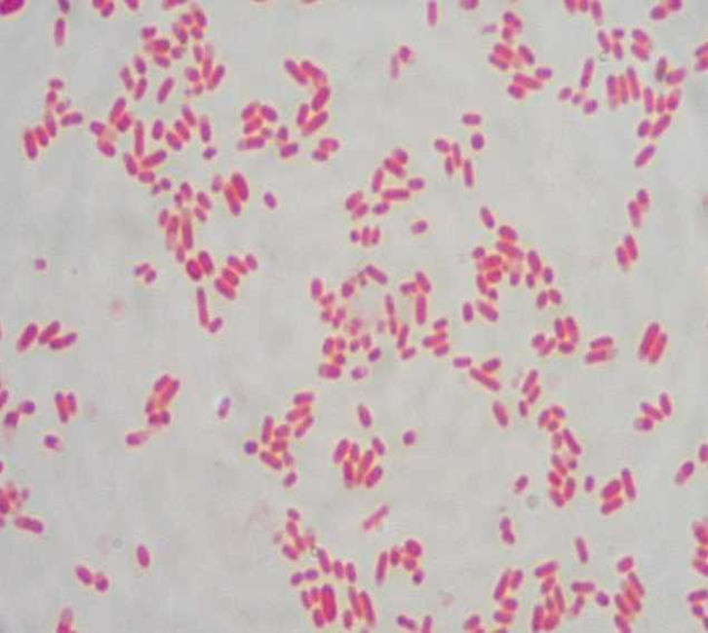
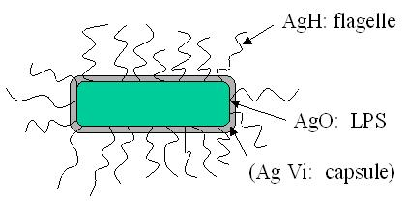
Salmonella
introduction | Gram negative facultative anaerobic bacilli Non lactose fermenting colonies Motile highest during the rainy season in tropical climates and during the warmer months in temperate climates.
Classification | Has two species: S.enterica (six subspecies I, II, III, IV, V, VI) S.borgori (rare) “doctor note: S.Non typhe : Cold blooded animal, birds, rodents, turtles, snake and fish” “doctor note: S.Typhe : human transmission”
Virulence factors | Fimbria for adherence ( reason for bacteremia ) Enterotoxin Endocytosis: SPI 1 T3SS / TLR Replication in microphage
Antigenic structures | O. somatic antigen H. flagellar antigen ( motile ) K. capsular antigen Vi (V=virulent) surface polysaccharide antigen in Salmonella serotype typhi (virulence) prevents phagocytosis & allow intracellular survival O Antigen (Heat – stable) is lipopolysaccharide in the outer membrane A,B,C1,C2,D,E H-antigen (Heat labile)
Have flagella

Slide 4
Clinical features
Acute gastroenteritis Typhoid fever Non-typhoidal bacteremia Carrier state following Salmonella infection
source
Water food and milk contaminated with human or animal excreta Salmonella typhi and S. paratyphi , the source is human
Gastroenteritis
Food poisoning through contaminated food S. enterica subsp. Enterica the common cause Source poultry الدواجن, milk, egg & egg products and handling pets Infective dose 10⁶ bacteria It needs large number of bacteria to start the disease IP 8 – 36 hrs. IP 12-48 hrs fever, chills, watery diarrhea and abdominal pain, self limiting in immunocompetent In sickle cell, hemolytic disorder and ulcerative colitis, elderly or very young patient the infection may be very severe. Require treatment. May cause septicemia or meningitis in the young patient Patient At high risk for dissemination & antimicrobial indicated

Slide 5
Enteric fever(Typhoid fever)
Prolonged fever Bacteremia Involvement of the reticulo endothelial system (liver, spleen, intestines and mesentery) Dissemination to multiple organs Ingestion of contaminated food by infected or carrier individual Caused by Salmonella serotype typhi or S. paratyphi A, B and C (less severe) Common in tropical , subtropical countries, and travelers to these countries due to inappropriate sewage disposal and poor sanitation. IP : 9 – 14 days.
First week:
fever, malaise, anorexia, myalgia and a continuous dull frontal headache then
Patient develops constipation
Mesenteric lymph node → blood stream liver, spleen and bone marrow
Engulfment of Salmonella by mononuclear phagocytes (multiply intercellularly)
Bacteria Released into the blood stream again that can lead to high fever (blood culture positive)
Stages are important
Second and third week:
Sustained fever, prolonged bacteremia
Invade gallbladder and payer's patches
Rose spots 2nd week of fever
Billiary tract →GIT
Organism isolated from stool in large number

Slide 6
COMPLICATION
Necrotizing cholecystitis Bowel hemorrhage and perforation Pneumonia and thrombophlebitis Meningitis, osteomyelitis, endocarditis and abscesses.
Can effect any organ
ANTIBIOTIC & MANAGEMENT
Enteric fever: Ceftriaxone Ciprofloxacin Trimelhoprim – Sulfamethoxazole Ampicillin Azithromycin or Ceftriaxone from patients from India and SE Asia due to resistance of strains. Ciprofloxacin from patients from other areas. Salmonella gastroenteritis: uncomplicated cases require fluid and electrolyte replacement only.

Slide 7
Shigella
CLINICAL INFECTION | Non lactose fermenter gram negative bacteria Cause bacillary dysentery ( blood, mucus and pus in the stool) S.sonnei most predominant in USA ( fever, watery diarrhea) from pork Young adult ( man who have sex with man) S.flexneri 2nd most common developing countries ( homosexual ) S. dysenteriae most common S. dysenteriae and S. boydii are most common isolates in developing countries S. dysenteriae type 1 associated with morbidity and mortality. Very serious infection Human is the only reservoir
ANTIGENIC STRUCTURE | Has 4 species and 4 major O antigen groups: S.dysenteriae, S.flexneri. S.boydii & S.sonnei. All have O antigens some serotype has K antigen ( heat labile removed by boiling) Shigella are non motile, lack H antigen
TRANSMISSION | Person to person through fecal –oral route Flies, fingers ( have a role in spread). Food and water Young children in daycare, people in crowded area and anal oral sex in developed countries Low infective dose < 200 bacilli ( can be transmitted easily unlike salmonella (More serious and virulent than salmonella Penetrate epithelial cells leads to local inflammation, shedding of intestinal lining and ulcer formation. Usually not go deep so no bacteremia due to rarely invading the blood
SYMPTOMS | High fever, chill, abdominal cramp and pain accompanied by tenesmus, bloody stool with mucus & WBC IP : 24 - 48 /72 hrs

Slide 8
COMPLICATION
Can lead to rectal prolapsed in children Complication ileus, obstruction dilatation and toxic mega colon Bacteremia in 4 % of severely ill patient Seizures, HUS (hemolytic uremic syndrome)
Lab diagnosis of Salmonella & Shigella in stool
Both are Gram negative bacilli Culture in selective media (selenite enrichment broth media MAC, SS and XLD,HEA BS0) Biochemical tests Motility test Serology for serotypes, Sero-grouping based on O and H antigen 1- sereny test
TREATMENT
Antibiotic indicated if symptoms were severe and used to reduce duration of illness Antimicrobial agents depending on susceptibility testing Including: Ampicillin or IV Ceftriaxone or oral TMP-SMX or Ciprofloxacin or doxycycline
Why do we need a selective media ?
Because if we culture the stool directly will show large number of different kind of bacteria and we wont be able to detect the salmonella and shigella

Slide 9
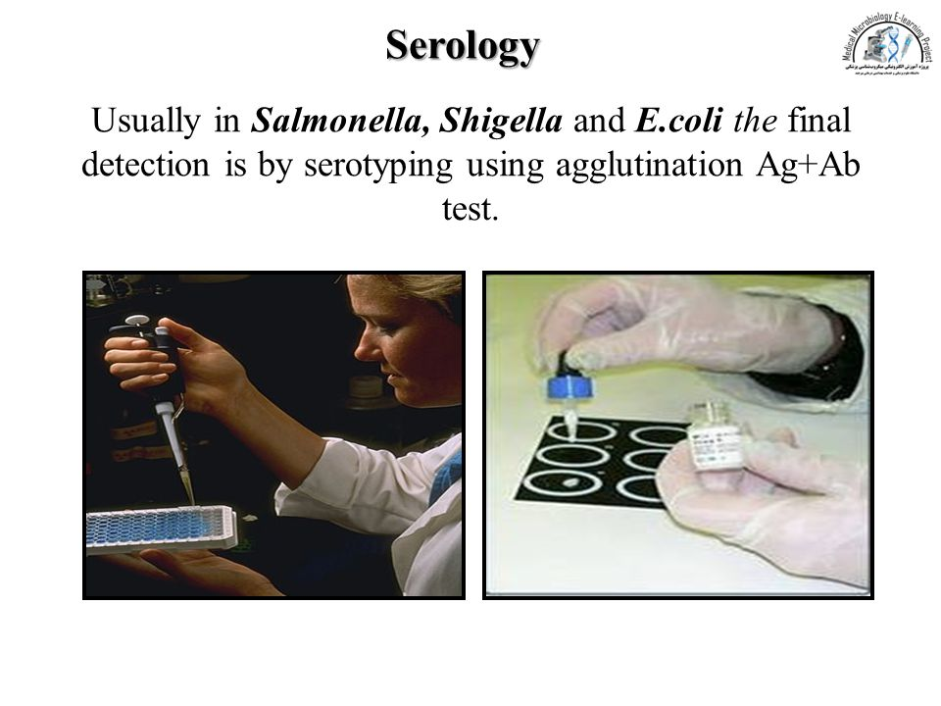
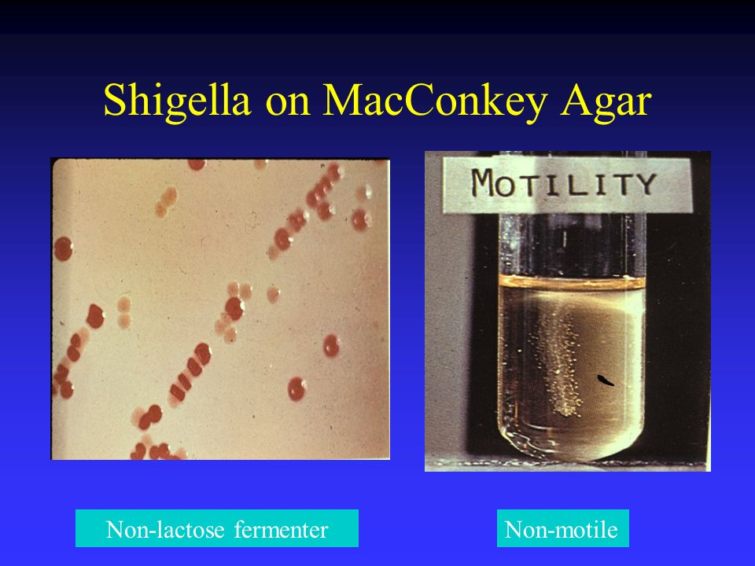
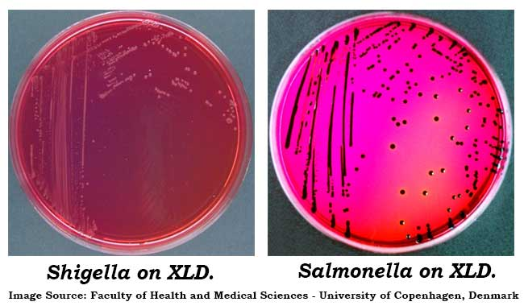
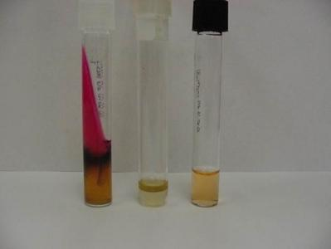
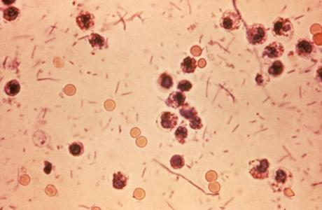
Only in male’s slides:
SALMONELLA SPECIES AND SUBSPECIES | NO. OF SEROTYPES WITHIN SUBSPECIES | USUAL HABITAT
S. enterica subsp. enterica (I) | 1504 | Warm-blooded animals
S. enterica subsp. salmae(II) | 502 | Cold-blooded animals and the environment*
S. enterica subsp. arizonae (IIIa) | 95 | Cold-blooded animals and the environment*
S. enterica subsp. diarizonae (IIIb) | 333 | Cold-blooded animals and the environment*
S. enterica subsp. houtenae (IV) | 72 | Cold-blooded animals and the environment*
S. enterica subsp. indica(VI) | 13 | Cold-blooded animals and the environment*
S. bongori (V) | 22 | Cold-blooded animals and the environment*
Total | 2541
BIOCHEMICAL TESTS:
DYSENTRY STOOL:

Slide 10
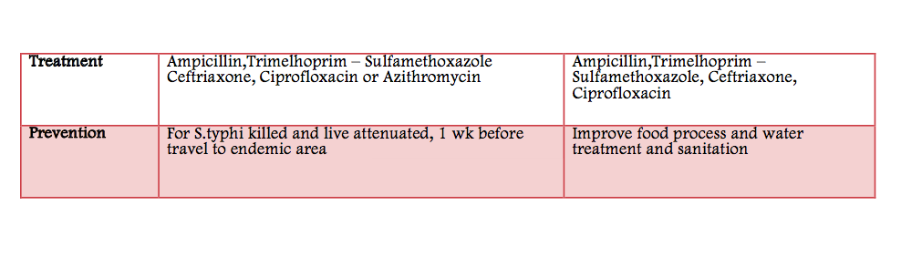
VERY VERY IMPORTANT
You can find it HERE

Slide 11
QUIZ:
1.Salmonella is a motile bacteria, while Shigella is a non-motile bacteria:
A) True B) False
2.A patient diagnosed with Enteric fever, which subspecies you’re supposed to see in his biopsy?
A) Salmonella enterica
B) Shigella dysenteriae
C) Salmonella typhi and paratyphi
D) Shigella sonnei
3. Acoording to the patient in Q.2, which one of theses symptoms will be present in his case?
A) Watery diarrhea
B) Prolong fever
C) Bacillary dysentry
D) Tenesmus
Answers :
1-A 2-C 3-B

Slide 12






THANK YOU FOR CHECKING OUR WORK, BEST OF LUCK!
Hamad Alkhudhairy
Nawaf alkhudhairy
Majed alzain
Talal alhuqayl
Shrooq Alsomali
Shatha Alghaihb
Doctors slides

