Slide 1
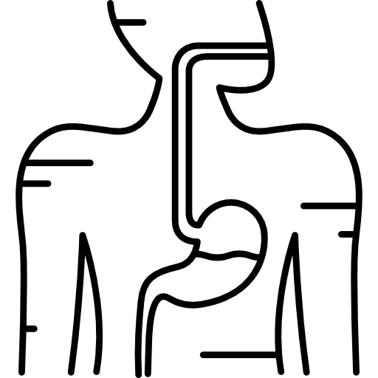
LECTURE: normal flora Of The GIT And Introduction To Infectious Diarrhea
Editing File
Important
Doctor’s notes
Extra explanation
Only F or only M
"لا حول ولا قوة إلا بالله العلي العظيم" وتقال هذه الجملة إذا داهم الإنسان أمر عظيم لا يستطيعه ، أو يصعب عليه القيام به .

Slide 2
OBJECTIVES:
Know common normal flora of the GIT
Understand the role of GIT normal flora in diseases
Define and recognize the various types of acute diarrheal illness
Describe the epidemiology the host defenses in preventing the gastrointestinal infection
Explain pathogenesis by which Escherichia coli campylobacter and yersinia and their management
Discuss the microbiological methods used for diagnosis of each of the bacterial agents including microscopy, selective media for maximal recovery
Describe the pathogens, risk factors, clinical presentation and prevention of food poisoning travelers and antibiotic associated diarrhea.
Name the etiological agents causing food poisoning and their clinical presentation

Slide 3
Introduction to normal flora:
Normal flora are microorganisms that are frequently found in various body sites in normal healthy individuals
Constituents and number vary according to the age and physiologic status
Able to colonize and multiply under the exiting condition of different body sites.
It has some advantages such as
Inhibit competing intruders. (تحمي الجسم من المايكرواورجانيزمز المتطفله)
Have symbiotic relationship that benefit the host (علاقة تكافلية مع الإنسان)
Can cause disease in immunocompromised patients
Normal flora - Gastrointestinal tract | Normal Flora Of GIT
Ecology Birth: sterile عند الولادة: لا يوجد نورمال فلورا Breast-fed Bifidobacteria species بعد ما ترضعه أمه يكتسب هذي البكتيريا Switch to cow’s milk Enteric, bacteroides, enterococci, lactobacilli and clostridia Switch to solid food Microflora similar to parents يبدأ يأكل مثلهم و يحصل على نفس النورمال فلورا حقتهم Primarily anaerobic Facultative aerobes deplete oxygen Adult excretes 3x1013 bacteria/day | Oral cavity: contain high number of flora which vary from site to site of the mouth. Saliva contain mixed flora :108 organism /ml Stomach : empty stomach* (sterile) has no normal flora in health due to HCL and peptic enzymes Small intestine : very scanty except near colon Colon of adults: 1010 org/gm stool, >90% are Bacteriodes ( the majority are anaerobic), 10% other bacteria (which are aerobic). Direct effect of diet composition.
-Ecology: the branch of biology dealing with the relations and interactions between organisms and their environment, including other organisms
*But after eating food, it may contain some bacteria from ingested food.

Slide 4
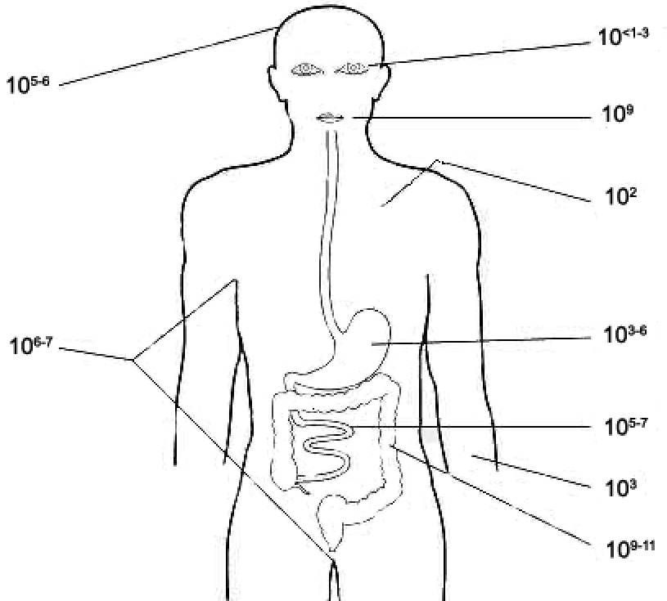
Only in Male’s slides
This table is from 435 team
GI ecology→ Varies كل لما نزلنا تحت كلما كثرت البكتیریا
Esophagus: Microbes associated with saliva and food | Stomach: Low pH limits population numbers (10 bacteria/ml)
Small intestine Proximal small intestine (duodenum and jejunum): Sparse (< 10^3 bacteria/ml fluid) due to acid from stomach, bile and pancreatic secretions Distal small intestine ( ileum): Increases ( 10^8 bacteria/ml) due to pH change In adult-bacteria per gram: Duodenum →10^3 -10^6 Jejunum and ileum→10^5 -10^8 | Large intestine 10^9-10^11/ml >350 species (E.coli = 0.1% of total population) In adult-bacteria per gram: Cecum and transverse colon →10^8 -10^10 sigmoid colon and rectum →10^11
Location (adult)* | Bacteria/gram contents
duodenum | 10³-10⁶
jejunum and ileum | 10⁵-10⁸
cecum and transverse colon | 10⁸-10¹⁰
sigmoid colon and rectum | 10¹¹
Increase in the number
What you need to know is that the least number is at the stomach and increases until it reaches the peek in the large intestine
*Explanation: the table includes the normal range of the normal flora population in different regions.
Notes:
1- النص المظلل بالأصفر مكرر مرتين
2- أرجوا إضافة النص الناقص من سلايد العيال رقم 5 أرسلت لكم صورة على الواتس

Slide 5
Only in female’s slides
Normal flora (low virulence)
Mouth | Nasopharynx | Stomach | Small intestine | Colon of adults | Colon of breast feding infants
1-Viridans streptococci 2-Neisseria spp Moraxella, Peptostreptococcus. | Niesseriaspp., Viridanssterpt. Moraxella, Peptostreptococcus. | streptococci, Peptosterptococcus, others from mouth. | scanty, variable | Bacteriodes, Fusobacterium, Bifidobacteria, Lactobacillus, enterobacteria(is Aerobic),, Clostridium | Bifidobacterium, Lactobacillus (are anaerobic)
Organ
The Normal Flora
Potential pathogen (carrier)*
Mouth | Nasopharynx | Stomach | Small intestine | Colon of adults | Colon of breast feding infants
Candida albicans | S.pneumoniae, N.meningitidis, H.infuenzae,S.pyogenes, S.aureus | none | none | B.fragilis, E.coli, Pseudomonas, Candida, Clostridium | None This gives a hint about the advantages of breast feeding compare to bottle feeding
Organ
The Normal Flora
*But after eating food, it may contain some bacteria from ingested food.

Slide 6
Role of GIT normal Flora in disease
Only in female’s slides
-Many are opportunistic pathogens. they do not cause the disease unless if there is Example: perforation of the colon from ruptured diverticulum, feces enters into peritoneal cavity and cause peritonitis (may lead to septicemia) (هنا النورمال فلورا انتقلت لمكان ثاني فسببت مرض)
-Viridans streptocci of oral cavity enters the blood and colonize damaged heart valves. (such as endocarditis). (هذي البكتيريا مكانها الطبعي في الفم و لكن اذا وصلت الدم بتسبب ضرر لصمامات القلب)
-Mouth flora play a role in dental caries. (ممكن تلعب دور في تسوس الأسنان)
-Compromised defense systems increase the opportunity for invasion. of this normal flora to cause serious disease (أمراض نقص المناعه تعطي النورمال فلورا المجال علشان تضر الجسم)
-Death after lethal dose of radiation due to massive invasion of normal flora. فهي سلاح ذو حدين
-E.coli: the most common Enterobacteriacae; a facultative flora of colon followed by Klebsiella, Proteus and Enterobacter.
-Salmonella, Shigella and Yersinia are NOT normal flora of the intestinal tract.
-Some strains of E.coli,Salmonella ,Shigella and Yersinia enterocolitica are able to produce diseases in the intestinal tract.

Slide 7
Acute diarrheal illness and food poisoning:
Introduction:
Acute diarrheal illness is one of the most common problems evaluated by clinicians. A major cause of morbidity and mortality world wide. Most of healthy people have mild illness but other might develop serious squeals so it is important to identify those individuals who require early treatment.
Definition of diarrhea:
Stool weight in excess of 200 gm/day or 3 or more loose or watery stools/day Acute < 14 days Alteration in normal bowel movement characterized by decreased consistency and increased frequency Less than 14 days in duration
Etiology:
Viral the majority: 70-80% of infectious diarrhea (In children) in developed countries Bacterial: 10-20% of infectious diarrhea but responsible for most cases of severe diarrhea Protozoan: less than 10% (and may be complicated)
Notes:
غيرنا اللون للأحمر مثل ما هي في سلايد الدكتور

Slide 8
Epidemiology:
1.4 million deaths in study in 2010 1.2-1.9 episodes per person annually in the general population 2.4 episodes per child >3 years old annually 5 episodes per year for children <3 years old and in daycare Seasonal peak in the winter
Risk Factors:
Food from restaurants. Family member with Gastrointestinal symptoms. Recent travel to developing countries. Patient underlying illness and mediation(↓Stomach acidity cyst, spores) These patient more liable to get GIT disease Abnormal peristalsis. Low Immunoglobulin IgA. Antibiotics decrease the normal flora to less 10¹² Median infective dose (ID₅₀) so if we have low ID50 , the Susceptibility will be high
In countries that have disaster e.g. yemen they have more diarrheal diseases
Mostly viral , usually if it is bacteria and the patient is not hospitalized campaylobacter is the organism and it is self limiting (the patients wont come to the hospital even.)

Slide 9
Classifications*
1. Infectious diarrhea: viral (Causes watery diarrhea) or Bacterial organism ( Campylobcator, Shigella,Solmonella,Yersinea, vibrio Cholera and E.coli). 2. Food poisoning: Staphylococcus aureus (their toxin is preformed thus their poisoning effect is quick (, Clostridium perfringens, Bacillus spp.) the incubation period of these 3 bcateria is Quick= 6 hours- half a day( 3. Traveler diarrhea: (can cause watery diarrhea) Enterotoxogenic (no invasion by the bacteria thus no pus ,and no fever because there is no inflammation) E-coli (incubation period 1-3 days and this is true for most of the diarrheal disease) 4. Antibiotic associated diarrhea: Clostridium difficile
Intestinal pathogens:
-Invasive and Cytotoxic strains produce inflammatory diarrhea ( Dysentry) with WBCs and /or blood in the stool.
-Enterotoxin –producing strains cause watery diarrhea with loss of fluid.
-Some produce not only produce local infection in GIT systemic illness due to spread to multiple organs such as enteric ( typhoid) fever.
Only in female’s slides
*The difference: Infectious Diarrhea : they eat infected food,
Food poisoning : They have the bacteria and then produce the toxin inside the food.

Slide 10
Clinical Presentation and Pathogenic Mechanism
1-Enterotoxin mediated: Here the bacteria is dead but they already released their poison | 2-Invasive: Here the bacteria are alive and the fight and release their poisons
Lack of pus in the stool (no gut invasion) Lack of fever (because no inflammation) Rapid onset preformed toxin<12 hour Small intestine are affected Vomiting ,non-bloody diarrhea, abdominal cramp Vibrio cholerae, Staphylococcus aureus, Clostridium perfringens and Bacillus cereus All of these produce toxin which usually affect the small intestine and cause some abdominal cramp, nausea, vomiting and watery diarrhea, there is no invasion Other viral and some parasitic infection can produce toxin but more common is via bacteria. | Pus and blood in the stool Fever due to inflammation Shigella, and Endameba histolytica (very important) Affect colonic mucosal surface of the bowel invasive mechanism → large intestine is usually affected For enterotoxin mechanism → small intestine is usually affected Sometime Solmonella spp, Campylobacter, some E-coli EHEC , Yersinia and Clostridium difficile Extension to lymph nodes Incubation period 1-3 days E.histolytica 1-3 wk Dysentery syndrome- gross blood and mucous with stool in small amounts after severe suprapubic pain , the pain is releaved after defection ends. (ممكن نسألكم عنها في الاختبار) EHEC bloody diarrhea If the cause is shigella we call it bacillus dysentery And if the cause is ameba histolytica we call amebic dysentery
(the parasites have longer incubation periods than others).
Notes:
غيرنا اللون للأحمر مثل ما هي في سلايد الدكتور

Slide 11
Only in Male’s slides
TOXIN TYPE | TOXIN PRODUCING BACTERIA | TOXIN NAME, IF RELEVANT
Neurotoxin Food poisoning | Staph aureus | Enterotoxin B
 | Bacillus cereus | Emetic toxin
 | Clostridium botulinum | Botulinum toxin
enterotoxin | Vibrio cholerae | Cholerae toxin
 | Enterotoxigenic E.coli | Heat-labile toxin, heat-stable toxin
 | Clostridium perfringens | Enterotoxin
cytotoxin | Shigella dysenteriae type I | Shiga toxin
 | Enterohemorrhagic E. coli | Shiga toxins 1 and 2 Globotriaosylceramide (Gb3) 23 S r RNA in 60 Subunit
 | Vibrio parahaemolyticus | Thermostable direct hemolysin
 | Campylobacter jejuni | Cytolethal distending toxin
 | Clostridium difficile | Toxin A and B
 | Clostridium perfringens | α-toxin
 | E. histolytica | Protozoal phospholipase A and pore-forming peptides

Slide 12
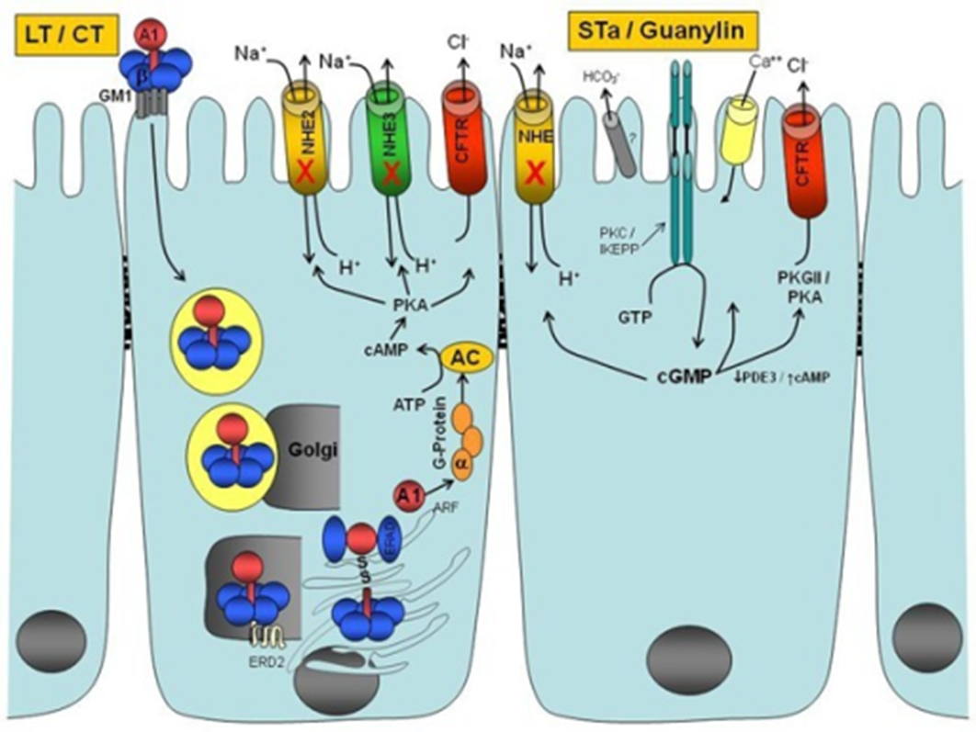
Only in Male’s slides
A1-B5 protein enterotoxin that is exported out of the bacterial cell by a type II protein secretion system

Slide 13
Shigella, salmonella
Salmonella enterica is the common cause of food poisoning in Saudi Arabia.
Salmonella typhi transmitted through human faeces
salmonella
It causes local Gastrointestinal invasion and bacteremia less common in normal host.
shigella

Slide 14
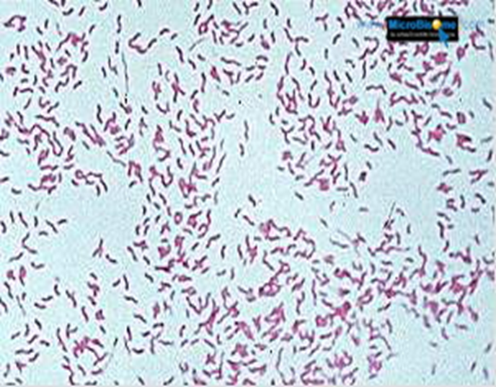
Campylobacter
 | Gram negative curved ( spiral or s-shape ) bacilli . world wide infection ,more common among children Common species : C.jejuni (the most common), C. coli, C fetus.
Family | Campylobacraceae -Genus arcobacter
Epidemiology: | Source: poultry, birds, dog , cat, →water, milk, meat, person to person can occur
Clinically | IP: 2-6 days Lower abdominal pain , watery or dysenteric diarrhea with pus and blood. fever in some patients, bloody diarrhea, Nausea and vomiting are rare Self limiting 2-6 Day Chronic carrier outbreaks uncommon. Complications: May lead to autoimmune disease like Guillain- Barrie’ syndrome* (neurologic disease characterize by paralysis) and extra-intestinal infections eg. Reactive arthritis ,bacteremia ,lung infection and others frequently preceded by C.jejuni infection.
Laboratory diagnosis | Transport media Cary Blair Because it may die quickly if it does not transported to the lab Culture on CAMPY BAP media contain antibiotics Incubate in microaerophilic atmosphere (5%)O₂ ,(10%)CO₂ ,(85%)N at 42°C except C.fetus 37°C Identification: Gram stain/culture biochemical/Serology
treatment | Only severe cases but usually is self limiting disease and no need for treatment. Ciprofloxacin, Erythromycin or Tetracycline
* The history is important, if we have patient who develop sudden paralysis after he had diarrhea we can think about Campylobacter, sure after excluding of other causes such as cardiovascular problems.

Slide 15
E. coli
E.Coli diarrhea
Enterotoxigenic E.coli
[ETEC]
Enterohemorrhagic E.coli
[EHEC]
Enteroadherent* E.coli
[EAEC]
Enteropathogenic E.coli
[EPEC]
Enteroinvasive E.coli
[EIEC]
One of the most common normal flora, and not all of them can cause diarrhea, Only about 10 -15% of strains of E. coli associated with diarrhea, Other strains associated with extra-intestinal diseases( septicaemia, meningitis in neonates & UTI).
Based on virulence factors, clinical manifestation, epidemiology and different O (lipopolysaccharides antigen) and H (flagella antigen) serotype.
There are five major categories of diarrheagenic E.coli:
*also called enteroaggregative e coli

Slide 16
 | Enterotoxigenic E.coli | Enteroinvasive E.coli
The diseases | Major cause of traveler's diarrhea in infant and adult in developing countries from contaminated food and water | Produce dysentery (Penetration, invasion and distraction), Common in children
Infective doses | High : 10⁶-10¹⁰ | 10⁶
Symptoms | watery diarrhea, abdominal cramps and some time vomiting | Fever, severe abdominal cramps, malaise and watery diarrhea
toxins | Has heat-labile toxin (LT) and heat-stable toxin (ST) each has two fragment (A and B). No invasion or inflammation, LT leads to accumulation of CGMP, which lead to hyper secretion of fluid with no cellular injury | -
diagnosis | No routine diagnostic method. | Diagnosis Sereny* test and DNA probes.
Other info | Self limiting - | -Similar to Shigella spp (Non motile, LNF) -transmition: Fecal oral route
*They take the bacteria or its toxin and they are inoculated into the eye of an animal, after a period of time , we will see that there is destruction of an animal’s eye. This indicate there is EIEC

Slide 17
Enterohemrrhagic E.coli ( very important) The most dangerous one and most common one
The diseases | O157H7 and Non O157H7 Hemorrhagic diarrhea, colitis and hemolytic uremic syndrome (HUS)=↓Platelet count, hemolytic anemia and kidney failure.
Prevalence | Fetal disease in young and elderly persons in nursing homes.
symptoms | Bloody diarrhea, low grade fever and stool has no leucocytes
toxins | Cytotoxin =vertoxin І and vertoxin ІІ Similar to Stx₁ (shigotoxin I&II).
Diagnosis | Diagnosis by culture on SMAC (sorbitol MacConkey agar cefixime), MUG test , Vertoxin detection by immunological test or PCR.
Other info | -Undercooked hamburgers it was known as hamburger’s disease, unpasteurized dairy products, apple cider, cookie dough happen to help the bacteria. -E.coli other than 0157H7 can cause HUS.

Slide 18
 | Enteroadherent E.coli Enteroaggregative Ecoli | Enteropathogenic E.coli
The diseases | Pediatric Diarrheal Disease. | Causes Infantile diarrhea ( bottle fed infants)
symptoms | Produce mucoid, Watery diarrhea, vomiting, dehydration and abdominal pain. | Low grade fever, malaise, vomiting and watery diarrhea
Other info | -produce Aggregative stacked bricked (like blocks), adherence to surface of intestinal epithelial cells. -resolve after 2 weeks or more | -Outbreak in hospital nurseries and day-care centers -Stool mucous but no blood. -Disrupt microvilli and intestinal absorptive function.
Notes:
Not found in Males slides

Slide 19
Yersinia enterocolitica
The diseases | Mesenteric lymphadenitis in children and septicemia in immunocompramised hosts
symptoms | Presented with enteritis, arthritis and erythema nodosum Systemic manifestation not GIT only
Prevalence | Common in Europe, USA, Canada and cat, dog, swine (chitterlings)
Characteristics | Survive cold temperatures and associated with transfusion of packed red blood cells.
Diagnosis | Growth at 25°c-30°c media Cefsulodin-Igrasan-Novabiacin (CIN)
Other info | Generalize infection in adult and children 1-5 yrs usually mild but in old children adult mimic appendicitis In saudi arabia it can be misdiagnosed with appendicitis

Slide 20
Clostridium difficile
The diseases | The most common cause of Antibiotic associated diarrhea, ( ampicillin, cephalosporins & clindamycin → is the most common one). Antibiotic use for the last 8 weeks ( community acquired= outpatient) or hospital stay for at least 3 days ( hospital acquired=inpatient). So the duration is very important.
Transmission | Transmit from person to person via Fecal-Oral route.
symptoms | Patient Presents with fever, leukocytosis, abdominal pain and diarrhea
toxins | Produce toxin A ( enterotoxic & cytotoxic effects ) and B (cytotoxic which more serious) that can bind to surface epithelial cell receptors leading to inflammation mucosal injury and diarrhea
Histological findings | Pseudomembrane With endoscopy we can see it can result (neutrophils, fibrin, and cellular debris in the colonic mucosa) and toxic megacolon.
Diagnosis* | direct toxin detection from stool by (EIA)
Treatment | Metronidazole ± oral Vancomycin and supportive treatment.
Other info | -Have been cultured from in animate hospital surfaces. -causes Disruption of the indigenous bacterial flora of the colon
*Once it is positive, we have two situations..
If the patient has sever symptoms and with history of antibiotic in last 3 day this indicate Clostridium difficile infection
-if the patient is asymptotic and does not have a history of antibiotic this indicate that it is just colonies of this bacteria without infection.

Slide 21
Diagnostic approach
Lab diagnosis of diarrheal diseases due to bacterial causes
Duration:
Chronic vs acute
Symptoms:
Fever, bloody, weight loss and dehydration
Risk factors:
-Travel ,immunocompromised , diet, medications, outbreak
-Fever and blood do culture
-Watery no fever symptomatic treatment
-Hospital acquire think about C.difficle
Chronic diarrhea think about:
-Protozoa (giardia, crypto, cyclo, microsporidia, MAC)
-Other malabsorption, lactase deficiency Or bacterial overgrowth
Stool specimen:
Microscopy: for the presence of polymorphs or blood may help
Culture :
on selective media for Salmonella, Shigella & Campylobacter. (routinely in patient with diarrhea other bacteria if the doctor request them).
Culture for Vibreo cholerae, EHEC or Yersinia if suspected.
Toxin assay: if C.difficile toxins is suspected.

Slide 22
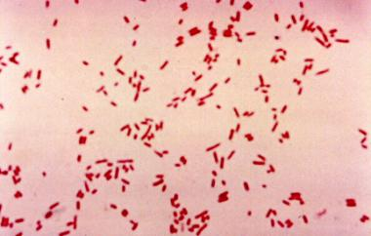
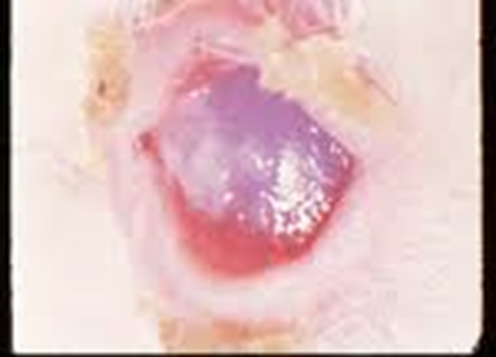
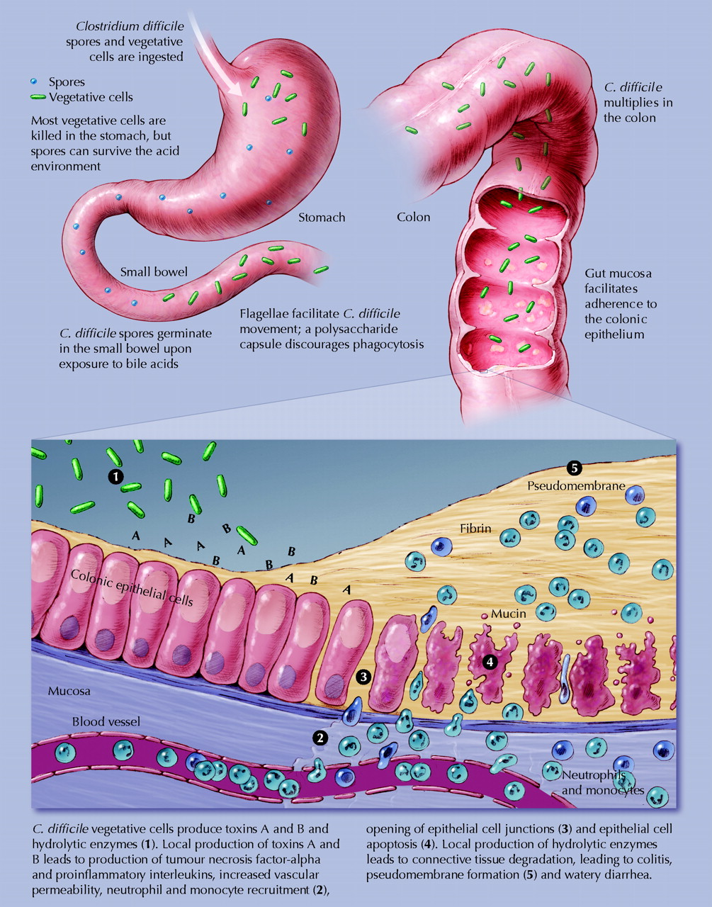
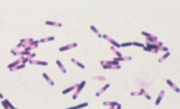
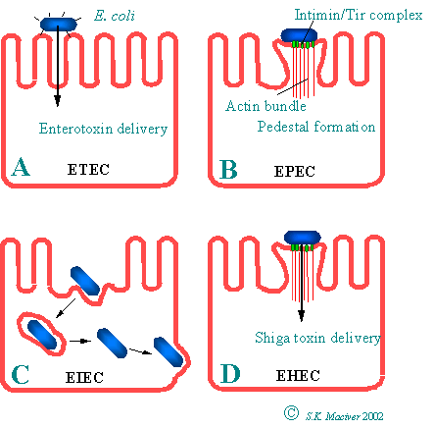
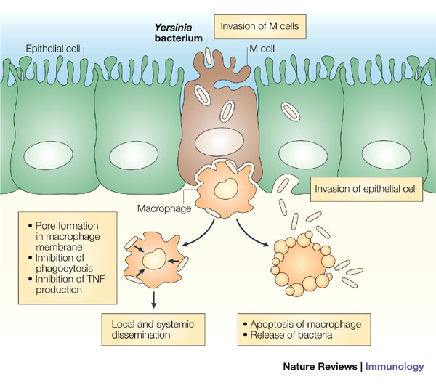
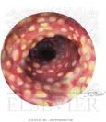
2. Enteroinvasive E.coli ( EIEC)
E.coli
Clostridium difficile
C.difficile & pseudomembraneous colitis
Yersinia enterocolitica

Slide 23
Recommended from prof ali:
Type | Organism | Incubation Period | Source Risk factors | Clinical | Diagnosis | Treatment
Infectious diarrhea Invasive Dysentery Blood+mucous | Shigella gram-negative rods | 1-3 Days | Contaminated Food or water with human excreta | Small amount of stool with blood and mucous and lower abdominal pain ( trismus) | Culture on selective media | Ciprofloxacin
 | Entamoeba histolytica | 1-3 wks |  |  | Microscopy | Metronidazole
 | EIEC gram-negative rods | 1-3 Days |  |  | Culture and toxin detection | Ciprofloxacin
Type | Organism | Incubation Period | Source Risk factors | Clinical | Diagnosis | Treatment
Food Poisoning Watery (preformed toxin) | Staphylococcus aureus | 1-6 hour | Contaminated food from human flora | Vomiting then watery diarrhea | Culture and toxin detection | Observation and supportive treatment
 | Clostridium perfringens | 8 to 16 hours | Food contaminated with Soil
 | bacillus cereus spore forming aerobic Gram pos bacilli | 8 to 16 hours | 8 to 16 hours
Travelers | ETEC | 1-3 Days | Travel | Watery diarrhea | Culture Toxin detection | ciprofloxacin
Antibiotics Associated | Clostridium Difficile | 1-3 Days | Antibiotics use patient→ patient | Bloody diarrhea Toxin A and B | Toxin detection PCR | Metronidazole +/- Vancomycin

Slide 24
Recommended from prof ali:
Type | Organism | Incubation Period | Source Risk factors | Clinical | Diagnosis | Treatment
Infectious diarrhea Non-invasive Watery +/-blood | Salmonella gram-negative rods | 1-3 Days | S.typhi and S.para Human Others reptiles and snakes | Watery+/-Blood | S.typhi and S.para typhi→ typhoid Others watery diarrhea | Ampicillin or ciprofluxaci or metronidazole or trimethoprim sulfa
 | campylobacter jejuni small, curved, gram-negative rods | 1-3 Days | poultry | Watery+/-Blood | Special media at 42 º C at microaerophilic condition | Erythromycin
 | EHEC | 1-3 Days | beef | Watery then bloody diarrhea Renal failure | Culture and toxin detection
 | Vibrio cholera Comma-shape gram-negative rods | 1-3 Days | Salt water | Rice water |  | Ciprofloxacin Doxycycline
 | Yersinia Gram Neg bacilli | 1-3 Days | Pork intestine | Pseudo appendicitis | Cold enrichment 25-30ºC CIN (Yersinia) | Gentamycin
 | Listeria Monocytogenes Gram pos bacilli | 2-3 wks | unpasteurized dairy products | Meningitis in neonate and old Abortion |  | Ampicillin

Slide 25
QUIZ:
Q1-which one of the following species of E.coli causes traveler’s diarrhea?
A-ETEC
B-EPEC
C-EHEC
Q2-the best drug used to treat clostridium difficile is?
A-ampicillin
B-metronidazole
C-erythromycin
Q3-A 24 year old patient presented with dysentery stool. The lab results showed gram –ve bacilli. Which one of the following is the causative organism?
A-EPEC
B-EIEC
C- EHEC
Answers: 1-A 2-B 3-B

Slide 26
THANK YOU FOR CHECKING OUR WORK, BEST OF LUCK!
Hamad Alkhudairy
Ibraheem Aldeeri
Basel almeflh
Shrooq Alsomali
Weam Babaier
Rawan Alqahtani
Doctors slides

