Slide 1
LECTURE: Schistosomiasis
Editing File
Important
Doctor’s notes
Extra explanation
Only F or only M
"لا حول ولا قوة إلا بالله العلي العظيم" وتقال هذه الجملة إذا داهم الإنسان أمر عظيم لا يستطيعه ، أو يصعب عليه القيام به .

Slide 2
OBJECTIVES:
know the global distribution of schistosomiasis
describe the life cycle of schistosomiasis
compare relation between chronic schistosomiasis and portal hypertension
know pathology, diagnosis and treatment of schistosomiasis
know life cycle of Fasciola hepatica
know pathology , diagnosis and treatment of Fasciola hepatica
compare between true infection and sheep liver infected with Fasciola hepatica which lead to false infection

Slide 3
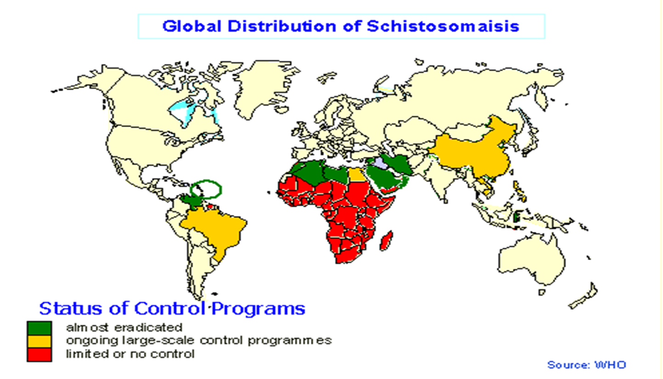
Recall
Protozoa | Helminths
Unicellular Single cell for all functions | Multicellular Specialized cells
Aoebae: move by pseudopodia. Flagellates: move by flagella. Ciliates: move by cilia Apicomplexa (Sporozoa): tissue parasites | Round worms (Nematodes): - elongated, cylindrical, unsegmented. Flat worms : - Trematodes: leaf-like, unsegmented. - Cestodes: tape-like, segmented.
Schistosoma
Schistosoma
General information | Genus of trematodes, Schistosoma, commonly known as blood-flukes(تمشي في الدم) , are parasitic flat-worms responsible for a highly significant group of infections in humans termed schistosomiasis. Schistosomiasis is considered by the World Health Organization as the second most socioeconomically devastating parasitic disease, (after malaria), with hundreds of millions infected worldwide.

Slide 4
Schistosoma =portal hypertension
General information |  | Adult flatworms parasitize blood capillaries of either : depending on the infecting species Mesenteries (Schistosoma mansoni )in GIT, blood in stool plexus of the bladder (Schistosoma haematobium) in bladder , blood in the urine
Lead to |  | intestinal schistosomiasis | urinary schistosomiasis
Prepatent period |  | 5-7 weeks | 10-12 weeks
Egg deposition and extrusion |  | dysentery (blood and mucus in stools) hepatomegaly splenomegaly CNS involvement (rare) | painless hematuria Inflammation of bladder and burning micturition CNS involvement (rare)
Tissue proliferation and repair |  | Papillomata in intestine, Periportal fibrosis, hematemesis Lung and CNS involvement. | Fibrosis , papillomata in the bladder and lower ureter leading to obstructive uropathy. Periportal fibrosis Lung and CNS involvement
Diagnosis | Microscopical | Examination of stools | Examination of urine
 | Immunological | Serological tests CFT,ELIZA.
 | Indirect | Radiological, endoscopy | Radiological, Cystoscopy
 | Intradermal test : | With cercaria antigen cause allergic reaction
Treatment |  | Drug of choice for schistosomiasis is Praziquantel
احفظوا الاسم بس

Slide 5
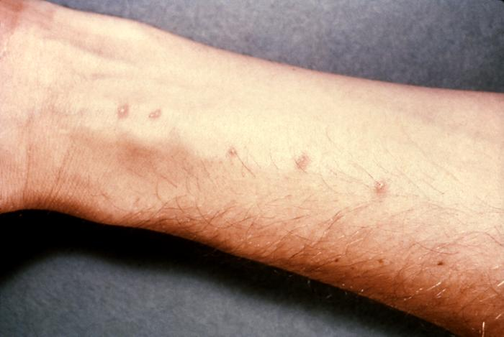
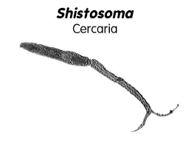
Life cycle
Schistosoma
Type | Schistosoma mansoni | Schistosoma haematobium
Infective stage | Cercaria : then transformed into a schistosomulae inside the host tissues. Cercaria lose tails during penetrating
Diagnostic stage | Egg in the feces | Egg in urine
Hosts : | 1- MAN is the DEFENITIVE HOST . | 2- SNAILS is the INTERMEDIATE HOST
Pathology | The EGG is the main cause of pathology in schistosomiasis . Many eggs become stranded in the tissues or are carried by the blood stream to other organs mainly the LIVER. The host reaction to the eggs may vary from small granulomas to extensive fibrosis .The extent of damage is generally related to the number of eggs present in the tissues.
Pathogenicity of Schistosomiasis | Cercarial dermatitis: at the site of entry of cercaria. Toxic Metabolites: liberated during the growth of schistosomulae in the circulation veins, may cause anaphylactic reaction ,fever ,urticarial rashes and eosinophilia. Terminal spined eggs : may erode blood vessels and cause hemorrhages. Schistosome eggs, deposited in the tissues, act as foreign protein ,cause irritation leading to cell infiltration and connective tissue hyperplasia ,egg granuloma around each egg (cell mediated immunity) .
Schistosoma dermatitis | or "swimmers itch” occurs when skin is penetrated by a free-swimming, fork-tailed infective cercaria. The dermatitis often develops 24 hours after exposure and last for 2 to 3 days and then spontaneously disappears.

Slide 6
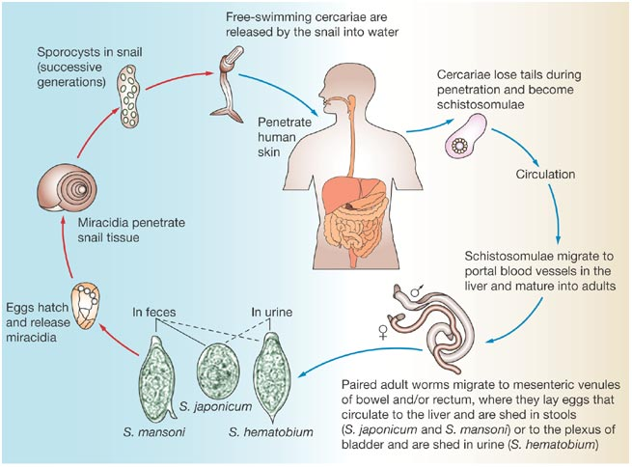
Type | Schistosoma mansoni | Schistosoma haematobium | Schistosoma haematobium
Life cycle | The eggs of the human-infected with S.mansoni & S.japonicum are passed mainly in stool/ feces into the water. | the eggs are passed during micturition from host infected with S.haematobium and passed mainly in the urine. | the eggs are passed during micturition from host infected with S.haematobium and passed mainly in the urine.
 | In the water the miracidium hatches out of the egg and searches for a suitable freshwater snail to act as an intermediate host . In the snail the miracidium develops to cercaria. From a single miracidium result a few thousand cercaria, every one of which is capable of infecting a human
 | Cercaria emerge from snail in the water and penetrate the skin of the human. The cercaria is transformed into a schisosomula inside the host tissues. The schistosula first enters the systemic circulation and then finds its way into….
 | into the portal circulation (S.mansoni and S.japonicum) worms mature in the mesenteric veins of the portal circulation(here where the adult stay) |  | worms generally remain in the systemic circulation and mature in the blood vessels of the vesical and venous plexus.

Slide 7
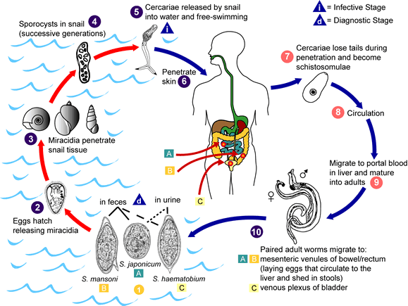
Type | Schistosoma mansoni | Schistosoma haematobium | Schistosoma haematobium
Life cycle | The cercaria emerge from the snail during daylight and they actively seeking out their final host. When they recognize human skin and become schistosomula Each schistosomule spends a few days in the skin and then enters the circulation starting at the dermal lymphatic and venles, they feed on blood. The schistosomule migrates to the lung and then moves via circulation through the left side of the heart then it develops into a sexually mature adult and the pair migrate to …
 | The mesenteric veins (S.mansoni &S.japonicum). | The urinary bladder veins (S.haematobium).
 | Each female lays 300 eggs a day the eggs move into the lumen of the host's intestines and are released into the environment with the feces (S.mansoni & S.japonicum) | The female fluke lays as many as 30 eggs per day which migrate to the lumen of the urinary bladder and ureters (S.haematobium)

Slide 8
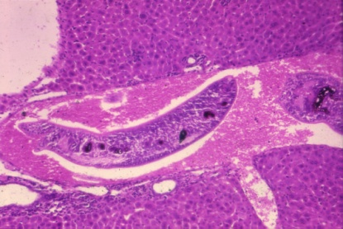
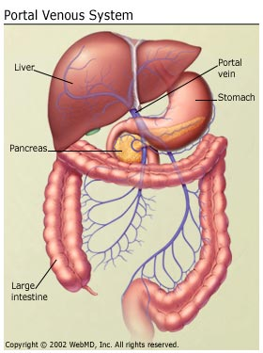
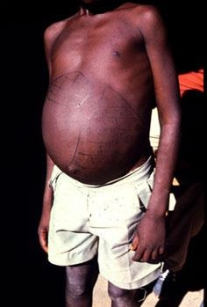
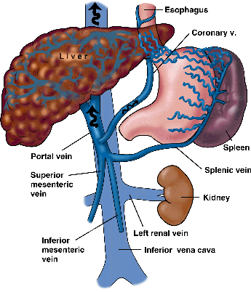
Developing schistosome in liver
S. mansoni & S. japonicum located mainly in mesenteric vein and its branches
The worm discharges EGGS ,the eggs travel in 2 directions :
2- other flow with blood stream in the portal circulation and enter the LIVER*.
1- some eggs find their way into the lumen of the bowel and appear in the faeces
again some of these eggs find their way through the liver tissue and enter the systemic circulation to another organ as brain
Most of these eggs are trapped in the liver and give rise to pathology ,fibrosis of the liver caused from eggs settled in the liver may produce portal hypertension (very very important!!), which may lead to hepatomegaly ,splenomegaly esophageal varices, hemorrhoids and ascites.
Hepatomegaly and splenomegaly with ascites.
Portal hypertension in chronic schistosomiasis
*Three parasite manly effect the liver 1-schistosoma 2-E-histolytica (abscess) 3-echiococuss granulosus

Slide 9
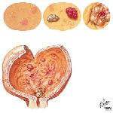
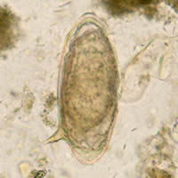
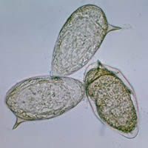
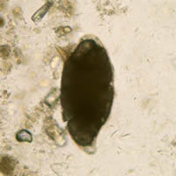
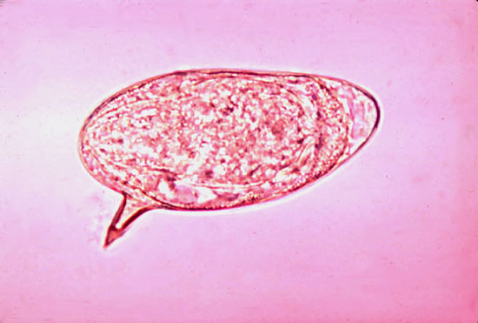
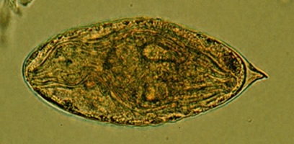
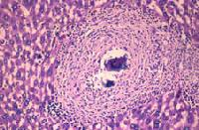
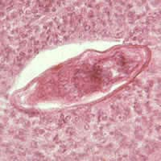
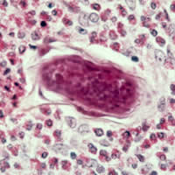
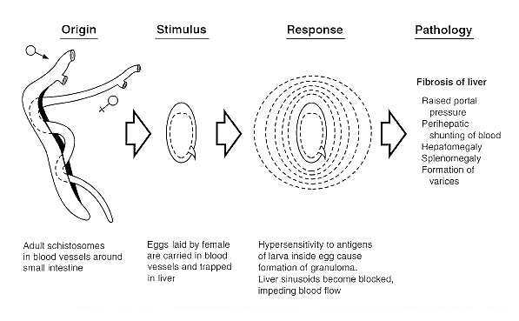
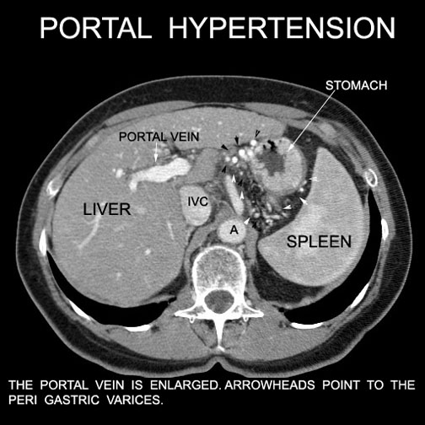
S. haematobium
the worm is located in the vesical venous plexus surrounding the urinary bladder .
Many eggs are trapped in the wall of the bladder where they may give rise to calcification and granuloma formation.
Constriction of the orifice of the ureter may produce kidney damage , hydronephrosis and cancer of the bladder.
Eggs of Schistosoma mansoni with lateral spine
Egg of S. mansoni lateral spine
Egg of S. haematobium central spine
Eggs of Schistosoma mansoni in the liver and cellular reaction.
Schistosoma mansoni

Slide 10
Fasciola hepatica
Fasciola hepatica=biliary obstruction
Hosts : | defenitive host: sheep ,cattle ,goat and man. | intermediate host: snails.
INFECTIVE STAGE: | metacercaria :ingested with contaminated grasses. Do not confuse with cercaria in schistosomiasis
DIAGNOSTIC STAGE: | eggs pass in stool or in the duodenal aspirate
Pathology and clinical picture | 1- true infection : occur when man accidentally ingests water plant (watercress) contaminated with metacercaria , the adult worm can causes mainly biliary colic with biliary obstruction (very important) , jaundice, generalised abdominal pain ,cholisistietis and cholithiasis.
 | 2- false infection is when eggs are eaten in infected animal liver and passed in stools. (false infection will not lead to liver infection only we can detect eggs in stool after eating rot cattle liver infected with Fasciola Hepatica so we can find the eggs in stool but patient is not infected.)*
Diagnosis | eggs in stools or duodenal aspirate. | serological test :cft and skin test are also used.
Treatment | triclabendazole, is the drug of choice to treat fascioliasis and is on the who list of essential medicines. the correct dosage is calculated based on the person’s weight (10 mg/kg) and the tablets are given at one time.
احفظوا الاسم بس
* That mean the human will be effected only if he eat water plant زينا زي البقرة نمرض فقط إذا أكلنا نباتات مائية

Slide 11
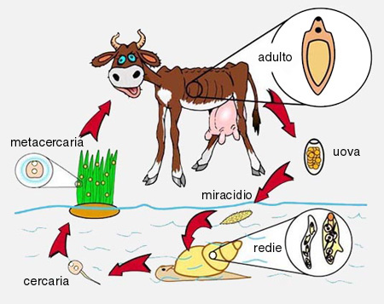
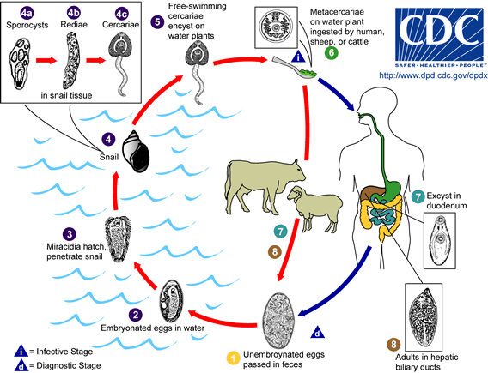
Life-cycle of Fasciola hepatica
LIVER FLUKE
How is Fasciola hepatica transmitted to man?
By ingestion of raw, fresh –water vegetation contaminated with the METACERCARIA.
METACERCARIA ,excyst in the duodenum ,migrate through intestinal wall to the liver and settle in the biliary tract, Then grow into adult worm, And liberate eggs in bile , throw bile eggs reach the intestine and then passed in stool.

Slide 12
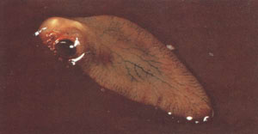
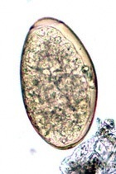
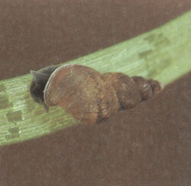
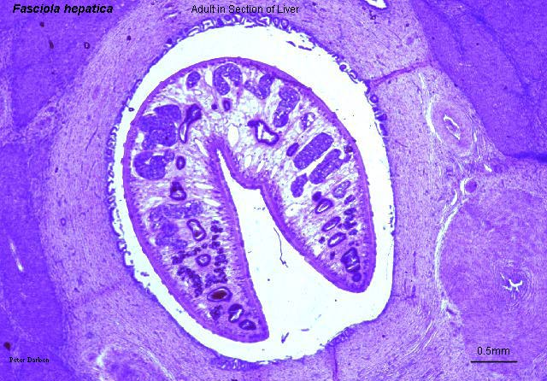
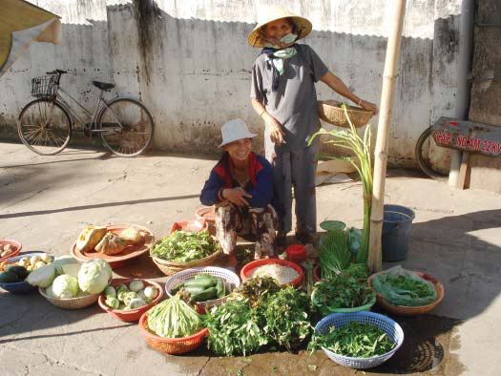
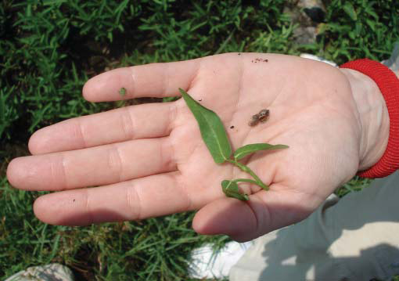
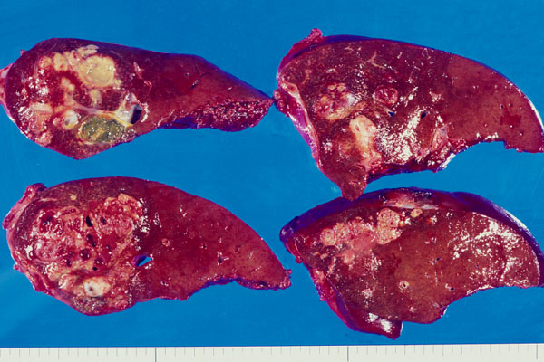
Fasciola hepatica worm in the definitive host
Egg of Fasciola hepatica can be seen in true patient's stool or in false infection.
Snail intermediate host of :
Fasciola hepatica
Fasciola hepatica in bile duct
Watercress , one means of transmission of fascioliasis
Snail intermediate host of :Fasciola hepatica
Sheep liver infected with Fasciola hepatica

Slide 13
QUIZ:
Which of the following is a complication of S. mansoni ?
a) Kidney failure b) Portal hypertension c) Hydronephrosis
2. Which of the following scenarios lead to false infection of liver fluke ( fasciola hepatica )?
a) Ingesting a liver of an infected cattle b) ingesting water-vegetable c) Both
Which of the following is the intermediate host for Schistosoma masoni?
Human b) Cattle c) snail
Which of the following stages of Schistosoma causes the pathology ?
Cercaria b) Egg c) adult worm
Cystoscopy is used to diagnose which of the following?
S. haematobium b) S. mansoni c) S. Japonicum
Upon stool analysis an egg with lateral spine was found. What is your diagnosis?
a) S. haematobium b) S. mansoni c) S. Japonicum
Metacercaria of Fasciola hepatica migrates to:
Bladder b) Bile c) Kidney
Adult S. haematobium migrates to:
a) Venous plexus of intestine b) venous plexus of bladder c) portal circulation
B
A
C
B
A
B
B
B

Slide 14
SUMMARY:

Slide 15
THANK YOU FOR CHECKING OUR WORK, BEST OF LUCK!
Hamad Alkhudhairy
Shrooq Alsomali
Reema Albarrak
Rawan Alqahtani
Ohoud Abdullah
Heba Alnasser
Jumana Alghtani
Doctors slides

