Slide 1
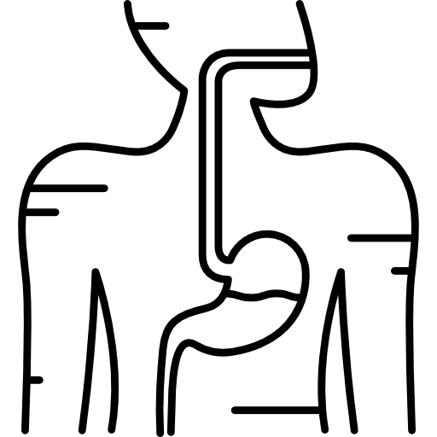
LECTURE: Trypanosomiases
Editing File
Important
Doctor’s notes
Extra explanation
Only F or only M
"لا حول ولا قوة إلا بالله العلي العظيم" وتقال هذه الجملة إذا داهم الإنسان أمر عظيم لا يستطيعه ، أو يصعب عليه القيام به .

Slide 2
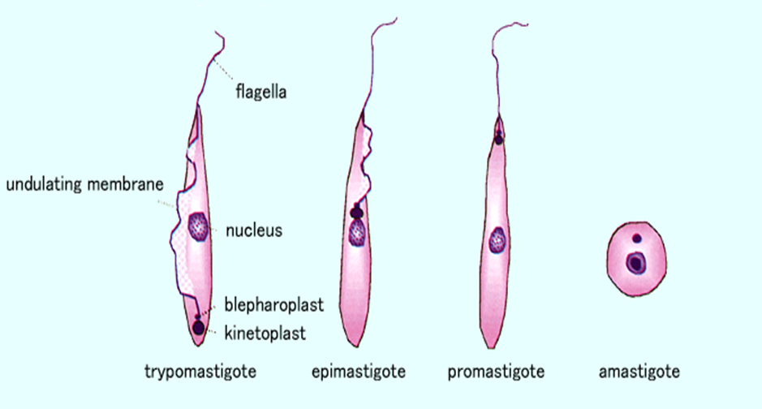
Different stages of Haemoflagellates
Mastigote = Flagella

Slide 3
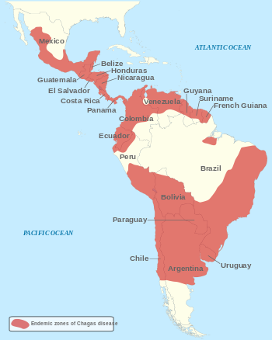
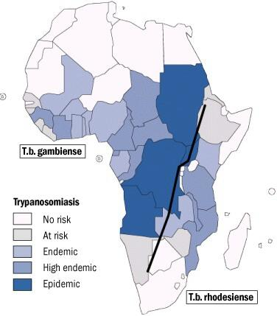
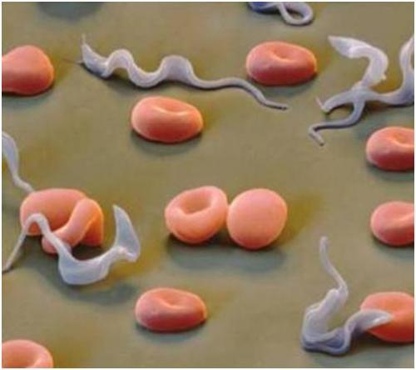
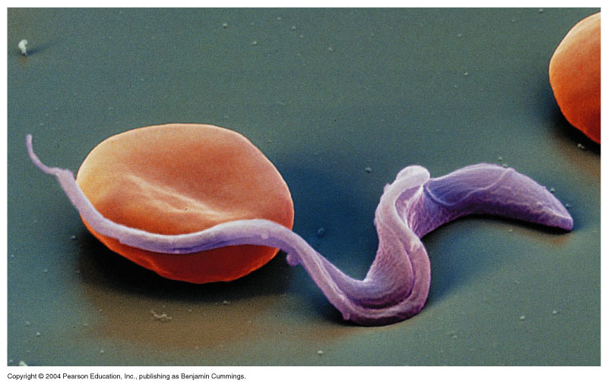
Trypanosomiasis
There are two types of trypanosomiasis that affect humans, they are divided according to their geographical location :
1-African sleeping sickness (mainly affects CNS) |  | 2-Chagas’ disease in central and south America (mainly affects the heart)
African trypanosomiasis, or sleeping sickness : is caused by Trypanosoma brucei parasites in Africa and is transmitted by the tsetse fly(vector). |  | American trypanosomiasis, or Chagas disease: is caused by Trypanosoma cruzi parasites in Latin America and is transmitted by the ‘kissing’ bug.
Trypanosoma brucei rhodesiense: East Africa, Humans and wild and domestic animal reservoirs | Trypanosoma brucei gambiense: West and Central Africa, mainly human infection | Trypanosma cruzi: cause Chagas’ disease.

Slide 4
What is African sleeping sickness?
African trypanosomiasis is a parasitic disease transmitted by the tsetse fly. It gets its nickname ‘sleeping sickness’ because symptoms can include a disturbed sleep pattern
intermediate host | Infection occurs through the bite of infected tsetse flies
definitive host | Humans , domestic cattle and wild animals are the main reservoir host for Trypanosoma
T. gambiense: causes a chronic illness | T. rhodesiense: causes a more acute illness.
Transmission: | Trypanosoma are transmitted from human to human through the bite of the tsetse fly which is only found in rural parts of Africa. However, trypanosomes can also be transmitted from mother to child as the parasite can cross the placenta in the blood and infect the baby while it is still in the womb. Contaminated needles can also contribute to the spread of trypanosomes, but this is rare.
Diagnosis | Diagnosis relies on recognition of the trypomastigote in peripheral blood during fever, sternal bone marrow, lymph node aspirates and CSF. Motile organisms may be visible in the buffy coat . Serological testing is also common as IF and ELIZA. PCR.
Treatment | For early infection: pentamidine / suramin For late infection : eflornithine (Diflouromethylornithine- DFMO)
Dr said not important

Slide 5
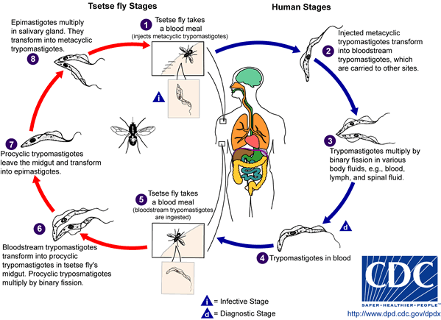
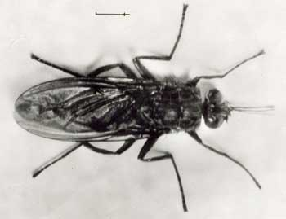
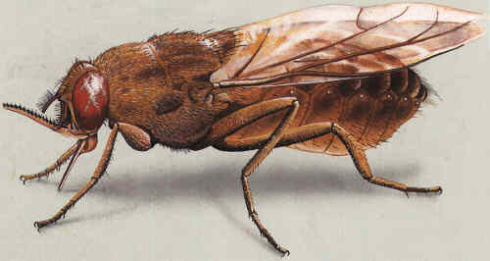
Trypanosome life cycle:
The trypanosome parasite is first introduced into the mammalian host as trypomastigotes when a tsetse fly takes a blood meal and secretes parasite-filled saliva into the host’s skin.
Once in the bloodstream the trypomastigotes multiply in the blood, lymph or spinal fluid .
Trypomastigote is both the infective and diagnostic stage!
Tsetse fly intermediate host

Slide 6
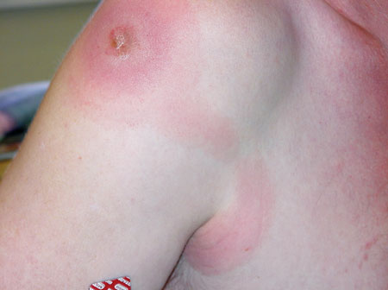
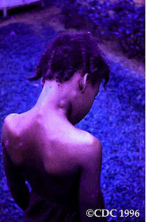
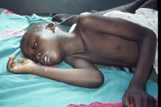
Pathology and clinical picture
A primary reaction: occurs at the site of inoculation of Trypanosomaskin skin stage: chancre¹ which resolve in 2-3 weeks.
Systemic Haemato-lymphatic stage:
intermittent fever
headache
generalized lymphadenopathy mainly in the cervical and sub occipital region (Winterbottom’ sign) (very important!)
Anaemia
Central nervous system stage (CNS):
This stage begins when the trypanosome parasites cross from the blood-brain barrier into the spinal fluid ,infecting the CNS including the brain, result in change in behavior ,confusion ,poor coordination ,difficulties with speech and disturbance of sleep (sleeping during day and insomnia at night.
(Development of the disease more rapid in Trypanosoma brucei rhodesiense)
3rd stage CNS: CNS involvement in typical case there is daytime sleeping, psychological changes, tremors, convulsions and finally coma.
Without treatment, the disease is invariably fatal.
Chancre skin stage
Winterbottom’s stage
¹Dermatitis.
To summarize 1st stage: chancre. 2nd stage: fever and Winterbottom’s sign. 3rd stage: CNS involvement.

Slide 7
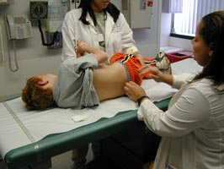
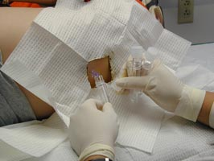
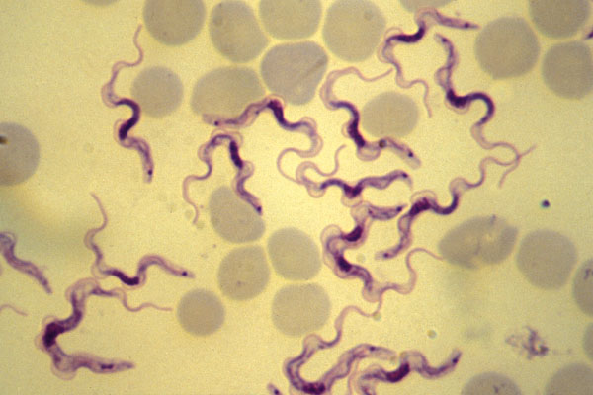
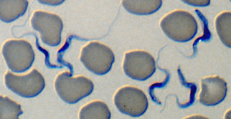
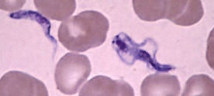
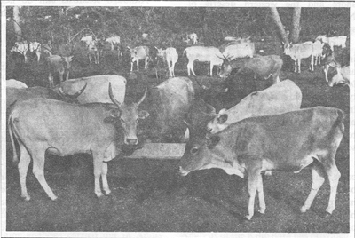
CSF lumbar puncture
Trypanosoma
Can be stained with giemsa or wet microscopic examination
Animal reservoir hosts for African sleeping sickness

Slide 8
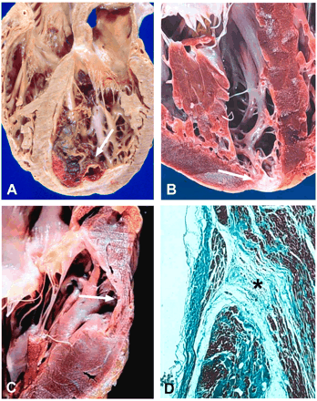
American trypanosomes Chaga’s disease: Acute stages: Chagoma and Romana’s sign. Chronic stage: Cardiomyopathy.
American trypanosomiasis, is a tropical parasitic disease caused by the Trypanosoma cruzi.
It is spread mostly by insects known as "kissing bugs .
The human disease occurs in two stages: an acute stage and chronic stage.
In the early stage, symptoms are typically either not present or mild, and may include fever, swollen lymph nodes, headaches, or local swelling at the site of the bite (chagoma) (cutaneous stage).
The most recognized marker of acute Chagas disease is called Romaña's sign, which includes swelling of the eyelids on the side of the face near the bite wound or where the bug feces were deposited or accidentally rubbed into the eye.
The parasites produce focal lymphangitis and oedema at the site of parasites entry (chagoma) after that parasites ( trypomastigote) enter the blood stream and find there way ,mainly on the face near the eyelids ,it produces a swelling of the eye and temporal region with conjunctivitis (ROMANA’S sign) (very important) , and also find their way mainly the cardiac muscles cells and RES². The most constant feature of the cardiac disease is cardiomyopathy , in severe cases can lead to partial or complete heart block which may lead to cardiac failure.
Heart damage due to American trypanosomiasis:
About two-thirds of people with chronic symptoms have cardiac damage, including dilated cardiomyopathy , which causes heart rhythm abnormalities and may result in sudden death.
²Reticuloendothelial system.
To summarize: 1st stage: Chagome. 2nd stage: Romana’s sign. 3rd stage: Cardiac disease.

Slide 9
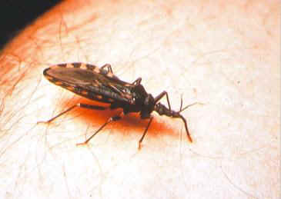
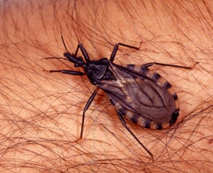
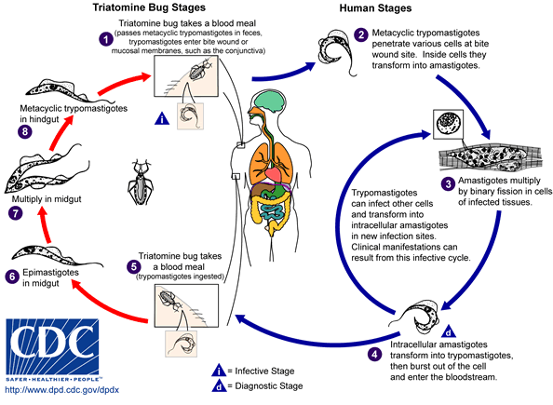
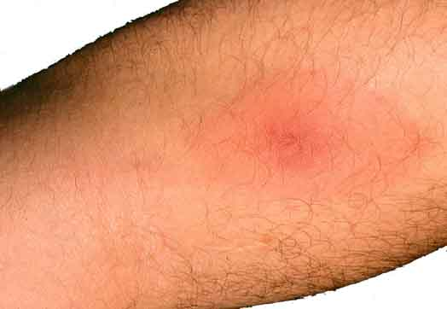
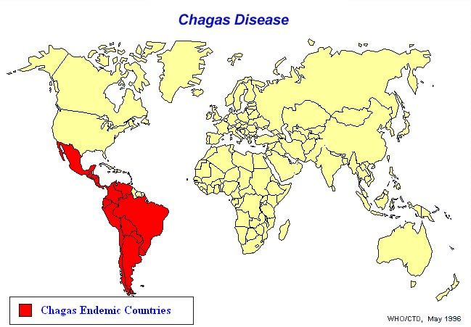
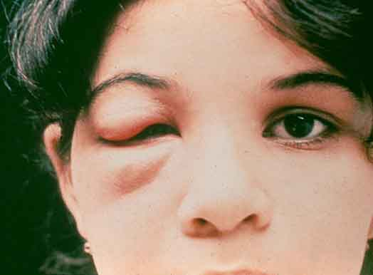
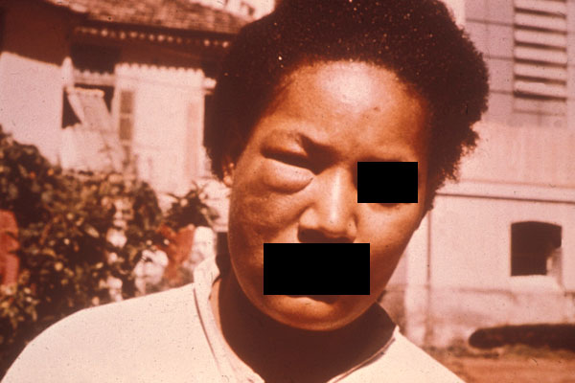
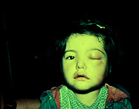
AMERICAN TRYPANOSOMIASIS:
LIFE CYCLE OF Trypanosoma cruzi
Reduviid (Triatomine) bug
Parasite when free in blood stream in form (TRYPTOMASTIGOT)
but in the tissue it become in form of (Amastigote).
T.cruzi causes cutaneous stage (chagoma)
Ocular lesion (Romana’s sign)

Slide 10
American trypanosomes :Chaga’s disease
T. cruzi causes a chronic illness with progressive myocardial damage leading to:
cardiac arrhythmias
cardiac dilatation
gastrointestinal involvement leading to mega-oesophagus and megacolon.
T. cruzi causes acute illness in children, which is followed by chronic manifestations later in life. , intracellular amastigotes destroy the intramural neurons of the autonomic nervous system in the intestine and heart, leading to megaintestine and heart aneurysms
If left untreated, Chagas disease can be fatal, in most cases due to heart muscle damage.
Diagnosis: | Microscopical examination of Giemsa –stained blood film. Serology: IFAT Xenodiagnosis³: feeding bugs on a suspected cases. PCR used to detect trypomastigotes.
TREATMENT(not important) | benznidazole NITROFURAZONE
³They bring normal bugs and let them feed on human infected with the disease then they check the bug to confirm the diagnosis.

Slide 11
QUIZ:
Which of the following is the diagnostic stage of sleeping sickness?
a) Amastigote b) trypomastigote c) promastigote
2. Which of the following is the infective stage of Chagas disease?
a) Amastigote b) trypomastigote c) promastigote
which of the following cause Acute trypanomiasis?
T. Rhodesiense b) T. Gambiense c) T. Cruzi
T. Cruzi produce …….. At the site of entry.
Chancre b) Chagoma c) Romana's sign
5. African man visited the clinic complaining of swelling in the cervical and sub-occipital region. What is his diagnosis?
Chagas disease b) sleeping sickness c) neither of those
Which of the following parasites can cause cardiac failure?
a) T. Rhodesiense b) T. Gambiense c) T. Cruzi
7. Which stage of T. Cruzi can be found in the host’s tissue?
a) Amastigote b) trypomastigote c) promastigote
8. Which of the following parasites produce “ Winterbottom sign “?
a) T. rhodesiense b) T. Gambiense c) Both
9. Which of the following is the vector of T. Gambiense ?
a) Testes fly b) Sand fly c) Triatomine
B
b
A
B
B
C
A
C
A

Slide 12
SUMMARY:
 | Trypanosomiasis
 | African Sleeping Sickness | Latin America = Chaga’s Disease
Species | Trypanosoma gambiense = chronic Trypanosoma rhodesiense = acute | Trypanosoma cruzi
Vector | Tsetse fly (through its saliva) | Kissing/Triatomine bug (through its fesces)
Pathology | 1st → chancre (skin) | 1st→ chagoma (skin)
 | 2nd → Winterbottom (lymph) | 2nd → romana’s sign (eye)
 | 3rd → CNS (coma) | 3rd → CVS (failure) + GIT
Diagnosis | Definitive host: humans, domestic cattle and wild animals
 | Diagnostic & Infective: trypomastigote
 | Trypomastigote in blood or CSF (if CNS involved) + GEMSA stain + PCR+ IF + ELIZA (Note: trypomastigote in blood but turns into amastigote in tissue)

Slide 13
THANK YOU FOR CHECKING OUR WORK, BEST OF LUCK!
Hamad Alkhudhairy
Shrooq Alsomali
Ebtisam Almutairi
Reem Alshathri
Ghada Alskait
Jawaher Alkhayyal
Jumana Alghtani
Doctors slides

