Slide 1
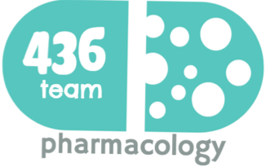
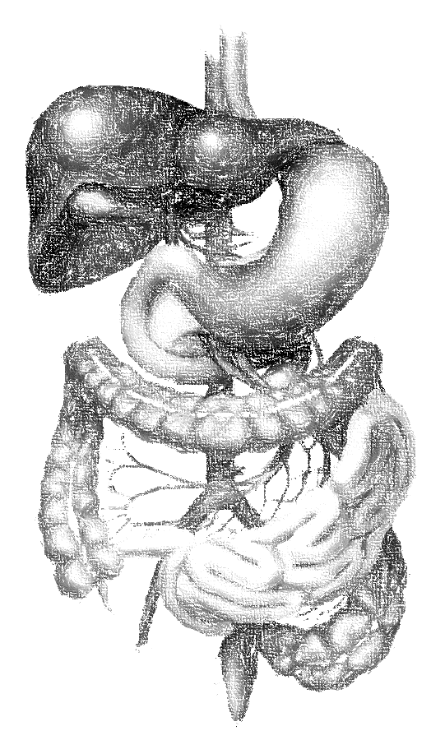
1: Peptic ulcer
objectives
Understand the key points of pathophysiology of the peptic ulcer disease .
Enumerate various classes of dugs used in peptic ulcer disease.
Know the characteristic pharmacokinetics, pharmacodynamics and side effects of drugs used in peptic ulcer disease.
Know the cyoprotective drugs mainly misoprostol and its use in NSAIDs-induced peptic ulcer.
Identify different antacids that are used to relief pain of peptic ulcer.
Identify potential adverse drug interactions of anti-ulcer drugs.
Color index
extra information and further explanation
important
doctors notes
Drugs names
Mnemonics
Kindly check the editing file before studying this document

Slide 2
Introduction
Peptic ulcer disease (PUD)
a localized lesion of the mucous membrane of the stomach (gastric ulcer) or duodenum (duodenal ulcer), typically extending through the muscularis mucosa.
Pathophysiology
is imbalance between aggressive factors (acid &pepsin) and defensive factors (e.g. prostaglandins, mucus & bicarbonate layer).
However, nowadays, it seems that H. pylori is a major cause
Mucus and bicarbonate ion secretions
protect mucosa Na bicarbonate is considered as a buffer so it inhibits auto digestion of the stomach wall
Prostaglandins (PGE2 & PGI2)
Aggressive factors
Defensive factors
protect mucosa by
inhibiting acid secretion
increasing mucus and bicarbonate production
enhancing mucosal blood flow.
Hydrochloric acid and pepsin
destroy gastric and duodenal mucosa.
The stomach between Esophagus & Intestine
One of the main action of Prostaglandins is increase the turnover and regeneration of damaged cells
Etiology
H. pylori infection is the major etiological factor in peptic ulcer disease (95% in duodenal and 80% in gastric ulcer).
Drugs (e.g.) NSAIDs; corticosteroids,
Hypersecretory states (Zollinger Ellison syndrome) “gastrin inducing tumor”
Alcohol
Smoking
Caffeine
Diet
Genetic factors
Increase HCl production
“Spicy food”
When a Pt. comes with peptic ulcer first thing we must do is excluding of H.pylori because its treatment is totally different
“O blood group are susceptible to have peptic ulcer”

Slide 3
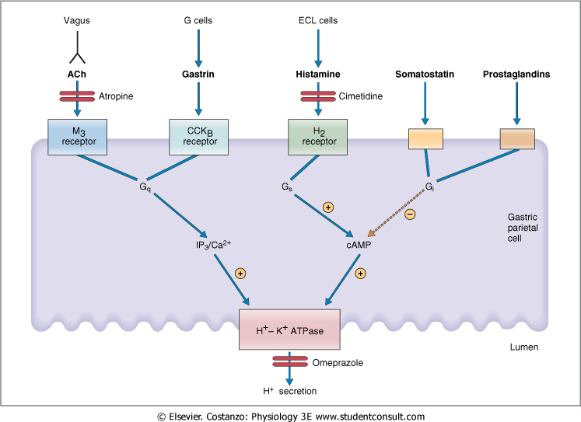
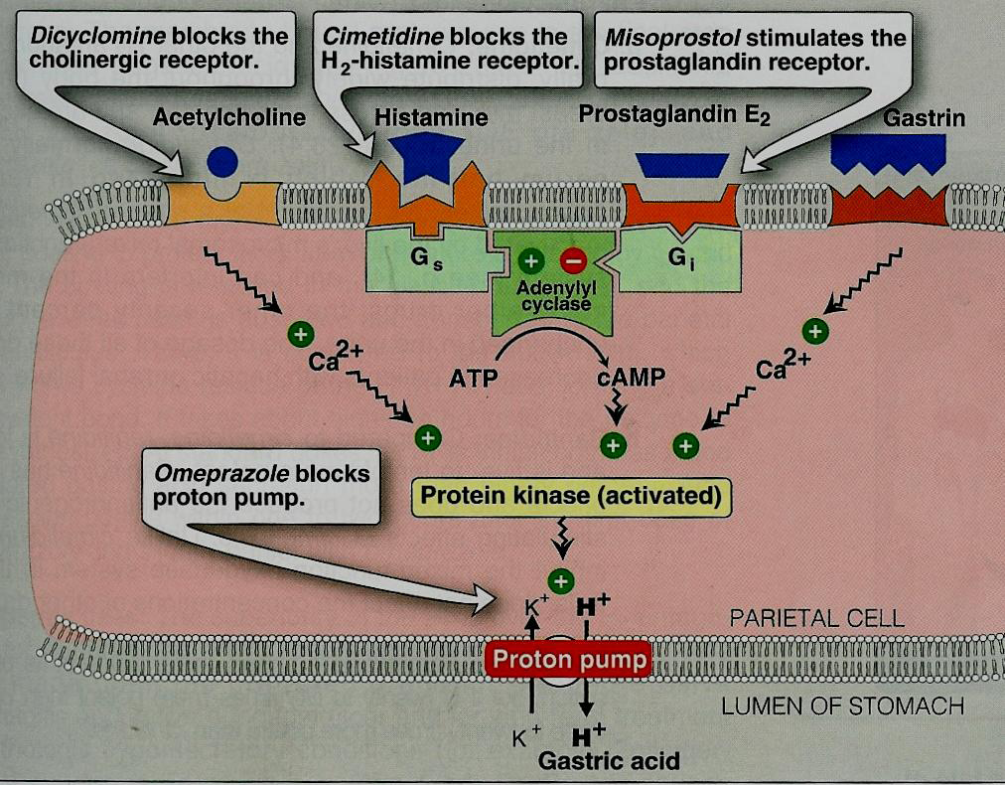
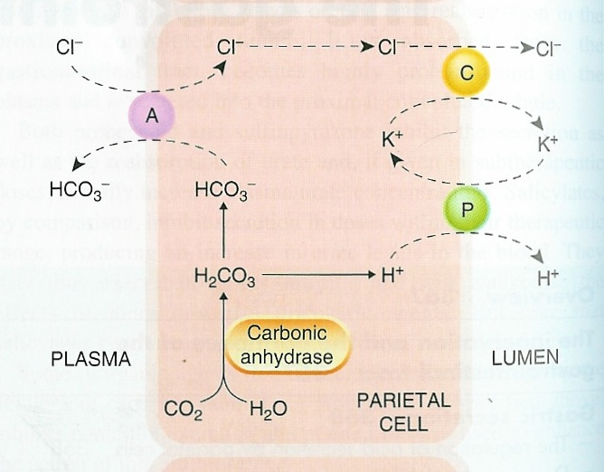
Introduction
Gastric secretions
1- HCl and intrinsic factor (Parietal cells).
2- Pepsinogens (Chief cells).
3- Mucus, bicarbonate (mucus-secreting cells).
Regulation of gastric secretions
Parietal cells secrete acid in response to:
1- Ach (neurotransmitter): M3 receptors. It is not effective alone
2- Gastrin (hormone): CCK2 receptors (cholecystokinin) it’s NOT approved yet
3- Histamine (local hormone): H2 receptors
4- Proton pump (H+/ K+ ATPase)
G-protein linked receptors (important)
Increase Ca2+ via IP3
“cAMP dependent pathway”
Gastric secretion by parietal cells
Its formation is an important step to get H+ and HCO3- to make HCl as a final products

Slide 4
Overview on the treatment of peptic ulcer
Two types of treatment (antibiotics) for H.pylori are:
1-triple treatment 2- Quadra treatment but when we use other agents symptoms will be relived for a while . After finishing of treatment assessment must be done to make sure of complete eradication .
Eradication of H. pylori infections
NaHCO3 Sodium bicarbonate
Al(OH)3 Aluminum hydroxide
Hyposecretory drugs
Mucosal cytoprotective agents
Neutralizing agents (antacids)
Not treatment
Proton pump inhibitors
H2 receptor blockers
Antimuscarinic drugs
Prostaglandin analogues
Lansoprazole
Pantoprazole
Omeprazole–
Raprazole
Nizatidine
Ranitidine
Cimetidine
Famotidine
Misoprostol
Mg(OH)2 Magnesium hydroxide
CaCO3 Calcium carbonate
Efficacy drops down
(لا نسوا) شكلهم إني (بنت) (أمي) ويحسبون ما لي (رب) زين،
(برا يا زول)
برا فيه زول قوي
(نزار) أنقذ حياة (ران) وسحب (سم) العقرب (بفمو) ، عشان كذا هي (تدين له بحياتها مرتين)
Decrease gastric acid secretion to promote healing and pain relief

Slide 5
Proton Pump Inhibitors (PPIs)
Drug | Omeprazole , Lansoprazole , Pantoprazole , Raprazole
Mech.of action | Acts by irreversible (long effect) inhibition of proton pump (H+/ K+ ATPase) that is responsible for final step in gastric acid secretion from the parietal cell (they covalently bind to the pump).
Pharmaco-dynamics | They are the most potent inhibitors of acid secretion available today. Produce marked inhibition of basal H2 receptors & meal stimulated-acid secretion (90-98%). Reduce pepsin activity. Promote mucosal healing & decrease pain. Proton pump inhibitors heal ulcers faster than H2 blockers, and have H. pylori inhibitory properties. One of triple therapy is PPIs (so they have Bactericidal & inhibitory effects because Because this organism need acidic medium to survive
Pharmacokinetics | Given orally Are pro-drugs (given inactive , coverts to the active form after metabolism in the body) Given as enteric coated formulations (unstable in acidic medium in stomach). Are rapidly absorbed from the intestine. Are activated within the acidic medium of parietal cell canaliculi. At neutral pH = 7, PPIs are inactivated. Such as in blood Should NOT combined with H2 blockers or antacids. Bioavailability is reduced by food. Given one hour before the meal. On empty stomach Why should be given one hour before meal ? While they reach intestine the Pt. started eating food stimulates parietal cells to produce HCl and meanwhile PPIs started to give their effect Have long duration of action (> 12 h-24 h). -> Once daily dose is sufficient Metabolized in the liver by Cyt-P450. although they get metabolized within one hour but their duration of action is long since the they block the H+/K+ ATPase irreversibly Dose reduction is required in severe liver failure.
Indications | Eradication of H. pylori (combined with antimicrobial drugs). Resistant severe peptic ulcer ( 4-8 weeks). They are expensive so it’s reserved for severe cases Gastroesophageal reflux disease (GERD or GORD). Hypersecretory conditions as Zollinger Ellison syndrome will be explained later and gastrinoma (First choice). M3 & H2 blockers can treat Zollinger Ellison syndrome but we choose PPIs why ? because they treat at lower dose (double or tribble normal dose ) comparing to H2 & M3 المشكلة في هذا المرض هي زيادة الاحماض فأي دواء ينوصف راح يكون بجرعة اكبر من المعتاد
ADRs | CNS: Headache GIT: Diarrhea & abdominal pain. Achlorhydria (absence of HCL) leads to Hypergastrinaemia but how ? The stomach sense the high PH low acidity effect of the drug so it sends signals to gastrin producing cells to secrete more gastrin but the pump IS STILL inhibited so it sends more signals to produce gastrin reflex Hypergastrinaemia. Is a trophic factors cause hyperplasia of parietal cells on lab animals not humans safe Gastric mucosal hyperplasia can cause: -Increased bacterial flora because HCl is reduced Increased risk of community-acquired respiratory infections & nosocomial pneumonia .: if used in a Long term use may lead to : Vitamin B12 deficiency, iron, calcium absorption. reducing the acidity of stomach can prevent it from digesting proteins Increased risk of hip fractures due to deficiency not advisable for long term use Precaution should be given NOT to combine omeprazole (CYP2C19 inhibitor) and clopidogrel antiplatelet like aspirin (CYP2C19 is required for activation of clopidogrel ). It increase the risk of cardiovascular thrombus
To prevent the stomach from breaking it down and reach the intestine
We shouldn’t administer it with anything that lowers the stomach acid secretions even more ! These drugs already have a long effect .
Prazole = zollinger
كلو بدو بنات (clo-pido-grel) إلا أمي (Ome-prazole)

Slide 6
H2 receptor blockers
Drug | Cimetidine not available in KSA , Ranitidine , Famotidine , Nizatidine
Mech. action | They reversibly and competitively (will be dissociated from receptors if agonist conc. Is higher) block H2 receptors on the parietal cells. They are cheap drugs
Pharmacodynamics | Block 90% of nocturnal acid secretion (which depend largely on histamine) & 60-70% of total 24 hr acid secretion. Therefore, it is better to be given before night sleep. before sleeping histamine controls acid secretions more than other mediators Reduce pepsin activity. Promote mucosal healing & decrease pain Reduce basal and food stimulated-acid secretion
Pharmacokinetics | * Good oral absorption * Given before meals. * Famotidine is the most potent drug. * Exposed to first pass metabolism (metabolized before reaching the blood circulation) (except nizatidine that has the greatest Bioavailability = conc. of active drug in blood circulation after administration ) * Duration of action (4-12 h). * Metabolized by liver. * Excreted mainly in urine.
Indications | - GERD (heartburn/ dyspepsia). - Acute ulcer healing in moderate cases *Duodenal Ulcer (6-8 weeks). *Benign gastric ulcer (8-12 weeks). *Prevention of bleeding from stress-related gastritis. - Pre-anesthetic medication (to prevent aspiration pneumonitis). - Post–ulcer healing maintenance therapy. After complete eradication of H.pylori
ADRs | GIT disturbances: Nausea & vomiting. CNS effects: Headache - confusion (Contraindicated in elderly, hepatic dysfunction, renal dysfunction). Bradycardia and hypotension (if given in rapid I.V.) so must be given slowly CYT-P450 inhibition (Only Cimetidine) decrease metabolism of warfarin increase risk of bleeding , phenytoin, benzodiazepines. Which causes the T1/2 to prolong Endocrine effects (Only Cimetidine) Galactorrhea (Hyperprolactinemia ) risk if infertility Antiandrogenic actions (gynecomastia –impotence) due to inhibition of dihydrotestosterone binding to androgen receptors.
Notes | Precautions Dose reduction of H2 receptor blockers in severe renal or hepatic failure and elderly.
The family is the most potent supporter in our lives
نزار قباني وصل صوت المرأة لكل مكان بشعره
لما يكون المريض منوم ممكن يصير ارتجاع لحمض المعدة فيدخل على الرئة ويسوي التهاب
2 Hours before surgery =H2 blockers
مثل السم شين

Slide 7
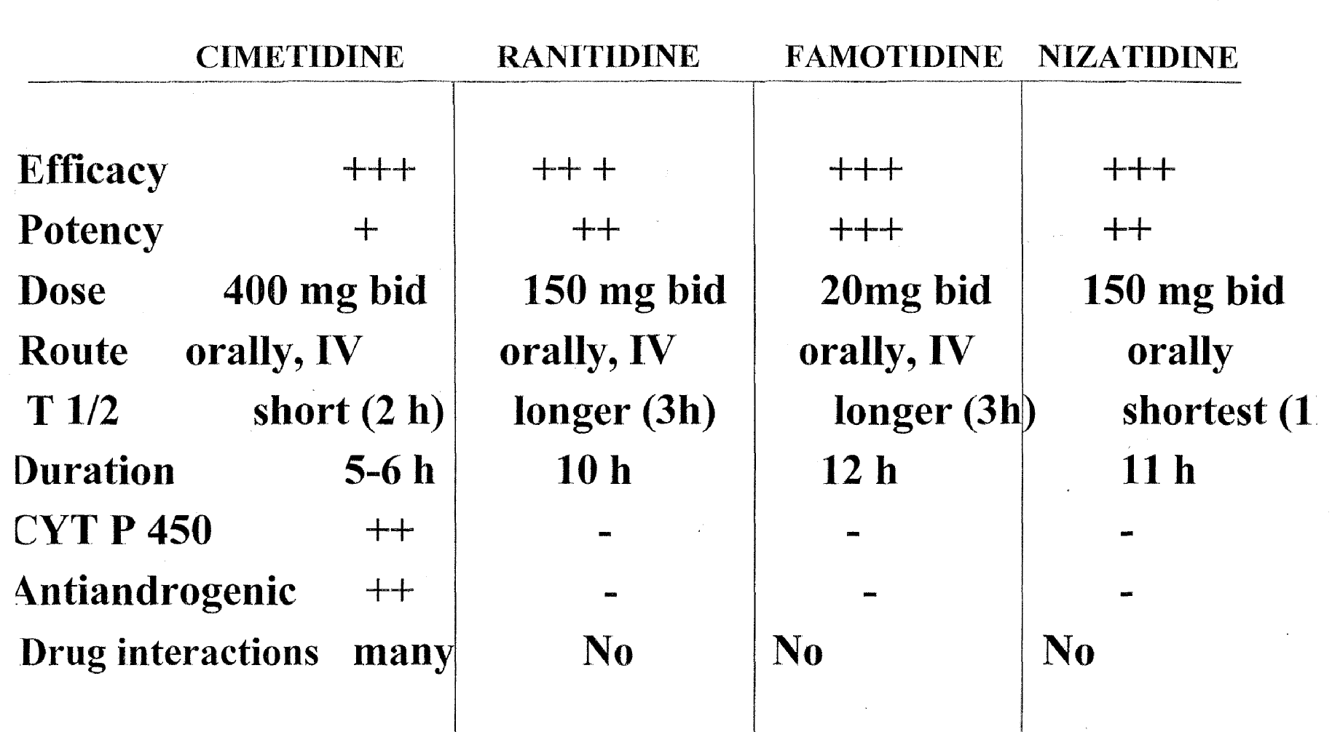
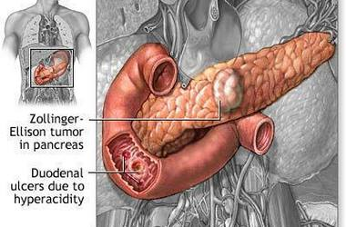
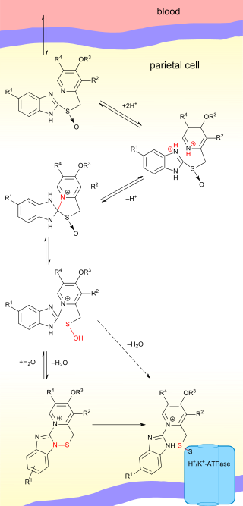
For better understanding
H2 receptor blockers
is equal
Most potent
Lowest dose , most potent
Due to its side effects it is not available in KSA
مثل السم شين
Zollinger Ellison syndrome
is a disease in which tumors cause the stomach to produce too much acid, resulting in peptic ulcers. Symptoms include abdominal pain and diarrhea.
Gastrin -secreting tumor of the pancreas.
Gastrin results in:
Parietal cell hyperplasia (trophic factor).
Excessive gastric acid production.
Zollinger-Ellison syndrome is a rare condition in which one or more tumors form in your pancreas or the upper part of your small intestine (duodenum). These tumors, called gastrinomas , secrete large amounts of the hormone gastrin, which causes your stomach to produce too much acid. The excess acid then leads to peptic ulcers, as well as to diarrhea and other symptoms
Activation of Proton Pump Inhibitors In Parietal cell
first it reaches the intestine as prodrug get inside the parietal cells activated by protonation (adding hydrogen ions) and this must happen in acidic medium within parietal cells
Active form
Sulfur atom
Makes a covalent bond with H+/K+ ATPase sulfur atom which is a strong bond

Slide 8
Prostaglandin analogues
Drug | Misoprostol Prostaglandin analogues (PGE1 ) why we use analogues instead of the actual prostaglandin ? prostaglandins have very short duration of action (minutes)
P.D | ↓ HCL secretion. ↑ protective measures (↑ mucous/bicarbonate & gastric mucosal blood flow).
P.K | Orally, must be taken 3-4 times/day. (short duration of action)
uses | Used for NSAIDS-induced peptic ulcer.
ADRs | Abdominal cramps; diarrhea. Uterine contraction (dysmenorrhea or abortion) Be careful with pregnant women Vaginal bleeding.
الآنسة (miss) أجهضت(miscarriage) طفلها
Antacids
These drugs are mainly inorganic salts (basic substance NOT treatment)
Drug | Sodium bicarbonate NaHCO3 Na is well absorbed | Aluminum hydroxide Al(OH)₃ It isn’t well absorbed | Magnesium hydroxide Mg(OH)₂ It isn’t well absorbed | Calcium carbonate CaCO₃
M.O.A | acts by direct chemical neutralization of HCL and as a result may decrease pepsin activity.
uses | used to relief pain of peptic ulcer & for dyspepsia.
ADRs | Effective, but systemic alkalosis may occur. | Constipation Systemic phosphate depletion (weakness, malaise, anorexia) in high doses It’s not well absorbed , but due to prolong use it might get absorbed and cause these side effects | Diarrhea Magnesium trisilicate-- slow-acting antacid | Milk-alkali syndrome happens when there is high source of Ca or production with alkalosis Hypercalcemia Renal failure
Contra-indications | CVS patients since Na may cause water retention | They usually use Aluminum hydroxide with Magnesium hydroxide to come over constipation and diarrhea
Notes | All antacids ↓ absorption of some drugs as : Tetracycline Deposition in the bone & teeth , fluoroquinolones, iron. (There must be gap at least 2 hours between their admiration with antacids)
It isn’t well absorbed
ألم المغص شين
مات وكان ماجن وقليل حياء

Slide 9
Summary
Peptic ulcer disease happens due to the imbalance between aggressive factors ( HCL/pepsin ) and the defensive factors ( mucus/ HCO3/prostaglandins )
Major etiological cause is H. Pylori infection
Treatment of PUD
Eradication of H. pylori infection
Hyposecretory drugs
Mucosal cytoprotective agents
Neutralizing agents
1- PPI : Omeprazole , Lansoprazole , pantoprazole , Raprazole
Acts by Irreversible inhibition of Proton pump by covalent “ di-sulphate ” bond Most potent hyposecretory drugs. Have H.pylori inhibition effect. Marked inhibition in basal and meal stimulates-acid secretion. Never combined with H2 blockers or Antacids Used for resistant and sever cases. 1st choice for treating Zollinger Ellison May cause Hyperplasia in parietal due to reflex hypergastrinaemia due to Achlorhyria (absence of HCl). Long term use may lead to Vitamin & iron deficiency, calcium absorption and increase the risk of hip fracture.
Prostaglandin analogues Misoprostol
Increase protective measures (Increase mucous/bicarbonate & gastric mucosal blood flow/ decrease HCl). Used for NASID-induced peptic ulcer. May cause uterine contraction (abortion) and vaginal bleeding and Abdominal cramps; diarrhea.
Inorganic basic salts Not treatment
Neutralizes HCL . used to relief pain of peptic ulcer & for dyspepsia. Decrease absorption of: Tetracycline ,fluoroquinolones , Iron
1- NAHCO3 : may cause systemic alkalosis C.I in CVS patients 2- Aluminum hydroxide: cause constipation and systemic phosphate depletion. 3- Magnesium Hydroxide: cause diarrhea # 2&3 are given together to antagonize each other’s ADR 4- calcium carbonate: cause milk-alkali syndrome , renal failure
OMEPRAZOLE which is a very potent liver enzyme inhibitor, should not be combined with CLOPIDOGREL which is anti-platelet that is Activated by CYP2C19.
2- H2 blockers : Cimetidine , Famotidine , Ranitidine , Nizatidine
Reversible & competitive block of H2 receptor. Used for moderate cases. Block Nocturnal acid secretions better given before sleep Pre-anesthetic to prevent aspiration pneumonitis. Used as Post-ulcer healing maintenance therapy. Famotidine is the most potent drug. nizatidine that has the greatest bioavailability. Cimetidine have Antiandrogenic effects and may cause gynecomastia. Cimetidine CYT-P450 inhibition decrease metabolism of other drugs.

Slide 10
MCQs
1- An elderly woman with a recent history of myocardial infarction is seeking a medication to help treat her occasional heartburn. She is currently taking several medications, including aspirin, clopidogrel, simvastatin, metoprolol, and Lisinopril. Which of the following choices should be avoided in this patient?
A. Famotidine B. Omeprazole C. Misoprostol
2- Which of the following medications for gastrointestinal problems is contraindicated in pregnancy and may lead to abortion ?
A. Famotidine B. Omeprazole C. Misoprostol
3- If we have a patient with cardiovascular disease who is taking aspirin as one of his medications, which one of the following anti-ulcer drugs will be recommended in his case?
A. Famotidine B. Omeprazole C. Misoprostol
4- 28 years old female has heartburn pain almost 5 days in a week, especially after the meals. Which one of the following drugs will be the best choice in her case ?
A. Cimetidine B. Lansoprazole C. Misoprostol
5- 41 years old male has heartburn pain, especially at the night during sleeping . Which one of the following drugs will be the best choice in his case ?
A. Famotidine B. Lansoprazole C. Misoprostol
6- Which one of the following is serious complication of prolong use of H2 blockers & Proton Pump inhibitors ?
A. Adenocarcinoma B. gynecomastia C. Pseudomembranous colitis
7- 22 years old female with Extra hair on her face and body and irregular periods. She is diagnosed with polycystic ovary syndrome and high level of androgens hormone. If she has peptic ulcer which one of the following anti-ulcer drug will be recommended in her case?
A. Cimetidine B. Lansoprazole C. Misoprostol
8- Which one of the following drugs may cause gynecomastia and impotence in male ?
A. Cimetidine B. Famotidine C. Nizatidine
B
C
C
B
A
C
A
A

Slide 11
MCQs
9- Which one of the following drugs may lead to excessive bleeding if it combines with warfarin ?
A. Cimetidine B. Famotidine C. Nizatidine
10- Which one of the following drugs does not exposed to first pass metabolism in the liver and has high bioavailability to be taken orally ?
A. Cimetidine B. Famotidine C. Nizatidine
11- Patient is diagnosed with gastrin-secreting tumor of the pancreas and he develop peptic ulcer due to excessive gastric acid production. Which one of the following is drug of choice ?
A. Famotidine B. Omeprazole C. Misoprostol
12- Which one of the following drugs can be used before surgery to prevent aspiration pneumonitis ?
A. Famotidine B. Omeprazole C. Misoprostol
13- Which one of the following antacids may cause constipation?
A. Sodium bicarbonate B. Aluminum hydroxide C. Magnesium hydroxide
14- Which one of the following antacids may cause Diarrhea ?
A. Sodium bicarbonate B. Aluminum hydroxide C. Magnesium hydroxide
15- Which one of the following antacids may cause water retention and increase the preload in patients with cardiovascular disease ?
A. Sodium bicarbonate B. Aluminum hydroxide C. Magnesium hydroxide
16- Which one of the following anti-ulcer drug may combine with antibiotic to treat H.pylori infections ?
A. Famotidine B. Omeprazole C. Misoprostol
17- Which one of the following hyposecretory drugs is the potent one, and act as Proton pump inhibitors ?
A. Famotidine B. Omeprazole C. Misoprostol
A
C
B
A
B
C
A
B
B

Slide 12
قادة فريق علم الأدوية :
- جومانا القحطاني - اللولو الصليهم
- فارس النفيسة
الشكر موصول لأعضاء الفريق المتميزين :
عبد الرحمن ذكري
روان القحطاني
شذا الغيهب
شوق الأحمري
وئام بابعير
References :
1- 436 doctor Hanan’s slides and notes
2- www.mayoclonic.org
3- 436 doctor Ishfaq Notes
pharma436@outlook.com
@pharma436
Your feedback
* الشعار و القالب الأساسي من تصميم لين التميمي

