Slide 1
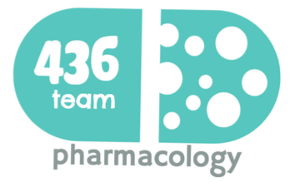
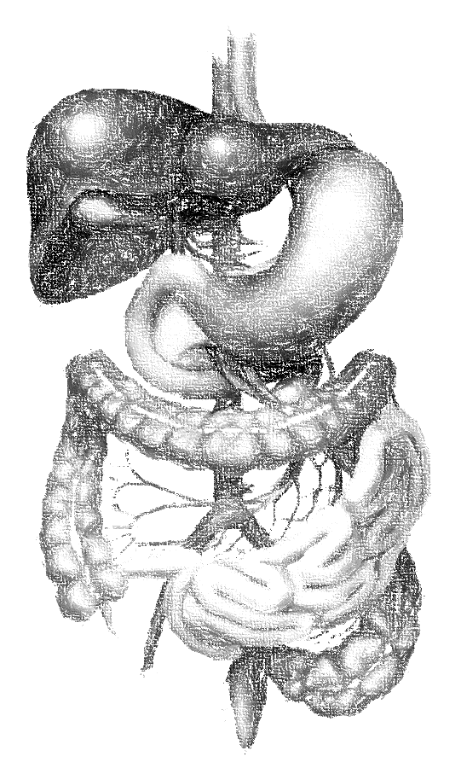
10: Anti-malarial drugs
objectives
Classify the main antimalarial drugs depending on their goal of therapy
Detail the pharmacokinetics & dynamics of main drugs used to treat attack or prevent relapses
State the WHO therapeutic strategy for treatment
Hint on the CDC recommendations for prophylaxis in travelers to endemic areas
Color index
extra information and further explanation
important
doctors notes
Drugs names
Mnemonics
We highly recommend you to study Microbiology lecture “Malaria” before studying this lecture
Kindly check the editing file before studying this document

Slide 2
تم بحمد الله
كل الشكر لـ(أعضاء فريق علم الأدوية) المتميزين
اشتغلوا في أكثر بلوك مضغوط في كل سنوات العلوم الأساسية وما قصروا أبد
لا تنسوهم من دعواتكم ♥
روان سعد القحطاني
أثير الرشيد
أنوار العجمي
جواهر ابانمي
دعاء عبدالفتاح
رحاب العنزي
ريم الشثري
شروق الصومالي
شذى الغيهب
شوق الأحمري
غادة المزروع
ليلى مذكور
وئام بابعير
وجدان الزيد
فيصل العباد
معتز الطخيس
عبدالكريم الحربي
عبدالرحمن الجريان
إبراهيم ماجد فتياني
عبدالرحمن الراشد
عبدالكريم العتيبي
مؤيد أحمد
خالد العيسى
سعد الرشود
محمد خوجة
قادة فريق علم الأدوية :
- جومانا القحطاني - اللولو الصليهم
- فارس النفيسة

Slide 3
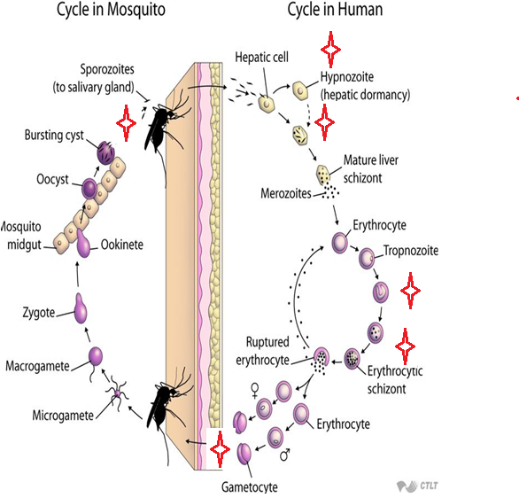
Overview
Cycle & Drugs site of action
Causal prophylaxis
Sporozoitocides
Radical cure
Clinical cure
Supressive prophylaxis
Drugs
Gametocides
Antimalarial drugs
Causal prophylaxis
Destroys parasite in liver cells & prevent invasion of erythrocytes
Suppressive prophylaxis
Suppresses the erythrocytic phase & thus attack of malaria fever
Radical cure
Gametocidal
Sprozoitocides
Fast acting high efficacy
Slow acting low efficacy
Eradicate all forms of vivax from the body
Destroys gametocytes & prevent transmission
Destroys sporozoites
Primaquine
Against vivax: Chloroquine, Quinine
Against all species : Primaquine
Chloroquine, Quinine, Mefloquine, Artemisinin
Pyrimethamine, Proguanil, Sulfonamides
Suppressive drug + Hypnozoitocidal
Proguanil, Pyrimethamine
Clinical cure (erythrocytic schizonicide)
Used to terminate an episode of malarial fever
Chloroquine, Mefloquine, Doxycycline
Antimalarial
By Armando (15:55 min) amazing video!
The primary site of infection is liver
Antimalarial
By Efham (19:15 min) amazing video!
ميثاء مين ؟ اللي بروقان تسولف ؟

Slide 4
Antimalarial drugs
Drug | Artemesinin most potent
Action/Mech. of action
Pharmacodynamics | Artemisinin is the active principle of the plant Artemisia annua (qinghaosu) Fast acting blood Schizontocide Affect all forms including multi-drug resistant P. falciparum Short duration of action High recrudescence rate (after short-course therapy Female only ) Poorly soluble in water & oil, can only be used orally Artemisinin & its analogs are very rapidly acting blood schizonticides against all human malaria parasites. No effect on hepatic stages.
Pharmacokinetics | Rapidly bio transformed in liver into dihydroartesiminin → active metabolite Artemisinin ,Artesunate, Artemether are prodrugs Derivatives (^) are rapidly absorbed orally Widely distributed t½ Artemisinin: 4hrs / Artesunate: 45min / Artemether: 4-11hrs Artesunate (water-soluble; oral, IV, IM, rectal administration) Artemether (lipid-soluble; oral, IM, and rectal administration) Dihydroartemisinin (water-soluble; oral administration) Induce its own CYP-mediated metabolism→ ↑ clearance 5 fold so its efficacy will decrease (this is a disadvantage of Artemether )
Clinical uses | Because Artemisinin derivatives have short t ½ : Monotherapy should be extended beyond disappearance of parasite to prevent recrudescence By combining the drug with long- acting antimalarial drug ex:(Mefloquine Female only) only we need to know its name & that it is long- acting antimalarial drug
ADRs | Transient heart block Decrease neutrophil count Brief episodes of fever because of its effect on the RBCs, which indicate high dose Resistance → was reported recently in Cambodia- Thailand border
Preparation | Artesunate IV or IM preparations for severe complicated cases as cerebral malaria (24h) followed by complete course of ACT Artemisin-based Combination Therapies (ACTs):given as a tablet Artemether + lumefantrine Artemether + amodiaquine Artemether + mefloquine Artemether + sulfadoxine - pyrimethamine
They have endoperoxide bridges that are cleaved by haem iron to yield carbon- centered free radicals, that will:
Alkylate membranes of parasite’s food vacuole and mitochondria → no energy
Irreversibly bind & inhibit sarco-endoplasmic reticulum Ca²⁺-ATPase of the parasite, thereby inhibiting its growth
Inhibiting formation of transport vesicles → no food vacuoles
The drug has a unique structure (endoperoxide bridges), it will bind with the iron of the patient to help the drug to release free radicals → destroy multiple things in the parasites and eventually kill them
Artemisinin = diminishing
I love sun and eating (ate)

Slide 5
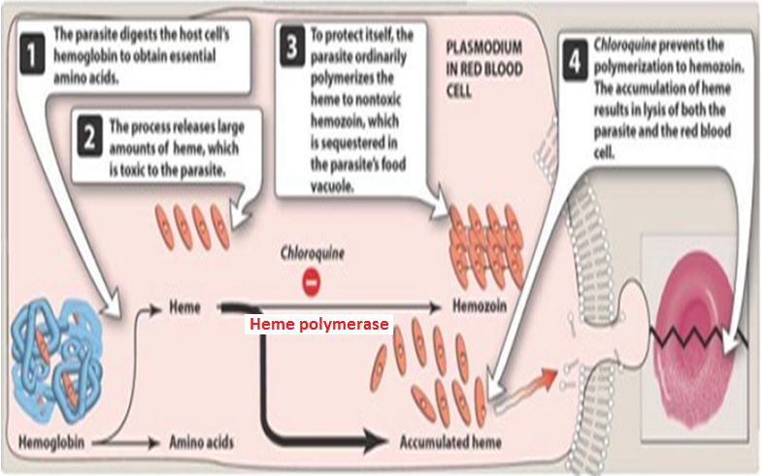
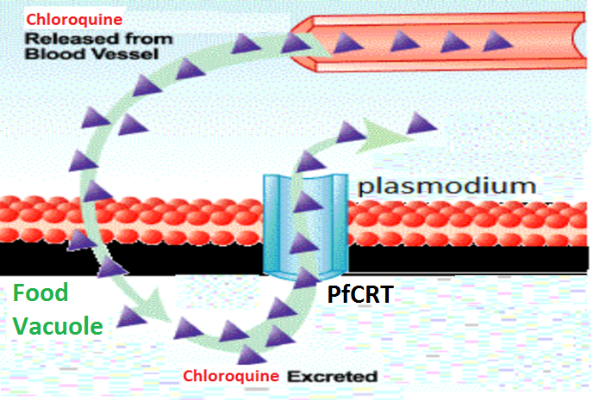
Antimalarial drugs
Drug | Chloroquine very famous, effective, safe & very old drug
Mechanism of action
Resistance
P.D | Safe in pregnancy Potent blood Schizontocide Active against all forms of the schizonts (exception is chloroquine-resistant P.f. ”P. falciparum” & P.v. “P. vivax”) No activity against tissue shizonts. blood only Gametoside: Against all species except P. falciparum It has antipyretic effect, and it is cheap
Pharmacokinetics | Rapidly & completely absorbed from the GIT PO=orally Has high volume of distribution(100-1000 L/kg) Concentrated into parasitized RBCs Released slowly from tissues Metabolized in the liver Excreted in the urine 70% unchanged Initial t½ =2-3days & terminal t ½=1-2months has 2 compartmental diffusion
Uses | Used to eradicate blood schizonts of Plasmodium.( It is given in loading dose to rapidly achieve effective plasma conc. Female only) Hepatic amoebiasis Rheumatoid arthritis
ADRs | Therapeutic dose: Mild headache and visual disturbances Gastro-intestinal upsets; Nausea, vomiting Pruritus, urticaria. | Prolonged therapy (more than 3 days) or in high dose: Ocular toxicity: Loss of accommodation, lenticular opacity (cataract), retinopathy فلازم نتأكد ان المريض ما يكون عمره كبير Ototoxicity Weight loss Bolus injection → hypotension & dysrhythmias
Malaria Parasite digest host cell’s Hb to obtain amino acids (remember: if we breakdown Hb → amino acids)
Heme is released → Toxic to the parasite
So parasite detoxifies it (by heme polymerase (an enzyme inside the parasites) →to Hemozoin (Nontoxic) & traps it in food vacuole
Chloroquine block This enzyme, so heme stays and kills the parasite, because heme is toxin for the parasite
Resistance (it’s a disadvantage in all antimalarial drugs) against the drug develops as a result of mutation of the chloroquine resistance transporter (PfCRT)
PfCRT enhances the efflux of chloroquine from the food vacuole
الدواء يدخل للبارسايت من الدم عن طريق الفود فاكيول ومع الوقت يصير طفرة في الباراسيت فيطور ناقل على سطحه يطلع الكلوروكوين منه فما يقدر يأثر عليه
الدكتور نبه كثير إن هذا الدوا صار عنده مقاومه
نقول للحامل “ كولي يا الملكة” ما راح يجيك شيء إن شاء الله
1- First it will go to highly perfusion tissues e.g.: liver, heart lung
2- After 2 or 3 days it will go to low perfusion tissues e.g.: bone

Slide 6
Antimalarial drugs
Drug | Quinine
M.O.A | Same as chloroquine
Resistance | Like chloroquine by mutation of chloroquine resistance transporter (PfCRT), also increased expression of P-glycoprotein transporter (the parasite will increase the transporter to get ride of Quinine. So it has double resistance)
Pharmacokinetics | Rapidly & completely absorbed from the GIT Peaks after 1-3 hours Metabolized in the liver & excreted in urine 5-20% excreted in the urine unchanged t½ = 10 hours but longer in sever falciparum infection(18hrs) Administered: orally in a 7 day course or by slow IV for severe P. falciparum infection
Pharmacodynamics | Safe in pregnancy The main alkaloid in cinchona bark Potent blood Schizontocide of all malarial parasites & weak gametoside for vivax & ovale (but not falciparum. It is Not active against liver stage parasites (Female only ) Depresses the myocardium, reduce excitability & conductivity Mild analgesic, antipyretic, stimulation of uterine smooth muscle, curare mimetic effect (muscle relaxant)
Uses | Parenteral treatment of severe falciparum malaria Oral treatment of falciparum malaria Nocturnal leg cramps Nocturnal leg cramps = involuntary contraction of the muscle The drug effective in some patient and not effective in other patients
الحامل كالملكة

Slide 7
Quinine (con.)
Drug | Quinine
ADRs | With therapeutic dose: poor compliance → bitter taste. some patients stop the drug because of its bad taste (this taste comes from the planet)
 | Higher doses: Blood dyscrasias; anemia, thrombocytopenic purpura & hypoprothrombinemia. Blackwater fever (RBCs will rapture and appear in urine, which will give the urine dark color), a fatal condition in which acute hemolytic anemia is associated with renal failure (due to hypersensitivity reaction to the drug Female only ) Cinchonism: (tinnitus, deafness, headaches, nausea & visual disturbances) Abdominal pain & diarrhea Hypotension & arrhythmias, hypoglycemia, because the drug enhance the secrestion of insulin (only if we give it as IV) Rashes, fever, hypersensitivity reactions If given IV → neurotoxicity → tremor of the lips and limbs, delirium, fits (نوبة), stimulation followed by depression of respiration & coma
Contraindications | Prolonged QT Interval type of arrhythmia Glucose-6-Phosphate Dehydrogenase (G6PD) Deficiency Myasthenia Gravis, the drug cause muscle relaxant and in Myasthenia Gravis most of the muscle relax (because the muscles lost their receptors for Ach → no AP → no contraction) Hypersensitivity Optic Neuritis, auditory problems Dose should be reduced in renal insufficiency because the drug secreted by kidney
Drug interactions | Antacids: Antacids containing aluminum &/or magnesium may delay or decrease absorption of Quinine, antacids bind with Quinine and decrease its absorption Mefloquine, because it cause prolonged QT interval Quinine can raise plasma levels of warfarin and digoxin
ملكة البحر المتوسط
الملكة موب طويلة بال أبداً

Slide 8
Antimalarial drugs
Drug | Primaquine
Action/Mech. of action
P.D | Hypnozoitocides → against liver hypnozoites & gametocytocides (the only drug can act on the liver) Against the 4 human malaria species Female only Radical cure of P. ovale & P. vivax Prevent spread of all forms (chemoprophylaxis) so it can be given as a prophylactic
P.K | Well absorbed orally Rapidly metabolized to etaquine & tafenoquine → more active (t½ → 3-6h)
Indications | Radical cure of relapsing malaria, 15mg/day for 14 days In falciparum malaria: a high single dose (45mg) to kill gametes & cut down transmission G-6-PD normal → 15 mg\day for 14 days G-6-PD deficiency (mild African form) → 45 mg\week for 8 weeks G-6-PD deficiency (more sever mediterranean variety) → 30 mg\week for 30 weeks
ADRs | At regular doses patients with G-6-PD deficiency → hemolytic anemia. Because the free radicals will rapture the RBCs Oxidation of Primaqune produces free radicals, free radicals will cause oxidative damage of RBCs → Hemolysis
 | At larger doses: Epigastric distress & abdominal cramps Mild anemia, cyanosis (bluish discoloration of nails and limbs) & methemoglobinemia Severe methemoglobinemia → rarely in patients with deficiency of NADH methemoglobin reductase. Granulocytopenia & agranulocytosis (rare) reduction in granulocyte
Contraindications | Should be avoided in pregnancy (the fetus is relatively G6PD-deficient and thus at risk of hemolysis) G6PD deficiency patients
Not well understood. It may be acting by:-
Generating ROS → can damage lipids, proteins & nucleic acids of the parasite
Interfering with the electron transport in the parasite → no energy
Inhibiting formation of transport vesicles → no food vacuoles
Resistance: Rare when Primaquine & Chloroquine are combined
Primaquine
Convert to electrophiles (free radicals)
Generate reactive
oxygen species Interferes with oxygen transport system
The primary site of infection is liver
The three doses are very important

Slide 9
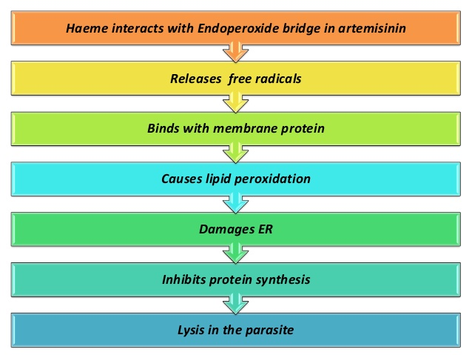
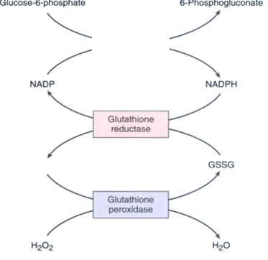
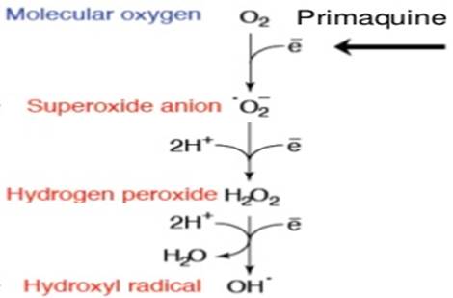
To understand !
الصور موجودة في سلايدز الدكاترة لكن الشرح إضافة من عندنا
Mechanism of action for Artemesinin
Glucose-6-phosphate
This reaction happen inside the RBCs, the G-6-P will be converted into phosphoguconate and NADPH via Glucose 6 phosphate dehydrogenase (G-6-P-D)
The NADPH will go to the glutathione system (antioxidant system)
Any decrease or deficiency in (G-6-P-D) will decrease the production of NADPH, so decrease the efficient of glutathione system
Glucose 6 phosphate dehydrogenase
Phosphoguconate + NADPH
أحد antioxidant systems هوglutathione اللي يحول H₂O₂إلى H₂O، كيف؟ فيه عندنا انزيم اسمه glutathione peroxidase راح يشيل ذرة الأوكسجين الموجودة في H₂O₂، لكن يحتاج مادة عشان تخليه active وهم بعد عشان ينقل لها هذا الأوكسجين، من هالمادة؟ GSH، لمن يشتغل الأنزيم ويسوي شغله راح يتحول GSH إلى GSSG. نحتاج نحوله مره ثانية إلى GSH عشان نستفيد منه مره ثانية، كيف؟ عن طريق NADPH
لو افترضنا ما صار عندنا NADPH وش راح يصير؟ ما نقدر نرجع GSH بالتالي ما راح نحفز الأنزيم بالتالي ما نقدر نتخلص من H₂O₂. وهذي المادة تعد ROS وتقدر تدمر أشياء كثيرة من ضمنها RBCs
G6PD
GSH
أخذناها في الكارديو إذا تتذكرون ☺
The cascade is the oxidation cascade, and Primaquine will enhance this cascade which has benefits (to kill the parasites) and harmful effects (side effects, like damaging of RBCs)

Slide 10
WHO treatment guidelines
In vivax:
 | Sensitive | Resistant
In vivax | Chloroquine for 3 days followed by Primaquine for 14 days Chloroquine to stop the symptoms and Primaquine to prevent relapse | ACT / 3 days followed by Primaquine for 14 days
In falicparum:
 | uncomplicated | complicated
In falicparum (All show Resistance) | ACT (Artemisin-based Combination Therapies) | IV Artesunate for 24 hrs followed by ACT Or Artemether + [Clindamycin / doxycyline] They can treat any infection including parasite Or Quinine + [Clindamycin / Doxycyline]
Special risk group :
هذي النقطة مهمه
Quinine + Clindamycin (7 days): | ACT (Artemisin-based Combination Therapies):
Pregnancy; 1st trimester | Pregnancy; 2nd & 3rd trimester Lactating women So pregnant and lactating ladys use ACT, but after lactating she use Primaquine to eradicate the parasite in the liver (dose: 15 mg\day for 14 days) Infants & young children
Prophylaxis in travelers
CDC (Control Disease Center) recommendationsنشيك في موقعهم على توصياتهم قبل ما نسافر
Chloroquine | Areas without resistant P falciparum | Begin 1-2 weeks before departure (except for doxycycline 2 days) & continue for 4 weeks after leaving the endemic area
Mefloquine | Areas with chloroquine-resistant P falciparum
Doxycycline | Areas with multidrug-resistant P falciparum

Slide 11
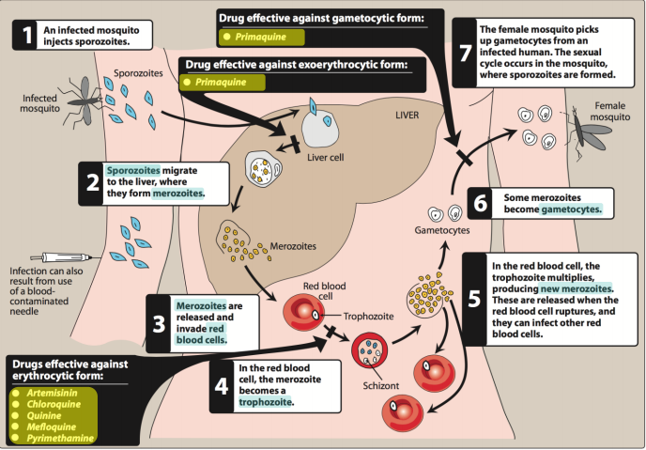
Summary
Life cycle of the malarial parasite & drugs site of action:
4-
4-
1-
435
2-
3-
1-Artemisinin: Fast acting blood Schizontocide , affect all forms including multi-drug resistant P. falciparum, short duration of action, and high recrudescence rate after short-course therapy.
Clinical uses : Because artemisinin derivatives have short t½ :
Monotherapy should be extended beyond disappearance of parasite to prevent recrudescence or by combining the drug with long- acting antimalarial drugs (Ex. mefloquine) .
2-Chloroquine:Potent blood Schizontocidal, active against all forms of the schizonts (except chloroquine -resistant P.f. & P.v.), and a gametoside: Against all species except P. falciparum .
Clinical uses : Eradicate blood schizonts of Plasmodium, Hepatic amoebiasis, and Rheumatoid arthritis ( it acts as anti-inflammatory drug).
3-Quinine: It is quinidine (anti-arrhythmic drug) isomer, both extracted from cinchona bark so it has some side effects of quinidine as depression of myocardium, reduce excitability & conductivity.Potent blood Schizontocide of ALL malarial parasites & gametoside for P vivax & ovale but not falciparum, it is not active against liver stage parasites, and has other effects like: Mild analgesic, antipyretic, stimulation of uterine smooth muscle (mild), curaremimetic effect (neuromuscular blocking effect).
Clinical uses : I.V (parenteral) treatment of severe falciparum malaria, Oral treatment of falciparum malaria, and Nocturnal leg cramps.
4-Primaquine: Hypnozoitocides against liver hypnozoites & gametocytocides against the 4 human malaria species,
radical cure of P. ovale & P. vivax, and Prevent spread of ALL forms (chemoprophylaxis) .
Clinical uses : Radical cure of relapsing malaria 15 mg/day for 14 days, In falciparum malaria: a single dose (45 mg) to kill gametes & cut down transmission, and Should be avoided in pregnancy (the fetus is relatively G6PD-deficient & thus at risk of hemolysis) & G6PD deficiency patients.
Special Risk Groups: (WHO treatment guidelines In falciparum)
Quinine + Clindamycin (7 days) : pregnancy 1st trimester .
ACT : Pregnancy 2nd, 3rd trimesters, lactating women, infants, and young children.
Prophylaxis in travellers: (CDC recommendations)
Chloroquine : Areas without resistant P. Falciparum .
Mefloquine : Areas with chloroquine-resistant P. Falciparum.
Doxycycline : Areas with multidrug-resistant P. Falciparum.
Begin 1-2 weeks before departure (except doxycycline 2 days prior) & continue for 4 weeks after leaving endemic area .

Slide 12
MCQs
Q1: A group of college students are traveling to a chloroquine-resistant malaria area for a mission trip. Which of the following medications can be used for prevention of malaria in these students?
A. Pyrimethamine. B. Mefloquine. C. Primaquinine
Q2: Which one of the following antimalarial drugs act on liver mainly ?
A. Artemisinin. B. Pyrimethamine. C. Primaquine.
Q3: Which one of the following antimalarial drugs can be used in case of severe complicated cases of malaria such as cerebral malaria?
A. Artemisinin. B. Artesunate . C. Artemether.
Q4: Which one of the following antimalarial drugs act as heme polymerase inhibitors?
A. Artemisinin. B. Chloroquine. C. Primaquine.
Q5: Malaria can develop resistance against Chloroquine by which transporters ?
plasmodium o falciparum chloroquine resistance transporter .
P-glycoprotein transporter .
Both of them .
Q6: Malaria can develop resistance against Quinine by which transporters ?
plasmodium o falciparum chloroquine resistance transporter .
P-glycoprotein transporter .
Both of them .
Q7: Which one of the following antimalarial drugs can cause Blackwater fever as serious adverse effect ?
A. Quinine. B. Chloroquine. C. Primaquine.
Q8: Patient with bradycardia and Arrhythmia, and his ECG shows prolong QT intervals. Which one of following antimalarial drug should be avoided in his case ?
A. Quinine. B. Chloroquine. C. Primaquine.
B
C
B
B
A
C
A
A

Slide 13
MCQs
Q9: Hemolytic anemia is a main side effect of :
A. Quinine. B. Chloroquine. C. Primaquine.
Q10: African child with G6PD deficiency who has infected by malaria which is resistant for chloroquine and artemether Which one of the following doses is required to eradicate them by primaquine ?
A. 15 mg\day for 14 days. B. 30 mg\week for 30 weeks. C. 45 mg\week for 8 weeks.
Q11: Turkish child with sever G6PD deficiency who has infected by malaria which is resistant for chloroquine and artemether Which one of the following doses is required to eradicate them by primaquine ?
A. 15 mg\day for 14 days. B. 30 mg\week for 30 weeks. C. 45 mg\week for 8 weeks.
Q12: which one of the following is the recommended dose of primaquine to be used in normal person without G6PD deficiency ?
A. 15 mg\day for 14 days. B. 30 mg\week for 30 weeks. C. 45 mg\week for 8 weeks.
Q13: A lady in her 2nd month of pregnancy. She get infected by malaria. Which one of the following Antimalarial drugs can be used in her case* ?
A. Artemether + mefloquine. B. Chloroquine. C. Primaquine.
Q14: A lady in her 6th month of pregnancy. She get infected by malaria. Which one of the following Antimalarial drugs can be used in her case** ?
A. Artemether + mefloquine. B. Chloroquine. C. Primaquine.
C
C
B
A
B
A
*Both Artemisinin & Primaquine should be avoided in her case.
Primaquine can not be used in all trimesters of pregnancy while Artemisinin and its derivatives can not be used in 1st trimesters only
**Pregnancy; 2nd & 3rd trimester & Lactating women & Infants & young children , the best for them is ACT.
But after lactating she has to use Primaquine to eradicate the parasite in the liver (dose: 15 mg\day for 14 days)

Slide 14
قادة فريق علم الأدوية :
- جومانا القحطاني - اللولو الصليهم
- فارس النفيسة
الشكر موصول لأعضاء الفريق المتميزين :
روان سعد القحطاني
شروق الصومالي
غادة المزروع
شوق الأحمري
سعد الرشود
خالد العيسى
محمد خوجة
References :
1- 436 Dr. Alia’s and Dr. Osama’s slides and notes
2- 435 pharmacology teamwork
3- 435 and 436 biochemistry teamwork
pharma436@outlook.com
@pharma436
Your feedback
* الشعار و القالب الأساسي من تصميم لين التميمي

