Slide 1
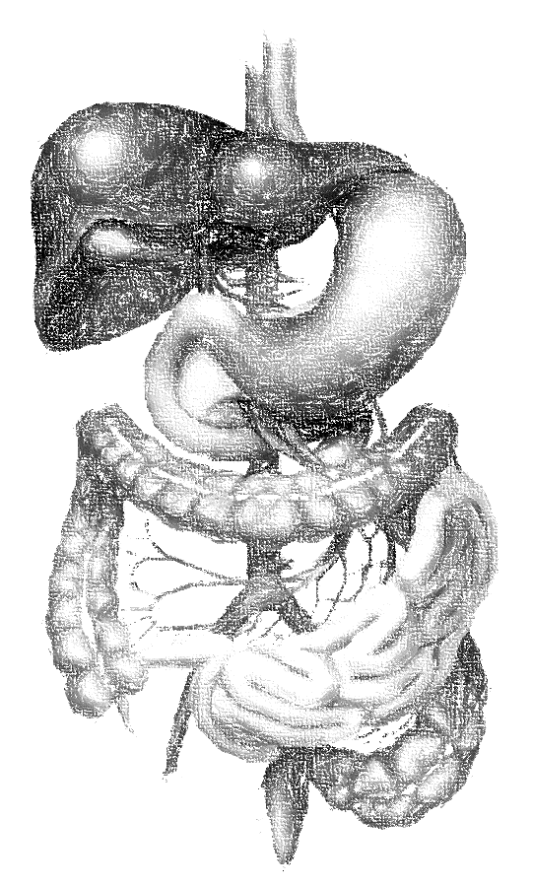
2: Antiemetics
objectives
Classify the main different classes of antiemetic drugs according to their mechanism of action.
Know the characteristic pharmacokinetics & dynamics of different classes of antiemetic drugs.
Identify the selective drugs that can be used according to the cause of vomiting.
Learn the adjuvant antiemetics..
Describe the major side effects for the different classes of antiemetics.
Color index
extra information and further explanation
important
doctors notes
Drugs names
Mnemonics
Kindly check the editing file before studying this document

Slide 2
Introduction
Vomiting
What is vomiting ?
is forceful expulsion of gastric contents through the mouth.
Can vomiting be considered as a disease?
It is a manifestation of many conditions and diseases. it is a sign of disease
Consequences of vomiting Severe vomiting may result in :
Dehydration Acid-base imbalance Electrolyte depletion Aspiration, pneumonia
How is vomiting induced? Vomiting center respond to inputs from:
2. Disturbance of vestibular system: Motion sickness (H1 & M1 receptors) | 1. Higher cortical centers stimulation (CNS): Emotional factors happiness or sadness Nauseating smells or sights
4. Stimulation of chemoreceptor trigger zone (CTZ) CTZ is an area of medulla that communicate with vomiting center to initiate vomiting. CTZ is physiologically outside BBB. (so any changes in the contents of the CSF or the blood will trigger this receptors, such as antihypertensive drugs. that’s why some drugs can't cross BBB and still can block the receptors of the CTZ -because they are distributed in the blood-) CTZ contains D₂ receptors, 5 HT₃ receptors & opioid receptors. stimulated by: Emetogenic drugs Can cross BBB (opioids stimulate the opioid receptors, general anesthetics, digitalis, L-dopa stimulates D2 receptors, anticancer drugs chemicals and toxins ‘chemical substance (including drugs) cannot cross BBB’ (blood, CSF). Radiation. Uremia urea inside blood. | 3. The periphery (Pharynx, GIT) via sensory nerves it is stimulated by: GIT irritation e.g. gastritis Myocardial infarction Renal or biliary stones post surgery: as side effect of anesthetic drugs Cancer food poising
Sometimes, It is a protective mechanism
one of the serious complication, aspiration while lying down especially common in children
Remember the two M’s
Morning sickness (especially in pregnancy)
We have this receptor in two place where they can induce the vomiting
- GI tract . - CTZ
Add a point:
Estrogen and hormonal
fluctuation, especially in pregnancy

Slide 3
To understand !
To understand !
This slide is NOT extra
Pathophysiology of Emesis
Helpful video 15:53
Antiemetics are all blockers
you can noticed that many places inducing vomiting has 5HT3 receptors
Vomiting Centre (medulla)
Receptors: Muscarinic, 5HT3
Cerebral cortex
Vestibular nuclei Receptors: Muscarinic M1 Histaminic H1
Pharynx & GIT
Receptors: 5HT3 receptors
Chemoreceptor Trigger Zone (CTZ) (Outside BBB)
Receptors: Neurokinin receptors (Substance P) ,5HT3, Dopamine D2 , Opioid receptors
Some CNS suppressant drugs can helps to decrease the vomiting such as benzodiazepine, but there dangerous and have many side effects.
Stimulated by: smell, sight, thought
Anticipator emesis
Stimulated by: chemotherapy opioids, anesthetics
+
+
+
Motion sickness
Stimulation
+
Antihistaminic (H1 blockers) as antiemetic we must use 1st generation, why? because the vestibular nuclei located in the CNS ,
and the 1st generation are the only generation can cross the BBB and go to the CNS -that’s why they cause sedation (unlike 2nd generation)-
+
Stimulated by: Chemo & radio therapy Gastroenteritis
المقصود هنا إن أي جزء من الأجزاء اللي باللون البنفسجي (مثلًا cerebral cortex أو CTZ) لمن يتحفز -بواسطة أي محفز لها مثل ما هو مذكور في المربعات الوردية- تحفيزها راح يؤدي إلى تحفيز vomiting center بالتالي الشخص راح يبدا يصير عنده vomiting
Dr. ishfaq is highly recommend us that after studying this lecture, to get back to this slide and write down every single drugs in a correct place to examine ourselves.

Slide 4
Overview on antiemetic drugs
Classification | Receptors | Neurotransmitter | Drugs
5-HT3 antagonists | 5-HT3 | Serotonin | Ondansetron Granisetron
D2 receptor antagonists | Dopaminergic receptors (D2) | Dopamine | Prokinetics drugs: Domperidone, Metoclopramide | Neuroleptics: Chlorpromazine (CPZ), droperidol
NK1 antagonists | Neurokinin receptors (NK1 receptors) | Substance P | Aprepitant
H1-receptor antagonists* | (Histaminergic receptors H1) | Histamine | Diphenhydramine, Promethazine, Meclizine, Cyclizine
Muscarinic receptor antagonists | (Muscarinic receptors) | Ach | Hyoscine (scopolamine)
Glucocorticoids | - | - | Dexamethasone , methylprednisolone
Cannabinoids | Cannabinoid receptors |  | They are not clinically use as antiemetic
Opioid | Opioid receptors | Opioid
Setron = serotonin
ممكن نقرأ اخر مقطع منهم
(الست الحديدية) فهم أقوى مجموعة هنا
دوم دن دوم دن.. كأنه صوت شيء يتحرك
متى صار كلو برا المعدة ! يعني استفرغ أو رجع
Apparently (Aprepitant) this drug Nice Kind (NK1) to be added to other drugs (adjuvant)
هأي يا ستي (hi-sta-mine) ، دي فينها وفين الدراما (Di-phenhy-dramine)
حسيت إن أخوي متحسن عن أول
My bro=Pro - Methazine
أحس أول(H1) كان يلعب ميسي زين
أحس أول (H1) السيكل كان زين
نفس اخر مقطع من الكورتيزون
* We do not prefer to use the 2nd generation of Antihistamine such as loratidine because they do not have sedative effect so they are use in allergy rather than antiemetic drugs
** EXTRA :
Receptor | Function
5-HT 3 | vomiting
5-HT 4 | Gut motility
D2 | Involved in many action e.g. motor , info processing ..etc.
H1 | mitigate certain inflammatory processes in associated cells

Slide 5
Serotonin (5-HT3) antagonists
Drug | Granisetron , Ondansetron
Action/Mech. of action | Act by blocking 5-HT3 receptor: centrally (in vomiting center, CTZ) peripherally (5HT3 receptors on GI vagal afferents).
Pharmacokinetics | Orally or parenterally (used parenterally for pts with chemotherapy). have long duration of action, first pass effect The most potent antiemetic drugs (However we will combine it with corticosteroids and NK₁ antagonists. To have better and stronger effect)
Indications | First choice for prevention of moderate to severe emesis : Chemotherapy-induced nausea and vomiting (CINV) especially cisplatin (it is a chemo drugs which cause sever vomiting because it acts on the vomiting center or CTZ) Post-radiation NV (nausea and vomiting) & Post-operative NV (nausea and vomiting) because the anesthetic drugs cause vomiting as a side effect. Their effects is augmented by combination with corticosteroids and NK₁ antagonists. (we use this combination if 5-TH3 isn’t effective with the patient)
ADRs | Are minimal as they are well tolerated. Headache, dizziness constipation. Minor ECG abnormalities (QT prolongation) it is produced by the action of 5-HT4 not 3 and it is very minor, so these drugs are not contraindicated in patients with heart disease
My grandpa is one of the oncology team
Setron = serotonin
5-HT antagonist drugs are potent because they have dual action on both stomach and brain.
ممكن نقرأ اخر مقطع منهم (الست الحديدية)Set iron =
We will not combine it with H1 blockers here, why? So In the case which does not control with 5-HT3, for sure it will not ne controlled with H1 blockers Because it very weaker than them. So the best choice is corticosteroids.

Slide 6
D2 receptor antagonists
Prokinetics
Neuroleptics (antipsychotics)
Drugs have Prokinetics effect and antiemetic effect
Drugs have ONLY antiemetic effect
Drug | Prokinetics
 | Metoclopramide | Domperidone
M.O.A | As Prokinetics: 5-HT4 agonist activity As Antiemetics: blocking D2 receptors in CTZ Both has antiemetic effect as CTZ has incomplete BBB
P.K | Oral, I.V | Oral
Pharmacodynamic | Are prokinetic agents, they increase: Upper GI motility that’s why we can’t use it for constipation Gastric emptying).
 | Can cross BBB | Can not cross BBB in significant amount (it has antiemetic effect as CTZ has incomplete brain barrier)
Indications | As Prokinetic: Gastroesophageal reflux disease (GERD) it increase the motility to get rid of the food that’s will decrease the acidity. Gastroparesis (impaired gastric emptying after surgery, or in diabetic patients with peripheral neuropathy
 | As Antiemetics Effective against vomiting due cytotoxic drugs, gastroenteritis, surgery, toxins, uremia, radiation
ADRs | Dyskinesia (extra-pyramidal side effects) parkinsonism like effect Galactorrhea, menstrual disorders, impotence, hyperprolactinemia which can cause infertility in female Postural hypotension (α-blocking action). Sedation, drowsiness
it’s safer.
So may have high risk of toxicity
Meta u close il pyramids Metoclopramide = extrapyramidal
Not of them because it can not cross BBB
So if we have patient with parkinsonism and he has vomiting we can use this drug
Especially if it combine with antihypertensive drugs

Slide 7
D2 receptor antagonists
Drug | Neuroleptics (antipsychotics)
 | Chlorpromazine(CPZ), Droperidol
M.O.A | block D₂ dopamine receptors in the CTZ
Indications | Postoperative vomiting Chemotherapy-induced emesis.
ADRs | Extra pyramidal symptoms because they block D2 centrally. Sedation Postural hypotension
Not commonly use
Usually psychotic patients
, So we use prokinetics instead
Just we can use them in sever and resistant cases, although it is not a good choice due to its side effects
Neurokinin1 (NK1) receptor antagonists
Drug | Aprepitant
M.O.A | Acts centrally as substance P antagonist by blocking neurokinin 1 receptors in vagal afferent fibers in substantial nigara (STN) and area postrema.
P.K | Orally
Notes | Usually combined with 5-HT₃ antagonists and corticosteroids in prevention of chemotherapy-induced nausea and vomiting and post- operative NV. we use this combination if the patient is not response to 5-TH3 antagonist drugs
Is he A pre patient ?
As antiemetic drug can help if it is combine with other drugs because it has a different Mechanism of action . But it is not that stronger to be given alone.

Slide 8
H1-receptor antagonists
Drug | Promethazine, Diphenhydramine, Meclizine, Cyclizine (meclizine and cyclizine has teratogenic effect)
Indications | Motion sickness Morning sickness in pregnancy Promethazine: severe morning sickness of pregnancy (if only essential). Ideally we don’t give pregnant lady Antihistaminic because it has teratogenic effect, but she has sever morning sickness she may develop dehydration so we should give her the safest Antihistaminic which is Promethazine in combination with vitamin B6 which has antiemetic effect
ADRs | Prominent sedation Hypotension (α-blocking action). Anticholinergic effects or atropine like actions (dry mouth, dilated pupils, urinary retention, constipation). (glaucoma and prostatic hypertrophy are contraindications)
Muscarinic receptor antagonists
Drug | Hyoscine (scopolamine)
M.O.A | Reduce impulses from vestibular apparatus
P.K | Orally, injection, patches
Indication | Used as transdermal patches in motion sickness (applied to the postauricular area). Better to take it before the induction of vomiting يعني لو عنده دوار من الطيران يأخذ الدوا قبل رحلة الطيران Not in chemotherapy-induced vomiting
ADRs | Sedation Tachycardia, blurred vision, dry mouth, constipation, urinary retention (atropine –like actions). (glaucoma, prostatic hypertrophy are contraindications)
This scope- lamine هذا الخبر السكوب لمين ؟

Slide 9
Glucocorticoids
Drug | Dexamethasone - methylprednisolone
Indications | chemotherapy-induced vomiting (combined with 5-HT₃ antagonists or NK1 receptor antagonists. Sometimes we combine all the 3 drugs together)
ADRs | Hyperglycemia Hypertension because glucocorticoids can cause water retention Cataract Osteoporosis it effect the Ca absorption, women should be carful Increased intraocular pressure cause glaucoma Increased susceptibility to infection glucocorticoids are immunosuppressant drugs Increased appetite & obesity (patients who are on glucocorticoids therapy gain Wight, why? Because these drugs cause water retention and increase appetite)
Most of side effects are hyper or increased
Choices of antiemetic :
Motion sickness | Vomiting with pregnancy (morning sickness) | Drug- induced vomiting (CTZ), uremia, gastritis | Post operative nausea & vomiting | Vomiting due to cytotoxic drugs (Chemotherapy-induced nausea and vomiting)
Antihistaminic | Avoid all drugs in the first trimester | Dopamine antagonists | Dopamine antagonists | 5-HT3 antagonists
 |  |  |  | NK1 antagonists
 | Pyridoxine (B6)
Muscarinic antagonists |  |  |  | D2- antagonists
 | Promethazine (late pregnancy).
 |  |  |  | Glucocorticoids
أول واحد هو أفضل خيار ثم اللي بعده وهكذا

Slide 10
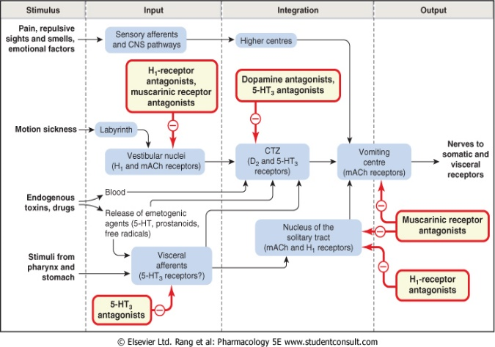
Summary
1- Serotonin (5-HT3 antagonists) : Ondansetron , Granisetron .
-The most potent antiemetic drugs.
-Their effects is augmented by combination with corticosteroids and NK₁ antagonists.
-First choice for prevention of moderate to severe emesis:
1- Chemotherapy-induced nausea and vomiting (CINV) especially cisplatin.
2-Post-radiation NV& Post-operative NV.
2-D₂ receptor antagonists
Prokinetics drugs: Metoclopramide, Domperidone
Uses:
1- antiemetic (blocking D2 receptors in CTZ)
2- prokinetic (5-HT4 agonist)
Metoclopramide crosses BBB while Domperidone cannot
Neuroleptics (antipsychotics):
Chlorpromazine (CPZ), droperidol
-used for postoperative vomiting and chemotherapy-induced emesis
3-NK₁ antagonists : Aprepitant .
-Usually combined with 5-HT₃ antagonists and corticosteroids in prevention of chemotherapy-induced nausea and vomiting and post- operative NV.
4-H₁-receptor antagonists : diphenhydramine,
promethazine, meclizine, and cyclizine .
-Uses :
1-Motion sickness.
2-Morning sickness in pregnancy.
3-Promethazine: severe morning sickness of pregnancy (if only essential).
5-Muscarinic receptor antagonists: Hyoscine
Used as transdermal patches in motion sickness
ADRs: Sedation, tachycardia, blurred vision (atropine like effect)
7-Glucocorticoids: Dexamethasone - methylprednisolone .
-Used in chemotherapy-induced vomiting.
-combined with 5-HT₃ antagonists or NK1 receptor antagonists.

Slide 11
MCQs
1. A 68-year-old patient is diagnosed with ovarian cancer. She begins using cisplatin but becomes nauseous and suffers from severe vomiting. Which of the following medications would be most effective to counteract the emesis in this patient ?
A. Droperidol. B. Ondansetron . C. Aprepitant .
2. A patient is receiving treatment with paracetamol prior to headache to help him to relief his pain, later he develop nausea and vomiting after overdose toxicity. Which of the following antiemetic drug can be used in this patient?
A. Ondansetron B. Domperidone. C. Aprepitant
3. Domperidone can increase the upper G.I motility and doesn’t cause diarrhea by acting as?
A. 5-HT3 antagonist. B. 5-HT4 agonist C. D2 Antagonist
4. Which one of the following is the target of Ondansetron as antiemetic drugs?
A. 5-HT3 antagonist. B. H1 Antagonist C. D Antagonist
5. 42 years old diabetic man had an appendectomy , after surgery he had an impaired gastric emptying. Which of the following is the best drug for him ?
A. Domperidone B. Granisteron C. hyoscine
6. Which of the following Antiemetic drugs is contraindicated for Parkinson patient due to its Extrapyramidal symptoms ?
A. Metoclopramide B. Domperidone C. Aprepitant
7. A patient who is on chemotherby have sever nausea and vomiting, and he was initially be given ondansetron but it does not control his case, Which of the following could be the best additive drug?***
A. Aprepitant B . Methylprednisolone C. Cyclizine
8. 40 years old man with a history of glaucoma complains of nausea and vomiting. Which of the following should be avoided ?
A. Meclizine B. Domperidone C. Dexamethasone
9. 28 years old lady visited planning to go on vacation , she visited a local clinic asking for something to help with her motion sickness. What would you recommend ?
A. Hyoscine B. Dexamethasone C. Chlorpromazine
10. 35 years old pregnant women visited her O.B. complaining of sever nausea in the morning. What would you recommend for her?
Promethazine B. Cyclizine C. Hyoscine
B
B
B
A
A
A
B
A
A
A
** Dr. Ishfaq said, although both of them is correct.
But in the exam if you have the both A & B the most potent is Glucocorticoid and you have to choose it.

Slide 12
قادة فريق علم الأدوية :
- جومانا القحطاني - اللولو الصليهم
- فارس النفيسة
الشكر موصول لأعضاء الفريق المتميزين :
خالد العيسى
سعد الرشود
محمد خوجة
وئام بابعير
أثير الرشيد
روان القحطاني
دعاء وليد
References :
1- 436 Prof.Hanan’s slides & notes
2- 436 Dr.Ishfaq notes
pharma436@outlook.com
@pharma436
Your feedback

