Slide 1
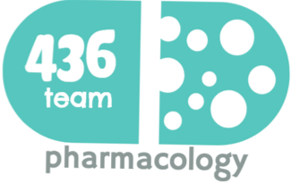
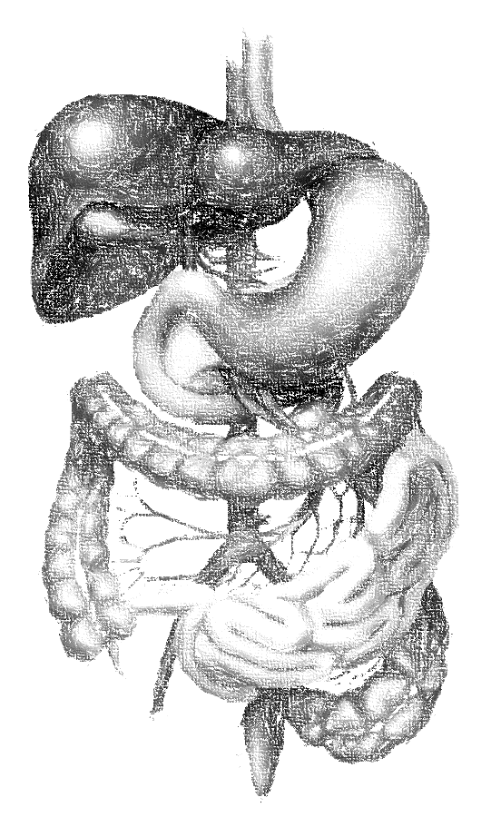
3: Treatment of dysentery and amebiasis
objectives
To understand different causes of dysentery.
To describe different classes of drugs used in treatment of both bacillary dysentery and amebic dysentery.
To be able to describe actions, side effects of drugs for treating bacillary dysentery.
To understand the pharmacokinetics, actions, clinical applications and side effects of antiamebic drugs.
To be able to differentiate between types of antiamebic drugs; luminal amebicides, and tissue amebicide.
Color index
extra information and further explanation
important
doctors notes
Drugs names
Mnemonics
Kindly check the editing file before studying this document

Slide 2
Dysentery
Definition
It is an inflammatory disorder of the intestine, especially of the colon, that results in severe diarrhea containing mucus and/or blood in the feces with fever and abdominal pain caused by any kind of infection.
Causes of Dysentery
Dysentery results from viral infections, bacterial infections, or parasitic infestations.
Treatment
Maintain fluid intake (Rehydration) by using oral rehydration therapy or intravenous fluid therapy to avoid electrolytes imbalance. Antimicrobial agents should not be given until stool analysis is done to specify the etiological agent. Anti diarrheal drugs are contraindicated because they delay fecal excretion that can prolong fever (diphenoxylate or loperamide). if the diarrhea is inflammatory diarrhea we should not give ani-diarrheal drugs Why? Because When you decreasing GI motility → retaining the organism (not excreted from the body by feces)
Bacillary dysentery (bacterial infection mainly by shigella).
The two most common causes
Amebic dysentery (protozoal infection mainly by Entameba Histolytica).

Slide 3
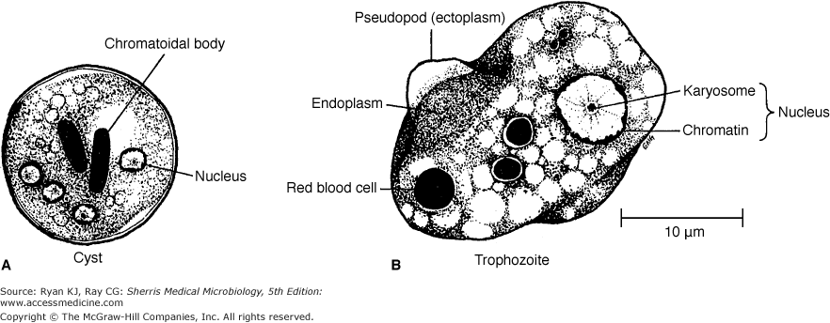
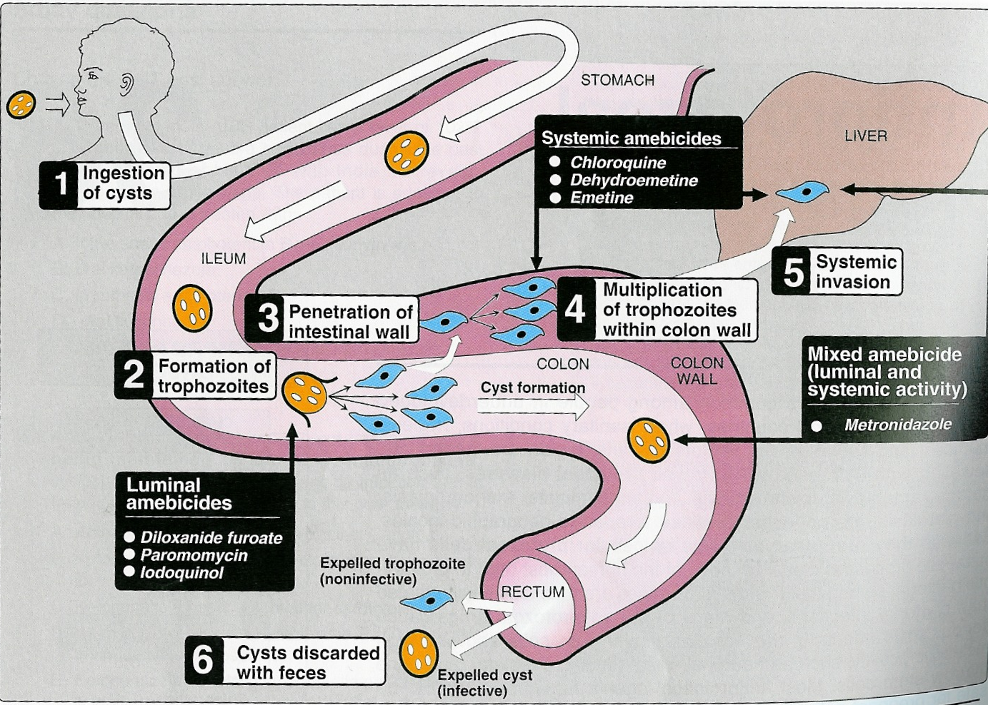
Amebiasis
Definition
Amebiasis is a protozoal infection of the intestinal tract that occurs due to ingestion of foods or water contaminated with cysts of Entameba Histolytica. The patients show varying degrees of illness from no symptoms to mild diarrhea to severe dysentery.
Life Cycle
Cysts ingestion in contaminated food or water. Liberation of trophozoites in the colon. Invasion of intestinal wall. Multiplication of trophozoites within colon wall. Systemic invasion to other organs (liver, lungs, brain). Cyst formation in rectum and excretion in feces which Could be a source of infection to other
Entamoeba histolytica exists in two forms
1.Cysts (infective stage): can survive outside the human body. When ingested, liberate trophozoites in the lumen of the intestine. | 2.Trophozoites (non-infective; invasive stage): Multiply and feed on intestinal bacterial flora. They may invade and ulcerate wall of large intestine or may migrate to liver or other tissues. In rectum, trophozoites transform to cysts and are excreted in feces.
Clinical presentations
The patients show varying degree of illness from no symptoms to mild diarrhea to severe dysentery. Asymptomatic intestinal infection (Carriers, passing cysts in stool) Mild to moderate intestinal disease (colitis) Severe intestinal infection (amoebic dysentery) Ameboma (localized granulomatous lesion of colon). Hepatic abscess, and other extra-intestinal diseases.
1
2
3
4
5
6

Slide 4
ANTIAMEBIC DRUGS
Divided into two types:
Luminal amebicides
Not treated systematically
Tissue or systemic amebicides
- Acts on the parasites in the lumen of the bowel. the drugs should not be absorbed (go out the GIT) to give its action at the site of infection (lumen)
- Act on ameba in tissues (trophozoites form)
e.g. the intestinal wall and/or other extra-intestinal
tissues as liver, brain and lung.
- used for treatment of asymptomatic amebiasis (carriers). didn’t invade the wall → the organism in the cyst form.
- used to eradicate cysts of E.histolytica after treatment of invasive disease
Used for treatment of systemic form of the disease (invasive amebiasis) e.g. intestinal wall infection or liver abscesses. After we finish treating the patient with these drugs we must give another course of luminal amebicides to eradicate the cysts in the lumen, so the cysts will not invade again and cause another infection
Incluede :
Diloxanide furoate
Iodoquinol
Antibiotics
Paromomycin can't be given orally because it is polar (aminoglycoside), so they are poorly absorbed
Tetracycline
Include:
Metronidazole/ tinidazole
Emetine its name comes from its emetic effect which means vomiting, so if we give it to the patient it will induce vomiting (dehydroemetine
Chloroquine (liver only)
برموا (parmo) اتفاقية (dil=deal) وأيدتها (iodo) يا سيتي (cysts)
شخص مسافر (travel = trophozite) ويسأل “الميترو (metro) التاني (tini) حيجي امتى (emeti) كلو ينتظر الملكة (chloroquine)”

Slide 5
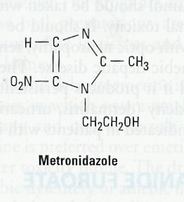
Tissue or systemic Amebicides
Drug | Metronidazole
Action/Mech. of action | Tissue amoebicide. Acts on trophozoites. Metronidazole inhibits DNA replication Of trophozoites –like Ciprofloxacin- Does not eradicate cysts from intestine because cysts are in the lumen, that’s why after tissue amebicides course we must use luminal course to eradicate the cysts Drug of choice for treating invasive amebic infections (intestinal & extra-intestinal amebiasis).
Pharmacokinetics | Given orally or IV we use it as IV with patients who have vomiting Absorption is rapid and complete (it is high lipid soluble). Wide distribution to all tissues and body fluids (CSF, saliva, milk) because of the pervious point Plasma half life is (8 h) so we have to repeat the dose Metabolized in liver (by CYP-450) by mixed function oxidase -first phase- followed by glucuronidation –second phase- (consider drug interactions). Excreted in urine. (should be used with precaution with kidney & liver diseases.) Clearance is decreased in liver impairment
Clinical Uses | Extra-luminal amoebiasis: is the drug of choice in all tissue amebiasis N.B. should be followed by luminal amebicides. Giardiasis Trichomoniasis Broad spectrum of anaerobic bacterial infections used in dentil practice Peptic ulcer (Helicobacter pylori) Pseudo-membranous colitis (Clostridium difficile).
ADRs | GIT: Dry mouth (infection may result from the dryness of mouth) Metallic taste (bad taste) which will lead to Nausea, vomiting, diarrhea (NVD) Oral Thrush (Moniliasis, yeast infection –one of the complication is fungal infection-) | CNS: Neurotoxicological effect (C.I. with epileptic patients) Insomnia, dizziness Peripheral neuropathy, paresthesia Encephalopathy, convulsion (IV infusion because there will be high conc. In the blood and may cross BBB, rare) | Dysuria, dark urine. Disulfiram-like effect if taken with alcohol. more explanation in the next slide Neutropenia (low neutrophils), Reversible
First choice
The NO₂ will react with the DNA of the microbes and destroy it
Metro trains are made of metal (metal =metallic)

Slide 6
Tissue or systemic Amebicides
Drug | Metronidazole
Drug – Alcohol Interaction | Combining metronidazole and alcohol causes nausea, vomiting, abdominal distress, flushing, headache, tachycardia, hyperventilation
Drug interactions | CYP-450 Enzyme inhibitors (cimetidine, ketoconazole all azole anti-fungal are inhibitors) increase duration of action of metronidazole Inducers (phenytoin and phenobarbitone) decrease duration of action of metronidazole. Metronidazole inhibits CYP-450 ( 2C9 & 3A4) so : increases anticoagulant effect of warfarin. Increases lithium toxicity.
C.I. / PRECAUTIONS | Pregnancy (especially in the 1st trimester) and breast feeding women. Alcohol intake CNS diseases like epilepsy because of its Neurotoxicological effect Severe renal disease Severe hepatic disease
أخذناها في CNS ما أمداكم تنسونها صح ☺
Alcohol
dehydrogenase
Aldehyde
dehydrogenase
Blocked by Metronidazole so we cannot combine this drug with alcohol
Ethanol
Acetaldehyde
Acetate
metroNIDazole= babies NEED their mother’s milk
Drunk people shouldn’t drive, they should ride the metro
Drug | Tinidazole
M.O.A | Tinidazole has similar activity to metronidazole but better potency.
Pharmacokinetics | Advantages of tinidazole : has longer duration of action (12-14h) يستخدم بمرات أقل في اليوم a simpler dosing regimen more potent. a better toxicity profile than metronidazole

Slide 7
Tissue or systemic Amebicides
Drug | Emetine and dehydroemetine Dehydroemetine better than Emetine | Chloroquine
Mechanism of action | Emetine is an alkaloid derived from ipeca it is a plant which was used in the past to induce vomiting in people who takes overdose of tablet of drugs to attempt to suicide while dehydroemetine is a synthetic analog. Both are effective against tissue trophozoites of E.histolytica causing irreversible block of protein synthesis. Because of major toxicity concerns they have been almost completely replaced by metronidazole, so we don’t use them until if we really need them such as resistance for Metronidazole | Anti-malarial drug
Pharmacokinetics | Have erratic oral absorption. the dose may or may not give the effect يعني ممكن يصير عندي تأثير للدوا وممكن لا Given preferably subcutaneously but could be given by IM, NEVER I.V (bc of CVS toxicity) Has long plasma half life about 5 days. The excretion will be difficult Metabolized & excreted slowly via kidney so they have a cumulative effect (stay in the blood for long time) Should not be used for more than 10 days (usually 3-5 days) bc their T1\2 is long & excreted slowly, therefore they will be accumulated if used for a long time. Dehydroemetine is less toxic than emetine
Clinical Uses | Intestinal wall infections. Amoebic liver abscess. Severe forms of amebiasis acute amoebic dysentery, dehydroemetine is preferable due to less toxicity (3-5 days). | Used in combination with metronidazole or dehydroemetine for amebic liver diseases why only liver? Bc they are concentrated in the liver.
ADRs | Serious toxicities: cardiotoxicity Due to long half life, should not be given IV GIT: nausea, vomiting, diarrhea. Hypotension, cardiac arrhythmias, heart failure Caution: the drug should not be used in patients with cardiac or renal disease, in young children, or in pregnancy teratogenic effect. | Hemolysis in G6PD deficient patients if I give it to patient with G6PD deficiency It will cause hemolytic anemia Pruritus is common Blurring of vision Remember from the neuropsychiatry block, they were depositing in the eye. Nausea, vomiting, abdominal pain, anorexia.
إلى متى ؟ مطول يعني ! (emetine)
Queen still alive!
أي مات بسبب التسمم

Slide 8
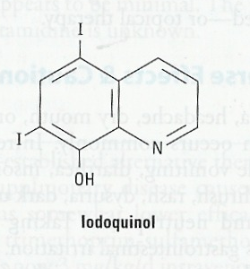
Luminal amoebicides amoebicides = with Asymptomatic (carrier) -to eradicate cysts-
Drug | Diloxanide furoate | Iodoquinol
Action/M.O.A | Mechanism of action is unknown Direct amoebicidal action against luminal forms cyst Not active against trophozoites in intestinal wall or extra-intestinal tissues. | Mechanism of action is unknown effective against the luminal forms of amebiasis it has iodine which gives ADRs
Pharmacokinetics | Ester of diloxanide + furoic acid . Given orally. It splits in the intestine liberating diloxanide The unabsorbed diloxanide is the amoebicidal agent . The absorbed portion (furoic acid or furoate) is excreted in urine . | Is given orally Poorly absorbed, excreted in feces.
Indications | Drug of choice for asymptomatic intestinal infection (cysts passers). to eradicate cysts of E.histolytica after treatment of invasive disease with systemic amebicides | Luminal amoebicide for asymptomatic amebiasis.
ADRs | Flatulence Nausea, vomiting, abdominal cramps. Because it is absorbed only in the GIT the ADRs will be related ONLY for GIT | GIT: Nausea, vomiting, diarrhea. Peripheral neuropathy including optic neuritis with high dose Enlargement of the thyroid gland because of the present of iodine Iodine sensitivity. Interference with thyroid function tests (increase protein-bound serum iodine, decrease in measured (¹³¹I* uptake). When the patient use Iodoquinol, It will do similar effect of ¹³¹l* in the test will give false measurements.
Contraindications | Pregnancy Children (less than 2 years). | Iodoquinol should be used with caution in patients with optic neuropathy, or thyroid disease. Discontinued if it produces persistent diarrhea or signs of iodine toxicity (dermatitis, urticaria, pruritus, fever).
*it is an I (i) letter, not L (l)

Slide 9
Luminal amoebicides
Drug | Paromomycin Sulphate
Action/M.O.A | Aminoglycoside antibiotic Direct amebicidal action: causes leakage by its action on cell membrane of parasite. Indirect effect: killing of bacterial flora essential for proliferation of pathogenic amoebae
Pharmacokinetics | Given orally Not significantly absorbed from GIT Effective only against luminal forms of ameba Small amount absorbed is excreted unchanged in urine (may accumulate with renal insufficiency).
Uses | Use in chronic amebiasis (carrier) to eliminate cysts (in cysts passers).
ADRs | Gastrointestinal distress and diarrhea. Remember that aminoglycosides may cause nephrotoxicity and ototoxicity!
C.I. | Severe renal disease patients with GIT ulceration
نتخيل البكتيريا والأميبيا برموا (promo) اتفاقية شراكة
Summary for treatment of amebiasis
Luminal amebicides Diloxanide or iodoquinol or Paromomycin | Asymptomatic dysentery (cyst carriers) The doctor will detect it when he do a stool analysis and find cysts, but the patient doesn't have any symptoms
Metronidazole or tinidazole followed by luminal amebicides 1st choice | Amebic colitis and dysentery ameboma, and extra-intestinal disease
Metronidazole or tinidazole or choroquine or dehydroemetine | Hepatic abscess

Slide 10
Bacillary dysentery
Bacillary dysentery is Treated by:
Beta-lactams: Ampicillin, amoxicillin, third-generation cephalosporins (ceﬁxime, ceftriaxone)
Cotrimoxazole (trimethoprim-sulfamethoxazole) (TMP-SMX) commonly used in traveller’s diarrhea.
Sulfamethoxazole prevent formation of dihydrofolic
Trimethoprim prevent formation of tetrahydrofolic
Fluoroquinolones such as ciprofloxacin, ofloxacin
Macrolides: Azithromycin
Antimicrobial therapy is typically administered for 5 days.
Resistance to ampicillin, amoxicillin and sulfonamides, has been reported worldwide, and these agents are not recommended as empirical therapy.
Fluoroquinolones are first-line treatment for shigellosis.
Second line therapy include third generation cephalosporins pregnant women or children or breast feeding women →use cephalosporins Not Fluoroquinolones!
Until the culture results come in dysentery caused by infection, give empiric therapy in → combination of anti-protozoal + antibiotic.

Slide 11
Bacillary dysentery treatment
Drug | Ciprofloxacin
M.O.A | Fluoroquinolones are first-line treatment for shigellosis. Active against a variety of gram-positive and gram-negative bacteria. block bacterial DNA synthesis and growth (DNA gyrase &topoisomerases).
Indications | Bacterial diarrhea caused by shigella, salmonella and E coli. Urinary tract infections Respiratory tract infections Soft tissues, bones, and joint infections
ADRs | Arthropathy (damage of growing cartilage). Especially in children so Here we should use Cephalosporins Phototoxicity GIT disorders (nausea, vomiting, diarrhea). CNS disorders (headache, dizziness). CVS disorder (prolonged QT interval). Liver toxicity.
Contraindications | Children, pregnancy, nursing mother. I should use Cephalosporins instead Epilepsy Arrhythmias. Should not be combined with antacids, divalent cations it will decrease the effect of the drug
نتخيل إننا نقول لأطفال متحمسين بالسوبر ماركت “اصبروا(cipro) تجي عربية التسوق(cart) ”
from these ADRs you can know what are the contraindications
Drug | Cephalosporins (cefixime , ceftriaxone)
M.O.A | They are 3rd generation cephalosporin. It acts with children Act by interfering with synthesis of peptidoglycan, a major structural component of bacterial cell wall.
P.K | Oral cefixime or parenetral ceftriaxone are safe and effective.
uses | In case of children or patient allergic to sulfonamides, cephalosporins or azithromycin may be used (note that sulfonamides are also C.I with preg. & child)

Slide 12
SUMMARY
Maintain fluid intake (oral rehydration therapy or Intravenous fluid therapy).
Asymptomatic luminal amebiasis is treated by luminal amebicides (diloxanide, or iodoquinol or paromomycin).
Metronidazole is the mainstay of therapy for invasive amebiasis (followed by luminal amebicides to prevent relapse).
Chloroquine has also been used for patients with hepatic amebiasis.
Dehydroemetine is useful but not preferable due to CVS toxicity
Ciprofloxacin is the drug of choice in bacillary dysentery In children and pregnancy, ceftriaxone or cefixime is the choice.
This summary was included in doctor’s slides
تقريبًا كل النقاط اللي ركزت عليها بروف. حنان موجودة هنا
The summary of all drugs that were mentioned in the lecture is on the next tow slides

Slide 13
systemic amebicides | Drugs | Action /Mechanism | Indications | ADRS | C.I | Notes
 | Metronidazole | treating invasive amebic infections (intestinal & extra-intestinal amebiasis). should be followed by luminal amebicides. Mechanism: inhibits DNA replication. Does not eradicate cysts from intestine | Extra-luminal amoebiasis: is the drug of choice Giardiasis Peptic ulcer Pseudo-membranous colitis anaerobic bacterial in dentil practice | metallic taste Oral Thrush Dysuria, dark urine Disulfiram-like effect if taken with alcohol Neurotoxicological effect Convulsion C.I: Pregnancy and breast-feeding women. Alcohol intake CNS diseases Severe renal disease Severe hepatic disease |  | Drug Interactions: increases anticoagulant effect of warfarin. Increases lithium toxicity. Tinidazole is the better drug (more potency).
 | Tinidazole
 | Emetine, dehydroemetine | Mechanism: effective against tissue trophozoites of E. histolytica causing irreversible block of protein synthesis. | Amoebic liver abscess. Intestinal wall infections. Severe forms of amebiasis acute amoebic dysentery | Serous Cardiotoxicity: Hypotension, cardiac arrhythmias, heart failure should not be used in patients with cardiac or renal disease, in young children, or in pregnancy. |  | dehydroemetine is preferable due to less toxicity
 | Chloroquine | combination with metronidazole or dehydroemetine for amebic liver diseases |  | Hemolysis in G6PD deficient patients. Pruritus Blurring of vision.

Slide 14
Luminal Amebicides | Drugs | Action/ Mechanism | Indications | ADRS | C.I | Notes
 | Diloxanide furoate | Action: The little unabsorbed diloxanide is the amoebicidal agent . Mechanism: Unknown | ^{1st} choice for asymptomatic intestinal infection (cysts passers). to eradicate cysts To eradicate cysts after tissue amebicides treatment | Flatulence | Pregnancy Children (less than 2 years). | Direct amoebicidal action against luminal forms Not active against trophozoites in intestinal wall or extra-intestinal tissues.
 | Iodoquinol | effective against the luminal forms of amebiasis Mechanism: Unknown | Luminal amoebicide for asymptomatic amebiasis | Peripheral neuropathy Enlargement of the thyroid gland. | optic neuropathy, or thyroid disease. | discontinued if it produces persistent diarrhea or signs of iodine toxicity
 | Paromomycin Sulphate | Direct effect: amoebicidal action (causes leakage by its action on cell membrane of parasite). Indirect effect: killing of bacterial flora essential for proliferation of pathogenic amoebae. | chronic amebiasis to eliminate cysts | Gastrointestinal distress and diarrhea nephrotoxicity and ototoxicity | Severe renal disease patients with GIT ulceration
Bacillary Dysentery | Ciprofloxacin | block bacterial DNA synthesis and growth (DNA gyrase &topoisomerases). | Bacterial diarrhea (caused by shigella, salmonella and E coli). | Phototoxicity Arthropathy (damage of growing cartilage). | Children, preg.& nursing mother. Epilepsy Arrhythmias Should not be combined with antacids, divalent cations. | Cotrimoxazole in traveler’s diarrhea.
 | Ceftriaxone & cefixime | Act by inhibiting cell wall synthesis (interfering with synthesis of peptidoglycan) | Indications: In case of children or patient allergic to sulfonamides, cephalosporins can be used.

Slide 15
MCQ
Q1: 26 years old male who came to the hospital for routine test with no symptoms or diarrhea, the stool analyze was done also. Which shown that he has many cysts of Entameba Histolytica. Which one of the following anti amoebic drug can be used in his case?
A- Metronidazole B- Diloxanide furoate C- Iodoquinol
Q2: Patient who has liver abscess due to intestinal amoebiasis was treating with metronidazole for 5 days. After he complete his treatment, which one of the following anti amoebic drug can be used as second treatment in next stage?
A- Metronidazole B- Diloxanide furoate C- Iodoquinol
Q3 : Epileptic Patient with intestinal amoebiasis, which one of the following anti amoebic drug is contraindicated in his case ?
A- Metronidazole B- Emetine C- Iodoquinol
Q4: A 53 years old male who is a chronic alcoholic, present to the ER with flushing, tachycardia, nausea and vomiting. His medical history shows that he started the symptoms after taking anti amoebic drug to treat his bloody diarrhea. Which of the following drug is most likely to cause these symptoms? A. Metronidazole B. Iodoquinol C. Chloroquine
Q5: Which one of the following anti amoebic drug can not be used if we have patient with cardiac disease ?
A- Metronidazole B- Emetine C- Iodoquinol
Q6: Which one of the following can not be used in patient with hemolytic anemia due to genetic defect in glucose phosphate dehydrogenase in his RBCs?
A. Metronidazole B. Iodoquinol C. Chloroquine
B
B
A
A
B
C

Slide 16
MCQ
Q7: Which one of the following anti amoebic drug is the best for cyst passers eradication of Entameba Histolytica ?
A- Metronidazole B- Diloxanide furoate C- Iodoquinol
Q8: Emetine is now used only as a reserve drug for amoebiasis in compare with metronidazole because :
A- It produces a slower response.
B- It has more cardiotoxic potential.
C- It is less effective in extra-intestinal amoebiasis
Q9: Which one of the following anti amoebic drug may give a false result for thyroid function test ?
A. Metronidazole B. Iodoquinol C. Paromomycin Sulphate
Q10: Which one of the following drug can be act as antibacterial and antiprotozoal ?
A. Metronidazole B. Iodoquinol C. Paromomycin Sulphate
Q11: 8 years old child who has dysentery diarrhea caused by shigella. Which one of the following antibiotic can not be used in his case ?
A. Ciprofloxacin B. Ceftriaxone C. amoxicillin
Q12: 8 years old child who has dysentery diarrhea caused by shigella. Which one of the following antibiotic can be safe to be used in his case ?
Ciprofloxacin B. Ceftriaxone C. tetracycline
B
B
B
C
A
B

Slide 17
قادة فريق علم الأدوية :
- جومانا القحطاني - اللولو الصليهم
- فارس النفيسة
الشكر موصول لأعضاء الفريق المتميزين :
روان القحطاني
وجدان الزيد
رحاب العنزي
شذا الغيهب
عبدالرحمن الراشد
عبدالكريم الحربي
References :
1- 436 doctors slides and notes
2- 435 teamwork
pharma436@outlook.com
@pharma436
Your feedback
* الشعار و القالب الأساسي من تصميم لين التميمي

