Slide 1
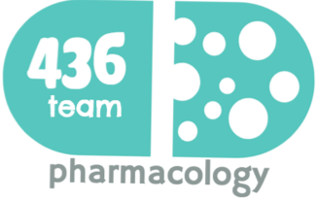
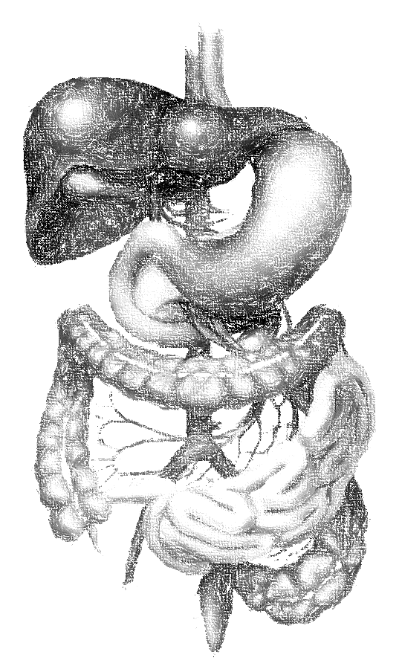
Drugs used in treating constipation and IBS
Objectives
Define constipation
Know the different symptoms of constipation
Know the different lines of treatment of constipation
Identify the different types of laxatives
Discuss the pharmacokinetics, dynamics, side effects and uses of laxatives
Discuss the difference between different treatment including bulk forming laxatives, osmotic
laxatives, stimulant laxatives And stool softeners (lubricants).
Define bowel syndrome (IBS).
Identify the pharmacokinetics, dynamics, side effects and uses of drugs used for IBS.
Color index
extra information and further explanation
important
doctors notes
Drugs names
Mnemonics
Kindly check the editing file before studying this document

Slide 2
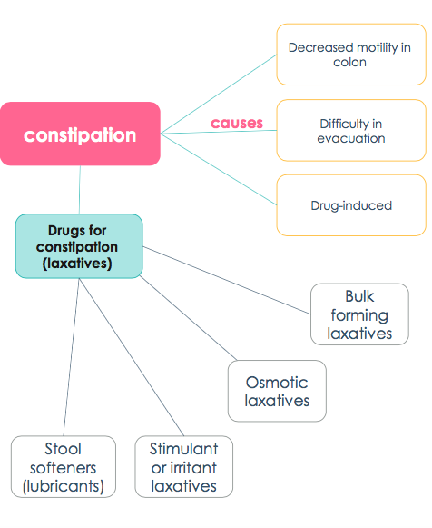
Introduction
constipation and IBS

Slide 3
To understand !
What is constipation?
Very useful. Don’t miss it
Infrequent defecation, often with straining and the passage of hard, uncomfortable stools. - May be accompanied by other symptoms: Abdominal discomfort and rectal pain, Flatulence, Loss of appetite, Lethargy & Depression.
Causes of constipations:
Decreased motility in colon:
Decrease in water and fiber contents of diet. “Unbalanced diet”
Difficulty in evacuation:
Local painful conditions: anal fissures, piles.
Lack of muscular exercise.
Drug-induced:
Anticholinergic agents
Opioids
Iron
Antipsychotics.
Anti-depressant, anti-histamine, has anticholinergic effect
Treatment by general measures
Adequate fluid intake
High fiber contents in diet
Use drugs (laxatives or
purgatives more watery effect)
Regulation of bowel habit.
Regular exercise
Avoid drugs causing constipation.
Medications used in constipations
Drugs that hasten the transit of food through the gastrointestinal tract are called laxatives (ملينات)or purgatives (محركات) (Or we say the drugs that increase GI motility)
Loosen stools and increase bowel movement

Slide 4
Classification of Laxatives or Purgatives:
Osmotic laxatives (cause water withdrawal by sugar or salt)
Increase water content in large intestine.
Stimulant or irritant laxatives (cause irritation to intestinal mucosa to increase the motility)
Increase volume of non-absorbable solid residue.
Bulk forming laxatives (increase the size of stool )
Stool softeners (lubricants)
Act by direct stimulation of nerve endings in colonic mucosa.
Alter the consistency of feces easier to pass
Bulk forming laxatives taken orally
Include | Dietary fibers: Indigestible parts of vegetables (broccoli) &fruits. Bran powder (نخالة) Whole grains(female’s slides only) | Hydrophilic colloids (They absorb water and increase the volume.) Psyllium seed (powder) “natural” Methyl cellulose “semisynthetic” Carboxymethyl Cellulose (CMC)
Mech. Of action | Dietary fibers and hydrophilic colloids are non-absorbable substances (main mechanism of action)→ Increase the bulk of intestinal contents by water retention → ↑mechanical pressure on walls of intestine→ the stimulation of stretch receptors →↑peristalsis → evacuation of soft stool. (الفكرة اننا نبي نوصل للأمعاء انك مليانه ولازم تتحركين بأننا نزيد الكتلة بالماء مو المواد اللي تطلع مع الغائط) نقدر نشبهها بحلى الجلي، بالبداية تكون على هيئة بودرة ولما نضيف عليها ماء تبدأ تتشكل وتصير صلبة ولها وزن وثقل
use | Acute and chronic constipation
ADRs | Delayed onset of action (1-3 days) Intestinal obstruction (should be taken with enough water ) it is not absorbed and it is a powder so it need a water for the action and also to prevent the obstruction Bloating, flatulence, distension. Interfere with other drug absorption (if taken at the same time)e.g. iron , cardiac glycosides.

Slide 5
Osmotic Laxatives
They are Water soluble compounds, poorly absorbed “high percentage is not absorbed”
They remain in the bowl
Attract water by osmosis (water retention in the bowel) → increase the volume of feces → increase peristalsis & evacuation
It has a hydroscopic effect.
Give with water to prevent the dehydration.
Sugars
Lactulose
Salts (saline laxatives)
Magnesium sulphate or hydroxide. Sodium or potasium phosphate.
Polyethylene glycol (PEG)
Polyethylene glycol (PEG)
Or potassium salts
DRUG | Lactulose
P.K | Semisynthetic disaccharide of fructose & galactose. Increase water content (osmotic effect) Non absorbable. Lactulose retains water in colon (osmotic effect) In the colon metabolized by bacteria to fructose & galactose. These sugars are fermented into lactic acid & acetic acid & formic acid thus lowering the PH. Acidification
INDICATIONS | Prevention (prophylaxis) of chronic constipation in patients as a long-term treatment. Because its well tolerated, it can be used with elderly patient and chronically. Hemorrhoids(بواسير) Hepatic encephalopathy in people with Liver cirrhosis as prophylactic therapy Opioid constipation → Why lactulose is used in Liver cirrhosis & Hyper-ammonemia ? ✱ Acidification of the colon (increase of the H+ concentration) by lactic acid & acetic acid causes increase of H+ concentration in gut, this will cause non-polar NH3 (ammonia) trapping (which is non-charged = lipid soluble= easily absorbed), by favors the formation of NON- absorbable (polar=easily excreted) NH4+ (ammonium) and thus reducing absorption. ✱ Simply: Lactulose → Lactic acid + Acetic acid + formic acid →Acidification of the colon → ↓ ammonia absorption (NH4+) (ammonium salt “polar” will be excreted in feces) .
ADRS | Delayed on set action(2-3Days) Abdominal cramps & flatulence. Electrolyte disturbance.
DOSE | 15 ml for constipation & 30 ml for Liver cirrhosis.
In pt. of cirrhosis → may cause diarrhea due to high dose

Slide 6
Osmotic Laxatives (cont.)
DRUG | Saline Laxatives | Polyethylene glycol (PEG) Macrogol.
DRUGS | Magnesium sulphate (Epson’s salt) Magnesium hydroxide (milk of magnesia) Sodium phosphate/potassium phosphate potassium phosphate | Osmotically active laxative. Isotonic solution of polyethylene glycol & electrolytes (NaCl, KCl, Na bicarbonate) they balance the effect of electrolytes by adding salt. Is a colonic lavage solution. Cause complete evacuation . Role of electrolytes in macrogol: (NaCl,KCl , Na bicarbonate) help mitigate the possibility of electrolyte imbalance & dehydration.
P.K | Poorly absorbed (90% NOT absorbed) Rapid effect (1-3h) acute situations (emergency) Isotonic or hypotonic solution should be used. If you used hypertonic solution it will cause dehydration by ↑ vomiting. It increases evacuation of watery stool.
Advantage | _ | Limited fluid& electrolyte imbalance. Less flatulence& cramps.
Uses | Short term Treatment of moderate to sever Acute Constipation. used With plenty of water. | Used for whole bowel irrigation (removal of feces) prior to colonoscopy or surgery. It should be ingested rapidly (4L over 24h)
ADRS | in case of repeated administration: Disturbance of fluid & electrolyte balance. May have systemic effects. | May cause Hypokalemia
Contraindication | o Sodium salts in: Congestive heart failure. o Magnesium salt in: Renal failure (little % excreted by the kidney) Heart blockers. CNS depression. Neuromuscular blockers (e.g. curium) (also can not be combine with Aminoglycosides) | _
We have a colonies of this macro-organism

Slide 7
Stimulant Laxatives
البسكويت يحمس الواحد يأكله
= Stimulant Laxativesيحمس/ تحمس
Bisacodyl
Castor oil
Anthraquinone (Senna, cascara, aloes)
Are the most powerful groups among laxative & should be used with care. Not for prolonged use.
Mechanism of action: They act via direct stimulation of enteric nervous system → increase peristalsis & purgation.
roller coaster ride تحمس الواحد يجربها
السنة النبوية تحمس الواحد يسويها عشان الأجر
هذي الماسكارا تحمس الواحد يجربها
DRUG | Anthraquinone glycoside (Senna, cascara, aloe vera) Natural products | Castor oil زيت الخروع |  | Bisacodyl
P.K | Delayed on set of action (8-12h) Bowel movements in 12h (orally) or 2h (rectally as suppository) Given at night. Hydrolyzed by bacterial colon into sugar + emodin (The absorbed emodin has direct stimulant action) Act on colon Emodin may pass into milk. o Senna is useful in treating opioid induced constipation. | Onset of action(2-6h) Given orally,5-20ml on empty stomach in the morning Act in small intestine Vegetable oil degraded by lipase → ricinoleic acid + glycerin. Castor change to ricinoleic acid by bacterial action. Ricinoleic acid is very irritating to mucosa. |  | Given orally. Before sleep because the delayed onset of action. Onset of action (6-12h) Per rectum (1h). Rapid onset of action. Act on colon Type: Diphenylmethane
ADRS | Abdominal cramps Dependence & destruction of myenteric plexus leading to Atonic Colon due prolonged use (the patient can’t go to the bathroom without these drugs because his/her bowel movement is Addicted to the drug!!) May cause Apoptosis to the intestinal mucosal cells
Contraindication | Senna is contraindicated in breast feeding (lactation) But we can use Lactulose is safer | In pregnancy (causes reflex contraction of uterus this will lead to abortion!! | __
نتخيل الطفل يقول ”أمي أديني الحليب”
السينما والسكاكر صاروا إدمان هالأيام
roller coaster ride تحمس الواحد يجربها وتخليه يدمن عليها
البسكويت هذا يخلي الواحد يدمن عليه
الطفل الرضيع اذا طلع سنه يبدأ يزعج الأم وهي ترضعه
The pregnant women should not play roller coaster ride

Slide 8
Fecal softeners
(Lubricants)/surfactants
Non-absorbed drugs
Act by either decreasing surface tension (by some chemical action) or by softening the feces thus promoting defecation.
Treat constipation in patient with hard stool or specific condition and for people who should avoid straining.
Drug | Docusate (sodium dioctyl sulfosuccinate) | Paraffin oil | Glycerin
Mech. of action | Surfactant act by decreasing surface tension of feces Increase water penetration into the stool thus softening of feces and make it easier to move through the G.I.T. | Mineral oil , Acts as lubricant thus softening the feces and promote defecation زي الواحد لما يحط صابون ويتزحلق بس هنا يكون زيت | Lubricant
P.K | Given orally(12-72h) or enema rectum form (5-20 min) | Given orally (not palatable) طعمه مش حلو | Given rectally (suppository)
Indications | often used as prophylaxis rather than acute treatment, - especially in hospitalized patients-because of delayed onset when given orally. | Good for radiology preparation. | __
ADRs | __ | Impairs absorption of fat soluble vitamins A,K,E,D. | __
Note | Stool softeners used for prevention of straining after rectal surgery and in acute peri-anal disease
صدمت لما عرفت إن دي أختك ، سولفوا لي عنها وعن نجاحاتها
AKED I like this perfume(Paraffin)

Slide 9
Irritable bowel syndrome (IBS)
Chronic bowel disorder characterized by: common in women , related to stress.
Abdominal discomfort (bloating, pain, distension, cramps)
Alteration in bowel habits (diarrhea or constipation or both)
Symptomatic treatment :
4:16 for better understanding
Low dose of tricyclic antidepressant e.g. amitriptyline or SSRIs → TCAs acts via:
↓ GI motility because of anticholinergic action.
↓ visceral afferent sensation.
Antispasmodics e.g.Mebeverine
Act by relaxing the smooth muscle
Laxatives in IBS with constipation
Tegaserod in IBS-C
Antidiarrheal in IBS with diarrhea
( diphenoxylate , loperamide)
In severe case
Alosetron in IBS-D
Alosetron
M.O.A | Selective 5HT₃ antagonist. Pharmacologically can be used for vomiting, but clinically it is not approved yet. 5-HT₃ receptor antagonism of the enteric nervous system of the GIT results into: Inhibition of colon motility → means there is time for the water to be absorbed → thus hardening of stool. Inhibition of unpleasant visceral afferent pain sensation (nausea, pain, bloating).
Uses | Used in severe IBS with diarrhea in women who have not had success with any other treatment.
ADRs | Sever Constipation and ischemic colitis “high risk→ not preferable” may occur. (People taking alosetron must sign a consent form before starting to take the medicine)
Tegaserod
M.O.A | 5HT₄ agonist. Stimulation of 5HT₄ of enteric nervous system of GIT → increase peristalsis
Uses | Short term treatment of IBS with constipation in women <55 year sold with no history of heart problems. May still be used in limited emergency situations.
ADRs | CVS side effects
(Alo-set-ron) , (diarrhea) نتخيل أحد يتصل ويعطي خبر ويقول “آلوو، الست الحديدية ماتت”
(Constipation)Patient say to his doctor ma tegaser (Tegaserod)

Slide 10
Summary
Constipation treatments
Increase the bulk of intestinal content by water retention.
Orally , has Delayed onset.
Interfere with other drugs absorption (iron, cardiac glycosides)
Bulk forming | Dietary fibers Hydrophilic colloids
Osmotic laxatives | Sugars ( Lactulose)
 | Saline
 | PEG
Stimulant laxatives | Bisacodyl
 | Castor oil
 | Anthraquinone
Fecal softeners | Glycerin
 | Paraffin oil
 | Docusate
Retains water in colon by osmotic effect.
Acidification of colon due to conversion of NH3 to NH4 “NH3 trapping” →↓PH
Use as as prophylactic therapy in Hepatic encephalopathy in people with Liver cirrhosis
Non-absorbable
Result in watery stools by osmotic effect.
Rapid effect , treat acute constipation.
C.Is: ( Na salt→ CHF) (Mg salt→ RF, HB CNS dep. , Nm block & aminoglycosides)*
↑water content by osmotic effect.
Used for complete evacuation of colon prior to colonoscopy or prior to surgery.
Given with Electrolytes to compensate the deficiency.
Orally / rectally “faster” acts on colon, at night
The most potent
Orally on empty stomach ,degraded in small intestine by lipase into ricinoleic acid which is very irritating to mucosa.
Most rapidly in oral form
In pregnancy (causes reflex contraction of uterus this will lead to abortion
They act via direct stimulation of enteric nervous system → increase peristalsis & purgation.
Dependence & destruction of my enteric plexus leading to Atonic Colon due prolonged use
Acts on colon & given at night
Hydrolyzed into emodin which may pass into milk → C.I breast-feeding mom (especially Senna)
Delayed onset & may cause dependence
Lubricant , rectally (suppository)
Lubricant , promote defecation
For Radiology preparation
Impairs absorption of fat soluble vitamins (A,K,E,D).
Sodium dioctyl sulfosuccinate
Surfactant (decrease surface tension)
Allow water mixing with stool for easier movement in the GIT
*RF→ renal failure
HB→ heart block
Nm block →neuromuscular

Slide 11
Summary
IBS treatments
Irritable bowel syndrome (IBS) | Alosetron
 | Tegaserod
Selective 5HT₃ antagonist.
Used severe IBS with diarrhea
5HT₄ agonist.
Severe IBS with constipation
MCQs
1- A 27-year-old woman who is 34 weeks pregnant is on bed rest and visits her obstetrician. During the visit, she informs her physician that she has been experiencing mild constipation. Which of the following medications is highly contraindicated in her case ?
Castor oil. B. lactulose C. Docusate.
2- 36 years old women who has given a birth recently, she has been experiencing mild constipation. Which of the following can be safe to be used to her and her feeding baby ?
A. Senna B. Lactulose C. castor oil
3- All of the following drugs are generally well tolerated for the treatment of chronic constipation and can be used for elderly except:
Methylcellulose B. Lactulose C. castor oil
4- 28 years old female visited the clinic complaining of abdominal pain and changes in her bowel movement , she takes a drug for constipation for the past 7 months but she has to take that drug consistently or the constipation will come back, so her bowel movement is addicted to the drug. What drug she is using?
Lactulose B. Bisacodyl C. Macrogol
5- 23 years old man with history of iron deficiency anemia and take supplements for it, visited the clinic complaining of constipation. Which of the following must be avoided?
Bulk forming laxatives B- Osmotic laxatives C- Stimulant laxatives
6- Anthraquinone is contraindicated in breast-feeding ladies’ due to which compound?
A. Emodin B. Diphenylmethane C. Ricinoleic acid
A
B
C
B
A
A

Slide 12
MCQs
7- Which of following stimulant laxatives act on small intestine & degraded into ricinoleic acid ?
A. Senna B. Bisacodyl C. castor oil
8- If we have patient with sever acute constipation and he need rapid effect. Which of the following has the fastest onset of action?
A. Saline Purgative B- Osmotic Purgative C- Fecal softeners
9- Which of the following laxative classes is the most powerful?
A. Saline Purgative B- Osmotic Purgative C- Stimulant Purgative
10- 33 years old male who use atracurium as muscle relaxants, if he had constipation, which one of the following drugs should not be used in his case ?
Docusate B. Magnesium Sulphate C. Sodium phosphate
11- 21 years old male who has infection and use gentamycin, if he had constipation, which one of the following drugs should not be used in his case ?
Docusate B. Magnesium Sulphate C. Sodium phosphate
12- Alcoholic patient who has liver cirrhosis and he may develop hepatic encephalopathy, to prevent that, which one of the following could be used ?
A. Lactulose B. Bisacodyl C. Macrogol
13- A patient was assigned a surgery the next day with colonoscopy, which of these is used to evacuate the colon and should be taken night before ?
A. Macrogol B. Bisacodyl C. Docusate
14- Which one of the following laxatives is not recommended to be taken before sleep ?
A. Cascara B. Bisacodyl C. Magnesium sulphate
15- Female patient who is diagnosed with severe irritable bowel syndrome associated with diarrhea. Which of the following could be used ?
A. Mebeverine B. Alosetron C. Tegaserod
16- Which of these drugs allow the water to be incorporated into the stool and decrease the surface tension?
Docusate B. Macrogol C. Lactulose
17- Patients must sign a consent form before administrating which drug?
A. Mebeverine B. Alosetron C. Tegaserod
C
A
C
B
B
A
A
C
B
A
B

Slide 13
قادة فريق علم الأدوية :
- جومانا القحطاني - اللولو الصليهم
- فارس النفيسة
الشكر موصول لأعضاء الفريق المتميزين :
عبد الرحمن الجريان
مؤيد أحمد
روان سعد القحطاني
ريم الشثري
أثير الرشيد
شذا الغيهب
References :
1- 436 Prof. Hanan, slides and notes
2- 435 team
3- 436 Dr. Saeed slides
pharma436@outlook.com
@pharma436
Your feedback

