Slide 1
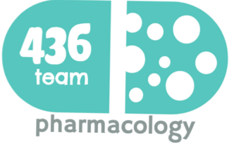
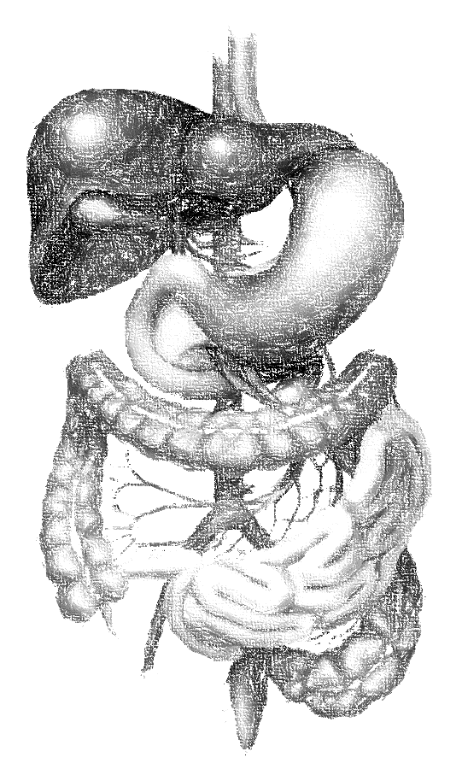
Drugs and biological and immune therapy in inflammatory bowel disease (IBD)
objectives
Define inflammatory bowel disease.
Differentiate between ulcerative colitis and Crohn’ disease.
Define the stepwise treatment of IBD.
Discuss the pharmacokinetics, pharmacodynamics, uses and adverse effects of 5-amino salicylic acid compounds (5-ASA), glucocorticoids, immunomodulators and biological therapy (TNF-α inhibitors).
Compare between drugs used for induction of remission and those used for maintenance of remission.
Color index
extra information and further explanation
important
doctors notes
Drugs names
Mnemonics
Kindly check the editing file before studying this document

Slide 2
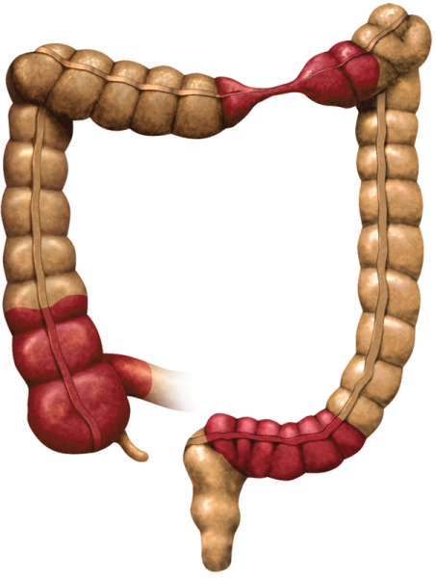
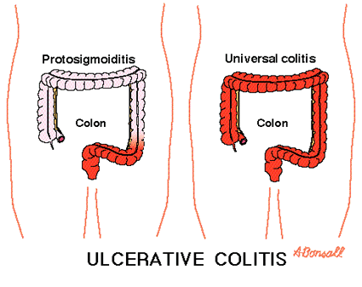
Inflammatory Bowel Diseases (IBD)
Definition
is a group of inflammatory conditions of the small intestine and colon. or all GIT
Causes
Not known. auto-immune disorder due to abnormal activation of the immune system. The susceptibility is genetically inherited.
Types
The major types of IBD are Crohn's disease and ulcerative colitis (UC).
 | Crohn's disease |  | Ulcerative colitis
Location | affect any part of the GIT, From mouth to anus |  | Restricted to colon & rectum
Distribution | Patchy areas of inflammation (Skip lesions) not Continuous |  | Continuous area of inflammation
Depth of inflammation | May be transmural, deep into tissues |  | Shallow, mucosal
Complications | Strictures, Obstruction, Abscess, Fistula |  | Toxic megacolon, Colon cancer
Symptoms |  | Complication
- Abdominal pain - vomiting - Diarrhea - Weight loss - Rectal bleeding. |  | - Anemia - Mega colon - Abdominal obstruction (Crohn’s disease). - Colon cancer
Treatment
There are two goals of therapy 1- Achievement of remission (Induction). 2-Prevention of disease flares (maintenance). Stepwise therapy: (in order we start from less ADRs to the ones that have more ADRs)
1
اعالج خطوة بخطوة واذا مانفع اعالج باللي بعده
5-amino salicylic acid compounds (5-ASA) or aminosalicylates .
2
Glucocorticoids
3
Immunomodulators
4
Biological therapy (TNF-α inhibitors).
5
Surgery in severe condition

Slide 3
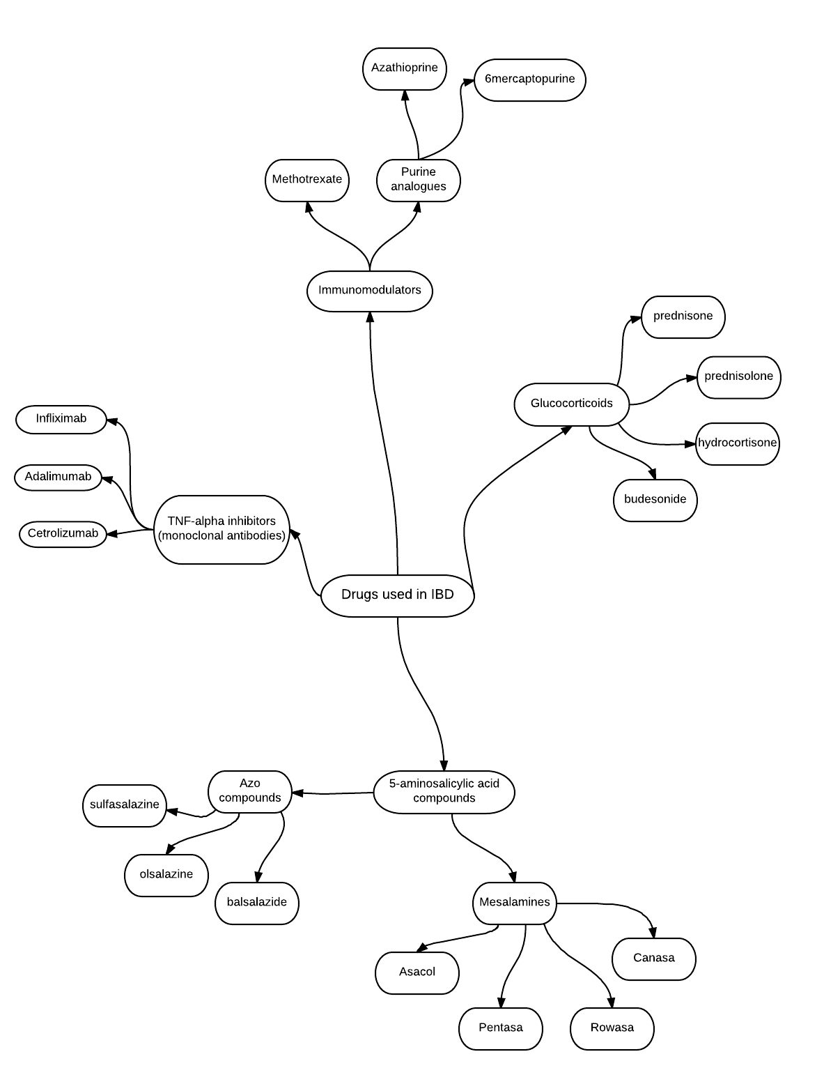
Inflammatory Bowel Diseases treatment OVERVIEW
3
2
4
We move to the next step if the previous one is unresponsive
1

Slide 4
Aminosalicylates
Drug | 5-amino salicylic acid compounds (5-ASA) Aminosalicylates aspirin- like
M.O.A | Have topical anti-inflammatory action due to inhibition of prostaglandins and leukotrienes. decrease neutrophil chemotaxis. Antioxidant activity (scavenging free radical production).
P.K | 5-ASA itself is absorbed from the proximal small intestine. Different formulations are used to overcome rapid absorption of 5-ASA from the proximal small intestine. All aminosalicylates are used for induction and maintenance of remission
Clinical uses | Induction and maintenance of remission in mild to moderate IBD (First line of treatment). Rheumatoid arthritis (Sulfasalazine only). Rectal formulations are used in distal ulcerative colitis, ulcerative proctitis and proctosigmoiditis
it has to applied topically .
Should come in contact with the inflamed area directly.
we have to keep the drug unabsorbed until it reach the inflamed area
formulations of aminosalicylates
The major differences are in the mechanism and the site of delivery.
Azo compounds
• Balsalazide
• Sulfasalazine
• Olsalazine
Mesalamines
• Asacol • Pentasa
• Canasa • Rowasa
بلاش تسولف لي عن علا
Azo.. alazineآذوا الزين ؟
Asa .. Mesala-mine آصه.. هذي مسألة مين؟!

Slide 5
Aminosalicylates
Azo compounds
These compounds contain (5-ASA) that is connected by azo bond (N=N) :
1- to sulfapyridine moiety (Sulfasalazine) → “ Sulfasalazine = 5-ASA + sulphapyridine”
2- to another molecule of 5-ASA (Olsalazine) → “Olsalazine = 5-ASA + 5-ASA”
3- to inert compound (Balsalazide) → “Balsalazide = 5-ASA + inert carrier” has no ADR
Azo structure reduces absorption of 5-ASA in small intestine.
In the terminal ileum and colon, azo bond is cleaved by azoreductase enzyme produced by bacterial flora releasing 5-ASA in the terminal ileum and colon.
Ol = all
علا دايم تسكتني وتقول لي آصه آصه
بلاش إضافات ووجع راس
This enzyme exist only in the terminal ileum & colon → it cleaves the double bond of nitrogen thus releasing its components
Drug | Sulfasalazine (Azulfidine)
M.O.A | ○ Pro-drug activated by enzyme ○ A combination of 5-ASA + sulfapyridine
 | 5-ASA has anti-inflammatory action due to: inhibition of prostaglandins and leukotrienes. decrease neutrophil chemotaxis. Antioxidant activity (scavenging free radical production).
P.K | Is given orally (enteric coated tablets). Little amount is absorbed (10%) the 90% left is saved until it reaches the terminal ileum In the terminal ileum and colon, sulfasalazine is broken by azoreductase into: 5-ASA (not absorbed, active moiety acting locally). Sulphapyridine (absorbed, causes most of side effects)
ADRs | Crystalluria. Megaloblastic anaemia. Impairment of male fertility (Oligospermia). | Bone marrow depression Folic acid deficiency (should be provided). Interstitial nephritis due to 5-ASA.
Most of the ADRs are caused by Sulfapyridine

Slide 6
Aminosalicylates
Mesalamine compounds
They are Formulations (oral & rectal) that have been designed to deliver 5-ASA in
terminal small bowel & large colon.
These formulations have the following characteristics:
Sulfa free
well tolerated
have less side effects compared to sulfasalazine
useful in patient sensitive to sulfa drugs
Coated with material that is sensitive to PH or time
Oral formulations
• Releases 5-ASA in the distal small bowel secondary to pH changes. → they release it in alkaline PH , stomach is acidic, therefor they wont release 5-ASA ( coated with PH sensitive coat)
• Releases start at the pylorus and continues throughout the small bowel and colon.
• Asacol: 5-ASA coated in pH-sensitive resin*** that dissolve at pH 7.
• Pentasa: micro granules**** that release 5-ASA throughout the small intestine time sensitive
Rectal formulations
• Release 5-ASA in the distal colon.
• Canasa (suppositories *)
• Rowasa (enema **)
Control the release either by time or PH
كان(can) يدعمني (support me) دائماً
Rawan has anemia
*Suppository → a solid, conical mass of medicinal substance that melts upon insertion into the rectum or vagina
**enema → the injection of a fluid into the rectum to cause a bowel movement.
*** resin is not an absorbable molecule يمسك حاجات على سطحه بس
**** each granule has a different coat that releases its components on different time intervals to sustain/prolong the action

Slide 7
Glucocorticoids
Drug | Oral preparation prednisone, prednisolone | Parenteral preparation hydrocortisone, methyl prednisolone |  |  | Rectal preparation Hydrocortisone | Budesonide
M.O.A | Inhibits phospholipase A2 Inhibits gene transcription of NO synthase, cyclo-oxygenase-2 (COX-2) Inhibit production of inflammatory cytokines
Indications | Indicated for acute flares of disease (moderate –to- severe active IBD). Are NOT useful in maintaining remission (not effective as prophylactic therapy). Asthma Rheumatoid arthritis immunosuppressive drug for organ transplants Antiemetic during cancer chemotherapy
 | Oral glucocorticoids is commonly used in active condition. |  | _________ | Rectal glucocorticoids are preferred in IBD involving rectum or sigmoid colon. |  | Used in treatment of active mild to moderate Crohn’s disease involving ileum and proximal colon. Not use in prophylactic
Notes | Higher rate of absorption More adverse effects compared to rectal administration Gradually given |  |  | As enema or suppository, give topical effect. Less absorption rate than oral. Minimal side effects & maximum tissue effects |  | A potent synthetic prednisolone analog Given orally (controlled release tablets) so release drug in ileum and colon. Low oral bioavailability (10%). Is subject to extensive first pass metabolism
حامل تقول أبغى(بدي) أجيب (ولد)
90% will reach the site of inflammation
the 10% absorbed percentage is the cause of ADRs

Slide 8
Immunomodulators
Drug | Methotrexate | Purine analogs: azathioprine & 6-mercaptopurine
Action/Mech. of action | a folic acid antagonist Inhibits dihydrofolate reductase required for folic acid activation (tetrahydrofolate) Impairs DNA synthesis Induction and maintenance of remission in IBD | Azathioprine is pro-drug of 6-mercaptopurine. In the body it become active which is 6-mercaptopurine Inhibit purine synthesis and inhibits synthesis of DNA, RNA, and proteins. It may decrease proliferation of immune cells, which lowers autoimmune activity. Suppress the inflamed cells Induction and maintenance of remission in IBD
indications | Are used to induce remission in IBD in active moderate-to-severe conditions or steroid dependent or steroid resistant (refractory) Patients and to maintain remission. Prophylactic therapy
 | Inflammatory bowel disease Rheumatoid arthritis Cancer Given Orally, S.C., I.M. | _________________
ADRs | Megaloblastic anemia. Bone marrow depression | Bone marrow depression: leucopenia, thrombocytopenia. Gastrointestinal toxicity. Hepatic dysfunction. Complete blood count & liver function tests are required in all patients
Inactive form
Active form

Slide 9
Monoclonal antibodies used in IBD (TNF-α inhibitors)
Mab =Monoclonal
Certo=certain target
Drug | Infliximab | Adalimumab ( Humira ) | Certolizumab ( Cimzia )
Mech. of action | - a chimeric mouse-human monoclonal antibody - 25% murine – 75% human. - TNF-α inhibitors - Inhibits soluble or membrane –bound TNF-α located on activated T lymphocytes. | - Fully humanized IgG antibody to TNF-α -it binds to TNFα, preventing it from activating TNF receptors. (Better than Infliximab) | - Fab fragment of a humanized antibody directed against TNF-α - Certolizumab is attached to polyethylene glycol to increase its half-life in circulation.
P.K | Given intravenously as infusion (5-10 mg/kg). Not given orally has long half life (8-10 days) 2 weeks to give clinical response. Delayed action | Has an advantage that it is given by subcutaneous injection | Given subcutaneously
indications | In moderate to severe active Crohn’s disease and ulcerative colitis. Patients not responding to immunomodulators or glucocorticoids. Treatment of rheumatoid arthritis Psoriasis الصدفية | is approved for treatment of, moderate to severe Crohn’s disease, rheumatoid arthritis, psoriasis. | for the treatment of Crohn's disease & rheumatoid arthritis
ADRs | Acute or early adverse infusion reactions (Allergic reactions or anaphylaxis in 10% of patients). Delayed infusion reaction (serum sickness-like reaction, in 5% of patients). Pre-treatment with diphenhydramine, acetaminophen, corticosteroids is recommended. Infection complication (Latent tuberculosis, sepsis, hepatitis B). Loss of response to infliximab over time due to the development of antibodies to infliximab. Severe hepatic failure. Rare risk of lymphoma. | ____ | ____
آدم
The foreign protein (murine) lead to hypersensitivity reaction
8
Infinity ( ) =inflixi
Longer action than adalimumab and BETTER
لاني اتعامل مع دواء يقلل المناعه

Slide 10
Summary
Stepwise therapy of IBD → in order , we move to the next step when the previous did not work ( pt. unresponsive )
1 . Aminosalicylates “5-ASA”
It has anti-inflammatory reaction. Used for induction & maintenance of remission 1st line of treatment mild to moderate IBD
Azo compounds: Sulfasalazine | Mesalamine compounds
azo bond is cleaved by azoreductase enzyme produced by bacterial flora releasing 5-ASA in the terminal ileum and colon Sulphapyridine is responsible for the ARDs: Crystalluria. Megaloblastic anaemia. Impairment of male fertility 5-ASA ARDs: Interstitial nephritis | They are Formulations designed to deliver 5-ASA in terminal small bowel & large colon.
 | Oral formulation | Rectal formulation
 | Releases 5-ASA in the distal small bowel Asacol: PH sensitive coat Pentasa: time sensitive coat | Release 5-ASA in the distal colon Canasa -suppositories Rowasa - enema
2. Glucocorticoids
Inhibits phospholipids A2 & gene transcription of NO synthesis Used for indications “ treating” ONLY → not for maintaining remission
Oral glucocorticoids Prednisone Prednisolone | Parenteral preparations Hydrocortisone Methyl , Prednisolone | Rectal glucocorticoids Hydrocortisone | Budesonide
Commonly used in Active conditions | ــــــــــــــــ | Used in IBD involving the rectum/sigmoid colon | Used in active Crohn’s disease in ileum& proximal colon
3. Immunomodulators
Used for induction & maintenance of active moderate to sever IBD. Used for steroid dependent & steroid resistant patients to maintain remission.
Methotrexate | Purine analogs : Azathioprine & 6-mercaptopurine
Folic acid antagonist→ it inhibits Dihydrofolate reductase required for folic acid activation | Inhibits purine synthesis Lower autoimmune activity

Slide 11
Summary ( cont.)
4. TNF-α inhibitors
Used for induction “treating” only
Infliximab | Adalimumab (humira) | Certolizumab (cimzia)
Mouse-human monoclonal antibody →has 25% murine (foreign protein lead to hypersensitivity reaction). Used for moderate to sever active Crohn’s disease. It lowers the immunity so it’s contraindicated for immunocompromised pts. | Fully humanized Binds to TNF-α preventing it from activating TNF receptors Treat moderate to sever Crohn’s disease | Fab fragment of humanized antibody directed against TNF-α Treat Crohn’s disease Better than Adalimumab and has a longer action
MCQs
23 y/o man visited the physician complaining of abdominal discomfort, rectal bleeding and diarrhea for the past month. Endoscopy of the colon showed patchy inflamed areas along the colon. What drug do you recommend for him first?
a) Asacol b) Methotrexate c) Sulfasalazine
2. Which of the following is the action of Azo structure?
a) Deliver 5-ASA in terminal small bowel b) reduce absorption of 5-ASA c) inhibits phospholipase
Which of the following isn’t used for maintaining remission of IBD ?
a) 5-ASA b) Immunomodulators c) TNF alpha inhibitors
Recently diagnosed pt. with IBD and was prescribed a treatment. After weeks he started developing hepatic dysfunction. What drug caused this adverse reaction?
a) Azathioprine b) Methotrexate c) certolizumab
5. Which of the following drugs id better used for Crohn’s disease pt. ?
a) Infliximab b) Certolizumab c) Adalimumab
C
B
C
A
B

Slide 12
قادة فريق علم الأدوية :
- جومانا القحطاني - اللولو الصليهم
- فارس النفيسة
الشكر موصول لأعضاء الفريق المتميزين :
عبد الكريم العتيبي
روان القحطاني
وجدان الزيد
رحاب العنزي
شوق الأحمري
References :
1- 436 Prof. Hanan's slides and notes
pharma436@outlook.com
@pharma436
Your feedback

