Slide 1
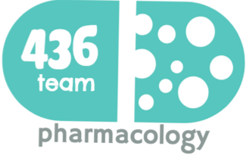
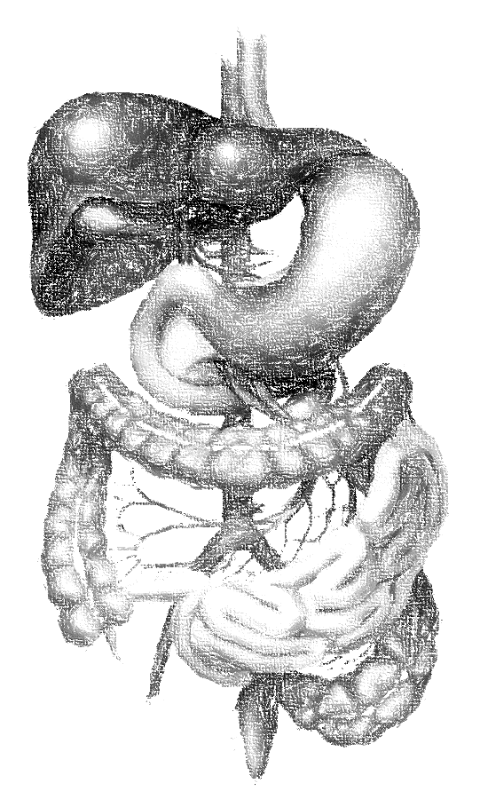
6: cytochrome system & drug metabolism
objectives
Revise the intent of drug metabolism and its different phases.
Define the role of cytochrome system in relation to drug metabolism.
Expand on the nature, location, nomenclature, structure, distribution & function of CYT P450.
Focus on its regulation; directly & indirectly, its induction & inhibition in relevance to drug interactions.
Interpret the molecular mechanism of interactions by CYT P450.
Classify its different isoforms, their substrates, inducers & inhibitors.
Delineate some of its genetic variations.
Color index
extra information and further explanation
important
doctors notes
Drugs names
Mnemonics
Kindly check the editing file before studying this document

Slide 2
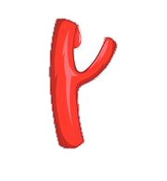
Metabolism and elimination of a substance
Pages 2-4 in 8 minutes ☺
When a substance is identified by the body as a foreign substance (drugs, toxins, etc.) the body will try to metabolize (change) and eliminate that substance out, this process occurs mainly (NOT always) in the liver.
Drugs being mostly lipophilic, the liver subjects them to chemical transformation (metabolism) to become inactive & easily excreted
Metabolism occurs mainly in the “METABOLIC CLEARING HOUSE”
Route of Elimination
Hydrophilic (Polar) product
Liver Metabolism
Renal elimination
Lipophilic (Non-polar) product
Biliary elimination
Absorption
Metabolism (by cytochrome system)
Elimination
Phase I*
Phase II**
Conjugate
Drug metabolite with modified activity
Conjugate
Inactive (hydrophilic)
Drug
(lipophilic)
Inactive drug metabolism
Conjugate
*Phase I:
Oxidation
Reduction
Hydrolysis
**Phase II:
It deals with:
Inactive metabolite
Active metabolite
Metabolite similar to parent
Metabolite more active than parent
A product with different effect
Toxic metabolite

Slide 3
الدكتورة قالت مب مهمه، يعني مروا عليها على السريع لا تعقدون نفسكم ☺
Cytochrome System More explanation in the next slide
cycle of Cytochrome P450 in drug oxidations: Microsomal drug oxidations require P450,P450 reductase, NADPH, and molecular oxygen
Step 1 | Briefly, oxidized (Fe³⁺) P450 combines with a drug substrate to form a binary complex
Step 2 | NADPH donates an electron to the flavoprotein P450 reductase, which in turn reduces the oxidized P450 drug complex
Step 3 | A second electron is introduced from NADPH via the same P450 reductase, which serves to reduce molecular oxygen & to form an activated oxygen-P450-substrate complex
Step 4 | This complex (oxygen-P450-substrate complex) in turn transfer activated oxygen to the drug substrate to form the oxidize product
The smooth microsomes rich in enzyme responsible for oxidative drug metabolism. in particular they contain the enzyme known as mixed function oxidases or monooxygenases.
The activity of these enzymes requires both:
a reducing agent (NADPH)
and molecular oxygen; (2atoms)
in a typical reaction, one molecule of oxygen is consumed(reduced) per substrate molecule, with one oxygen atom appearing in the product and other in the form of water
Only in male slides
In this oxidation – reduction process, two microsomal enzymes play a key role.
The first is a flavoprotein, NADPH-cytochrome P450 reductase (Flavin mono nucleotide and Flavin dinucleotide)
The second is a hemoprotein called cytochrome P450 which serves as a terminal oxidase
Only in male slides
NADP⁺
Reduced
Oxidized
Drug + O₂
Reductase
P450
NADPH
Oxidized
Reduced
Drug-OH + H₂O
Cytochrome P450 “CYT450”: superfamily is the terminal rate limiting oxidase of this system
Its enzymes are part of a cascade → transfers electrons from molecular oxygen to oxidize the drugs

Slide 4
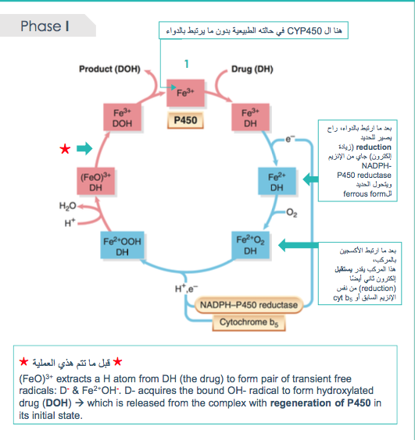
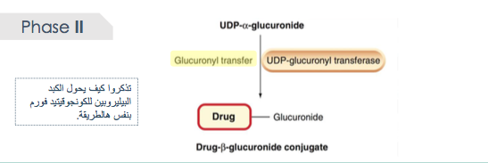
Extra explanation (phase I & II)
Step 4
Step 1
Step 2
Step 3
Step 3

Slide 5
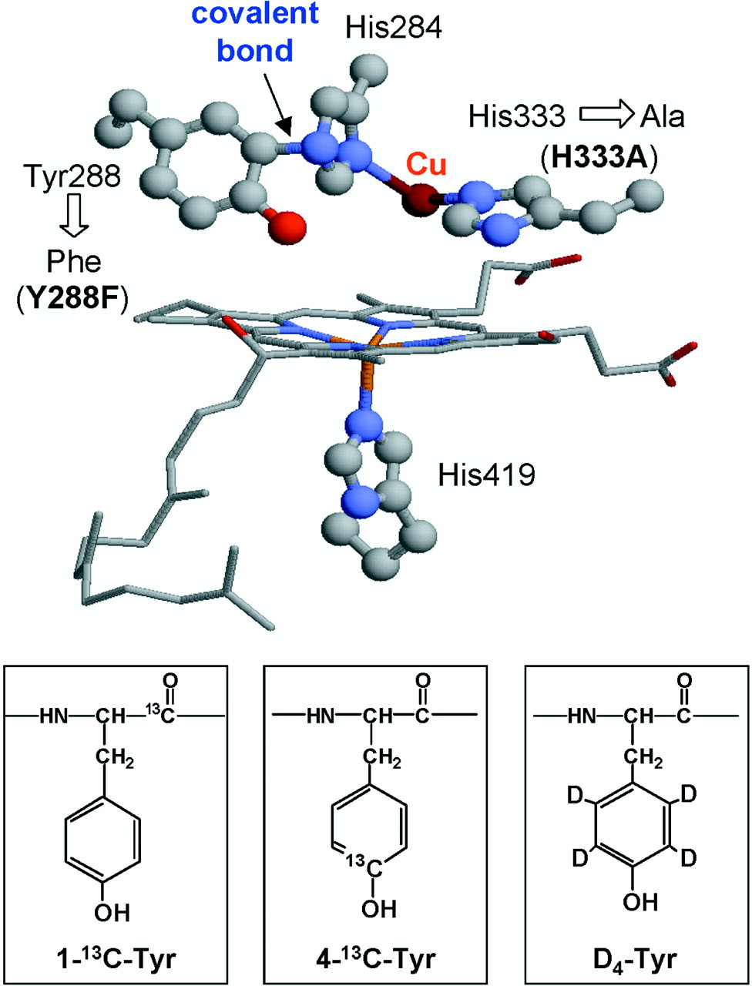
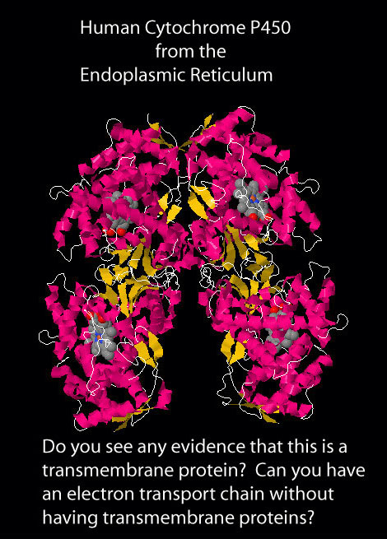
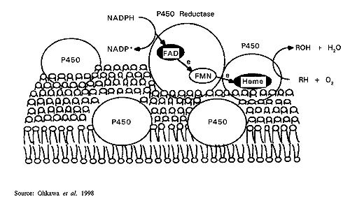
Cytochromes P450 (CYPs)
Cytochrome P450 | There are family of enzymes located mainly attached to the smooth endoplasmic reticulum (SER) of hepatocytes Cyto = cells. chromes = colored They color the liver cells dark red as they contain iron P450 = absorbs a very characteristic wavelength (450 nm) of UV light when it is exposed to carbon monoxide. They are isolated in the subcellular fraction termed the MICROSOMES = liver microsomal enzymes
Structure | They are heme-containing isoenzymes.
Distribution | Highly concentrated in hepatocytes Enterocytes of the small intestine present their principal extra-hepatic source Very small quantities in kidneys, lungs, & brain.
Function
Classification and isoforms | CYT P450 has been classified into: Families designated by number Sub families designated by letter Isoforms and their distribution in the liver: CYP3A4/5 : 36% CYP2D6: 19% CYP2C8/9: 16% CYP1A/2 : 11% CYP2C19: 8% CYPE1
heme
Responsible for most of the OXIDATIVE METABOLISM of:
Endogenous substances: steroid hormones, prostaglandins, lipids and fatty acids.
Exogenous compounds: diet (food & beverages), Drugs, environmental xenobiotics.
P450 Reductase
CYT P450 Oxidase
From more abundant to less

Slide 6
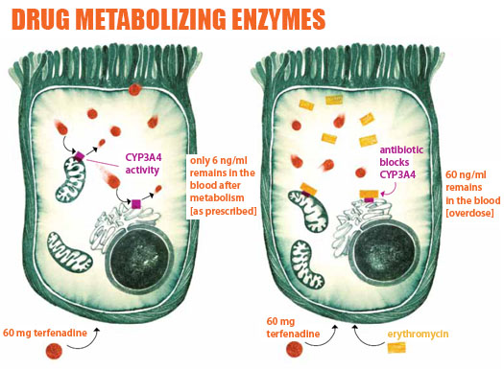
Cytochromes P450 (CYPs)
Regulation | General info. | Activation or Inactivation can be processed by any food, intrinsic products or extrinsic xenobiotics as drugs (usually the lipophylic) that have to be metabolized.
 | Direct
 | Indirect | Indirectly by expression or repression of its relevant genes by activation or inhibition of the responsible transcription factors (affect on the gene transcription of specific cytochrome enzyme –either decrease or increase transcription → less or more synthesis of the enzyme → less or high number of enzymes-)
Pharmacokinetic drug-drug-interaction |  | When drugs play a role in regulation of the CYT P450, they are termed: Enzyme Inducers if Activate the enzyme Enzyme Inhibitors if Inactivate the enzyme
Cytochrome enzyme
Ex. Antagonistic action
(Not related to cytochrome enzyme)
Cytochrome enzyme
The dose of 60mg of terfenadine will metabolized normally by CYP3A4 and only 6ng/ml will remains in the blood
Erythromycin is an enzyme inhibitor (inhibit CYP3A4).
If we combined Erythromycin and 60mg of terfenadine.
The terfenadine won’t be metabolized since CYP3A4 is inhibited and the avlibelity of terfenadine will be high in the blood (overdose)

Slide 7
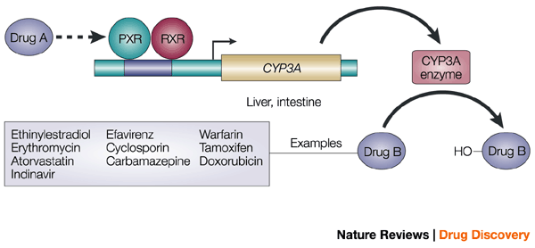
CYPs: Drug-Drug interaction
Molecular Basis Of Drug–drug Interaction | The orphan nuclear receptor PXR (pregnane X receptor) is a TRANSCRIPTION FACTOR that regulates the expression of the CYP P450 genes
Drug A-inducer | An enzyme inducer that: Binds and activates PXR (Transcription factors) PXR translocate in nucleus dimerize (joins up) with RXR (retinoid X receptor) The heterodimer PXR/RXR will induce expression of CYT P450 isoenzymes to increase metabolism of drug B. Outcome: Increase metabolism of the inducer itself which will decrease its pharmacological actions leading to tolerance or even complete nullification and also it will increase co-administrated drugs metabolism. (Decreased EFFICACY)
Drug B-inhibitor | enzyme inhibitor that: Binds and prevents activates PXR. Repression of CYPs P450 isoenzymes Decrease in Drug B metabolism. Outcome: Retard (decreased) metabolism and excretion of inhibitor and co- administrated drugs leading to prolong action of those drugs (inhibitors and co-administered drugs) (Increased TOXICITY)
Transcription factors

Slide 8
CYT P450 3A4/5
نربط هالمجموعة بجملة ”ثلاث (3) نسخ على ورق“ A4
بس اللي لازم تعرفونه من graphs إن CYP3A4/5 أكثر إنزيم موجود وله فاعلية كبيرة
Most common, 30% of CYP
Found in the liver & GIT. Responsible for the metabolism of: - Most calcium channel blockers, Most benzodiazepines, Most HIV protease inhibitors, Most HMG-CoA-reductase inhibitors, Cyclosporine, Most non-sedating antihistamines, Cisapride
أغلب طباعتنا تكون على ورق“ A4
هذا الجدول الدكتورة نبهت عليه كثير وقالت إنه أهم جدول بالمحاضرة!
Substrates Drugs that metabolize by CYP3A4/5 | Inhibitors Dugs inhibit CYP3A4/5 | Inducers Drugs induce CYP3A4/5
Immunosuppressant: Cyclosporine | Immunosuppressant: Cyclosporine AzoleAntifungals: Fluconazole Ketoconazole Itraconazole Antibiotics: Erythromycin Clarithromycin Troleandomycin Protease Inhibitors : Ritonavir Cimetidine Chloramphenicol Nefazadone Grape Fruits | Barbiturates Carbamazepine Dexamethasone Rifampicin / Rifampin Rifabutin Phenytoin Progestins
Azole Antifungals: Fluconazole
Antibiotics: Erythromycin Clarithromycin
Ca²⁺ channel blockers: Amlodepine Verapamil
Statins: Atorvastatin
Cancer Chemotherapy: Cyclophosphamide Tamoxifen
Non-Sedating Antihistaminics Astamizole
Benzodiazipines Midazolam Clonazepam
ثالث مره أقول لكم (3) لا ترمون أوراق A4 سووا لها إعادة تدوير( recycle )
ثالث مره أقول لكم (3) لا ترمون أوراق A4 سووا لها إعادة تدوير، ( recycle ) ، دايم فيه تثبيط لهالمبدأ
باربي دايم متحمسة
فلوسي كأنها يا زول قاعده تطير عندكم، ترى كلها 3 نسخ A4 !
باين إنه يحمس (Amazing)
ليش إذا أحد قال لا تكون زول يخطر ببالنا معنى سلبي !
دي متحمسة للاختبار ليه ؟
نتخيل أمل هذي مسؤولة مكتبة تصوير ونقول لها نبي (3) نسخ على ورق A4
رفيف دايم متحمسة
بالمعكوس نقراها باين دي أمل
نقراها فيه رابر اسمها أمل
فين اللي توه متحمس
نتخيل عندنا تحليل إحصائي (statistic = statin) ونبي (3) نسخ على ورق A4 له
(Navir) Never give the other the chance to inhibit/ discourage your spirits
السم شين ويثبط وظائف الجسم
المرأة بأول حمل لها تكون مرره متحمسة تشوف المولود
نقراها ما فيه
ثالث مره أقول لكم (3) لا ترمون أوراق A4 سووا لها إعادة تدوير( recycle )
فترة النفاس تكون النفسية مثبطة
أسهل رتبوها كذا لما تحفظون
BCD RR PP ☺
نقرأ أول مقطع لا فوز، والواحد يتثبط إذا ما فاز
خلاص تم يا زول راح نطبع (3) نسخ على ورق A4
يمديك يا زلمي تطبع (3) نسخ على ورق A4

Slide 9
Genetic variation:
Genetic variation: genetic polymorphisms in CYT P450 isoenzymes have been observed & are reasons behind the ALTERED RESPONSE to drug therapy
Cytochromes P450 (CYPs) con.
CYP2D6
Catalyzes primary metabolism of: Codeine, Many B-blockers, Many tricyclic antidepressants
Inhibited by: Haloperidol, Fluoxetine, Paroxetine, Quinidine
Genetic variation: This isoenzyme has the most frequent polymorphisms in all CYT P450 and When polymorphism occurs→ ↓ metabolizing capacity of CYP2D6 i.e those who exhibit the polymorphism become poor metabolizers:
1- Metabolism of some neuroleptics, tricyclic antidepressants, antianginals agent (perihexiline), antiarrhythmics (propafenone & metoprolol) is suppressed → so side effects & toxicity develop. i.e.:
* Neuropathy after therapeutic doses of perihexiline
* Bradycardia & arhythmias on therapeutic dose of propafenone or metoprolol.
2- The pro-drugs cannot be converted to their therapeutically active metabolite; e.g. poor analgesia with codeine & tramadole because they are not transformed into active forms.
* Absent in 7% of Caucasians, 1-2% non-Caucasians
* Hyperactive in up to 30% of East Africans.
نربط هالمجموعة بجملة “ To Do” or “to open the door”
(2D)=Co- deine, always when we use Co we refer to combination of two things,
Tell me the code to (2) open the door (D)
B is the 2nd alphabet, block the door
We have Two (t) letters + D
This queen inhibit us to do a lot of things
That’s why we are too Different
الواحد يتثبط إذا ينادونه يا ثور تاني وثالث مره
2D6
Could be found could be not
CYP1A2
Induced by: smoking tobacco
Catalyzes primary metabolism of: Theophylline, Imipramine, Propranolol, Clozapine
Inhibited by: Many fluoroquinolone antibiotics, Fluvoxamine, Cimetidine
دايم يتحمس الواحد ويبدأ التدخين بتجربة مره وحده وبعدها تصير ثانية وثالثة ....

Slide 10
Cytochromes P450 (CYPs) con.
CYP2C9
* Absent in 1% Caucasians and African-Americans
Primary metabolism of: Most NSAIDs (including COX-2) , S-warfarin (the active form) , Phenytoin
Inhibited by: Fluconazole
Genetic variation: Warfarin, phenytoin, & tolbutamide are examples of drugs with narrow therapeutic index that are metabolized by CYP2C9. Clearance of these drugs is impaired in genetic variation of the enzyme this will ↑ toxicity
نربط هالمجموعة بجملة “ To see you at 9 “
اللون الأخضر هو عنوان، مب ملاحظات الدكاتره
فين أشوفك ؟To see you /
Too toxic =(2C)
نربط هالمجموعة بجملة “ To see you “
CYP2C19
* Absent in 20%-30% of Asians, 3-5% Caucasians
Primary metabolism of: Diazepam, Omeprazole, Phenytoin
Inhibited by: Omeprazole, Isoniazid, Paroxetine, Ketoconazole
Genetic variation: Polymorphism in CYP2C19 shows increased & prolonged action of its substrates as omeprazole. This has been an advantage as in those variants → ↑ cure rates in peptic ulcer patient with Helicobacter pylori Benefit.
نربط هالمجموعة بجملة (2019=2C19)
شخص ما مات عام 2019
عام 2019 بيصير الأطفال وقحين ويطردون أمهم فيقولون “ أمي برا”!
فين أشوفك ؟To see you /
عام 2019 بيصير الأطفال وقحين ويطردون أمهم فيقولون “ أمي برا”! ، فتتحطم الأم وتزعل.

Slide 11
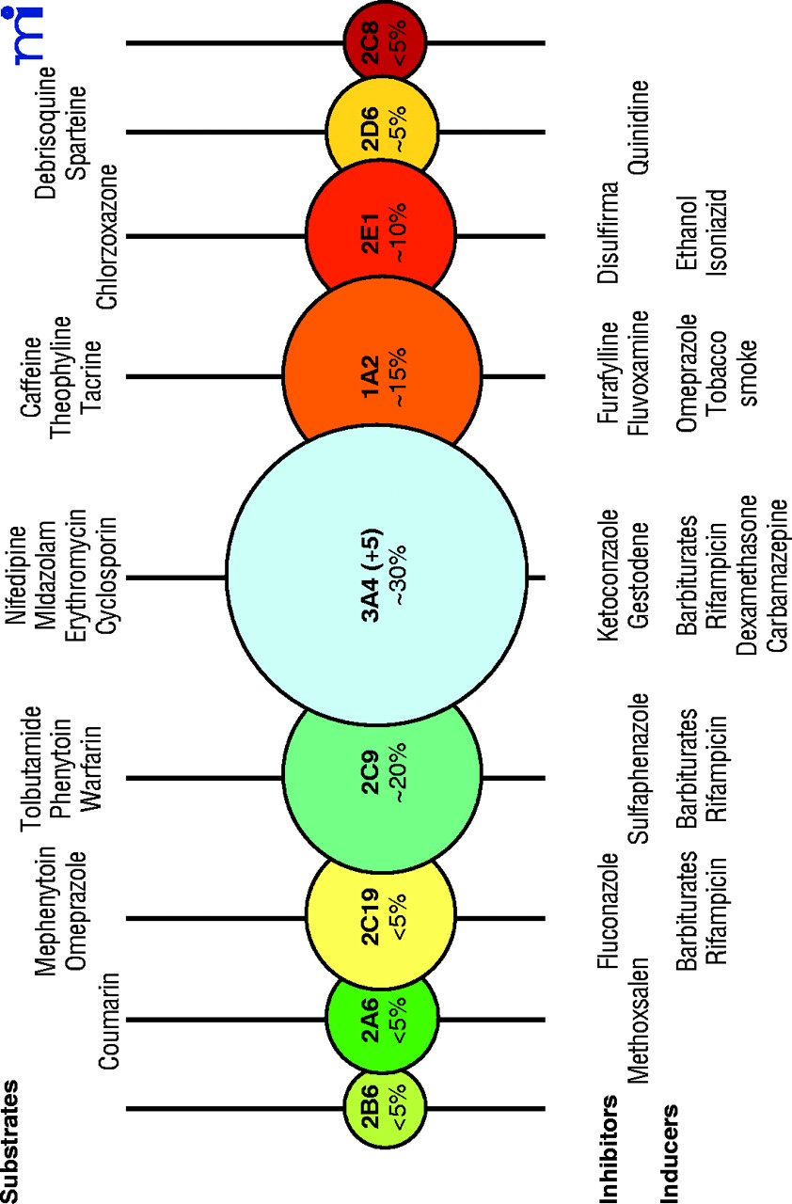
الدكتورة قالت لنا نركز على الأدوية اللي عليها نجوم وتشتغل على أي cytochrome
The queen inhibit us to do a lot of things
Disulfiram
دايم يتحمس الواحد ويبدأ التدخين بتجربة مره وحده وبعدها تصير ثانية وثالثة ....
دي متحمسة للاختبار ليه ؟
باين إنه يحمس (Amazing)
ليش إذا أحد قال لا تكون زول يخطر ببالنا معنى سلبي !
باربي دايم متحمسة
رفيف دايم متحمسة
Substrate
Inhibitors
Inducers

Slide 12
Summary
Cytochrome System
Phase 1 | Oxidation, Reduction, Hydrolysis
Phase 2 | It deals with: Inactive metabolite Active metabolite Metabolite similar to parent Metabolite more active than parent A product with different effect Toxic metabolite
Distribution | Highly concentrated in hepatocytes Enterocytes of the small intestine
Function | Responsible for most of the OXIDATIVE METABOLISM Endogenously and Exogenously
Regulation | Activation or Inactivation can be processed by any food, intrinsic products or extrinsic xenobiotics as drugs. Either directly or by expression or repression of its relevant genes
 | The orphan nuclear receptor PXR (pregnane X receptor) is a TRANSCRIPTION FACTOR that regulates the expression of the CYP P450 genes.
Classification and isoforms | CYP3A4/5 : 36% (most abundant) CYP2D6: 19% CYP2C8/9: 16% CYP1A/2 : 11% CYP2C19: 8%
CYP3A4 (MOST COMMON) |  |  | CYP2D6 | CYP1A2 | CYP2C9
Substrate: Immunosuppressant: Cyclosporine Azole Antifungals: Fluconazole Antibiotics: Erythromycin Clarithromycin Ca²⁺ channel blockers: Amlodepine Verapamil Statins: Atorvastatin Cancer Chemotherapy: Cyclophosphamide Tamoxifen Non-Sedating Antihistaminics Astamizole Benzodiazipines Midazolam Clonazepam | Inhibitors : Immunosuppressant Cyclosporine Azole Antifungals: Fluconazole Antibiotics: Erythromycin Clarithromycin Troleandomycin -Ritonavir -Grape Fruits -Cimetidine -Chloramphenicol -Nefazadone | Inducers: Rifampicin / Rifampin Rifabutin Phenytoin Carbamazepine Barbiturates Dexamethasone Progestins BCD RR PP | has the most frequent polymorphisms in all CYT P450 . Therefore the metabolism will decrease then: side effects will appear The pro-drugs cannot be converted to their therapeutically active metabolite Catalyzes primary metabolism of: Codeine, Many β-blockers, Many tricyclic antidepressants . Inhibited by: Fluoxetine, Haloperido, Paroxetine, Quinidine | Induced by: smoking tobacco Catalyzes primary metabolism of: Theophylline, Imipramine, Propranolol, Clozapine Inhibited by: fluoroquinolone antibiotics, Fluvoxamine, Cimetidine | Primary metabolism of: Most NSAIDs (including COX-2) , S-warfarin (the active form) , Phenytoin Inhibited by: Fluconazole
 |  |  |  |  | CYP2C19
 |  |  |  |  | Primary metabolism of: Diazepam, Omeprazole, Phenytoin Inhibited by: Omeprazole, Isoniazid, Paroxetine, Ketoconazole
هذا الجدول الدكتورة نبهت عليه كثير وقالت إنه أهم جدول بالمحاضرة!

Slide 13
MCQ
Q1 was in doctors’ slides
Q1:A 50 years old, patient was treated for the last 3 years by the hypocholestrolemic agent; atorvastatin. Yesterday he began to complain of severe muscle pains, weakness & reddish discoloration of urine He receives daily multivitamins & his lab results last week, proved that he has become diabetic, for which he was prescribed metformin. He was also started on a course of fluconazole for a concomitant fungal infection. From drug history, the diagnosis of his current state was likely rhabdo-myositis (severe musculoskeletal toxicity) & was verified by the lab finding of severe elevation in creatinine phosphokinase. “ Which one of the following drug-drug interaction on CYT 3A4 is the likely cause of his current state?
Metformin + Atrovastatin
Atrovastatin + Fluconazole
Metformin + Fluconazole
Q2: The cytochrome P435 are mainly responsible for metabolism of many drugs , In which phase they act ?
Phase I B. Phase II C. Both of them
Q3: Which one of the following cytochrome P450 isoenzymes is involved in the metabolism of largest number of drugs in human's liver ?
CYP1A2 B. CYP2D6 C. CYP3A4
Q4: Which one of the following cytochrome P450 isoenzymes is the most common to Genetic variation in human?
CYP1A2 B. CYP2D6 C. CYP3A4
Q5: An epileptic patient who use phenytoin as antiepileptic drugs, he also use Astamizole to treat his urticaria and allergy. If he develop drug-drug interaction, what may happen in his case ?
Sub-therapeutic effect of Astamizole .
Increase the risk of tolerance for phenytoin .
Both of them.
B
A
C
B
C

Slide 14
MCQ
Q6: An patient who use Cimetidine as antiulcer drug. , he travelled to endemic area with fungal infection, so he was given fluconazole as antifungal. If he develop drug-drug interaction, what may happen in his case ?
Sub-therapeutic effect of Cimetidine .
Increase the risk of toxicity by Cimetidine .
Both of them.
Q7: Patient with cardiac diseases who is on many medications to control his case. These drug are: Amiodarone as antiarrhythmic drugs, & Verapamil as antihypertensive/ antianginal/ antiarrhythmic drug, Atorvastatin as antihyperlipidemia. Later, he had infected by TB and was given Clarithromycin and Rifampicin as anti-TB drugs. 6 weeks later, he develop arrhythmia even he did not stop any of his antiarrhythmic drugs. Which one of the following drug-drug interaction on CYT 3A4 is the likely cause of his current state?
Amiodarone & Clarithromycin
Amiodarone & Rifampicin
Both of them
Q8: Patient with cardiac diseases who is on many medications to control his case. These drug are: Amiodarone as antiarrhythmic drugs, & Verapamil as antihypertensive/ antianginal/ antiarrhythmic drug, Atorvastatin as antihyperlipidemia. Later, he had infected by TB and was given Clarithromycin and Rifampicin as anti-TB drugs. 6 weeks later, he develop statin-induced myopathy including severe muscle pains and weakness . Which one of the following drug-drug interaction on CYT 3A4 is the likely cause of his current state?
Atorvastatin & Clarithromycin
Atorvastatin & Rifampicin
Both of them
B
B
A

Slide 15
قادة فريق علم الأدوية :
- جومانا القحطاني - اللولو الصليهم
- فارس النفيسة
الشكر موصول لأعضاء الفريق المتميزين :
روان سعد القحطاني
ريم الشثري
شذى الغيهب
غادة المزروع
References :
1- 436 Dr. Alia and Dr. Saeed’s slides and notes
2- 435 teamwork
pharma436@outlook.com
@pharma436
Your feedback
* الشعار و القالب الأساسي من تصميم لين التميمي

