Slide 1
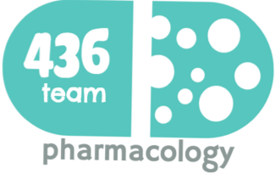
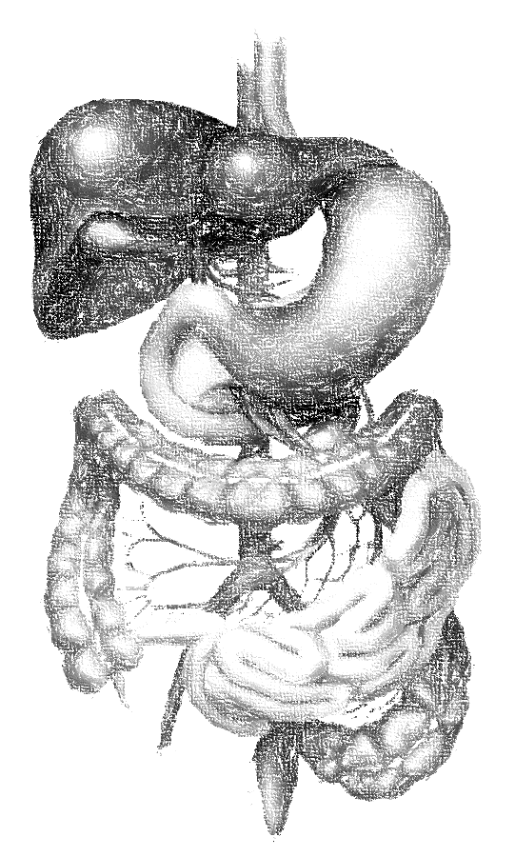
Hepatotoxic Drugs
objectives
Define the role of liver in drug detoxification
Discuss the types (patterns) of hepatotoxicity
Classify hepatotoxins
Explain how a drug can inflict hepatotoxicity
State the pathological consequences of hepatic injury
Contrast the various clinical presentation of hepatotoxicity
Enlist the possible treatment
Color index
extra information and further explanation
important
doctors notes
Drugs names
Mnemonics
Kindly check the editing file before studying this document

Slide 2
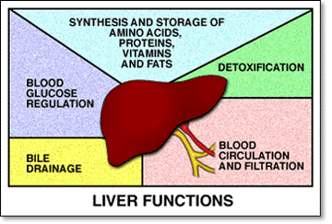
Introduction
physiological
Has multiple functions (>5000)
Can be categorized into:
Regulation, synthesis & secretion
utilization of glucose, lipids & proteins + bile for digesting fats.
Storage
Glucose (as glycogen), fat soluble vitamins (A, D, E & K) & minerals.
Purification, transformation & clearance
of endogenous (steroid hormones, cholesterol, FA, & proteins..) & exogenous (drugs, toxins, herbs…etc ) chemicals.
Pharmacological
drugs
Human body identifies almost all drugs as foreign substances i.e. XENOBIOTIC
Has to get rid of them
"METABOLIC CLEARING HOUSE"

Slide 3
Introduction
Liver subjects drugs to chemical transformation (metabolism) to become inactive and easily excreted “ convert drugs from lipophilic → Hydrophilic to excrete in urine”
Since most drugs are lipophilic they’re changed into hydrophilic water soluble products for elimination through the bile or urine.
Such metabolic transformation usually occur in 2 phases:
Phase 1 reactions
Oxidation, Reduction, Hydrolysis, Hydration Catalyzed by CYT P-450
Yields intermediates ➔ polar, transient, usually highly reactive ➔ far more toxic than parent substrates ➔ may result in liver injury ➔ Drug-Induced Liver Injury (DILI)
Phase 2 reactions
Conjugation with a moiety
(acetate, a.a., glutathione, glucuronic a., sulfate )
Yields products of increased solubility
If of high molecular weight ➔ excreted in bile.
If of low molecular weight ➔ to blood ➔ excreted in urine.

Slide 4
Hepatotoxicity
Hepatotoxic drugs
Hepatotoxic drugs are the leading cause of ADRs.
Hepatotoxic drugs → drug induced liver injury (Inflammation →Apoptosis→ Necrosis).
↓
Injury / damage of the liver is Caused by exposure to a drug → Inflict varying impairment in liver functions → Manifests clinically a long range → hepatitis → failure
Why the liver is the major site of ADRs ?
It is the first organ to come in contact with the drug after absorption from the GIT.
Being the metabolic clearing house of the body → it expresses the highest levels of drug metabolizing enzymes that converts some drugs (PROTOXINS) into intermediate (TOXINS) before being conjugated for elimination.
Drug (Pro-toxin) → Toxin → Injury.
Paracetamol → CYT P450 → NABQI lead to centrilobular liver necrosis.
(NAPBQI) : N-acetyl-p-benzoquinone imine.
Can any drug cause liver-related ADRs?
Not all drugs do so
Drugs that can cause ADRs in the liver (hepatotoxicity) are called → HEPATOTOXIN.
Toxicity potential of the drug
Chemical composition of the drug itself.
Nature of its reactive metabolite.
Conjugation reactions linked to it & their availability.
Mitochondrial effects of the drug.
Drug formulation (Long-acting drugs).

Slide 5
Hepatotoxicity
If the toxicity of HEPATOTOXIN is inflected by:
Supertheraputic / Cumulative dose of the drug
↓
INTRINSIC Hepatotoxin
Type of the hepatotoxicity inflected:
↓
DIRECT hepatotoxicity
Belong to type A (dose dependent) ADRs
↓
Predictable/ Direct
Normal dose of the drug
↓
Idiosyncratic Hepatotoxin
Type of the hepatotoxicity inflected:
↓
INDIRECT hepatotoxicity
Belong to type B (dose independent) ADRs
↓
Unpredictable/Bizzar/Idiosyncratic
Due to hypersensitivity
e.g. when we give oral anti-coagulant we predict that bleeding could be one of ADRs
Drugs that cause these types of hepatotoxicity
e.g. when we give antibiotic and the pt. has sudden reaction to it → not predicted
DIRECT increased dose dependent Hepatotoxicity | Acetaminophen | Increased dose
 | Salicylates
 | Statins
DIRECT cumulative Hepatotoxicity | Amiodarone | Cumulative Hepatotoxicity
 | Oral Contraceptives
Methotrexate ،Alcohol |  | BOTH
Type B dose dependent is divided into:
Immunoallergic idiosyncratic hepatotoxicity | Metabolic idiosyncratic hepatoxicity
A drug or its metabolite binds to hepatic membranes or proteins → act as hapten to induce a variety of immune reactions. | The metabolite of the offending drug interferes with hepatic metabolism as that of bilirubin or protein synthesis…etc
أمي داريه (Ami-o-darone)إني قاعد أجمع (cumulative) فلوس لبعدين
Metho=mix
Drugs causing Inflammatory cholestasis:
Chlorpromazine
Chlorpropamide
Erythromycin
Drugs that interfere with bilirubin metabolism:
Erythromycin
Rifampicin
Chole = Chlo
= eryth, bili=billionالإرث كان بليون
Chol eryth = كل الإرث لنا
Rafeef(=rifa) is beautiful(=bili=Bella) girl. Bella in Latin and Italy mean beautiful
Drugs causing viral Hepatitis-like pattern:
Isoniazid anti TB
Phenytoin anti epeliptic
methyldopa
Drugs that interfere with protein synthesis:
Corticosteroids
Tetracycline
= Iso-niazid & Hepaآذوا نياز وهبة
هبة فين توني شفتها !
In protein synthesis we have primary and secondary structure , so we can say tetra also 4
مثل الدوبه هبة !

Slide 6
Hepatotoxcity
Covalent & Non-covalent bonds
Prof. Yieldes said:
Bonds for Reading only
Drug or its reactive metabolites can form covalent bonds with target molecules or alter the target molecule by non-covalent interactions or both
Covalent interactions : change in molecule itself
a type of chemical bond involving the sharing of electrons between atoms in a molecule (strong)
It is adduct formation between the metabolite of the drug & cellular macromolecules.
If covalent binding to protein → immunogenic reaction
If binding to DNA → carcinogenesis
Non-Covalent interactions : change in function
Lipid peroxidation → generation of cytotoxic oxygen radicals.
- Impairment of mitochondrial respiration.
- Depletion of GSH reactions → 'oxidative stress'
- Modification of sulfhydryl groups → impair Ca2+homostasis
Protein synthesis inhibition
…..etc
Hepatotoxins cause liver disease
Most Hepatotoxins cause liver disease only in certain persons depending on:
Environmental factors:
Race , Age , Sex , Nutritional status , Concomitant habits , drugs , diseases
Host genetic makeup:
Metabolizing Enzymes , Detoxifying System , Drug Transport
Incidence of hepatotoxicity depends on:
Toxicity potential
Host genetic makeup
Environmental Host factors
Those factors lead to:
Drug induced hepatotoxicity

Slide 7
Drug induced hepatic injury
Incidence of DIHI
Drugs produce about 10% of all cases of hepatitis in young adults and 40% of cases in patients older than 50 years.
Categories of people who are exposed to Hepatotoxins:
Tolerators
No injury
Adaptors
Mild transient injury but adapt
Susceptibles
Develop overt symptoms depending on existing predisposing factors
In threat
DIHI accelerates beyond initial targets due to loss of synthetic & clearance function of hepatocyte with recruitment of inflammatory cells provoke apoptotic & necrotic signals
presenting manifestations
short (hrs/dys), intermediate (1-8ws), long (1-12ms)
In Direct dose-dependent Hepatotoxicity → the Latency period is SHORT as it occurs after a threshold of toxicity is reached → acetaminophen
In Direct cumulative or In Indirect Immunoallergic Idiosyncratic Hepatotoxicity → the Latency period is INTERMEDIATE , but may continue to evoke even after drug
Latency period:
Prof. Yieldez said it’s NOT important
No universal histo-pathological pattern of DIHI exist.
The commonest are : Hepatocellular necrosis , Cholestasis , Steatosis.
More than one type of injury may occur in the same patient and Any one agent may produce different types of injury in different patients
Histopathological finding
Clinical pattern :
Will be explained in the next slide

Slide 8
Drug induced hepatic injury
presenting manifestations
Clinical patterns
The clinical presentation could be of variable intensity ranging from asymptomatic ↑ of liver enzymes to Fulminant hepatic failure
it’s important
ASYMPTOMATIC | SYMPTOMATIC MANIFESTATIONS
increase In aminotransf -erases | injury targets hepatocytes Hepatocellular | If injury targets biliary system (canalicular or ductal) (CHOLESTASIS ) | If injury targets both hepatocytes & biliary system (MIXED TYPE)
Examples Phenytoin Statins Sulfonamides Sulfonylureas | apoptosis or necrosis (HEPATITIS)(cytotoxic) Symptoms: develops rapid onset of malaise, severe anorexia(loss of appetite) and jaundice, Flu-like symptoms, muscle aches, weakness, GIT symptoms, diarrhea, urine discolored, Increase(3 fold) in alanine aminotransferases (ALT). Normal level of ALP. | Symptoms: develop jaundice + severe pruritis predominate , dark urine, rash, stool may be light, hyperbilirubinaemia Normal level of ALT Increase(2 fold rise) in alkaline phosphatase(ALP) | ALT: increase 3 folds ALP: increase 2 folds
 | Examples: Acetaminophen NSAIDs Isoniazid Amiodarone | Examples: Chlorpropamide Erythromycin Rifamycin Oral contraceptives | Examples: Phenytoin Carbamazepine Sulfonamides ACE Inhibitors
استنى أمين، فين هبة ؟
Chole = Chlo
ما يدري فين يشتغل ! على هذا أو ذاك
Hepa said that
Chol eryth = كل الإرث لنا
= Iso-niazid & Hepaآذوا نياز وهبة
Chole ya rafeef
سولفوا لي عن هذا و ذاك
أمي داريه عنك يا هبة (Ami-o-darone)
= Chole orally, no it is contraindicatedكليه عن طريق الفم

Slide 9
Lines Of Treatment
1st step: Immediate withdrawal of any suspected drug.
No specific treatment , largely symptomatic & supportive :
Symptomatic:
If a severe allergic reaction is observed (Corticosteroids)
If pruritus → enhance bile acid excretion (Cholestyramine)
If cholestatic liver injury
Ursodeoxycholic acid (Ursodiol)
If coagulopathy or encephalopathy develop → treat accordingly
Supportive:
High carbohydrate, moderate protein and fat diet adequate in calories
Specific antidotes :
For Acetaminophen toxicity → N-acetylcysteine
For Valproate toxicity → L-carnitine
For Drug induced Fulminant Hepatic failure
↓
Emergency liver transplantation

Slide 10
Cases- From doctor’s slides
Case 1
A long standing rheumatoid arthritic patient developed TB 2 months ago. Today she was received in the ER complaining of yellowish discoloration, severe anorexia, vomiting, and flu like manifestations since two days. She is very weak and looks toxic. Her drug history reveals that she has been 4 months ago on cyclosporine to control the arthritic exacerbations. A month ago, she was put on isoniazid when she developed TB and multivitamins because she is weak. Currently she is given domperidone for the emesis. Lab results reveals severe elevation in ALT but no elevation on ALP.
Q1: Which one of the following drugs is the likely cause of her symptoms?
Cyclosporine
Multivitamins
Isoniazid
Domperidone
Q2: Which type of Hepatotoxin is considered? Immunoallergic Idiosyncrotic
Q3: What is the likely hepatotoxic pattern inflicted by the drug?
Hepatocellular / Hepatitis-like pattern
Case 2
A hypercholesterolemic patient was received in the ER complaining of yellowish discoloration of the skin, change in the color of the urine & stools, and severe itching. He has been receiving statins for the long time for the hypercholestrolemia. 3 months ago he was diagnosed as being diabetic and hypertensive and since then he is receiving chlorpropamide for the diabetes and nadolol for the hypertension. The last couple of days he has a flue for which he was given acetaminophen for muscle aches and nasal drops for his nasal stuffiness. Lab investigation shows severe elevation of ALP and no significant elevation in ALT
Q1: Which one of the following drugs is the likely cause of his symptoms?
Nadolol
Chlorpropamide
Acetaminophen
Statins
Q2: Which type of Hepatotoxin is considered? Immunoallergic Idiosyncrotic
Q3: What is the likely hepatotoxic pattern inflicted by the drug?
Cholestasis / Inflammatory cholestasis

Slide 11
قادة فريق علم الأدوية :
- جومانا القحطاني - اللولو الصليهم
- فارس النفيسة
الشكر موصول لأعضاء الفريق المتميزين :
روان القحطاني
ليلى المذكور
أنوار العجمي
دعاء وليد
References :
1- 436 Prof. Yieldez slides and notes
2- male’s notes
pharma436@outlook.com
@pharma436
Your feedback

