Slide 1
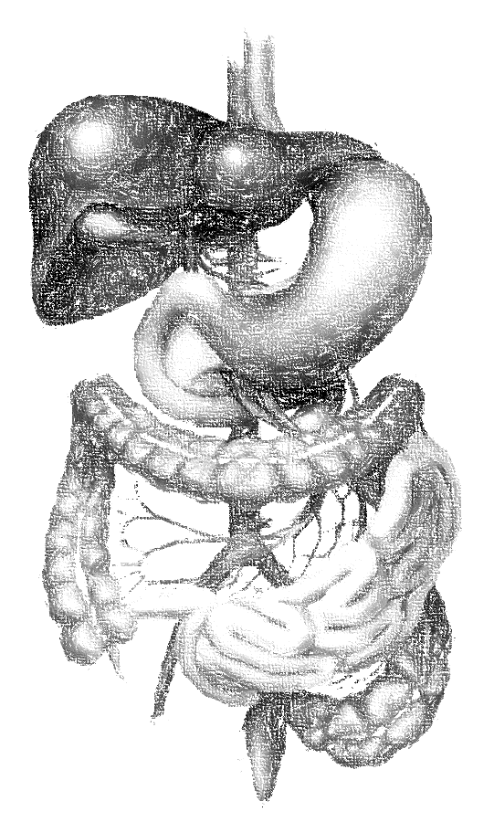
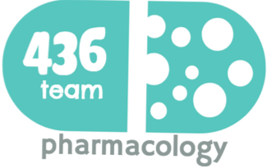
المحاضرة فيها اختلافات كبيرة بين البنات والأولاد
بعد الرجوع إلى الدكاترة قالوا لنا نركز على المشترك (اللي مكتوب بالأسود)
8: Anticoagulants
objectives
Introduction about coagulation cascade
Classify drugs acting as anticoagulants
Elaborate on their mechanism of action, correlating that with methods of monitoring
Contrast the limitations & benefits of injectable anticoagulants in clinical settings
Emphasis on the limitations of VKAs & on variables altering or modifying their response.
Color index
Extra information and further explanation
Important
Doctors notes
Drugs names
Mnemonics
We highly recommend you to study physiology lecture “coagulation” before studying this lecture
Only male’s slides
Only female’s slides
Kindly check the editing file before studying this document

Slide 2
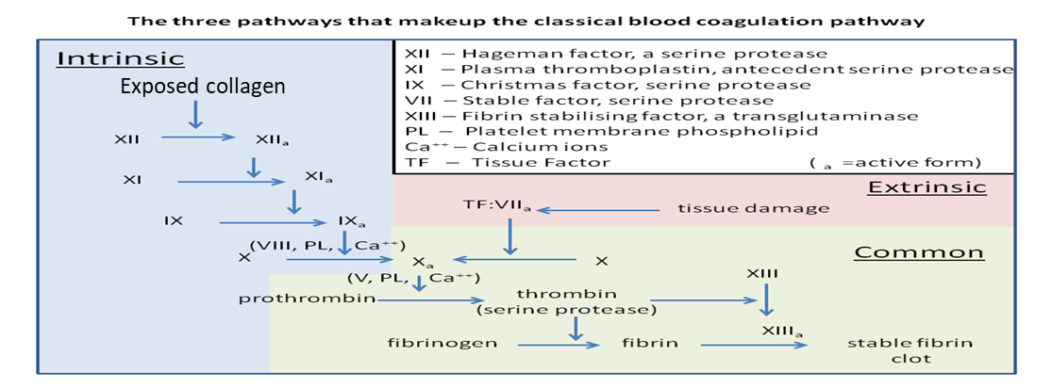
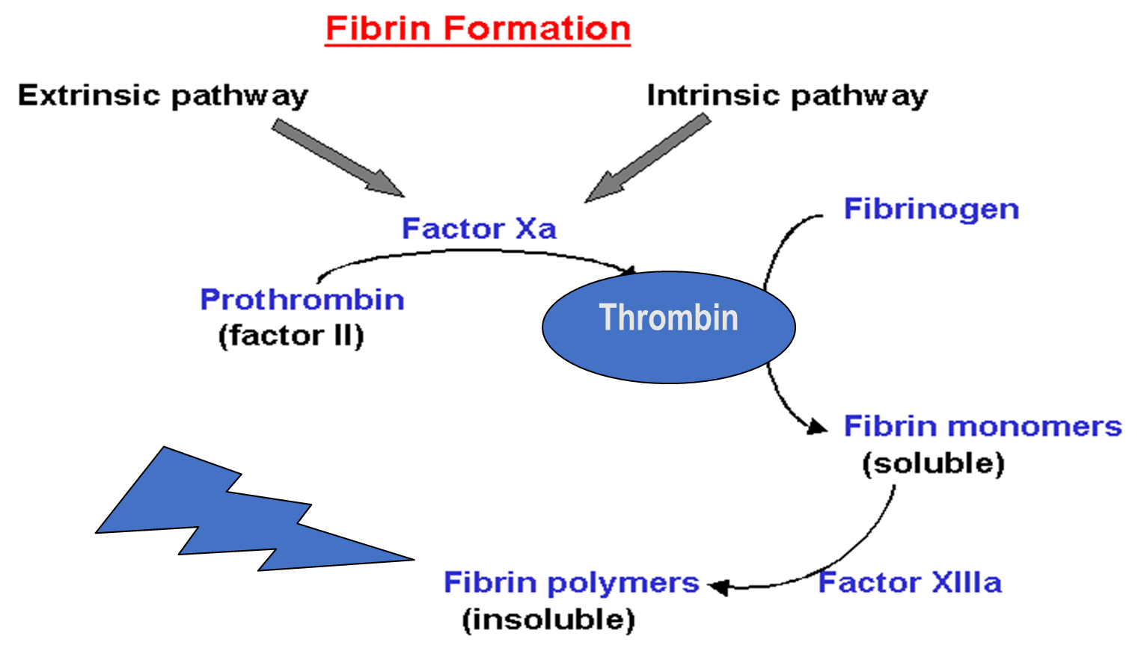
Introduction
Drugs and Coagulation
Anticoagulants
Antiplatelet drugs
Fibrinolytic agents
Molecules that prevent thrombus formation and extension by inhibiting clotting factors.
They inhibit the chemical process of formation of the fibrin polymer.
e.g. heparin, low molecular weight heparin, coumarins/ warfarin.
Reduce risk of clot formation by inhibiting platelet functions
Molecules that do not allow platelets to aggregrate and thus prevent clotting, especially in the arteries
e.g. aspirin and ticlopidine.
Molecules that dissolve (disintegrate) thrombi already formed, that’s why we don’t need to use it if there is no thrombus (as prophylaxes)
e.g. streptokinase
Coagulation Pathways
Intrinsic pathway
Extrinsic pathway
All clotting factors are within the blood
Initiating (triggering) factor is outside the blood
(tissue factor = thromboplastin)
Both converge to a common pathway
13 soluble factors are involved in clotting which normally circulate in an inactive state and must be activated to form a fibrin clot.
* Ca²⁺ are? required for promotion and acceleration of almost all blood clotting reactions
* Removal of Ca²⁺ with calcium chelators such as EDTA ethylenediamine tetra-acetic acid or citrate is used to prevent clotting in test tube
Thrombin plays a key role in coagulation as it is responsible for generation of fibrin mesh?
في السلايد موجود صورة غير، لكن أحنا أضفنا هذي الصورة لأنها أوضح

Slide 3
To understand !
Endogenous Inhibitors of Coagulation
Antithrombin III
It is a plasma protein that inhibits activated thrombin (factor IIa) and Xa (10), IXa (9), XIa (11), XIIa (12) by forming complex with these factors
It is the site of action of heparin.
Prostacyclin (PGI2)
synthesized by endothelial cells and inhibits platelet aggregation
Protein C and Protein S
these are vitamin K dependent proteins that slow the coagulation cascade by inactivating factor Va and VIIIa.
Anticoagulants
Parenteral Anticoagulants Thrombin inhibitors: Indirect activate Antithrombin III: Heparin (molecular weight: 3000-30000) LMWH: (molecular weight: < 8000) e.g. Direct inhibit thrombin (IIa): * Bivaluridin : R Is * Argatroban : R Is * Lepirudin : IR Is * Dabigatran oral : R Is Factor Xa: is Pentasaccharide * Indirect : Fondaparinux * Direct : Rivaroxaban (oral) | Oral Anticoagulants Vitamin K antagonists: Warfarin > 40 times potency than Dicumarol It acts on II, VII, IX & X
Indications: Myocardial infarction (MI) Deep venous thrombosis (DVT) Peripheral arterial emboli, pulmonary embolism (PE) and many other conditions Anticoagulants are also used in blood transfusions, and dialysis procedures
They act on: XIIa, XIa, IXa, Xa, IIa
Enoxaparin, Dalteparin
Heparin and heparin-related agents
Heparin is an injectable rapidly acting anticoagulant
Active in vitro and in vivo
Low–molecular–weight forms (LMWHs), 1/3 the size of UFH are used as well and have many advantages over UFH (UnFractionated Heparin)

Slide 4
Indirect Thrombin Inhibitors
المحاضرة شرحتها لنا بروف. يلدز، اللي ركزت عليه حطيناه لكم بالعنابي
Drug | Unfractionated Heparin
Notes | Normally occurs as macromolecule in mast cells with histamine (its physiological role is unknown) Commercial preparations are extracted from beef lung or pig intestine (can cause hypersensitivity reaction) Heparin stops the expansion of a thrombus and prevents the formation of new thrombi but it DOES NOT dissolve an existing thrombus
Mechanism of action | Indirect Thrombin Inhibitor (both UFH and LMWH) It acts indirectly by increasing the activity of the endogenous anticoagulant “Antithrombin III” (1000 folds) which inhibits activated (inactivate) clotting factors mainly thrombin (factor IIa and Xa 10 and VIIa 7) , In the absence of heparin this incativation (of anithrombin) is slow When Heparin binds to Antithrombin III, it causes conformational changes that accelerates its rate of action 1000 fold
Pharmacokinetic | Heparin is not absorbed from the GIT It should be administered by IV or SC injection. Not injected IM as it causes haematomas at injection site Once in the blood stream, UFH (UnFractionated Heparin) binds to plasma proteins, endothelial cells and macrophages (so it has low bioavailability) Heparin does not cross the placenta; therefore it is the drug of choice as anticoagulant during pregnancy No predictable anticoagulant effects; inter-patient & intra-patient variability in response to a given dosage → in hospital setting, repeated monitoring Close monitoring of the activated partial thromboplastin time (aPTT) is necessary in patients receiving UFH. مهم تحفظون اسم الفاكتور اللي نستخدمه في المراقبة
Heparin has high MW, so it can bind antithrombin III with thrombin and antithrombin III will inhibit thrombin
If we have a case: pregnant lady has DVT, what is the drug of choice? Heparin
بليز ركزوا على هالمعلومة مره مهمه

Slide 5
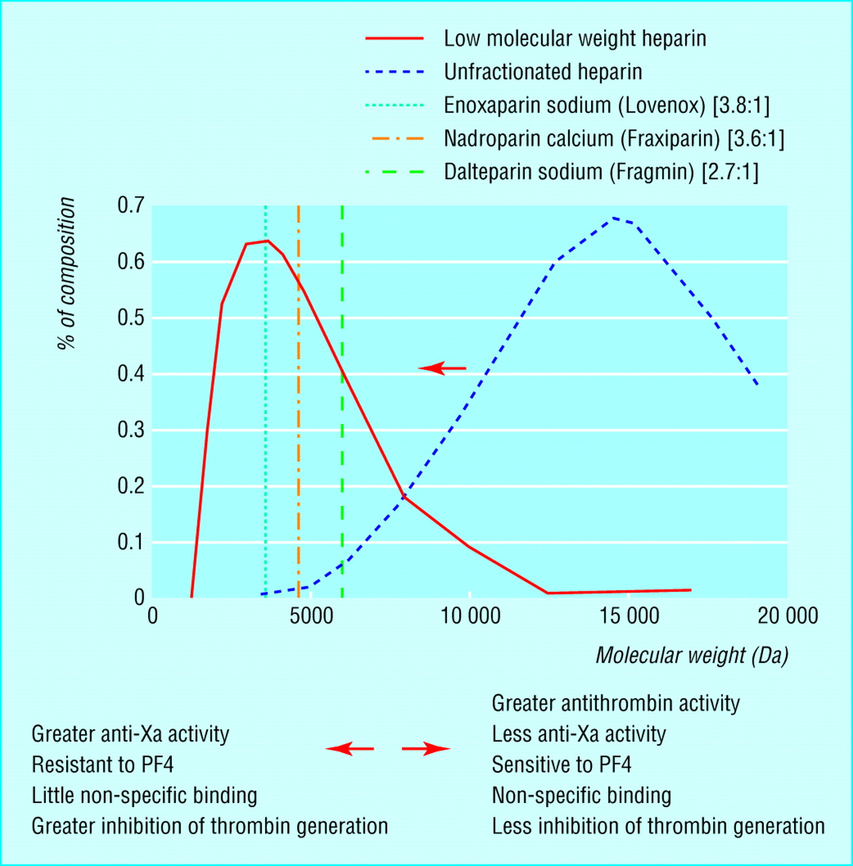
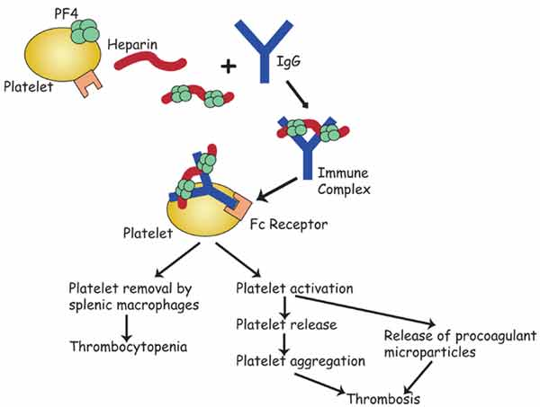
Indirect Thrombin Inhibitors (con.)
Drug | Unfractionated Heparin
Indications | Due to its rapid onset of action, it is used to initiate immediate anticoagulation in thromboembolic disease (PE, DVT, MI) in emergency conditions, mainly as induction for oral vitamin K antagonists (VKAs) Prevention of postoperative DVT (in patient undergoing hip replacement) Prevention of coagulation during renal dialysis or cardiac surgery
Disadvantage | The inconvenience of administration by injection Re-thrombosis: activates platelets as it does not neutralize fibrin-bound IIa Heparin discontinuation, No packed platelets → More thrombosis, No warfarin → ppt .venous gangrene. Give → DTIs (Direct Thrombin Inhibitors) هم معقدين السالفة هنا ☺ باختصار ميزة الهيبارين إن أول ما نوقفه عادي نعطيه أي دوا ثاني (مثلًا المريض صار عنده سايتوبينيا بسبب الهيبارين على طول أوقف هيبارين وأعالجه بهيرودين) عكس الوارفرين لازم أراقب وقت البروثرومبن عشان أتأكد إنه طلع من الجسم وماراح يأثر بشكل عكسي بعدين أعطي هيرودين The need for regular monitoring (aPTT) UFH carries a risk of heparin-induced thrombocytopenia (HIT), a fall in the platelet count and increased risk of thrombosis due to binding to platelets. In 4% pts. on heparin, latency 5-10 days. after 1st exposure or 2-3 days. after re-exposures → Venous > Arterial thrombosis. Heparin-induced thrombocytopenia (HIT): Generally, if the number of platelets is too low, excessive bleeding can occur If the number of platelets is too high, blood clots can form thrombosis However, There are disorders that reduce the number of platelets, such as heparin-induced thrombocytopenia (HIT) that typically cause thrombosis, or clots, instead of bleeding
ADRs | Heparin-induced thrombocytopenia (HIT ) The major adverse effect of heparin is bleeding Allergic reactions (chills, fever, urticaria) as heparin is of animal origin and should be used cautiously in patients with allergy Long-term heparin therapy is associated with osteoporosis
C.I. | Bleeding disorders, hemophilia اي دواء يزود سيولة الدم مانقدر نعطيه لاحد عنده هيموفيليا او يكون مسوي من قريب عملية عشان مايصير عنده نزيف Patients with hypersensitivity to the drug Recent surgery of the brain, eye or spinal cord, threatened abortion
Reversal of action (antidote of heparin) | Discontinuation of the drug Heparin is strongly acidic and is neutralized by IV protamine sulfate (a strongly basic protein) It combines with heparin to form a stable complex devoid of anticoagulant activity

Slide 6
Indirect Thrombin Inhibitors (con.)
Only in female’s slides
Low-Molecular-Weight Heparins (LMWH)
Drug | Heparin fragments (e.g. enoxaparin, dalteparin) | Synthetic pentasaccharide (fondaparinux)
Advantages | LMWHs are derived from the chemical or enzymatic degradation of UFH into fragments approximately one-third the size of heparin. Have equal efficacy, without frequent laboratory monitoring ( suitable for outpatient therapy) Have a more predictable anticoagulant response ( better bioavailability, longer t ½) Binding to platelets and osteoblasts is reduced with LMWH compared with UFH, so it will not cause osteoporosis or HIT
M.O.A | LMWHs increase the action of antithrombin III on factor Xa 10 but not its action on thrombin, because the molecules are too small to bind to both enzyme and inhibitor
Use | Are used increasingly in place of unfractionated heparin
Synthetic Heparin Derivatives
Drug | Fondaparinux
M.O.A | A synthetic compound that inhibits factor Xa 10 by antithrombin but does not inhibit thrombin
Advantages | Fondaparinux can be given once a day at a fixed dose without coagulation monitoring Less likely than UFH or LMWHs to trigger HIT it will not cause HIT

Slide 7
Differences between UFH and LMW Heparins تجميعه جميله جدا
Drug characteristics | Heparin (UFH) | LMWH
IV ½ life | 2 hours | 4 hours longer
Bioavailability after SC injection | 20% | 90% As it hardly binds to plasma proteins, endothelium & macrophages
Anticoagulant response | Variable (Unpredictable) We need to monitor the blood to see if the dose in the therapeutic level or not | Predictable i.e. little inter-patient and intra-patient variability in response to a given dosage.
Major adverse effect | Frequent bleeding, HIT, osteoporosis | Less frequent bleeding because it has less effect on AT III , less HIT and osteoporosis as it seldom sensitive to PF4
Specific antagonist | Protamine sulphate | Incomplete
Setting for therapy | Hospital | Hospital and OPC (outpatient)
Laboratory monitoring | Needed aPTT | Not needed
Advantages of LMWHs over UFH
The theoretical pharmacologic advantages of LMWH over UFH arise from the preferential binding ratio to factor Xa (10) over thrombin
The convenience of once- or twice- daily subcutaneous injections without regular coagulation monitoring due to:
More predictable response
Long plasma half-life and improved bioavailability (Good bioavailability)
Less plasma protein binding
Less platelet activation and lower risk of re-thrombosis and thrombocytopenia
Much better tolerability
Given subcoutanous

Slide 8
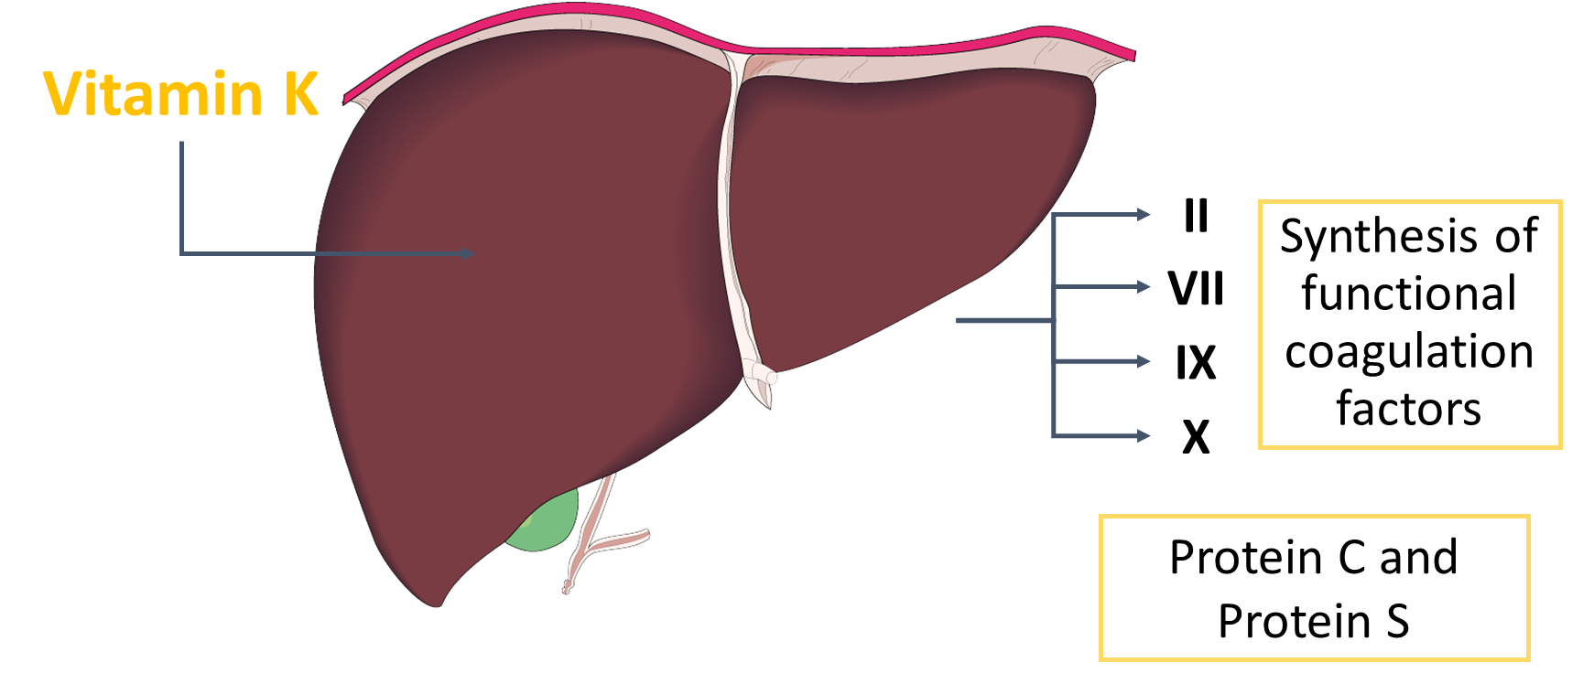
Direct Thrombin Inhibitors (DTIs)
Only in female’s slides
Drug | Hirudin | Lepirudin
Notes | The first DTI to be developed, which was isolated from the saliva of the leech (علقة) | A polypeptide that binds directly to the active site of thrombin
M.O.A | DTIs exert their anticoagulant effect by direct binding to thrombin This direct effect is rapid and potent DTIs are not associated with the development of thrombocytopenia
Uses | Recombinant hirudin “Lepirudin” is used as IV anticoagulant in patients with heparin-induced thrombocytopenia (HIT).
Only in female’s slides
Oral Anticoagulants
“Vitamin K Antagonists”
Vitamin K (Fat soluble vitamin)
Source of vitamin K
Green vegetables.
Synthesized by intestinal flora excessive use of antibiotic will kill this bacteria and may lead to vitamin K deficiency
Required for synthesis of:
Active form of Factors II, VII 7, IX 9,X 10
Protein C and S (endogenous anticoagulants)
Causes of deficiency
Malnutrition
Malabsorption
Antibiotic therapy

Slide 9
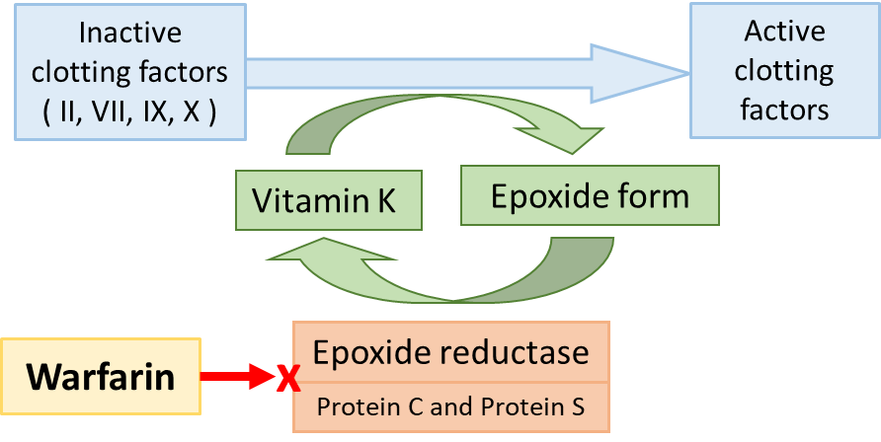
Oral Anticoagulants
Drug | Coumarins: Warfarin
Mechanism of action
Pharmacokinetic | Monitoring anticoagulant effect of warfarin by measuring PT, which is expressed as an International Normalized Ratio (INR) مهم مره تعرفون هذا الفاكتور Warfarin has a slow offset of action (slow elemination) due to the time required for synthesis of new, functional coagulation factors Act only in vivo (in human) Bioavailability 100% 98% bound to plasma proteins (albumin) Their effect takes several days (3-4 ) to develop because of the time taken for degradation of circulating functional clotting factors Therefore the onset of action starts when these factors have been eliminated Wide variation in drug response
Disadvantages | Variable, unpredictable effect necessitating regular INR monitoring and dose adjustment Narrow therapeutic window leading to increased risk of severe bleeding we have to monitor the drug’s level in the blood Slow onset and offset of action يعني يأخذ وقت عشان يبدا مفعوله ويأخذ وقت عشان يطلع من الجسم Polymorphisms in CYT P450 isoforms that metabolizes warfarin → adds to its non predictable response → liability to toxicities or under use. Numerous interactions with foods containing vitamin K and drugs
C.I. | Warfarin is contraindicated during pregnancy as it can cross the placental barrier and cause abortion, hemorrhagic disorder in the fetus and birth defects → Teratogenicity
Inhibits synthesis of biologically active forms of Vitamin K-dependent coagulation factors II, VII (7), IX (9) , & X (10), these factors require carboxylation of their glutamic a. residues to allow them to bind to phospholipid surfaces. This is provided by Vit. K as it changes from its oxidized to its reduced form. Instantaneously , the reduced Vit K has to recycle back to oxidized form by Vit K epoxide reductase. This enzyme is blocked by VKAs (like warfarin) losing the coagulation factors the ability to function, so The anticoagulant effect of vitamin K antagonists, such as warfarin, is due to the synthesis of non-functional clotting factors. Prothrombin, factors VII, IX and X as well as anticoagulant protein C and protein S are all inactivated by vitamin K antagonists
Does not have any effect on already-synthesized coagulation factors; therefore, the therapeutic effects are not seen until these factors are depleted.
3-4 days until effect is seen

Slide 10
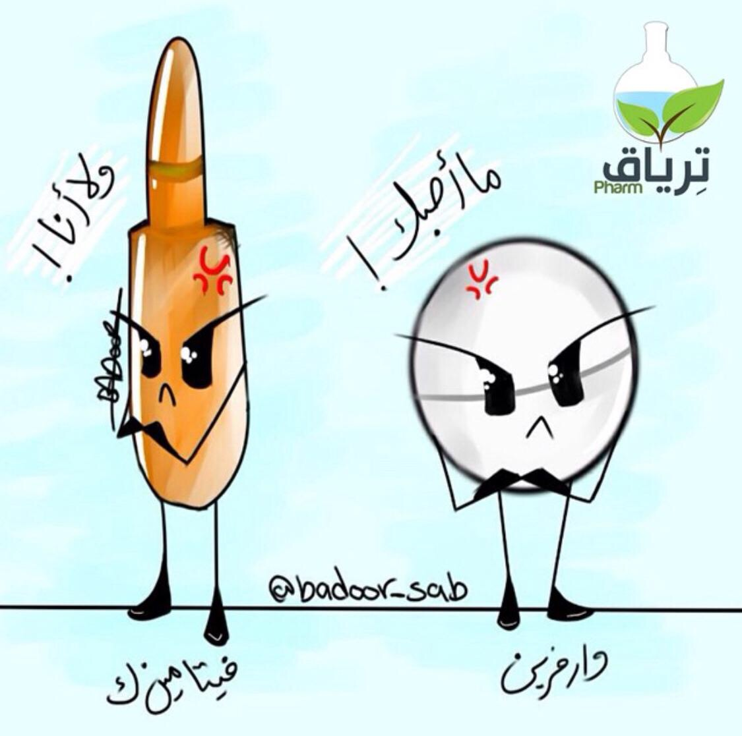
Oral Anticoagulants (con.)
Drug | Coumarins: Warfarin
Drug Interaction الدكتورة ركزت كثير على النقاط اللي بالأسود وحرصت عليهم | Increase the effect of warfarin Vitamin K deficiency: Inadequate diet: malnutrition, dieting, decreased GI absorption…etc Impaired synthesis of clotting factors: In hepatocellular disorders; ( hepatitis; infective or chronic alcoholism ... etc.) Increased catabolism of clotting factors: In hypermetabolic states: as in fever, thyrotoxicosis Inhibition of Vit. K synthesis by intestinal flora: oral antibiotics Inhibition of Vit K absorption: liquid paraffin Decrease in drug metabolism by microsomal enzyme inhibitors: chloramphenicol, & cimetidine Displacement of the drug from protein binding sites: phenylbutazone & salicylates Co-administration of drugs that increase bleeding tendency by: (inhibiting platelet function: NSAIDs like aspirin,) or (inhibiting coagulation factors: heparin “Be carful when give warfarin together with heparin because the bleeding tendency will increase and we should keep monitoring both drugs”)
 | Decrease the effect of warfarin Decreased plasma protein binding: ↑ elimination of free drug & shortening of its t ½. as pts with nephrotic syndrome (proteinuria) Decreased catabolism of clotting factors: Hypothyroidism Hereditary resistance to oral anticoagulants Inhibition of drug absorption from GIT: cholystyramine, colestipol Increase in synthesis of clotting factors: Vit K, oral contraceptives Increase in drug metabolism by microsomal enzyme inducers: Carbamazepine, barbiturates, rifampicin
Reversal of action (antidote) | If the patient develop Bleeding due to Warfarin: Stop the drug IV injection of vitamin K Fresh frozen blood because it contain active clotting factors
شكرًا لرسامتنا المبدعة بدرية ♥
Both warfarin and heparin need antidote but LMWH doesn't need

Slide 11
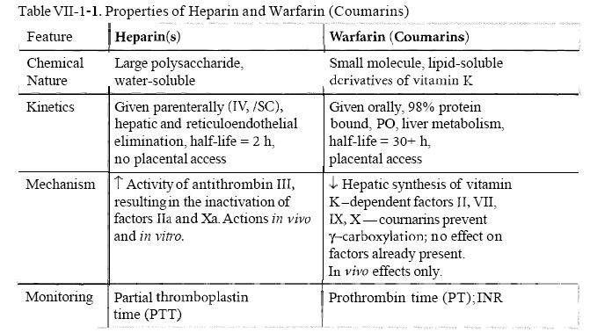
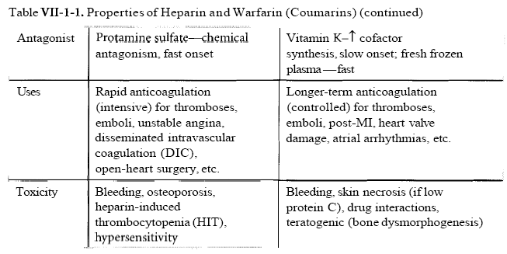
Summary
Drug of choice for pregnant women
Indirect effect
مهم
بس ركزوا على clotting factors أو البروتينات اللي راح يشتغل عليها الدوا

Slide 12
Summary
Indirect thrombin inhibitors (parenteral) | Unfractionated Heparin (IV,SC) | stops the expansion of a thrombus by increasing the activity of “Antithrombin III” which inhibits activated clotting factors mainly thrombin (factor IIa “2a”) and Xa 10 (which means at M.O.A is indirect) prevents the formation of new thrombi DOES NOT dissolve an existing thrombus Drug of choice as anticoagulant during pregnancy initiate immediate anticoagulation in thromboembolic disease Prevention of postoperative DVT Need close monitoring of the activated partial thromboplastin time (aPTT) Can cause heparin induces thrombocytopenia (HIT ) Prevention of coagulation during renal dialysis of cardiac surgery Threatened abortion Antidote: protamine sulfate
 | low molecular weight heparin ( enoxaparin, dalteparin Fondoparinux) | without frequent laboratory monitoring (no need for monitoring aPTT) Binding to platelets and osteoblasts is reduced with LMWH compared with UFH, so it will not cause osteoporosis or HIT no action on thrombin Outpatient therapy
 |  | Fondoparinux: inhibits factor Xa 10 by antithrombin but does not inhibit thrombin
Direct thrombin inhibitors (parenteral) | Hirudin, lepirudin | direct affect on thrombin Not associated with thrombocytopenia Used as IV anticoagulant in heparin induced thrombocytopenia
Vitamin k anticoagulants (oral) | warfarin | * The effect take days * Slow offset of action * Narrow therapeutic window * Monitoring anticoagulant effect of warfarin by measuring International Normalized Ratio (INR) * Warfarin has a slow offset of action due to the time required for synthesis of new, functional coagulation factors * Numerous interaction (بليز أرجعوا لسلايد ١٠ موجودة فيها تعارضات الأدوية) * Teratogenic (contraindicated in pregnancy) * Antidote: IV injection of vitamin K

Slide 13
Cases – From Dr.Ishfaq’s slides.
An old, peptic ulcer patient, sustained on cimetidine, has been bed ridden since a month following a major orthopedic surgery for pelvic fracture. The last week he began to complain of pain, tenderness, warmth & swelling of his left leg. He was diagnosed as deep vein thrombosis. His treating physician put him first on heparin that was replaced after three days by VKAs. Today he began to show bleeding of gums.
Q1: What is the expected explanation of his finding?
Warfarin toxicity, because Cimetidine inhibits its metabolism.
Q2: Will the treating physician 1st of all, consider giving an antidote to stop bleeding (if so then state) or will he probably ask for lab investigation (if so then state)?
we can stop the warfarin and give him Vitamin K as antidote or actually bleeding of gums not emergency situation, so we have time to do lab investigations.
Q3: Once lab findings are there, is the physician expected first to withdraw or to adjust the existing therapy?
Give him another anti-peptic ulcer drug. Or change Warfarin to heparin.
_________________________________________________________________
A young rheumatic arthritic patient has underwent valve replacement and is sustained on warfarin therapy for the last three years. When she married, last summer, she did not want to get pregnant, so she has taken since then, oral contraceptive pills. Her regular lab monitoring today showed a decrease in INR this time.
Q1: What is the expected explanation of her lab result?
Contraceptive pills induces the coagulation factors → ↓ INR → increase tendency of thrombus.
Q2: What will the treating physician consider doing?
A. Giving heparin on top >> the best choice (given instead of).
B. Adjusting warfarin dose >> 1st step, and we can decrease the dose to the half.
C. Stopping the OC >> it is Better, but maybe she want to continue on this medication.
D. Stopping warfarin

Slide 14
MCQs
Q1: Which must heparin bind to in order to exert its anticoagulant effect?
GP IIb/IIIa receptor. B. Thrombin. C. Antithrombin III.
Q2: Which is most appropriate for reversing the anticoagulant effects of heparin?
Aminocaproic acid. B. Protamine sulfate. C. Vitamin K .
Q3: A 32-year-old female is diagnosed with as deep vein thrombosis. Her past medical history shows that she was stable on Warfarin for DVT, and now she want to be pregnant. What the doctor should do in this case ?
A. Stop Warfarin and start Heparin. B. Adjust the dose of Warfarin. C. Give her Vitamin K supplement
Q4: A62-year-old male taking warfarin for stroke prevention in atrial fibrillation presents to his primary care physician with an elevated INR of 10.5 without bleeding. He is instructed to hold his warfarin dose and given 2.5 mg of oral vitamin K1. When would the effects of vitamin K on the INR most likely be noted in this patient?
1 hours. B. 6 hours. C. 24 hours.
Q5: Which of the following anticoagulant is a proven to be associate with human teratogen?
A. Fondaparinux B. Warfarin C. Heparin
Q6: An 80-year-old male is taking warfarin indefinitely for the prevention of deep venous thrombosis. He is a compliant patient with a stable INR and has no issues with bleeding or bruising. He is diagnosed with a urinary tract infection and is prescribed sulfamethoxazole/ trimethoprim. What effect will this have on his warfarin therapy?
Sulfamethoxazole/trimethoprim will decrease the anticoagulant effect of warfarin.
Sulfamethoxazole/trimethoprim will increase the anticoagulant effect of warfarin.
Sulfamethoxazole/trimethoprim will not change anticoagulation status.
Q7: A patient with pulmonary embolism and he was on heparin for that later he developed thrombocytopenia. Now he need immediately Anticoagulation for parenteral administration. Which one of the following Anticoagulation can be used and has no risk to develop drug-induced thrombocytopenia?
Lepirudin B. Enoxaparin C- Both of them
Q8: Which of the following is a major adverse effect of Heparin?
A. Allergic reactions B. Osteoporosis C. Bleeding
Q9: Which of the following is a major adverse effect of Heparin in long-term use ?
A. Allergic reactions B. Osteoporosis C. Bleeding
C
B
A
C
B
B
A
C
B

Slide 15
قادة فريق علم الأدوية :
- جومانا القحطاني - اللولو الصليهم
- فارس النفيسة
الشكر موصول لأعضاء الفريق المتميزين :
روان سعد القحطاني
جواهر ابانمي
دعاء وليد
أنوار العجمي
معتز الطخيس
ابراهيم فتياني
References :
1- 436 Prof. Yieldez’s and and notes
2- 436 Dr. Ishfaq’s slides
pharma436@outlook.com
@pharma436
Your feedback
* الشعار و القالب الأساسي من تصميم لين التميمي

