Slide 1
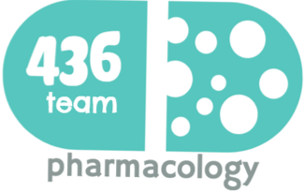
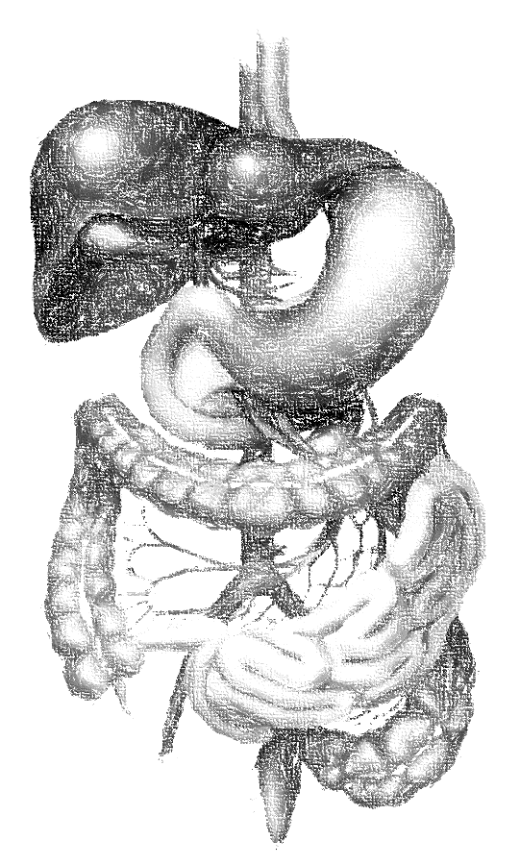
Antiplatelet Drugs
objectives
describe different classes of anti-platelet drugs and their mechanism of action
understand pharmacological effects, pharmacokinetics, clinical uses and adverse effects of anti-platelet drugs
Color index
extra information and further explanation
important
doctors notes
Drugs names
Mnemonics
Kindly check the editing file before studying this document

Slide 2
Introduction
Platelets and Vessels
In healthy vessels, nitric oxide and prostacyclin (released by endothelial cells lining the blood vessels) inhibit platelets aggregation.
Damage to the vessel wall leads to interaction between (1) Platelets, (2) Endothelial cells and (3) Coagulation factors which lead to formation of the CLOT:
THROMBOSIS: is the formation of unwanted clot within the blood vessel, producing life threatening conditions such as:
- Acute myocardial infarction (MI) - Acute ischemic stroke
- Deep vein thrombosis (DVT) - Pulmonary embolism (PE)
THROMBUS:
is the CLOT that adheres to vessel wall
EMBOLUS:
is the CLOT that floats in the blood
Role of Platelets in Homeostasis
Following vascular injury, von Willebrand factor binds to collagen in the exposed subendothelium at the site of injury.
The other site of the “rod-formed” von Willebrand factor binds to the platelet receptor GPIb and platelets are thereby anchored to the site of the injured endothelium. This is called adhesion.
Following adhesion, agonists such as collagen, thrombin, adenosine diphosphate (ADP), and thromboxane A₂ activate platelets by binding to their respective platelet receptors.
As a result of agonist binding, platelets undergo a shape change and new structures such as phospholipids and GPIIb/IIIa receptors are exposed on the cell membrane. This is called activation
The third step of platelet response is aggregation. After activation, binding of fibrinogen to GPIIb/IIIa causes platelets to adhere to each other into a loose platelet plug.

Slide 3
To understand !
Vascular Injury
Exposure of collagen and vWF
Tissue factor exposure
Platelet adhesion and release
Activation of coagulation
Platelet recruitment and activation
Thrombin generation
Platelet aggregation
Fibrin formation
Platelet – fibrin thrombus
Drugs used in thrombosis
Anticoagulants
Antiplatelets
Thrombolytics or Fibrinolytics
drugs which prevent clotting by inhibiting clotting factors (coagulation process)
(used in prevention and treatment of thrombosis).
drugs which prevent and inhibit platelet activation and aggression
(used as prophylactic therapy in high risk patients).
act by dissolving existing or already formed thrombi or emboli
(used in the acute treatment of thrombosis).
بنجيب لكم دوا ونقولكم ايش الميكانزيم
Classification of Antiplatelet Drugs
Arachidonic acid pathway inhibitors
e.g. Aspirin
Phospho-diesterase inhibitors
e.g. Dipyridamole
ADP
inhibitors
e.g. Ticlopidine Clopidogrel
Glycoprotein IIb/IIIa inhibitors
e.g. Abciximab – Eptifibatide -Tirofiban

Slide 4
Mechanisms of action of antiplatelet drugs
Plaque Disruption
Collagen
vWF
Platelet adhesion and secretion
Aspirin
COX-1
TXA2
ADP
Ticlopidine
Clopidogrel
X
Platelet recruitment and activation
GPllb / llla activation
Abciximab
Eptifibatide
Tirofiban
X
Platelet aggregation
Arachidonic acid pathway inhibitors
Drug | Aspirin (Acetylsalicylic Acid)
M.O.A | Irreversible inhibition of cyclooxygenase enzyme ( COX-1 ) via acetylation. Small dose inhibits thromboxane (TXA2) synthesis in platelets But not prostacyclin (PGI₂) synthesis in endothelium (larger dose).
Use | Prophylaxis of thromboembolism e.g. prevention of transient ischemic attack, ischemic stroke and myocardial infarction. Prevention of ischemic events in patients with unstable angina pectoris. can be combined with other antiplatelet drugs (clopidogrel) or anticoagulants (heparin).
Dose | Low-dose aspirin (81 mg enteric coated tablet/day ) is the most common dose used to prevent a heart attack or a stroke. Given as prophylaxis
ADRs | Risk of peptic ulcer. Because it inhibits prostaglandin synthesis Increased incidence of GIT bleeding (aspirin prolongs bleeding time)
الذبحة الصدريه اللي تجي وقت الراحة

Slide 5
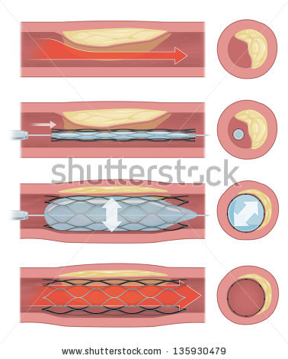
ADP pathway inhibitors
الدين كله أدب
البنت حلاها بالأدب
(ADP= dine)
(ADP= Grel/Girl)
Drug | Ticlopidine | Clopidogrel
M.O.A | These drugs specifically and irreversibly inhibit ADP receptor of subtype P2Y12*, which is required for platelets activation thus prevent platelet aggregation. * P2Y12 is purinergic receptor and is a chemoreceptor for adenosine diphosphate (ADP).
P.K | are given orally. have slow onset of action (3 - 5 days). pro-drugs, they have to be activated in the liver. bound to plasma proteins
Use | Secondary prevention of ischemic complications after myocardial infarction, ischemic stroke and unstable angina.
ADRs | Sever neutropenia, CBC should be done monthly during treatment. Bleeding ( prolong bleeding time ). G.I.T : nausea, dyspepsia, diarrhea. Allergic reactions.
Drug Interactions | inhibit CYT P450 causing increased plasma levels of drugs such as phenytoin and carbamazepine.
Notes | can’t be taken with food | is more potent than ticlopidine Longer duration of action than ticlopidine Less frequency of administration (given once daily ). Less side effects (less neutropenia). Bioavailability is unaffected by food. Clopidogrel has replaced ticlopidine
Indication |  | For patients with a history of recent myocardial infarction (MI), recent stroke, or established peripheral arterial disease. For patients with acute coronary syndrome (unstable angina/ MI): either those managed medically or with percutaneous coronary intervention* (PCI) with or without stent.
اتكلوا بالدين
صار كلو بدو قيرل
Better!
Bye to you (P2Y)من الأدب نقول
اتكلوا بالدين، لأن ديننا وسطي
(neutralize = neutropenia)
(ticlopidine)
Worse with ticlopidine
Why clopidogril had replaced ticlopidine?
كلها زي بعض الا الاسبيرين بروفيلاكسس
*Coronary angioplasty (percutaneous coronary intervention, PCI) is a procedure used to open clogged heart arteries. Angioplasty involves temporarily inserting and inflating a tiny balloon to help widen the artery.

Slide 6
New ADP Pathway Inhibitors
البنت حلاها بالأدب
(ADP= Grel/Girl)
Drug | Prasugrel | Ticagrelor
M.O.A | Irreversible inhibitor of the P2Y12 receptor | Reversible inhibitor of the P2Y12 receptor
P.K | both have more rapid onset of action than clopidogrel both drugs do not need hepatic activation. not prodrug
Use | to reduce the rate of thrombotic cardiovascular events (including stent thrombosis) in patients with acute coronary syndrome who are to be managed by PCI.
ADRs | both increase bleeding risk | both increase bleeding risk dyspnea
More preferred than the old ones
يرتبط معه تكا ويروح ما يطول
باقي تكا يا بنتي ويروح نفسي
Glycoprotein IIb/ IIIa receptor inhibitors
Strongest pathway
من شافوه طاروا فيه باين
ابدي فيه بالتايد ويروح
Drug | Abciximab | Tirofiban (Non peptide drug) | Eptifibatide (peptide drug)
M.O.A | inhibits platelet aggregation by preventing the binding of fibronigen, von Willebrand factor, and other adhesive molecules to GPIIb/IIIa receptor sites on activated platelets prevent the activation and final step of aggregation | Act by occupying the site on glycoprotein IIb/ IIIa receptor that is required to bind the platelet to fibrinogen (act as fibrinogen- mimetic agents).
P.K | Given I.V. infusion | They are given intravenously
Use | Used with heparin and aspirin as adjunct to PCI for the prevention of cardiac ischemic complications. | Used for the reduction of incidence of thrombotic complications during coronary angioplasty (PCI)
Notes | Glycoprotein IIb/ IIIa receptor is required for platelet aggregation with each others and with fibrinogen and von Willbrand factor.
شفت أي بي سي زيها أبيك تحفظ الخريطة
عبسي زيي راح بخرايطها

Slide 7
Phosphodiesterase Inhibiter
Drug | Dipyridamole
M.O.A | It is a vasodilator. Inhibits phosphodiestrase ( an enzyme that normally break down cAMP) thus increases cAMP and decreased synthesis of thromboxane A2 and other platelet aggregating factors.
Use | Given orally. Adjunctive therapy for prophylaxis of thromboembolism in cardiac valve replacement (with warfarin). Secondary prevention of stroke and transient ischemic attack (with aspirin).
ADRs | Headache Postural hypotension
Two mole of phosphate
Dipyridamole = Phosphodiesterase
used in combination with other drugs due to its Weakness
Because it’s a vasodialator
Summary
Mechanism of action | Drug | ROA
Inhibition of thromboxane A2 synthesis via inhibiting COX-1 | Aspirin | Oral
ADP receptor antagonists | Clopidogrel | Oral
 | Ticlopidine
GP IIb / IIIa receptor antagonists | Abciximab Tirofiban Eptifibatide | I.V.
Phosphodiestrase (PDE) inhibitor | Dipyridamole | Oral
Given in surgeries

Slide 8
Summary
1-Arachidonic acid pathway inhibitors: Aspirin
-M.O.A:
Irreversible inhibition of COX-1 via acetylation
-Use:
Prophylaxis of thromboembolism and Prevention of ischemic events
-Dose: Low-dose aspirin
-ADRs:
Risk of peptic ulcer
Increased incidence of GIT bleeding
4-New ADP Pathway Inhibitors:
Prasugrel: Irreversible inhibitor of the P2Y12 receptor
Ticagrelor: Reversible inhibitor of the P2Y12 receptor & cause dyspnea
-Use:
reduce the rate of thrombotic cardiovascular events
-ADRs:
increase bleeding risk
No risk of Neutropenia.
2-Phosphodiesterase inhibitors: Dipyridamole
-M.O.A:
Inhibits phosphodiesterase & It is a vasodilator
-Use:
Adjunctive therapy for prophylaxis of thromboembolism (with warfarin)
& Secondary prevention of stroke and transient ischemic attack (with aspirin)
-ADRs:
Headache & Postural hypotension
5-Glycoprotein IIb/IIIa inhibitors:
Abciximab:
-M.O.A:
inhibits the binding to GPIIb/IIIa receptor
-P.K: I.V. infusion→ acute case / during surgery(such as coronary angioplasty)
-Use:
with heparin and aspirin as adjunct to PCI for the prevention of cardiac ischemic complications
Eptifibatide –Tirofiban:
-M.O.A:
act as fibrinogen- mimetic agents
-P.K: I.V. infusion
3-ADP pathway inhibitors: Ticlopidine & Clopidogrel
-M.O.A:
Irreversibly inhibit ADP receptor of subtype P2Y12
-P.K: orally, pro-drugs,
have slow onset of action
-Use: Secondary prevention
For patients with acute coronary syndrome (unstable angina/ MI)→clopidogrel
-ADRs:
Sever neutropenia→ Ticlopidine
-interactions:
inhibit CYT P450

Slide 9
MCQs
Q1: Which of the P2Y12 ADP receptor antagonists reversibly binds the receptor
A. Tirofiban. B. Ticagrelor. C. Ticlopidine.
Q2: A 56-year-old man came to the emergency room with complaints of swelling, redness, and pain in his right leg. The patient is diagnosed with acute DVT and requires treatment with an antiplatelet immediately. Which one of the following can be used in his case ?
A. Tirofiban. B. Ticagrelor. C. Ticlopidine.
Q3: A 59-year-old female presents to the emergency room and she is diagnosed with valvular atrial fibrillation. She requires valve replacement surgery immediately. Which one of the following Antiplatelet can be used in her case during surgery ?
A. Tirofiban. B. Ticagrelor. C. Ticlopidine.
Q4: All of the following Antiplatelet drugs act as ADP inhibitors except :
A.Tirofiban. B. Ticagrelor. C. Ticlopidine.
Q5: All of the following Antiplatelet drugs act by blocking the adhesion or activation of platelet except* :
A. Aspirin. B. Tirofiban. C. Ticlopidine.
Q6: Which one of the following Antiplatelet drugs act as fibrinogen mimetic agent and block GP IIb / IIIa receptors in platelet ?
Aspirin. B. Epitafibatide. C. Prasugrel.
Q7: Which one of the following Antiplatelet drugs can be used in patient with liver diseases** ?
A. Clopidogrel. B. Ticlopidine. C. Ticagrelor.
B
A
A
A
B
B
C
*Q5: Tirofiban act mainly on aggregation phase of platelet.
** Q7: the new ADP such as Ticagrelor do not need hepatic activation.because they are not prodrug

Slide 10
MCQs
Q8: Which of the following is a common serious side effect of ticlopidine ?
Prolong Bleeding. B. Postural hypotension. C. Neutropenia.
Q9: Which one of the following Antiplatelet drugs should be monitored by complete blood count for the patient every month ?
A. Clopidogrel. B. Ticlopidine. C. Ticagrelor.
Q10: Which one of the following Antiplatelet drugs is not recommended to be used in patient who is on phenytoin as anti-epileptic drug ?
A. Tirofiban. B. Ticlopidine. C. Abciximab.
Q11: Which one of the following Antiplatelet drugs can cause dyspnea as adverse effect ?
A. Tirofiban. B. Ticagrelor. C. Ticlopidine.
Q12: Which one of the following Antiplatelet drugs can cause postural hypotension as adverse effect ?
A. Prasugrel. B. Clopidogrel. C. Dipyridamole.
Q13: Which one of the following drugs is the most potent as Antiplatelet ?
A. Abciximab. B. Aspirin.. C. Clopidogrel.
Q14: Which one of the following Antiplatelet drugs act by blocking GP IIb/IIIa and inhibit platelet aggregation ?
A. Abciximab. B. Ticagrelor. C. Prasugrel.
Q15: Which one of the following Antiplatelet drugs is given intravenously and can be used during operation and acute emergency case ?
A. Abciximab. B. Aspirin. C. Clopidogrel.
C
B
B
B
C
A
A
A

Slide 11
قادة فريق علم الأدوية :
- جومانا القحطاني - اللولو الصليهم
- فارس النفيسة
الشكر موصول لأعضاء الفريق المتميزين :
فيصل العباد
روان سعد القحطاني
جواهر أبانمي
رحاب العنزي
أنوار العجمي
References :
1- 436 Prof. Yieldez slides
pharma436@outlook.com
@pharma436
Your feedback

