Slide 1
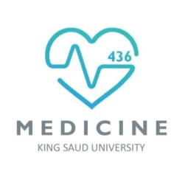
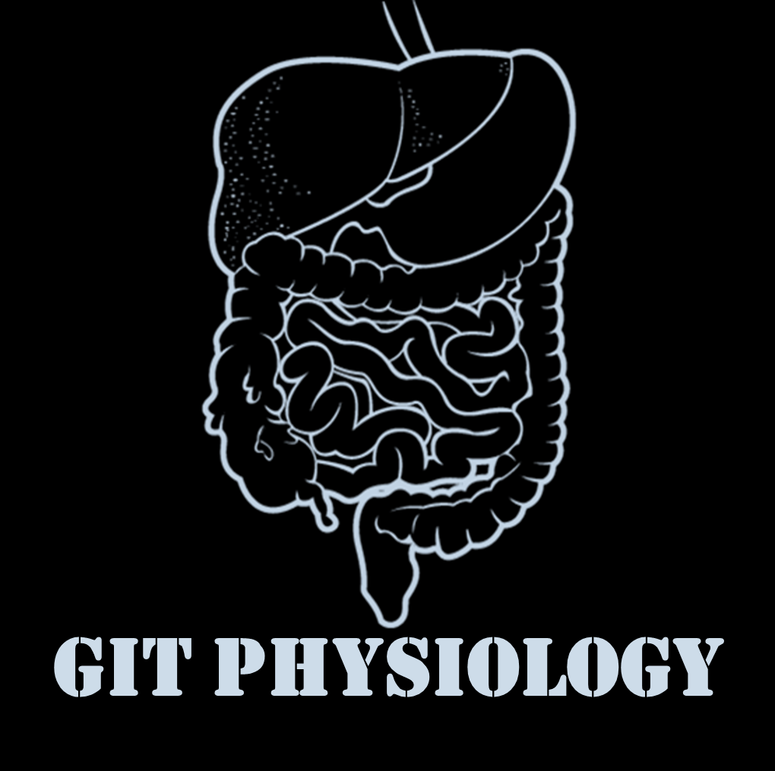
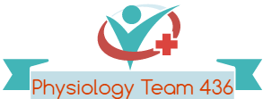

Text
Only in Females’ slide
Only in Males’ slides
Important
Numbers
Doctor notes
Notes and explanation
Lecture No.10
“Do The Best You Can Until You Know Better. Then When You Know Better, Do Better”
المحاضرة عبارة عن جزئين، جزء الـBilirubin وجزء الـJaundice
جزء الـBilirubin لو ما عندكم وقت سلايد 3+8+13 تغني عن السلايدز من 2 حتى12 ☺
جزء الـ Jaundice مو موجود في اوجكتف القايد، لكن الدكتور منبه عن أشياء فيه، ادرسوه احتياط

Slide 2
Bilirubin Metabolism
Objectives:
Definition of bilirubin.
Bilirubin metabolism.
Bilirubin formation.
Transport of bilirubin in plasma.
Hepatic bilirubin transport.
Excretion through intestine.
Other substances conjugated by glucuronyl transferase.
Differentiation between conjugated & unconjugated bilirubin.
Other substances excreted in the bile.

Slide 3
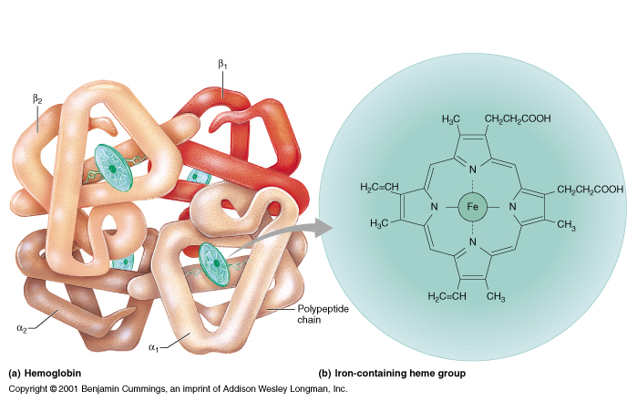
Porphyrin metabolism
Only in Males’ Slides
Structure of hemoglobin
Important
Heme is found in hemoglobin, a principal component of RBCs (Heme= iron + organic compound “porphyrin”)
The hemoglobin as a whole can be easily degraded because its made of of polypeptides but degrading the porphyrin ring is the issue.
Porphyrins are cyclic compounds that readily bind metal ions usually Fe²⁺ or Fe⁺³ which can carry O₂.
Porphyrins are heterocyclic macrocycles composed of four modified pyrrole (a colorless, toxic, liquid, five-membered ring compound, C₄ H₅ N) subunits interconnected at their α carbon atoms via methine bridges (=CH-).
The most prevalent porphyrin in the human is heme, which consists of one ferrous (Fe²⁺ ) iron ion coordinated in the center of tetrapyrrole ring of protoporphyrin IX.
Degradation of porphyrin is the complex part about hemoglobin metabolism and if it was not degraded properly it can be very toxic.
  Structure of Hemoglobin showing the polypeptides backbone that are composed of four subunits (chain):
  2 α.
  2 β.
Every subunit is consisted of one ferrous (Fe²⁺) iron ion coordinated in the center porphyrin compound.
Each chain is complexed with a heme group shown as a green beaded structure.
One heme group in the center of each subunit

Slide 4
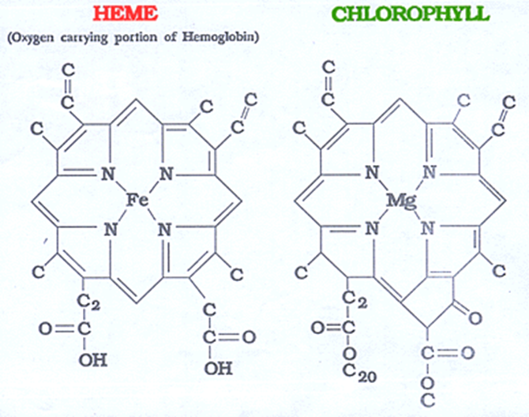
Bilirubin
Bilirubin: is the end product of heme degradation derived from breakdown senescent (aging) erythrocytes by mononuclear phagocytes system specially in the spleen, liver and bone marrow (it’s an excretory pathway). It is the water insoluble breakdown product of normal heme catabolism. It is the greenish yellow pigment excreted in bile, urine & feces. if we have any excessive amounts of hormones or drugs in the blood the blood will get rid of it through the bile. The major pigment present in bile is the orange compound bilirubin. It is highly soluble in all cell membranes (imp note: it can also cross BBB) (hydrophobic) and is also very toxic. Therefore, its excretion in the bile is one of the very important functions of the liver. Serum bilirubin level is an important clinical marker of hepatobiliary excretory function (it’s one of the liver function tests & if it increases it leads to jaundice). Heme source in body: 80% from hemoglobin. 20% other hemo-protein: cytochrome, catalase, peroxidase, myoglobin.
Bilirubin metabolism
1. Formation | 2. Plasma Transport | 3. Hepatic Phase | 4. Intestine Excretion
 |  | Hepatic uptake
 |  | Conjugation
 |  | Secretion in bile
The four steps are finely balanced. Therefore: Reduction at any step may cause hyperbilirubinemia. Enhancement of the throughput requires induction of multiple genes, probably coordinated by nuclear receptors.
Iron is in the center and the porphyrin group is around it forms the heme

Slide 5
هذه السلايد زبدة الخطوات الجاية، اقرووها قبل تكملون يسهل عليكم!
ثاني عملية هي الـ Conjugation: كل Bilirubin واحد راح يرتبط باثنين (UDPGA) ويصير لهم Catalyzed by the enzyme glucuronyl transferase in the smooth ER.
ثالث عملية في الكبد هي الـ Secretion in bile:
(conjugated bilirubin) is actively secreted by the liver cells by an active transport process into the bile canaliculi, This energy-dependent, rate –limiting step is susceptible to impairment in liver disease.Uncojugated bilirubin is normally not excreted.
وبكذا وصل الـ Bilirubin الى الـ bile canaliculi وانتهت عندي الـ (Hepatic Phase)
اخر مرحلة عندي هي الـIntestinal Excretion:
بهذي المرحلة الـ Bilirubin يروح من الـ bile canaliculi الى الـintestine ، صعب امتصاصه في حالة الـ (Bilirubin) فراح تجي بكتيريا تحوله الى (Urobilinogen).
الـ Urobilinogen هذا
70% of the Urobilinogen can be oxidized in the large intestine to Stercobilin (by bacteria).
20% of Urobilinogen can be absorbed by the small intestine (this represents the enterohepatic circulation of bile pigments).
طيب باقي 10% وش يصير لها؟ ترجع للدم اما عن طريق الليمفاتكس او مباشرة عن طريق الساينوسويدز وهذه راح تخرج من الكلى.
أول شيء لما نكسر الدم بيطلع لنا هيم + جلوبين.
الجلوبين راح يتكسر ويمر بمراحل لين يصير simple Amino asids ويتخزن في الجسم، ماعلينا منه هنا، المهم عندنا الهيم، الهيم راح يتحول بمساعدة انزيم اسمه (Heme oxygenase) الى (biliverdin+iron).
الـbiliverdin راح يتحول الى Bilirubin عن طريق انزيم اسمه (biliverdin reductase) وبكذا صار عندنا Bilirubin اللي كل المحاضرة تقريبا عنه! وهذا اختصار مرحلة الـFormation.
الـ Bilirubin اللي تكوّن هذا سام، محب للدهون وكاره للماء (hydrophobic) كيف نقدر نتخلص منه؟
عن طريق اننا نوديه للكبد! لكن بما انه كاره للماء كيف يقدر يوصل للكبد بسلام بما انه سام ومؤذي؟ عن طريق مساعدة carrier او بروتين اسمه Albumin وأول ما يرتبط فيه الألبومين راح يصير الـ Bilirubin (unconjugated).
بعد ما يرتبط بالألبومين راح يروح للكبد ويكون كذا الألبومين أدّى مهمته وهي توصيله للكبد بدون ما يتأذى أي عضو او نسيج، بالتالي راح ينفصل عن الـ Bilirubin ويرجع الـ Bilirubin الى حالته قبل ما يرتبط فيه الألبومين وهي (conjugated). وهذا اختصار مرحلة الـTransport.
الحين هو في الكبد (Hepatic Phase) راح يمر بثلاث عمليات:
أول عملية Hepatic uptake: في هذه المرحلة أو ما يوصل الـ Bilirubinللكبد راح تتعرف عليه الريسبوترز وتمتصه بمساعدة بروتينات اسمهم (Y+Z).
unconjugated is a lipid soluble but when it combines with plasma protein it increases its water solubility but it still lipid soluble.
conjugated is a water soluble.

Slide 6
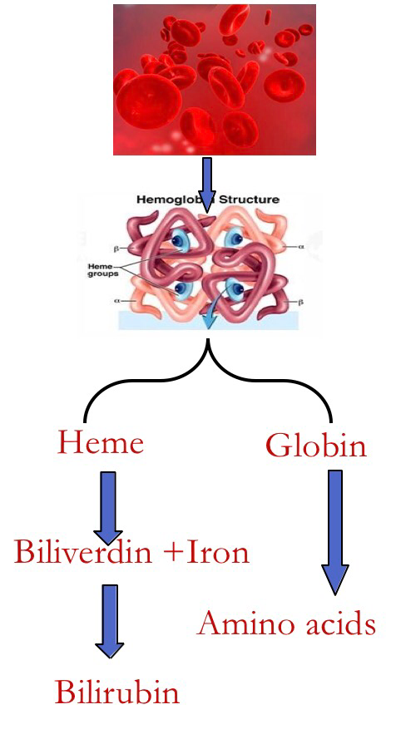
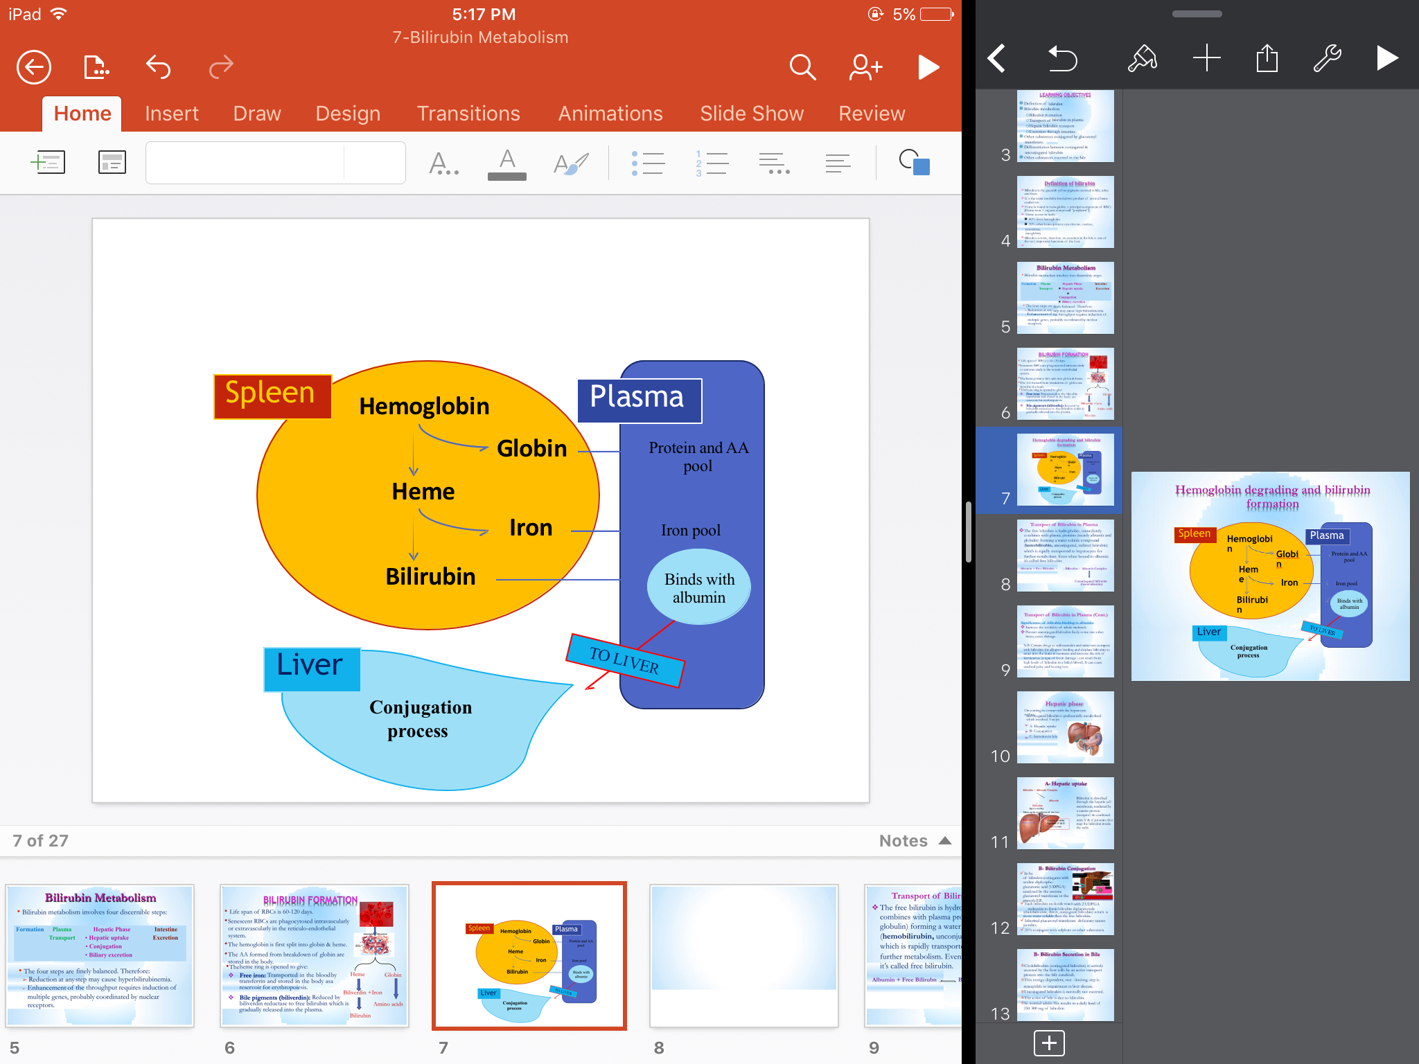
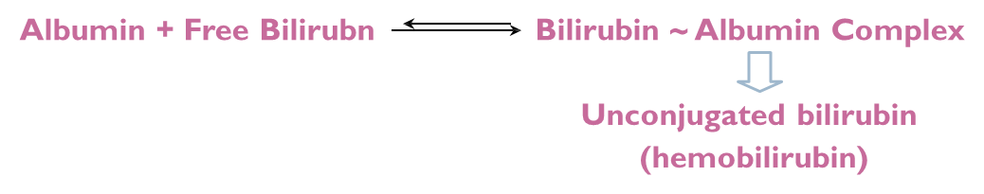
Bilirubin metabolism
1. Formation | Life span of RBCs is 60-120 days. Senescent (old) RBCs are phagocytosed intravascularly or Extravascularly (mainly) in the reticuloendothelial system. The hemoglobin is first split into globin & heme. The AA (Amino acids) formed from breakdown of globin are stored in the body. The heme ring is opened to give: 1. Free iron: Transported in the blood transferrin and stored in the body as reservoir for erythropoiesis. 2. Bile pigment (biliverdin): (it's the first bile pigment formed) reduced by biliverdin reductase to free bilirubin which is gradually released into the plasma.
2. Plasma Transport | The free bilirubin is hydrophobic And toxic, immediately combines with plasma proteins (mainly albumin and globulin) forming a water soluble compound (hemobilirubin, unconjugated, indirect bilirubin) which is rapidly transported to hepatocytes for further metabolism. Even when bound to albumin it’s called free bilirubin. Significance of bilirubin binding to albumin (Transportation): Increase the solubility of whole molecule. Prevent unconjugated bilirubin freely come into other tissue, cause damage. N.B: Certain drugs as sulfonamides and salicylates compete with bilirubin for albumin binding and displace bilirubin to enter into the brain in neonates and increase the risk of kernicterus (a type of brain damage can result from high levels of bilirubin in a baby's blood. It can cause cerebral Palsy and hearing loss. (it’s common in babies because of their incomplete formation of blood brain barrier).
الكلام بالتفصيل هذه السلايد عند البنات، لكن الدكتور شارحها سلايد 8 بالمختصر وكلهم نفس المعنى
البیلروبین لما یوصل للبلازما یكون ھیدروفوبیك (محب للدهون، كاره للماء) بعدین یرتبط بمركب یخفف كرھه للماء إلى حدٍ ما (Albumin) فلما یرتبطون مع بعض مانقدر نقول إن المركب الناتج صار ھیدوفیلیك (محب للماء، كاره للدهون) لكن نقدر نقول صار أقل كرھاً للماء وأكثر تقبلاً له.

Slide 7
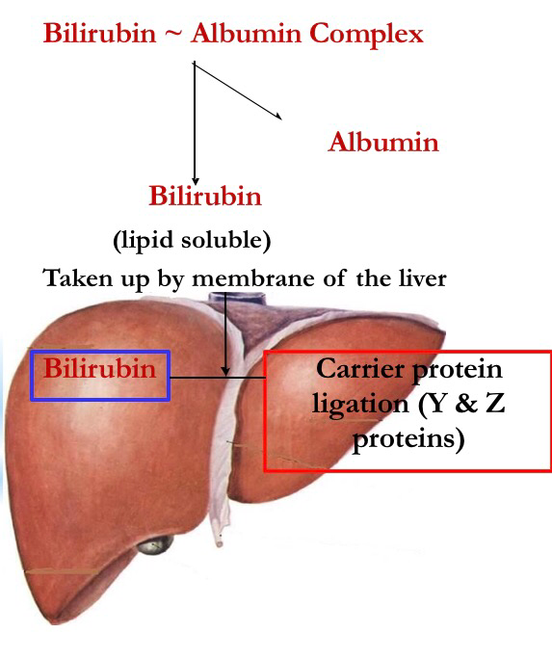
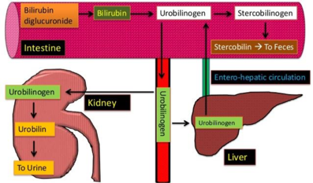
Cont.
3. Hepatic Phase | On coming in contact with the hepatocyte surface, unconjugated bilirubin is preferentially metabolized which involved 3 steps
 | Hepatic uptake | Bilirubin is absorbed through the hepatic cell membrane, mediated by a carrier protein (receptor) (bilirubin enters a hepatocyte via facilitated diffusion, and binds to intracellular proteins, particularly the protein ligandin) & combined with Y & Z proteins that trap the bilirubin inside the cells. Y & Z proteins facilitate the absorption. Any genetic defect in carriers will lead to failure of hepatic uptake of bilirubin.
 | Conjugation | Of bilirubin conjugates with uridine diphospho-glucuronic acid (UDPGA) Catalyzed by the enzyme glucuronyl transferase in the smooth ER. (To make it water soluble and facilitate its excretion). Each bilirubin molecule reacts with 2 (UDPGA) Catalyzed by the enzyme glucuronyl transferase molecules to form Bilirubin diglucuronide (cholebilirubin, direct, conjugated bilirubin) which is More water soluble than the free bilirubin. Inherited glucuronyl transferase deficiency causes jaundice. 20% conjugate with sulphate or other substances.
 | Secretion in bile | Cholebilirubin (conjugated bilirubin) is actively secreted by the liver cells by an active transport process into the bile canaliculi giving bile its color. This energy-dependent, rate –limiting step is susceptible to impairment in liver disease. Uncojugated bilirubin is normally not excreted. In normal adults this results in a daily load of 250-300 mg of bilirubin.
الكلام بالتفصيل هذه السلايد عند البنات، لكن الدكتور شارحها سلايد 8 بالمختصر وكلهم نفس المعنى
To the excretable form

Slide 8
4. Intestine Excretion | Bilirubin Is the Major Component of Bile Pigments.
هذه السلايد عند الأولاد تتكلم عن كل المرحلة من الـFormation وحتى الـExceretion،مرحلة الاكسكريشن لحالها من خطوة 8
هذه السلايد جدا مهمة وخاصةً الإنزيمات!
1. Hemoglobin is first dissociated into heme and globin.
2. In the presence of NADPH and O₂, the Heme oxygenase enzyme hydroxylates Heme, with a concomitant oxidation of ferrus Fe²⁺ iron to ferric Fe⁺³, and converts it into Biliverdin.
3. Biliverdin is then reduced or converted into bilirubin by biliverdin reductase enzyme.
4. Bilirubin is transported in blood bound to albumin forming a water soluble compound called hemobilirubin (unconjugated bilirubin, free bilirubin, indirect bilirubin) which is rapidly transported to hepatocytes for further metabolism (even when bound to albumin, it’s called free bilirubin ¹).
5. The liver removes bilirubin from the circulation rapidly, mediated by a carrier protein (receptor), and conjugates most of it with glucuronic acid and only 10% with sulfate.
6. This reaction is catalyzed by the enzyme glucuronyl transferase in the smooth endoplasmic reticulum to have conjugated bilirubin, which is more water soluble than bilirubin.
7. The bilirubin-glucuronide (conjugated bilirubin²) is secreted into the bile canaliculi through an active carrier-mediated process³. Note: the unconjugated bilirubin is normally not secreted ⁴.
8. In the small intestine, bilirubin glucuronide is poorly absorbed (because it is water soluble). In the gut, however, bacteria deconjugate it back to bilirubin, and convert it to the highly soluble colorless compound called Urobilinogen.
9. Only 20% of Urobilinogen can be absorbed by the small intestine (this represents the enterohepatic circulation of bile pigments).
¹ Once it comes down to the hepatocytes there is a specific receptor for the free bilirubin.
² water soluble.
³ in case of dysfunction in this transporter there will be an increase in conjugated bilirubin in the hepatocytes then it will go to the plasma (high conc. of free and conjugated bilirubin in the blood) and cause hepatic jaundice.
⁴ because there is no receptor/carrier for unconjugated bilirubin.
Imp note: 5+6 = rate limiting step in the formation of conjugated bilirubin and the most important step.
7,9,10= second most important steps.
10. 70% of the Urobilinogen can be oxidized in the large intestine to Stercobilin (by bacteria).

Slide 9
الكلام اللي بالوردي فقط مشروح سلايد 8 بالمختصر وكلهم نفس المعنى، الباقي اقروه
Conjugated bilirubin & Urobilinogen
Fate | conjugated bilirubin |  | Urobilinogen
 | A small portion of the conjugated bilirubin returns to the plasma and bound less tightly to albumin & is excreted in the urine. This causes a small portion of the bilirubin in the ECF to be of the conjugated type. Both forms are found in the blood but mainly unconjugated Small amount is deconjugated in the small intestine and absorbed into the portal blood to the liver where it is extracted by the liver cells and conjugate again and excreted in the bile (enterohepatic circulation of bile pigments). The majority of conjugated bilirubin passes via the bile ducts to the intestine where it is transformed through bacterial action into urobilinogen (The mian fate) which is highly soluble. |  | Most of the Urobilinogen 70% is converted into stercobilinogen in the intestine , oxidized and excreted in the feces as stercobilin that causes dark brown color of the feces (Patients with obstruction of bile duct won’t have stercobilin in their stool making it pale & grayish in color). Some of urobilinogen (20 %) is reabsorbed through the intestinal mucosa into the portal vein and reexcreted by the hepatic cells in the bile (enterohepatic circulation). Small amount of urobilinogen escapes to the general circulation and excreted by the kidneys in the urine where it is oxidized to urobilin when the urine is exposed to air (Only urobilin and conjugated bilirubin can be found in urine. NOT the unconjugated form). Once in the intestine, about half of the “conjugated” bilirubin is converted by bacterial action into the substance urobilinogen, which is highly soluble. Some of the urobilinogen is reabsorbed through the intestinal mucosa back into the blood. Most of this is re-excreted by the liver back into the gut, but about 5 percent is excreted by the kidneys into the urine. After exposure to air in the urine, the urobilinogen becomes oxidized to urobilin; alternatively, in the feces, it becomes altered and oxidized to form stercobilin.
 | After they leave the hepatocyes | A small portion of the conjugated bilirubin returns to the plasma either directly into the liver sinusoids or indirectly by absorption into the blood from the bile ducts or lymphatics. This represents 10% only. This causes a small portion of the bilirubin in the extracellular fluid always to be of the conjugated type rather than of the free type. These conjugated bilirubin that escaped into the blood, they bind less tightly to albumin & are excreted readily in the urine. Small amount of bilirubin glucuronide (20%) is de-conjugated (and converted to urobilinogen) and absorbed by the small intestine into the portal blood to the liver where it is extracted by the liver cells and is conjugated again and excreted in the bile (enterohepatic circulation of bile pigments). However, 5% of the reabsorbed urobilinogen is excreted by the kidneys into the urine.
excreted | - |  | Urine (where it is converted to yellow urobilin in the urine, after exposure to air in the urine) Or fesses (after it is converted to stercobilin which is responsible for the brown color of fesses)

Slide 10
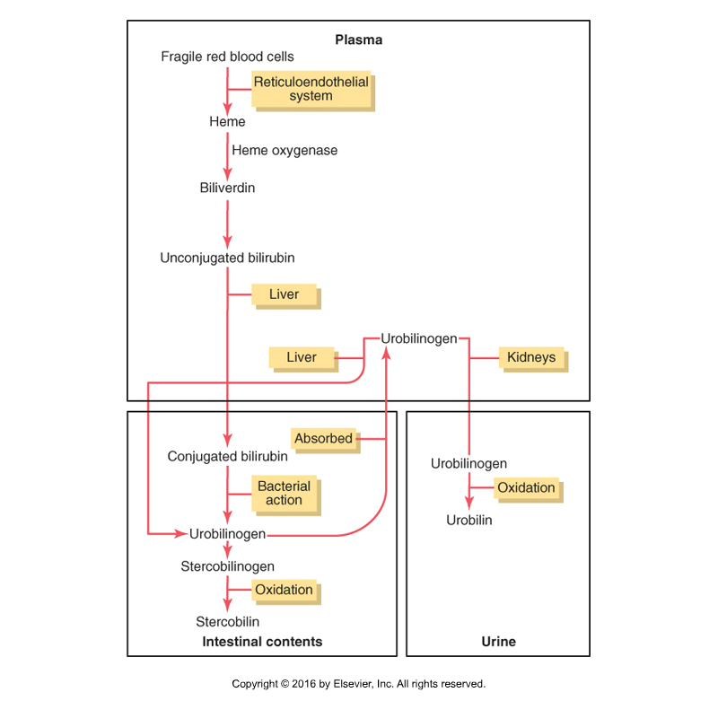
Summary of bilirubin metabolism (from slides)
Only in Females’ Slides
Senescent red cells are major source of hemeproteins.
Breakdown of heme to bilirubin occur in macrophage of reticuloendithelial system ( tissue macrophages, spleen and liver).
Unconjugated bilirubin is transported through blood (complex to albumin) liver.
Only in Males’ Slides
Bilirubin is taken into liver and conjugate with glucuronic acid.
Bile is secreted into intestine where glucuronic acid is removed and the resulting bilirubin is converted to urobilinogen.
A portion of urobilinogen is reabsorbed into blood, where it is converted to yellow urobilin and excreted by kidneys.
Urobilinogen is oxidized by intestinal bacteria to the brown stercobilin.

Slide 11
Summary of bilirubin metabolism (Pic from slides)
Only in Females’ Slides
when the red blood cells have lived out their life span (on average,
120 days) and have become too fragile to exist in the circulatory system, their cell membranes rupture, and the released hemoglobin is phagocytized by tissue macrophages (also called the reticuloendothelial system) throughout the body. The hemoglobin is first split into globin and heme, and the heme ring is opened to give:
free iron, which is transported in the blood by transferrin,.
a straight chain of four pyrrole nuclei, which is the substrate from which bilirubin will eventually be formed.
The first substance formed is biliverdin, but this is rapidly reduced to free bilirubin, also called unconjugated bilirubin, which is gradually released from the macrophages into the plasma. This form of bilirubin immediately combines strongly with plasma albumin and is transported in this combination throughout the blood and interstitial fluids.
Within hours, the unconjugated bilirubin is absorbed through the hepatic cell membrane. In passing to the inside of the liver cells, it is released from the plasma albumin and soon thereafter conjugated about 80 percent with glucuronic acid to form bilirubinglucuronide, about 10 percent with sulfate to form bilirubin sulfate, and about 10 percent with a multitude of other substances. In these forms, the bilirubin is excreted from the hepatocytes by an active transport process into the bile canaliculi and then into the intestines.

Slide 12
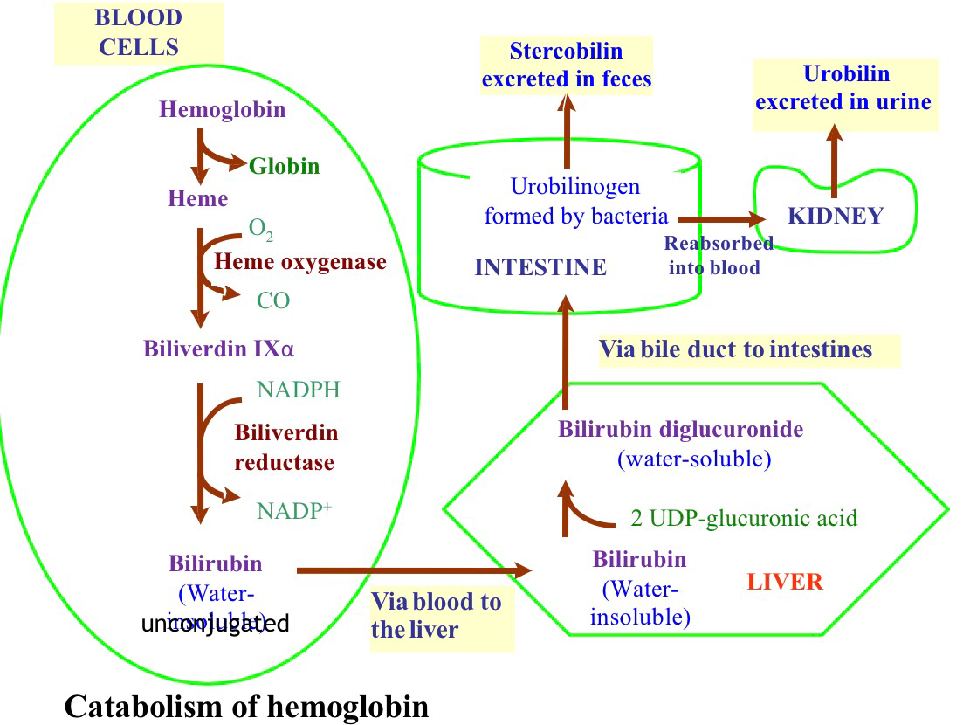
Other substances conjugated by Glucuronyl transferase
Only in Females’ Slides
The glucuronyl transferase system in the smooth endoplasmic reticulum catalyzes the formation of the glucuronides of a varity of substances in addition to bilirubin.
The list includes steroids & various drugs.
These compounds can compete with bilirubin the enzyme system when they are present in appreciable amounts (Therefore, Bilirubin won’t be conjugated and excreted in bile leading to excess bilirubin in blood and aggravating clinical condition of jaundice)
In addition several barbiturates, antihistamines,anticonvulsants and other compounds can cause marked proliferation of the smooth endoplasmic reticulum in the hepatic cells, with a concurrent increase in hepatic glucuronyl transferase activity.
Phenobarbital has been used successfully for the treatment of a congenital disease in which there is a relative deficiency of glucuronyl transferase (type 2 UDP-glucuronyl transferase deficiency).

Slide 13
Deference between Conjugated & Unconjugated
Important
Feature | Conjugated | Unconjugated
Water solubility | Water soluble | Insoluble in water
Affinity to lipids | Absent | present
Binding | Bind to glucuronic acid | Bind to albumin
Reaction to reagents | Direct | Indirect (total minus direct)
Binding with albumin | Loosely bound to albumin | Tightly complex to albumin
Renal excretion | Filtered through renal glomeruli and excreted in urine. | Not filtered through renal glomeruli, is not excreted in urine.
Affinity to brain tissue | Non-toxic | Toxic substance (kernicterus)
Normal serum level | Present in low concentration in the blood | The chief form of bilirubin in the blood (represents the normal bilirubin in the blood; 0.5 mg/dl of plasma)
unconjugated is a lipid soluble but when it combines with plasma protein it increases its water solubility but it still lipid soluble.
conjugated is a water soluble.

Slide 14
Types of bilirubin in serum
Direct bilirubin | is conjugated (water soluble) bilirubin, reacts rapidly with reagent (direct reacting).
Indirect bilirubin | is unconjugated (water insoluble) bilirubin because it is less soluble, it reacts more slowly with reagent (reaction carried out in methanol).
Total bilirubin | In this case both conjugated and unconjugated bilirubin are measured given total bilirubin. Unconjugated will calculated by subtracting direct from total and so called indirect. Total bilirubin = D+ ID Knowing the level of each type of bilirubin has diagnostics important (We can specify the type jaundice if its pre-hepatic, hepatic, or post-hepatic).
Normal Range of bilirubin
Normal |  | Jaundice | Occult
Normal serum bilirubin is 0.3-1.2 mg/dl (1～16 umol/l) ( 0.1 ～1 mg/dl) of blood. 4/5 are unconjugated bilirubin, others are conjugated bilirubin. The rate of bilirubin production is equal to the rates of hepatic uptake, conjugation, and biliary excretion. We’ll find mainly hemobilirubin in serum. |  | Jaundice becomes evident when the serum bilirubin levels rise above 2.0-2.5 mg/dl, levels as high as 30 to 40 mg/dl can occur with severe disease. Bilirubin level from 0.5 to 2 mg/dl is called subclinical jaundice. | 1-2mg/dl pre-clinical jaundice (not seen clinically)
 |  | Hyperbilirubinemia
If D increases: obstruction
If ID increases: prehepatic (hemolysis)
Both: intrahepatic (liver disease)
ID cannot be measured in the blood so we measure it be:
ID = total bilirubin - D
الأرقام مهمة هنا

Slide 15
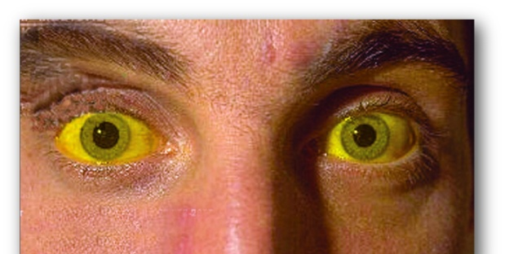
Jaundice
Only in Males’ Slides
الأرقام هنا مهمة
Jaundice
Definition | It is the yellow coloration of the skin, sclera, mucous membranes and deep tissues. The usual cause is large quantities of bilirubin in the ECF, either free or conjugated bilirubin.
The normal plasma concentration | The normal plasma concentration of total bilirubin is 0.3-1.2 mg/dl of blood.
Main causes | Excessive production of bilirubin (hemolysis or erythrocyte degradation). Decrees hepatocyte uptake. Impaired conjugation. Decrees hepatocyte excretion of bilirubin glucuronides. Impaired bile flow (obstruction of bile duct).
However, in certain abnormal conditions this can rise up to 40 mg/dl of blood. But the skin usually begins to appear jaundiced when the concentration of total bilirubin in the plasma is greater than 2 - 2.5 mg/dl of blood. Bilirubin level from 0.5 to 2 mg/dl is called subclinical jaundice.

Slide 16
Types of Jaundice
1. Pre-hepatic (hemolytic) jaundice | In hemolytic jaundice, the excretory function of the liver is not impaired. It results from excess production of bilirubin (beyond the liver’s ability to conjugate it) following hemolysis of erythrocytes (RBCs). Excess RBC lysis is due to: Autoimmune disease. Hemolytic disease of the newborn. Rh- or ABO- incompatibility (common between new born and mother). Structurally abnormal RBCs (Sickle cell disease). Breakdown of extravasated blood. Therefore, the plasma concentrations of free bilirubin rises to levels much above normal but it is not filtered through the kidney, because they are unconjugated bilirubin (because they are tightly bound to albumin). The urine is free from bilirubin. The stools appear darker than the normal color due to excessive stercobilin formation.
2. Hepatic (hepatocellula) jaundice | Hyper-bilirubinemia (increased levels of bilirubin in the blood) may be due to: |  | Impaired uptake of bilirubin into hepatic cells. Disturbed intra cellular protein binding or conjugation (dysfunction of the glucuronyl transferase for conjugation (rate limiting step)). Disturbed active secretion of bilirubin into bile canaliculi.
 | causes |  | Damage of liver cells: e.g., viral hepatitis, drugs, chemical, alcohol, or toxins. Genetic errors in bilirubin metabolism. Genetic errors in specific proteins. Autoimmune hepatitis.
 | The diseased liver cells are unable to take all the unconjugated bilirubin formed, increasing its concentration in the blood (in this case most of the bilirubin found in the blood will be in the unconjugated form). Also, there is intrahepatic biliary duct obstruction that leads to regurgitation of conjugated bilirubin to blood (swelling of cells and edema due to inflammation cause mechanical obstruction of intrahepatic biliary tree). Both types of bilirubin (conjugated & unconjugated) are present in blood in high concentration.
 | Clinical Features | Stools appear pale grayish in color due to deficiency of Stercobilin. Urine appears dark brown due to filtration of excess conjugated bilirubin through the kidney, How? probably by rupture of the congested bile canaliculi and direct emptying of the bile into the lymph leaving the liver. In this case, hyper-bilirubinemia is usually accompanied by other abnormalities in biochemical markers of liver function such as: Alanine amine transferase (ALT), Aspartate amine transferase (AST), alkaline phosphatase (ALP) and Gamma-glutamyltransferase (GGT). By looking at the ratio between these different liver enzymes, we can distinguish the causes of jaundice whether it is from biliary (cholestatic) or liver (hepatic). The main diagnostic tip is in the biliary obstruction: the ALT goes up and down (pulsatile increase) and the bilirubin concentration in the blood is high. But in hepatic jaundice, ALT shows persistent increase for along period of time (months).
النوت مهمة هنا

Slide 17
Cont.
3. Post-hepatic jaundice | The rate of bilirubin formation is normal. bilirubin enters the liver cells and become conjugated in the usual way. The conjugated bilirubin formed simply can not pass into small intestine and it returns back into blood, probably by rupture of the congested bile canaliculi and direct emptying of the bile into the lymph leaving the liver. Most of the bilirubin in the plasma becomes the conjugated type rather than the unconjugated type. In this type of jaundice, conjugated bilirubin is filtered through the kidney and appears in urine giving it dark brown color. Urine is free from urobilinogen. Stools are clay color due to absence of stercobilin.
 | Caused by an obstruction of the biliary tree
 | Intra-hepatic bile duct obstruction |  |  | Extra-hepatic bile duct obstruction (more common)
 | Primary biliary cirrhosis | Drugs | Cholangitis | Gallstones | Cancer at the head of pancreas Which is usually accompanied by high levels of serum alkaline phosphatase enzyme).

Slide 18
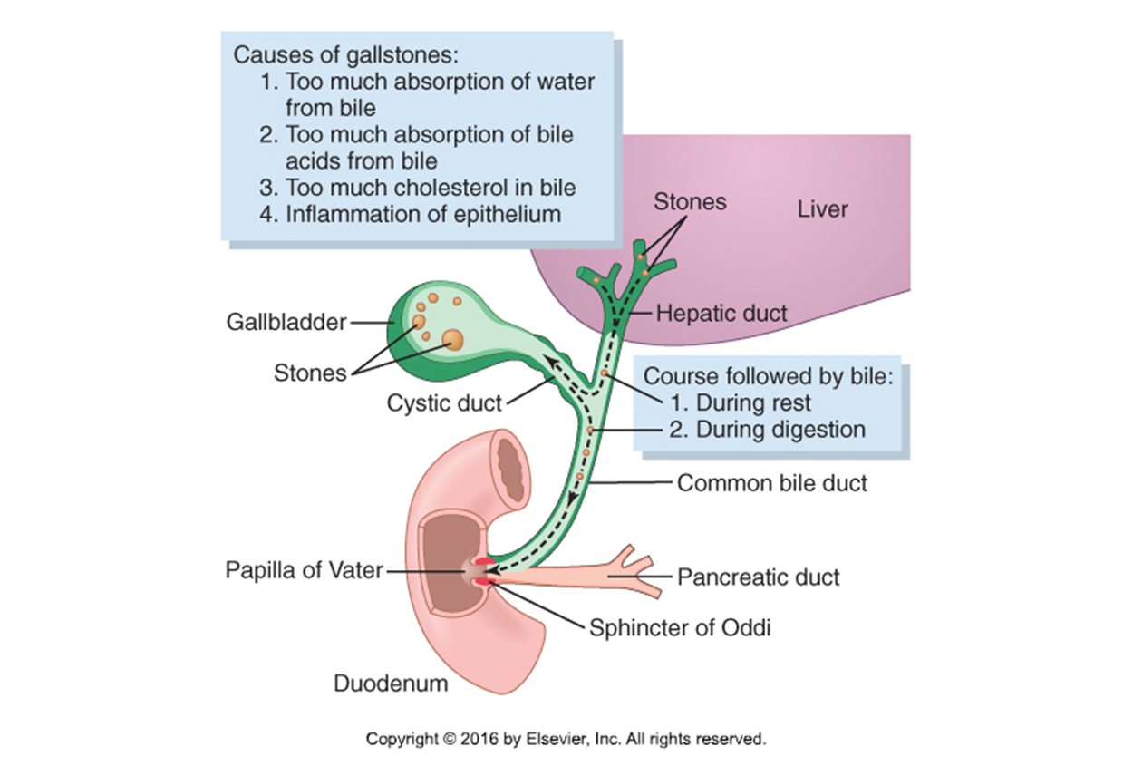
Other substances excreted in the bile
Cholesterol & alkaline phosphate are execrated in the bile in patients with jaundice due to intra or extra hepatic obstruction of the bile duct, the blood levels of these 2 substances usually rise. A much smaller rise is generally seen when the jaundice is due to non obstructive hepatocellular disease. Adrenocortical, other steroid hormones & a number of drugs are excreted in the bile and subsequently reabsorbed (enterohepatic circulation) (Impairment of this metabolic function can increase estrogen in men causing gynecomastia).
Enterohepatic circulation of bile pigments
Small amount of bilirubin glucuronide (20%, which is de-conjugated and converted to Urobilinogen) is absorbed by the small intestine into the portal blood to the liver where it is extracted by the liver cells and is re-conjugated again and excreted in the bile. However, 5% of the reabsorbed Urobilinogen is excreted by the kidneys into the urine.
Liver secretion of cholesterol and gallstone formation
Under abnormal conditions, the cholesterol may precipitate in the gallbladder, resulting in the formation of cholesterol gallstones. The amount of cholesterol in the bile is determined partly by the quantity of fat that the person eats, because liver cells synthesize cholesterol as one of the products of fat metabolism in the body. For this reason, people on a high-fat diet over a period of years are prone to the development of gallstones. Inflammation of the gallbladder epithelium, often resulting from low-grade chronic infection, may also change the absorptive characteristics of the gallbladder mucosa, sometimes allowing excessive absorption of water and bile salts but leaving behind the cholesterol in the bladder, and then progressing to large gallstones.

Slide 19






Thank you!
اعمل لترسم بسمة، اعمل لتمسح دمعة، اعمل و أنت تعلم أن الله لا يضيع أجر من أحسن عملا.
The Physiology 436 Team:
Females Members:
Deena Alnowaiser
Anwar Alajmi
Reema Alshayea
Ghada Alskait
Nouf AlAmari
Ebtisam Alsugyani
Males Members:
Abdulaziz Alseffay
Team Leaders:
Laila Mathkour
Mohammad Alayed
Contact us:
References:
2017-2018 Dr. Hayam Gad’s Lecture.
2017-2018 Dr. Mohammed Al Zoghaibi’s Lecture.
Guyton and Hall Textbook of Medical Physiology (Thirteenth Edition.)
اللهم اني استودعتك ما حفظت وما قرأت وما فهمت، فرده لي وقت حاجتي إليه إنّك على كل شيءٍ قدير.

