Slide 1
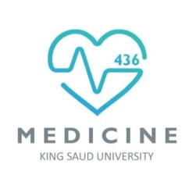
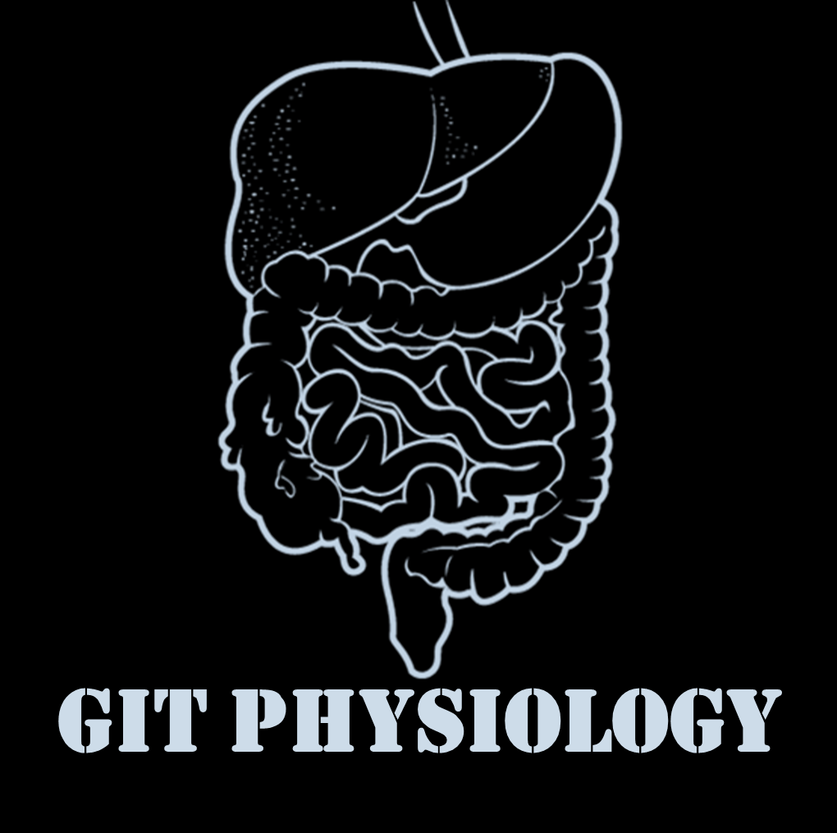
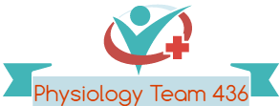

Text
Only in Females’ slide
Only in Males’ slides
Important
Numbers
Doctor notes
Notes and explanation
Lecture No.11
“What You Plant Today, You Will Harvest Latter”

Slide 2
Physiology of bile salts & enterohepatic circulation
Objectives:
Functions of the bile and stages of bile secretion.
Characteristics of bile.
The main constituents of bile.
Functions of gall bladder.
Differences between hepatic bile and gall bladder bile.
Control of biliary system.
Primary and secondary bile acids.
Enterohepatic circulation of bile salts.
Absorption and uptake of bile acids.
Functions of bile acids.

Slide 3
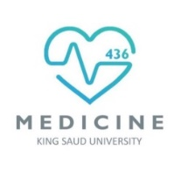
شكر وعرفان
من لا يشكر الناس لا يشكر الله..
اتمام هذا العمل تطلّب جهد ووقت عظيم وجبَّار من الإجازة الصيفية وحتى انتهاء البلوك.
لحظات من الشكر والتقدير والعرفان لأعضاء الفريق الكِرام وللقادة الأكاديميين ولكل من بادر وساهم بإخراج وإنجاز هذا العمل وكان خير عون لنا رغم ضيق الوقت. شكرا لكم على إخلاصكم وجهدكم ووقتكم وتفانيكم في العمل.
لا تنسوهم من دعواتكم، الله يكتب أجرهم ويسهل أمرهم ويبارك لهم بوقتهم وينفع بهم وبعلمهم.
ﺗﻢ ﺑﺤﻤﺪ الله وتوفيقه وتيسيره الإنتهاء ﻣﻦ ﻣﺤﺎﺿﺮات ﻓﺮﯾﻖ ﻋﻠﻢ وﻇﺎﺋﻒ اﻷﻋﻀﺎء لـ ﺑﻠﻮك الجهاز الهضمي.. نسأل الله أن نكون قد وفقنا في تقديم الأفضل، ونعتذر عن أي تقصير...
ﻗﺎدة فريق علم وظائف الأعضاء
نتمنى لكم اختبار #روعة
ولا تنسونا من دعواتكم الصادقة جدا ☹
أحب الناس إلى الله أنفعهم للناس

Slide 4
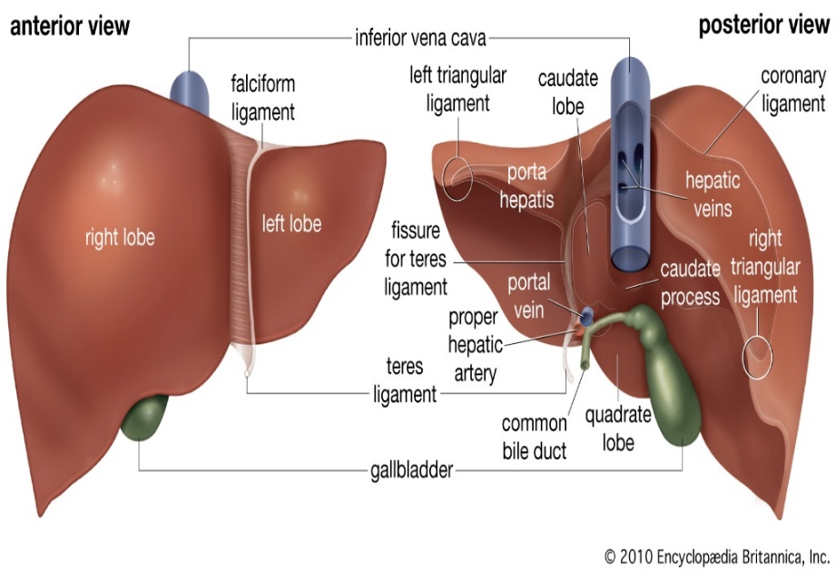
Only in Males’ Slides
Liver
The liver is the largest internal organ in the body, constituting about 2.5% of an adult’s body weight. Receives 25% of the cardiac output via the hepatic portal vein and hepatic artery. Takes up, stores, and distributes nutrients and vitamins. Plays an important role in maintaining blood glucose levels. Regulates the circulating blood lipids by the amount of very low-density lipoproteins (LDL) it secretes. Synthesizes (Not synthesis) many of the circulating plasma proteins. Takes up numerous toxic compounds and drugs from the portal circulation. Serves as an excretory organ for bile pigments (Bilirubin wich is very toxic), cholesterol, and drugs. Performs important endocrine functions.
Liver lobule | Liver lobule is the basic functional unit of the liver.
 | Hepatocytes form irregular plates arranged in spoke-like fashion. Bile canaliculi carry bile to bile ductules. Bile ductules lead to portal areas.
The Liver Receives Most of Its Blood Flow Through the Portal Vein
The hepatic portal vein provides about 70% to 80% of the liver’s blood supply, the hepatic artery provides the rest (30-20%). The portal vein branches repeatedly, forming smaller venules that eventually empty into the sinusoids. The hepatic artery branches to form arterioles and then capillaries, which also drain into the sinusoids. Liver sinusoids can be considered specialized capillaries. The hepatic sinusoids porous and allows the rapid exchange of materials between the perisinusoidal space and the sinusoid. The sinusoids empty into the central veins, which subsequently join to form the hepatic vein, which then joins the inferior vena cava.
The Lymphatic System Is Important in Liver Function The hepatic lymphatic system is present in three main areas
1. Adjacent to the central veins |  | 2. Adjacent to the portal veins | 3. Coursing along the hepatic artery.
These channels drain ﬂuid and proteins. The protein concentration is highest in lymph from the liver. The largest space drained by the lymphatic system is the perisinusoidal space. Disturbances in the balance of filtration and drainage are the primary causes of ascites, the accumulation of serous fluid in the peritoneal cavity.
I don’t care about the number & anatomy!
Don’t skip it, there is someone else care ☺

Slide 5
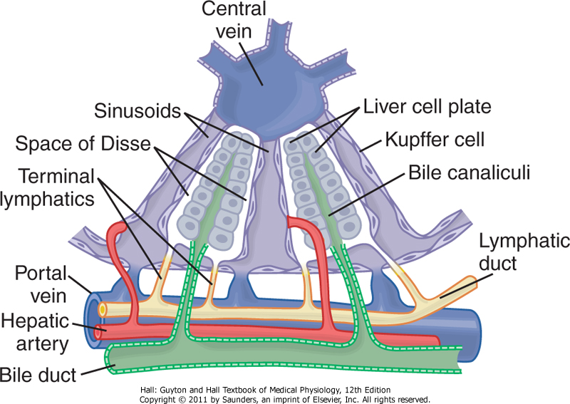
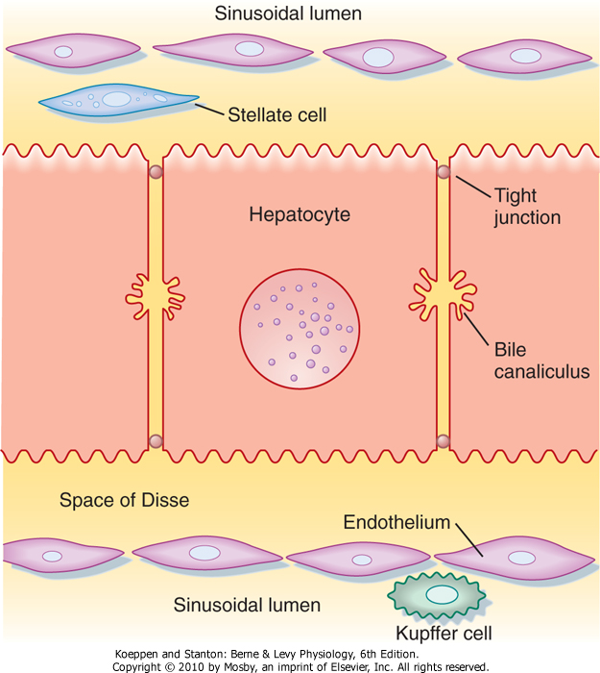
Hepatocyte Arrangement Aids in the Rapid Exchange of Molecules
1. Hepatocytes (The most important one) | Highly specialized cells, the metabolic factories of the liver. Their apical membranes are in the form of grooves between adjacent cells, known as canaliculi. Their tight junctions are relatively permeable to glucose, Ca, glutathione, amino acids and urea.
2. Sinusoidal endothelial cells | separates the perisinusoidal space (Disse space). They lack a basement membrane. They have sievelike plates that permit the ready exchange of materials between the perisinusoidal space and the sinusoid. Particles as big as chylomicrons (80 to 500 nm wide) can penetrate these porous plates.
3. Kupffer cells | Line the hepatic sinusoids and are part of the reticuloendothelial system (monocyte/macrophage).
4. Stellate cells | In normal condition, they store lipids and vitamin A. In inflammatory condition, they become transformed to myoﬁbroblasts, which then become capable of secreting collagen and extracellular matrix into the space of Disse and regulating sinusoidal portal pressure by their contraction or relaxation.
Only in Males’ Slides
فيه سؤال زي اللوز من هذه السلايد ☺
The Hepatocytes can receive the blood from the perisinusoidal space or space of Disse.
We get the material and, toxic subunits and waste product from the portal vain. Then all of them get infiltrated.
After infiltrated they drain into lymphatic vessels.
Any mistake in filtration we will have portal hypertension, accumulation of fluid in peritoneal cavity (ascites disease).

Slide 6
Liver Functions
1. Exocrine (digestive) role |  |  | 2. Endocrine role (only in males’)
Synthesizes and secrets bile salts. Secrets into the bile a bicarbonate-rich solution Destroys old erythrocytes. |  |  | Synthesizes clotting factors and plasma proteins. Metabolizes the organic substances and Cholesterol.
 |  |  | Carbohydrate | Glycogen storage. Conversion of galactose and fructose to glucose. Gluconeogenesis & many biochemical compounds from carbohydrate.
The main digestive function of the liver is the secretion of bile (normally 600-1000 ml/day).
Function's of the Bile
plays an important role in fat digestion and absorption by the following: Emulsifying the large fat particles of the food into minute particles. They aid in absorption of the digested fat end products through the intestinal mucosal membrane, via micells formation. | 2. serves as a means for excretion of waste products from the blood. These include especially bilirubin, an end product of hemoglobin destruction.
 |  |  | Fat metabolism | B-oxidation of fat to generate ATP. conversion of amino acids and two-carbon fragments derived from carbohydrates to fats for storage. synthesizes lipoproteins, phospholipids and cholesterols.
Bile Secretion Bile is secreted in two stages:
The initial portion is continually secreted by the hepatocytes. It is secreted into bile canaliculi that originate between the hepatic cells. Hepatic Bile: Isotonic secretion, with high Na+, Cl⁻ and HCO3 and low K⁺ and Ca²⁺. |  | 2. The bile flows in the canaliculi toward the hepatic duct and common bile duct. From these the bile either empties directly into the duodenum or is diverted for minutes up to several hours through the cystic duct into the gallbladder (this is the second portion of liver secretion which is added to the initial bile). Gallbladder bile: high Bile acid anion and Ca²⁺ , but low Na+ , Cl⁻ , HCO3 and H₂O.
The common bile duct open into the duodenum in company with the pancreatic duct at the ampulla of vater. This opening is guarded by the sphincter of Oddi (choledochoduodenal sphincter).
The function of Bile secretion is very important
When gallblader constrasc, the sphincter of oddi will be relaxed.

Slide 7
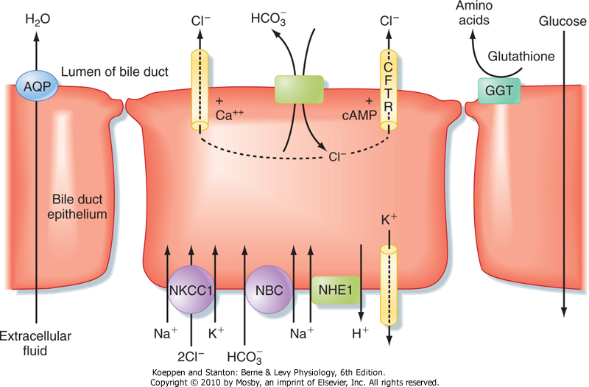
Bile Modification in the Ductules
Only in Males’ Slides
I’m really care about the modification
The major transport processes of cholangiocytes that secrete an alkaline-rich fluid
The cholangiocytes lining the biliary ductules are specifically designed to modify the composition of bile. Useful solutes, such as glucose and amino acids, are reclaimed by the activity of specific transporters.
Chloride ions in bile are also exchanged for HCO₃⁻, thus rendering the bile slightly alkaline and reducing the risk of precipitation of Ca⁺⁺.
Glutathione is broken down on the surface of cholangiocytes into its constituent amino acids by the enzyme γ-glutamyl transpeptidase (GGT), and the products are reabsorbed.
The bile is also diluted at this site, in concert with ingestion of a meal, in response to hormones, such as secretin, that increase HCO₃⁻ secretion and stimulate the insertion of aquaporin water channels into the cholangiocyte's apical membrane.
Flow of bile is thereby increased during the postprandial period, when bile acids are needed to aid in assimilation of lipid.

Slide 8
Cont. Bile
Characteristic of bile | Bile is a viscous golden yellow or greenish fluid with bitter taste. It is isotonic (all GI secretions are Isotonic except salivary, It's hypotonic) with plasma and slightly alkaline with high Na⁺, Cl⁻, HCO₃ and low K⁺ and Ca²⁺. NaHCO3 in bile is responsible for its alkaline reaction and participates with pancreatic and duodenal secretion in neutralization of acid chyme delivered from stomach (Neutralization of acidic chyme from stomach occurs by the action of 3 secretions: bile, pancreatic & intestinal secretions).
Components of bile
From hepatocytes |  | From bile ducts
Organic constituents: Bile acids (bile salts) (65% of dry weight of bile). Cholesterol (4%), the major route for cholesterol excretion. Phospholipids (Lecithin), phosphatidylcholine(20%). Bile pigments (Bilirubin) (0.3%). Ions and water. Proteins (5%). All of these constituents are secreted by hepatocytes into bile canaliculi, along with an isotonic fluid that resembles plasma in its electrolyte concentration. |  | Aqueous alkaline Solution (NaHCO3) Electrolytes mainly HCO3⁻ , in addition to H₂O. These contribute to the volume of hepatic bile. HCO3⁻ aids in neutralization of acid chyme.
Regulation of Bile Secretion | Bile secretion is primarily regulated by a feedback mechanism, with secondary hormonal and neural controls. The major determinant of bile acid synthesis is its concentration in hepatic portal blood (feedback control). CCK, Secretin and estrogen (hormonal control). Parasympathetic and sympathetic nerves supply the biliary system. Parasympathetic (vagal) stimulation results in contraction of the gallbladder and relaxation of the sphincter of Oddi, as well as increased bile formation. Bilateral vagotomy results in reduced bile secretion after a meal, suggesting that the parasympathetic nervous system plays a role in mediating bile secretion. By contrast, stimulation of the sympathetic nervous system results in reduced bile secretion and relaxation of the gallbladder.
خلّي بالك من الـCCK

Slide 9
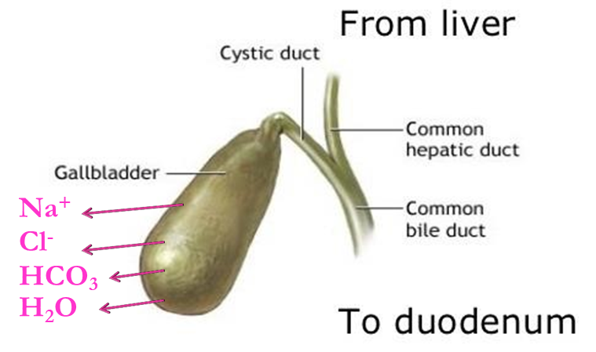
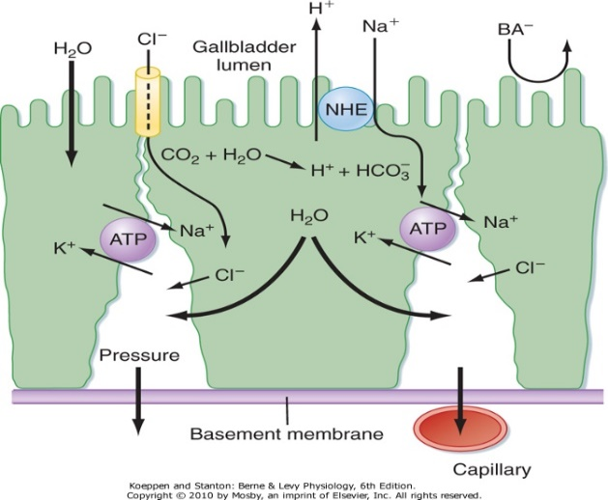
I’m really care about the modification & storing
Functions of gallbladder
1. Gallbladder not only stores bile but it concentrates bile.
The liver produces about 5 L /day, but the total secretion of bile each day is about 700-1200 ml per day. Bile is secreted continually by the liver cells and then normally stored in the gallbladder until needed in the duodenum (gallbladder can hold 30-60 ) The maximum volume of the gall bladder. Gallbladder concentrates the bile, which has the bile salts, cholesterol, lecithin, and bilirubin during every 12 hours of bile secretion (usually about 450 mL) because water, Na, Cl, and most other small electrolytes are continually absorbed through the gallbladder mucosa by active transport of sodium, and this is followed by secondary absorption of chloride ions, water, and most other diffusible constituents. Bile is normally concentrated in this way about 5 fold, but it can be concentrated up to a maximum of 20 fold. Concentration of bile in the gall bladder occur by: Active absorption of Na+, Cl-, and HCO3- by the lining epithelium. Associated passive water movement out of the lumen. This result in drop of pH of gall bladder bile due to decreased NaHCO3 concentration. ايش فائدة انخفاض هذا الـPh؟ يمنع تكوين الـgallstones . لأن زيادة الحمضية تزيد من ذوبان الكالسيوم بالتالي تزيد تجمع من الـstones. When we need more bile, the bile will secret from both the gallbladder and the liver. This is happen when you eat McDonald’s or
2. Gall bladder epithelium secretes mucus which has protective function(Against low PH of concentrated bile)
3. Buffer of biliary pressure by storing of bile, so it prevents increase in biliary pressure & enables the liver to secret bile, because hepatic cells can not secret against high pressure. If pressure increases, bile secretion will stop
The gall bladder bile & hepatic bile, both of them have low pH, but the gall bladder rare lower because absorption of NaHCO3. Ït's important to have lower pH in gall bladder, because It has concentrated solubilizes as Ca & bilirubin (they can be in stones form) when pH is low, Ca solubility is high. low pH prevents forming bile stones.
when Na,Cl, HCO3 are absorptive by active transported, followed by the osmosis of the water. the water moves from low to high concentrates of Na.
مفطح
شرح الصورة في السلايد الجاي!
عرفنا فوق أن مجموع الـsecretions يساوي1200 ml .وأن الـ gall bladder تقدر تشيل 60 مل بس كحد أقصى.
طيب الباقي كيف تطلّعه؟
احنا اذا بغينا نقلل حجم شيء وش نسوي له؟ نزيد التركيز، كيف؟
راح نسحب الـsalt اللي هي Na+, Cl-, and HCO3- عن طريق اننا نمتصها وبكذا قللنا الأجسام الصلبة، بعدها راح تلحقهم المويا الزايدة عن طريق الـ osmosis من التركيز المنخفض الى تركيز اعلى عشان تعادله وبكذا نكون زدنا التركيز وبالتالي قل الحجم ونقدر نخزنه

Slide 10
Cont.
Only in Males’ Slides
CFTR: Cystic fibrosis transmembrane conductance regulator, chloride channel.
The tight junctions have low permeability, they resist the passage of Bile Acid anions (BA) out of the lumen.
bile enters the ducts and is conveyed toward the intestine. However, in the period between meals, outflow is blocked by constriction of the sphincter of Oddi, and thus bile is redirected to the gallbladder.
The gallbladder is a muscular sac lined with high-resistance epithelial cells.
During gallbladder storage, bile becomes concentrated because sodium ions are actively absorbed in exchange for protons, and bile acids, as the major anions, are too large to exit across the gallbladder epithelial tight junctions.
However, although the concentration of bile acids can rise more than 10-fold, bile remains isotonic because a single micelle acts as only one osmotically active particle.
Any additional bile acid monomers that become available as a result of concentration are thus immediately incorporated into existing mixed micelles. This also reduces, to some extent, the risk that cholesterol will precipitate from bile.
However, cholesterol is supersaturated in the bile of many adults, with precipitation normally being inhibited by the presence of antinucleating proteins. Prolonged storage of bile increases the chance that nucleation can occur, thus making a good case for never skipping breakfast and perhaps explaining why gallstone disease is relatively prevalent in humans.

Slide 11
Differences between hepatic bile & gall bladder Bile
Only in Females’ Slides
مو مطلوب حفظهم، فقط افهموا الكلام اللي بالأحمر
 | Hepatic bile | Gall bladder bile
Water | 98% | 89%
Total solids | 2-4% | 11%
Bile salts | 26 | 145
Bilirubin | 0.7 | 5
Cholesterol | 2.6 | 16
Phospholipids | 0.5 | 4
Na+ | 145 | 130
HCO3 | 28 | 10
Ca++ | 5 | 23
Cl- | 100 | 25
K+ | 5 | 12
PH | 8.3 | 7.5
المطلوب من هذه السلايد:
مهم تعرفون أن الGall bladder دائما أعلى من الـHepatic لأنها تكون مركزة
ماعدا القيم المظللة بأصفر تكون أقل، والسبب في ذلك انها من الأملاح اللي يحصل لها absorption زي ما قلنا قبل عشان نزيد تركيز الBile.

Slide 12
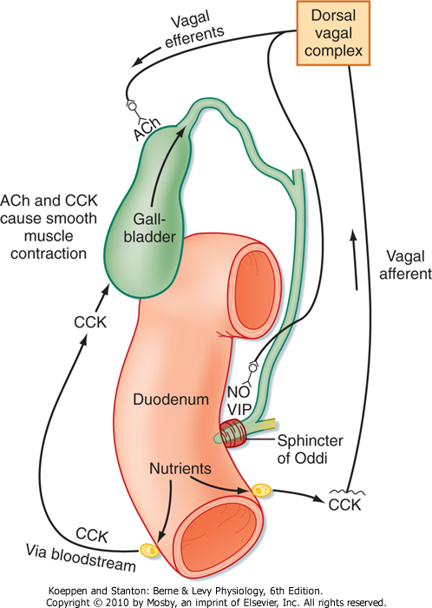
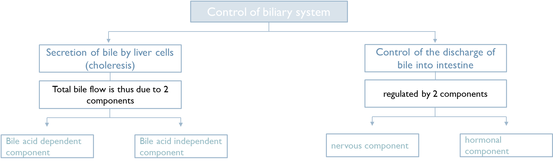
Control of biliary system
Only in Females’ Slides
الدكتور شرح موضوع الكنترول باختصار على الصورة (نفس كلام الدكتورة) !
The human liver secretes bile at a pressure of about 25 cm H₂O.
Between the meals, the choledochoduodenal sphincter is closed offering a resistance of about 30 cm H₂O.
Bile secreted by liver is thus diverted to the gall bladder during the interdigestive peroids.
Pressure in the lumen of the gall bladder varies between 0-16 cm H₂O.

Slide 13
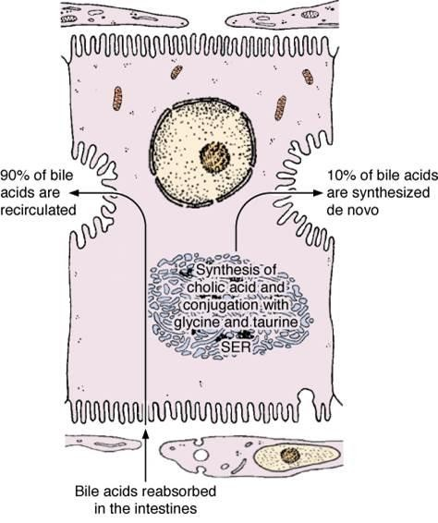
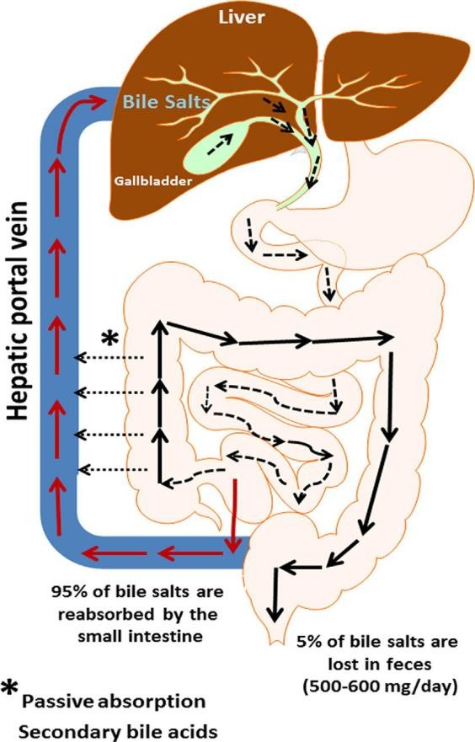
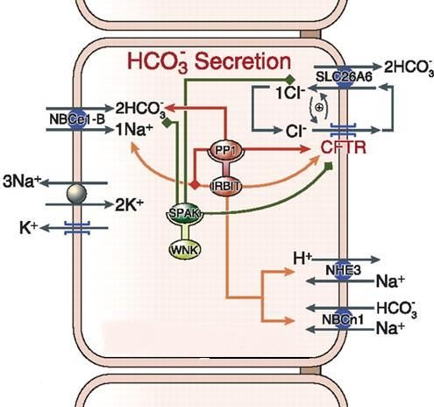
1. Secretion of bile by liver cells (choleresis)
Substances that stimulate hepatic secretion of bile (choleresis) are choleretics. The deriving force for bile secretion is active transport of bile acids into canaliculi with passive. H₂O flow along osmotic gradient. In the biliary ducts HCO3⁻ is secreted independently of bile acid secretion & is followed passively by water.
Bile acid dependent component | Bile acid independent component
90% of the rate of secretion of bile acids is determined by the rate of clearance of eabsorbed bile acids from the portal vein via enterohepatic circulation. The remaining 10% is due to synthesis of new bile acids by hepatocytes. Interruption of the enterohepatic circulation results in markedly reduced choleresis (like portal vein obstruction or resection of terminal part of ileum). | This fraction of bile secretion is due to secretion of HCO3⁻ ,followed by water by the biliary duct cells. It depends on active Na+ transport.
 | It is stimulated by
 | Hormones (the most important one) | Vagal stimulation
 | As secretin, glucagon, CCK and gastrin. They all stimulate HCO3⁻ & passive water transfer by the biliary duct cells. | Stimulates bile flow. The effect is mediated mainly indirectly, through stimulation of gastric acid secretion, which leads to release of secretin & CCK.
Only in Females’ Slides
Don’t skip it!
الدكتور شرح الكلام
الـCCK مهم
secretin is the most powerful of them all.
c
N.B (not related to hormones only):
Increase portal blood flow during digestion increases bile secretion. But when the liver is markedly congested bile secretion stops due to increase intrahepatic vascular pressure.
liver cant secret against high pressure.

Slide 14
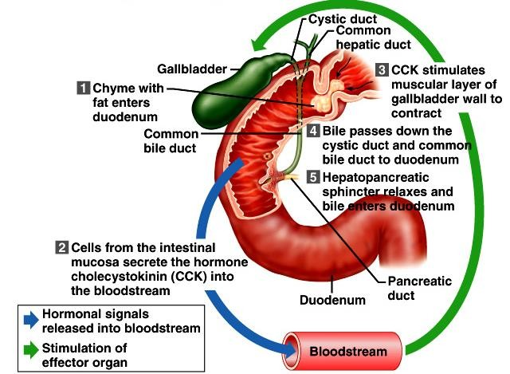
2. Control of the discharge of bile into intestine
Discharge of bile into the duodenum occurs by contraction of gall bladder wall and relaxation of Oddi sphincter. The highest rate of gall bladder emptying occurs during the intestinal phase (When chyme reaches the duodenum). Gall bladder evacuants are called cholagogues (While Choleretics stimulates bile secretion from hepatocytes). Discharge of bile into the duodenum is regulated by nervous & hormonal mechanisms.
The nervous component | The hormonal component
Parasympathetic (vagal) stimulation results in: Contraction of the gallbladder. Relaxation of the sphincter of Oddi. Increased bile formation. N.B: Bilateral vagotomy (Cutting both vagi nerves) results in reduced bile secretion after a meal. Stimulation of the sympathetic nervous system results in relaxation of the gallbladder and reduced bile secretion. | The presence of digestive products of fat & proteins releases CCK from the upper intestine into the blood. CCK (The most important Cholagogue) contracts gall bladder and relaxes Oddi sphincter, thus discharging bile into the duodenum. Both vagal excitation & secretin augment the action of CCK on the gall bladder.
Only in Females’ Slides
الدكتور شرح الموضوع باختصار!

Slide 15
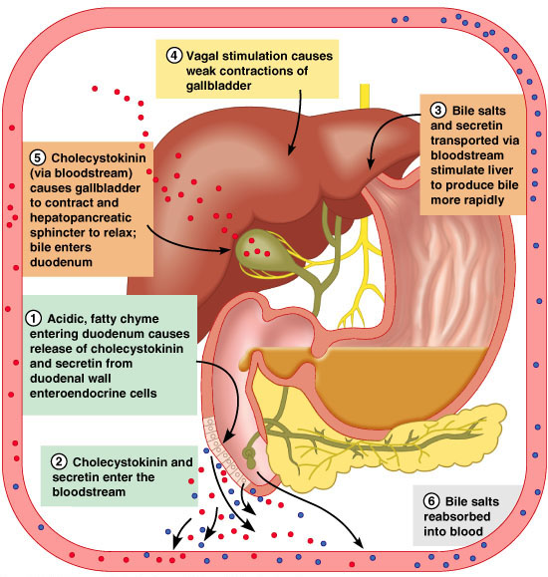
Summary of the control (from slides)
Only in Females’ Slides

Slide 16
Bile acids and salts
Bile acids are steroid acids, synthesized in the liver from cholesterol by the enzyme cholesterol (7α-hydroxylase ) and a carboxyl group are added to the steroid nucleus.
Bile acids include
Primary | Secondary
Cholic. Chenodeoxycholic acids. | Deoxycholic. Lithocholic acids.
Bile Acids Are Formed in the Liver From Cholesterol
Synthesis by hepatocytes (by C 27- dehydroxylase), which include cholic acid and chenodeoxycholic acid. Bile acids are secreted as conjugates of taurine or glycine. When bile enters the GI tract, bacteria present in the lumen act on the primary bile acids and convert them to secondary bile acids by dehydroxylation. Cholic acid is converted to deoxycholic acid and chenodeoxycholic acid to lithocholic acid, which is cytotoxic and can be sulfated by the liver if it presents in high concentration. At a neutral pH, the bile acids are mostly ionized and are referred to as bile salts. Conjugated bile acids ionize more readily than the unconjugated bile acids and, thus, usually exist as salts of various cations (e.g., sodium glycocholate or Sodium taurocholate) and we call it bile salt. The conjugation biochemical reaction decreases the pKa of the compound and make it more ionized. Bile salts are much more polar than bile acids and have greater difficulty penetrating cell membranes (because the membrane contain lipids). Consequently, the small intestine absorbs bile salts much more poorly than bile acids. This property of bile salts is important because they play an integral role in the intestinal absorption of lipid. Therefore, it is important that the small intestine absorb bile salts only after all of the lipid has been absorbed (Bile salts r kept in small intestine until most of fat is digested & absorbed). Bile acids are amphipathic that is having both hydrophilic & hydrophobic domains and tend to form molecular arrangement called micelles. Bile salts have the ability to form micelles, each bile salt molecule is composed of a sterol nucleus that is fat-soluble and a polar group that is water soluble. Micelles are small spherical, cylindrical globules 3 to 6 nm in diameter composed of 20 to 40 molecules of bile salt. The polar groups are (-) charged, they allow the entire micelle globule to dissolve in the water of the digestive fluids and to remain in stable solution. The micelles act as a transport medium to carry the monoglycerides and free fatty acids to the brush borders of the intestinal epithelial cells. In bile acid micelle, the hydrophobic side of bile acid faces inside & away from water. The hydrophilic surface faces outward towards the water. Bile acid micelles form when the concentration. of bileacids exceed a certain limit (critical micelle concentration). Above this concentration, any additional bile acid will join the micelle. Normally bile acid concentration in bile is much greater than critical micelle concentration.

Slide 17
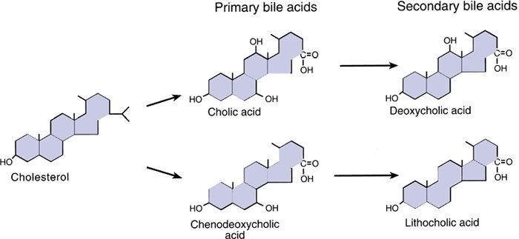
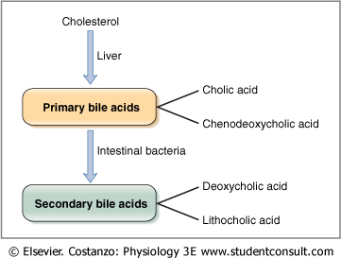
Cont.
Pic is Only in Males’ Slides
Only in Females’ Slides
Bile acids are formed from cholesterol in the liver.
Bile acids are conjugated with the amino acid, glycine, and taurine (which is an organic compound available in animal tissue) in the liver.
At neutral pH, the bile acids are mostly ionized and referred to as bile salts.
Extract bile acid from blood > deconjugated > rehydroxylated secondary bile acid (convert secondary bile acid to primary bile acids) > reconjugated > secreted again.

Slide 18
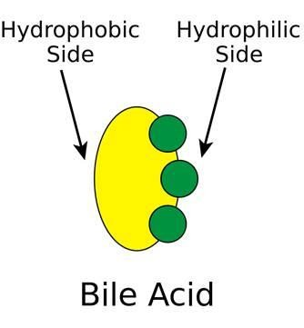
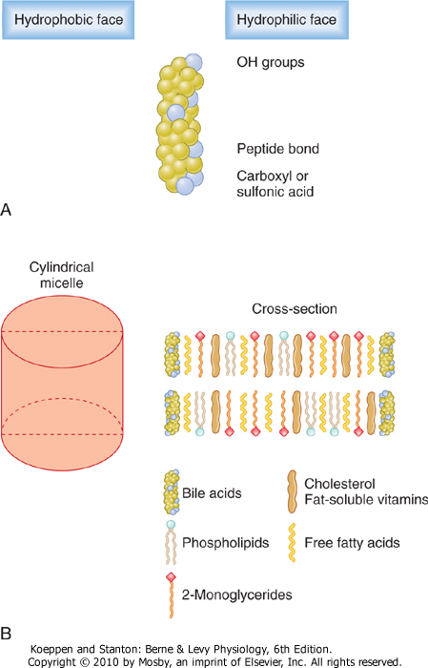
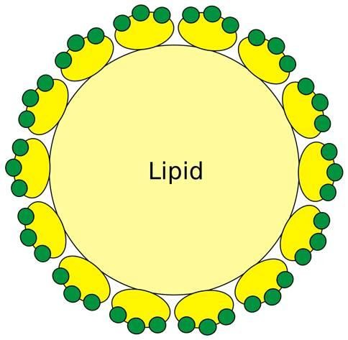
Micelles
Micelles Formation
Only in Males’ Slides

Slide 19
Function of bile acids | 1. Digestion of fats | They have a detergent action (emulsifying) on the fat particles in the food which decreases the surface tension of the particles. They help in the absorption of fatty acids, monoglycerides, cholesterol, and other lipids from the intestinal tract.
 | 2. Absorption of fats | Bile salts combine with fats to form micelles (water soluble compounds) from which fatty acids, monoglycerides, cholesterol, and other lipids can be absorbed from the intestinal tract. Without the presence of bile salts in intestinal tract up to 40% of lipids are lost into the stools (steatorrhea). الـMicelles مهمتها بس التوصيل، او ما توصل البايل للانتسيتاين راح يدخل البايل لانه دهني.
 | 3. bile acids are essential for absorption of fat soluble Vitamins | Vitamins (A, D, E and K).
 | 4. In the colon bile acids inhibit reabsorption of water & electrolytes, stimulate intestinal motility, prevent constipation & may cause diarrhea.
 | 5. In the liver, bile salts are important for stimulating bile secretion and flow (choleretic action). They also take part in the formation of micells which render cholesterol soluble in bile.
 | 6. Bile acids have a –ve feedback effect on the release of CCK from its cells in the upper intestine & thus contribute to the regulation of pancreatic secretion & the discharge of bile into intestine. (When they reach a certain level , they inhibit secretion of CCK).
 | 7. They have a –ve feedback effect on the synthesis of cholesterol by the intestinal mucosal cells.
 | 8. Anti putrifactive (تخمر او تعفّن): Bile acids have no direct anti septic effect but they prevent putrifaction by absorption of fat. In their absence undigested fats cover the protein particles & hinder their digestion.

Slide 20
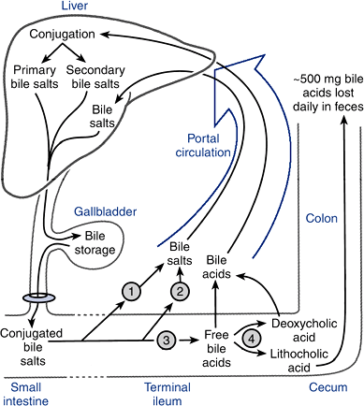
Enterohepatic Circulation of Bile Salts | Bile Salts Are Recycled Between the Small Intestine and the Liver
 | Hepatocytes extract bile acids, essentially clearing the bile acids from the blood in a single pass through the liver & It is essential for stimulating and maintaining the secretion of bile by hepatocytes.
 | In the Hepatocytes, most deconjugated bile acids are reconjugated & some 2ry bile acids are rehydroxylated.
 | The reprocessed bile acids, together with newly synthesized bile acids, are secreted into bile, The greater the quantity of bile salts in the enterohepatic circulation, the greater the rate of bile secretion.
 | By cycling several times during a meal, a relatively small bile acid pool can provide the body with sufficient amounts of bile salts to promote lipid absorption (The total amount of bile acids in the body, primary or secondary, conjugated or free, at any time is defined as the total bile acid pool).
 | In healthy people, the bile acid pool ranges from 2 to 4 g. The enterohepatic circulation of bile acids in this pool is physiologically extremely important. By cycling several times during a meal, a relatively small bile acid pool can provide the body with sufficient amounts of bile salts to promote lipid absorption. in your body you only have 2-4g, but in your GI you have 10 times of the normal bile pool, how? by reabsorption. Your body only has 2-4g but it secreted in your GI then they absorbed again & secreted again, this cycle happens 6-10 times per day. So in one day the total bile acids were secreted in your GI is 20-30g.
 | In a light eater, the bile acid pool may circulate 3 to 5 times a day; in a heavy eater, it may circulate 14 to 16 times a day.
 | The intestine is normally extremely efficient in absorbing the bile salts by carriers located in the distal ileum. Inflammation of the ileum can lead to their malabsorption and result in the loss of large quantities of bile salts in the feces e.g., inflammatory bowel diseases (Crohn’s disease & Ulcerative Colitis) ☹.
 | Depending on the severity of illness, malabsorption of fat may result and steatorrhea* (fat in stool) because bile salt pool was depleted following the ileal inflammation or resectioning. Presence of bile salt in the colonic lumen will activate Cl secretion, Na and water will follow Cl into the intestinal lumen, producing secretory diarrhea (Excess amount of bile acids entering the colon may result in diarrhea). Diarrhea Because it increases intestinal motility.
 | Bile salts or bile acids in the intestine lumen are absorbed via four pathways into portal circulation (enterohepatic circulation): | 1. Passive diffusion
 |  | 2. An active carrier-mediated process.
 |  | 3. De-conjugation and/or transforming of bile salts to bile acids (by bacteria).
 |  | 4. Transforming the primary bile acids to secondary bile acids (by bacteria).
يعني السايكل تعتمد على الفات، كلما زاد، زاد الـrecycling.
* Steatorrhea is loss of fat in stool caused by interruption of hepatic circulation or insufficient bile salts or deficiency of pancreatic.

Slide 21
Enterohepatic Circulation of Bile Salts | About 20-30 g of bile acids are poured into the duodenum /day.
 | In the intestine, some of bile acids are deconjugated and dehydroxylated in the 7 α position by intestinal bacteria that normally colonize in the digestive tract.
 | Dehydroxylation results in the production of secondary bile acids. Cholic acid is converted to deoxycholic acid and chenodeoxycholic acid to lithocholic acid.
 | On reaching the terminal ileum, about 95% of bile acids are absorbed and reach the liver through the portal vein.
 | About 0.3-0.5 g of bile acids are lost in feces daily (15-35% of total bile acid pool).
 | These are replaced by new synthesis in liver so that the total bile acid pool is maintained constant at 2 - 4 g.
 | Since the amount of bile acids poured into the duodenum each day is 20-30 g, the daily turnover of total bile acid pool through the enterohepatic circulation must be 6-10 times.
Only in Females’ Slides

Slide 22
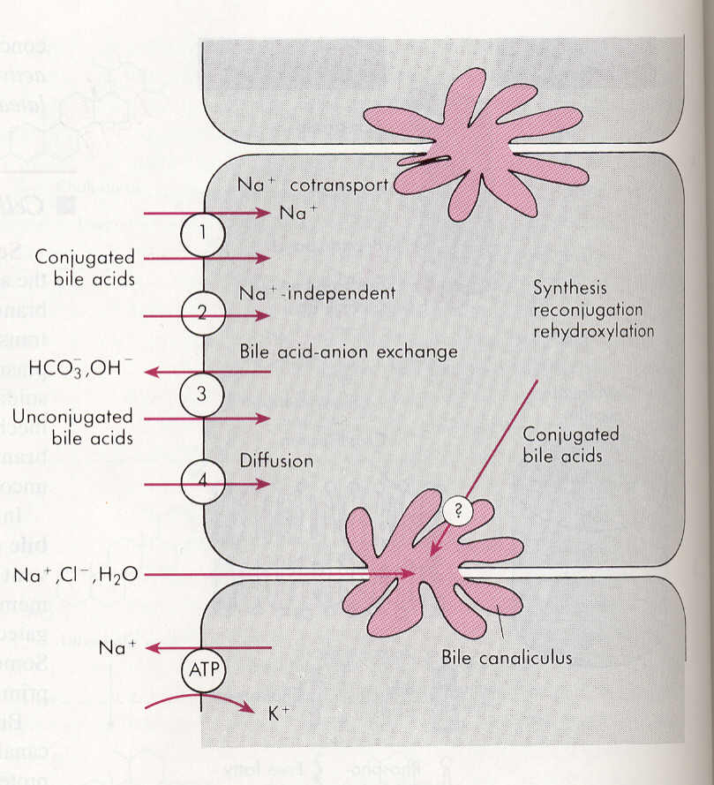
Absorption of bile acids in intestinal lumen | Bile acids are absorbed largely in the terminal part of the ileum.
 | They cross the brush border plasma membrane by two routes:
 | 1. Active transport process. It is 2ry active transport (Sodium cotransport) powered by the Na+ gradient across the brush border membrane. | Simple diffusion.
 | The conjugated bile acids are the principal substrates for active absorption. Unconjugated bile acids have poor affinity for the transporter. They are less polar than conjugated bile acids, they are better absorbed by simple diffusion. Bile acids may be bound to proteins, (which remain to be identified), in intestinal epithelial cells. Absorbed bile acids are carried away from the intestine in the portal blood, mostly bound to albumins. N.B: In the small intestine, cholic acid is absorbed faster than chenodeoxycholic acid, and primary bile acids are absorbed better than secondary bile acids. Some unconjugated bile acids are absorbed passively in the colon and reach the liver through portal vein.
Absorption of bile acids in intestinal lumen | Bile salts or bile acids in the portal circulation are absorbed via four pathways into hepatocytes: | 1. An active carrier-mediated process: conjugated bile acids-Na co-transport.
 |  | 2. Na-independent pathway.
 |  | 3. Bile acid-HCO3 or Bile acid-OH exchange.
 |  | 4. Passive diffusion (very little).

Slide 23
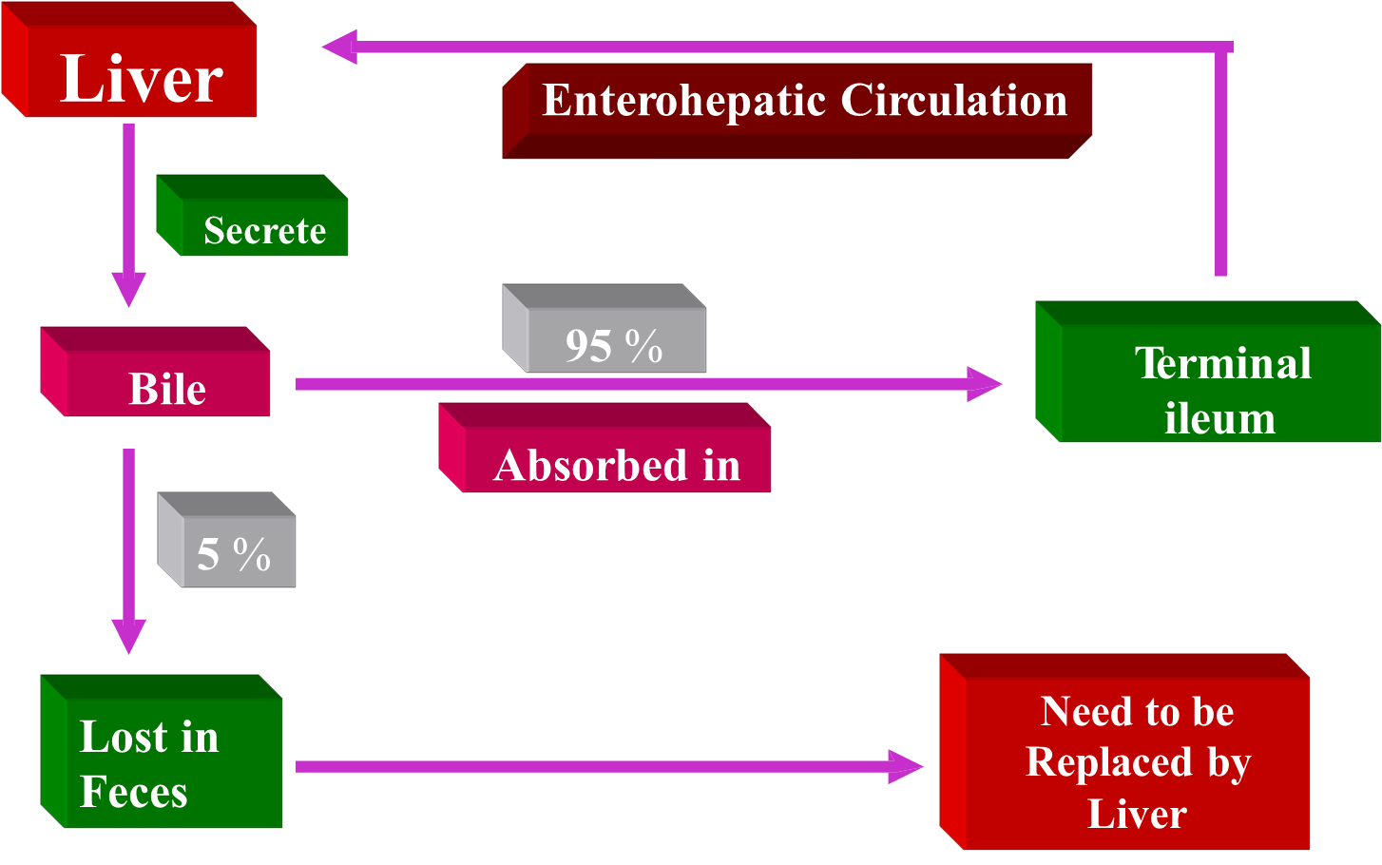
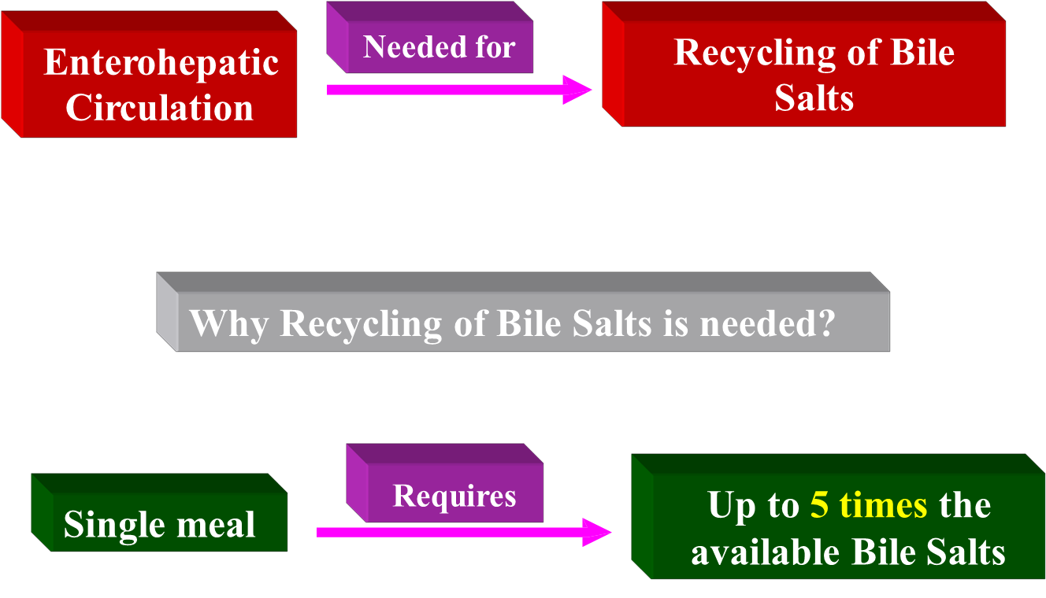
Only in Females’ Slides
Summary (from slides)

Slide 24
Cholesterol secretion in bile
Only in Females’ Slides
About 1-2 g of cholesterol appears in bile per day.
No specific function is known for cholesterol in the Bile & it is presumed that it is simply a by product of Bile salt formation & secretion.
Cholesterol is water insoluble; it is solubilized by incorporation in micelles along with the bile acids & phospholipid.
تمَّ بحمد الله وتوفيقه وتيسيره
Best of the luck ☺

Slide 25






Thank you!
اعمل لترسم بسمة، اعمل لتمسح دمعة، اعمل و أنت تعلم أن الله لا يضيع أجر من أحسن عملا.
The Physiology 436 Team:
Team Leaders:
Laila Mathkour
Mohammad Alayed
Females Members:
Ebtisam Alsugyani
Nada Aldakheel
Zaina Alkaff
Males Members:
Mohammad Nusser
Qais Almuhaideb
Contact us:
References:
2017-2018 Dr. Hayam Gad’s Lecture & notes.
2017-2018 Dr. Mohammed Al Zoghaibi’s Lecture & notes.
Guyton and Hall Textbook of Medical Physiology (13th Edition).
Bern & Levy physiology (6th Editition).
اللهم اني استودعتك ما حفظت وما قرأت وما فهمت، فرده لي وقت حاجتي إليه إنّك على كل شيءٍ قدير.

