Slide 1
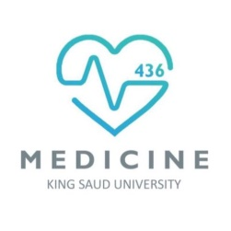
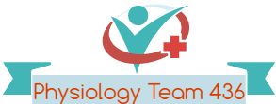
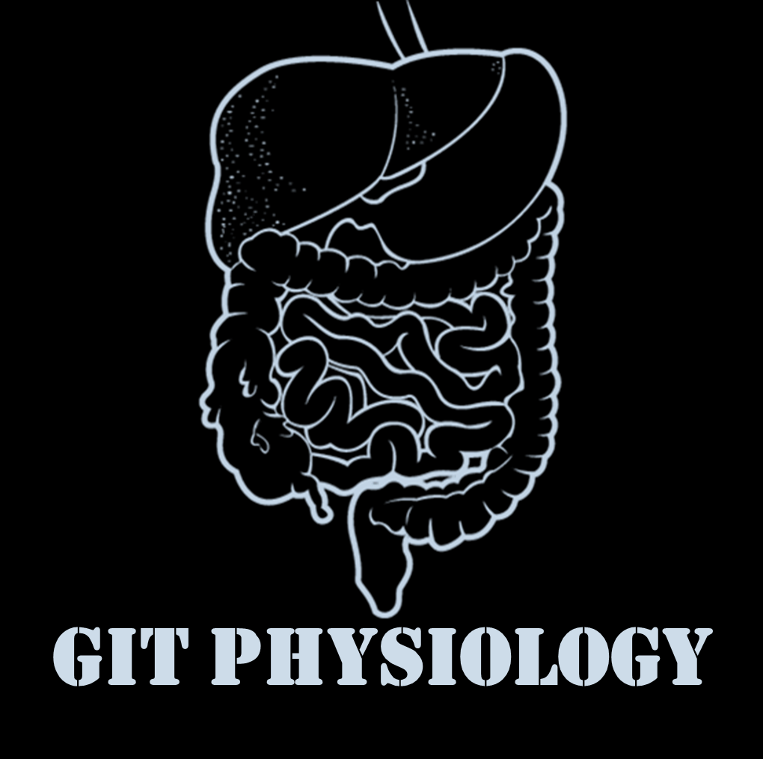
Text
Only in Females’ slide
Only in Males’ slides
Important
Numbers
Doctor notes
Notes and explanation
Lecture No.3
" وأن أُثابر في طلب العلم "

Slide 2
Physiology of the stomach and regulation of gastric secretions
Objective:
Functions of stomach.
Gastric secretion.
Mechanism of HCl formation.
Gastric digestive enzymes.
Neural & hormonal control of gastric secretion.
Phases of gastric secretion.
Motor functions of the stomach.
Stomach Emptying.

Slide 3
Overview
Only in Females’ Slides
Just read it

Slide 4
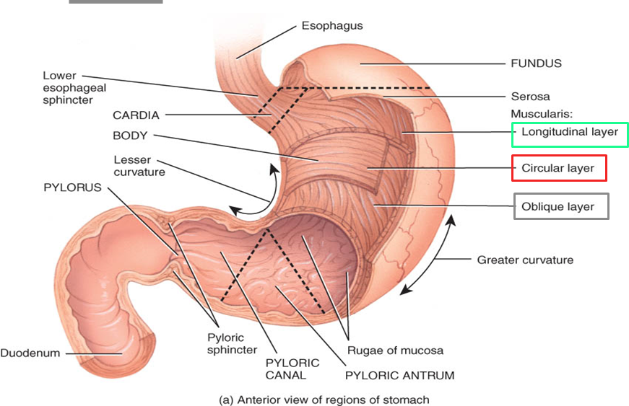
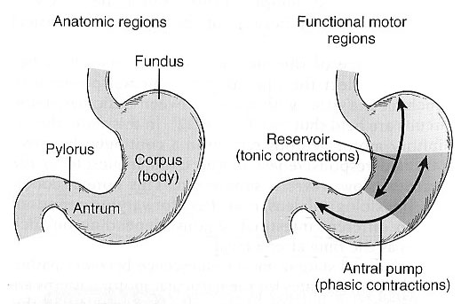
Anatomy and Physiology of the Stomach
*on the food.
**Up to a certain limit:
350ml> fullness
500 ml> discomfert/pain
Stomach
Anatomically | Physiologically | Muscular wall (only in Females’ slides)
Fundus | The orad portion (Fundus and upper two thirds of the body) Reservoir part (tonic contraction)*** The main functions of reservoir part: To maintain a continuous compression.* To accommodate the received food without significant gastric wall distention or pressure (Storage of food).** | Longitudinal (Outer layer)
Body | Caudad (Lower third of the body plus antrum) Antral pump (phasic contraction).**** | Circular (Middle layer)
Antrum | - | Oblique (inner layer)
Only in Females’ Slides
Rugae = large folds.
Mucus = protects lining of stomach (Very thick alkaline mucus layer formed by surface mucus cells to protect the mucus membrane by neutralizing the acidity).
***Receptive dilatation to receive food coming.
****For strong contractions
The reservoir part: for storage and always contracted.
The antrum: contraction and relaxation

Slide 5
Motor functions of the stomach ( ادرسوها بالترتيب، انتهوا من كل خطوة اذا كان مكتوب أن لها تكملة وبعدين روحوا للي بعدها، خطوة 2 & 4 & 6 لهم تكملة)
1. Storage Storage & emptying are most important functions. | 2. Mixing and propulsion | 3. Absorption | 4. Emptying The most impotant function | 5. Hunger contractions (Just read it) | 6. Digestion (Only in females’ slides)
- Storage of f large quantities of food. - The stomach can store (accommodate up to) 0.8-1.5 L of food. - Gastric contents may remain unmixed for 1hour in the corpus (body). - When the stomach is stretched by food, a vagovagal reflex is initiated from the stomach to the brain stem and back to the muscular wall of the stomach resulting in reduction in muscular wall tone in the body of the stomach which allows storage (stomach wall bulges progressively). - The pressure in the stomach remains low until the volume reaches ~1.5 L of food. To accommodate the food without pressure and expose it to HCl we need neural response (enteric nervous system). عشان كذا بمسابقات الأكل آخرها يروحون الإسعاف ، لأن المعدة امتلت وماهي قادرة تتحمل زيادة على قدرتها فيحصل vomiting or rupture. وبكذا خلصنا أول وظيفة! | Mixing and propulsion of food in the stomach with gastric secretions to produce chime & preparing the chyme for digestion in the small intestine. تكملة هذه الوظيفة في السلايد القادم، كملوها قبل الإنتقال للوظيفة الثالثة. | Absorption of water and lipid-soluble substances (alcohol and drugs). Stomach is a poor absorptive area of GIT. It lacks the villous type of absorptive membrane and It has tight junctions between epithelial cells. Only a few highly-lipid soluble substances can be absorbed such as: Alcohol & Aspirin وبكذا خلصنا ثالث وظيفة! | Emptying of the chyme from the stomach into the small intestine at a suitable rate for proper digestion & absorption. تكملة هذه الوظيفة في السلايد رقم 8 و9، كملوها قبل الإنتقال للوظيفة الخامسة. | Hunger contractions occur when the stomach has been empty for several hours. They are rhythmical peristaltic contractions in the body of the stomach that can become very strong and fuse into a continuing tetanic contraction lasting 2-3 min. Hunger contractions are intense in young healthy people and increase by low blood glucose levels. Sometimes they cause mild pain (hunger pangs) begin 12-24 hrs after last meal In starvation they reach greatest intensity in 3-4 days. Leptin and Ghrelin hormones are important in regulating hunger. وبكذا خلصنا خامس وظيفة! | 1. Mechanical: Mix – churn (Mixed with anzymes) 2. Chemical: Protein digestion The real digestion happens in small intestine. تكملة هذه الوظيفة في السلايد رقم 11.
This function is regulated by receptive relaxation reflex (vagovagal ): triggered by swallowing reflex. (مشروحة في سلايد 12 ) | Chyme: is a murky semi-fluid or paste composed of food that is thoroughly mixed with gastric secretions. Gastric juice: converts meal to acidic chyme. HCl: ph 2, kills bacteria, denatures proteins. Pepsin: enzyme breaks down proteins.
Chyme: ( مثل عجينة الكيك)

Slide 6
Cont. Mixing and Propulsion
*
So it causes 3 slow waves/sec.
And this is the only place in the GIT where slow waves cause contractions.
It works even without food its always contacting.
Major mixing activities take place in the antrum (antral pump region, phasic contraction).
The digestive gastric juices are secreted by gastric glands and these secretions come in contact with the food lying against the mucosal surface of the stomach.
The Basic Electrical Rhythm of the Stomach Wall:
The presence of food (As long as food is in the stomach) causes weak peristaltic constrictor* waves called mixing waves begin in the mid to upper portions of the stomach wall and move toward the antrum once every 15-20 sec.
These waves are initiated by the gut wall basic electrical rhythm (slow spontaneous electrical waves).
These waves progress from the body to → antrum.
and become intense forcing the chyme to mix and move under high pressure from the antrum toward → pylorus.
Each time a peristaltic wave passes from to the antrum to the pylorus, few millimeters of antral content move into the duodenum through the pyloric sphincter.
Some become extremely intense providing peristaltic action potential-driven constrictor rings that force antral contents under higher pressure toward the pylorus.
Constrictor rings play an important role in mixing the stomach contents:
Each time it digs deeply into the food contents in the antrum
The opening of the pylorus allows only a few millimeters of antral contents to be expelled into the duodenum with each wave.
As each wave approaches the pylorus the pyloric muscle contracts.
Most of the antral content are squeezed upstream through the peristaltic ring toward the body.
The moving peristaltic ring + upstream squeezing action called Retropulsion is an important mixing mechanism.
Retropulsion Phenomena:
As the trailing contraction approaches the closed pylorus, the gastric contents are forced into an antral compartment of ever- decreasing volume and progressively increasing pressure.
This results in jet-like retropulsion through the orifice formed by the trailing contraction.
Repetition at 3 cycles/min reduces particle size to the 1-mm to 7-mm range that is necessary before a particle can be emptied into the duodenum.
These intense peristaltic contractions that cause emptying increase the pressure in the stomach to 50-70 cm* of H₂O (compared to a pressure of ~10 cm of H₂O during the mixing peristaltic contractions).
The weak peristaltic constriction is produced by slow wave without action potential.
This part is the only part of git that is contracted by the slow wave.
* The pressures mentioned here is important.

Slide 7
Summary of Mixing & Propulsion (from slides)
Only in Females’ Slides

Slide 8
Cont. Emptying
Stomach Emptying is the result of: intense peristaltic antral contractions against resistance to passage of chyme at the pylorus.
Role of the Pylorus in Controlling Stomach Emptying:
Pylorus is the distal opening of the stomach. The pyloric sphincter is characterized by strong circular muscle (as compared to the antrum) (Thickness of circular muscles is 50-100% greater than in the antrum) and remains tonically contracted most of the time.
It is named the pyloric sphincter.
However, during pyloric constriction, watery chyme can still pass through the pylorus into the duodenum, but not food particles (It is usually open enough to allow water & fluids).
Pyloric constriction is determined by nervous and humoral reflex signals from the stomach and the duodenum.
Pyloric pump:
Most of the time contractions are weak and cause mixing of food with gastric secretions.
20% of the time contractions in the form of tight ringlike constrictions cause stomach emptying.
يعني لو عندي 100 كونتراكشن 20 منها بس هي اللي راح تسمح بمرور الكايم
They are 6 times as powerful as mixing waves.

Slide 9
Regulation of the emptying of the stomach
The rate of stomach emptying is controlled by signals from the duodenum and stomach. The signals from the duodenum are far stronger and control emptying of chyme at a rate that allows the proper digestion and absorption in the small intestines
Duodenum (more potent) More potent because it’s the receiver part |  | Stomach (gastric factors)
Powerful duodenal factors that inhibit stomach emptying |  | Gastric factors that promote stomach emptying
1. Inhibitory effect of enterogastric nervous reflexes from the duodenum | 2. Hormonal feedback | 1. Effect of gastric food volume on rate of stomach emptying. | 2. Effect of the hormone gastrin on stomach emptying.
When food enters the duodenum, multiple nervous reflexes are initiated from the duodenal wall and pass back to the stomach to regulate stomach emptying depending on the volume of chyme in the duodenum. These duodenal reflexes are mediated by three routes: 1. Directly from the duodenum to stomach through the enteric nervous system in the gut wall. 2. Through extrinsic nerves that go to the prevertebral sympathetic ganglia and then back through inhibitory sympathetic nerve fibers to the stomach. 3. Through the vagus nerves reflex to the brain stem to inhibit the normal excitatory signals that are transmitted to the stomach through the vagus nerves. These reflexes inhibit the pyloric pump and increase the tone of the pyloric sphincter thus< decreasing stomach emptying. The duodenal factors that can initiate these include: duodenal distention. duodenal irritation. Acidity of the duodenum activates S cells to release Secretin which constricts the antrum. osmolality of the chyme in the duodenum (Hyperosmotic or hyposmotic solutions delay gastric emptying). protein (and maybe fat, monoglycerides) content of the chyme in the duodenum activates different cells to produce CCK and GIP that delay gastric emptying. Amino acids elicit inhibitory enterogastric reflexes; by slowing the rate of stomach emptying. | Fat entering the duodenum(is the main stimulus for releasing these inhibitory hormones) or acidity of chyme or excess quantities of chyme causes (probably a receptor mediated mechanism through receptors on epithelial cells) the release of: Cholecystokinin (CCK), the most potent hormone. Released from jejunum by fat. Other inhibitory hormones such as secretin, released from duodenal mucosa in response to acid. And gastric inhibitory peptide (gip) from the epithelium of the duodenum and jejunum. From upper small intestine mainly by fat in chyme and carbohydrates. - When released, cck (and probably secretin and gip) circulates and inhibit the pyloric pump and increase the tone (contraction) of the pyloric sphincter thus< decreasing stomach emptying. - Cck also acts as an inhibitor to block increased stomach motility caused by gastrin. | An increase in gastric food volume results in: Increased stretch in the stomach wall which elicits local myenteric reflexes that: 1. Increase the activity of the pyloric pump. 2. Inhibit the pylorus (the tonic contraction of the pyloric sphincter) leading to increased stomach emptying. Gastrin hormone comes from g cells in the antrum, when there is distention in this part g cells release gastrin which goes to the parietal cells and promotes acid release in the body of the stomach thus increasing the motility in the antrum part so it pushes food down to the duodenum. | - Gastrin is released from the antral mucosa in response to the presence of digestive products of meat. - In turn, gastrin promotes the secretion of acidic gastric juices (ex. Hcl) by the stomach gastric glands (or oxyntic glands) located on the inside surface of the body and fundus of the stomach; (i.E. Proximal 80% of the stomach). - Gastrin also increases the activity of the pyloric pump and motor stomach function (moderate effect) and probably promotes stomach emptying.

Slide 10
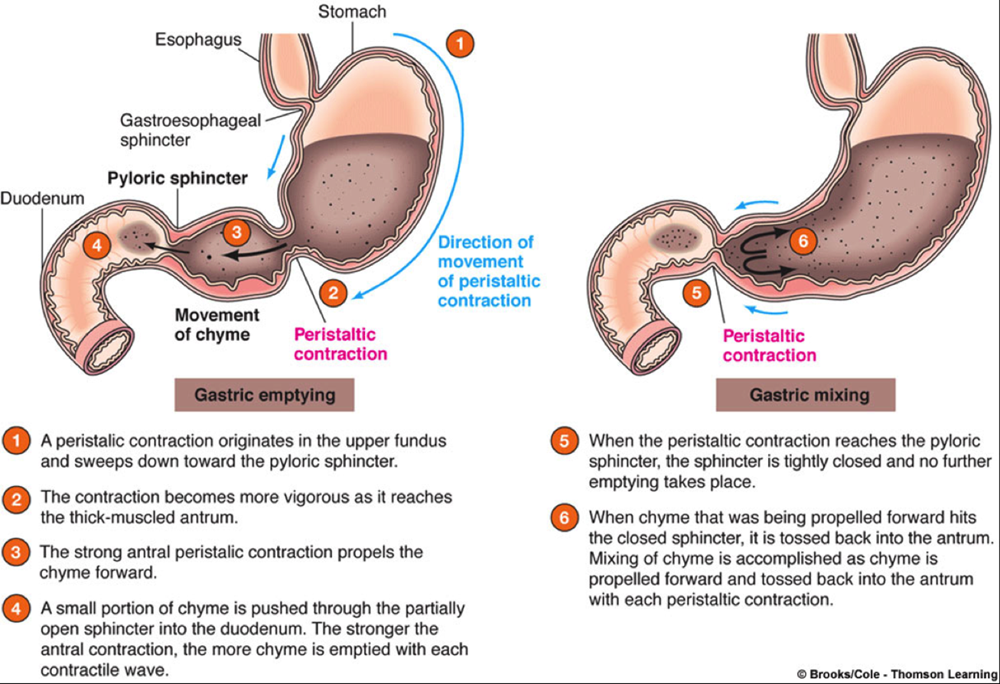
Summary of Emptying (from slides)
Only in Males’ Slides
Only in Females’ Slides
Regulation of stomach emptying
Gastric factors that promote emptying |  | Powerful duodenal factors that inhibit stomach emptying
Food volume | Gastrin hormone | At the presence of food in the duodenum, multiple nervous reflexes are initiated from the duodenal wall that pass back to the stomach to slow or even stop stomach emptying via one of the following routes:
Increased food volume in the stomach promotes emptying from the stomach (inhibits the pylorus). | Enhances the activity of the pyloric pump. Thus, it, too, probably promotes stomach emptying. | Directly through ENS. | Through extrinsic nerves that go to the prevertebral sympathetic ganglia and then back through inhibitory sympathetic nerve fibers to the stomach. | Through the vagus nerves.
Constriction of Pyloric Sphincter
Hormones promote constriction | Sympathetic innervation
1. Cholecystokinin (CCK) | -
2. Secretin
3. Glucose-dependent insulinotropic peptide (GIP)

Slide 11
Cont. Digestion
Only in Females’ Slides
Digestion
Digestion of carbohydrate in mouth & stomach | Digestion of proteins in the stomach
- | Pepsin | Hydrochloric acid
- Food mixed with saliva that contain ptyalin (an α amylase) secreted by parotid gland. - It hydrolysis starch to maltose. - It continues in stomach for 1 horse - Gastric acid deactivate it. | - secreted by chief (peptic) cells. - It is active at pH 2-3 and inactive at pH 5. - Initiate protein digestion (10-20% of protein digestion). - Can digest collagen. | secreted by parital (oxyntic) cells
وبكذا نكون خلصنا من
Motor Functions of the Stomach
وأخيراً ☺

Slide 12
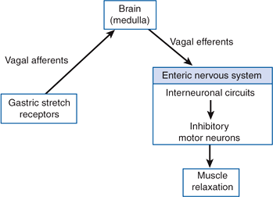
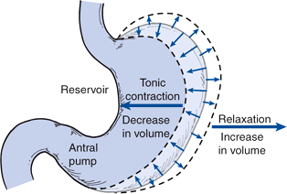
Relaxation Reflexes in Gastric Reservoir Part Three Kinds of Relaxation Occur in the Gastric Reservoir
Receptive Relaxation Reflex | Adaptive relaxation | Feedback Relaxation
Triggered by swallowing reflex. When the esophageal peristaltic waves reach the stomach, the stomach relaxes through inhibition of myenteric neurons which prepares the stomach to receive the food that is propelled into the esophagus during swallowing. It relieves the tonic contractions. Pushes the food to the stomach by: relaxing the sphincter and relaxing the reservoir part. the receptive relaxation reflex is not enough to store food, that’s why there is other reflex witch is adaptive reflex. | Triggered by stretch receptors (vago-vagal reflex). Normally, when food stretches the stomach, a “vagovagal reflex” from the stomach to the brain stem and then back to the stomach reduces the tone in the muscular wall of the body of the stomach so that the wall bulges progressively outward. Adaptive relaxation is lost in patients who have undergone a vagotomy. Following a vagotomy, increased tone in the musculature of the reservoir decreases the wall compliance, which in turn affects the responses of gastric stretch receptors to distention of the reservoir. Pressure–volume curves obtained before and after vagotomy reflect the decrease in compliance of the gastric wall. The loss of adaptive relaxation after a vagotomy is associated with a lowered threshold for sensations of fullness and pain. This mechanism is more important for adaptation and accommodation. | The presence of nutrients in the small intestine triggers feedback relaxation. It can involve both local reflex connections between receptors in the small intestine and the gastric ENS or hormones that are released from endocrine cells in the small intestinal mucosa and transported by the blood to signal the gastric ENS and stimulate firing in vagal afferent terminals in the stomach. The main goal of this is to inhibit the emptying but by doing so it causes it relax so it can adapt the amount of food and keep it. Enterogastric reflex is example of Feedback Relaxation.
Only in Males’ Slides
شرح هذا النوع والرسمة في السلايد الجاي ☺
if someone eat too much food, stomach wall distention will happen, then he will feel pain and discomfort.
The reservoir part undergo tonic contraction similar to lower esophageal sphincter but differ in the severity

Slide 13
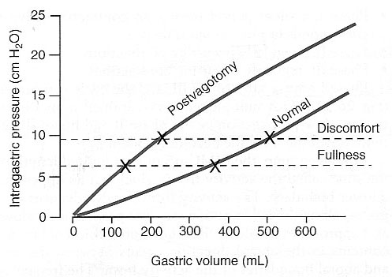
Doctor explanation (Adaptive relaxation)
350ml of food is adaptable, which means the stomach is able to accommodate certain amount/size of food without generating pressure. How does the adaptation reflex do that? Via certain threshold.
350 ml> normal>threshold of fullness> activates the adaptive relaxation reflex>sends info to the medulla “I’m full stop eating”.
That’s why its important.
500ml> threshold of discomfort/pain> vomits the extra volume or the all of it.
Threshold of fullness = 350ml
Threshold of discomfort = 500ml
الأشخاص المصابين بالسمنة يقدرون ياكلون كمية كبيرة من الأكل من غير ما يحسون بعدم الراحة عكس الأشخاص النحيفين، و هذا بسبب أن المصابين بالسمنة تعودوا لمدة طويلة جدا أنهم ياكلون كمية كبيرة من الأكل فبالتالي مدى الـAdaptive reflex مرتفع مقارنة بالناس النحيفين.
إذاً الـ adaptive reflex تلعب دور مهم في تعود الشخص لكمية أكله.

Slide 14
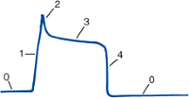
Gastric Action Potential
Only in Males’ Slides
Motor Behavior of the Antral Pump Is Initiated by a Dominant Pacemaker (Motility in the Antrum).
Gastric action potentials determine the duration and strength of the phasic contractions of the antral pump.
They are initiated by a dominant pacemaker ICC (interstitial cells of cajal).
The action potentials propagate rapidly around the gastric circumference and trigger a ring-like contraction.
The action potentials and associated ring-like contraction then travel more slowly toward the gastroduodenal junction.
Electrical syncytial properties of the gastric musculature account for propagation of the action potentials from the pacemaker site to the gastroduodenal junction.
The pacemaker region in humans generates action potentials and associated antral contractions at a frequency of 3/min.
The gastric action potential lasts about 5 seconds and has a rising phase (depolarization), a plateau phase, and a falling phase (repolarization).
Each Action Potential gives 2 contraction
Electrical action potentials in gastrointestinal muscles occur in four phases, determined by specific ionic mechanisms
Phase 0 | Phase 1 | Phase 3 | Phase 4
Resting membrane potential. outward potassium current | Rising phase (upstroke depolarization). activation of voltage-gated calcium channels and voltage-gated potassium channels. | Plateau phase. balance of inward calcium current and outward potassium current | Falling phase (repolarization). inactivation of voltage-gated calcium channels and activation of calcium-gated potassium channels.

Slide 15
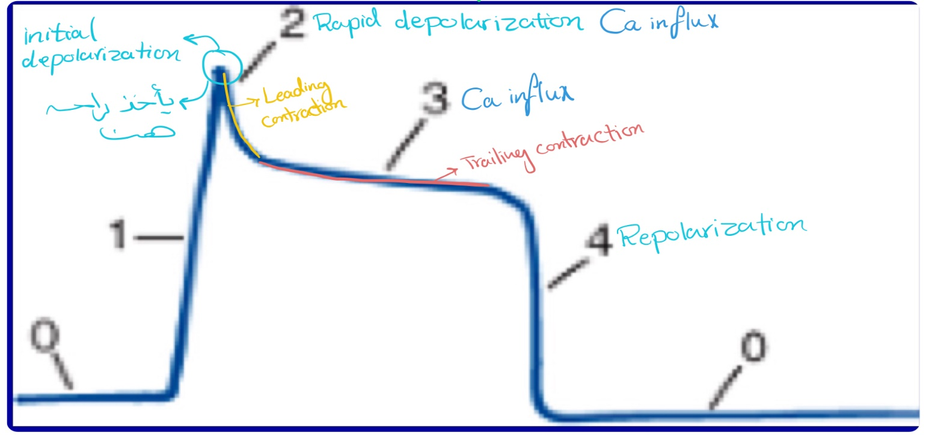
Doctor Explanation
In the antrum pump region:
In addition to the weak peristatic wave of contraction that’s usually generated by a slow wave, we have very severe contraction.
Slow waves are 3/sec they all will succeed, each will give 10 spikes and each will last 1—20ms, so it’s a very long action potential, 40 times the duration in large nerves- normal nerve is 0.1ms.
So 1 slow wave > 1-10 spikes >1-10 action potentials > each lasts 10-20ms
The doctor: I don’t like asking about numbers but I just want you to know its long.
Because we have a long action potential and two phases of Ca influx, we will get two types of contractions: leading and trailing (more severe).
All contractions will succeed why? 1.the region is well stretched. 2.well supplied by parasympathetic acetylcholine so the firing is excellent.
These contractions will keep going through the stomach till they reach the pyloric sphincter, if the food particle is still larger than 7mm2 it will go back for further digestion, if it does go back we call it retropulsion.
How will it happen? The intestines has somatosensory receptors and proprioceptors which will sense the size of the chyme so it will close the sphincter more and the leading contraction will help it to close even more.
The trailing contraction will squeeze the region and return the food for digestion. So the contraction that responses to retropulsion is the trailing contraction.

Slide 16
Cont.
Only in Males’ Slides
The gastric action potential triggers two kinds of contractions:
The gastric action potential is responsible for two components of the propulsive contractile behavior in the antral pump.
A trailing contraction |  | A leading contraction
Is associated with the plateau phase. | Of variable amplitude | Is associated with the rising phase of the action potential. | Which has relatively constant amplitude.
The trailing contraction follows the leading contraction by a few seconds. |  | Have negligible amplitude as they propagate to the pylorus. As the rising phase reaches the terminal antrum and spreads into the pylorus, contraction of the pyloric muscle closes the orifice between the stomach and duodenum.

Slide 17
Gastric Secretion
The Video here is very Important
The stomach's mucosal lining, the glandular gastric mucosa, contains three main types of glands:
1. Cardiac glands | 2. Oxyntic glands. |  | 3. Pyloric glands
- | They are tubular gland
 | They are composed of three types of cells: mucus neck cells, peptic (chief) cells, and parietal cells (oxyntic cells). These glands are the most abundant gastric glands, found in fundus and corpus. |  | Many G cells
 | Secrete | Location | Secrete | Location
 | - Hydrochloric acid Pepsinogen Intrinsic factor Mucus | Located in body & fundus (In proximal 80%of stomach) | - Mucus Protection Gastrin Pepsinogen | Located in the antrum (In the distal 20% of stomach)
This Video was included in the slides
Secretion of Bicarbonate from Pancreatic Cells
0:35

Slide 18
Gastric Cells
Functionally different cell types compose glands:
1. Parietal cells (oxyntic cells) -most distinctive cells in stomach (HCl & intrinsic factor) (That’s why gastrectomy will cause Intrinsic factor deficiency then vit B-12 deficiency and therefore Anemia).The Parietal cells of stomach is the only source in GIT to pepsinogen and HCL
2. Chief cells (peptic cells), they are available in oxyntic glands & few in pyloric glands, pepsinogen.
3. Mucus neck cells:
HCO₃⁻
Mucus
4. G cells: gastrin (hormone) → increases HCl secretion.
5. D cells: somatostatin (antrum) → decreases HCl secretion.
6. enterochromaffin-like cell: histamine.
7. enteroendocrine cells.
Gastric mucosa has numerous openings called gastric pits.
Gastric glands empty into bottom of pits.
The secreted pepsinogen is not active, that’s why it doesn’t destroy the gland itself.

Slide 19
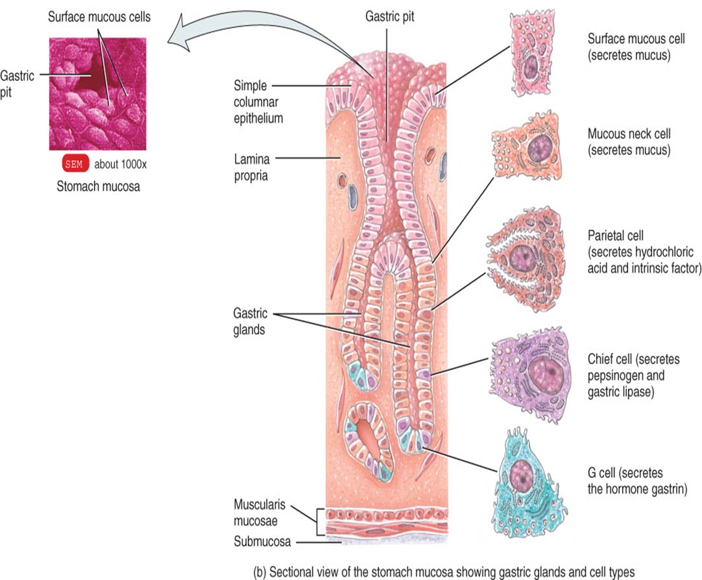
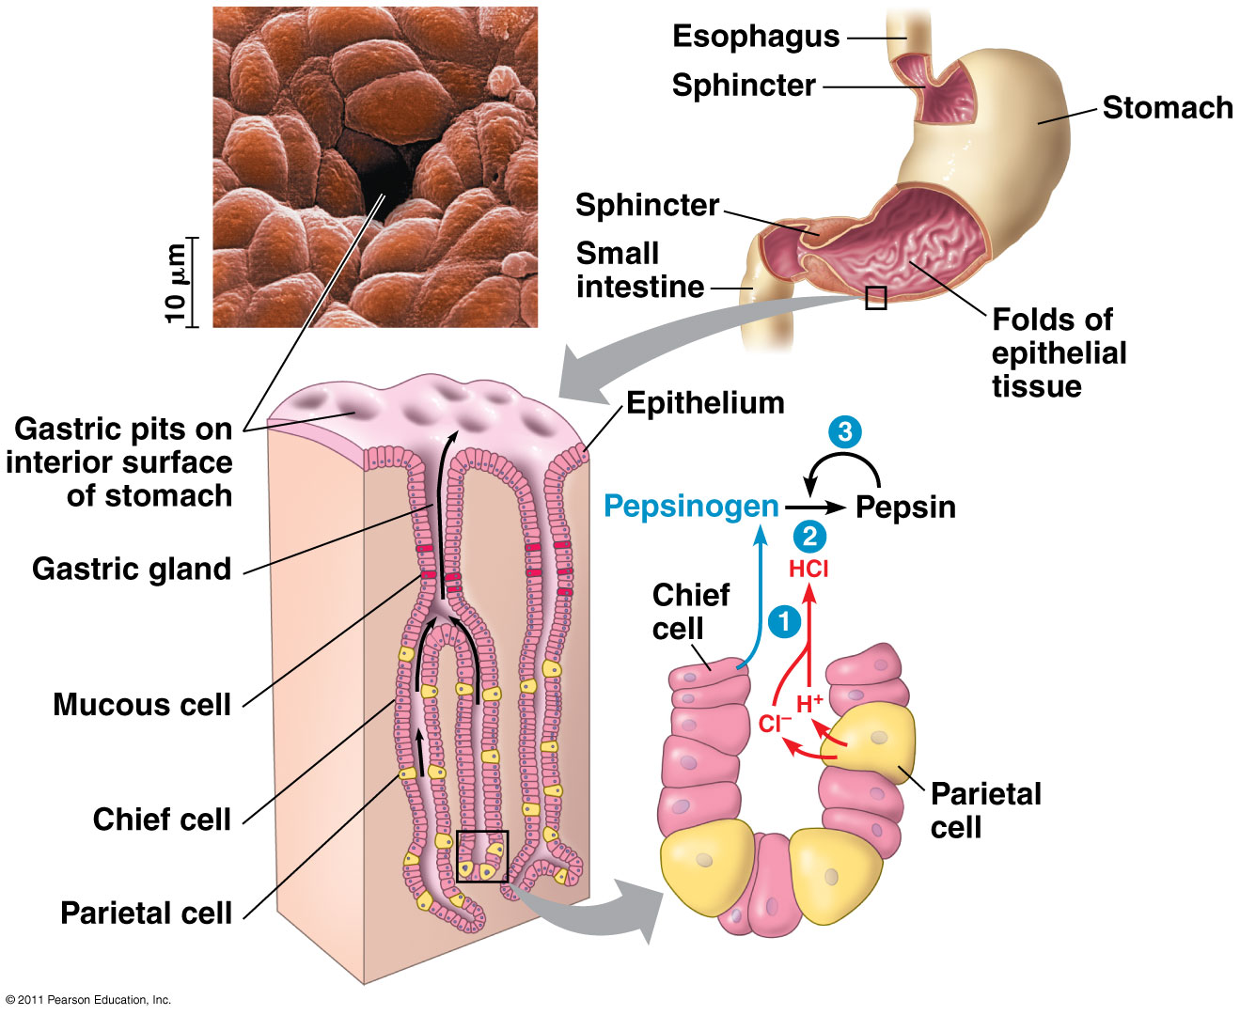
Cont.
Only in Females’ Slides
تخيلوا القاستريك بتز مثل فتحة البير صغيرة من برا ومن جوا هيوج كيفيتي وتطلع السيكريشنز منها
الببسينوجين ما يقدر يشتغل من نفسه ، يحتاج ان الاتش سي ال يكسره الى ببسين اللي هو عبارة عن انزايم قوي فيقدر يرجع يسوي اكتيفيشن لنفسه !
احفظوا شكلها وان فيها canaliculi

Slide 20
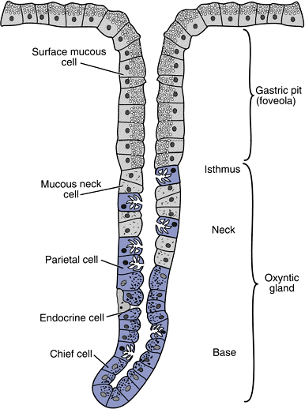
Oxyntic Gland
Only in Males’ Slides
Structure of a Gastric Oxyntic Gland:
Parietal cells are the most distinctive cells in the stomach. Their structure is unique in that they have intracellular canaliculi as well as an abundance of mitochondria and ER.
This network consists of clefts and canals that are continuous with the lumen of the oxyntic gland.
HCl is secreted across the parietal cell microvillar membrane and flows out of the intracellular canaliculi into the oxyntic gland lumen.
The surface mucous cells line the entire surface of the gastric mucosa and the openings of the cardiac, pyloric, and oxyntic glands.
These cells secrete mucus and HCO₃⁻ to protect the gastric surface from the acidic environment of the stomach.
The distinguishing characteristic of a surface mucous cell is the presence of numerous mucus granules at its apex.

Slide 21
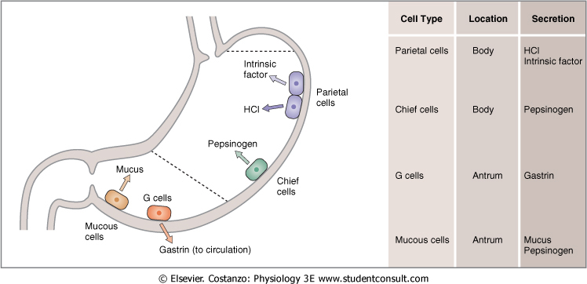
Gastric Cells & Gastric juice
The Normal Locations of Gastric Cells:
Only in Males’ Slides
HCL
The most important. The only source for it in the body is parietal cells.
Pepsinogen
Gastric juice
Electrolytes
Intrinsic factor
Mucus (mucus gel layer)

Slide 22
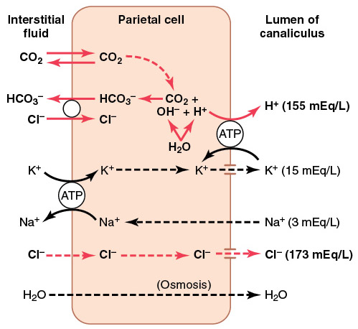
Hydrochloric acid secretion
Only in Males’ Slides
The Notes here is very Important
Mechanism for secretion of hydrochloric acid:
Chloride ion is actively transported from the cytoplasm of the parietal cell into the lumen of the canaliculus and sodium ions are actively transported out of the canaliculus into the cytoplasm of the parietal cell.
Water becomes dissociated into hydrogen ions and hydroxyl ions in the cell cytoplasm.
The hydrogen ions are then actively secreted into the canaliculus in exchange for potassium ions
Carbon dioxide, either formed during metabolism in the cell or entering the cell from the blood, combines under the influence of carbonic anhydrase with the hydroxyl ions to form bicarbonate ions. These then diffuse out of the cell cytoplasm into the extracellular fluid in exchange for chloride ions that enter the cell
CO2 + H2O in the presence of carbonic anhydrase give> H2CO3-.
H2CO3- will break down to> HCO2 + H+.
HCO2> will be excreted into the blood in exchange with Cl, so the blood pH around the stomach will increase (alkaline tide).
H+> will be secreted towards the lumen via K and H+ pump (exchanger) , which depends on ATP and the concentration of K in the lumen.
How do we get K? by 1.Na and K pump 2.K has the ability to leave the cell into the lumen actively, Cl also has the ability to leave the cell into the lumen actively.
To maintain the osmolarity water will follow to the lumen.
End results: H+ and Cl will be secreted into the lumen of the stomach.

Slide 23
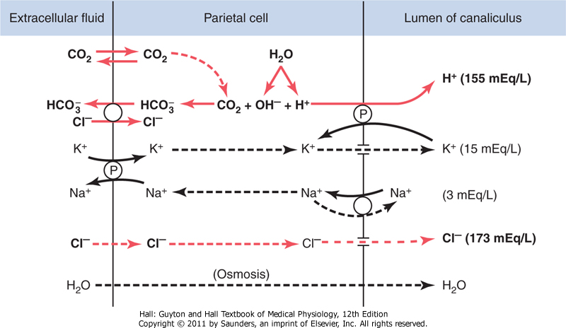
Cont.
Mechanism of HCl production:
Only in Males’ Slides
Only in Females’ Slides
شرح الصورة في السلايد الجاي
Postulated mechanism for secretion of hydrochloric acid.
The points labeled "P" indicate active pumps, and the dashed lines represent free diffusion and osmosis.
Depends on H/K ATPase
Inhibited by: omeprazole
H/K pump depends on [K]_{out}
[HCl] drives water into gastric content to maintain osmolality
During gastric acid secretion: amount of HCO₃⁻ in blood = amount of HCl being secreted
Alkaline tide
It means that the blood near parietal cells become alkaline

Slide 24
Explanation
بسم الله نبدأ ☺
اول شيء يدخل ثاني أكسيد الكربون للخلية عن طريق الديفيوجن (السهم اللي طالع برا الخلية هذا ثاني أكسيد الكربون الطالع نتيجة الميتابوليزم جوا الخلية).
- داخل الخلية : ثاني أكسيد الكربون راح يتحد مع الماء (عن طريق الكاربونيك انهايدريز)عشان يعطيني بيكاربونيت + هيدروجين ايون.
- تركيز البيكاربونيت جوا الخلية راح يكون عالي فيطلع برا الخلية جهة الاكستراسيليولار فلويد طبيعيا بالتبادل مع الكلورايد.
- تذكرون الهيدروجين اللي تكون ؟ راح يطلع الحين برا الخلية للكاناليكيولاي عشان يبدا يكون الاتش سي ال ، لكن تركيز الهيدروجين في الكاناليكيولاي عالي جداً وما يقدر يستقبل زيادة هيدروجين فنحتاج اكتف بمب عشان نوصله هناك (هيدروجين/بوتاسيوم بمب).
- راح يطلع الهيدروجين ويدخل البوتاسيوم ، لاحظوا ان البوتاسيوم جالس يدخل للخلية من جهتين من الكاناليكيولاي ومن الاكستراسيلولار فلويد وكلهم بطريقة اكتف (لأن تركيز البوتاسيوم بالخلية حيكون عالي جدا فلازم يكون اكتف).
- الحين البوتاسيوم انحبس جوا الخلية ومن الجهتين مسكر عليه ، وزيادة على كذا انه كل شوي يزيد فما يلاقي حل غير انه يحاول يتخبى جنب الاكتف بمب حقت الهيدروجين ويحاول يطلع للكاناليكيولاي (احفظوها ان الهيدروجين طيب وحبوب ومو بصرامة الصوديوم فيحاول يخليه يمشيها هالمرة ☺).
- البوتاسيوم للأسف ما يمديه يطلع للكاناليكيولاي ، الا تمسكه البمب و تدخله ثاني جوا و تطلع الهيدروجين برا ، و تستمر الدورة الى مالا نهاية (الهيدروجين يبغى يطلع من الكاناليكيولاي و البوتاسيوم يتمنى يدخلها).
- الكلورايد اموره سهالات فيمر على كل الحوسة هذي و يطلع مثل ما دخل.
الماء راح يطلع من الخلية بسبب كثرة الاملاح جواها عن طريق الاوزموزيز و يروح للكاناليكيولاي ، وبكذا تكمل مكونات الاتش سي ال.
الحمدلله خلصنا

Slide 25
Neural and Hormonal Control
Only in Males’ Slides
Gastric secretion is under neural and hormonal control.
Gastric acid secretion is mediated through neural and hormonal pathways.
Vagus nerve stimulation is the → neural effector.
Histamine and gastrin are the → hormonal effectors.
Parietal cells possess special histamine receptors, h₂ receptors, whose stimulation results in increased acid secretion.
Special neuroendocrine cells of the stomach, known as enterochromaffinlike (ECL) cells, are believed to be the source of this histamine.
They are located mostly in the acid-secreting regions of the stomach.
The mechanisms that stimulate the ecl cells to release histamine are poorly understood.
The effectiveness of cimetidine, (a h₂ blocker) in reducing acid secretion has indirectly demonstrated the importance of histamine as an effector of gastric acid secretion.
H₂ blockers are commonly used for the treatment of peptic ulcer disease or gastroesophageal reflux disease.

Slide 26
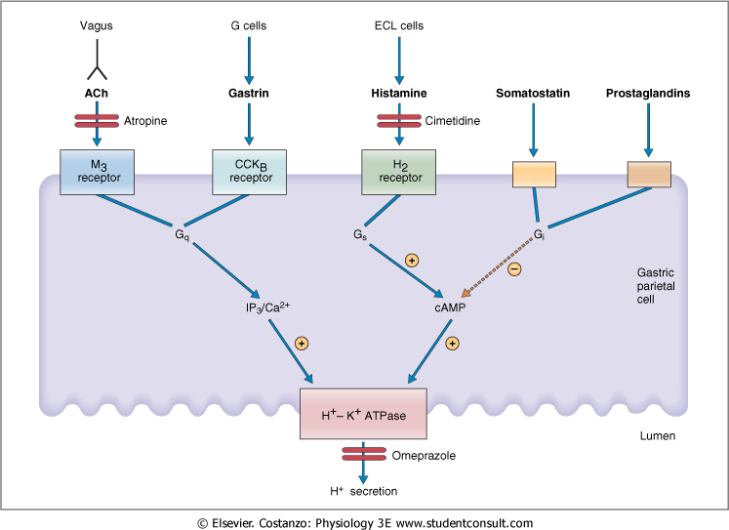
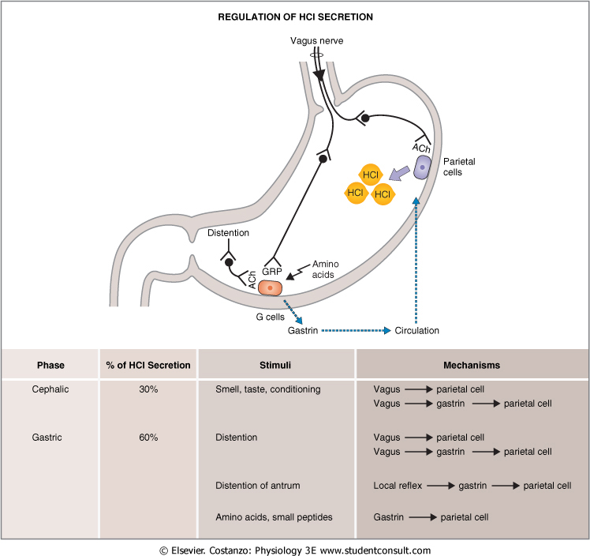
Cont.
The Notes here is very Important
Vagus nerve (neural effector) either by:
Releasing ach (direct activation of parietal cells).
By releasing gastrin releasing peptide, GRP
(indirect activation).
Gastrin (hormonal effector).
Enterochromaffin like cells release histamine.
Activates h₂ receptor (parietal cells)
Increases acid secretion.
Agents that stimulate and inhibit H⁺ secretion by gastric parietal cells.
Neural activation (direct).
Hormonal activation (indirect), gastrin works on CCKB receptor because they are from the the same family ”you have to know this its even important for the SMLE”. Gastrin releasing peptide is a neurotransmitter which is released in the presence of proteins or distention of the stomach.
Histamine you have to know its H2 receptor.
There are different stimuli that activate parietal cells witch are:
Ach from vagus activates M3 receptor.
Gastrin from G cells activates CCKB receptor .
Histamine from ECL cells activates H2 receptor.
These activators will stimulate H/K Pump and therefore, increased acid secretion.
On the other hand, there are stimuli that inhibit parietal cells witch are:
Somatostatin from D cells.
Prostaglandins from arachidonic acid metabolism.
These inhibitors will reduce cAMP witch will inhibit H/K Pump and therefore, decreased acid secretion.

Slide 27
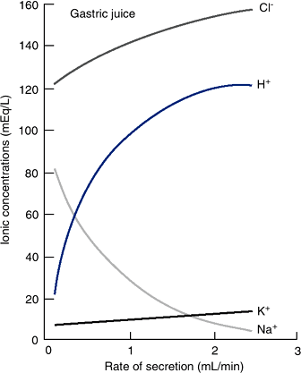
Rate of Secretion
Only in Males’ Slides
At a low secretion rate, gastric juice contains:
high concentrations of Na⁺ and Cl⁻
low concentrations of K⁺ and H⁺.
When the rate of secretion increases:
the concentration of Na⁺ decreases
whereas that of H⁺ increases significantly.
Also coupled with this increase in gastric secretion is an increase in Cl⁻ concentration.
To understand the changes in electrolyte composition of gastric juice at different secretion rates, remember that gastric juice is derived from the secretions of two major sources:
parietal cells.
nonparietal cells.
Secretion from nonparietal cells is probably constant; therefore, it is parietal secretion (HCl secretion) that contributes mainly to the changes in electrolyte composition with higher secretion rates.
In gastric secretion, increased rate of secretion is better for digestion. Opposite to slivery glands , increased rate of secretion isn’t beneficial for digestion
-Low secretion rate (between meals) - high NaCl.
-High secretion rate (after a meal)- high HCl.
-Always isotonic.
Because of water secretion , Gastric secretion is always isotonic.

Slide 28
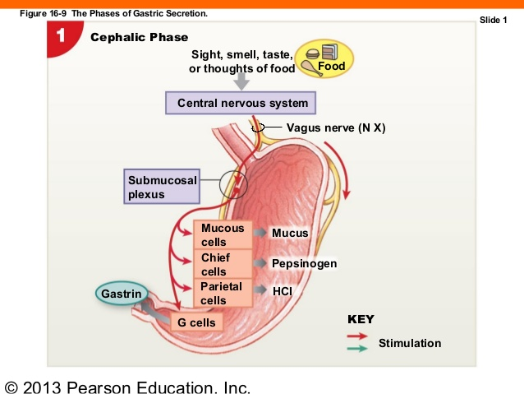
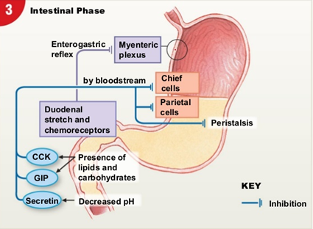
The stimulation of acid secretion resulting from the ingestion of food can be divided into three phases: the cephalic phase, the gastric phase, and the intestinal phase
1. The cephalic phase (الرئيسية أو المركزية) |  | 2. The gastric phase (The most important phase) | 3. During the intestinal phase
Only in Males’ Slides | -involves the central nervous system. -Smelling, chewing, and swallowing food send impulses via the vagus nerves to the parietal and G cells in the stomach: 1-The nerve endings release Ach, which directly stimulates acid secretion from parietal cells. 2-The nerves also release gastrin-releasing peptide (GRP), → which stimulates G cells to release gastrin, → indirectly stimulating parietal cell acid secretion. | -is mainly a result of gastric distention and chemical agents such as digested proteins. 1-Distention of the stomach stimulates mechanoreceptors, which stimulate the parietal cells directly through: A- short local (enteric) reflexes. B- long vago-vagal reflexes. 2-Digested proteins in the stomach are also potent simulators of gastric acid secretion, an effect mediated through gastrin release. -Several other chemicals, such as alcohol and caffeine, stimulate gastric acid secretion through mechanisms that are not well understood. | -protein digestion products in the duodenum stimulate gastric acid secretion through the action of the circulating amino acids on the parietal cells. -Distention of the small intestine, probably via the release of the hormone entero-oxyntin from intestinal endocrine cells, stimulates acid secretion. When there are proteins or distention within the intestines
Only in females’ Slides
Inhibition of Acid Secretion
Inhibitory hormones (Enterogastrones)
Somatostatin (D-cells) in antrum | Secretin (S-cells) in duodenum | Glucose-dependent insulinotropic peptide (GIP) in duodenum

Slide 29
Summary of the Phases (from slides)
Only in Males’ Slides
The percentage here is very Important
Cephalic phase (30%):
So chewing gum increases HCl production, Because of Vagus .
Smelling, Chewing and swallowing Stimulate 1-parietal, 2-G-Cells (via GRP)
Gastric phase (60%):
Firing of all the reflexes, mediators are: vagus, gastrin, histamine
gastric distention
Intestinal phase (10%):
By proteins and distention in releases entero-oxyntin hormone which increases HCl, its not mentioned in the schedule because it’s a local hormone.
digested proteins
proteins

Slide 30
Hormonal Control of Gastrointestinal Motility (GI Peptides)
Only in Males’ Slidesc
احفظوا الجدول زي اسمكم
Hormone | Site of secretion | Stimuli for secretion | Actions
Gastrin | G cells of the antrum, duodenum and jejunum. | Protein Distention of the stomach Vagal stimulation (GRP) Acid inhibits release | Stimulates: gastric H⁺ secretion and growth of gastric mucosa.
Cholecystokinin (CCK) | I cells of the duodenum, jejunum, and ileum. | Protein Fatty acids Acids | Stimulates: pancreatic enzyme secretion, pancreatic HCO₃⁻ secretion, gallbladder contraction, growth of the exocrine pancreas, and relaxation of the sphincter of oddi. Inhibits: gastric emptying.
Secretin | S cells of the duodenum, jejunum, and ileum | Acids and fat in the duodenum. | Stimulates: pepsin secretion, pancreatic HCO₃⁻ secretion,biliary HCO₃⁻ secretion, and growth of the exocrine pancreas. Inhibits: gastric H⁺ secretion.
Glucose-dependent insulinotropic peptide (GIP) | K cells of the duodenum and jejunum. | Protein Fatty acids Oral glucose | Stimulates: insulin secretion from pancreatic β cells. Inhibits: gastric H⁺ secretion.
Motilin | M cells of the duodenum and jejunum | Fat Acid Nerve | Stimulates: Gastric motility Intestinal motility

Slide 31
Thank you!
اعمل لترسم بسمة، اعمل لتمسح دمعة، اعمل و أنت تعلم أن الله لا يضيع أجر من أحسن عملا.
The Physiology 436 Team:
Team Leaders:
Laila Mathkour
Mohammad Alayed
Female Members:
Ghada Almazrou
Nada Aldakheel
Nouf AlAmari
Male Members:
Hassan alshammari
Abdullah Alsaeed
Contact us:
References:
2017-2018 Dr. Hana Alzamel’s Lecture.
2017-2018 Dr. Mohammed Al Zoghaibi’s Lecture.
Guyton and Hall Textbook of Medical Physiology (Thirteenth Edition.)
اللهم اني استودعتك ما حفظت وما قرأت وما فهمت، فرده لي وقت حاجتي إليه يا من لا تضيع عنده الودائع.

