Slide 1
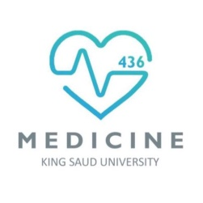
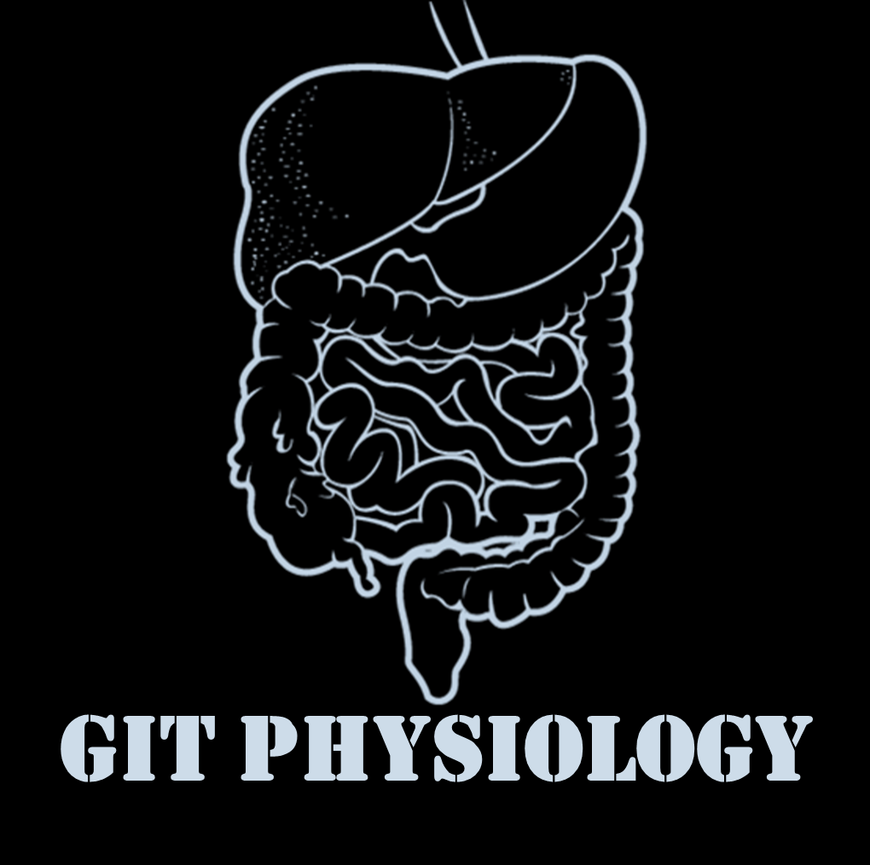
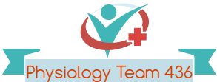
Text
Only in Females’ slide
Only in Males’ slides
Important
Numbers
Doctor notes
Notes and explanation
Lecture No.5
“Great Things Never Came From Comfort Zones”

Slide 2
Physiology of The Small Intestine
Objectives:
1- Motility in the small intestine.
2- Control of intestinal motility.
3- Secretions of the small intestine.
4- Digestion of carbohydrates, proteins and fats.
5- Basic principles of gastrointestinal absorption.
Absorption of carbohydrates.
Absorption of proteins.
Absorption of fats.
Absorption and secretion of electrolytes and water.

Slide 3
الأرقام لا تُحفظ ☺
The movements of the small intestine can be divided into: ( ادرسوها بالترتيب، انتهوا من كل نوع اذا كان مكتوب أن له تكملة وبعدين روحوا للي بعده، نوع 2 مشروح في السلايد القادم.. أول نوعين أخذناها بالمحاضرة الأولى والثلاثة الباقية جديدة)
1. Segmenting (Mixing) contractions | 2. Propulsive contractions (Peristalsis) | 3. Migrating motor complex Like peristalsis but stronger. Inter-digestive period: period between two meals. | 4. Antiperistalsis | 5. Peristaltic rush
When a portion of small intestine becomes distended (food bolus stimulates it) which is usually the stimulus, the segmentation contraction of circular smooth muscle is activated by ENS (enteric nervous system) to divide the intestine into spaced segments which last for fraction of min, and have the appearance of a chain of sausages. As one set of segmentation contractions relaxes, a new set often begins at points between the previous ones. The segmentation contractions become weak when the excitatory activity of ens is blocked by the drug atropine. The significance of segmentation contractions: Blend different juices with the chyme. Bring products of digestion in contact with absorptive surfaces. وبكذا خلصنا أول نوع! | النوع هذا مشروح في السلايد الجاي | Associated with hunger, but it’s not responsible for the hunger feelings. Begins from antrum by motilin. to the terminal ilium. It is bursts of depolarization accompanied by peristaltic contraction that begins in empty stomach during inter-digestive period (after absorption occurs). Travels a long whole length of small intestine to reach ileocaecal valve after 1.5-2 h. where it disappears. a new wave of MMC starts. The activity of MMC terminates as soon as food is ingested (Only after disappearance of the first motor complex). The function of MMC is to propel any remnants (undigested food residues, dead mucosal cells and bacteria) in stomach & small intestine into colon during the inter-digestive period (Clearing and cleaning). Regulated by autonomic nerves and by release of hormone motilin (Released from intestinal mucosa). Inter-digestive period = being fasting. We don't find MMC in colon ! وبكذا خلصنا ثالث نوع! | The normal peristalsis occurs from mouth to anus, but here will occur in the opposite direction. A wave of contraction in the alimentary canal that passes in an oral (i.e. upward or backwards) direction and force the contents in the opposite direction to the normal. Occurs between: Stomach and duodenum to allow more time for giving time to neutralization of chyme. Ileum and cecum to allow time for absorption to giving time to absorption. وبكذا خلصنا رابع نوع! | Powerful rapid peristalsis due to intense irritation of intestinal mucosa (as in infectious diarrhea) (Abnormal contraction (to remove all the remaining pathogenic bacteria and toxins). Initiated mainly by extrinsic nervous reflexes to brain stem and back to gut (long vagal reflex). Sweeps the contents of intestine into the colon without much absorption leading to diarrhea and thereby relieving the small intestine of irritative chyme or excessive distension. It happens when there is chemical irritation or mechanical irritation. We can't stop it مثل لما يكون الواحد في الطائرة ويحتاج يروح الحمام حتى لو هو وقت الإقلاع! وبكذا خلصنا خامس وآخر نوع!
Chyme: ( مثل عجينة الكيك)
Multiple points of contraction.
this type Doesn't care about propulsion.
3

Slide 4
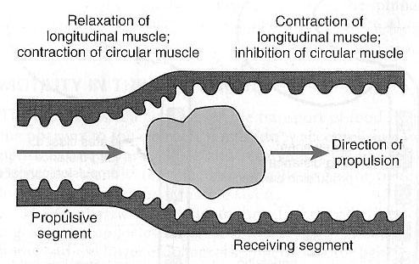
Propulsive Movements (Peristalsis)
It is a contraction ring appears around gut, then moves forward (The aim is to push the bolus of food).
Usual stimulus is distention نفس حركة الأصابع(When you do constriction ring then propagate along the whole length).
Organizes propulsion of material over variable distances within the intestinal lumen.
It can occur in any part of the small intestine, at a velocity of 0.5 to 2.0 cm/sec.
They are faster in the proximal intestine and slower in the terminal intestine.
They normally are very weak after traveling only 3 to 5 centimeters, and the net movement along the small intestine normally averages only 1 cm/min. This means that 3 to 5 hours are required for passage of chyme from the pylorus to the ileocecal valve.
Myenteric plexus is important for these movements.
It can be blocked by the drug atropine (Anti-cholinergic).
Receiving segment:
Contraction (longitudinal muscle).
Relaxation (circular muscle).
Propulsive segment:
Contraction (circular muscle).
Relaxation (longitudinal muscle).
Animation

Slide 5
Peristalsis Vs Segmentation
Only in Females’ Slides
Peristalsis
Segmentation
Animation
Animation
Mixing include many constrictions ring which divide the lobe of the intestine into segments, then those series of segments disappear then the series start from the peristalsis

Slide 6
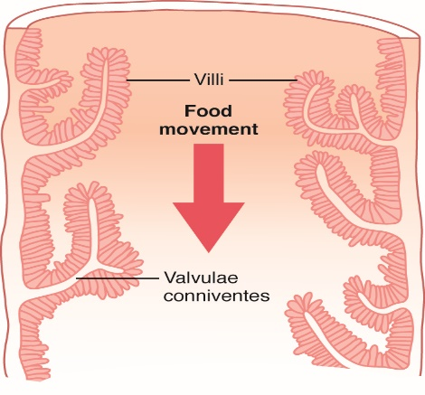
Villi
Movement of the villi
Absorptive Surface of the Small Intestinal Mucosa Villi
The villous movement consists of fast shortening and slow lengthening as well as side to side movements.
Villous contractions are initiated by local nervous reflexes (From entric nervous system) in response to chyme in small intestine.
They facilitate absorption and lymph flow from central lacteals into lymphatic system + secretion of enzymes.
They are stimulated by villikinin (Stimulates movement of intestinal villi therefore stimulates absorption) hormone released by intestinal mucosa when it comes in contact with digestive products.
Movements Caused by the Muscularis Mucosae and Muscle Fibers of the Villi. The muscularis mucosae can cause short folds to appear in the intestinal mucosa. In addition,
individual fibers from this muscle extend into the intestinal villi and cause them to contract intermittently. The mucosal folds increase the surface area exposed to the chyme, thereby increasing absorption.
The absorptive surface of the small intestinal mucosa, showing many folds called valvulae conniventes (villi).
They increase the surface area of the absorptive mucosa about 3 folds .
They are well developed in the duodenum and jejunum.
The presence of villi on the mucosal surface enhances the total absorptive area another 10 fold.
The epithelial cell on each villus is characterized by a brush border, consisting of as many as 1000 microvilli protruding into the intestinal chyme (increases the surface area another 20 fold).
The brush border has the most significant role in increasing the surface area.
All these increase the intestinal surface 600x (Provides the surface area equivalent to a tennis court).
Longitudinal section of the small intestine, showing the valvulae conniventes covered by villi.
Brush border of a GIT epithelial cell

Slide 7
Control of intestinal motility
Gastrin and CCK are from the same family so often have the same action.
Secretin and glucagon are from the same family (biochemical family).
Here stimulate = increase.
السيمباثاتيك يركز على الإنزايم والبارسمثبتك يؤثر اكثر على السكرشنز الاخرى ويحفز أيضاً الغدد (منها اللعابية إليّ تفرز الامايليز)
Control of intestinal motility
1. Neural control | 2. Hormonal control
Vagal (parasympathetic) excitation increases intestinal and villous movements. Stimulate the contraction of the wall & relaxation of the sphincter. | Gastrin, CCK (cholecystokinin) , insulin and serotonin stimulate intestinal motility. Gastrin and CCK relax ileocaecal sphincter. يعني يبغون الماتيريلز تروح للقولون
Sympathetic excitation decreases intestinal and villous movements. | Motilin secreted from duodenum (mucosa) stimulates intestinal motility and regulates MMC (migrating motor complex). حق ال MMC لما يكون fasting
Gastroileal reflex: (initiated by the stomach (gastric distention) and finish in the ileum) Initiated by gastric distension. Impulses are conducted through myenteric plexus to initiate a fast peristaltic wave passing to the ileum. The ileocaecal valve relaxes allowing chyme to pass into cecum (to prepare the ileum to receive new food). This reflex is mediated by vagus nerve. لما يصيرdistintion of stomach يصير معها increase motility of illum قارنوا مع الgastroceliac reflex لكن يختلف التحكم بالرفليكس.. زبدة هذه النقطة: إذا أكلت الأخضر واليابس وصارت المعدة فُل، ترسل تنبيه للأمعاءالدقيقة أنه استعدي جايّك ضيف، وبالعادة لما يجي الأم ضيف مفاجئ تتحول إلى سوبرمان و تفضي كل المجلس بثواني! الأمعاء الدقيقة نفس الشيء تفضي كل اللي فيها إلى الأمعاء الغليظة لإستقبال الوجبة ☺ | Secretin and glucagon inhibit intestinal motility and contract ileocaecal sphincter (like sympathetic effect). هنا عكس الـ CCK &gastrine
 | Villikinin stimulates movement of the villi. its a local hormone
Leptin and Grilin are hormones to feel hunger

Slide 8
Secretions of the small intestine
1.Secretion of mucus Mucin, bicarbonate. No digestive enzymes only protection | 2.Secretion of intestinal juices (succus entericus)
By brunner’s glands in the duodenum Brunner respond to secretin | By the crypts of Lieberkühn Crypts of Lieberkühn are stricter of two types of cell, and they are more in the duodenum and first part of the jejunum.
Stimulated by secretin (Mucin, bicarbonate. To neutrlize the acidic chyme by the mucos), tactile and vagal stimulation. | Stimulated by: A. Distension, tactile and irritating stimuli. B. Hormones as gastrin, secretin, CCK , glucagons , enterocrinin. C. Sympathetic system inhibits the intestinal secretion.
Brunner’s glands are located in the wall of the first few centimeters of the duodenum. They secrete large amounts of alkaline mucus, which contains a large amount of bicarbonate ions, in response to: Irritating stimuli on the duodenal mucosa. Vagal stimulation. Secretin. Mucus protects the mucosa. حموضة المعدة تحفز افراز ھذا الھرمون وھذا الھرمون یحفز افراز ھذي الغدة للميوكس القاعدي اللي یحمي الغشاء من حموضة المعدة وبطّتنا بطّت بطّتكم ☺ | - Crypts of lieberkühn are small pits which lie between intestinal villi. - Volume: 1800 ml/day. - Ph: 7.5-8. It participates in the neutralization of acid chyme delivered from stomach. - Composition: 0.6 % organic (Enzymes and mucus), 1 % inorganic (Electrolytes) substance. Most of the enzymes Are found either in the brush border (by direct contact) or in the cytoplasm of the enterocytes. The enzymes that are actually secreted into the lumen are enteropeptidase (Aminopeptidase) and amylase. The rest of the enzymes secreted from the brush boareder or from the enteric cell while the digestion occur in the lumen.
Inhibited by sympathetic stimulation. Sympathetic inhibit the gland | The surfaces of both the crypts and the villi are covered by an epithelium composed of 2 types of cells: Goblet cells, secrete mucus, same as Brunner’s glands. Enterocytes, secrete large quantities of H₂O and electrolytes and over the surfaces of adjacent villi, reabsorb H₂O , electrolytes & end products of digestion. We call it also "transporter cells" لأنها هي تنقل النيوترنز للفسلز The enterocytes covering the intestinal microvilli brush border of the mucosa contain digestive enzymes. These enzymes are the following: (these are a brush border enzymes / can be synthesis by enterocytes) Aminopeptidases, oligopeptidases, intracellular di and tripeptidases for splitting small peptides into amino acids. Four enzymes: sucrase, maltase, isomaltase, and lactase to split disaccharides into monosaccharides. Small amounts of intestinal lipase for splitting neutral fats into glycerol and fatty acids. Nucleotidases for splitting nucleotides into purine and pyrimidine bases, phosphoric acid and pentose sugar.
Only in Females’ Slides
Like bile and pancreatic secretion
السيمباثاتيك يركز على الإنزايم والبارسمثبتك يؤثر اكثر على السكرشنز الاخرى ويحفز أيضاً الغدد (منها اللعابية إليّ تفرز الامايليز)

Slide 9
Carbohydrates
Digestion of Carbohydrates Usually parasympathetic controls aqueous secretion not enzymatic secretion, except for α-amylase (from pancreas and saliva) it is controlled by parasympathetic . |  | Absorption of Carbohydrates
In the mouth and stomach | In the small intestine | All the carbohydrates in the food are absorbed in the form of monosaccharides; only a small fraction are absorbed as disaccharides. Glucose and galactose absorption occurs in a co-transport mode with active transport of na+ (secondary active transport) (means they need energy by being transported with another molecule). That’s why the usually mix glucose with Na in patient’s saline Fructose is independent on na+ but it transports in luminal membrane via facilitated diffusion. Pentose is transported by passive diffusion (Slowest, no energy or carrier)
The ptyalin (an α-amylase) enzyme in saliva hydrolyzes starch into the disaccharide maltose and other small polymers of glucose. The starch digestion sometimes continues in the fundus and body of the stomach for as long as 1 hour before the food becomes mixed with the stomach secretions. | Digestion by Pancreatic Amylase. Pancreatic secretion has α-amylase that is almost identical in its function with the α-amylase of saliva but is several times as powerful. Therefore, within 15 to 30 minutes after the chyme empties from the stomach into the duodenum and mixes with pancreatic juice, virtually all the carbohydrates will have become digested. The carbohydrates are almost totally converted into maltose and/or other very small glucose polymers before passing beyond the duodenum or upper jejunum.
Hydrolysis of Disaccharides by Intestinal Enzymes
The enterocytes lining the villi of the small intestine contain four enzymes (lactase, sucrase, maltase, and α-dextrinase), which are capable of splitting the disaccharides lactose, sucrose, and maltose, plus other small glucose polymers, into their constituent monosaccharides. These enzymes are located in the enterocytes covering the intestinal microvilli brush border, so that the disaccharides are digested as they come in contact with these enterocytes.
Alpha amylase can be released by parotid (only alpha)
Basal boarder, contains 3Na/2K pump leading to decreased Na in the cell

Slide 10
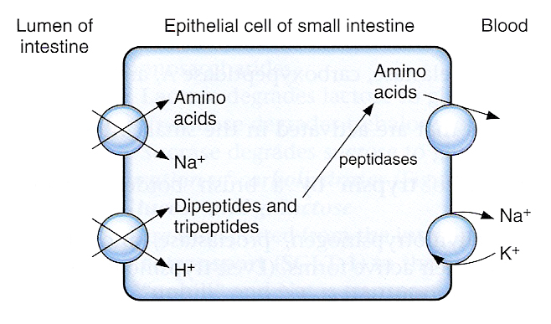
Cont.
The names of transporters and substances should be memorized.
Notice that there are different carrier protein in the luminal and basolateral surface.
SGLT1 is Na+ co-transporter.

Slide 11
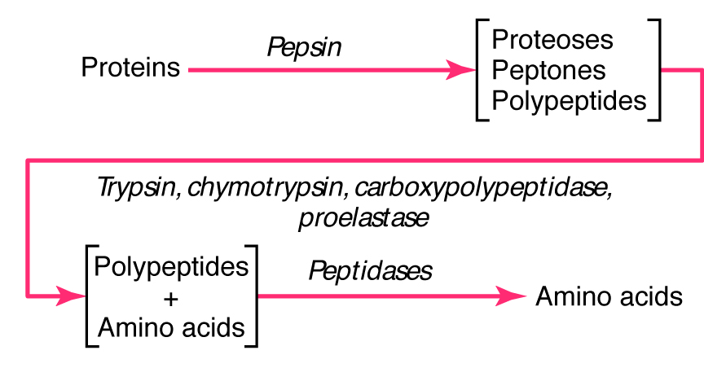
Proteins
Digestion of Proteins |  | Absorption of Proteins
In the stomach (Only in males’ slides) | By pancreatic secretions | Proteins are absorbed in the form of dipeptides, tri-peptides, and a few free amino acids. D- AA are transported by passive diffusion. L- AA are transported by secondary active transport. ( D-AA + L-AA, The isomers, the mirror structures for each other) Di and tripeptides cross the brush border by active transport protein carrier. Then, they are hydrolyzed by brush border and cytoplasmic oligopeptidases. AA leaves the cell at the basolateral membrane by facilitated transport.
Pepsin is the important peptic enzyme of the stomach (active at a pH=2.0 - 3.0 and is inactive at a pH above about 5.0). The pH of the stomach averages around 2.0 - 3.0. One of the important features of pepsin digestion is its ability to digest the protein collagen. Collagen is a major constituent of the intercellular connective tissue of meats; therefore, for the digestive enzymes of the digestive tract to penetrate meats and digest the other meat proteins, it is first necessary that the collagen fibers be digested. Pepsin only initiates the process of protein digestion, usually providing only 10 to 20 percent of the total protein digestion. Digestion of Proteins start in the stomach. Pepsinogen is the only enzyme need acidity to be activated. pepsin act on the most aggressive type of protein found in meat < collagen. 15% of protein digestion is by pepsin in stomach. | Most protein digestion occurs in the duodenum and jejunum by aminopeptidases, oligopeptidases, intracellular di and tripeptidases. Both trypsin and chymotrypsin split protein molecules into small polypeptides; carboxypolypeptidase then cleaves individual AA from the carboxyl ends of the polypeptides. Proelastase is converted into elastase, which then digests elastin fibers that partially hold meats together. Only a small percentage of the proteins are digested all the way to their constituent AA by the pancreatic juices. Most remain as dipeptides and tripeptides to be digested by Peptidases in the Enterocytes mainly in the duodenum and jejunum. Gastric phase release 5-10% of pancreatic enzymes (IMP).

Slide 12
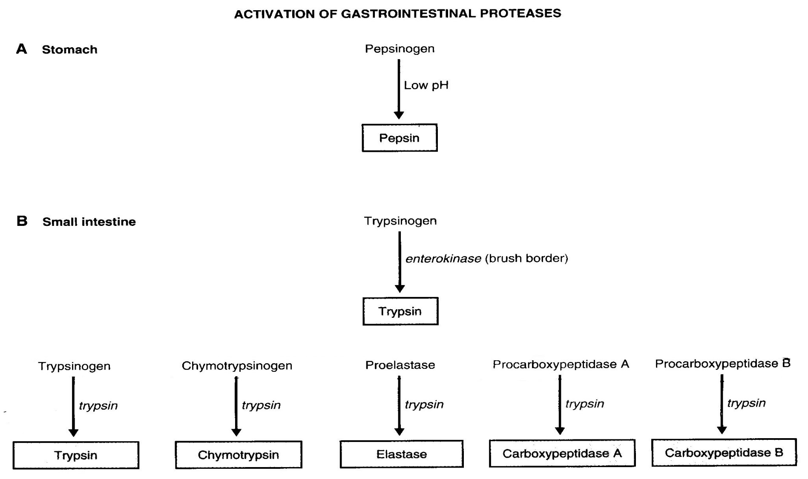
Activation of Gastrointestinal Proteases
Only in Males’ Slides

Slide 13
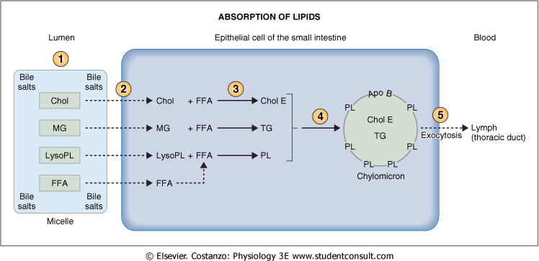
Fats
Digestion of Fats in the Intestine | Emulsification of Fat by Bile Acids Emulsification= Breaking fat gloubules into smaller parts by decreasing surface tension | Absorption of Fats Also same mechanism for cholesterol and fat soluble vitamins
Less than 10 % of triglycerides is digested in the stomach by lingual lipase. All fat digestion occurs in the small intestine. | Break the fat globules into very small sizes under the influence of bile salts , so that the water-soluble digestive enzymes can act on the globule surfaces The polar parts (the points where ionization occurs in water) of the bile salts and lecithin molecules are highly soluble in water. So, they are amphipathic molecules. The major function of the bile salts and lecithin, especially the lecithin, in the bile is to make the fat globules readily fragmentable by agitation with the water in the small bowel (emulsification of the fat). | In the presence of an abundance of bile micelles, about 97% of the fat is absorbed; in the absence of the bile micelles, only 40 to 50 % can be absorbed. Fatty acids (FA) & monoglycerides (MG) associated with the micelles in lumen of intestine. FA & MG leave micelles and enter epithelial cell by diffusion. FA are used to synthesis triglycerides in agranular endoplasmic reticulum. Fatty globules are combined with proteins to form chylomicrons within Golgi apparatus. Vesicles containing chylomicrons leave epithelial cells by exocytosis and enter a lacteal (lymph capillary). Lymph in the lacteal transport chylomicrons away from the intestine.
Role of Bile Salts to Accelerate Fat Digestion Formation of Micelles
Bile salts have the ability to form micelles, (each bile salt molecule is composed of a sterol nucleus that is fat-soluble and a polar group that is water-soluble. Micelles are small spherical, cylindrical globules 3 to 6 nm in diameter composed of 20 to 40 molecules of bile salt Long chain FA, MG, cholesterol and fat soluble vitamins are incorporated into the interior of the micelle. The polar groups are (-) charged, they allow the entire micelle globule to dissolve in the water of the digestive fluids and to remain in stable solution. The micelles act as a transport medium to carry the monoglycerides and free fatty acids to the brush borders (luminal border) of the intestinal epithelial cells.
Chylomicron > coated with protein.
Micelles > Coated with bile salts.
Apo B is important to form the wall of chylomicrons.
FFA stands for free fatty acids.
13
13

Slide 14
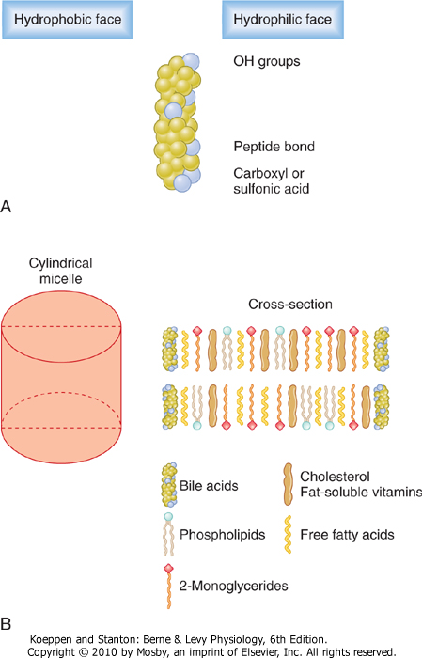
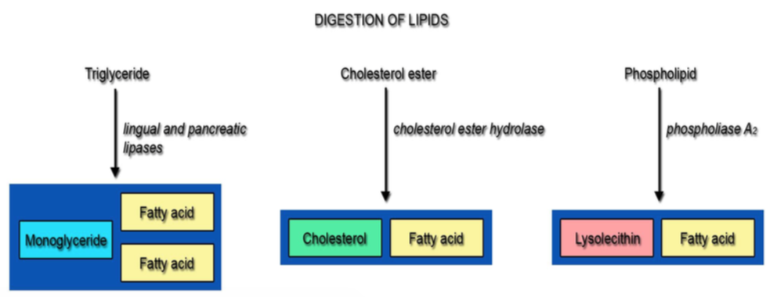
Cont.
Only in Males’ Slides
Lipase can enter the micelle by “co-lipase”, co-lipase comes from intestinal wall.
Digestion of Triglycerides by Pancreatic Lipase
The most important enzyme for digestion of the triglycerides is pancreatic lipase.
End Products of Fat Digestion:
Only in Males’ Slides

Slide 15
Explanation
The First Step in Fat Digestion Is Emulsification by Bile Acids and Lecithin. The first step in fat digestion is physically to break the fat globules into small sizes so that the water-soluble digestive enzymes can act on the globule surfaces. This process is called emulsification of the fat, and it begins by agitation in the stomach to mix the fat with the products of stomach digestion.
Then, most of the emulsification occurs in the duodenum under the influence of bile, the secretion from the liver that does not contain any digestive enzymes. However, bile does contain a large quantity of bile salts, as well as the phospholipid lecithin. Both of these, but especially the lecithin, are extremely important for emulsification of the fat. The polar parts (the points where ionization occurs in water) of the bile salts and lecithin molecules are highly soluble in water, whereas most of the remaining portions of their molecules are highly soluble in fat. Therefore, the fat-soluble portions of these liver secretions dissolve in the surface layer of the fat globules, with the polar portions projecting. The polar projections, in turn, are soluble in the surrounding watery fluids, which greatly decreases the interfacial tension of the fat and makes it soluble as well.
When the interfacial tension of a globule of nonmiscible fluid is low, this nonmiscible fluid, on agitation, can be broken up into many tiny particles far more easily than it can when the interfacial tension is great.
Consequently, a major function of the bile salts and lecithin, especially the lecithin, in the bile is to make the fat globules readily fragmentable by agitation with the water in the small bowel. This action is the same as that of many detergents that are widely used in household cleaners for removing grease.
Each time the diameters of the fat globules are significantly decreased as a result of agitation in the small intestine, the total surface area of the fat increases manyfold. Because the average diameter of the fat particles in the intestine after emulsification has occurred is less than 1 micrometer, this represents an increase of as much as 1000 fold in total surface areas of the fats caused by the emulsification process.
The lipase enzymes are water-soluble compounds and can attack the fat globules only on their surfaces. Consequently, this detergent function of bile salts and lecithin is very important for digestion of fats.
when fats are digested to form monoglycerides and free fatty acids, both of these digestive end products first become dissolved
in the central lipid portions of bile micelles. Because the molecular dimensions of these micelles are only 3 to 6 nanometers in
diameter, and because of their highly charged exterior, they are soluble in chyme. In this form, the monoglycerides and free fatty
acids are carried to the surfaces of the microvilli of the intestinal cell brush border and then penetrate into the recesses among the
moving, agitating microvilli. Here, both the monoglycerides and fatty acids diffuse immediately out of the micelles and into the
interior of the epithelial cells, which is possible because the lipids are also soluble in the epithelial cell membrane. This leaves the
bile micelles still in the chyme, where they function again and again to help absor still more monoglycerides and fatty acids. Thus,
the micelles perform a “ferrying” function that is highly important for fat absorption. In the presence of an abundance of bile
micelles, about 97 per cent of the fat is absorbed; in the absence of the bile micelles, only 40 to 50 per cent can be absorbed. After
entering the epithelial cell, the fatty acids and monoglycerides are taken up by the cell’s smooth endoplasmic reticulum; here, they
are mainly used to form new triglycerides that are subsequently released in the form of chylomicrons through the base of the
epithelial cell, to flow upward through the thoracic lymph duct and empty into the circulating blood.
سبحان الله!

Slide 16
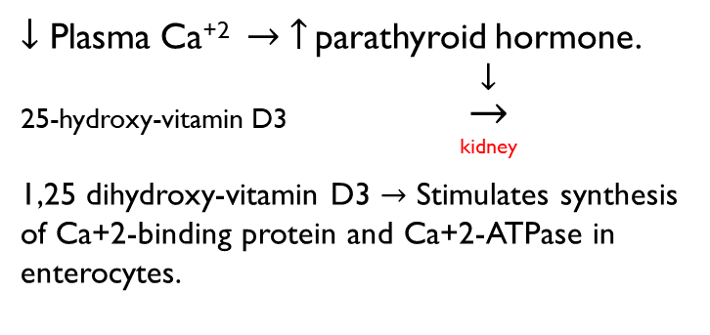
Basic Principles of Gastrointestinal Absorption
Absorption of vitamins | Absorption and secretion of electrolytes and water | Absorption of Na+ |  | Absorption of Cl- | Absorption and secretion of K+ | Ca++Absorption by Enterocytes | Secretion of Bicarbonate Ions in the Ileum
Fat-soluble vitamins (A, D, E, & K) are incorporated into micelles and absorbed along with other lipids. Most water-soluble vitamins (C, B1, B2, B6, and folic acid) are absorbed by Na-dependent co-transport mechanisms. (1+2, Mostly in proximal parts of intestine). Vitamin B12 is absorbed in the ileum and requires Intrinsic factor. Gastrectomy or mucosal damage due to autoimmune disease results in the loss of parietal cells and loss of intrinsic factor > pernicious anemia. Supplement must be given with ingection. | Electrolytes and H₂O may cross intestinal epithelial cells by either cellular or paracellular route. The permeability of the tight junctions varies with the type of epithelium: A tight epithelium is in the colon. Leaky epithelia are the small intestine and gallbladder. Water absorption occurs mainly in the small intestine due to concentration gradient. Transcellular transport > through the cell. paracellular > between 2 cells. | - Na+ moves into the intestinal cells by the following mechanisms: Passive diffusion. Na-glucose or Na-amino acid co-transport. Na-Cl exchange. Na-H exchange. الصوديوم بيروح للدم والهيدروجين لللومين فيزيد الاسيدتي - The next step in the transport process is osmosis of water into the paracellular spaces because a large osmotic gradient has been created by the elevated concentration of ions in the paracellular space. - Aldosterone Greatly Enhances Na+ Absorption: This effect of Aldosterone is especially important in the colon because it allows virtually no loss of NaCl and water. - Once Cl & Na moves the water should move also to maintain osmolarity. - Aldosterone also cause K secretion. |  | Cl- absorption accompanies Na+ absorption by the following mechanisms: Passive diffusion. Na-Cl co-transport. Cl-HCO3 exchange. (هذه مهمة في المحافظة على القاعدية في الاليوم) | - K+ is absorbed in the small intestine by passive diffusion. - K+ secretion in the colon is stimulated by aldosterone. - Excessive loss of K+ in diarrheal fluids causes hypokalemia. - hypokalemia is very dangers. | Without Ca we can't do muscle. 25-hydroxy-vitamin D3 is inactive form, it is activated to 1,25 dihydroxy-vitamin D3 by parathyroid hormone. | The epithelial cells on the surfaces of the villi in the ileum and large intestine have a special capability of secreting bicarbonate ions (HCO3⁻) in exchange for absorption of chloride ions (Cl⁻) This is important because it provides alkaline bicarbonate ions that neutralize acid products formed by bacteria in the large intestine.
Hormonal control of absorption & secretion (only in Females’ Slides)
Hormone |  |  | Action |  | Location
Glucocorticoid |  |  | $$↑\text{absorption} \text{of} \text{H}\text{2}\text{O}\text{ \& }\text{ions}$$ |  | small & large intestine
Somatostatin |  |  | $$↑\text{H}\text{2}\text{O}\text{ \& }\text{ions} \text{absorption}$$ |  | ileum & colon
Epinephrine |  |  | $$↑\text{NaCl} \text{absorption}$$ |  | ileum
Aldosterone |  |  | $$↑\text{synthesis} \text{of} \text{Na}\text{+ }\text{channels}$$ |  | colon

Slide 17
Thank you!
اعمل لترسم بسمة، اعمل لتمسح دمعة، اعمل و أنت تعلم أن الله لا يضيع أجر من أحسن عملا.
The Physiology 436 Team:
Team Leaders:
Laila Mathkour
Mohammad Alayed
Females Members:
Ghada Alhadlaq Leena Alwakeel
Hanin Bashaikh
Ghada Almazrou
Males Members:
Qais Almuhaideb
Abdullatif Alabdullatif
Contact us:
References:
2017-2018 Dr. Hayam Gad’s Lecture.
2017-2018 Dr. Mohammed Al Zoghaibi’s Lecture.
Guyton and Hall Textbook of Medical Physiology (Thirteenth Edition.)
اللهم اني استودعتك ما حفظت وما قرأت وما فهمت، فرده لي وقت حاجتي إليه يا من لا تضيع عنده الودائع.

