Slide 1
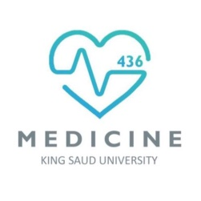
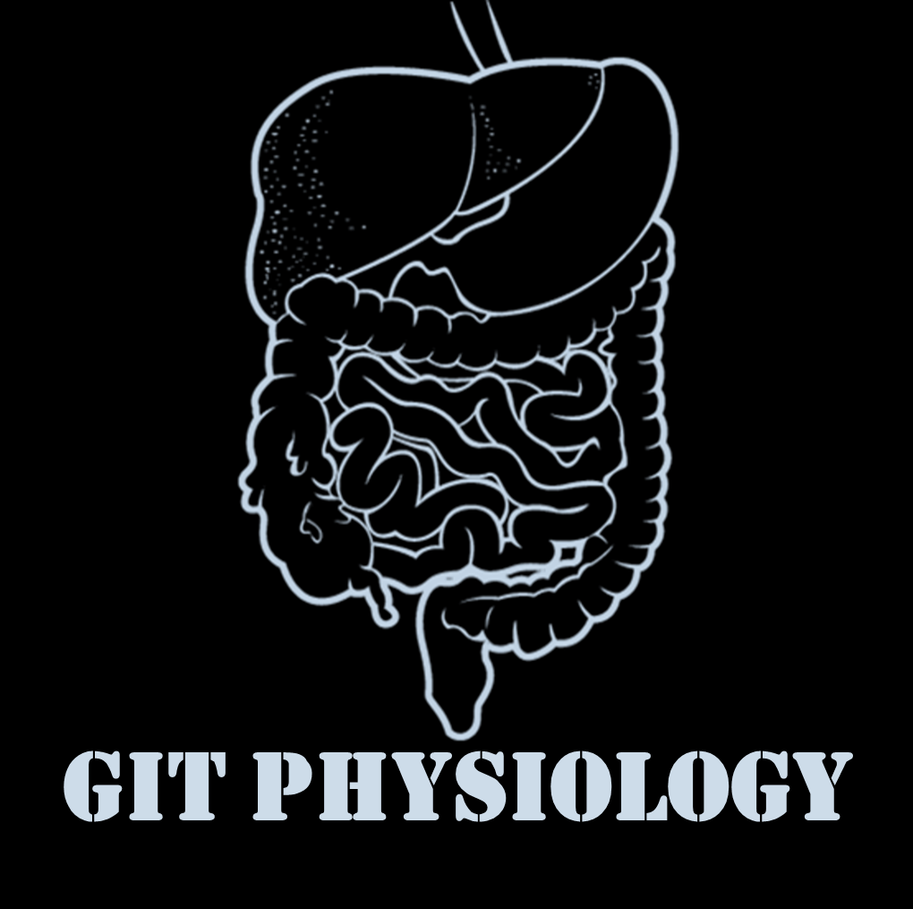
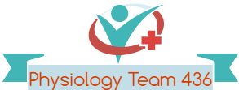
Text
Only in Females’ slide
Only in Males’ slides
Important
Numbers
Doctor notes
Notes and explanation
Lecture No.6
“إنّ معي ربي سيهدين”

Slide 2
physiology of the colon
Objectives:
Parts of the colon.
Functions of the colon.
The physiology of different colon regions.
Secretion in the colon.
Nutrient digestion in the colon.
Absorption in the colon.
Bacterial action in the colon.
Motility in the colon.
Defecation reflex.

Slide 3
The large intestine
Parts of the colon
This is the final digestive structure.
It does not contain villi.
By the time the digested food (chyme) reaches the large intestine, most of the nutrients have been absorbed.
The primary role of the large intestine is to convert chime into feces for excretion.
The colon has a length of about 1.5 meters (one-fifth of the whole length of GIT).
It consists of the ascending & descending, transverse and sigmoid colon, rectum and anal canal.
The transit of
radiolabeled chyme
through the large
intestine occurs in
36-48 hrs.

Slide 4
The mucous membrane of the colon
Lacks villi and has many crypts of Lieberkühn
The epithelial cells contain almost no enzymes (Because the colon is not a place for digestion).
They consist of simple short glands lined by mucous-secreting goblet cells (Main colonic secretion is mucous, as the colon lacks digestive enzymes)
The outer longitudinal muscle layer is modified form three longitudinal bands called tenia coli (Three thickened bands of muscles) visible on the outer surface.
Since the muscle bands are shorter than the length of the colon, the colonic wallis sacculated and forms haustra (Sacculation of the colon between the taenia).
Mucus in the large intestine protects the intestinal wall against excoriation, but in addition, it provides an adherent medium for holding fecal matter together. Furthermore, it protects the intestinal wall from the great amount of bacterial activity that takes place inside the feces, and, finally, the mucus plus the alkalinity of the secretion (a PH of 8.0 caused by large amounts of sodium bicarbonate) provides a barrier to keep acids formed in the feces from attacking the intestinal wall.

Slide 5
The physiology of different colon regions
1. The ascending colon | \ 2. The transverse colon | 3. The descending colon | 4. The rectosigmoid region, anal canal, together with pelvic floor musculature
Reabsorption of some water, mucous secretion and mixing. Specialized for processing chyme delivered from terminal ileum (but still not the major site of the absorption). When rediolabeled chyme is instilled (put gradually) into cecum, half of the instilled volume empties from ascending colon in 87 min. This period is short in comparison with the transverse colon. The ascending colon is not the primary site of storage, mixing and removal of water. The important characteristic for the ascending colon is to keep the abdominal content watery to make an easier movement against the gravity inside the ascending colon. | Specialized for the storage and removal of water & electrolytes from feces (Also NaCl through active transporters). Real water absorption. Labeled material is retained for 24 hours (Consume most of the time). First one half has the most absorption, The rest + 3,4 are for storage) | A conduit between the transverse and sigmoid colon. This region has the neural program for power propulsion that is involved in defecation reflex. Labeled feces begin to accumulate in the sigmoid colon about 24 hours after the label is instilled in the cecum. | They maintains fecal continence: The sigmoid and rectum are reservoirs with a capacity of up to 500 mL. But a defecation reflex can be initiated if only 25% of it is full. The puborectalis muscle and external anal sphincter comprise a functional unit that maintain continence (voluntary). Fibers of puborectalis pass around the anorectum and join behind it to form a U-shaped sling (physiological involuntary valve). External anal sphincter is considered voluntary and internal is involuntary and tonically contracted when we don’t need to go to the bathroom, and the muscle is relaxed. This movement sharpens the angle between the rectum and the anal canal, to trap the fecal material in the rectum.
Functions of the colon
Absorb vitamins produced by bacteria. Reabsorb water and compact material into feces Store fecal matter prior to defecation. The proximal half of the colon is concerned with absorption and the distal half with storage. The transit of small labeled markers through the large intestine occurs in 36-48 hrs.
5

Slide 6
Secretion in the colon
The epitive enzymes. The secretion is mainly mucus.
Functions of the secretion
It neutralizes against any acids present (Since non mucus secreting epithelial cells secrete HCO3, making mucus alkaline (pH of 8)). It protects against irritation (alkaline mucus protects against acids produced by bacteria in the lumen). Helps to lubricate feces. It provides a binding medium for fecal mattera.
Effects of parasympathetic stimulation on secretion
Stimulation of the pelvic nerves from spinal cord cause : second half of transverse colon and down is pelvic nerve, vagus nerve before that - Marked increase in mucus secretion. - Increase in peristaltic motility of the colon. During extreme parasympathetic stimulation (Abnormal condition), so much mucus can be secreted into the large intestine that the person has a bowel movement of ropy mucus as often as every 30 minutes; this mucus often contains little or no fecal material.
Effects of parasympathetic stimulation on secretion
Whenever a segment of large intestine becomes irritated as occurs in bacterial infection, the mucosa secretes large amount of water & electrolytes in addition to the alkaline mucus. This dilute the irritating factors and causes rapid movement of the feces toward the anus.
Ropy mucus materials meaning that it has a gelatinous character
6

Slide 7
Nutrient digestion in the large intestine
- The large population of bacteria digests small amounts of fiber; produce gases and organic acids. - Bacterial action produces nutrients - vitamin K, thiamin, biotin, vitamin B12, riboflavin, Organic wastes, Urobilinogens and Sterobilinogens,Bile salts and Toxins. - The mucosa, like that of the small intestine, has a high capability for active absorption of Na, Cl and water (We have active transporters). - It secretes bicarbonate ions.
Absorption in the large intestine (Formation of Feces) (NO villi)
Most of absorption in the colon occurs in the proximal half of the colon (Ascending and half of the transverse colon) (absorptive colon). Whereas the distal colon (The other half of the transverse and descending colon) function for storage (storage colon). In the large intestine, one liter of fluid material (in the cecum, then as it moves towards the anus the material gradually solidifies) is gradually reduced to 200 grams of brown fecal material.
Water absorption | About 0.5- 1.5L/day is absorbed. The net water loss is 150-200 ml/day. The large intestine can absorb a maximum of 5 to 8 liters of fluid and electrolytes each day. the entire fluid content passing each day is 9L (2L from food, 2L from gastric juice, 3L pancreatic juice and bile, 1L saliva and 2L intestinal secretions. However, more than 90% of the 9L is absorbed by the small intestines.
In the presence of Na+-K+ ATPase at the basolateral membrane
Na+ | Actively absorbed.
K+ | Secreted into the lumen of colon.
Cl | Absorbed in exchange for HCO3 which is secreted.
Vitamins | As Vitamin K, biotin, B5, folic acid and some AA and short chain FA resulting from bacterial fermentation of CHO are absorbed. It doesn't absorb Vitamin B12 (absorbed mainly in the terminal part of the ileum and requires intrinsic factor).
Drugs | Certain drugs as steroids and aspirin may be absorbed.
Bile salts and organic wastes | Bile salts and organic wastes as urobilinogen and sterobilinogen can be absorbed.
For the water, Na and Cl the reason behind absorbing it is maintain osmolality.
As for the HCO3 secretion is to prevent acidity.
7

Slide 8
Gut flora ( GI microbiota )
That live in the digestive tracts. It is established at one to two years after birth.
Bacterial flora is living in symbiosis with human and its effects are beneficial to the body as follows:
1-synthesis of vitamin K and some B group vitamins as folic acid, biotin, thiamine and B12.
Thiamin is responsible for creating gases, vitamin K is important for coagulation in the liver (factor 2).
The bacteria-formed vitamin k is especially important because the amount of this vitamin daily ingested foods is normally insufficient to maintain adequate blood coagulation.
2-deconjugation and decarboxylation of bile salts.
3- break down of bile pigments to produce stercobilinogen.
4- decarboxylation of some aa to produce amine and histamine. The amines are excreted in feces
And are responsible for its smell.
5- break down of urea by bacterial urease to ammonia. Most ammonia is absorbed and reconverted into urea by liver.
N.B: in hepatic failure, accumulation of ammonia can cause hepatic encephalopathy.
6- fermentation of endigested CHO (Cellulose produce gases).

Slide 9
The ileocaecal valve
Only in Females’ Slides
K flow of contents from colon into small intestine.
It remains closed and open only when an intestinal
peristaltic wave reaches it.
Distension of the cecum, secretin, Ach, alpha adrenergic
stimulation contract it.
Gastrin, CCk, B adrenergic stimulation relax it.

Slide 10
Motility in the colon
1. mixing movement (Haustrations) | 2. propulsive (mass) movement | 3. antiperistalisis
The motor events in the cecum and ascending colon (And small part of transverse) At constrictions points, 2.5 cm of the circular muscle contracts, at the same time the longitudinal strips contract. These combined contractions cause the unstimulated portion of large intestine to bulge outward into baglike sacs (haustrations). They also at times move slowly analward during their period of contraction. After another few minute new haustral contractions occur in other areas nearby. In this way all fecal material is gradually exposed to the surface of the large intestine & fluid is progressively absorbed. Ring-like contractions (about 2.5 cm) of the circular muscle divide the colon into pockets called haustra. Here it is longer than small intestine, it participates in pushing materials to transverse colon against gravity. Not much water absorption because we need it as semifluid. In transverse the material becomes semisolid due to water absorption. | - The motor events in transverse & descending colon. - These movements occur few times each day, most abundantly for 15 min during the first hour after eating breakfast. - A mass movement is a modified type of peristalsis. - A constrictive ring occurs at a distended or irritated points in the colon. - Then rapidly the 20 or more cm of the colon distal to the constriction contract almost as a unit forcing the fecal material en mass down the colon. - It starts at the middle of transverse colon and is preceded by relaxation of the circular muscle and - the downstream disappearance of haustral contractions. - The initiation of contraction is complete in about 30 seconds. - During the next 2 to 3 min another mass movement occurs. - The whole series of mass movement will usually persist for only 10 min to half an hour. They will - then return after a half day or even a day later. - When they have forced a mass of feces into the rectum the desire for defecation is felt. Initiation of mass movement: Gastrocolic & duodenocolic reflexes after meals. They result from distension of the stomach & duodenum. triggered by the increased delivery of ileal chyme into ascending colon following a meal. Irritation of the colon e.g. castor oil(زيت الخروع☺) Intense stimulation of parasympathetic NS. Over distension of a segment of the colon. | - It starts at the junction of ascending and transverse colon and traveling towards the cecum. - It mixes contents and help water absorption.
Control of colonic motility
The intramural plexuses directly control the contractile behavior of the colon. Stimulatory enteric motor neurons use acetylcholine & substance P as neurotransmitters. Inhibitory enteric motor neurons release VIP & NO onto colonic smooth muscle cells. The extrinsic autonomic nerves to the colon modulate the control of The colonic motility by the enteric nervous system.
Is like peristalsis but much stronger, middle of transverse colon to sigmoid, which is same area of pelvic nerve innervation.

Slide 11
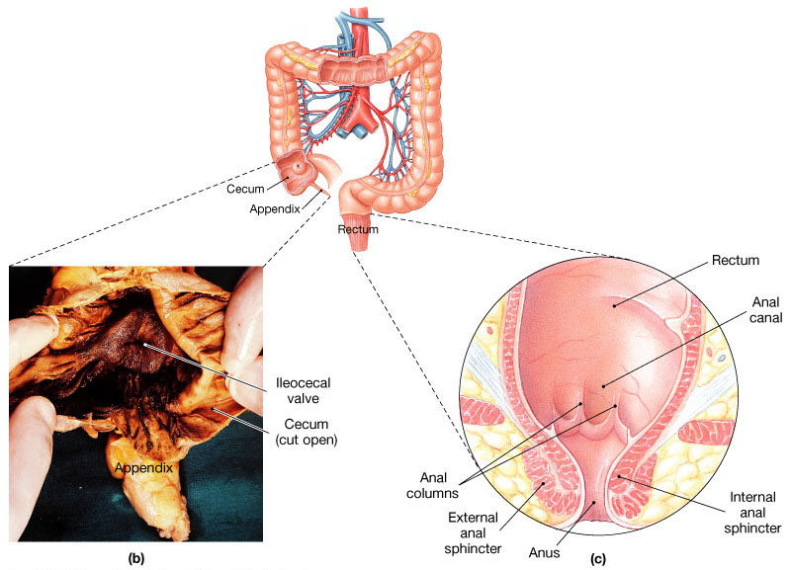
The rectum & anal canal
The rectum: Last portion of digestive tract that terminates at theanal canal.
It contains mechanoreceptors that detect distention
and supply ENS.
The anal canal: in the region of the skin is innervated by
somatosensory nerves that transmit pain, temperature
and touch signals to CNS .
Contraction of anal sphincters and puborectalis muscle
blocks the passage of feces and maintains continence
with small volumes in the rectum.

Slide 12
Defecation
It is a spinal ref which is influenced by higher center. Most of the time the rectum is empty and both internal and external anal sphincters are maintained in a state of tonic contraction. The rectum is distended and sends signals to cerebral cortex producing the desire to defecate.
Gastric or intestinal filling initiate a mass movement in the colon that pushes feces into rectum (gastrocolic & Dudenocolic reflexes).
Defecation reflex : 1-Distension of the rectum. 2- Stimulation of the stretch receptors in the rectum. The reflexes will be:
Short reflex | long reflex (Mass movement) |  | stimulation of somatic motor neuronsed in the cecum. (Contraction of external anal sphincter and puborectails)
Stimulation of myenteric plexus in sigmoid colon and rectum. | stimulation of parasympathetic motor neurons in sacral spinal cord (Through pelvic nerve and vagus). (The stimulus is distention of colon, will make mass movement).
Increased local peristalsis. Relaxation of internal anal sphincter and contraction of external anal sphincter.
If the surrounding circumstances are suitable |  | If situation is NOT suitable for defecation
Defecation reflex will be allowed. Stretch of the rectal wall is signaled to SC by pelvic nerve. Efferent pelvic impulses cause reflex contraction of the rectum and relaxation of internal anal sphincter (IAS). This is followed by reduction in tonic impulses to external anal sphincter (EAS), so it relaxes and feces leave the rectum assisted by voluntary straining and contraction of pelvic floor muscle. |  | The reflex is inhibited by the cerebral cortex. Tonic contraction of EAS is voluntary maintained which leads to accommodation the rectum to distension and return of tonic contraction of the IAS (And puborectalis muscle will delay defecation). The repeated inhibition of the defecation is the common cause of constipation.
12

Slide 13
Fecal incontinence
Only in Females’ Slides
Fecal continence is the ability to voluntarily control fecal and urinary discharge.
The spinal reflex of defecation operates without interference from higher centers.
Causes:
In infants (physiological).
Spinal cord lesion.
Weakness of IAS and EAS.
Weakness of pulborectalis.
Altered rectal or anal sensation.
Diarrheal conditions.
Diminished rectal capacity.

Slide 14
Thank you!
اعمل لترسم بسمة، اعمل لتمسح دمعة، اعمل و أنت تعلم أن الله لا يضيع أجر من أحسن عملا.
The Physiology 436 Team:
Team Leaders:
Laila Mathkour
Mohammad Alayed
Females Members:
Lama Alfouzan
Najd Altheeb
Rana Barasian
Shatha Alghaihb
Males Members:
Basel almeflh
Abdullatif Alabdullatif
Contact us:
References:
2017-2018 Dr. Hayam Gad’s Lecture.
2017-2018 Dr. Mohammed Al Zoghaibi’s Lecture.
Guyton and Hall Textbook of Medical Physiology (Thirteenth Edition.)
اللهم اني استودعتك ما حفظت وما قرأت وما فهمت، فرده لي وقت حاجتي إليه يا من لا تضيع عنده الودائع.

