Slide 1
Text
Only in Females’ slide
Only in Males’ slides
Important
Numbers
Doctor notes
Notes and explanation
Lecture No.7
“Stay Focused And Extra Sparkly”
All the videos in this lecture is very very helpful ☺

Slide 2
Reticuloendothelial System (RES) & Function of the Spleen
Objectives:
Define the term Reticuloendothelial system (RES).
Describe the cellular components of RES.
Describe the functions of the RES.
Define the structural function of the spleen.
Describe the functions of the spleen.
Understand the basic concept of the indication and risks of splenectomy.
Mechanism of chemotaxis, phagocytosis and microbial killing
Functions of monocytes/macrophages in different tissues

Slide 3
Overview of the immune system
Only in Males’ Slides
Immunity
Innate Immunity
Acquired immunity
(specific, adaptive)
(non specific)
Examples:
Complement,
Barriers,
Phagocytes (Neut, Mono, NK)
Humoral
(T lymphocytes)
Cell mediated
Antibody mediated
(B lymphocytes)
Note: Macrophages are key components of the innate immunity and activate adaptive immunity by transforming into Antigen Presenting Cells.

Slide 4
Reticuloendothelial system (RES)
Cellular components of RES
Reticuloendothelial System is an older term for the Mononuclear Phagocyte System.
although they are neither reticular (mesh or network) in appearance nor they have endothelial origin just these phagocytic cells are located in reticular connective tissue.
Therefore, the term reticuloendothelial system is not used nowadays.
It is a network of connective tissue fibers inhabited (occupied) By phagocytic cells such as macrophages ready to attack and ingest microbes.
RES is an essential component of the immune system.
Most endothelial cells are not macrophages.
Cellular components of RES
Monocytes
Macrophage
Specialized Endothelial cells
Next slides
Next slides
In bone marrow , spleen , lymp node.
cells that line the interior surface of blood vessels and lymphatic vessels, forming an interface between circulating blood or lymph in the lumen and the rest of the vessel wall. It is a thin layer of simple squamous cells called endothelial cells. Endothelial cells in direct contact with blood are called vascular endothelial cells, whereas those in direct contact with lymph are known as lymphatic endothelial cells.
The total combination of monocytes, mobile macrophages, fixed tissue macrophages, and a few specialized endothelial cells in the bone marrow, spleen, and lymph nodes is called the reticuloendothelial system.
However, all or almost all these cells originate from monocytic stem cells; therefore, the reticuloendothelial system is almost synonymous with the monocyte-macrophage system. Because the term reticuloendothelial system is much better known in medical literature than the term monocyte-macrophage system, it should be remembered as a generalized phagocytic system located in all tissues, especially in the tissue areas where large quantities of particles, toxins, and other unwanted substances must be destroyed.

Slide 5
1st Monocytes
Definition | Are a type of white blood cell “leukocyte.” They are the largest type of leukocyte and can differentiate into macrophages.
Location | In the blood
Size | 15-20 µm (active cells 60-80 µm)
Small granules | Prim & Vacoules
Efficient | More Efficient Phagocytosis than Neutrophils. 100 bacteria vs 3-20 by Neutrophils, larger particles like RBCs & malarial parasites.
Life span | 10-20 hours in blood & in tissues.
Types | Mobile (to ingest large particle) Fixed (often in tissue)
N.B | - Lysosomes contain lipases unlike Neutrophils. - Acts as Antigen Presenting Cells.
Picture
Monocytes transform themselves into macrophages in tissue & this system of phagocytes is called as Monoctye-Macrophage Cell. Characterized by an increase in: Cell size. Number and complexity of intracellular organelles Golgi, mitochondria, lysosomes. Intracellular digestive enzymes.
Only in Males’ Slides
زي حدوة الحصان
Neutrophils is the fastest & most potent chemotactic cell, while the monocyte is slower but stronger in response to the inflammatory process.

Slide 6
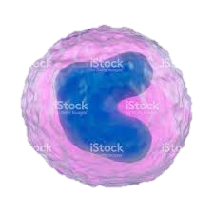
2nd Macrophages
Definition |  |  | A large phagocytic cell found in stationary form in the tissues or as a mobile form white blood cell, especially at sites of infection.
Function |  |  | - They filter and destroy objects which are foreign to the body, such as bacteria, viruses. - Some macrophages are mobile, and they can group together to become one big phagocytic cell in order to ingest larger foreign particles.
Location |  |  | - In all tissues. - often remain fixed to their organs.
Formation of Macrophages
Life spine |  |  | 10-20 hours - months
Types of Macrophages Macrophage differ depending on the organs in which they reside.
Types | Kupffer cells Picture |  | Alveolar cells (Duct cells) Picture, another picture | Tissue histiocytes (langerhans cell) (fixed macrophages) | Microglia | Reticular cells | Sinus histiocytes | Mesangial cells Picture | Osteoclasts | Hofbauer | Epithelioid
Location | Liver Picture Picture |  | Lung “Dust cells” because of their content of intracellular carbon particles. | - Skin. - Mucosa. - Subcutaneous tissues. | Brain | - Lymph nodes. Picture - Bone marrow. - Spleen. Picture | Lymph nodes. Picture Picture | Kidneys | Bone | Placenta | Granulomas
Macrophages Line Nodal Medullary sinuses: 1) subcapsular sinus macrophages (SSMs). 2) medullary sinus macrophages (MSMs). 3) medullary cord macrophages (MCMs).
Picture
Tissue macrophages provide a first line defense against infection
Begin by Stem cell in Bone Marrow
Monoblast maturing to promonocyte
mature monocytes released into blood
Stay for 10-20 hours in circulation
Then leave blood to tissues transforming into larger cells macrophage
Macrophage life span is longer up to few months in tissues

Slide 7
3rd Neutrophils
Definition | Neutrophils are a type of white blood cell. In fact, most of the white blood cells that lead the immune system’s response are neutrophils. Most Abundant WBCs 60-70 %.
Size | 15-20 µm
Nucleus | Multilobed, 2-5 lobes
Life span | 6-8 hours
POOLS: “three populations of neutrophils”
Bone Marrow pool |  |  | Circulating pool | Marginating Pool
Neutrophils within bone marrow. |  |  | Neutrophils within blood. | Neutrophils adherent to endothelium in low flow exchange vessels.
Neutrophil granules
Monocytes contain primary granules and vacoules only, neutrophils Contain glycogen granules. Why it contain glycogen granules? for anaerobic glycolysis.
Primary Granules |  |  | Secondary Granules | Tertiary Granules
Non Specific. 33% Azurophilic. Lysosomes contain: - Acid hydrolases. - MPO. - HOCl. - Defensins |  |  | Specific 67% Granules contain: - Lysozyme NOT Lysosomes. - Lactoferrin. - Alkaline Phaphatase. - Gelatinase. - Bacteriostatic & Bacericidal products. | Help to digest tissues Granules contain: - Collagenase. - Hyaluronidase & Gelatinase.
كل الجرانيلوز يشتغلون لما نحتاجهم فقط، فلنفترض جانا التهاب، البرايمري راح يصير له activeted، اذا ما كان كافي للسيطرة على الالتهاب راح يشتغل الثاني، بينما لو كان كفاية ما راح نحتاج الباقي وهكذا ☺
Picture
Only in Males’ Slides
Neutrophils is the fastest & most potent chemotactic cell, while the monocyte is slower but stronger in response to the inflammatory process.

Slide 8
General Functions of RES
1. Phagocytosis: Bacterial, dead cells, foreign particles (direct).
Phagocytosis is the processes of engulfing and ingestion of bacteria or other foreign bodies.
It is part of the natural or innate immune process.
Macrophages are a powerful phagocytic cells:
Macrophages also means “Big eater”, they are capable of phagocytosis.
They are modified monocyte in tissues.
Ingest up to 100 bacteria.
Ingest larger particles such as old RBC.
Get rid of waste products.
2. Immune function: processing antigen and antibodies production (indirect).
3. Breakdown of aging RBC.
4. Storage of RBC and circulation of iron.

Slide 9
Responses During Inflammation Macrophage and Neutrophil
1st line of defense – Tissue macrophages & Physical Barriers. 2nd line of defense – Neutrophil Invasion of the inflamed area. 3rd line of defense – Monocytes – macrophage (invasion of inflamed area). 4th line of defense – Increased production of granulocytes and Monocytes by Bone marrow.
Defensive Properties Of macrophages & Neutrophils
Margination | Diapedesis | Chemotaxis | Phagocytosis
WBC Roll, Bind and then stick along the walls of blood capillaries. | WBC squeezes itself through endothelial holes leaving blood capillaries. | WBC move by amoeboid motion towards inflammation area following chemotactic substances(Bacterial toxins, Complement [C5a], LKB4) are released from site of infection. | Upon reaching the site of infection neutrophils start to engulf infecting organism.

Slide 10
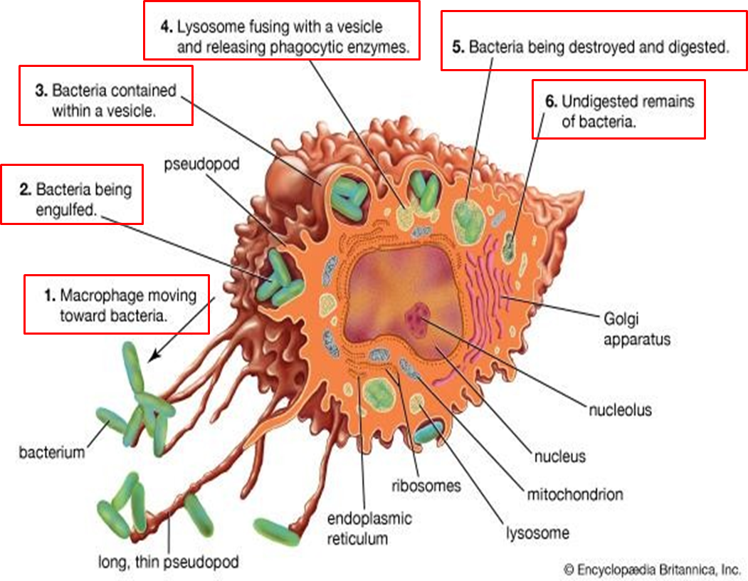
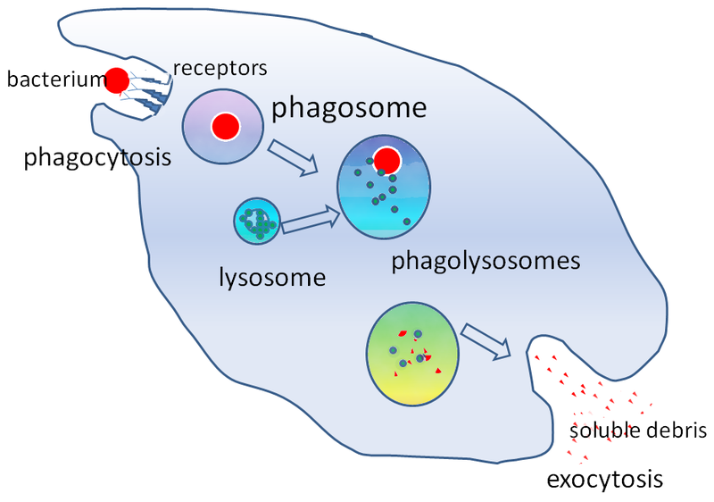
Direct anti-inflammatory function (Phagocytosis)
Bacteria vs. Macrophage
3:14
وش المقصود بهذه العملية بإختصار؟
Macrophage moves toward the pathogen which will be engulfed in a phagosome.
The lysosome will bind to the phagosome & release its substances.
Now it becomes a phagolysosome which will digest the pathogen.
The residual part of the digested pathogen will be released out of the cell by exocytosis.
The residual part contain
indigestible material which
will be cleared from
the tissue gradually
through the blood
circulation.
Phagocytosis
2:27

Slide 11
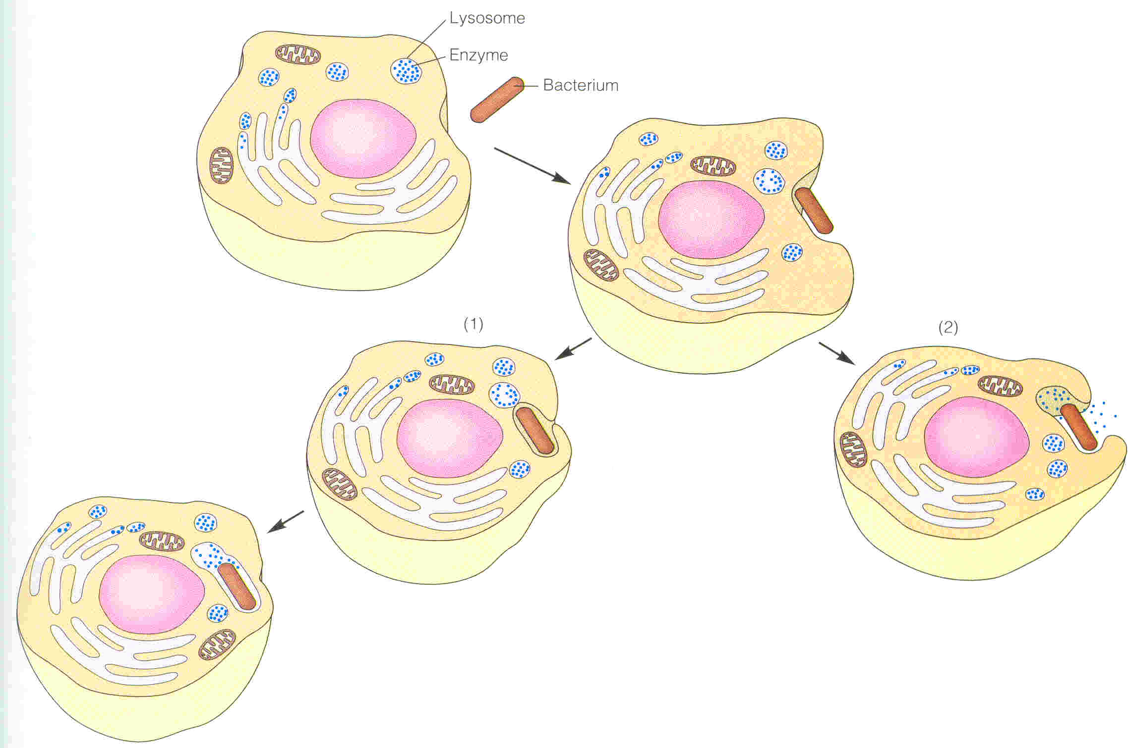
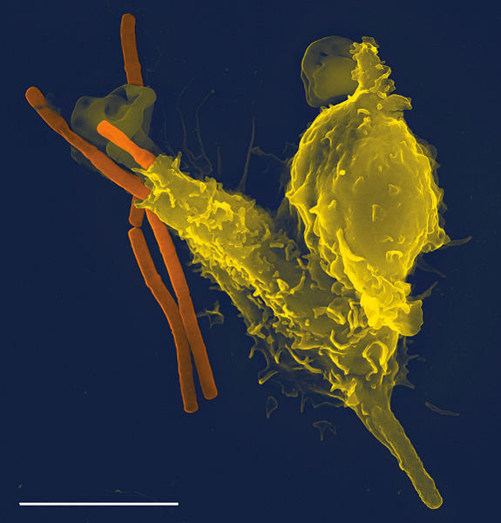
Only in Females’ Slides
Cont.
A scanning electron microscope: image of a single neutrophil yellow, engulfing anthrax orange.
Phagocytosis by a neutrophil cell or macrophage. A phagocytic cell extend its pseudopods around the object to the engulfed (such as a bacterium). (Blue dots represent lysosomal enzymes).
If the pseudopods fuse to form a complete food vacuole, lysosomal enzymes are restricted to the organelle formed by the lysosome & food vacuole.
If the lysosome fuses with the vacuole before fusion of the pseudopods is complete, lysosomal enzymes are released into the infected area of tissue.
Neutrophil Phagocytosis
1:00

Slide 12
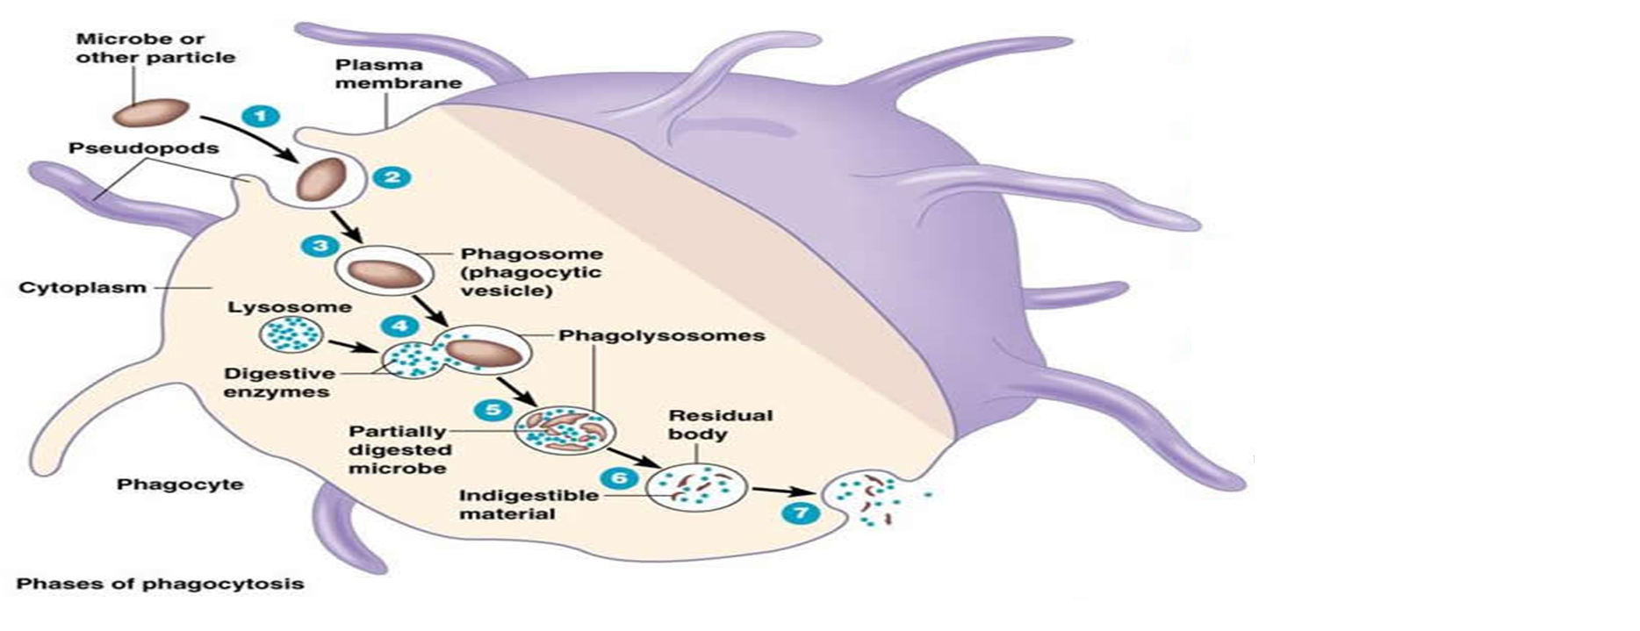
Microbial killing
1. Chemotaxis & adherence of microbe to phagocyte.
2. Ingestion of microbe by phagocyte.
3. Formation of a phagosome.
4. Fusion of the phagosome with a lysosome to form a phagolysosome.
5. Digestion of ingested microbe by enzymes.
6. Formation of residual body containing indigestible material.
7. Discharge of waste material.
Macrophage: a wandering, walking cell. “Big eater”capable of phagocytosis. Is a modified monocyte in tissues.

Slide 13
Indirect Immune function Of RES
Indirect immune function of RES:
As Antigen Presenting Cells.
Displaying it attached to an MHC class II molecule.
Ingest foreign body, process it and present it to lymphocytes.
وش المقصود بهذه العملية بإختصار؟
Same as further steps in Direct function. But here after the pathogen get digested, a copy of the protein structure of antigen is taken and exposer on the surface of the surface of the cells and this is what we call it antigen presenting cell (APC).
Finally this expressed by MHC class II

Slide 14
Role of an antigen-presenting cell
Only in Males’ Slides
1. Phagocytosis of enemy cell (antigen).
2. Fusion of lysosome & phagosome.
3. Enzymes start to degrade enemy cell.
4. Enemy cell broken into small fragments.
5. Fragments of antigen presented on APC surface.
6. Leftover fragments released by exocytosis.
What I have to know from this picture?
That phagocytosis is either due to inflammatory response or apoptotic bodies that get ingested from macrophage and degraded to be cleared from the body.

Slide 15
Lymphoid Organs
Only in Females’ Slides
Lymphoid Organs
Thymus | Lymph nodes | Spleen
High rate of growth and activity until puberty, then begins to shrink. Site of t-cell maturation. | Small, encapsulated, bean-shaped organs stationed along lymphatic channels and large blood vessels of the thoracic and abdominal cavities. | Structurally similar to lymph node, it filters circulating blood to remove worn out rbcs and pathogens.

Slide 16
spleen
Main characteristic |  | Is soft purple gray in color located in the left upper quadrant of the abdomen. It is a highly vascular lymphoid organ. It plays an important roles in: red blood cells integrity and has immune function. It holds a reserve of blood in case of hemorrhagic shock. It is one of the centers of activity of the RES and its absence leads to a predisposition toward certain infections. Despite its importance, there are no tests specific to splenic function.
White pulp |  |  | Red pulp
Structural Function | Thick sleeves of lymphoid tissue. provides the immune function of the spleen. trapping and processing of antigens. the major site of antibody synthesis. key role in removal of encapsulated bacteria (Strep pneumo). |  | Surrounds white pulp, composed of venous sinuses filled with whole blood and splenic cords of reticular connective tissue rich in macrophages. provides the filtrate function of the spleen. RBC’s able to deform through sinusoidal wall and endothelium Culling. Macrophage activation macrophages filter and destroy foreign material in blood Macrophage activation.
Immune function | Reservoir of lymphocytes Site of B cell maturation into plasma cells, which synthesize antibodies and initiates humoral response. |  | Site for Phagocytosis of bacteria and worn-out blood cells (Slow blood flow in the red pulp cords allows foreign particles to be phagocytosed ) It contains (in its blood reserve) half of the body monocytes within the red pulp, upon moving to injured tissue (such as the heart), turn into dendritic cells and macrophages that promoting tissue healing.
 | Destruction and processing of antigens. Because the organ is directly connected to blood circulation, it responds faster than other lymph nodes to blood-borne antigens. Removes antibody-coated bacteria along with antibody-coated blood cells.
General function | 1. Hematopoiesis: fetal life. Formation of blood cells, - it plays an important role in the hemopoietic function in embryo, - during the hepatic stage, spleen produces the blood cells along with liver. 2. Destruction: Spleen is a main site for destruction of lymphocytes & thrombocytes and RBCs specially old and abnormal e.g. spherocytosis. 3. Filtered (defense of body): Blood is filtered through the spleen. by removing the microorganism & foreign bodies. 4. Reservoir: Reservoir of thrombocytes and immature erythrocytes. A large number of RBCs and platelets are stored in spleen. RBCs are released form spleen into circulation during the emergency conditions like hypoxia & hemorrhage. 5. Iron: Recycles of iron. 6:Cytopoiesis: - From the fourth month of intrauterine life, some degree of hemopoiesis occurs in the fetal spleen. - Stimulation of the white pulp may occur following antigenic challenge, resulting in the proliferation of T and B cells and macrophages. - This may also occur in myeloproliferative disorders, thalassemias and chronic hemolytic anemias.

Slide 17
Role in defense of body
Spleen filters the blood by removing the microorganism. Macrophages in splenic pulp phagocytose microorganisms & foreign bodies. Spleen contains about 25% of T lymphocytes & 15% of B lymphocytes. The spleen processes foreign antigens and it is the site of antibody production mainly IgM. The non-speciﬁc opsonins, properdin and tuftsin, are synthesized. These antibodies are of b- and t-cell origin and bind to the speciﬁc receptors on the surface of macrophages and leukocytes, stimulating their phagocytic, bactericidal and tumoricidal activity.
Splenectomy
Indications | Risks & complications
1. Hypersplenism: enlargement of the spleen (splenomegaly) with defects in the blood cells count. 2. Primary spleen cancers. 3. Haemolytic anaemias: Sickle cell anemia, Thalassemia ,hereditary spherocytosis (HS) and elliptocytosis (Hereditary elliptocytosis, also known as ovalocytosis, is an inherited blood disorder in which an abnormally large number of the patient's RBCs are elliptical rather than the typical biconcave disc shape). 4. Idiopathic thrombocytopenic purpura (ITP) (a bleeding disorder in which the immune system destroys platelets). 5. Trauma. 6. Hodgkin's disease (type of lymphoma). 7. Autoimmune hemolytic disorders. | Overwhelming bacterial infection or post splenectomy sepsis. Patient prone to malaria. Inflammation of the pancreas and collapse of the lungs. Excessive post-operative bleeding (surgical). Post-operative thrombocytosis and thrombosis.

Slide 18
Summary (from slides)
Only in Males’ Slides
WBCs Concentration
WBCs Concentration (Normal Counts)
Cells |  | Approximate Normal range (/µL) | Percentage of Total WBC | Life Span
Granulocytes | Neutrophils | 3000-6000 | 50-70% | 4-8 hours in blood. 4-5 days in tissues
 | Eosinophils | 150-300 | 1-4%
 | Basophils | 0-100 | 0.4
 | Lymphocytes | 1500-4000 | 20-40% | Weeks-months
 | Monocytes (macrophages) | 300-600 | 2-8% | 10-20 hours (months)
Total WBC: 4000-11000 µL

Slide 19
Summary (from slides)
Only in Males’ Slides

Slide 20
Thank you!
اعمل لترسم بسمة، اعمل لتمسح دمعة، اعمل و أنت تعلم أن الله لا يضيع أجر من أحسن عملا.
The Physiology 436 Team:
Team Leaders:
Laila Mathkour
Mohammad Alayed
Females Members:
Rawan Alqahtani
Zaina Alkaff
Males Members:
Fouad Faathi
Contact us:
References:
2017-2018 Dr. Nervana Bayoumi’s Lecture.
2017-2018 Prof. Shahid Habib’s Lecture.
Guyton and Hall Textbook of Medical Physiology (Thirteenth Edition.)
اللهم اني استودعتك ما حفظت وما قرأت وما فهمت، فرده لي وقت حاجتي إليه إنّك على كل شيءٍ قدير.

