Slide 1
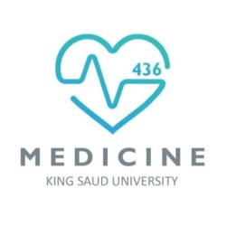
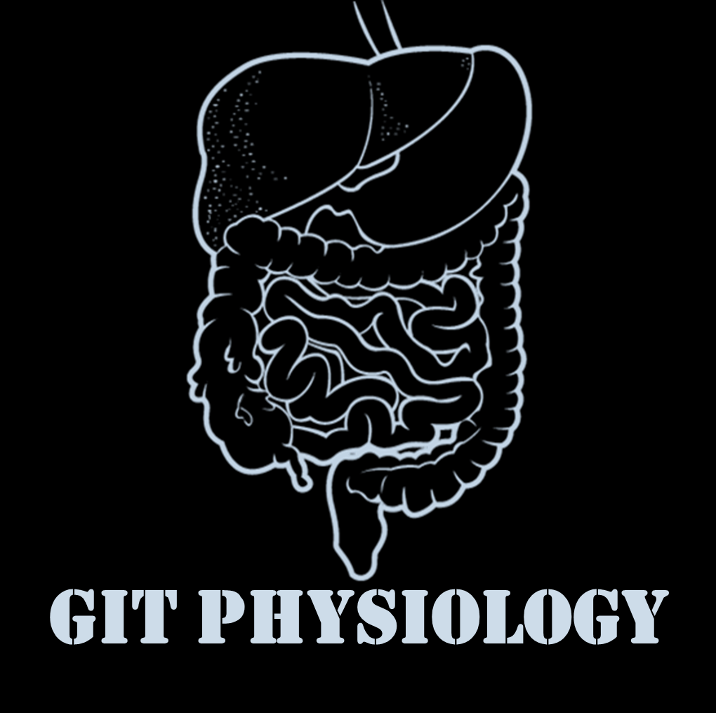
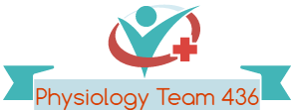

Text
Only in Females’ slide
Only in Males’ slides
Important
Numbers
Doctor notes
Notes and explanation
Lecture No.8
( إذا مات ابن ادم انقطع عمله إلا من ثلاث إلا من صدقة جاريه أو علم ينتفع به أو ولد صالح يدعوا له)..
الأفضل تدرسون محاضرة الـPlatelets أول، لو درستوا هذه أول بعد ما تخلصون دراستها، ادرسوا جزئية الـThrombin & tests من محاضرة الـPlatelets.. مشروحة بالتفصيل هناك منعا للتكرار
To prevent excessive bleeding of marks, please study this lecture Very Well!! This lecture is very important.

Slide 2
Coagulation mechanism and hypercoagulability
Objectives:
1- Recognize the different clotting factors.
2- Understand the role of calcium ions during clotting cascades.
3- Describe the cascades of intrinsic and extrinsic pathways for clotting.
4- Recognize process of fibrinolysis and function of plasmin.
5- Recognize some conditions causing excessive bleeding.
6- Understand some important anticoagulants and their mechanism of action.
  7- Normal Hemostasi: Coagulation cascade, Fibrinolysis, Natural anti-coagulants, Hemostatic balance.
  8- Hypercoagulability: Definition, Types, Causes, Laboratory testing.

Slide 3

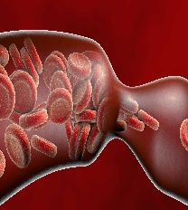
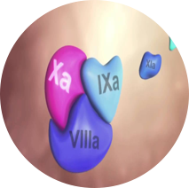
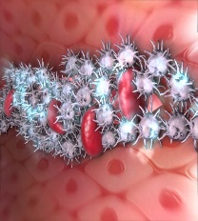
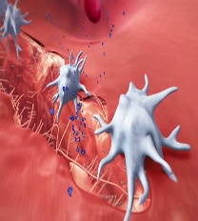
Hemostasis
الفيديو راح يساعدكم على فهم المحاضرة كاملة
Hemostasis
9:59
Hemostasis: the spontaneous arrest (Prevention or stoppage) of bleeding from ruptured blood vessels.
Stages of Hemostasis:
Coagulation: formation of fibrin meshwork (threads) to form a clot.
1. Vascular phase:
Vascular spasm (vasoconstriction)
3. Coagulation phase:
Blood coagulation & clot retraction
2. Platelet phase:
Production, activation and
Formation of platelet plug
4. Fibrinolytic phase:
fibrinolysis
الفيديو هذا للناس البصريّة!
3:27

Slide 4
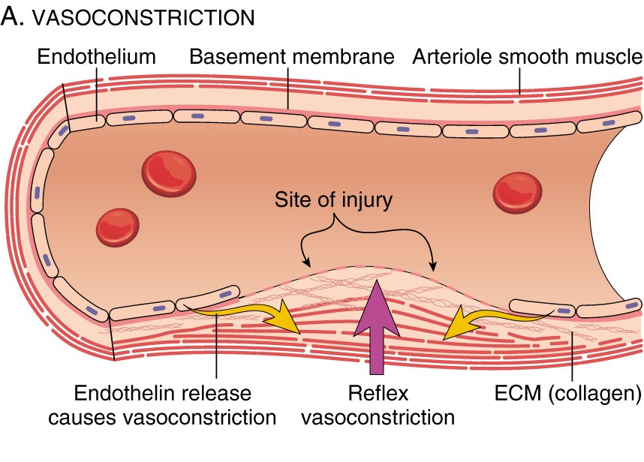
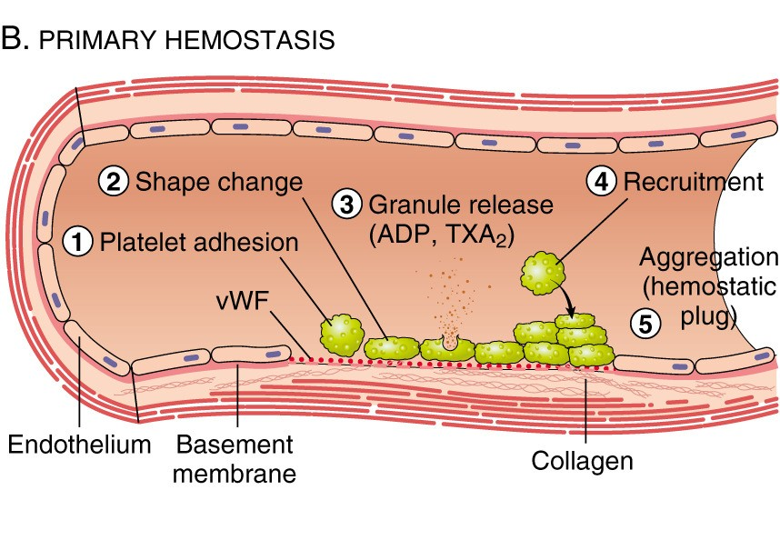
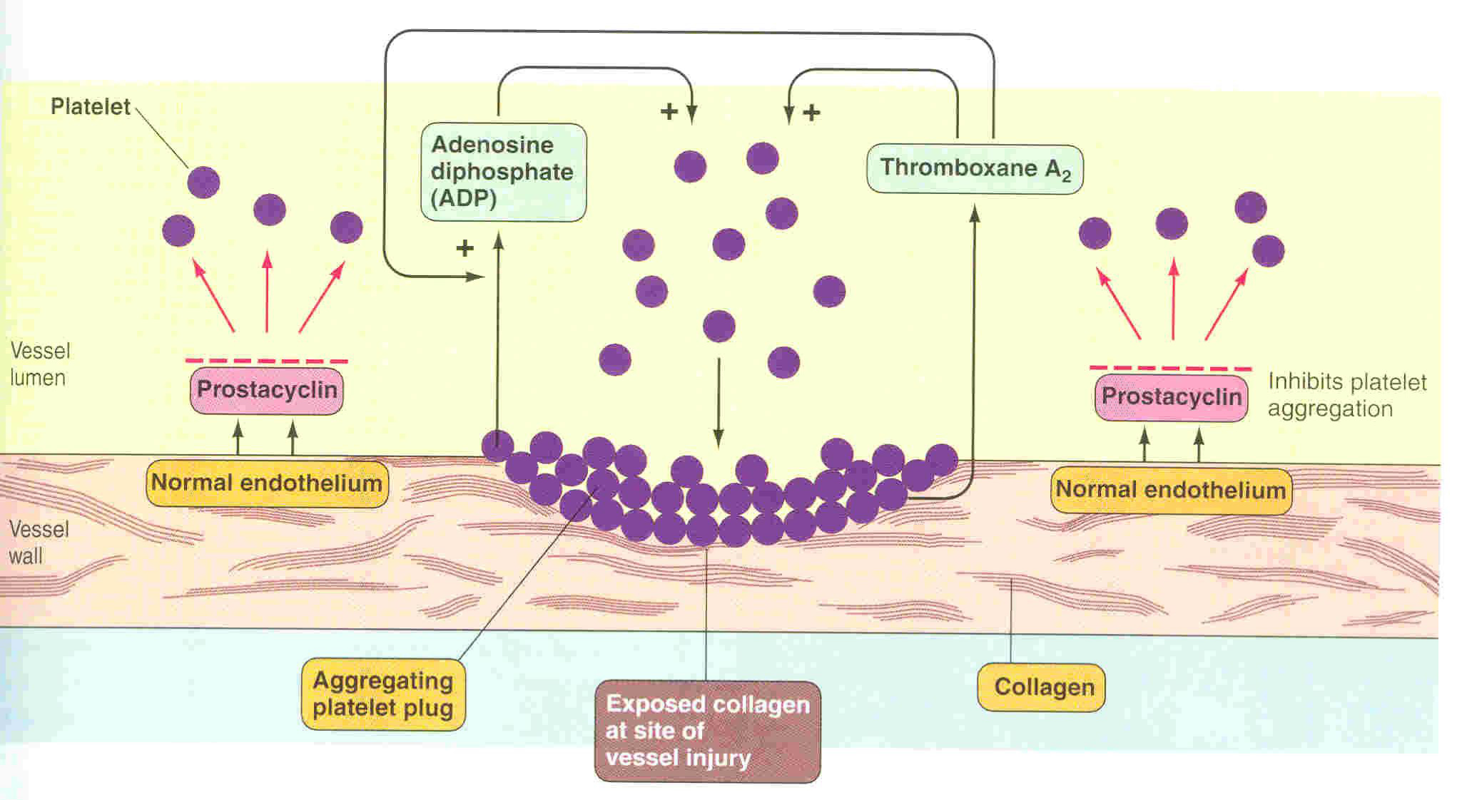
Mechanism Hemostasis
1. Vascular phase: | Immediately After injury there is localized Vasoconstriction (Vascular spasm). |  | Picture
 | Causative Factors | Importance
 | Nervous reflexes. Local myogenic spasm. Local humoral factor → Platelets Thromboxane A2 [TXA2] (Vasoconstrictor). TXA2 (Thromboxane A2) is inhibited by aspirin. | Crushing injuries → Intense spasm → No lethal loss of blood.
2. Platelet phase: | formation of platelet plug (primary hemostasis).
 | Will Secret (very important) | Importance
 |  | Enough to stop bleeding from small vascular damage.
Only in Males’ Slides
ADP causes stickiness
Secret:
prostacyclin
PG12
NO
ADP phosphatase
Serotonin & thromboxane A2 are vasoconstrictors

Slide 5
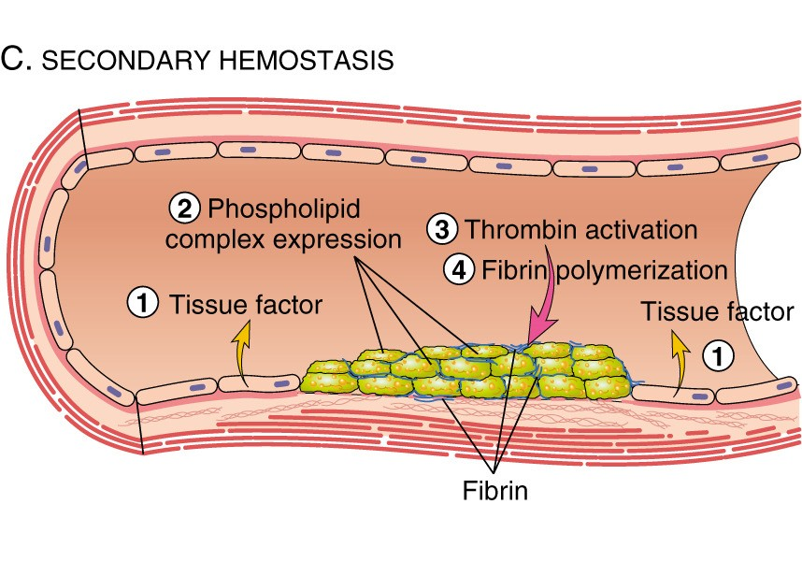
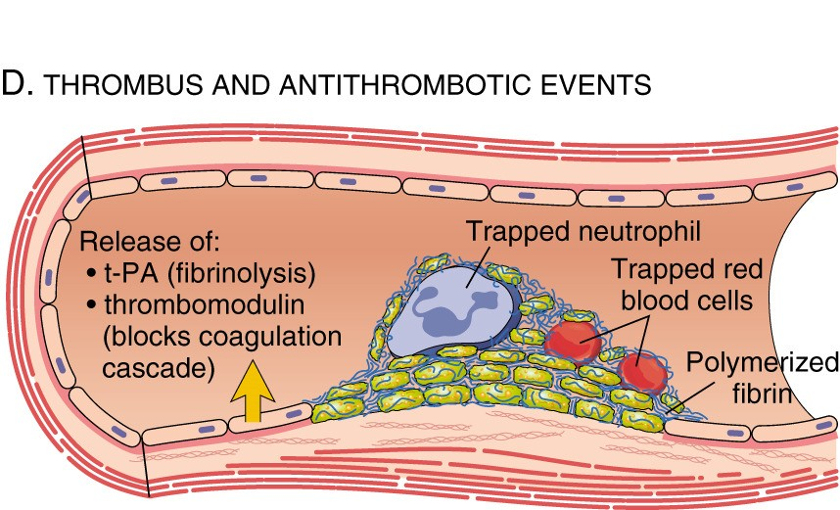
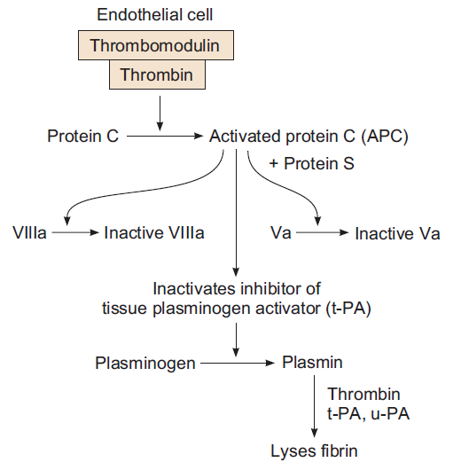
Mechanism Hemostasis
3- blood coagulation (formation of clot or thrombus) {secondary hemostasis} | Blood clotting is the transformation of blood (soluble fibrinogen) from a liquid into a solid gel form (insoluble fibrin strands). |  |  | Picture
 | Pathways: |  | Begins to develop in:
 | Intrinsic Extrinsic |  | 1-2 min → Minor trauma. 15-20 sec → Severe trauma.
 | Clot is a meshwork of fibrin fibers running in all directions entrapping blood cells, platelets and plasma.
 | Mechanism of clotting – STEPS:
4- fibrinolysis (lysis of blood clot by plasmin) | Formed blood clot can either become fibrous or dissolve.
 | Fibrinolysis (dissolving): Break down of fibrin by naturally occurring enzyme plasmin therefore prevent intravascular blocking.
 | There is a balance between cloting and fibrolysis: Excess clotting → blocking of Blood Vessels. Excess fibrinolysis → tendency for bleeding.
The Mechanism of clotting is very important
Blood clotting is considered a positive feedback mechanism
Formation of Prothrombin activator complex (Xa + Ca + PF-3 + V) by Extrinsic & Intrinsic Pathways leading to Common Pathway
Conversion of prothrombin into thrombin
Conversion of fibrinogen into fibrin
Fibrin converts to stable fibrin polymer
Only in Males’ Slides
Plasminogen (Profibrinolysin)
it can only be given within 3 hours only
if it was given after 3 hours the patient will die
The fibrinolytic system and its regulation by Protein C
T-PA (Tissue Plasminogen Activator)
Only in Males’ Slides
Thrombin and plasmin both circulate in inactive form
↓ Antiplasmin from the liver
Only in Males’ Slides
Plasmin (Fibrinolysis)
Fibrous clots tend to form in people of old age.
Lysis of clot
Tissue Plasminogen Activator (TPA) used to activate plasminogen to dissolve coronary and cerebral clots.

Slide 6
بعض الـFactors لهم أكثر من اسم، لازم ينحفظون كلهم ☹
Clotting factors
Blood clot: is composed of a meshwork of fibrin fibers running in all directions and entrapping blood cells, platelets, plasma.
Name |  | Factor
Fibrinogen |  | I
Prothrombin |  | II
Tissue factor or thromboplastin |  | III
Calcium |  | IV
Proaccelerin (Labile factor) accelerator |  | V
Proconvertin (Stable factor) |  | VII NOT VI انتبهوا أن مافي 6
Antihaemophilic factor A Antihaemophilic globulin |  | VIII
Antihaemophilic factor B Plasma thromboplastin component Christmas factor |  | IX
Stuart-Prower factor |  | X
Plasma thromboplastin antecedent (PTA) Antihaemophilic factor C Rosenthal syndrome |  | XI
Hageman factor |  | XII
Fibrin stabilising factor Laki-Lorand factor |  | XIII
Clotting factors mnemonic | Person Told Cancer Leads Sickness, Another Chap Said Protein High Fat. Fresher's Party Tonight, Come Let's Sing And Call Seniors, Please Have Fun.
Clotting factors mnemonic
1:00

Slide 7
Cont.
Fibrinogen ( I ) | High-molecular-weight plasma protein. Mol. W_{t}. – 340,000 It is continually formed by the liver. Little or no fibrinogen leak from blood vessels. Plasma conc. – 100 – 700 mg/dl
Prothrombin ( II ) | Is a plasma protein, α2-globulin. Mol. W_{t}. - 68,700 present in normal plasma in a concentration of 15 mg/dl. It is unstable protein that can be split easily into thrombin. It is continually formed by the liver. Vitamin K is important for normal production of prothrombin by the liver. Lack of Vit-K or liver disease can decrease the of prothrombin formation to a very low level → bleeding.
Fibrin stabilising factor ( XIII ) Laki-Lorand factor | Is a plasma protein. It is also released from platelets that is entrapped in the clot. It must be activated before it affects the fibrin fibres. Activated XIII factor operates as an enzyme causing additional strength of fibrin meshwork.

Slide 8
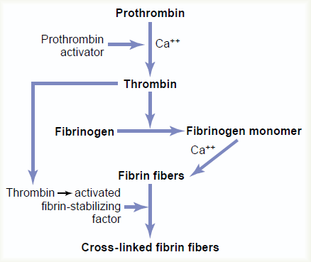
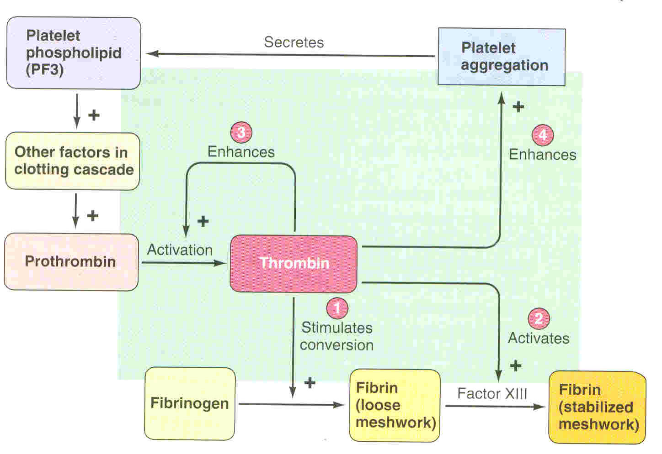
Thrombin (key enzyme)
Thrombin: is a protein enzyme with weak proteolytic capabilities.
It acts on fibrinogen to form one molecule of fibrin monomer. Fibrin monomers polymerize with one another to form fibrin fibres. It activates factor XIII. Thrombin is essential in platelet morphological changes to form primary plug. Thrombin stimulates platelets to release ADP & thromboxane A2; both stimulate further platelets aggregation.
Role of thrombin in hemostasis | Role of thrombin in fibrinolysis (Action of thrombin on fibrinogen to form fibrin)
This slide is very important INCLUDE the PICTURES
Thrombin is a serine protease that converts fibrinogen into fibrin and plays a crucial role in haemostasis and thrombosis.
During coagulation, factor Xa/Va complex formed on phospholipid or platelet membrane converts prothrombin to thrombin in the presence of Ca²⁺
Important to know what normal endothelium secretes & remember to write ADP Phosphatase not just ADP alone!
Secret:
prostacyclin
PG12
NO
ADP phosphatase
Fibrinogen is formed in the liver, and liver disease can decrease the concentration of circulating fibrinogen, as it does the concentration of prothrombin, pointed out earlier. Because of its large molecular size, little fibrinogen normally leaks from the blood vessels into the interstitial fluids, and because fibrinogen is one of the essential factors in the coagulation process, interstitial fluids ordinarily do not coagulate. Yet, when the permeability of the capillaries becomes pathologically increased, fibrinogen does then leak into the tissue fluids in sufficient quantities to allow clotting of these fluids in much the same way that plasma and whole blood can clot.
Thrombin is a protein enzyme with weak proteolytic capabilities. It acts on fibrinogen to remove four low-molecular-weight peptides from each molecule of fibrinogen, forming one molecule of fibrin monomer that has the automatic capability to polymerize with other fibrin monomer molecules to form fibrin fibers. Therefore, many fibrin monomer molecules polymerize within seconds into long fibrin fibers that constitute the reticulum of the blood clot. In the early stages of polymerization, the fibrin monomer molecules are held together by weak noncovalent hydrogen bonding, and the newly forming fibers are not cross-linked with one another; therefore, the resultant clot is weak and can be broken apart with ease. But another process occurs during the next few minutes that greatly strengthens the fibrin reticulum. This involves a substance called fibrin-stabilizing factor that is present in normal plasma but is also released from platelets entrapped in the clot. It must be activated. The same thrombin that causes fibrin formation also activates the fibrin-stabilizing factor. Then this activated substance operates as an enzyme to cause covalent bonds between more and more of the fibrin monomer molecules, as well as multiple cross-linkages between adjacent fibrin fibers.
الصورة هذه موجودة عند البنات بمحاضرات أخرى

Slide 9
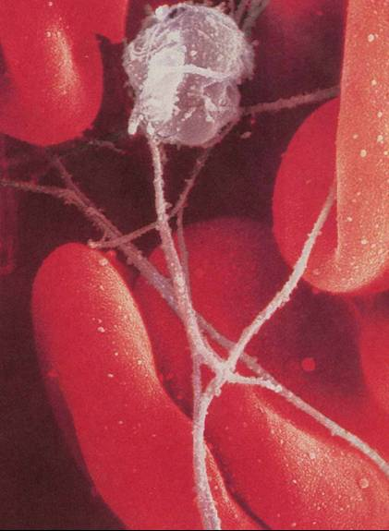
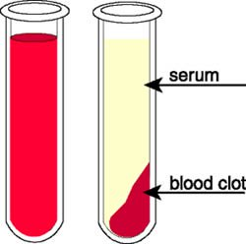
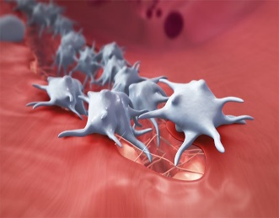
Clot retraction
Only in Males’ Slides
When clot retracts (contracts), it expresses most of the
fluid from the clot within 20-60 min called → Serum
Serum cannot clot
Role of platelets in clot formation &
Retraction → they are contractile.

Slide 10
Extrinsic & intrinsic mechanism
The Notes here is very Important
- افهموا هذه السلايد كويس، لو ما فهمتوا بسطناها لكم بالسلايد الجاية، ولو لسا ما فهمتوا اقرؤوا شرح قايتون بسلايد 12 و13 ☺
- بعد ما تفهمون الباثواي كويس، اختاروا واحد من الـdiagram الأنسب لكم من اللي بسلايد 14 و15 وطبقوا الكلام عليه !
Intrinsic mechanism | Extrinsic mechanism
Trauma to the blood itself or exposure of the blood to collagen (from a traumatized blood vessel wall), foreign surface/glass. All clotting factors present in the blood. The trigger is the activation of factor XII by contact with foreign surface, injured blood vessel, and glass. Activated factor XII will activate factor XI. Activated factor Xl will activate IX. Activated factor IX + factor VIII + platelet phospholipid factor (PF3)+ Ca activate factor X. | TF (tissue thromboplastin) includes phospholipids from the membranes of the tissue plus a lipoprotein complex that functions mainly as a proteolytic enzyme. Triggered by material released from damaged tissues (tissue thromboplastin). Tissue thromboplastin + VII + Ca → activate X.
Common pathway
Activated factor X + factor V +PF3 + Ca activate prothrombin activator; a proteolytic enzyme which activates prothrombin. Activated prothrombin activates thrombin. Thrombin acts on fibrinogen and change it into insoluble thread like fibrin. Factor XIII + Calcium → strong fibrin (strong clot).
Blood coagulates in a plain glass tube by the intrinsic pathway
Coagulation Cascade
5:22
الفيديو رهيب خاصة للناس البصريّة!
1:53
PTT¹ is for the intrinsic pathway while PT² is for the extrinsic pathway
¹ PPT= Partial Thromboplastin Time
² PT= prothrombin time

Slide 11
Simple way to memorize the coagulation cascade (Extra)
- لو ما فهمتوا السلايد السابق، بسطناها لكم هنا، ولو لسا ما فهمتوا اقرؤوا شرح قايتون بالسلايدتين الجاية ☺
- بعد ما تفهمون الباثواي كويس، اختاروا واحد من الـdiagram الأنسب لكم من اللي بسلايد 14 و15 وطبقوا الكلام عليه !
Intrinsic mechanism | Extrinsic mechanism
12 → 11 → 9 → 10. The pattern? Split 12 into two numbers; 1 and 2 First, minus 1 to get from 12 to 11 Then, minus 2 to get from 11 to 9 In order for factor 9 to activate factor 10, there needs to be factor 8 present. The pattern? Count 8, 9, 10 You need 8 to get 9 to activate 10 | 3 → 7 → 10. The pattern? Split the 12 from the intrinsic pathway again into two numbers; 1 and 2 Add them together so that 1 + 2 = 3 In order to get to 10, you need 7 more
Thrombin comes before fibrin Back at the start when we talked about how factor 3 is generally the “spark” that starts it all? Which is known as tissue factor 3 (TF). TF. : thrombin –> fibrin

Slide 12
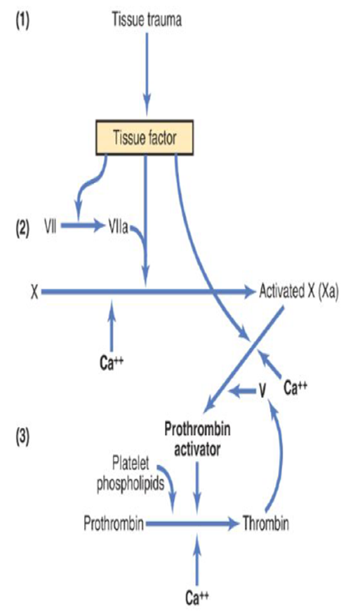
Extrinsic pathway for initiating clotting (Guyton)
- لو فهمتوا اللي قبل Skip
- بعد ما تفهمون الباثواي كويس، اختاروا واحد من الـdiagram الأنسب لكم من اللي بسلايد 14 و15 وطبقوا الكلام عليه !
The extrinsic pathway for initiating the formation of prothrombin activator begins with a traumatized vascular wall or traumatized extravascular tissues that come in contact with the blood. This leads to the following steps, as shown in the picture.
1. Release of tissue factor. Traumatized tissue releases a complex of several factors called tissue factor or tissue thromboplastin. This factor is composed especially of phospholipids from the membranes of the tissue plus a lipoprotein complex that functions mainly as a proteolytic enzyme.
2. Activation of Factor X—role of Factor VII and tissue factor. The lipoprotein complex of tissue factor further complexes with blood coagulation Factor VII and, in the presence of calcium ions, acts enzymatically on Factor X to form activated Factor X (Xa).
3. Effect of Xa to form prothrombin activator—role of Factor V. The activated Factor X combines immediately with tissue phospholipids that are part of tissue factors or with additional phospholipids released from platelets, as well as with Factor V to form the complex called prothrombin activator. Within a few seconds, in the presence of calcium ions (Ca++), this splits prothrombin to form thrombin, and the clotting process proceeds as already explained. At first, the Factor V in the prothrombin activator complex is inactive, but once clotting begins and thrombin begins to form, the proteolytic action of thrombin activates Factor V. This then becomes an additional strong accelerator of prothrombin activation. Thus, in the final prothrombin activator complex, activated Factor X is the actual protease that causes splitting of prothrombin to form thrombin; activated Factor V greatly accelerates this protease activity, and platelet phospholipids act as a vehicle that further accelerates the process. Note especially the positive feedback effect of thrombin, acting through Factor V, to accelerate the entire process once it begins.

Slide 13
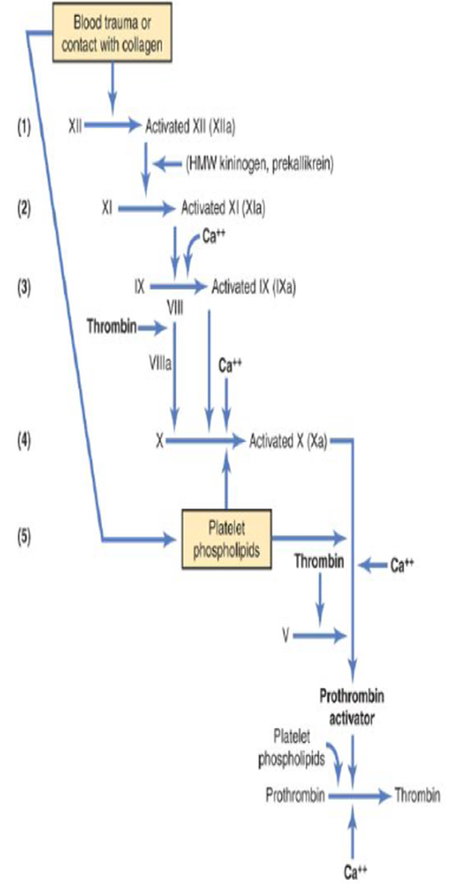
Intrinsic pathway for initiating clotting (Guyton)
- لو فهمتوا اللي قبل Skip
- بعد ما تفهمون الباثواي كويس، اختاروا واحد من الـdiagram الأنسب لكم من اللي بسلايد 14 و15 وطبقوا الكلام عليه !
The second mechanism for initiating formation of prothrombin activator, and therefore for initiating clotting, begins with trauma to the blood or exposure of the blood to collagen from a traumatized blood vessel wall. Then the process continues through the series of cascading reactions shown in the picture.
1. Blood trauma causes (1) activation of Factor XII and (2) release of platelet phospholipids.Trauma to the blood or exposure of the blood to vascular wall collagen alters two important clotting factors in the blood: Factor XII and the platelets. When Factor XII is disturbed, such as by coming into contact with collagen or with a wettable surface such as glass, it takes on a new molecular configuration that converts it into a proteolytic enzyme called “activated Factor XII.” Simultaneously, the blood trauma also damages the platelets because of adherence to either collagen or a wettable surface (or by damage in other ways), and this releases platelet phospholipids that contain the lipoprotein called plateletfactor 3, which also plays a role in subsequent clotting reactions.
2. Activation of Factor XI. The activated Factor XII acts enzymatically on Factor XI to activate this factor as well, which is the second step in the intrinsic pathway. This reaction also requires HMW (high-molecular-weight) kininogen and is accelerated by prekallikrein.
3. Activation of Factor IX by activated Factor XI. The activated Factor XI then acts enzymatically on Factor IX to activate this factor as well.
4. Activation of Factor X—role of Factor VIII. The activated Factor IX, acting in concert with activated Factor VIII and with the platelet phospholipids and factor 3 from the traumatized platelets, activates Factor X. It is clear that when either Factor VIII or platelets are in short supply, this step is deficient. Factor VIII is the factor that is missing in a person who has classic hemophilia, for which reason it is called antihemophilic factor.Platelets are the clotting factor that is lacking in the bleeding disease called thrombocytopenia.
5. Action of activated Factor X to form prothrombin activator—role of Factor V. This step in the intrinsic pathway is the same as the last step in the extrinsic pathway. That is, activated Factor X combines with Factor V and platelet or tissue phospholipids to form the complex called prothrombin activator. The prothrombin activator in turn initiates within seconds the cleavage of prothrombin to form thrombin, thereby setting into motion the final clotting process

Slide 14
The Coagulation Cascade
بعد ما تفهمون الباثواي كويس، اختاروا واحد من الـdiagram الأنسب لكم سواء هذا أو من السلايد الجاية، وطبقوا الكلام عليه !
Intrinsic Pathway
2)
Extrinsic Pathway
tissue thromboblastin
Damaged vessel surface/ foreign surface / exposed collagen
Tissue damage
FXII
Inactive factor XII
FXIIa
active factor XII
Tissue factor factor III (thromboplastin)
Haemostatic Activation
Markers
(4 markers with this. Sign )
Hageman factor
contact factor (if it finds anything other than the smooth endothelium it will get activated)
FXI
Inactive factor XI
FXIa
active factor XI
3)
FVII & Ca++
FIX
Inactive factor IX
FIXa
active factor IX
FX
Inactive factor X
FVIII
FXa
active factor X
Common Pathway
FV+ Ca⁺⁺ +P
Fraction 1+2
Antithrombin III
Prothrombin
Thrombin
Thrombin-antithrombin complex (TAT)
Fibrinogen
Fibrin
Coagulation
Fibrin
FPA
4)
Fibrinolysis
Plasmin
Plasminogen
D-Dimer (FDP)
Anti-plasmin
Anti-activators PAI-1&2
Plasminogen activators t-PA,u-PA

Slide 15
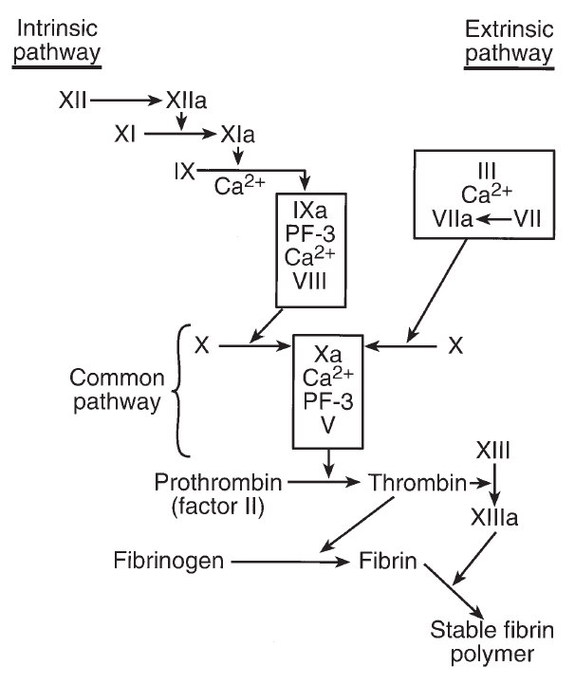
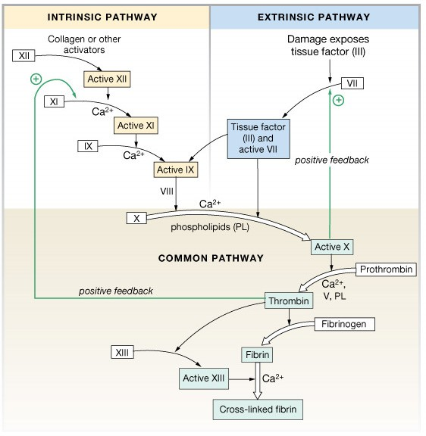
Extrinsic & intrinsic mechanism
بعد ما تفهمون الباثواي كويس، اختاروا واحد من الـdiagram الأنسب لكم سواء من هنا أو السلايد السابق، وطبقوا الكلام عليه !
Blood Trauma or Contact with collagen
Tissue Factor
Prothrombin Activator Complex
stabilizing factor
Fibrin Stabilizing Factor XIII

Slide 16
Activation & Inactivation of coagulation
Only in Females’ Slides
Activation and Inactivation of coagulation
Activation of coagulation | Inactivation of coagulation
Are not coded for by specific genes, and their concentrations reflect the overall activation of the coagulation and fibrinolytic systems. | By natural anticoagulants
Enzymatic activation products of coagulation and fibrinolytic mechanisms such as : prothombin 1+2 (F1+2) thrombin-antithrombin complex (TAT) FPA D-dimer | Natural anticoagulants : Anti-thrombin III (AT-III) Protein C (inhibits Va & VIIIa) Protein S (cofactor for protein C)

Slide 17
Cell based model
Only in Females’ Slides
This is ONLY FOR YOUR INFORMATION.
بس المطلوب تعرفون من هذه الصورة أن الـ
Cell based model means the Extrinsic & intrinsic pathway occur in the surface of the platelets & endothelium.
TF
VIIa
IXa
fibroblast
Propagation
Xa
Prothrombin
Thrombin
Thrombin
Prothrombin
VIIIa
XIa
Xa
IXa
XIa
Platelet
Amplification
Activated platelets

Slide 18
Role of CALCIUM ions in clotting
Only in Males’ Slides
No Ca⁺⁺ → No clotting (needed in many steps)
Blood samples are prevented from clotting by:
Citrate ions
Deionization of Ca⁺⁺
Oxalate ions
Precipitate the Ca⁺⁺
Heparin
Combines with antithrombin effectiveness increases by 100-1000 fold, also remove factors XII, XI, X, and IX (monitored by PTT time)
Warfarin
Decrease Production of factors VII , IX and X by liver (monitored by PT time)
EDTA
Chelates (binds) calcium ions

Slide 19
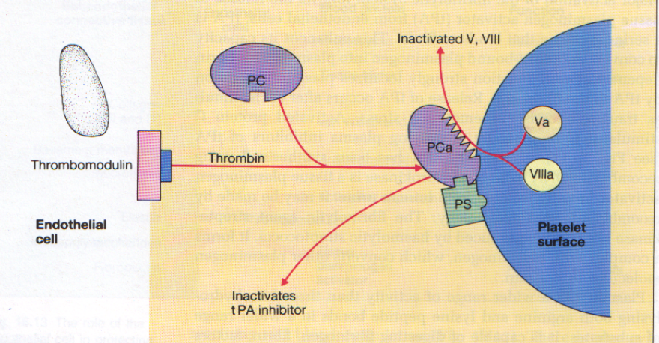
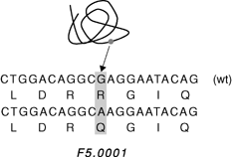
Natural anticoagulants
Antithrombin III |  |  | Protein C & S
Synthesis | Hepatocytes & endothelial cells. |  | Protein C | Vitamin K-dependent. Synthesized by the hepatocytes Activated protein C resistance (APC-R): is mainly due to a genetic abnormality of clotting factor V called (factor V Leiden mutation).
Action | ATIII + thrombin → thrombin-ATIII complex. Heparin dramatically enhances this action. |  | Action
 |  |  | Note on the picture: point mutation in the factor V gene, G1691A in exon 10, leading to Arg506Gln.
Natural intravascular anticoagulant (prevention of blood clotting in the normal vascular system and anticoagulant)
Endothelial Surface Factors |  | Smoothness of Endothelium. Glycocalyx Layers. Thrombomodulin Protein binds to thrombin → Activates Protein C (with ProtS) → inactivates factors V & VIII and inactivates an inhibitor of tPA → increasing the formation of plasmin.
Antithrombin action of Fibrin and Antithrombin III |  | 85-90 % Thrombin binds with Fibrin. 10-15 % Thrombin binds with Antithrombin III. Antithrombin III is a circulating protease blocking clot factors. Antithrombin III, combines the remaining thrombin and removes it from blood.
Heparin |  | vely charged conjugated polysaccharide. Increase the effectiveness of Antithrombin III Produced by : Mast cell , Basophil cells , liver , lung. Most widely used anticoagulant clinically e.g. in stroke. Alpha₂ – Macrogobulin acts as a binding agent for several coagulation factors (combines with Antithrombin III and quickly removes thrombin from blood).
Fibrin fibers |  | adsorbs ~ 90% of thrombin to removes it from circulating blood.
This slide is very Important

Slide 20
Plasmin
Only in Females’ Slides
Plasmin
Important information
Controlled by
Uses
Is present in the blood in an inactive form plasminogen.
Is activated by tissue plasminogen activators (t-PA) in blood.
Digests intra & extra vascular deposit of Fibrin → fibrin degradation products (FDP).
Unwanted effect of plasmin is the digestion of clotting factors.
Tissue Plasminogen Activator Inhibitor (TPAI).
Antiplasmin from the liver.
  Tissue Plasminogen Activator (TPA) used to activate plasminogen to dissolve coronary clots.

Slide 21
Hemostatic balance
A crucial physiological balance exists between factors promoting coagulation (procoagulants) and factors inhibiting coagulation (anticoagulants).
Homeostasis of the clotting system: | A crucial physiological balance exists between factors favoring clotting and factors that oppose it. Disturbances in this balance can lead to thrombotic diseases or bleeding.
Coagulation of blood depends on the balance between these two factors.
Hemostatic Disturbances
DVT & PE (Deep vein thrombosis & pulmonary embolism) |  | MI (Myocardial infraction) |  | Placental infraction Recurrent abortions | Stroke
Virchow Triads 1845
Etiological factors for thrombosis: - Changes in blood flow (stasis). - Changes in the endothelium. - Changes in blood composition (Hypercoagulability).
Only in Females’ Slides
Disturbances in this balance could lead to:
Fibrinolytic system
Coagulation inhibitors
Coagulation factors
Thrombosis
Bleeding
An imbalance in one of these 3 can lead to hyper coagulability an imbalance between the pro and the anti.

Slide 22
Bleeding and clotting disorders (condition that cause excessive bleeding)
Thrombocytopenia |  | Hemophilia |  | Liver disease and vitamin-K deficiency
Bleeding disorder & related to platelet problems. Very low numbers of platelets in blood (< 50,000/ul) may cause spontaneous bleeding. Less than 10,000 ⇢ Fatal. |  | Small Comp. → Hemophilia A → ↑PTT (Partial Thromboplastin Time). Large Comp. → Von-Willebrand’s disease → ↑PTT & BT (bleeding time). |  | e.g. Hepatitis, Cirrhosis, acute yellow atrophy, GI disease. Liver disease can have signs of bleeding and clotting together.
Etiology |  | Hemophilia A: Classic hemophilia. 85% cases. Deficiency of factor VIII. | Hemophilia B: 15% case. Deficiency of factor IX. | Decreased formation of clotting factors. Increased clotting time. Vitamin K dependent factors: II (Prothrombin) , VII, IX & X.
Decrease production: Aplastic anemia. Leukemia. Drugs. Infections (HIV, Measles). | Increased destruction: ITP (Idiopathic thrombocytopenic purpura). Drugs. Infections (HIV).
Clinical feature |  | Clinical feature
Easy brusability, Epistaxis, Gum bleeding, Hemorrhage after minor trauma, Petechiae /Ecchymosis. |  | Easy bruising, massive bleeding after trauma or operation, hemorrhages in joints. |  | Vitamin-K :
 |  |  |  | Fat soluble. vitamin Required by liver for formation: Prothrombin. Factor VII. Factor IX. Factor X. | Deficiency
Diagnosis |  | Increase bleeding to tendency Genetic disorders (X-linked disease). Transmitted by female chromosome as recessive trait. Occurs exclusively in males, Females are carriers. Hemophilia is one of the clotting disorders are related to clotting problems. Remember that: in Hemophilia a PTT is increased, while in In Von-Willebrand’s disease PTT and BT is increased. |  |  | Malabsorption syndromes. Biliary obstruction. Broad spectrum antibiotics. Dietary deficiency (in Neonates).
Platelets decreased, B.T (bleeding time) increased.
Treatment
Treatment of the underlying cause. Palates concentrates. Fresh whole blood transfusion. Splenectomy.
 |  |  |  | Source | Treatment
Thrombocytopenia purpura, hemorrhages throughout all the body tissues. Idiopathic Thrombocytopenia, unknown cause. |  |  |  | Diet. Synthesized in the intestinal tract by bacteria. | Treat the underlying cause. Vit-K injections.
Hemophilia is very important

Slide 23
Hypercougulability
The dynamic balance between procoagulant reactions & their downregulation by natural anticoagulants in conjunction with the fibrinolytic system should function within normal parameters to prevent abnormal thrombus formation or propagation. However, in some instances, alteration of just one variable in this complex series of interacting components will bring about a significant hypercoagulable (prothrombotic) state, which can manifest itself clinically as arterial and/or venous TE.
Definition |  | Is a laboratory phenotype whereby activation of the of clotting, fibrinolysis, endothelial cells and platelets are identified.
Hypercougulability / Prothrombotic States
Hereditory Hemostatic disorders |  |  |  | Acquired Hemostatic disorders:
Factor V Leidin (Deficincey). Prothrombin G20210A (Mutation). Hyperhomocysteinaema Deficiencies of AT III, Proteins C & S Increased FVIII. |  |  |  | Raised Levels of fibrinogen & FVII (With growth and pregnancy). Antiphosphlipid Antibodies (LA & ACAs). Oestrogen therapy (Contraception pills, infertility treatment). Pregnancy and its complications. Surgery and prolonged immobility. Major Trauma. Malignancy. Hyperviscosity. |  |  | Nephrotic Syndrome Dehydration Thrombocytosis Polycycaemia Sepsis Smoking Obesity Age Varicose veins
Laboratory tests of hypercoagulability
Natural anticoagulant | Fibrinolysis |  | Coagulation activation marker |  | Activation protein C resistance (APCR) | Genotyping
ATIII (Antithrombin 3) Protein C Protein S | PAI-1 FDPs (D-Dimer) |  | Thrombin-Antithrombin complexes (TAT). Prothrombin fraction 1+2. D-Dimer. |  | Functional Assay. Genetic assay (Factor V Leiden). | Factor V Leiden. Prothrombin G20210A. Hyperhomocysteinaemia (MTHFR).
Only in Females’ Slides

Slide 24
Questions'!
This slide is very Important
What prevents blood from coagulating in normal (not injured) conditions? What are the natural intravascular anticoagulants?
Endothelial Surface Factors (Smoothness, Glycocalyx layers and action of Thrombomodulin Protein C and S).
Antithrombin action of Fibrin and Antithrombin III.
Heparin.
Alpha2 Macroglobulin.
What are the actions of Thrombomodulin, Protein C and S?
Thrombomodulin Protein binds to thrombin → Activates Protein C (with Protein S) → inactivates factors V & VIII and inactivates an inhibitor of TPA → increasing the formation of plasmin.
What aids in the mechanism of clot retraction?
The contractile property of platelets.
Main ENDOTHELIAL factors that prevent platelets from aggregating?
  PGI2
  NO
  ADP Phosphatase
What are the actions of thrombin?
Stimulates conversion of Fibrinogen into Fibrin.
Activates Factor XIII (Fibrin Stabilizer).
Enhances its own activation(Prothrombin to Thrombin).
Enhances platelet aggregation.
Main source of Heparin?
Mast cells and Basophils.
How is the bleeding time changed in Haemophilia A?
It is normal. While in Von-Willebrand’s disease it is increased.

Slide 25





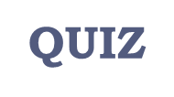
Thank you!
اعمل لترسم بسمة، اعمل لتمسح دمعة، اعمل و أنت تعلم أن الله لا يضيع أجر من أحسن عملا.
The Physiology 436 Team:
Team Leaders:
Laila Mathkour
Mohammad Alayed
Females Members:
Allulu Alsulayhem
Shrooq Alsomali
Aseel Alsulimani
Males Members:
Faisal Alfawaz
Contact us:
References:
2017-2018 Dr. Nervana Bayoumi’s Lecture & Notes.
2017-2018 Prof. Shahid Habib’s Lecture & Notes.
Guyton and Hall Textbook of Medical Physiology (13th Edition).
Ganong’s Medical Physiology (25th Edition)
Linda S. Costanzo (5th Edition).
اللهم اني استودعتك ما حفظت وما قرأت وما فهمت، فرده لي وقت حاجتي إليه إنّك على كل شيءٍ قدير.

