Slide 1
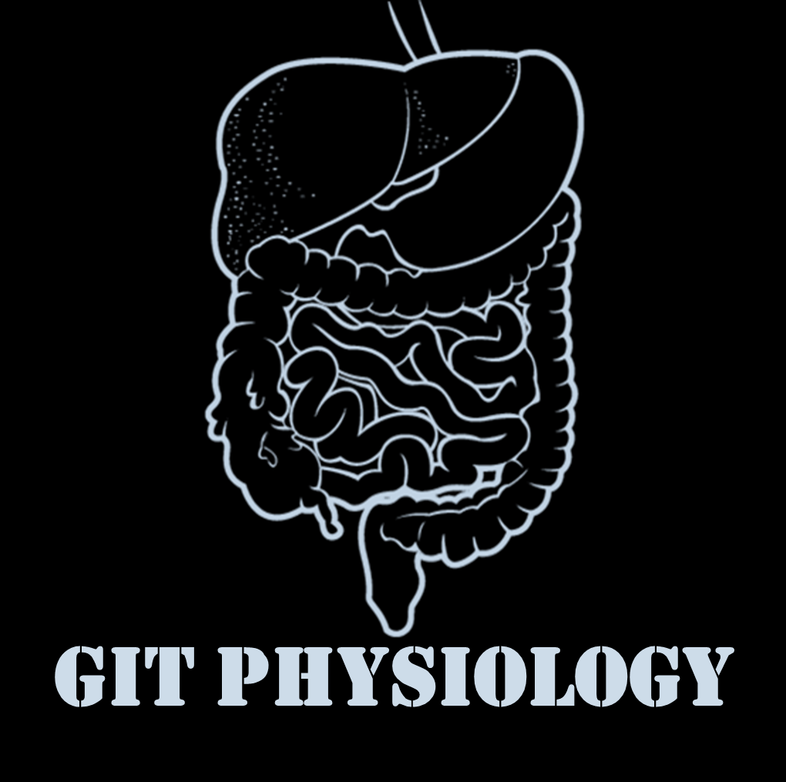
Text
Only in Females’ slide
Only in Males’ slides
Important
Numbers
Doctor notes
Notes and explanation
Lecture No.9
“Nothing Is Impossible. The Word Itself Says I'm Possible ”

Slide 2
platelet structure & function
Objectives:
1-Understand platelet normal ultrastructure.
2-Understand the functions of different platelets organelles and surface receptors.
3-Understand the mechanisms of platelet functions.
4-Relate membrane receptors and granule content to normal function in homeostasis and bleeding platelet disorders.

Slide 3
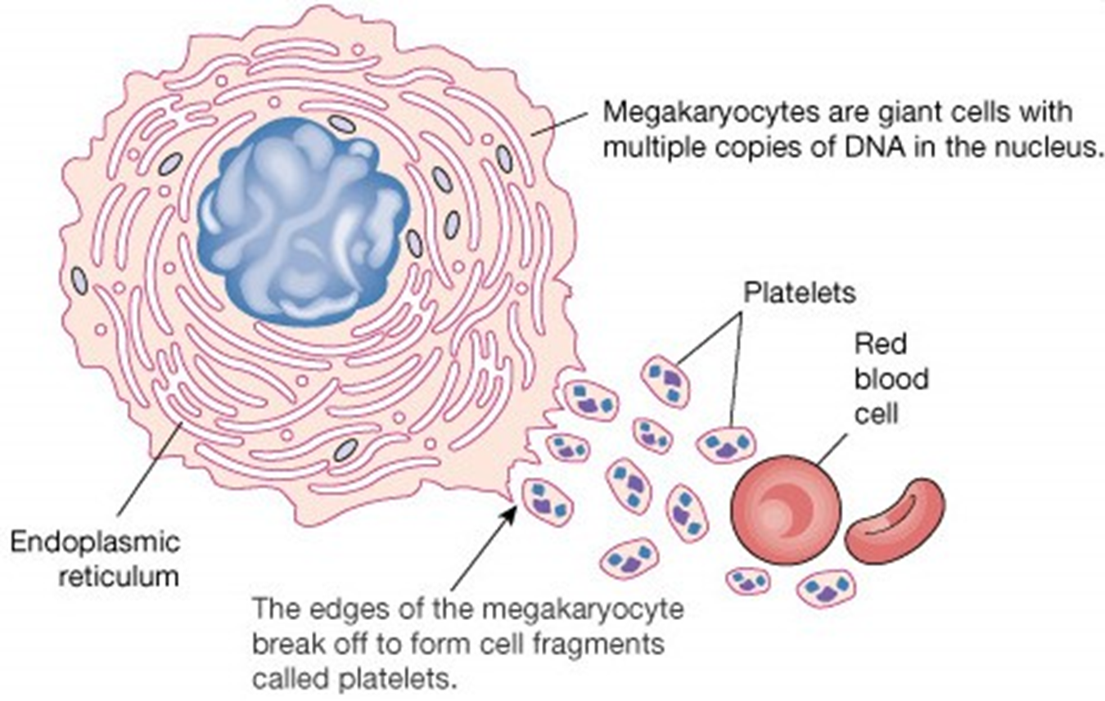
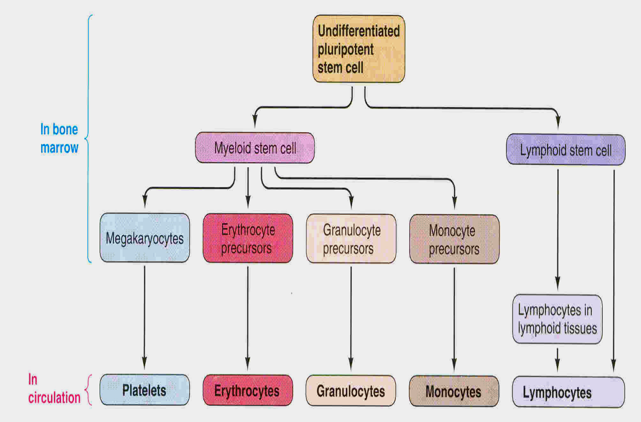
Platelet characteristic
Anuclear and discoid cell ( spherical when activated) Contractile, adhesive, cell fragments. Store coagulation factors & enzymes. Surface binding sites glycoproteins (surface antigens). Sequestered in the spleen, (hypersplenism may lead to low platelet count). They are formed in the bone marrow from megakaryocyte.
shape | minute round or oval discs
size | 1.5–3.0 µm
Count | 150 x103-300x103/ml
location | 80% in blood & 20% in spleen.
Life spine & Half life | 7-10 days
كانو يعتقدون ان السيرفس الخارجي للبلاتليتس سموذ واملس لكن لما شافوها بالالكترومايكروسكوب وكبروها لاحظوا ان سيرفسها غير مستوي يشبه السلكاي والقيراي في الدماغ عشان يزيد لي السيرفس ايريا.
البلاتليتس ما اكتشفوها زي الوايت بلود سيلز والرد بلود سيلز كانو لما يشوفونها في السمير يعتبرونها بكتيريا او سيل فما كانوا يعطونها اي اهتمام حتى اكتشفوها وبدأت الابحاث عليها
More than WBCs and less than RBCs
لاني احتاجها وقت الطوارئ بس مو زي الرد بلود سيلز احتاجها طول الوقت
Platelets rich in actin and myosin which means it's able to contract that’s why it called small smooth muscle.
Functional characteristic of platelet
motile | Actin and myosin molecules
Active | Endoplasmic reticulum Golgi apparatus & mitochondria.
Enzymes | Systems For Synthesis Of Prostaglandins
granules | Dense or alpha granules | Alpha granules
 | Serotinin ADP Ca++ | Coag factor PDGF kemokines
If the patient has normal platelet count but still have problems in aggregation and clotting formation, we should do platelet functional studies to check the receptors.

Slide 4
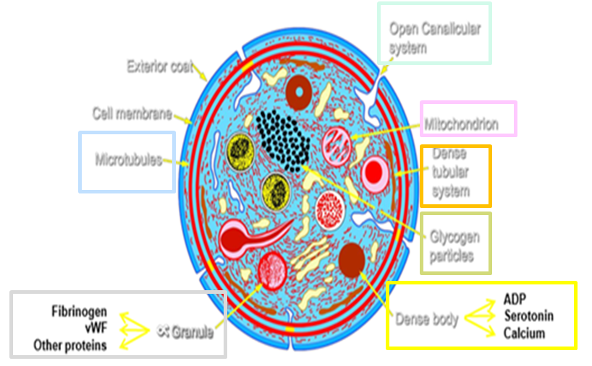
Important
Platelet ultra-structure
Dens body (delta granules) | Calcium
 | Serotonin
 | ADP\ATP
Alpha granules | Von Willebrand factor(VWF)
 | Thrombospondin
 | P-selectin
 | fibrinogen
 | Chemokines (PF4)
Mitochondria
Dens tubular system
Glycogen particles
Microtubules
Open canalicular system (OCS)
الالفا قرانيولز شكلها يشبه الدنس بدي لكن الدنس بدي لونها اغمق تحت الالكترومايكروسكوب والالفا قرانيولز عددها اكثر
هذي القنوات (الكنال) تميز البلاتليتس وهي عباره عن انفاجنيشن للسيل ممبرين داخل الخليه، وهو سستم من القنوات داخل الخليه له ثلاث وظائف:
لما يصير اكتفيشن للرستنغ بليتلتس الاوبن كاناليكيولار سيستم بتطلع منه زي الاذرع فايدتها انها تزيد السيرفس ايريا.
تطلع منه محتويات القرانيولز من الاوبن كاناليكيولار سستم.
اي ستميولاي في البلازما او البلود تدخل للبليتلتس عن طريق الاوبن كاناليكيولار سيستم، والقنوات حقت الاوبن كاناليكيولار سستم تتميز انها متصله ببعضها.
السيتوبلازم للبلاتليتس يتميز انه ما فيه نواه زي الار بي سي

Slide 5
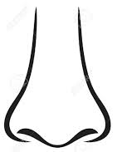
Platelet receptors
Very Important
Missing of anyone of these receptor the patient may suffer from bleeding disorder “disease” (patient has normal platelets COUNT).
Hi ! I’m the platelet ☺
I’ve 5 receptor
GP Ia, GP VI
Collagen
will bind with collagen
(GP Ib-IX-V)
vW Factor
One of coagulation factors and it's synthesis by endothelial cells
Responsible for adhesion
(TP α)
TXA2 (thromboxane a2)
(GP IIb-IIIa)
Fibrinogen
& vWF
Fibrinogen is coagulation factor find in plasma.
Responsible for aggregation
(P2Y12)
ADP

Slide 6
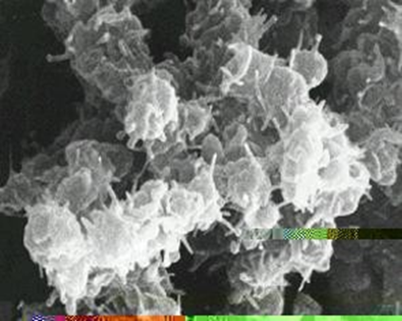
Platelet function
Maintenance of vascular integrity
Initial arrest of bleeding by platelet plug formation |  |  | Stabilization of hemostatic plug by contributing to fibrin formation
Adequate number and function of platelet is essential to participate optimally in haemostasis
General function of platelets ( hemostatic )
1. Vascular phase | 2. Platelet phase | 3. Coagulation phase |  | 3. Fibrinolytic phase
Vasoconstriction probably results from local myogenic contraction of the blood vessels initiated by direct damage to the vascular wall. | platelet responsible for much of vasoconstriction by releasing vasoconstrictor substance thromboxane A2 also it migrate to the site of endothelial wall rupture forming platelet plug. | the clot begin to develop in 15 to 20 seconds if the trauma to the vascular wall has been severe. Activator substance from traumatized vascular wall, from platelets, and from blood proteins adhering to the traumatized vascular wall initiate the clotting process. |  | once the blood clot has formed, it can follow one of two courses: 1) it can become invaded by fibroblasts which subsequently form connective tissue all through the clot, or 2) it can dissolve. The fibrous tissue formation is partially promoted by growth factors secreted by platelet
Only in Females’ Slides
Just read it
The formed plug is weak and transient so it needs to be more strong by formation of fibrin
Hemostasis
9:59
Coagulation & Fibrinolisis
3:56

Slide 7
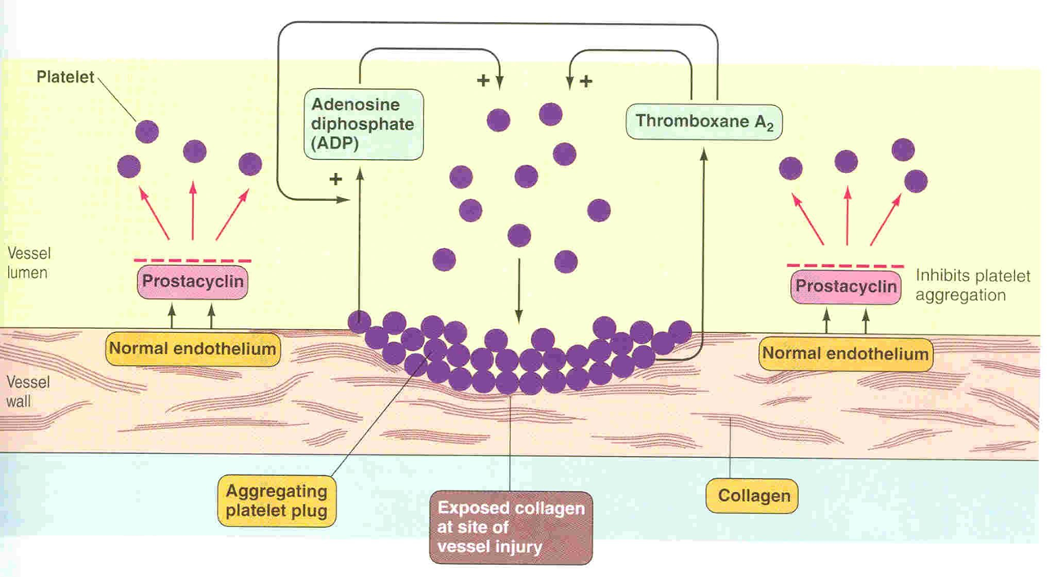
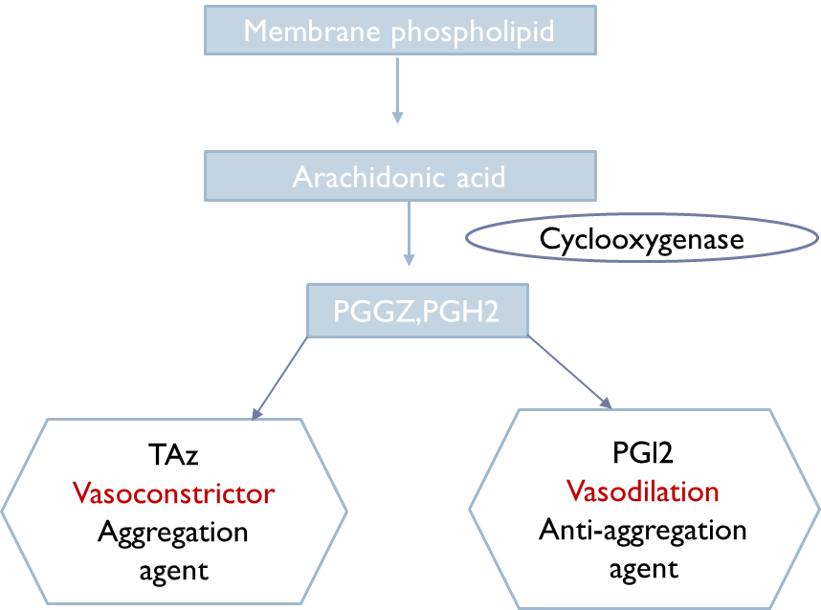
Platelet activation
1. Adhesion (Platelets + Endothelial tissue) | Platelets stick to exposed collagen underlying damaged endothelial cells in vessel wall. Platelets are activated by adhesion: extend projections to make contact with each other. platelet is a quiet cell they call it quiescent cell, but don't touch her it will turn to dangerous cell. البلاتيت هذي تمشي طول الوقت بس في حالة خاملة زي المرور تمشي بهدوء وو قت الحاجة تجي، وزي العلكة قبل الاستخدام ماتلصق، يصير في انتراكشن بين الكولاجين والبلاتليتس عن طريق الرسبتور glycoprotein 1A and glycoprotein 6 لان في جاذبيه شديده بين الكولاجين والبلاتليتس وهذي العمليه تسمى Adhesion وهذي الطريقه الاولى اللي هي الكولاجين مع البلاتليتس دايركت لكن في طريقه ثانيه ان البلاتليتس تشبك مع الكولاجين عن طريق وسيط اللي هو vWf ☺ adhesion (interaction between platelet and subendothelial tissue) - direct way: when there's injury, the collagen explode (there's strong attraction between platelet and collagen, so as long as the collagen covered the platelet won't adhere endothelial cells, and when there's explosion there will be uncover to the collagen and the attraction will happen (binding by coreceptor)). - indirect way: the Von Willebrand factor will stick to the collagen when there's injury and help the platelet to bind toit.
2. Shape change (Platelet Activation) | Platelet Activation means changing in platelet shape to form the plug. When platelets come in contact with damaged vascular surface, especially collagen fibers, they immediately change their shapes into globular disc, begin to swell and form irregular shape with protruding from their pores. ADP will activate more platelets and make it sticky and then platelet can interact with another platelet to form aggregation.
3. Aggregation (Platelets + Platelets) | Adhering one platelet with other one. Activated platelets stick together and activate platelets to form a mass called a platelet plug. Plug reinforced by fibrin threads formed during clotting process. Fibrinogen is needed to join platelet to each other via platelet fibrinogen receptors.
Only in Females’ Slides Except the Purple sentence.
الأصفر كولاجين والأخضر بلاتيت
بلاتيت +كولاجين = Adhesion
why thromboxane A2 and prostacyclin are together even when they're opposite in action? to maintain balance.
- platelet plug fast to form but weak and easy to break down, what's make it strong? when phospholipide released to the surface of the cell and reaction of coagulation and formation of fibrin will happen.

Slide 8
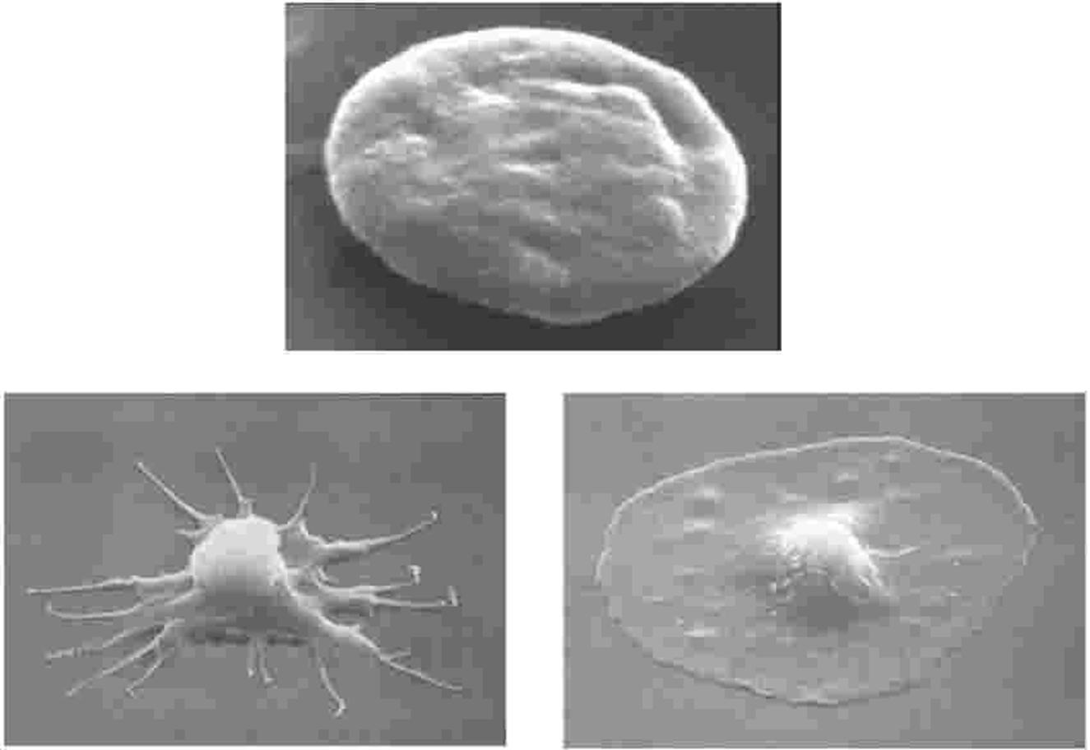
Platelet activation
4. Release reaction | Activated Platelets Secrete the component inside dense body (ADP,ATP,CA+) released: 1. ADP \ ATP: causes stickiness and enhances aggregation. ATP released by activated platelet will travel to another silent platelet and turn it to active. 2. Platelet phospholipid (PF3): causes clot formation. 3. 5HT: causes vasoconstriction (decreasing blood flow through the injured vessel) and activating other platelets. 4. Thromboxane A2 (TXA2): is a prostaglandin formed from arachidonic acid. Its Function: - vasoconstriction (decreasing blood flow through the injured vessel). - Platelet aggregation (Very strong aggregator) -TXA2 inhibited by aspirin (Aspirin will inhibit cyclooxygenase enzyme)
5. Clot reaction | Myosin and actin filament in platelet are stimulated by to contract during aggregation further reinforcing the plug and help release of granule contents. 1- Platelets activated by adhesion. 2- Extend projections to make contact with each other. 3- Release: thromboxane A2, serotonin & ADP activating other platelets. Serotonin & thromboxane A2 are vasoconstrictors decreasing blood flow through the injured vessel. ADP causes stickiness and enhance aggregation. clot retraction is a result of actin and myosin, so they're stimulated to contract during aggregation, why? inforce further platelet plug and help healing. after sealing the platelet release growth factor those proteins act as healing factor to repair blood vessels, stimulation for smooth muscle cell synthesis and fibroblast. نفس فكرة حقن نضارة البشرة
Only in Females’ Slides
Resting platelet
Activated platelet
Spread platelet
The benefit of spreading is to act as physical covering of injuries

Slide 9
Role of platelet in coagulation (Cell based model)
Only in Females’ Slides
This is ONLY FOR YOUR INFORMATION.
بس المطلوب تعرفون من هذه الصورة أن الـ
Cell based model means the Extrinsic & intrinsic pathway occur in the surface of the platelets & endothelium.
TF
VIIa
IXa
fibroblast
Propagation
Xa
Prothrombin
Thrombin
Thrombin
Prothrombin
VIIIa
XIa
Xa
IXa
XIa
Platelet
Amplification
Activated platelets

Slide 10
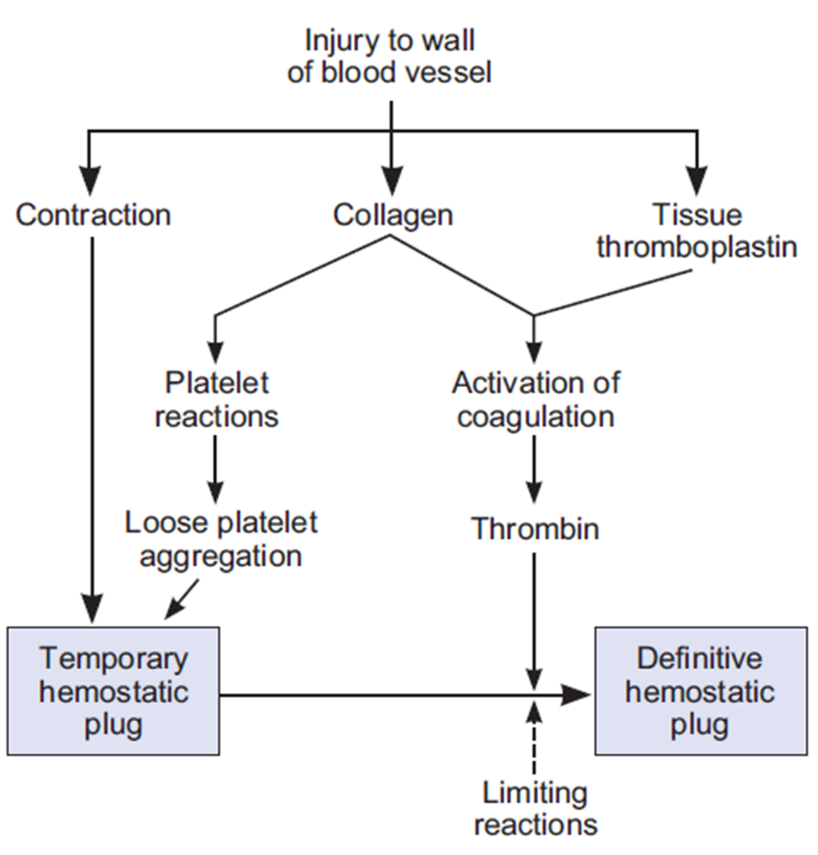
Only in Females’ Slides
Summary of platelet activation (from slides)
Platelets are cell fragments derived from megakaryocyte in the bone marrow .
Platelets play a pivotal role in hemostasis by arresting bleeding from an injured blood vessels.
Bleeding can result from : platelet defects acquired or congenital.
Platelet function tests are used to detect abnormal platelet function.
Platelets are activated when brought into contact with collagen ,exposed when the endothelial blood vessel lining is damaged.
Activated platelets release a number of different coagulation and platelet activating factors.
Transport of negatively charged phospholipids to the platelet surface; provide a catalytic surface for coagulation cascade to occur.
Platelets adhesion receptors (integrins): Platelets adhere to each other via adhesion receptors forming a hemostatic plug with fibrin.
Myosin and actin filaments in platelets are stimulated to contract during aggregation further reinforcing the plug and help release of granule contents.
GPIIb/IIIa: the most common platelet adhesion receptor for fibrinogen and von Willebrand factor (vWF).
Only in Males’ Slides

Slide 11
Bleeding disorders (platelet defects)
Deficiency in number (Thrombocytopenia) |  |  | Defect in function (May be acquired or congenital)
Thrombocytopenia
Causes | Decreased production | Leukemia or lymphoma. Cancer treatments such as radiation or chemotherapy ☹. Various anemias & Toxic chemicals. Medications: diuretics, chloramphenicol. Viruses: chickenpox, mumps, Epstein-Barr, parvovirus, AIDS. Alcohol in excess. Genetic conditions: Wiskott-Aldrich, May-Hegglin.
 | Abnormal distribution | Splenomegaly with sequestration in the spleen.
 | Increased destruction | Medications: quinine, antibiotics containing sulfa, Dilantin, vancomycin, rifampin, heparin-induced thrombocytopenia. Surgery: man-made heart valves, blood vessel grafts, bypass machines. Infection: septicaemia. Pregnancy: about 5% of pregnant women develop mild decrease: Thrombotic thrombocytopenic purpura. Disseminated intravascular coagulation Pseudothrombocytopenia. Partial clotting of specimen EDTA-platelet clumping (عدد البلاتليت ممتاز، ولكن المشكلة في تأديتها وظيفتها) Platelet satellitism around WBCs. Cold agglutinins. Giant platelets.
Only in Females’ Slides
Normally in healthy people there are thousands of injuries occur in blood vessels but we don't feel them because platelets repair everything but if our platelets aren't normal, it may cause bleeding need long time to stop, bruises without trauma, spots on skin, epistaxis or abnormal menstrual bleeding in females.

Slide 12
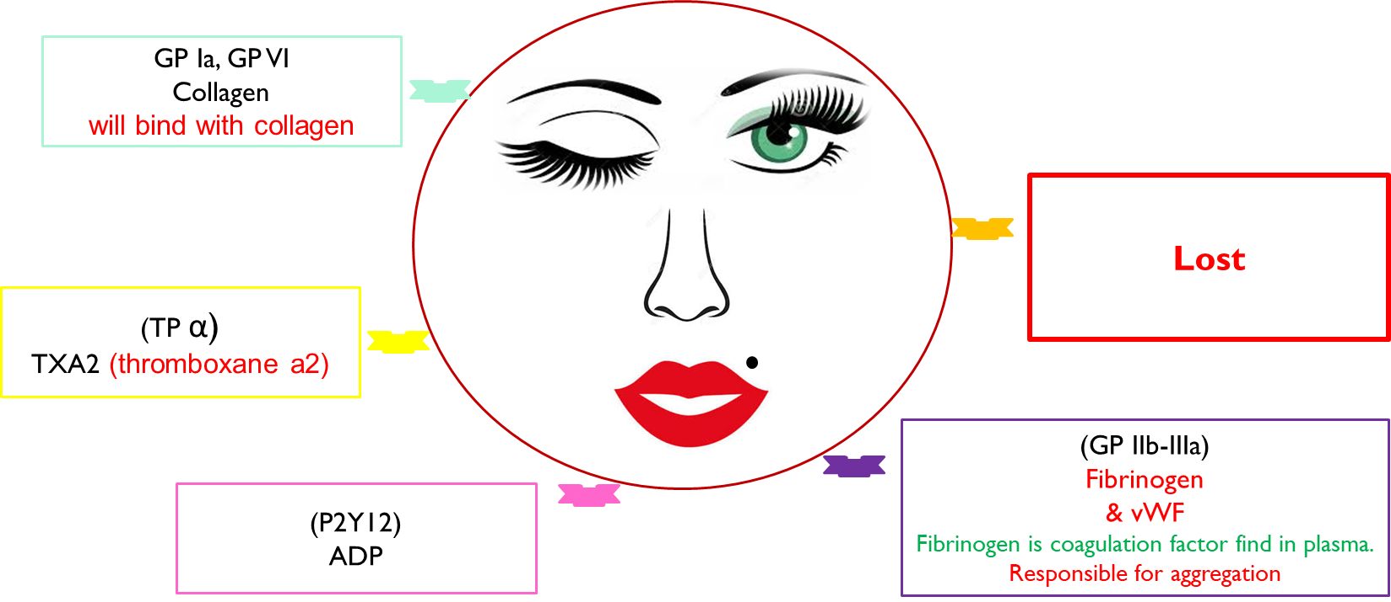
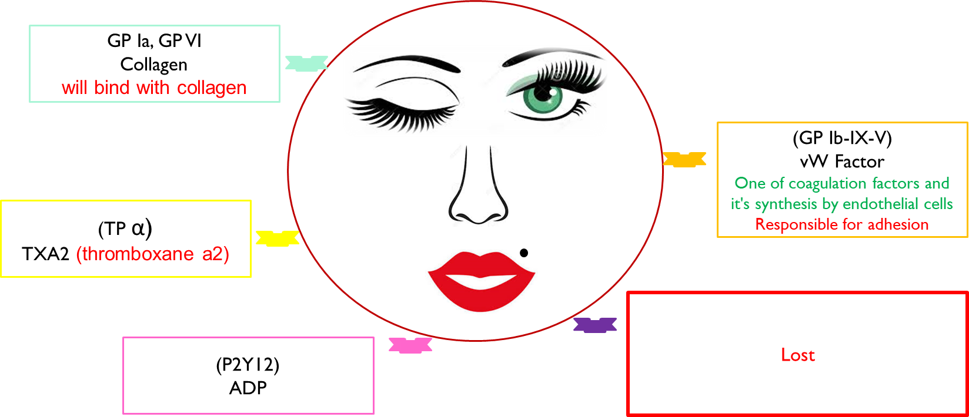
Congenital platelet disorders
Congenital platelet disorders
site | Disorders
Disorders of adhesion | Bernard-Soulier. Deficiency of glycoprotein Ib (Gp Ib), the receptor for von Willebrand factor. BSS is a giant platelet disorder, meaning that it is characterized by abnormally large platelets.
Disorders of aggregation | Glanzmann thrombosthenia. Is an abnormality of the platelets. It is an extremely rare coagulopathy. Deficiency or low levels of glycoprotein IIb/IIIa (Gp IIb/IIIa), which is a receptor for fibrinogen. As a result --> no fibrinogen bridging of platelets to other platelets can occur, and the bleeding time is significantly prolonged ( Aggregation ).
Disorders of granules | Grey Platelet Syndrome. Storage Pool deficiency. Hermansky-Pudlak syndrome. Chediak-Higashi syndrome.
Disorders of cytoskeleton | Wiskott-Aldrich syndrome.
Disorders of Primary Secretion | Receptor defects (TXA2, collagen, ADP, epinephrine).
Disorders of production | Congenital amegakaryocytic thrombocytopenia. MYH9 related disorders. Thrombocytopenia with absent radii (TAR). Paris-Trousseau/Jacobsen.
Bernard-Soulier syndrome
Glanzmann thromasthenia

Slide 13
Laboratory testing of platelet function
Test | Normal value | Important | N.B
Platelet count shape or Peripheral smear and platelet count | 100,000 - 400,000 cells/mm³ | Thrombocytopenia | اذا كان عندها نازل معناته عندها ثرومبوسايتوبينيا
Electron-microscope | - | To see the shape and granules | ادرس اذا القرانيولز موجوده ولا لا
Bleeding time (duke method) | 2-8 minutes | Bleeding disorders | If it's prolonged that's mean platelets defect We check for platelet plug formation (aggregation) so, in thrombocytopenia bleeding time prolonged but clotting time normal.
Platelet aggregation | - | A platelet aggregation test requires a blood sample. The sample will be examined to see how the platelets are distributed through the plasma. Plasma is the liquid part of the blood. The lab technician will also add certain chemicals to your blood sample to tes how quickly your platelets form a clot. Also called aggregometry. | In (PRP) platelet rich plasma : Provides information on time course of platelet activation. Agonists: ADP Adrenaline Collagen Arachidonic acid Ristocetin Thrombin Reference ranges need to be determined for each agonist.
Platelet function analyzer (PFA -100) | Normal aggregation | Thrombocytopathy (normal count) (congenital or acquire → aspirin) | In hemophilia bleeding time normal but clotting time prolonged in severe cases both are prolonged
Flow-cytometry | - | - | -
Granule release products | - | - | -
prothrombin time (pt) | 10-15 secs | Measures effectiveness of the extrinsic pathway | Warfarin prolong this
partial thromboplastin time (ptt) | 25-40 secs | Measures effectiveness of the intrinsic pathway | Heparin prolong this
thrombin time (tt) | 9-13 secs | A measure of fibrinolytic pathway Time for thrombin to convert fibrinogen to fibrin | -

Slide 14
Factors affecting blood platelet count
Only in Males’ Slides
Age
↓in newborn
↑adrenaline
↓Pregnancy
↑Injury
Menstrual cycle:
↓prior to menstruation
↑After menstruation
↑Hypoxia
↓Smoking
Nutritional deficiencies↓
E.g.: vitamin b12,folic acid, iron

Slide 15
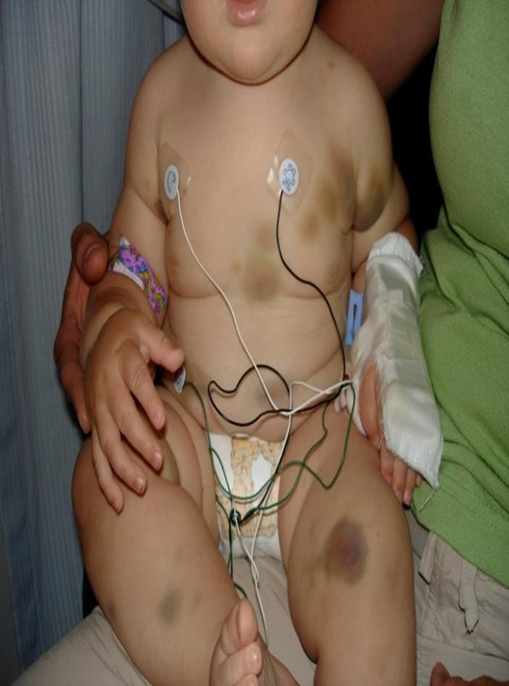
Case study
Only in Females’ Slides
A 7 years old girl complaining of severe bruising since birth and if she had injury she would blee for days. She had epistaxis which lasted for days ,her mother said :”she just bruise more easily than her older sister.”
Investigation:
CBC
RBC
WBC
platelet
Platelet morphology:
Normal
Aggregometry :
Absent platelet aggregation in response to ADP,collagen ,thrombin and epinephrine.
Diagnosis: Glanzmann's Thrombasthenia

Slide 16
Summary
Platelet Activation:
Platelets are activated when brought into contact with collagen exposed when the endothelial blood vessel lining is damaged.
Activated platelets release a number of different coagulation and platelet activating factors.
Transport of negatively charged phospholipids to the platelet surface; provide a catalytic surface for coagulation cascade to occur.
Platelets adhesion receptors (integrins): Platelets adhere to each other via adhesion receptors forming a hemostatic plug with fibrin.
Myosin and actin filaments in platelets are stimulated to contract during aggregation further reinforcing the plug and help release of granule contents.
GPIIb/IIIa: the most common platelet adhesion receptor for fibrinogen and von Willebrand factor (vWF) Bleeding

Slide 17
Thank you!
اعمل لترسم بسمة، اعمل لتمسح دمعة، اعمل و أنت تعلم أن الله لا يضيع أجر من أحسن عملا.
The Physiology 436 Team:
Team Leaders:
Laila Mathkour
Mohammad Alayed
Females Members:
Haifa Alwael
Shatha Alghaihb
Monera alayuni
Males Members:
Fouad Faathi
Hassan alshammari
Contact us:
References:
2017-2018 Dr. Dr. Abeer Alghomals’s Lecture & Notes.
2017-2018 Prof. Shahid Habib’s Lecture & Notes.
Guyton and Hall Textbook of Medical Physiology (Thirteenth Edition.)
اللهم اني استودعتك ما حفظت وما قرأت وما فهمت، فرده لي وقت حاجتي إليه إنّك على كل شيءٍ قدير.

