Slide 1
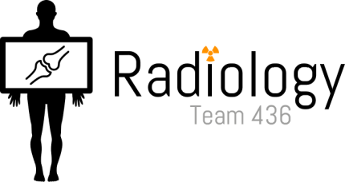
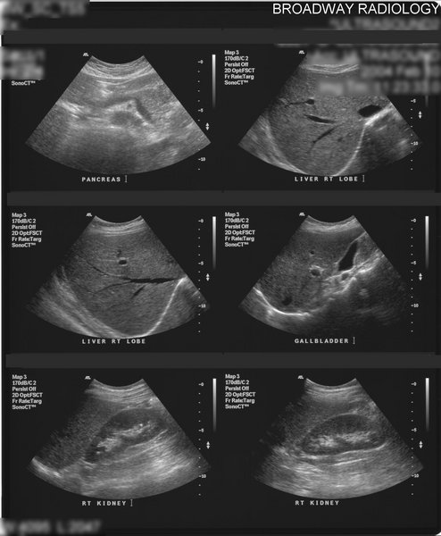
Radiology of the abdomen Lecture -1-
Gastrointestinal tract Block
Objectives
To know radiology modalities used in abdomen imaging mainly GI tract.
To know advantages and disadvantages of each modality.
To know indications and contraindications of each modality.
Overview on normal abdomen appearance and common pathologies including:
Pneumoperitomium.
Peptic ulcer.
Bowel obstruction.
Inflammatory bowel disease.
Large bowel masses/malignancies.
Color codes
Doctor notes Important! Extra

Slide 2
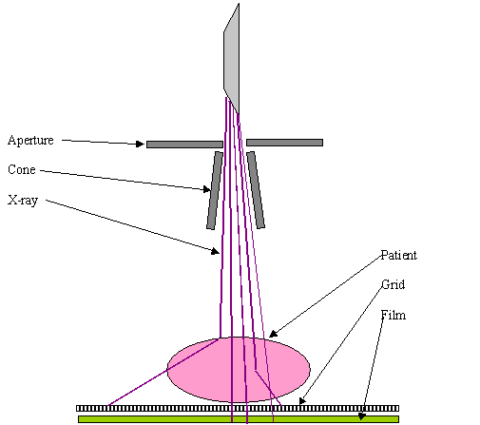
What radiological modalities are GOOD in imaging the abdomen mainly the STOMACH and BOWEL LOOPS?
X-ray
Fluoroscopy
CT scan (CT is ideal for diagnosis)
MRI
US (ultrasound imaging is limited by bone- and gas filled structures, and usually used to asses liver, gall bladder and urinary bladder). So it is NOT used to asses bowels.
X
X-Ray (Abdominal X-ray) First step
X-ray is a form of radiation, that are focused into a beam
X-ray can pass through most objects including the human body.
When X-rays strike a piece of photographic film, they make a picture.
Radiation generator
Beam
The image will
be reflected on
the film.
X-ray crossing the
patient's body.
Important:
Free air means there is a perforation
Multiple air fluid levels means obstruction

Slide 3
Abdominal x-ray (continue)
White: bone and calcification
Grey: soft tissue
Black: air
Advantages | Disadvantages
Widely available fast | Radiation
Cheap and not time consuming | Poor soft tissue details
Excellent in diagnosing free air in the abdomen ex: pnumoperitonium
Good in diagnosing bowel obstruction & stones/calcifications
Indications
Abdominal pain.
Bowel obstruction*.
Stones better by CT.
Masses.
Trauma.
Others, foreign body (swallowed coin), supportive lines (nasogastric tube).. Etc.
Contraindications
Pregnancy is contraindicated in all radiological modalities except ultrasound and MRI.
*In patient history the patient will be presented with pain, cramps and constipation for more than 3 days.

Slide 4
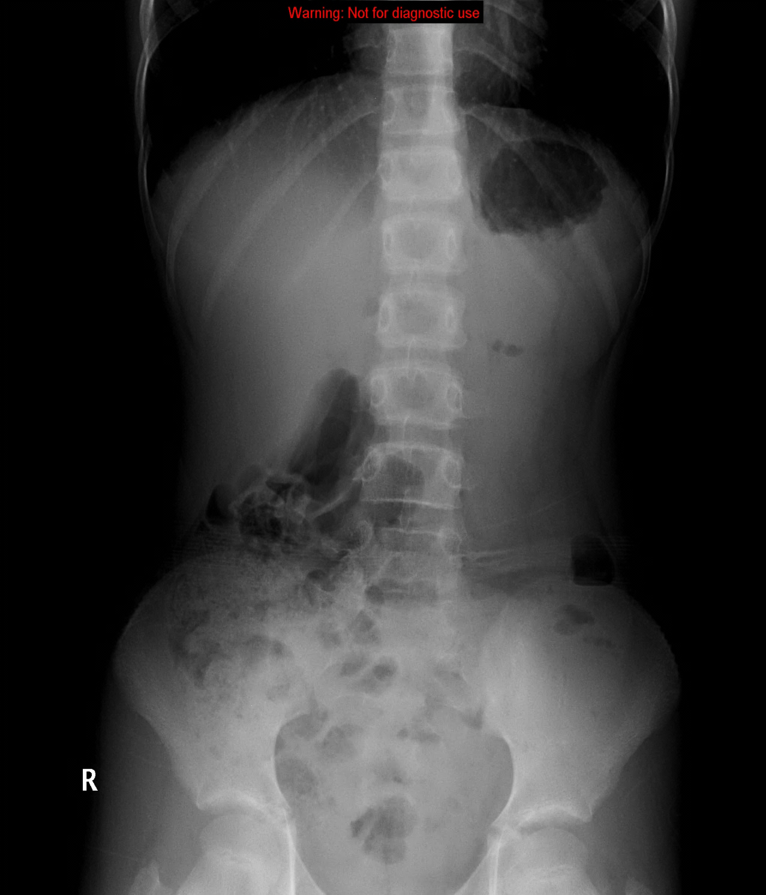
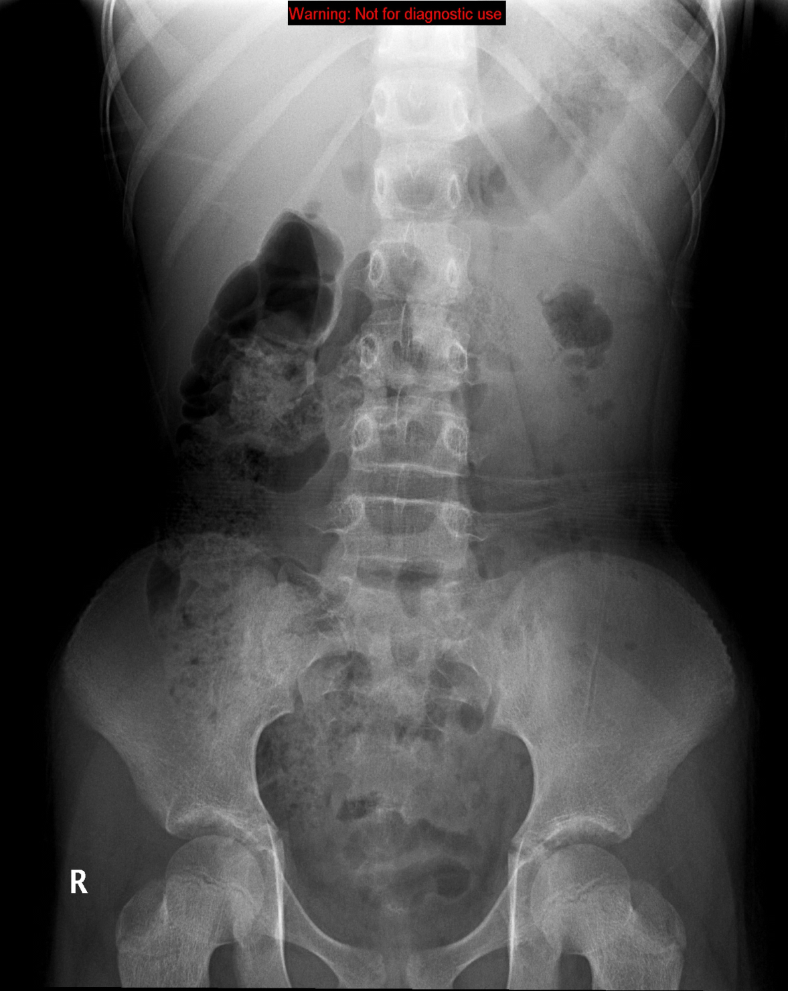
Normal abdominal X-ray*
Right side Left side
Right side Left side
Standing
Supine
1
1- Stomach.
2- Small bowel.
3- Large bowel.
4- Rectum (it’s important to
have air in rectum, if not it means there is an obstruction).
2
3
4
* Notice the different levels of air and fluids due the gravity.
Usually the pancreas is not seen by the x-ray image except if we have calcifications.

Slide 5
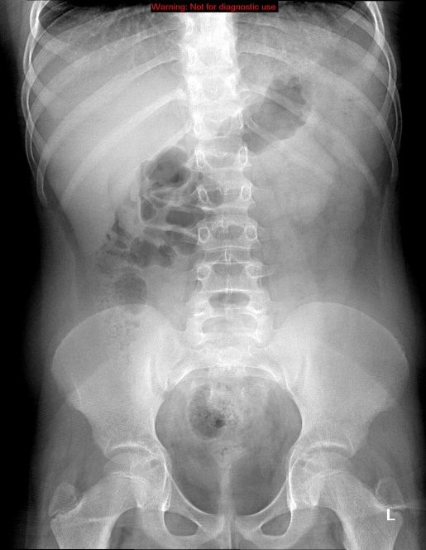
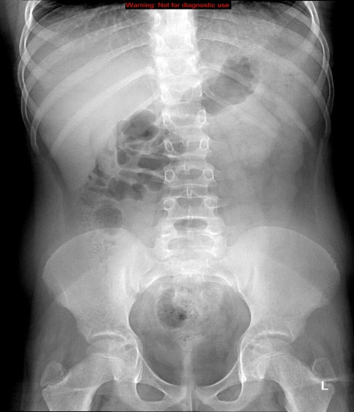
Soft tissues:
2
1
1- Liver.
2- Spleen.
3- Kidneys.
4- Psoas muscles.
3
Right kidney
4
Liver
Spleen
Kidney
Psoas muscle

Slide 6
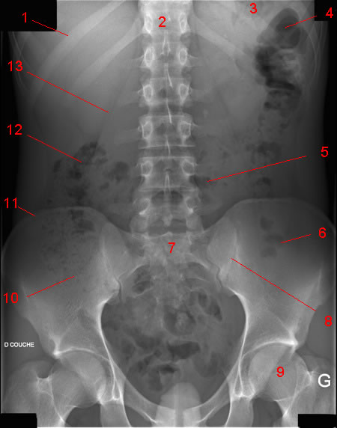
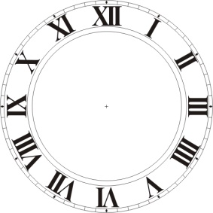
Normal X-ray:
1
2
3
4
1. 11th rib.
2. T12 vertebra.
3. Gas in stomach.
4. Splenic flexure.
5. Transvers colon.
6. Gas in sigmoid.
7. Sacrum.
8. SI (sacroiliac) joint.
9. Femoral head.
10. Gas in caecum.
11. Illiac crest.
12. Hepatic flexure.
13. Psoas margin.
14. Liver.
15. Left kidney.
16. Bladder shadow.
13
14
15
12
5
11
7
6
10
8
16
9
What is normal?
Stomach: Almost always air in stomach*.
Small bowel: Usually small amount of air in 2 or 3 loops.
Large bowel: Almost always air in rectum and sigmoid colon, and varying amount of gas in rest of large bowel.
3, 6, 9 Rule Maximum Normal Diameter of bowel
Small bowel 3cm
Large bowel 6cm
Caecum 9cm
* Absence of air indicates a problem.
In bowel obstruction: the loop preceding the obstruction is dilated, while the loop after the obstruction is narrowed.

Slide 7
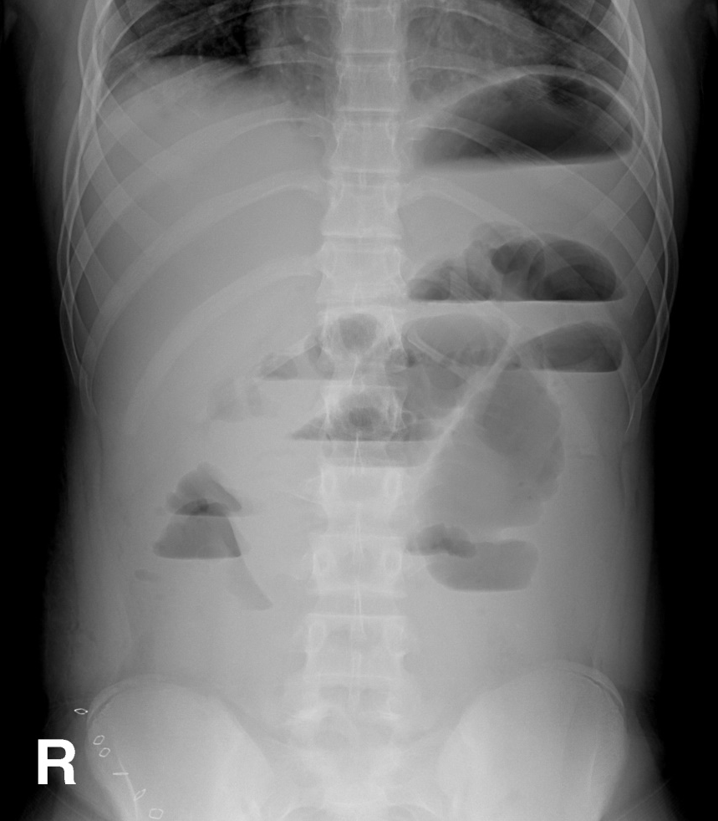
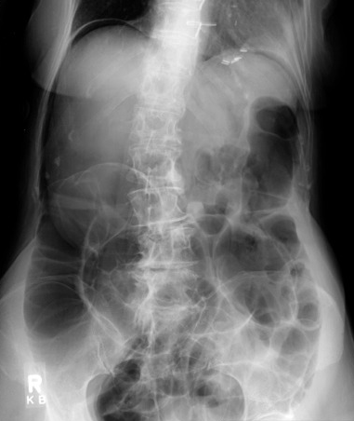
Abnormal X-ray:
Bowel Obstruction*
Is this x ray normal or abnormal? And why?
1- Dilated bowel loops.
2- Multiple air fluid levels.
3- No air in rectum
Is the air inside or outside the
bowel loops?**
It is outside
(pneumoperitonium)
Pneumo = air
Peritonium = in the abdomen
Free air
indicates perforation
(the black area above
The diaphragm)
*To find the cause, we have to use CT or other modality.
** Notice that when we say free air we mean pneumoperitonium, while multiple air levels is for obstruction.

Slide 8
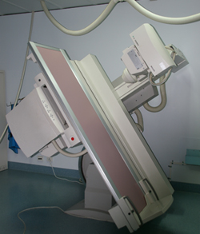
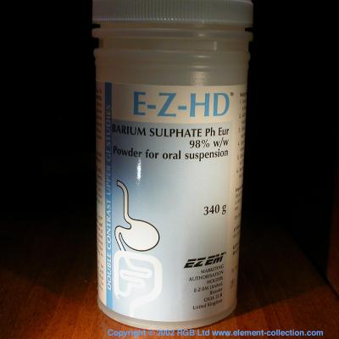
Fluoroscopy
X-ray
+
Oral contrast*
Uses of Barium
Barium swallow Esophagus
Barium meal Stomach
Barium follow through** Small bowel
Barium enema*** Large bowel
Advantages | Disadvantages
Available | Radiation (x2 dose)****
Relatively cheap | Poor in evaluating extra luminal pathologies (outside the GIT)
Excellent in evaluation the bowel lumen and mucosa
*This what shows us the difference from the normal x-ray.
** The longest. *** حقنة شرجية
**** Double radiation: the radiation from x-ray waves & contrast media.

Slide 9
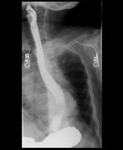
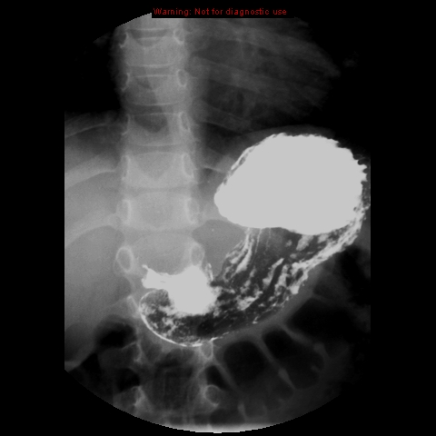
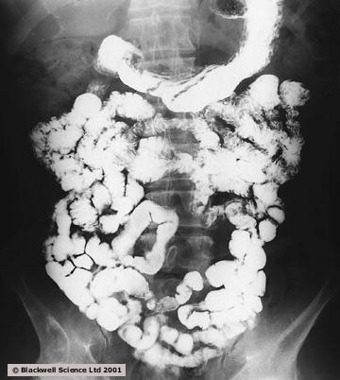
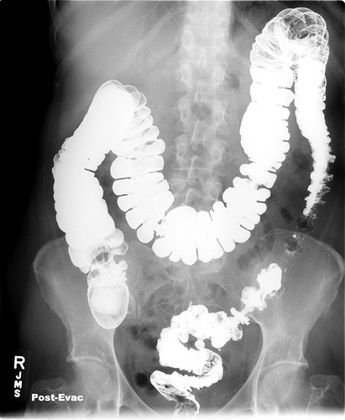
Indications
Assessing the mucosal outline.
Abdominal pain.
Gastro esophageal reflux.
Masses.
Inflammatory bowel diseases. (Auto-immune disorder)
Post surgical, leak.
Contraindications
Pregnancy.
Bowel obstruction.
Bowel perforation (with barium type of contrast). Barium is fat soluble so it may lead to inflammation of the peritoneum (peritonitis), water soluble substances can be used instead.
Fundus
Body
Barium swallow
Barium meal
Lesser
curvature
Esophagus
Antrum
Greater
curvature
Barium follow through
Pathology*
Barium enema
Sigmoid
Rectum
*Normally the contrast will be shown throughout the whole colon.
-Single contrast:evaluate any filling defect within bowel .
-Double contrast: gives us dilates of mucosa .

Slide 10
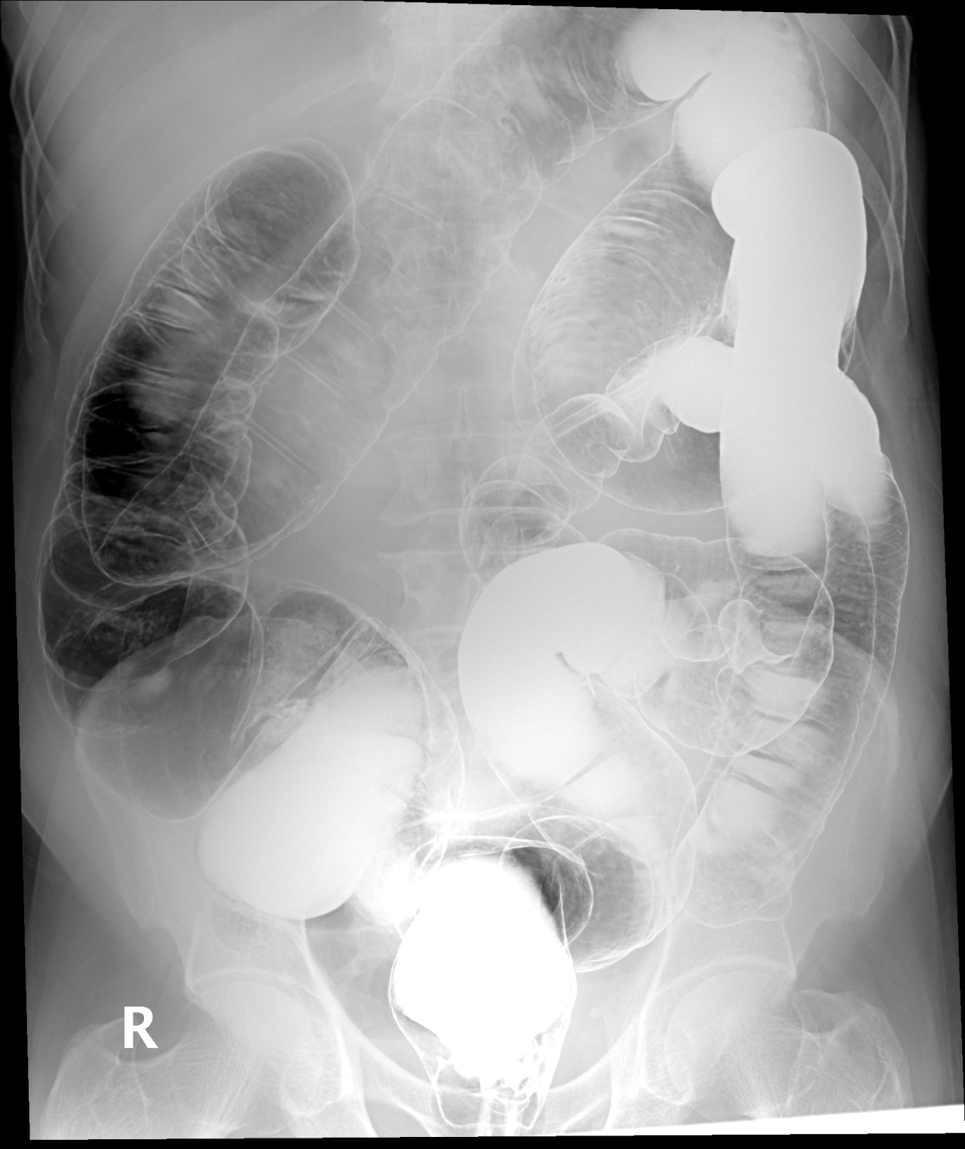
Radiograph of the abdomen:
Double contrast study*
5
4
6
3
7
2
8
1
Rectum. 2.Sigmoid colon. 3. Descending colon.
4. Splenic flexure. 5. Transvers colon. 6. Hepatic flexure.
7. Ascending colon. 8. Cecum.
*Presence of air and fluid.

Slide 11
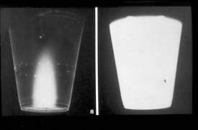
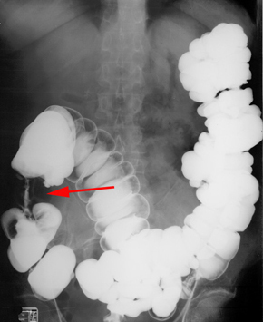
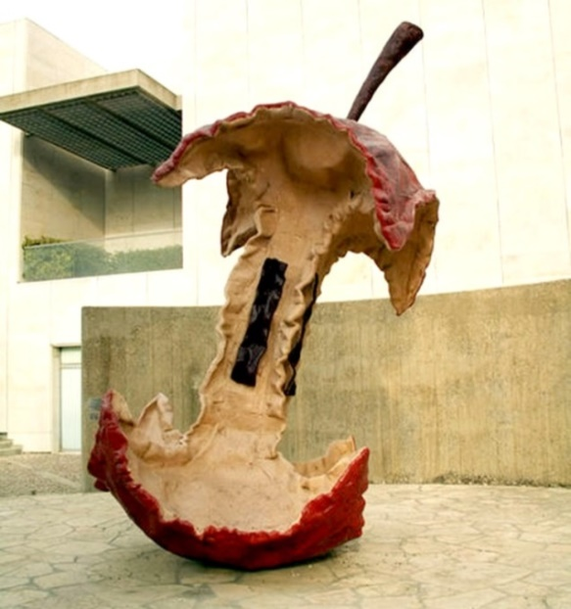
What is double Contrast Barium Enema (DCBE)? EXTRA
Barium is inserted into the colon and then drained out, with only a thin layer of it remaining on the colon wall then filled with air to expand it and provide more details.
Peptic ulcer Disease
Double contrast
Single contrast
*
Apple core sign (Colon cancer):
Abnormal study (Performed by Barium enema)
*Projection from the lesser curvature of the stomach.

Slide 12
CT Scan
Advantages | Disadvantages
Available | Radiation
Short scan time | Some times need intra venous contrast (contraindicated with renal disease)
Much more soft tissue and bone details
Excellent in diagnosing extra-luminal lesions | Relatively expensive
Excellent in diagnosing the cause of bowel obstruction
Indications
Abdominal pain.
To look for bowel obstruction cause .
To diagnose intra-abdominal masses .
Trauma.
Contraindications
Pregnancy.
No IV contrast in renal failure.
Unstable patients (severe trauma/ICU).
If we want to assess:
extra + intra luminal lesions we use CT
intra luminal lesions we use fluoroscopy

Slide 13
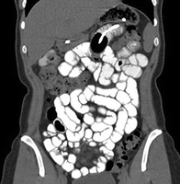
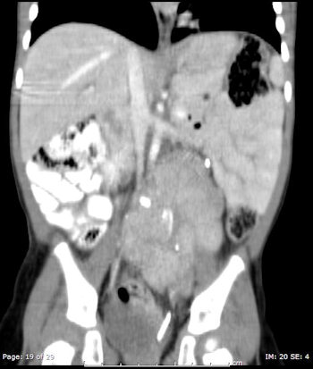
Images with barium follow through
CT with oral contrast (more clear)
Fluoroscopy
(X-ray + contrast)
CT with oral contrast (more clear)
Where is this mass ? Inside or outside the bowel loops?
It is outside* the bowel and causing mass effect.
If the lesion was inside (intra-luminal) so it will not push the bowel.
* Outside because it is pushing the whole bowel to the other side.

Slide 14
MRI
Advantages | Disadvantages
Relatively safe in pregnancy (no radiation) | Expensive
Give much more soft tissue details | Long scanning time
Excellent in diagnosing abdominal solid organ lesion: liver, spleen, kidneys. | Sensitive to motion
Indications
Abdominal solid organ masses.
Inflammatory bowel disease.
Contraindications
uncooperative patients. Moves a lot (Like children)*
Early pregnancy (relative contraindication). In the first trimester the noise of MRI may cause hearing loss in the embryo because it is the time of forming cochlea in inner ear, so usually it is used in very urgent situations only.
No IV contrast in renal failure (relative contraindication).
*in these situations (pediatrics/seizures) usually anesthesia is used to induce sedation.

Slide 15
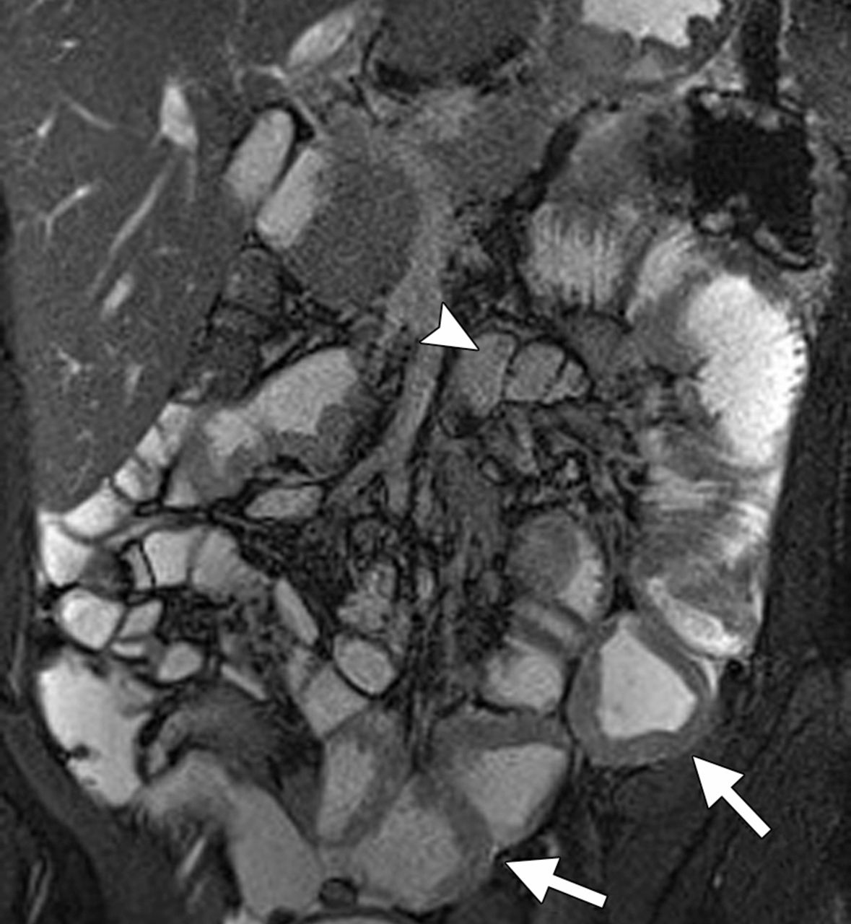
Notice the details are clear
CT scan
MRI
Can you identify what is abnormal ?
Inflammatory bowel disease
Bowel wall thickening
We have 2 types of IBD: 1- Ulcerative colitis. 2- Crohn’s disease.
Ulcerative colitis: Lesion occurs in large bowel except colon.
Crohn’s disease: Skipped lesions, any part of GI usually iliucecal junction.

Slide 16
Summary
X RAY | Fluoroscopy | CT scan | MRI
- Available. - Cheap. | - Available. - Relatively cheap. | - Available. - Short scan time. - More soft tissue and bone details. | - Safe in pregnancy (no radiation). - More soft tissue details.
- Radiation. - Poor soft tissue details. | - x2 Radiation. - Poor in evaluating extra luminal pathologies. | - Radiation. - Some times need intravenous contrast (renal disease). - Relatively expensive. | - Expensive. - Long scanning time. - Sensitive to motion.
- Diagnose obstruction (without the cause). - Free air fluid levels. | - Intra-luminal lesions only such as: a- Colon cancer (apple core sign). b- Peptic ulcer. | - Identify the cause of obstruction. - Extra luminal and intra luminal lesions. - Mass. | - Inflammatory bowel disease.
- Pregnancy. | - Pregnancy. - Bowel obstruction. - Bowel perforation (with barium type of contrast). | - Unstable patients (severe trauma/ICU). - Pregnancy. - No IV contrast in renal failure. | - Uncooperative patients. - Early pregnancy. - No IV contrast in renal failure.
Advantages
Disadvantages
Indications
Contraindications
Uses of Barium
Special thanks for our friends: Elham Alobaid & Rana Barasain for sharing us their summaries =)
Barium swallow Esophagus
Barium meal Stomach
Barium follow through** Small bowel
Barium enema*** Large bowel

Slide 17
Thank you for checking our team =)!
Group Leaders
Hanin Bashaikh
Mohammed Alduayj
Group Members
Ghaida Alsaeed
Najd Altheeb
Abdullah Hashem
Rayan ALQarni
References
Feedback!
Males’ and females’ slides.
Contact us
Editing file
@Radiology436
Radiology436@gmail.com
Test yourself

