Slide 1
General Mechanisms of Hormone Actions
Endocrine Block

Slide 2
OBJECTIVES
By the end of this lecture, students should be able to:
Acquire the knowledge for general consequence of hormone-receptor interaction
Understand different mechanisms of action of hormones
Recognize the biomedical importance due to disturbance in the normal mechanisms of hormonal action

Slide 3
Lecture Outlines
Background
Factors determining the response of a target cell to a hormone
Hormone-receptor interaction
General features of hormone classes
Classification of hormones by mechanism of action
Biomedical importance

Slide 4
Background
Multicellular organisms depend in their survival on their adaptation to a constantly changing environment
Intercellular communication is necessary for this adaptation to take place
Human body synthesizes many hormones that can act specifically on different cells of the body

Slide 5
Background
More than one hormone can affect a given cell type
Hormones can exert many different effects in one cell or in different cells
A target is any cell in which the hormone (ligand) binds to its receptor

Slide 6
Factors determining the response of a target cell to a hormone
The rate of synthesis & secretion of the hormones
The conversion of inactive forms of the hormone into the fully active form
The rate of hormone clearance from plasma (half-life & excretion)
The number, relative activity, and state of occupancy of the specific receptors
Post-receptor factors

Slide 7
Stimulus
Group I hormones
Group II hormones
Hormone release
Hormone/receptor binding
at the target cells
Recognition
Hormone-receptor complex
Second messengers
Signal generation
Effects
Gene transcription
Transporters, channels
Protein translocation
Protein Modification
Coordinated response to stimulus

Slide 8
General Features of Hormone Classes
Group II | Group I
Polypeptides Glycoproteins Catecholamines | Steroids Thyroid Hs (T3 & T4) Calcitriol, retinoids | Types
Hydrophilic | Lipophilic | Solubility
No | Yes | Transport proteins
Short (minutes) | Long (hours – days) | Plasma half-life
Plasma membrane | Intracellular | Receptor
cAMP, cGMP, Ca²⁺, metabolites of complex phosphoinositols, tyrosine kinase cascades | Receptor-hormone complex | Mediator

Slide 9
Classification of Hormones by Mechanism of Action
I. Hormones that bind to intracellular receptors (Steroid-Thyroid superfamily):
Steroid hormones Thyroid Hormones (T₃ & T₄) Calcitriol (active form of vitamin D, 1,25[OH]₂-D₃) Retinoic acid

Slide 10
Mechanism of Action of Steroid-Thyroid Hormones
Steroid Hormones:
Glucocorticoids
Mineralocorticoids
Sex hormones:
Male sex hormones: Androgens
Female sex hormones:Estrogens & Progestins
Thyroid Hormones (T₃ & T₄)
Calcitriol (1,25[OH]₂-D₃)
Retinoic acid

Slide 11
Classification of Hormones by Mechanism of Action continued…
II. Hormones that bind to cell surface receptors A. The second messenger is cAMP
Catecholamines (α₂- Adrenergic) Catecholamines (β- Adrenergic) Ant. Pituitary: ACTH, FSH, LH & TSH ADH (Renal V2-receptor) Calcitonin & PTH Glucagon

Slide 12
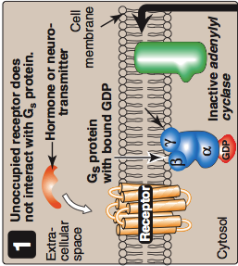
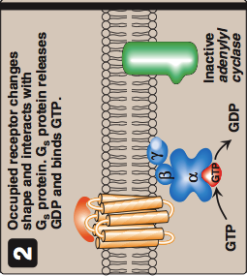
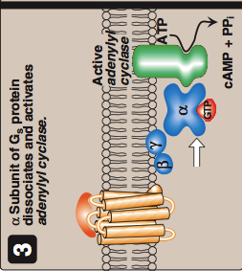
Cascade for formation of cAMP
by cell-surface hormones

Slide 13
Actions of cAMP

Slide 14
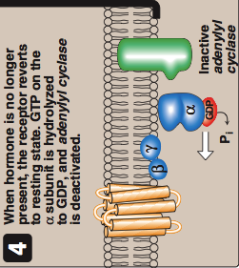
Abortion of Hormonal Stimulus
Х
Release of hormone from its receptor
(unbound receptor)
2. Dephosphorylation of protein
substrate by phosphatase
3. Degradation of cAMP into AMP
by phosphodiesteras
4. Inactivation of protein kinase A
by a decrease of cAMP
5. Hydrolysis of GTP into GDP
6. Binding of α-subunit to βγ-subunits
7. Inactivation of adenylyl cyclase

Slide 15
Classification of Hormones by Mechanism of Action continued…
II. Hormones that bind to cell surface receptors B. The second messenger is cGMP
Atrial natriuretic peptide (ANP) Nitric oxide

Slide 16
Atrial Natriuretic Peptide (ANP)
GC: Gunaylate cyclase

Slide 17
Classification of Hormones by Mechanism of Action continued…
II. Hormones that bind to cell surface receptors C. The second messenger is calcium or phosphatidylinositol (or both)
Acetylcholine (muscarinic) Catecholamines (α₁- Adrenergic) Angiotensin II ADH (vasopressin): Extra-renal V1-receptor

Slide 18
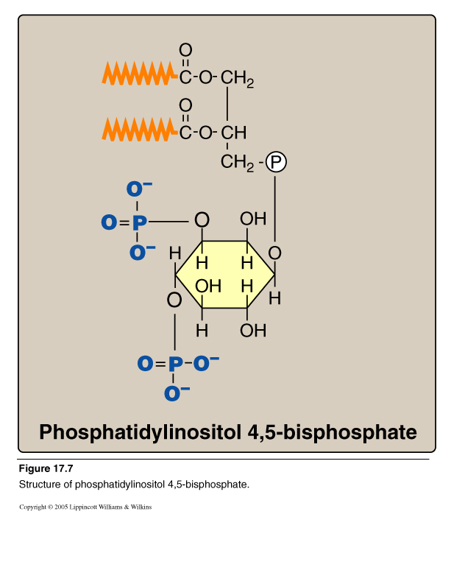
Calcium/Phosphatidylinositol System
Diacylglycerol
(DAG)
Inositol Trisphosphate
(IP₃)
Phospholipase C

Slide 20
Classification of Hormones by Mechanism of Action continued…
II. Hormones that bind to cell surface receptors D. The second messenger is a tyrosine kinase cascade
GH & Prolactin Insulin Erythropoietin

Slide 21
Mechanism of Insulin action

Slide 22
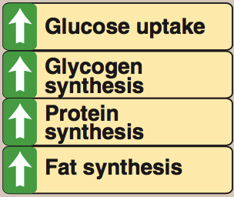
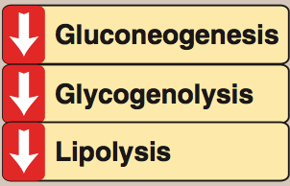
Biologic Effects of Insulin

Slide 23
Biomedical Importance
Excessive (e.g., hyperthyroidism, Cushing), deficient (e.g., hypothyroidism, Addison), or inappropriate secretion (e.g., syndrome of inappropriate secretion of ADH “SIADH”) of hormones are major causes of diseases
Pharmacological treatment of these diseases depends on replacement of deficient hormone (hypo-) or use of drugs that interfere with the mechanism of action of the hormones (hyper- or inappropriate)

Slide 24
Take home message
Hormones are involved in responses to a stimulus, using a variety of signaling mechanisms to facilitate cellular adaptive responses.
Group I hormones are lipophilic, while group II are hydrophilic. Other differences exist between both groups.
Hormones can be classified according to their mechanism of action (specific examples of each category were discussed)
Biomedically, studying hormones’ actions in details helps to:
understand consequences of abnormal hormone release-related diseases (excessive, deficient or inappropriate)
design therapeutic approach for such diseases.

Slide 25
References
Lippincott’s Illustrated Reviews Biochemistry: 6th edition, Chapters 8, 17 and 23.
‪Buxton, Iain LO, and Dayue Duan. "Cyclic GMP/Protein Kinase G Phosphorylation of Smad3 Blocks Transforming Growth Factor-β–Induced Nuclear Smad Translocation." (2008): 151-153.‏‬

Slide 26
THANK YOU

