Slide 1
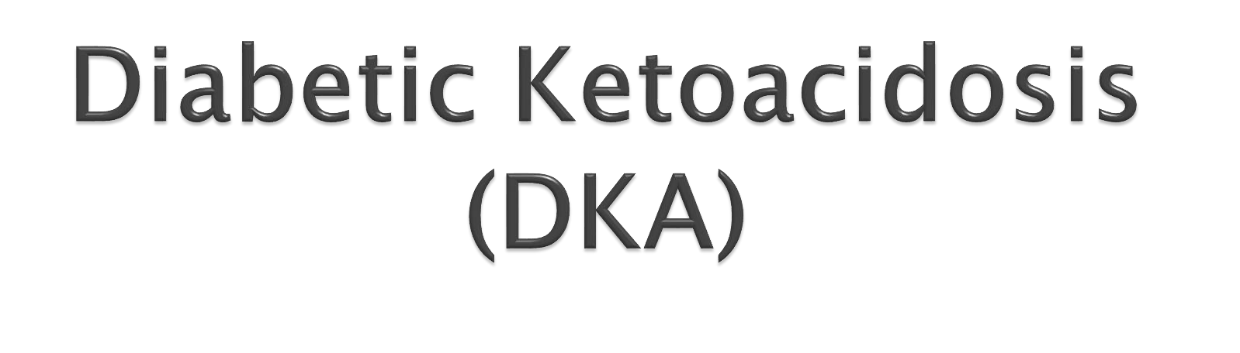

Dr. Reem Sallam, MD, MSc, PhD Clinical Chemistry Unit, Pathology Dept. College of Medicine, King Saud University

Slide 2

Diabetic Complications
Ketone bodies metabolism
DKA:
Definition
Causes and Mechanisms Manifestations Precipitating Factors
Hyperosmolar hyperglycaemic state (HHS) = Hypperosmolar non-ketotic acidosis (HONK):
Definition
Causes and Mechanisms Manifestations
Hypoglycemia: Causes Manifestations
Hormonal mechanisms preventing or correcting hypoglycemia
A case of DKA: (Presentation, Examination, Lab results & their interpretation)
Metabolic changes in DKA:
Changes in CHO, protein and
lipid metabolism
Changes in water, electrolytes, and pH

Slide 3

Diabetic Ketoacidosis (DKA)
Hyperosmolar hyperglycaemic state (HHS)=
Hypperosmolar non-ketotic acidosis (HONK)
Hypoglycemia

Slide 4

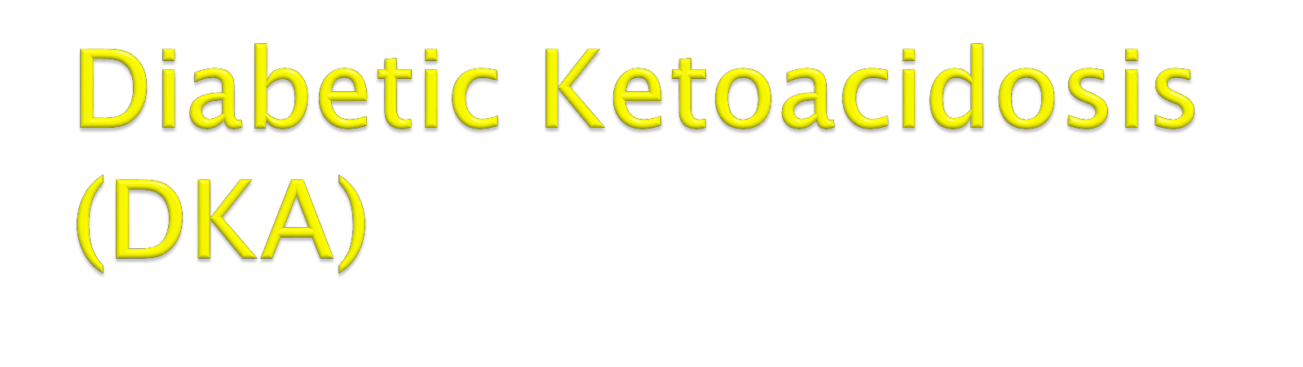





Slide 5

Triad of hyperglycemia, high anion gap
metabolic acidosis, and ketonemia
Characteristically associated with T1DM
It has become increasingly common in T2DM
DKA may be the first presentation of T1DM

Slide 6



Acetoacetate
Acetone
β-Hydroxybutyrate
They are produced by the liver (ketogenesis) and utilized for energy production by peripheral tissues (Ketolysis)

Slide 7
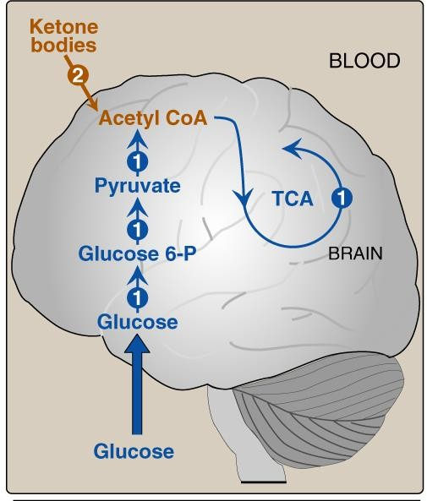
Normally, glucose is the primary fuel for the brain.
It can penetrate the blood brain barrier.
The brain’s GLUT is
insulin-independent.
If glucose is not available for the brain, the brain can utilize plasma ketone bodies, that can penetrate the blood brain barrier, and serve as fuel molecules.

Slide 8
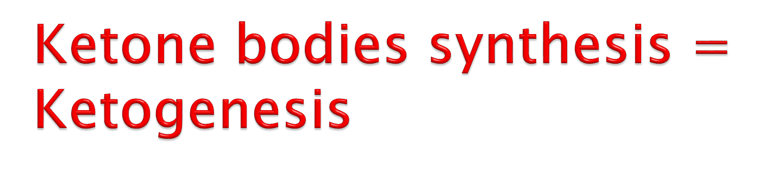
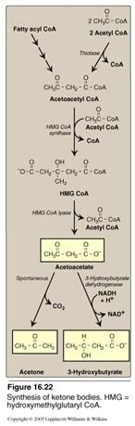
 Occurs in the hepatocyte mitochondria
 In uncontrolled DM there is ↑lipolysis in
adipose tissue → ↑ [FFA] mobilization to liver
→ ↑hepatic FA oxidation → ↑ acetyl CoA which will be channeled into KB synthesis
 HMG CoA synthase is the rate limiting enzyme
 The first KB to be synthesized is acetoacetate.
 Acetoacetate can be:
 reduced to β-Hydroxybutyrate, or
 spontaneously decarboxylated to acetone.

Slide 9

 ↑hepatic FA oxidation → ↑ acetyl CoA which will
be channeled into KB synthesis
 Acetyl CoA + oxaloacetate (OAA) → Krebs cycle
 ↑ Acetyl CoA production activates pyruvate
carboxylase
 Pyruvate carboxylase converts pyruvic acid into OAA
 OAA is used for gluconeogenesis (rather than
Krebs cycle)
 Acetyl CoA is channeled into KB synthesis

Slide 10

 Takes place in extrahepatic tissues
 Occurs in the mitochondria (so cannot occur in RBCs)
 Does not occur in the liver (as the liver lacks the
thiophorase enzyme required for ketolysis)
 β-Hydroxybutyrate is oxidized to acetoacetate (by a dehydrogenase)
 Acetoacetate is converted to acetoacetyl CoA (catalyzed
by thiophorase)
 Acetoacetyl CoA is converted to acetyl CoAs.

Slide 11
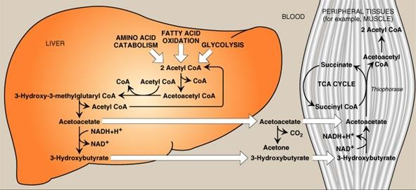

Slide 12



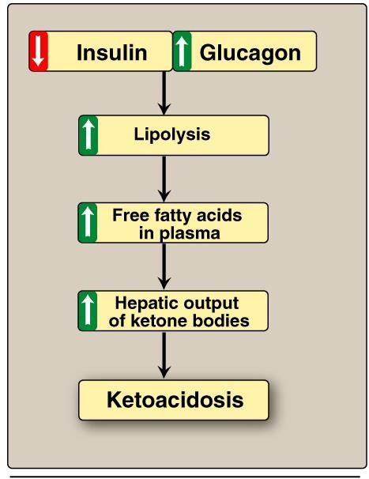
Mechanisms of DKA:
In uncontrolled DM there is
↑lipolysis in adipose tissue → ↑ [FFA] → ↑ mobilization of FFA to liver → ↑hepatic FA
oxidation → ↑ hepatic acetyl
CoA which will be utilized in KB synthesis (ketogenesis) →  ketoacidosis

Slide 13








Mechanisms & Manifestations of DKA
 In uncontrolled DM the rate of ketogenesis is > the rate of ketolysis → ketonemia (↑[KB] in blood)→ ketonuria (↑[KB] in urine).
 Manifestations of DKA:
Fruity odor on the breath (acetone)
Acidosis (low pH of blood because KBs are acids)
Dehydration (due to glucosuria)

Slide 14

 Infection (30-40%)
 Inadequate insulin treatment or non-
compliance (20%)
 Severe illness e.g., Myocardial infarction
 Trauma
 Drugs: e.g., steroids

Slide 15
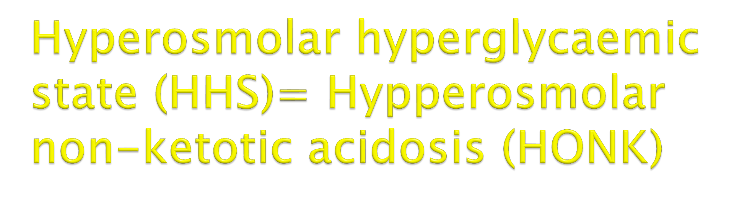

Slide 16
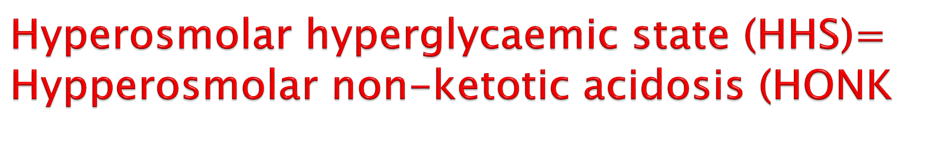
Little or no accumulation of ketone bodies
Serum [glucose] is often >50 mmol/L
Plasma osmolality may reach 380 mosmol/Kg (normal 275-295)
Neurological abnormalities are frequently present
Insulin levels are insufficient to allow appropriate glucose utilization but are adequate to prevent lipolysis and subsequent ketogenesis
Usually occurs in elderly patients with T2DM
Has a substantially higher mortality than DKA (up to 15%)

Slide 17


Slide 18

Common complication of treatment with insulin or oral
hypoglycaemics
More common in patients with T1DM
Manifestations: Characterized by:
  CNS Symptoms (confusion, aberrant behavior, or coma):
see details later
  Low blood [Glucose]
  Symptoms resolved within minutes following the administration of glucose

Slide 19
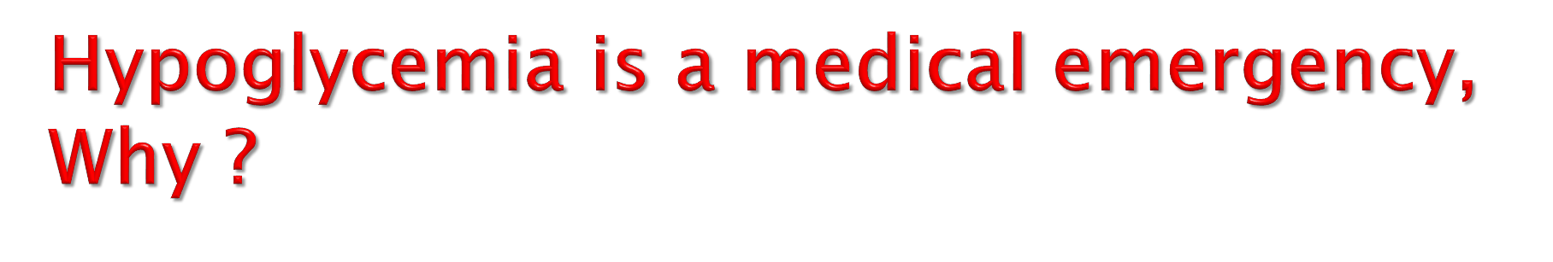
The brain has absolute requirement for a continuous supply of glucose
Transient hypoglycemia → cerebral dysfunction
Severe, prolonged hypoglycemia → brain
death

Slide 20

 Hypoglycemia occurs due to impaired protective responses to hypoglycemia:
Insulin is supplied exogenously and its
release cannot be turned off
Glucagon & adrenaline response to hypoglycemia becomes impaired later in the course of DM

Slide 21





 Clinical presentation:
Symptoms of sympathetic overactivity (plasma [glucose] <3.6 mmol/L, abrupt fall): anxiety, tremors, sweating & palpitation
Symptoms of neuroglycopenia (plasma [glucose]
<2.6 mmol/L, gradual fall): headache, confusion, drowziness and ultimately loss of consciousness or seizures (at plasma [glucose] <1.5 mmol/L)

Slide 22
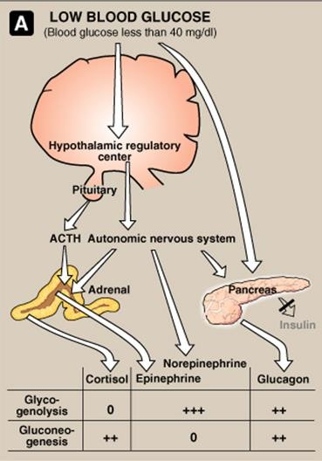
i.e. <2.22 mmol/L
Hormonal mechanisms to
prevent or correct
hypoglycemia:
↓ Production of insulin
↑production of:
Epinephrine & glucagon
Growth hormone
Cortisol

Slide 23
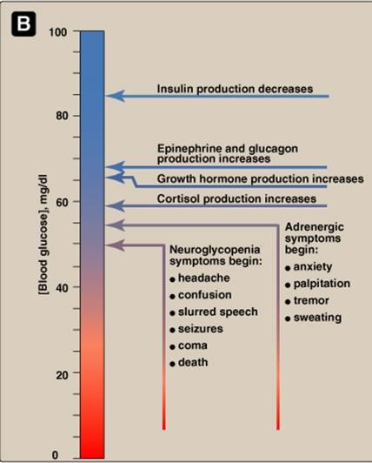
Glycemic thresholds for the various responses to hypoglycemia:
Blood glucose, mmol/L
5.6
4.4
3.3
2.2
1.1

Slide 24

 A 14-year-old girl
was admitted
to a mother
children’s hospital in coma. Her
stated that the girl had been in good health until approximately 2 weeks previously, when she developed a sore throat and moderate fever. She subsequently lost her appetite and generally did not feel well.

Slide 25

 Several days before admission she began to complain of undue thirst and also started to get up several times during the night to urinate. However, on the day of admission the girl had started to vomit, had become drowsy and difficult to arouse, and accordingly had been brought to the emergency department.

Slide 26

On examination:
 She was dehydrated
 Her skin was cold
 She was breathing in a deep sighing manner
(Kussmaul respiration)
 Her breath had a fruity odor
 Her blood pressure was 90/60 mmHg (N:
120/80)
 Her pulse rate 115/min.
 She could not be aroused
A provisional diagnosis of T1DM with complicating ketoacidosis and coma (DKA) was made by the intern on duty

Slide 27

The admitting diagnosis was confirmed by the laboratory findings shown below:
Plasma analytes | Patient’s results | Normal levels
Glucose (mmol/L) | 50 | 3.9-5.6
Ketoacids | ++++ | (trace)
Bicarbonate (mmol/L) | 6 | 22-30
Arterial blood pH | 7.07 | 7.35-7.45
Na⁺ (mmol/L) | 136 | 136-146
Cl⁻ (mmol/L) | 100 | 102-109

Slide 28

Plasma analytes | Patient’s results | Normal levels
PCO₂ (kPa) | 2.7 | 4.3-6.0
*Anion gap (mmol/L) | 35.5 | 7-16
K⁺ (mmol/L) | 5.5 | 3.5-5.0
Urea nitrogen (mmol/L) | 15 | 2.5-7.1
Creatinine (μmol/L) | 200 | 44-80
Albumin (g/L) | 50 | 41-53
Osmolality (mOsm/kg serum water) | 325 | 275-295
Hematocrit | 0.500 | 0.354-0.444
*Anion gap (A⁻)= (Na⁺ + K⁺ )– (HCO₃⁻ + Cl⁻)

Slide 29

Urine analyte | Patient’s results | Normal level
Glucose | ++++ | -
Ketoacids | ++++ | -

Slide 30

Results | Interpretation
Hyperglycemia | Confirm the diagnosis of DKA
Glucosuria
Ketonemia
Ketonuria
↓ pH | Severe metabolic acidosis due to ↑ production of ketone bodies
↓ bicarbonate and PCO₂ | Metabolic acidosis with partial respiratory compensation (the hyperventilation)
↑ anion gap | Due to ↑ ketone bodies in the blood
↑ urea & creatinine | Renal impairment (dehydration → ↓ blood volume →↓ renal perfusion) Dehydration Degradation of protein (for urea)
↑K⁺ | ↓ Uptake of potassium by cells in the absence of insulin
↑ Plasma osmolality | Due to hyperglycemia and fluid loss

Slide 31
Multiple effects
CHO
metabolism
•↓glucose uptake by certain tissues (adipose tissue & muscle)
•↑glycogenolysis
•↑gluconeogenesis
Lipid metabolism
•↑ lipolysis
•↑ fatty acid oxidation
•↑ production of Ketone bodies
Protein
metabolism
•↓ protein synthesis
•↑ protein
degradation
K⁺, Water & pH
•↓ entry of K⁺ into
the cells
•Water loss secondary to glycosuria
•Acidosis due to ↑ production of ketone bodies
DM
DKA

Slide 32

Acute complications of DM include: DKA, HHS, and hypoglycemia 
DKA is a triad of hyperglycemia, ketonemia and high anion gap   metabolic acidosis, and can be precipitated by several stressful   factors.
Ketone bodies (KB) are synthesized in the liver (HMG CoA synthase is 
the rate limiting enzyme) and utilized by peripheral organs and not
the liver (liver lacks thiophorase enzyme)
KB can serve as energy source (this is important for the brain in case 
of hypoglycemia) 

Slide 33
In DKA there is excessive ketogenesis (more than ketolysis) (details of the mechanisms and consequences are required)
HHS is a serious condition, usually occurs in elderly with T2DM, and has high mortality rate.

Hypoglycemia is a medical emergency that might be caused by DM treatment (intensive) and impaired protective mechanisms against hypoglycemia. Its clinical manifestations are due to sympathetic overactivity and neuroglycopenia.
Case presentation, examination of DKA can provide provisional diagnosis, and should be confirmed by comprehensive blood and urine lab investigation including measuring blood glucose, KB, pH, pCO2, electrolytes, osmolality, protein, and kidney function test; anion gap calculation; hematocrit; and urine glucose and KB.

Slide 34


