Slide 1
Endocrine System
Practical Pictures

Slide 2
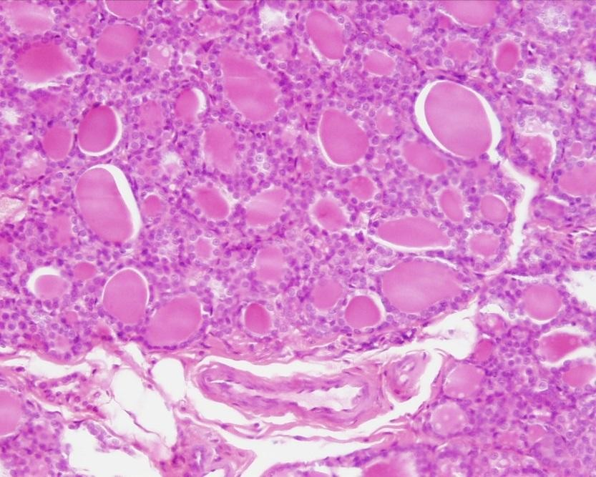
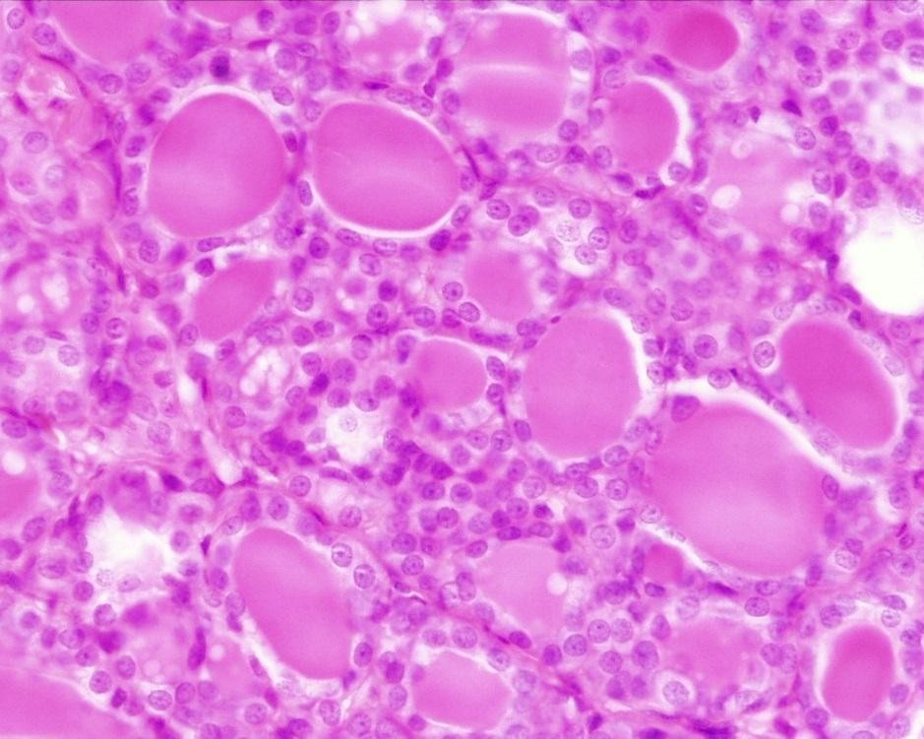
Thyroid Gland

Slide 3
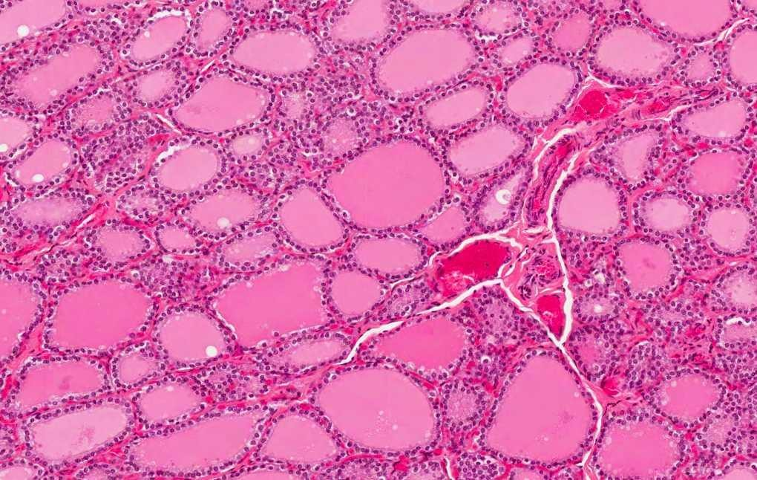
Thyroid Gland

Slide 4
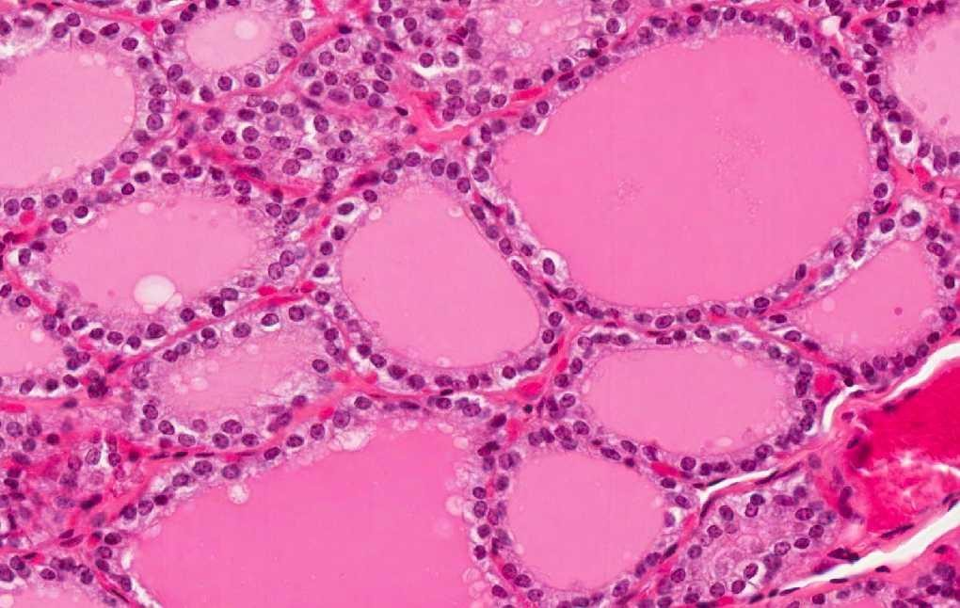
Thyroid Gland

Slide 5
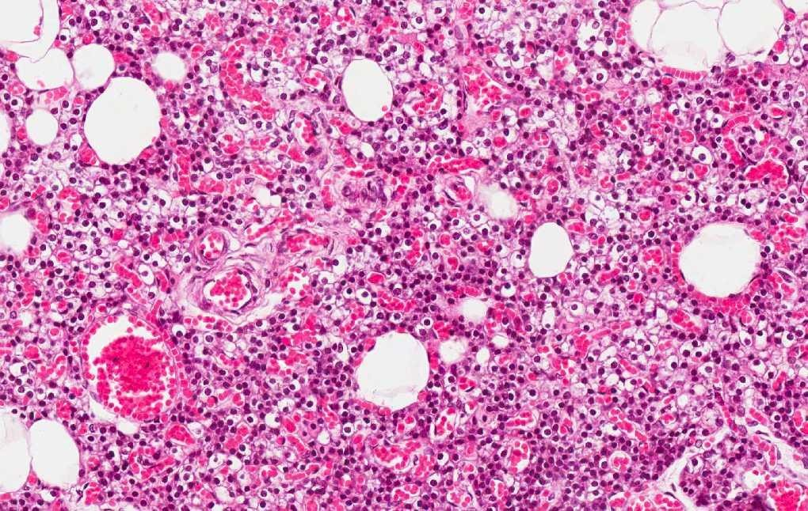
Parathyroid Gland

Slide 6
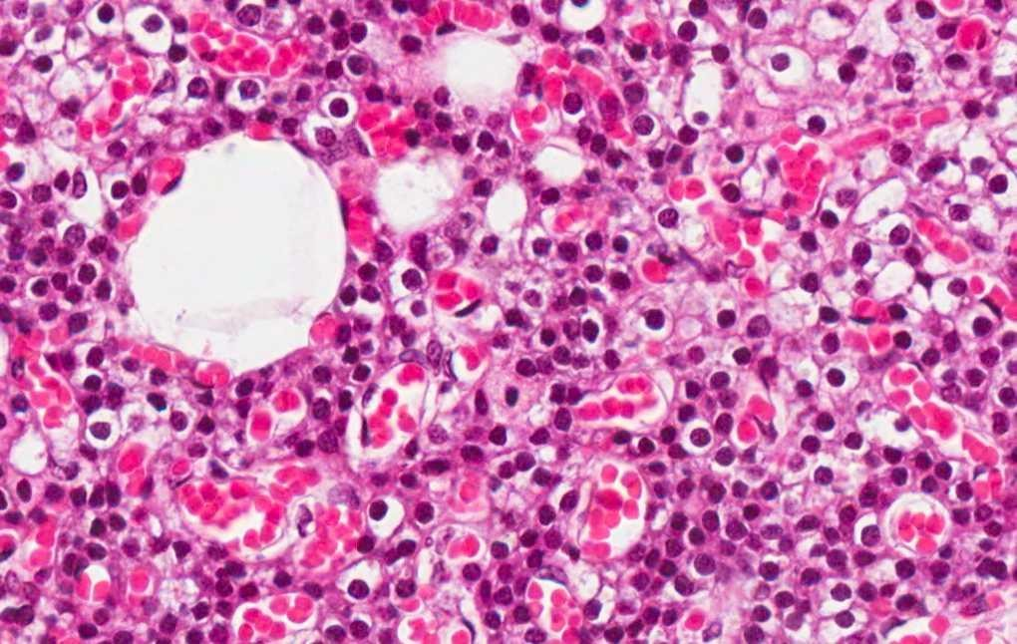
Parathyroid Gland

Slide 7
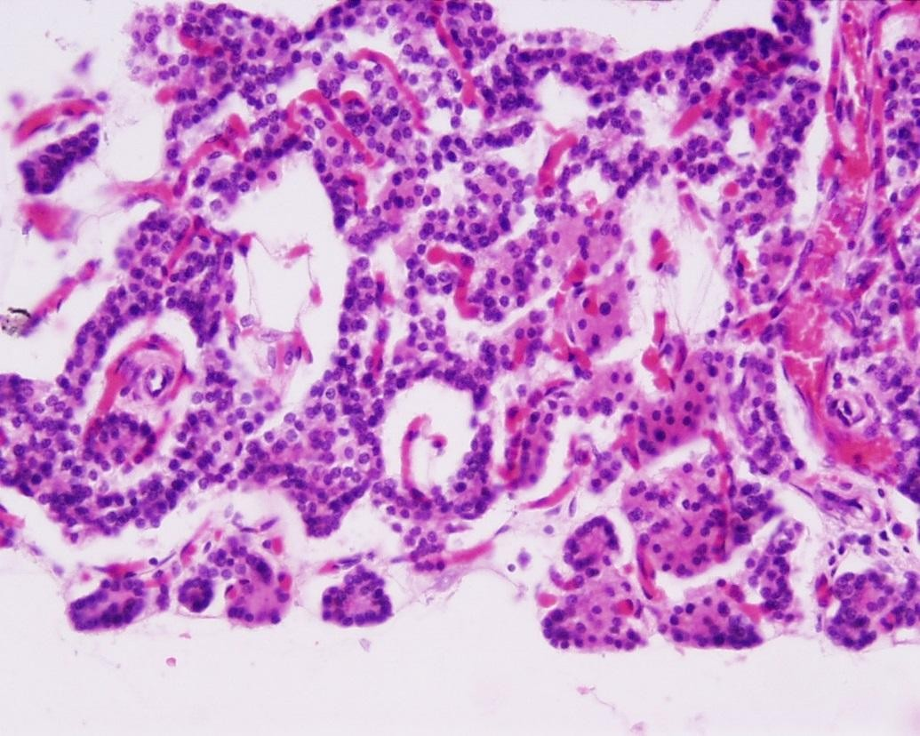
Parathyroid Gland

Slide 8
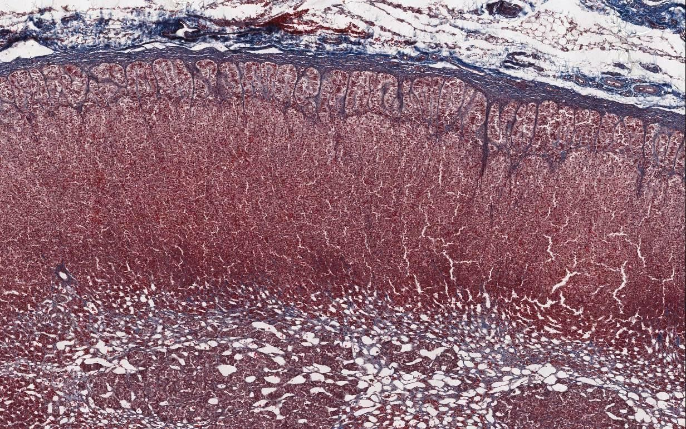
Adrenal Gland

Slide 9
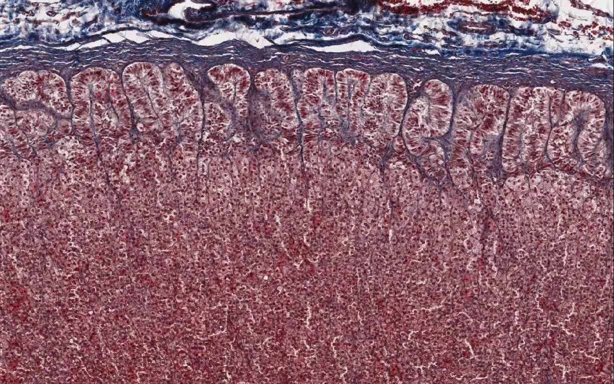
Adrenal Gland

Slide 10
Adrenal Gland-Cortex
Zona reticularis
Zona fasciculata
Zona glomerulosa

Slide 11
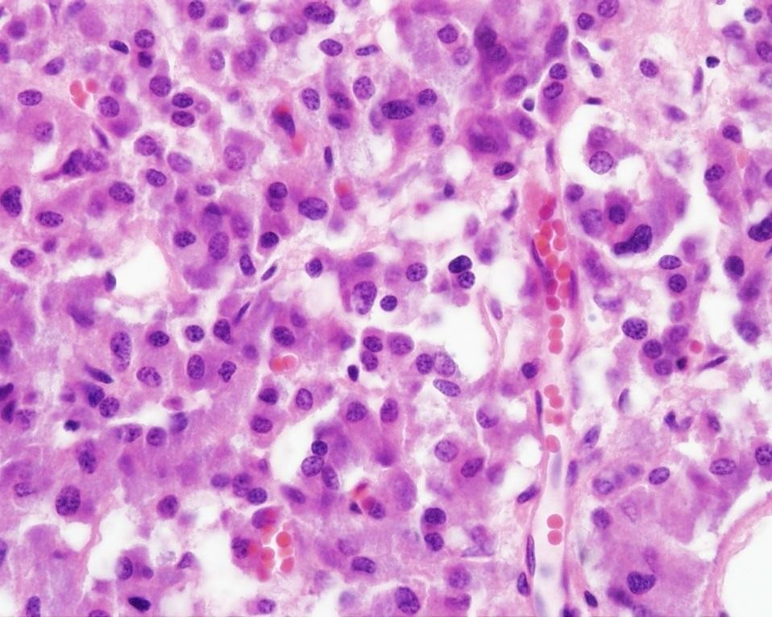
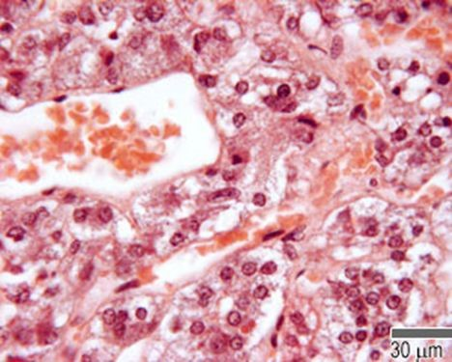
Adrenal Gland-medulla

