Slide 1
DRUGS USED IN HYPOTHYROIDISM
Prof. Abdulrahman
Almotrefi
Prof. Yieldez
Bassiouni

Slide 2
Learning objectives
By the end of this lecture, students should be able to:
- describe different classes of drugs used in hypothyroidism and their mechanism of action
- understand their pharmacological effects,
clinical uses and adverse effects.
recognize treatment of special cases of
hypothyroidism such as myxedema coma

Slide 3
Hypothyroidism
Thyroid gland does not produce enough hormones
may be congenital, primary or secondary
Congenital: in children, hypothyroidism leads to delay in growth (dwarfism),and intellectual development (cretinism)
People who are most at risk include those over age
50 & mainly in females
Prevalence is 14/1000 females and 1/1000 males
Diagnosed by low plasma levels of T3 & T4 and TSH

Slide 4
Primary hypothyroidism
Inadequate function of the gland itself - causes
Iodine deficiency is the most common cause of primary hypothyroidism and endemic goiter worldwide
Autoimmune: Hashimoto’s thyroiditis
Radioactive iodine treatment of hyperthyroidism
Post thyroidectomy
Anti-thyroid drugs (CMZ , PTU)
Other drugs (lithium, amiodarone)
Sub-acute thyroiditis
Thyroid carcinoma

Slide 5
Secondary hypothyroidism-causes
- Hypothalamic disease
Pituitary disease

Slide 6
Early Manifestations of Hypothyroidism
Fatigue and lack of energy
Cold intolerance
Constipation
Weakness
Muscle or joint pain
Paleness
Thin, brittle hair and fingernails

Slide 7
Late Manifestations of Hypothyroidism
Decreased sense of taste and smell
Dry flaky skin
Hoarseness
Menstrual disorders
Puffy face, hands, and feet
Thinning of eyebrows

Slide 8
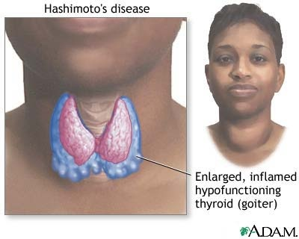

Slide 9
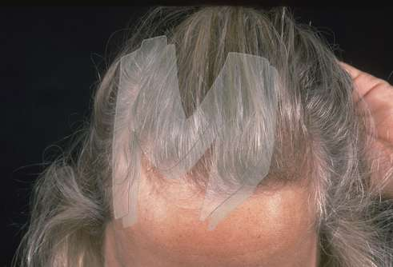

Slide 10
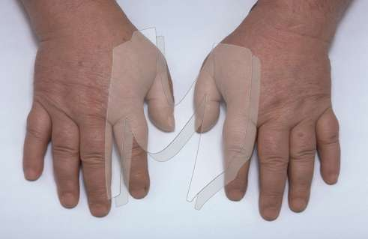

Slide 11
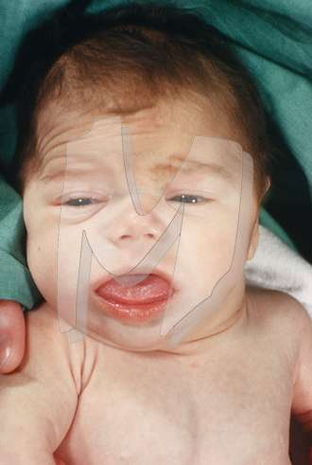

Slide 12
Treatment of Hypothyroidism
Replacement therapy with synthetic thyroid hormone preparations :
LEVOTHYROXINE (T₄)
LIOTHYRONINE (T₃)
LIOTRIX

Slide 13
Thyroid preparations
LEVOTHYROXINE: (T₄)
A synthetic form of the thyroxine (T₄) , is the drug of choice for replacement therapy
Stable and has a long half life ( 7 days)
Administered once daily.
Restore normal thyroid levels within 2-3 weeks
Absorption is increased when hormone is given on empty stomach

Slide 14
Thyroid preparations
LEVOTHYROXINE: (T₄)
Oral preparations available from 0.025 to 0.3 mg tablets
Parnteral preparation 200-500µg
In old patients and in patients with cardiac problems , treatment is started with reduced dosage.
Levothyroxine is given in a dose of 12.5 – 25 µg/day for two weeks and then increased every two weeks.

Slide 15
Clinical uses
Hypothyroidism, regardless of etiology
including :
Congenital
Hashimoto thyroiditis
Pregnancy

Slide 16
Metabolism of thyroid hormones
Major pathway of thyroid hormone metabolism is through sequential deiodination
80% of circulating T₃ is derived from peripheral T₄ by monodeiodination
The liver is the major site of degradation for both T₄ and T₃
80% of the daily dose of T₄ is deiodinated to yield equal amounts of T₃ and rT₃ (reverse T₃ ,which is inactive)

Slide 17
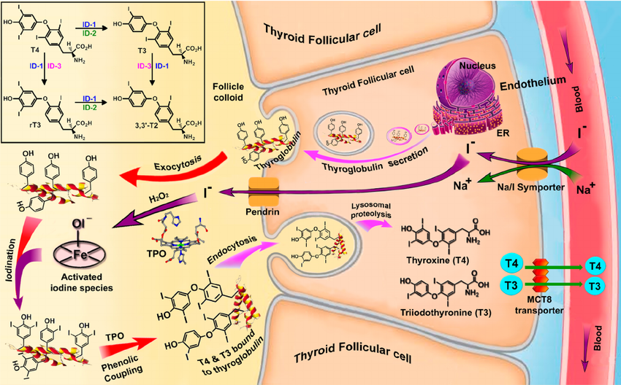
Mechanism of Action
Inhibit synthesis of thyroid hormones by inhibiting the peroxidase enzyme that catalyzes the iodination of tyrosine residues
- Propylthiouracil ( but not methimazole )
blocks the conversion of T4 to T3 in
peripheral tissues

Slide 18
ADVERSE EFFECTS OF OVER DOSE
CHILDREN :
- restlessness , insomnia
accelerated bone maturation
ADULTS :
- cardiac arrhythmias (Tachycardia, atrial fib.)
tremor , restlessness ,headache
heat intolerance
muscle pain
- change in appetite, weight loss

Slide 19
Thyroid preparations
LIOTHYRONINE (T₃) :
More potent (3-4 times) and rapid onset of action than levothyroxine
has a short half life - not recommended for routine replacement therapy ( requires multiple daily doses)
should be avoided in cardiac patients
oral preparation available are 5-50µg tablets
- parenteral use 10µg/ml

Slide 20
Pharmacokinetic of Thyroid Hormones
Hormone | Biologic Potency | t_{1/2}(days) | Protein Binding (%)
Levothyroxine (T₄) | 1 | 6-7 | 99.96
Liothyronine (T₃) | 4 | ≤ 2 | 99.5

Slide 21
Thyroid preparations
LIOTRIX :
Combination of synthetic T4 & T3 in a ratio 4:1 that attempt to mimic the natural hormonal secretion
The major limitations to this product are high cost and lack of therapeutic rationale because 35% of T4 is peripherally converted to T3

Slide 22
MYXEDEMA COMA
Life –threatening hypothyroidism
The treatment of choice is loading dose of levothyroxine intravenously 300-400µg initially followed by 50µg daily.
I.V. liothyronine for rapid response but it may provoke cardiotoxicity
I.V. hydrocortisone may be used in case of adrenal and pituitary insufficiency.

Slide 23
HYPOTHROIDSM AND PREGNANCY
In pregnant hypothyroid patient 20-30 % increase in thyroxine is required because of :
- elevated maternal thyroxine binding
globulin (TBG) induced by estrogen
- early development of fetal brain which depends
on maternal thyroxine

