Slide 1
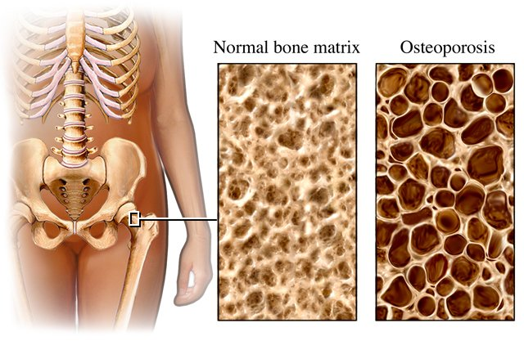
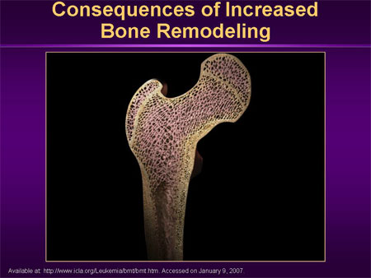
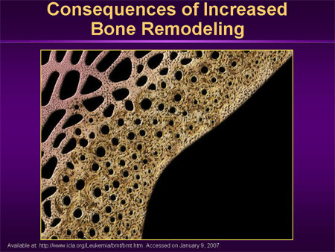
OSTEOPOROSIS and drugs used
Dr. Ishfaq Bukhari
Dr. Aliah Alshanwani
7 Feb 2018

Slide 2
OSTEOPOROSIS
ILOs
By the end of this lecture you will be able to:
Revise the composition, regulation & the remodeling stages
of bone turnover
Recognize the interlinks of osteoblastic & osteoclastic function
Relate changes to the development of osteoporosis
Classify drugs according to their replacement, antiresorptive or
anabolic mechanism of action
Detail the pharmacology of such group of drugs & their clinical
utility in combating osteoporosis.

Slide 3
OSTEOPOROSIS: “The Silent Disease”
OSTEOPOROSIS; Key points
“Osteo” is Latin for “bone”
“Porosis” means “porous or full of holes”
“Osteoporosis” means “bones that are full of holes”.

Slide 4
TYPES OF BONE
(1) Cortical – is hard, compact, dense bone (e.g., long-bones of arms and legs)
(2) Trabecular – is spongy, porous and flexible bone (example: end of the wrist, hip and the spine).
Activity - Understanding Our Bones

Slide 5
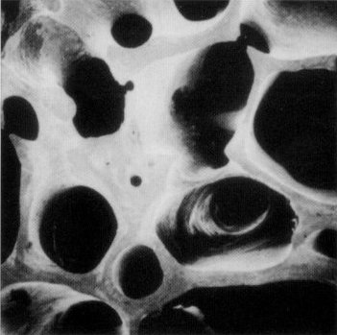
HEALTHY BONE
Bone is living tissue, which is constantly being broken down and rebuilt, a process called remodeling
Bone is renewed like skin, hair and nails.

Slide 6
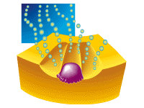
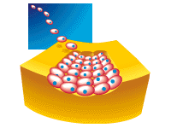
BONE “REMODELING”
Resorption: removes old bone
Formation: replaces old bone with new bone.

Slide 7

BONE “REMODELING”
OSTEOCLASTS-PHASE 1
Cells called osteoclasts (think “C” for cutting of bone) seek out old bone or damaged bone tissue and destroy it, leaving small spaces (resorption).

Slide 8
BONE “REMODELING”
OSTEOBLASTS – PHASE 2
Cells called osteoblasts (think “B” for builder) use minerals like calcium, phosphorus, and vitamin D to fill in the spaces with new bone (formation).

Slide 9
BUILD YOUR BONE BANK
You build bone until about age 30
Steps to building healthy bones include:
Calcium & vitamin D
Limit Caffeine & Alcohol
Exercise
Don’t Smoke.

Slide 10
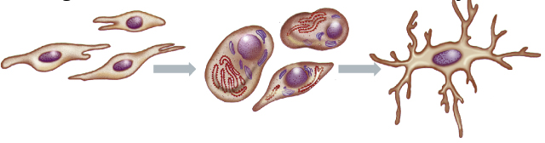
Bone is basically composed of 2 types of tissues
  INORGANIC 65% of mass  Consists of crystaline calcium phosphate salts (hydroxyapatite)
  Organic  35% of mass  Consists of ;osteoblasts, osteoclasts and osteocytes).
• Bone cells are either; Bone Forming or Bone Resorptive
Osteoblasts
Osteocytes
A. Bone Forming Cells:
    Osteogenic cells  mesenchymal in origin  are found on all bone surfaces
    Osteoblasts  forms osteoid framework & help in its mineralization.

Slide 11
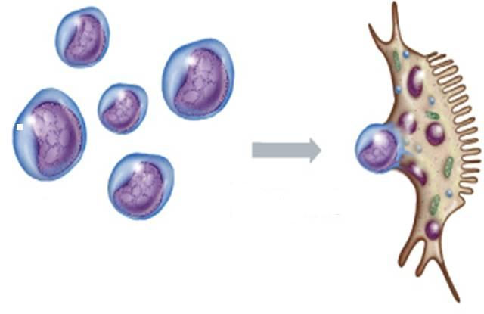
B. Bone Resorptive Cell:
Osteoclastes 
Reside in pits (resorption bays) that form by eaten bone surface. Secretes lysosomal enzymes (collagenase & metalloproteinase) + hydrochloric a.  dissolve bone matrix
Osteoclasts
NORMALLY
bones continuously form & resorb
○ BONE REMODELING
Under control of systemic hormones, body mineral contents
& local autocrine-paracrine secretions (Cytokines, Growth Factors, PGs)
It is meant to maintain calcium homeostasis & to renew bone in repair of microdamage & microcracks.

Slide 12
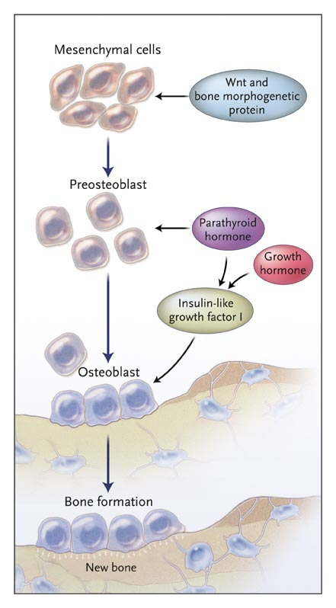
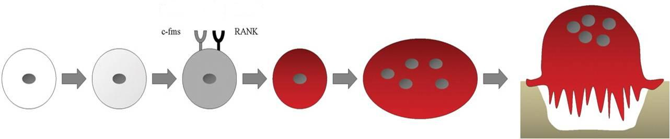
OPG and bone
Osteoprotegerin [OPG]
RANKL
HSC
Myloid Proginator
Monocyte
Pre-Osteoclast
Mature
Osteoclast
Resorbing
Osteoclast
Notes:
???

Slide 13
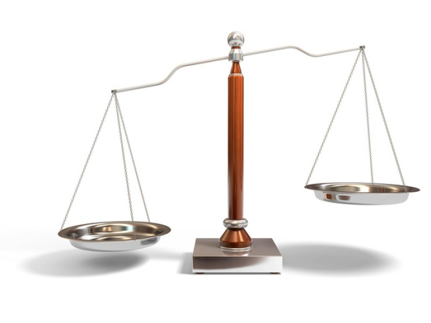
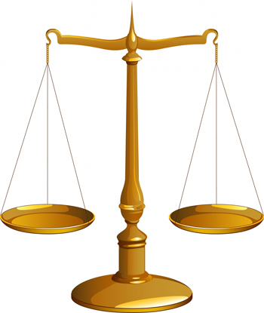
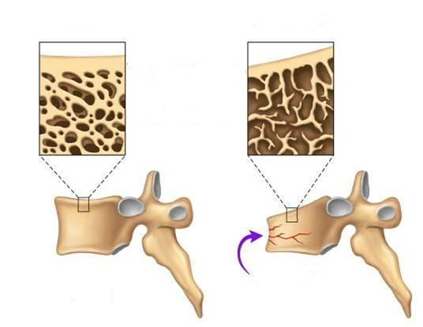
BONE REMODELING
Formation
Resorption
Formation
Resorption
OSTEOPOROSIS
A complex endocrinologic disorder of bone & mineral metabolism
(bone resorption > formation)
Low bone mass
Disruption of bone architecture
Reduced bone strength
Risk of fractures
Notes:
Bone undergoes a continuous remodeling process involving resorption and formation. Any process that disrupts this balance by increasing bone resorption relative to formation results in osteoporosis.
Inadequate gonadal hormone production is a major cause of osteoporosis in men & women. Estrogen replacement therapy at menopause is a well-established means of preventing
osteoporosis in the female, but many women fear its adverse effects, particularly the increased risk of breast cancer from continued estrogen use (the well-demonstrated increased risk of endometrial cancer is prevented by combining the estrogen with a progestin) & do not like the persistence of menstrual bleeding that often accompanies this form of therapy.

Slide 14
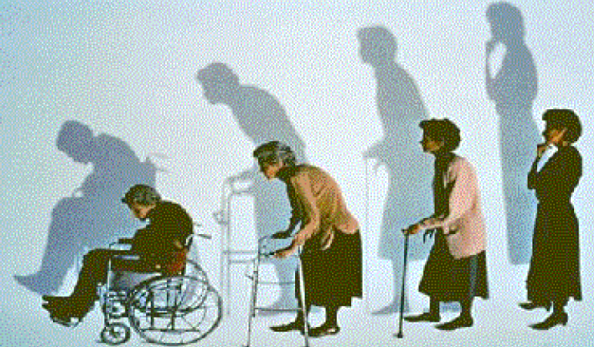

OSTEOPOROSIS
PREVENTION
TREATMENT
Potentially Modifiable | Non-modifiable
Current cigarette smoking | Personal history of fracture
Diet low in calcium/vitamin D | 1st degree relative has fracture
Glucocorticoids, anticonvulsants | Race (Caucasian or Asian)
Excessive alcohol intake | Elderly age
Sedentary lifestyle | Poor health
Body weight | Dementia
 | Hormonal disorders
Environmental risks | Neoplastic disorders
 | Metabolic abnormalities
14
Notes:
Can lead to early bone loss
Environmental risk F: lead & cadmium, AL toxicity

Slide 15
BONE LOSS & AGING
The first 5-15 years after menopause a woman can lose approximately 25 - 30% of trabecular bone & approximately 10 – 15% of cortical bone
Bone loss often occurs
without symptoms or
warning signs.

Slide 16
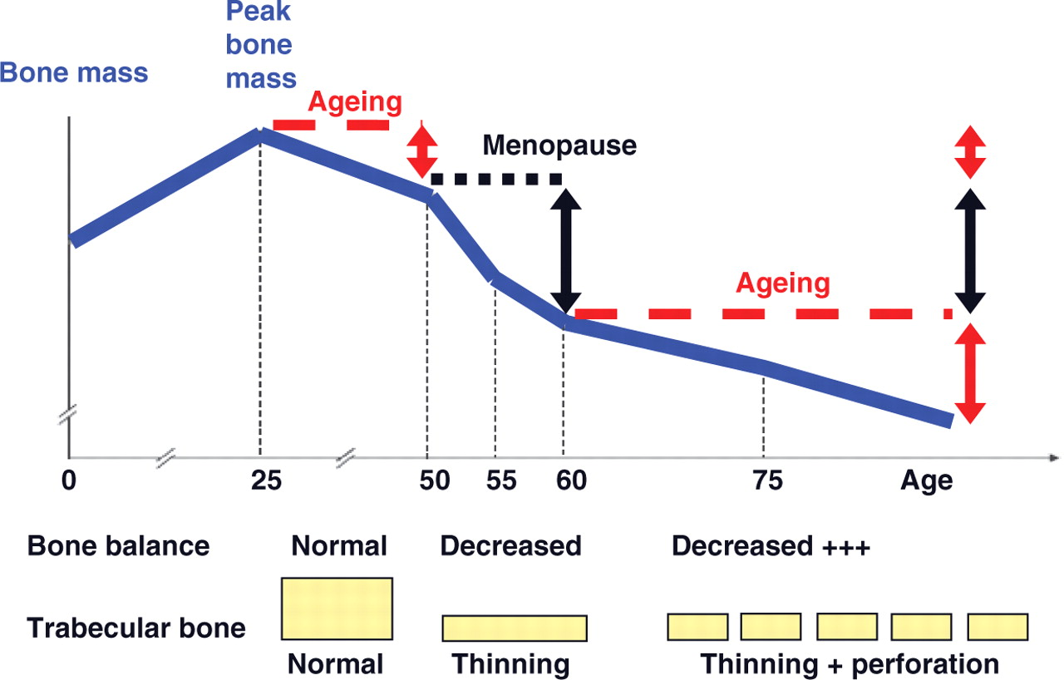

Slide 17
TREATMENT OF OSTEOPOROSIS
  Replace what is missing….Ca, Vit D, Na fluoride
  Reset back the balance of remodeling
Used to enhance the strength by the formation of fluorapatite
Is considered only when trabecular bone is  in presence of normal cortical bones.
ANTIRESORPTIVE AGENTS
BONE ANABOLIC (building) AGENTS
BISPHOSPHONATES
ESTROGEN ANALOGES
ANDROGEN ANALOGES
SERMS
CALCITONIN
RANKL INHIBITORS
(Parathyroid hormone; TERIPARATIDE
STRONTIUM
Notes:
Fluorapatite is more stable & resistant to acid dissolution than is hydroxyapatite. Fluoride also delays mineralization & is capable of altering bone crystal structure
Androgens & anabolic agents have been used in the TR of osteoporosis, either alone or in conjunction with estrogens. With the exception of substitution therapy in hypogonadism, bisphosphonates have largely replaced androgen use for this purpose.

Slide 18
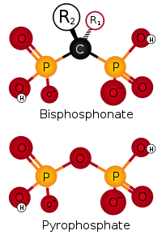
BISPHOSPHONATES
Are compounds that have two phosphonate (PO₃) groups
Non-Nitrogenous
Nitrogenous
Etidronate
Clodronate
Tildronate
po
po
po
IV
Alendronate
Ibandronate
Risedronate
Zoledronate
Mechanism
Are structurally similar to pyrophosphate
They preferentially "stick" to calcium  concentrate in bones, bound to hydroxyapatite, decreasing its solubility & making it more resistant to osteoclastic activity
They prevent bone resorption by inhibiting osteoclast function
- Their relative potencies for osteoclast inhibition is the most with 3rd generation “Zoledronate”.
Notes:
Currently available bisphosphonates include etidronate, tiludronate, …
Nitrogenous are less potent than & nonnitrogenous
Pyrophosphate ???
Hydroxapatite ??
Bisphosphonates attach to hydroxyapatite binding sites on bony surfaces, especially surfaces undergoing active resorption. When osteoclasts begin to resorb bone that is impregnated with bisphosphonate, the bisphosphonate released during resorption impairs the ability of the osteoclasts to form the ruffled border, to adhere to the bony surface, & to produce the protons necessary for continued bone resorption. Bisphosphonates also reduce osteoclast activity by decreasing osteoclast progenitor development & recruitment & by promoting osteoclast apoptosis.

Slide 19
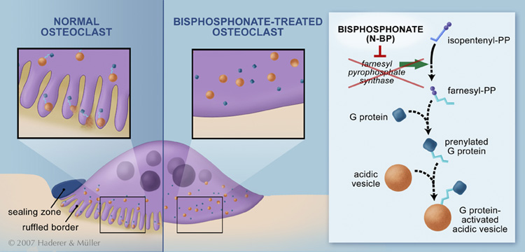
BLOCK STEPS IN CHOLESTROL SYNTHETIC PATHWAY IN OSTEOCLAST
that act as signaling molecules responsible for the osteoclastic hydrolytic & phagocytic activity
Stop function  apoptosis (increased death of osteoclast)
It is also taken up by osteoclast  blocks steps in cholesterol synthetic pathway within osteoclast  end up by osteoclast apoptosis.
Notes:
How do they inhibit osteoclasts???

Slide 20
BISPHOSPHONATES
Kinetics
Poorly abs (< 10%), food impair absorption more  must be given on
an empty stomach / infused IV
t_{1/2} 1 hr
Half of absorbed drug accumulates in bones, remainder  excreted
unchanged in urine
In bone it is retained for months, depending on bone turnover.
Indications
Osteoporosis, 2ndry to menopause, glucocorticoids, ….
Paget’s Disease
Malignancy- associated hypercalcaemia
Dosing
- Once weekly, or on two consecutive days each month
- Should be taken in upright position (to avoid esophagitis)
- Separate 4 hrs before giving Ca, Mg, Al containing drugs
Note : calcium & vit D supplementation given during bisphosphonate therapy don’t ingest it along with bisphosphonate, give a gap as mentioned above…?

Slide 21
BISPHOSPHONATES
ADRs
GIT irritation; nausea, vomiting, gastritis, ulceration  give large amount of water to avoid risk of the tablet getting stuck in the esophagus
Gastro-esophageal reflux + ulcerations  to avoid give on empty
stomach while sitting in upright for 30 min
Flue-like manifestations (fever, chills) upon IV infusion
Osteo-necrosis of the mandible bone of jaw upon long use with IV infusion preparation usually after dental surgical procedures
If a dental implant or extraction is already planned, delay bisphosphonate therapy for a few months until healing of the jaw is complete
Atrial fibrillation > women with alendronate & zolidronate.
Contraindications
Decreased renal function and Peptic ulcer / esophageal reflux.
Notes:
after dental surgical procedures ??

Slide 22
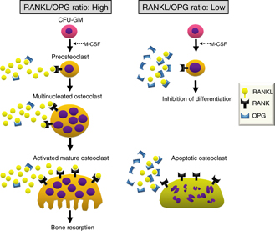
DENOSUMAB (still under investigation)
RANKL INHIBITORS
It is a fully human MOA that mimics the activity of osteoprotegerin
Mechanism
Blocks RANKL from interacting with RANK expressed on preosteoclasts   osteoclastogenesis (no mature osteoclasts)
It binds also to mature osteoclast  its apoptosis
So net effect   bone resorption.
Administration
Subcutaneous every 6 month
Contraindications
In patients with hypocalcemia Correct Ca & Vit D levels before starting denosumab.
Notes:
So given twice/ yr
Denosumab, a recently approved therapy, is a fully human monoclonal antibody (MOA) that binds the cytokine RANKL (receptor activator of NFκB ligand), an essential factor initiating bone turnover.
RANKL inhibition blocks osteoclast maturation, function & survival, thus reducing bone resorption.
In contrast, bisphosphonates bind bone mineral, where they are absorbed by mature osteoclasts, inducing osteoclast apoptosis & suppressing resorption. These differences in mechanism influence both the onset and reversibility of treatment.

Slide 23
Mechanism of action of Denosumab:
-RANKL binds to its receptor RANK on the surface of precursor & mature osteoclasts & stimulates these cells to mature & resorb bone.
-OPG, which competes with RANKL for binding to RANK, is the physiological inhibitor of RANKL
-Denosumab binds with high affinity to RANKL, mimicking the effect of OPG.
Note: Densosumab decreases serum calcium conc, should not be given to patients with hypocalcemia.
Its extremely expensive & reserved for patients who can not tolerate or respond to bisphosphonate.
Infections; urinary & respiratory
Eczema & skin rash
pancreatitis.
ADRs
Notes:
human IgG2 monoclonal antibody with affinity & specificity for human RANKL (receptor activator of nuclear factor kappa-B ligand).
Why infections ? Receptor activator of nuclear factor kappa-B ligand (RANKL) is expressed on activated T and B lymphocytes & in lymph nodes. Therefore, a RANKL inhibitor such as Prolia may increase the risk of infection, suggesting that there could be an increased risk of infection associated with the use of denosumab.

Slide 24
STRONTIUM
Sr²⁺, is a divalent cation, resembling Ca²⁺ in atomic & ionic properties
It is orally active as distrontium
Mechanism
1st drug to possess “ dual action “ i.e has both anabolic & antiresorptive effects, resulting in a rebalance of bone turnover in favor of bone formation
On Osteoblast;
1- Since it is like Ca, it acts as agonist on Ca Sensing Receptor [CaSR]; which is a GP coupled receptor that enhances differentiation of pre-oteoblast to osteoblast  bone formation
2- It stimulates the expression of OPG RANKL binding  -ve of osteo-clustogenesis   bone resorption
On Osteoclast;
Acts as agonist on CaSR suppress differentiation of pre-osteoclast to osteoclast  osteoclast apoptosis   bone resorption.
Notes:
ve of osteo-clustogenesis ??

Slide 25
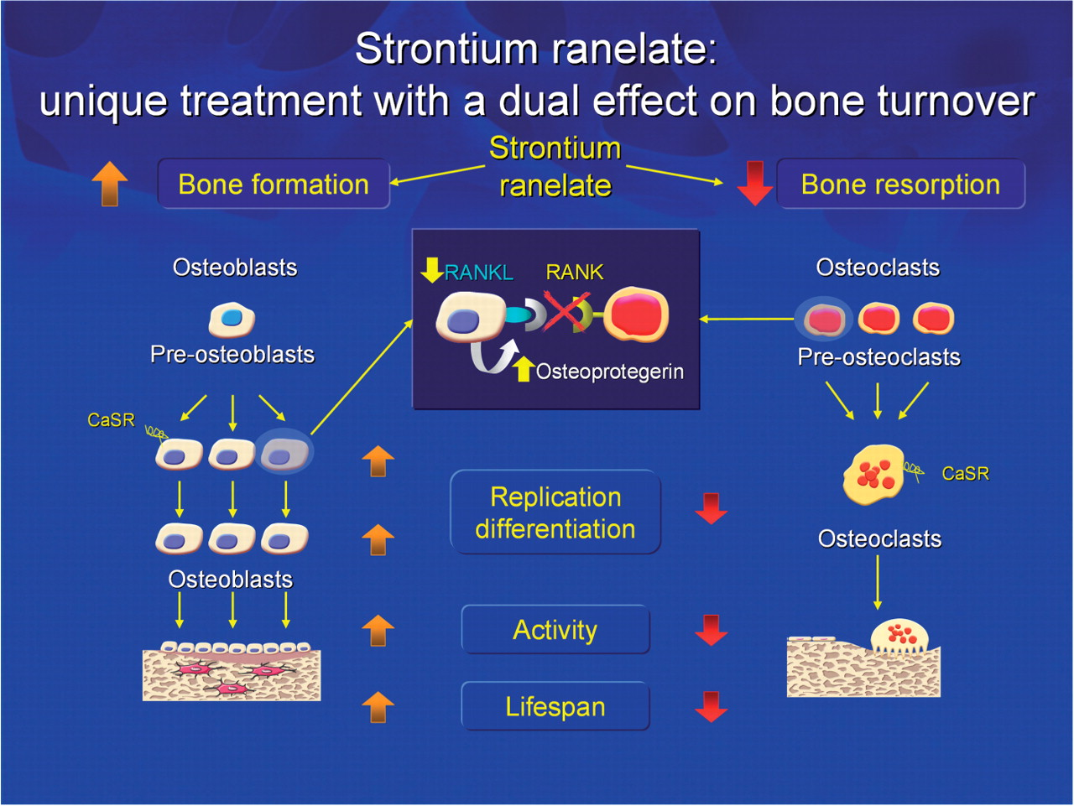

Slide 26
Pharmacokinetics
STRONTIUM
Orally with a modest bioavailability 25%
Binds partially to plasma proteins & strongly to bones
t ½  60 hrs
Excreted mainly by the kidney
Indications
Osteoporosis, 2dry to menopause, glucocorticoids, ….
Malignancy- associated hypercalcaemia
Contraindications
In severe renal disease
In hypersensitivity to it
In increased risk of venous thromboembolism
In phenylketonuria
Interactions
Precautions
Food specially containing milk+ its products 
Antacids 
Oral tetracycline & quinolones chelate it
2 hrs spacing
ADRs
GIT irritation; nausea, vomiting, headache, eczema
All resolve in 1st 3 months.
Notes:
All patients prescribed Protos should be fully informed of the risk of cardiovascular events and venous thrombosis. Not given to immobile patients
In phenylketonuria ? PKU is an inborn error of metabolism that results in decreased metabolism of the amino acid phenylalanine. Precaution is advised in patients with phenylketonuria, as formulations of strontium ranelate contain phenylalanine.

Slide 27


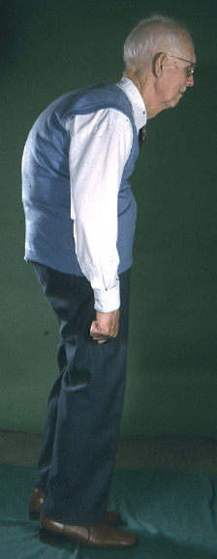
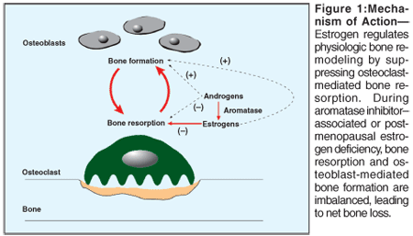
ESTROGENS
If hystrectomy
+ progestins if uterus present
HRT
Menopausal Symptoms
SERMs
Menopause /
Elderly
Estrogen in females & Androgen in males
is essential for normal bone remodeling
ANDROGENS
Elderly men
 osteoclast apoptosis & inhibit osteobalst apoptosis
 release of growth factors from osteoblasts
◉ No. & depth of resorption cavities
◉ release of inflammatory cytokines causing resorption
Adverse effects: HRT (estrogen): vaginal bleeding, risk of breast cancer & venous thromboembolism.

Slide 28
SERMs
RALOXIFENE
1st selective estrogen Receptor modulator (SERM) for prevention & treatment of osteoporosis
Mechanism
Anti-estrogens that exhibits partial agonistic action; acting as an agonist in bone & an antagonist in some female sex organs
 | Brain | Uterus | Vagina | Breast | Bone | CVS
Estradiol | ++ | ++ | ++ | ++ | ++ | ++
Raloxifene | — | — | — | — | + | +
Advantages
   bone density (2%) &  fracture risk (30%)
  No stimulation of breast or endometrial tissue
  No need for progestin in women with uterus
  ◉ LDL
  Good for women with risk of uterine & breast cancer
  Lower risk of thromboembolism compared to estrogen
Disadvantages
  May  hot flushes
  No effect on HDL.

Slide 29
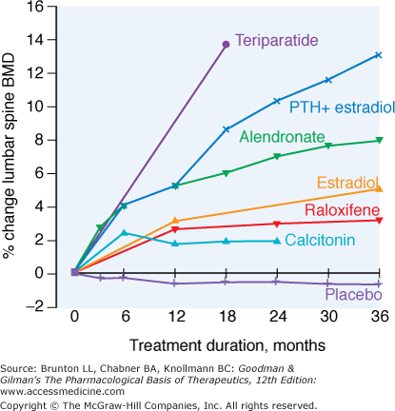
Relative efficacy of different therapeutic interventions on bone mineral density of the lumbar spine

Slide 30
OSTEOPOROSIS
GOOD LUCK

