Slide 1
Pharmacology of Corticosteroids Dr. Aliah Alshanwani Dept. of Pharmacology College of Medicine, KSU Feb 2018

Slide 2
The Corticosteroids are steroid hormones produced by the adrenal cortex.
They consist of two major groups:
1. Glucocorticoids [Major cortisol (Hydrocortisone)]
2. Mineralocorticoids (most important Aldosterone)

Slide 3
Biosynthesis of adrenal hormones

Slide 4
1. Glucocorticoids:
They have important effects on intermediary metabolism, catabolism, immune responses, growth & inflammation.
2. Mineralocorticoids:
They have salt-retaining activity which regulate sodium & potassium reabsorption in the collecting tubules of the kidney.

Slide 5
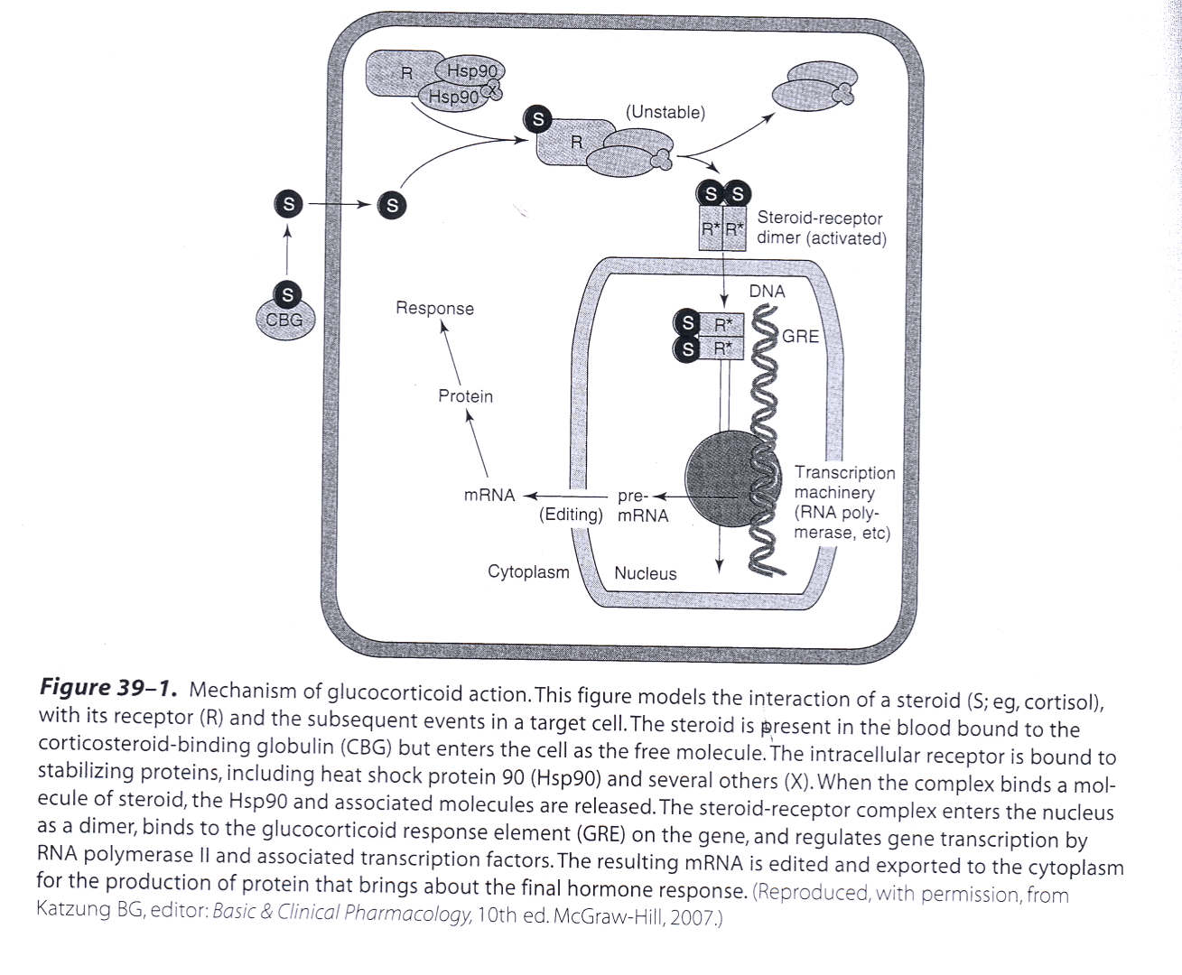

Slide 6
Pharmacodynamics A. Mechanism of Action
Corticosteroid is present in the blood bound to the corticosteroid binding globulin (CBG) & enters the cell as the free molecule.
The intracellular receptor (R) is bound to the stabilizing proteins, including heat shock protein 90 (Hsp90) & several others(X). When the complex binds a molecule of steroid, the Hsp90 & associated molecules are released.

Slide 7
The Steroid– R complex enters the nucleus as a dimer, binds to the glucocorticoid response element (GRE) on the gene & regulates gene transcription by RNA polymerase II & associated transcription factors.
The resulting mRNA is edited & exported to the cytoplasm for the production of protein that brings about the final hormone response.

Slide 8
B. Metabolic effects:
Glucocorticoids stimulate gluconeogenesis, as a result:
Blood glucose rises
Insulin secretion is stimulated
Stimulate lipolysis & lipogenesis (due to increased insulin)
With a net increase of fat deposition in certain areas (e.g, the face (moon faces) & shoulder & back (buffalo hump).
These effects occur when the patient is treated with 100 mg of hydrocortisone or > for longer than 2 weeks.

Slide 9
C. Catabolic effects:
Glucocorticoids cause muscle protein catabolism ( muscle mass)
Lymphoid & connective tissue fat & skin undergo wasting
Catabolic effects on bone lead to osteoporosis
In children, growth is inhibited.

Slide 10
D. Anti – inflammatory effects:
Glucocorticoids have important inhibitory effects on the distribution, function & migration of leukocytes
Suppressive effect on the inflammatory cytokines & chemokines
These drugs increase neutrophils & decrease lymphocytes,
eosinophils, basophils & monocytes
Inhibit phospholipase A2 & Prostaglandins synthesis.

Slide 11
E. Immunosuppressive effects:
Glucocorticoids inhibit cell-mediated immunologic
functions, especially dependent on lymphocytes &
decrease interleukins secretion.
Glucocorticoids do not interfere with the development of
normal acquired immunity but delay rejection reactions in patients with organ transplants.

Slide 12
F. Other effects:
Glucocorticoids such as cortisol are required for normal renal excretion of water loads.
CNS: When given in large doses these drugs may cause profound behavioral changes (first insomnia & euphoria then depression).
GIT: Large doses also stimulate gastric acid secretion & decrease resistance to ulcer formation.

Slide 14
Important Glucocorticoids:
1- Cortisol (hydrocortisone)
The major natural glucocorticoid
The physiologic secretion of cortisol is regulated by adrenocorticotropin hormone (ACTH) & secretion rate varies during the day (circadian rhythm), peaks in the early morning & declines about midnight.

Slide 15
Pharmacokinetics:
Given orally, cortisol is well absorbed from GIT
Cortisol in the plasma is 95% bound to CBG
It is metabolized by the liver & has short duration of
action compared with the synthetic congeners
It diffuses poorly across normal skin & mucous membranes
The cortisol molecule also has a small but significant mineralocorticoid effect. This is an important cause of hypertension in patients with cortisol secreting adrenal tumor or a pituitary ACTH secreting tumor (Cushing’s syndrome).

Slide 16
2. Synthetic Glucocorticoids
Large number are available for use:
Prednisone & its active metabolite prednisolone
Dexamethasone
Beclomethasone
Budesonide
Their properties (compared with cortisol) include:
longer half life & duration of action
reduce salt retaining effect
better penetration of lipid barriers for topical activity.

Slide 17
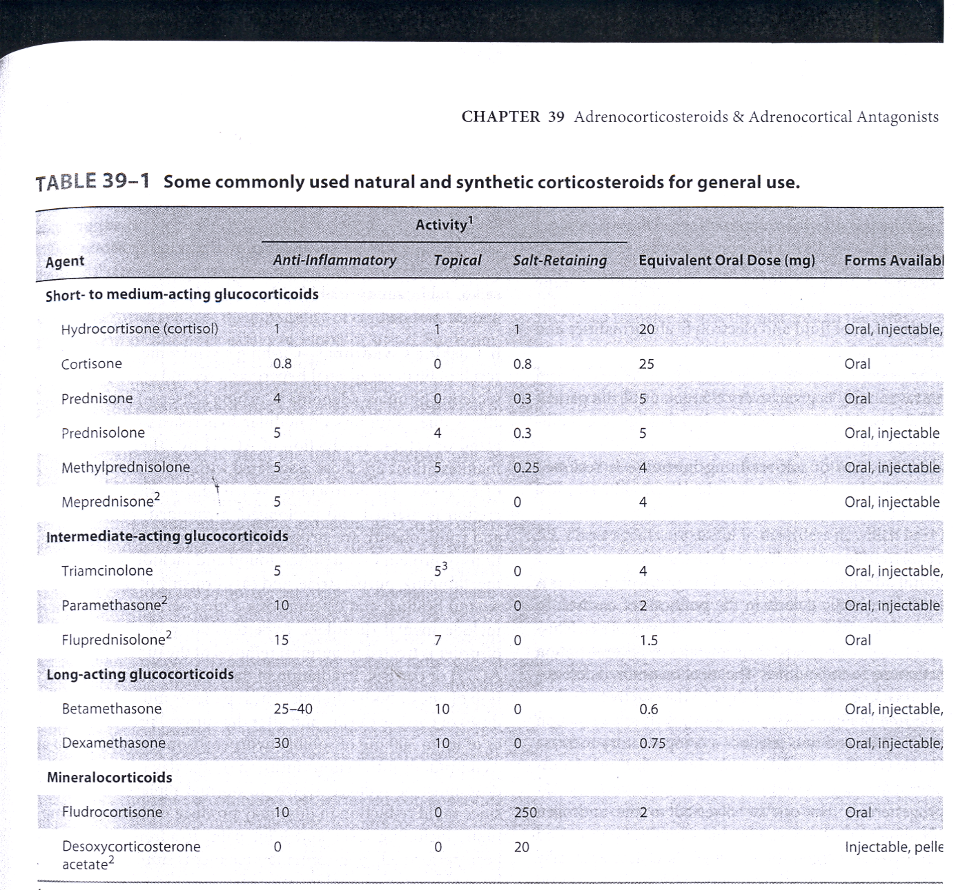

Slide 18
Beclomethasone & budesonide have been developed for use in asthma & other conditions in which good surface activity on mucous membrane or skin is needed & systemic effects are to be avoided.
These drugs rapidly penetrate the airway mucosa but have very short half lives after they enter the blood, so that systemic effects & toxicity are greatly reduced.

Slide 19
Clinical uses of corticosteroids
A. Adrenal disorders:
1. Addison’s disease (chronic adrenal cortical insufficiency)
2. Acute adrenal insufficiency associated with life threatening
shock, infections or trauma
3. Congenital adrenal hyperplasia (in which synthesis of
abnormal forms of corticosteroids are stimulated by ACTH).

Slide 20
B. Non-adrenal disorders:
1. Allergic reactions (e.g. bronchial asthma, angioneurotic edema,
drug reactions, urticaria, allergic rhinitis)
2. Collagen vascular disorder (e.g; rheumatoid arthritis,
systemic lupus erythematosus, giant cell arteritis, polymyositis, mixed connective tissue syndrome)
3. Organ transplants (prevention & treatment of rejection –
immunosuppression).
Clinical uses of corticosteroids Cont’

Slide 21
Clinical uses of corticosteroids Cont’
4. GI disorders such as inflammatory bowel disease
5. Hematologic disorders (leukemia, multiple myeloma, acquired hemolytic anemia, acute allergic purpura)
6. Infections (acute respiratory distress syndrome, sepsis)
7. Neurologic disorders (to minimize cerebral edema after brain surgery, multiple sclerosis).

Slide 22
Clinical uses of corticosteroids Cont’
8. Pulmonary diseases (e.g.; aspiration pneumonia, bronchial asthma, sarcoidosis).
9. Thyroid diseases (malignant exophthalmos, subacute thyroiditis)
10. Renal disorders (nephrotic syndrome)
11. Miscellaneous (hypercalcaemia, mountain sickness).

Slide 23
Toxicity (Adverse effects)
Cushing’s syndrome (iatrogenic, by higher doses > than 100 mg hydrocortisone daily for > than 2 weeks characterized by moon shape face & buffalo hump)
Increased growth of fine hair on face, thighs & trunk. Myopathy, muscle wasting, thinning of skin, Diabetes Mellitus
Osteoporosis & aseptic necrosis of the hip
Wound healing is impaired
Peptic ulcer
Acute psychosis, depression
Subcapsular cataracts
Growth suppression
Hypertension
Adrenal suppression.

Slide 24
Methods for minimizing these toxicities include
Local application (e.g, aerosol for asthma)
Alternate day therapy (to reduce pituitary suppression)
Tapering the dose soon after achieving a therapeutic response
To avoid adrenal insufficiency in patients who have had long term therapy, additional stress doses may need to be given during serious illness, or before major surgery.

Slide 25
Mineralocorticoids:
A. Aldosterone:
The major natural mineralocorticoid in human.
Aldosterone is the main salt-retaining hormone, promotes Na reabsorption, K excretion, in the distal convoluted tubule & thus it is very important in the regulation of blood volume & blood pressure. Its secretion is regulated by ACTH & by the renin-angiotensin system.
Aldosterone has short half life & little glucocorticoid activity.
Mechanism of action:
Same as that of glucocorticoids.
Fludrocortisone is favored for replacement therapy after adrenalectomy & in other conditions in which mineralocorticoid therapy is needed.

Slide 26
Corticosteroid Antagonists:
A. Receptor Antagonists
Spironolactone (mineralocorticoid antagonist & K-sparing diuretic)
antagonists of aldosterone at its receptor, used in the treatment of primary aldosteronism
Mifepristone:
A competitive inhibitor of glucocorticoid receptors &
useful in the treatment of Cushing's syndrome.

Slide 27
B. Synthesis inhibitors:
Ketoconazole (anti fungal)
Clinical uses:
Adrenal cancer, when surgical therapy is impractical or
unsuccessful because of metastasis.

Slide 28
Ketoconazole :
Mechanism of Action:
It inhibits the cytochrome p450 enzymes necessary for the synthesis of all steroids & is used in a no. of conditions in which reduced steroid level are desirable such as:
1. Adrenal carcinoma
2. Hirsutism
3. Breast cancer
4. Prostate cancer.

