Slide 1
ميحرلا نمحرلا الله مسب

Slide 2
The Adrenal Gland
ENDOCRINOLOGY
Adrenal Androgens
Dr. Abeer Al-Ghumlas

Slide 3
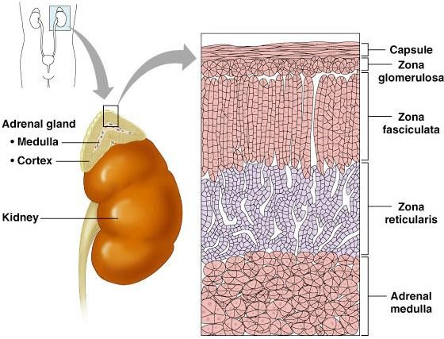
Adrenal Cortex

Slide 4
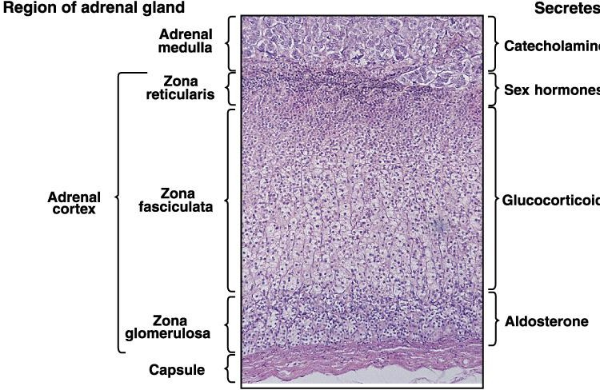
The Adrenal Gland
√
(Cortisol)
√
Mineralocortico
( )

Slide 5
Androgens
Androgens are the hormones that exert masculinizing
effects and they promote anabolism and growth.
Testosterone
(Testis)
adrenal androgens (Adrenal Gland)
the major active androgen
have less than 20% of testosterone activity.

Slide 6
Adrenal cortex
Male sex hormones
(Androgens)
Female sex hormones
Estrogens
Progesterone
Adrenal androgens
includes :
- dehydroepiandrosterone (DHEA),
- Androstenedione.
The adrenal cortex in both sexes produces small
amounts of sex hormone of the opposite sex.

Slide 7
adrenal androgens (Adrenal Gland)
Produced from Zona reticularis in small amounts
Control of secretion of adrenal androgens is by ACTH
dehydroepiandosterone (DHEA):
It is the most abundant adrenal androgen
DHEA is the primary precursor of natural estrogens.
Normally they exert very little masculinizing effect (weak) when secreted in normal amount (mild effect in female).
Androstenedione:
An androgenic steroid produced by the testes, adrenal cortex,
and ovaries
Androstenediones are converted metabolically to testosterone and to estrogens in the fat and other peripheral tissues. It is an important source of estrogen in men and postmenopausal women.
Androstenedione were used as an athletic or body building supplement.

Slide 8
Role of Androgens
Males
Females
Spermatogenesis
Inhibition of fat deposition
Muscle mass
growth of pubic and axillary hair.
pubertal growth spurt
development
 Brain: have the
Androgen levels
been implicated in
of
regulation aggression and
 Androgens have potential
human
libido.
roles in relaxation of
the myometrium preventing
 masculinization of the
fetus and
premature uterine
developing (including
male penis
contractions in pregnancy
scrotum formation).

Slide 9
Adrenogenital syndrom
Excessive adrenal androgens secretion
Cause:
Adrenocortical tumors
Congenital adrenal hyperplasia
inherited as autosomal recessive diseases
affect both boys and girls.
Due to deficiency of one of the enzymes of the cortisol synthesis (21-hydroxylase) and steroids are 'diverted' to becoming androgens.
Lead to increase ACTH leading to excessive production of adrenal androgens
Tt: glucocorticoids

Slide 11
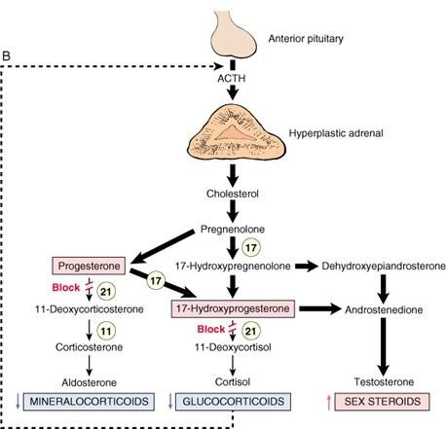

Slide 12
Adrenogenital syndrom
Excessive adrenal androgens secretion
Before birth
After birth
 Psudohermaphrodite
Male
Female

Slide 13
Adrenogenital syndrom
Before birth (female)
After birth (Male) After birth (Female)
Psudohermaphroditism:
Before 12 weeks in
female fetus
XX true female with external male genitalia
Cause: exposure of the mother to excessive androgens
Precocious puberty
Early appearance of
male characters
Increase musculature
Development of external genitalia organ to adult size
No spermatogenesis
Virilization
Development of male characters in females:
Increase bulk of
muscles
Hoarseness
Increase body hair
Increase facial hair
Atrophy of the breast
Amenorrhea

Slide 14
Adrenogenital Syndrome
Adrenocortical tumor secretes excessive quantities of androgens that cause intense masculinizing effects throughout the body.
In a female:
she develops virile characteristics, including: growth of a beard, a much deeper
voice, occasionally baldness, masculine distribution of hair on the body.
In prepubertal male: a virilizing adrenal tumor causes the same characteristics
as in the female plus rapid development of the male sexual organ.
In the adult male: the virilizing characteristics of adrenogenital syndrome are usually obscured by the normal virilizing characteristics of the testosterone secreted by the testes.
It is often difficult to make a diagnosis.
However, the excretion of 17-ketosteroids (derived from androgens) in urine
may be 10 to 15 times normal, used in diagnosing the disease.

