Slide 1
Endocrinology
Posterior pituitary
Dr. Hana Alzamil

Slide 2
Physiology of posterior Pituitary gland
Hypothalamic control
Posterior pituitary hormones
  ADH
    Physiological functions
    Control of secretion
      Osmotic stimuli
      Non-osmotic stimuli
  Oxytocin
    Physiological functions
    Control of secretion

Slide 3
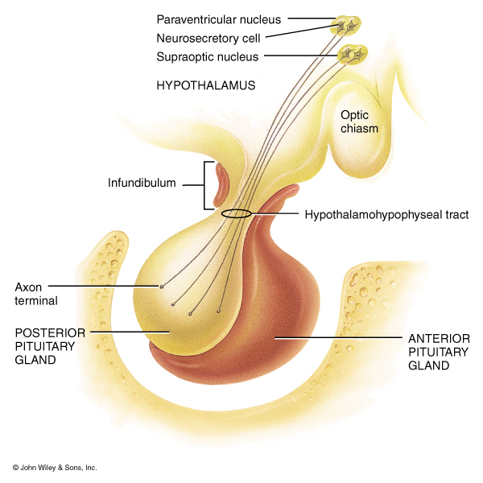
Posterior Pituitary Gland
Does not synthesize hormones
Consists of axon terminals of hypothalamic neurons

Slide 4
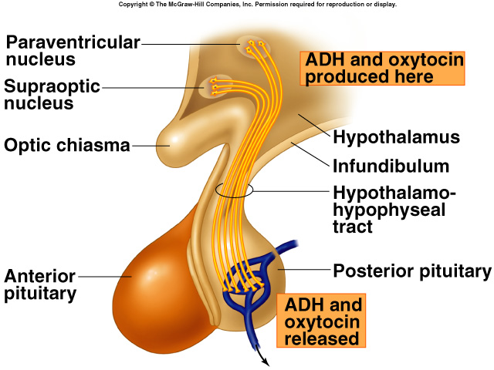
Hypothalamic control of pituitary secretions
Secretions of the posterior pituitary are controlled by
  Nervous signals from hypothalamus

Slide 5
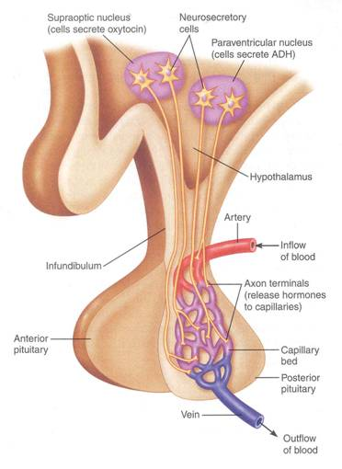
Oxytocin and Vasopressin are manufactured in the hypothalamus, but released in the posterior pituitary

Slide 6
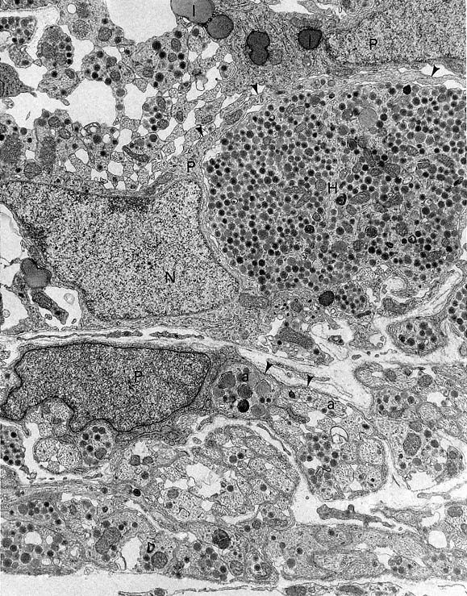
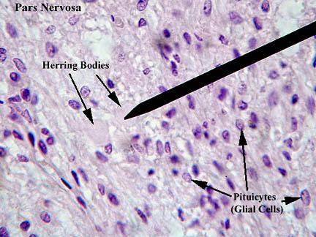
Herring Body
Pituicytes function
It forms physical and
chemical barrier between nerve terminal and blood vessels
Amplify auto receptor negative feedback

Slide 7


Slide 8
Antidiuretic hormone
(vasopressin)

Slide 9
Synthesis of ADH
It is synthesized as pre-prohormone and processed into a nonapeptide (nine amino acids).
ADH synthesized in the cell bodies of hypothalamic neurons(supraoptic nucleus)
ADH is stored in the neurohypophysis (posterior pituitary)

Slide 10
Receptors of ADH (vasopressin)
There are 3 types of receptors for ADH:
  V1A
  V1B
  V2
  V1A receptors mediate vasoconstriction
  V1A receptors also found in the liver glycogenolysis
  V1B receptors are unique to anterior pituitary and mediate increased ACTH secretion
  V2 receptors are located in the principle cells in distal convoluted tubule and collecting ducts in the kidneys

Slide 11
Mechanism of action of ADH: antidiuresis
ADH binds to V2 receptors on the peritubular(serosal) surface of cells (principle cells) of the distal convoluted tubules and medullary collecting ducts.
Via adenylate cyclase/cAMP induces production and insertion of aquaporin2 into the luminal membrane and enhances permeability of cell to water.
Increased membrane permeability to water permits back diffusion of solute-free water, resulting in increased urine osmolality (concentrates urine).

Slide 12
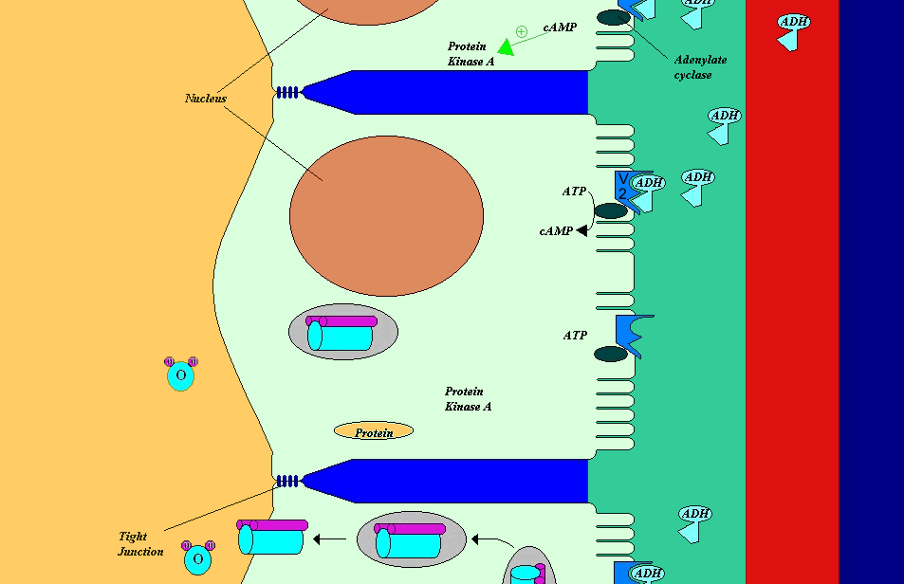
Mechanism of action of ADH

Slide 13
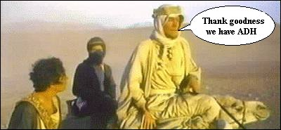
The single most important function of ADH is to conserve body water by reducing urine output

Slide 14
Secretion of ADH osmotic stimuli
If plasma osmolality is directly increased by administration of solutes, only those solutes that do not freely or rapidly penetrate cell membranes, such as sodium, cause ADH release.
Conversely, substances that enter cells rapidly, such as urea, do not change osmotic equilibrium and thus do not stimulate ADH release.
ADH secretion is very sensitive to changes in osmolality.
Changes of 1-2% result in increased ADH secretion.

Slide 15
Secretion of ADH non-osmotic stimuli
Hypovolemia is perceived by “pressure receptors” -- carotid and aortic baroreceptors, and stretch receptors in left atrium and pulmonary veins.
Normally, pressure receptors tonically inhibit ADH release.
Decrease in blood pressure induces ADH secretion by reducing input from pressure receptors.
The reduced neural input to baroreceptors relieves the source of tonic inhibition on hypothalamic cells that secrete ADH.
Sensitivity to baroreceptors is less than osmoreceptors– senses 5 to 10% change in volume

Slide 16
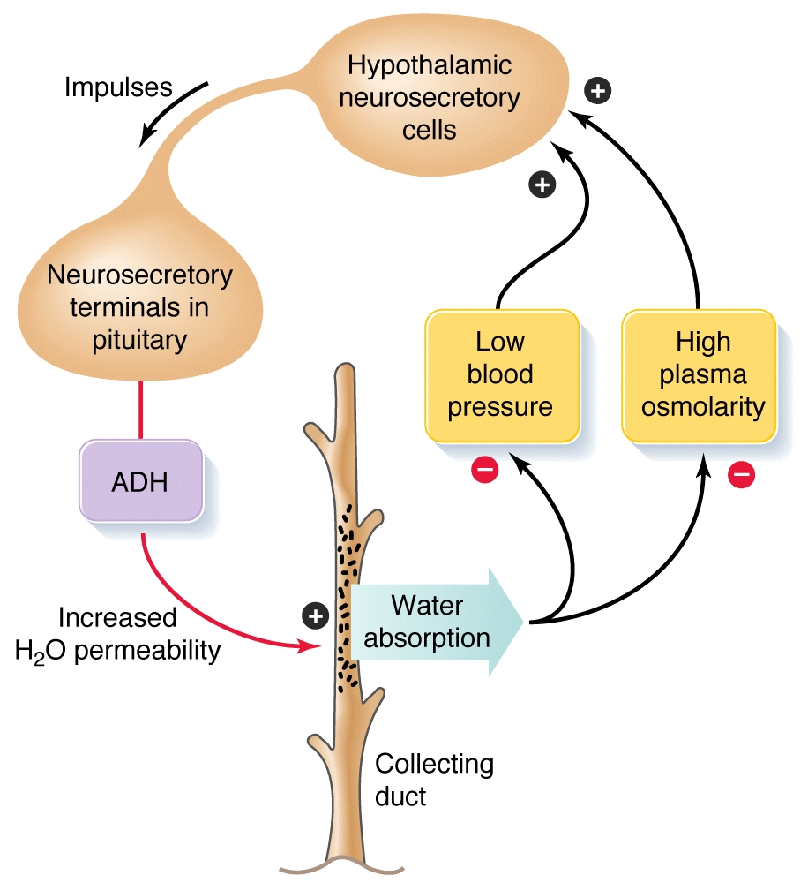
Function of ADH
(vasopressin)

Slide 17
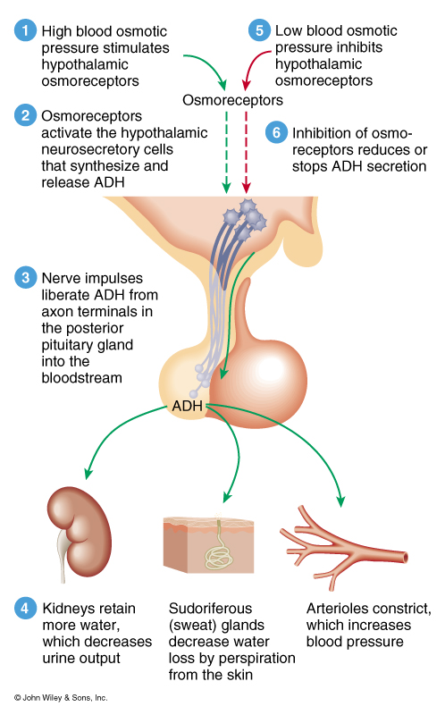
Regulation of ADH
Dehydration
  ADH released
Overhydration
  ADH inhibited

Slide 18
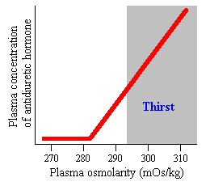
Plasma Osmolarity stimulates both ADH release and thirst via
OSMORECEOPTORS

Slide 19
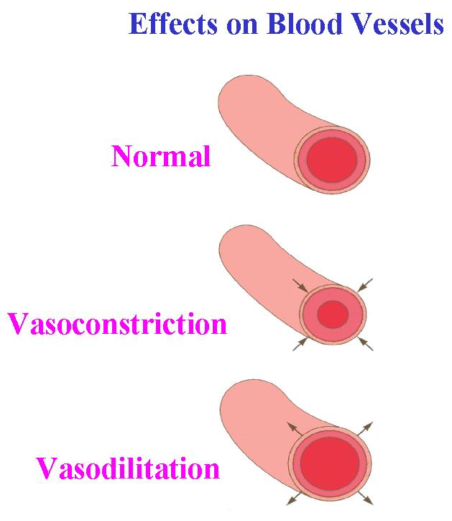
Angiotensin II
ADH
Increased
Blood
Pressure

Slide 20
Other stimuli that affect ADH secretion
Stimuli that increase ADH secretion:
  Pain
  Nausea
  Surgical stress
  Emotional stress
Stimuli that decrease ADH secretion:
  Alcohol intake

Slide 21
Table summarizes the major characteristics of osmoreceptors and baroreceptors
Receptors | Osmoreceptors | Baroreceptors
Location | Anterolateral hypothalamus | Carotid sinus & aortic arch
Value Measured | Plasma osmolality | Circulating volume
ADH Release Stimulated By | Activation of receptor | Suppression of receptor
Change Required for Action | 1% above 280 mosm/kg | 10-15% decrease
Resulting Amount of ADH | Small | Large (vasoconstriction)
Override Other? | no | yes

Slide 22
Control of ADH Release
Osmotic pressure:
  Osmoreceptor mediated
  osmolality  ADH secretion
  osmolality   ADH secretion
Volume effects
  Baroreceptor mediated (vagus nerve)
  blood pressure   ADH secretion
  blood pressure   ADH secretion

Slide 23


Slide 24
Oxytocin

Slide 25
Function of oxytocin
Breast-feeding
  contracts the myoepithelial cells of the alveoli
  (classic neuroendocrine reflex)
Childbirth (parturition)
  in late pregnancy, uterine smooth muscle (myometrium) becomes sensitive to oxytocin
  (positive feedback)

Slide 26
Breast feeding

Slide 27
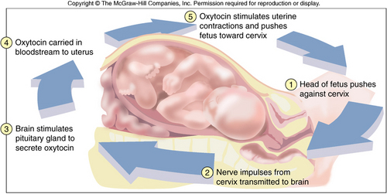
Childbirth

Slide 28
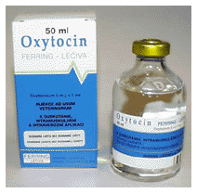
Pitocin

Slide 29

Other stimuli that control release of oxytocin
In humans, oxytocin is thought to be released during hugging, touching, and orgasm in both sexes.
Release increased during stress
Release inhibited by alcohol
In males secretion increases at
time of ejaculation (contraction of smooth muscle of vas deferens)

Slide 30
Oxytocin and autism
Autistic group had significantly lower plasma oxytocin levels than in the non-autism group
Elevated oxytocin was associated with higher scores on social and developmental measures for the non-autistic children

Slide 31
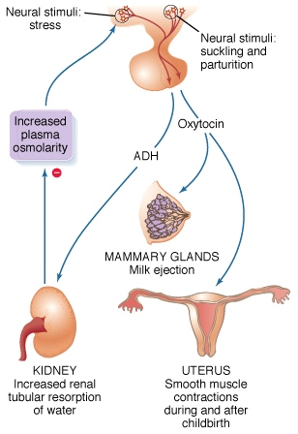
Summary of posterior pituitary hormones actions

Slide 32


