Slide 1

ميحرلا نمحرلا الله مسب

Slide 2
The Adrenal Gland
ENDOCRINOLOGY
Mineralocorticoids
Dr. Abeer Al-Ghumlas

Slide 3
Objectives
At the end of this lecture student should be able to know:
The cellular arrangements and functional components
of the adrenal gland.
The hormones secreted by the medulla and cortex of
the adrenal gland.
The synthesis of the adrenocortical steroids.
The physiological actions of aldosterone.
The regulation of aldosterone secretion.
The major stimuli for aldosterone secretion.

Slide 4
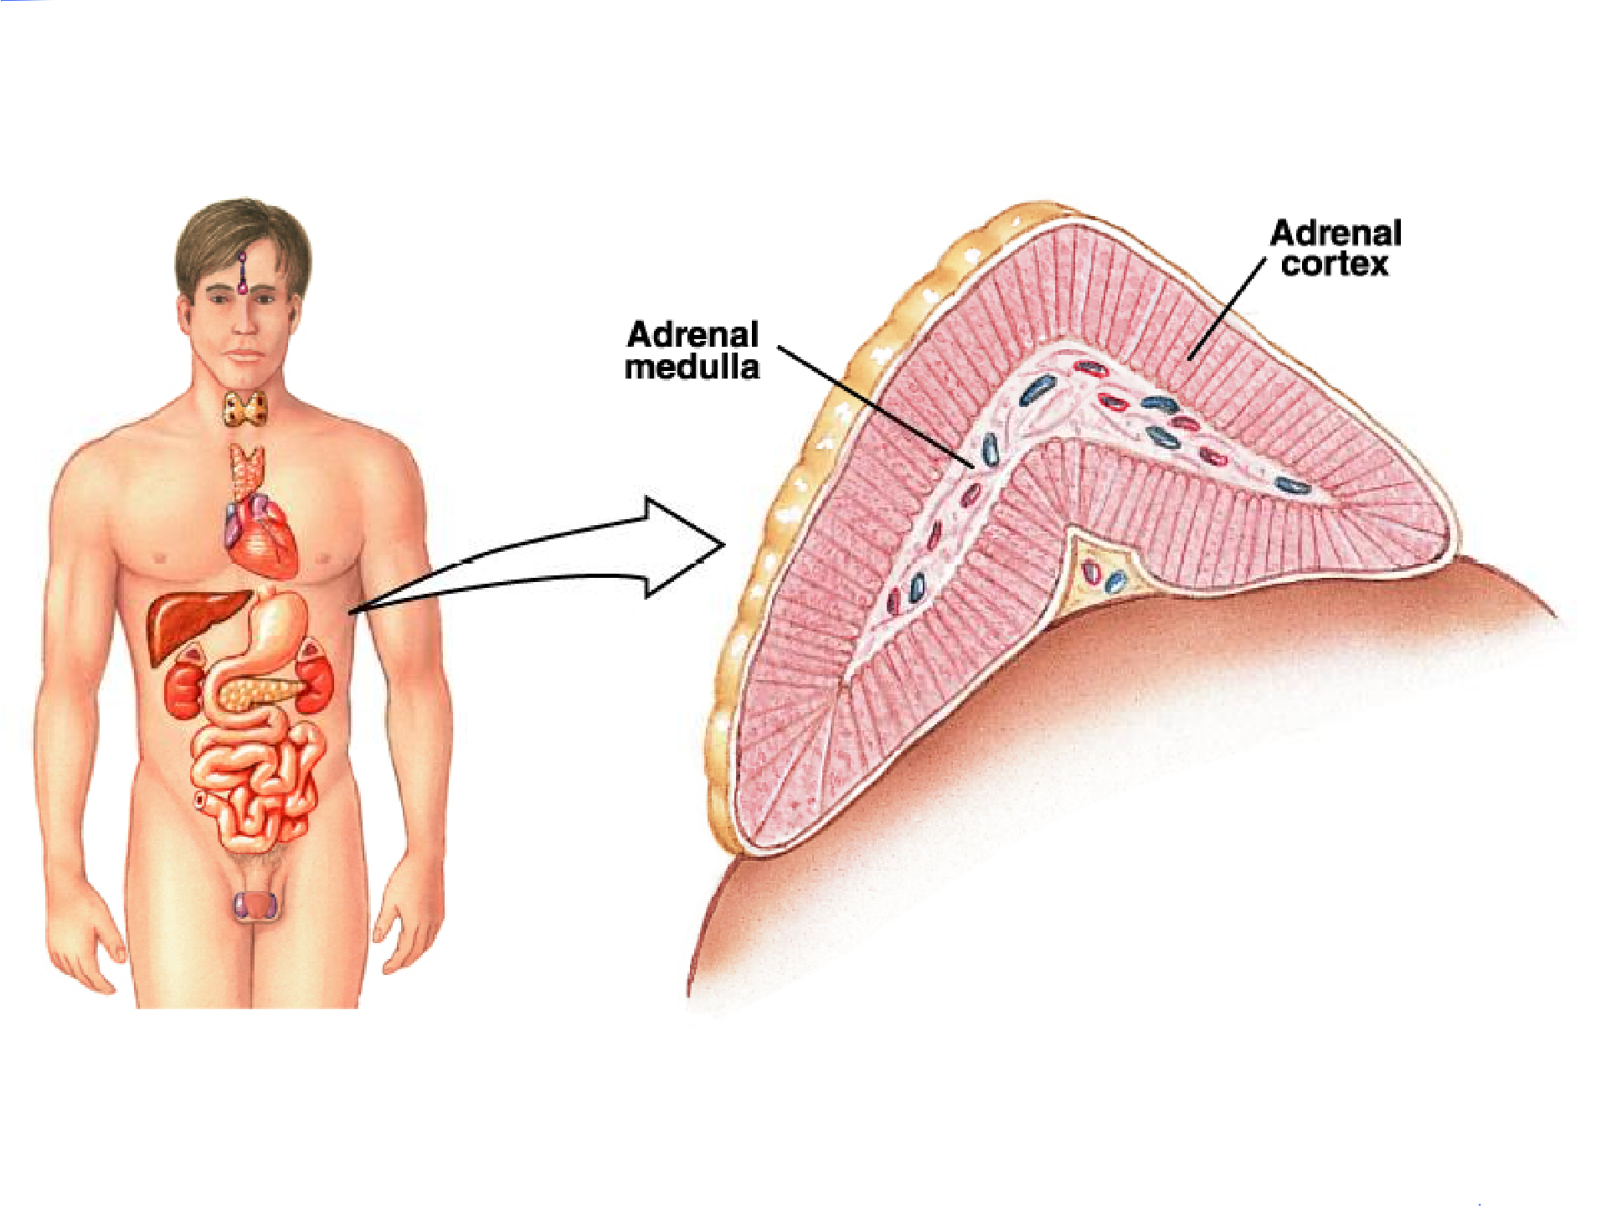

Adrenal Gland

Slide 5
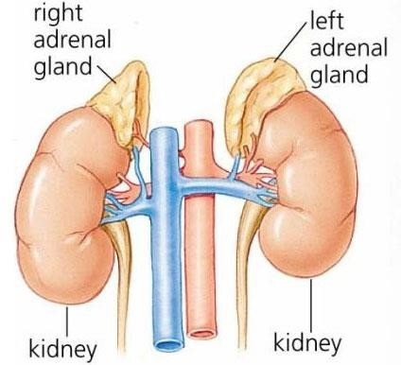
The Adrenal Gland
There are two adrenal (suprarenal) glands that lie at the superior pole of the two kidneys
Small, pyramid-shaped
Weigh 6-10 g

Slide 6
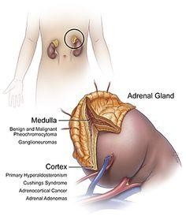
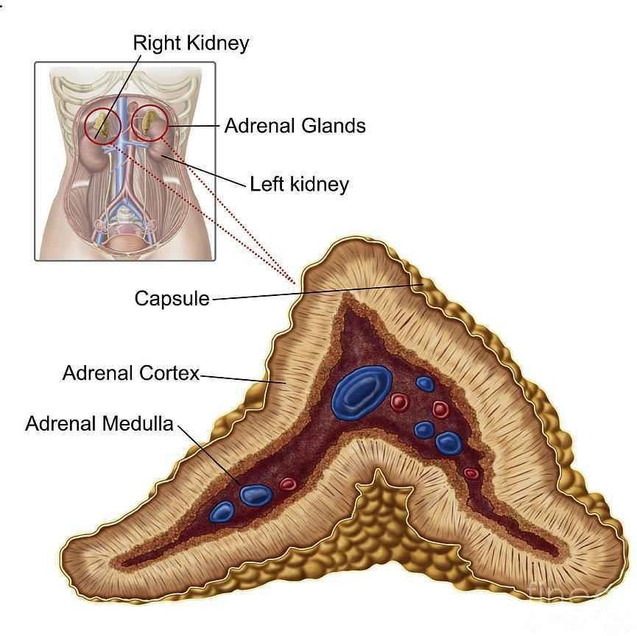
Adrenal Gland
Divided into two morphologically and distinct regions:
-Adrenal cortex.
-Adrenal medulla.

Slide 7
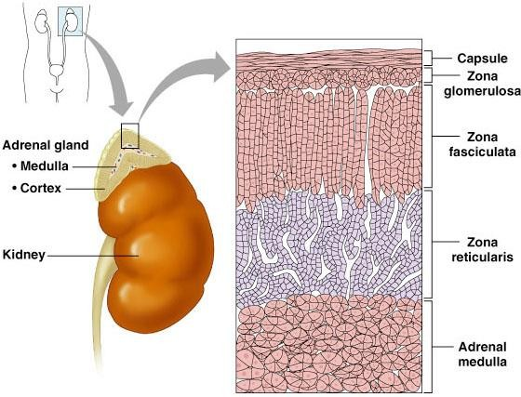
Adrenal Cortex

Slide 8
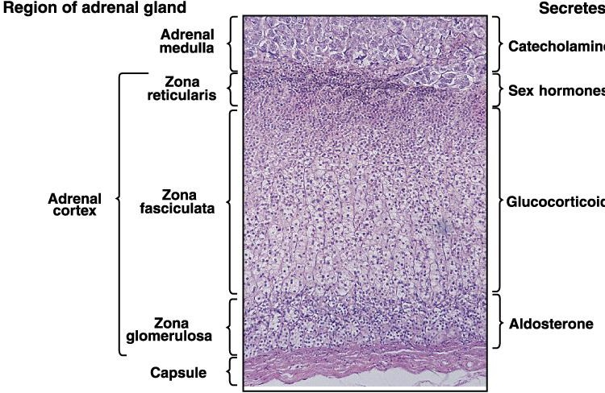
The Adrenal Gland
Corticosteroid hormones
(Cortisol)
Mineralocortico ( )

Slide 9
The Adrenal Gland
Adrenal Cortex:Synthesizes and releases steroid hormones (corticosteroids)
Different corticosteroids are produced in each of the three layers.
Region | Types | Hormones
Zona glomerulosa | Mineralocorticoids | Aldosterone
Zona fasciculata | Glucocorticoids | Cortisol (mainly) Corticosterone Androgens (small amount) Estrogens (small amount)
Zona reticularis | Gonadocorticoids | Androgens: DHEA Androstenedione Estrogen (small amount) Glucocorticoids

Slide 10
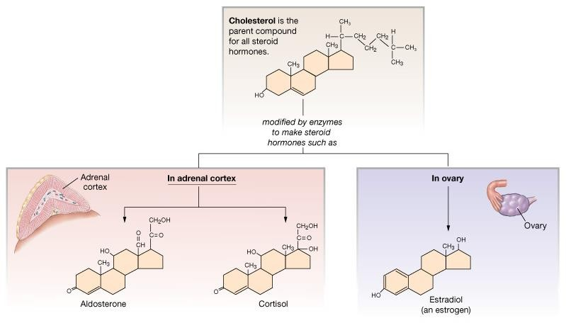
Steroid Hormones: Structure
Guyton and Hall

Slide 11
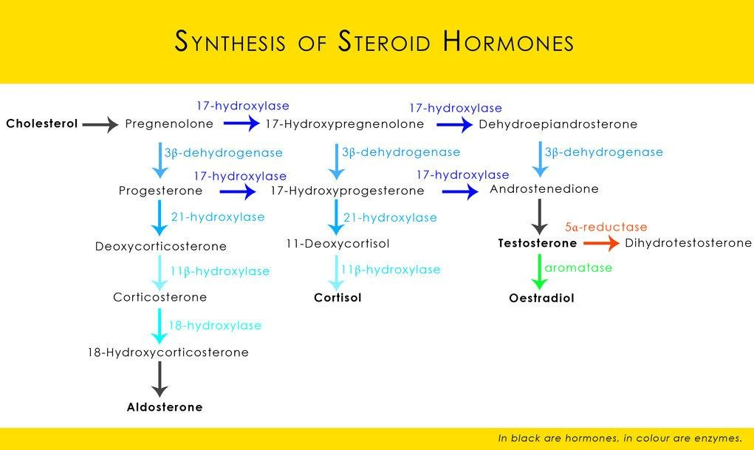

Slide 12
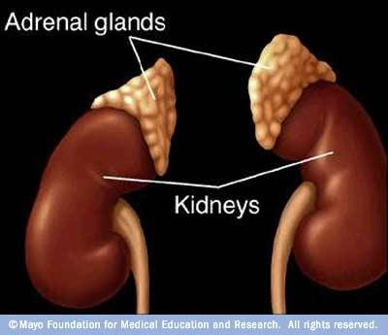
Aldosterone
The main mineralocorticoid
produced by the adrenal gland

Slide 13
Mineralocorticoids:
Aldosterone
A steroid hormone.
Essential for life.
Synthesized in zona glomerulosa
Aldosterone exerts 90% of all the
mineralocorticoid activity.
Target cells are called “principal
(P) cell”.
60% of aldosterone bound to
plasma protein…40% is free form.
Half life: 20 min
Much of secreted aldosterone is metabolized by the liver and converted to tetrahydroglucuroind derivative.

Slide 14
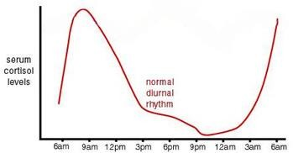
Aldosterone levels
fluctuate diurnally—highest
concentration being at 8 AM, lowest at 11 PM, in parallel to cortisol rhythms.

Slide 15
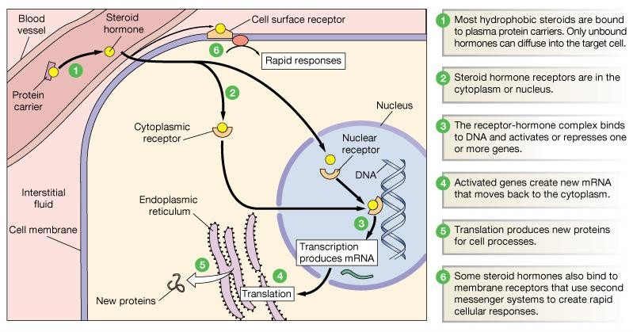
Steroid Hormones: Action

Slide 16
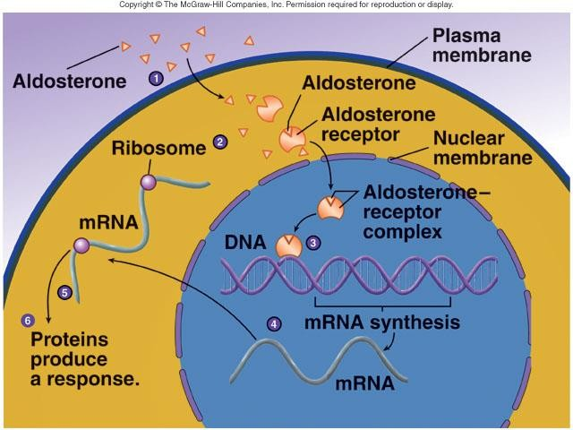
Steroid Hormones: Action
Increases transcription of Na⁺/K⁺ pump
Increases the expression of apical Na⁺ channels and Na⁺
/K⁺ /Cl⁻ cotransporter

Slide 17
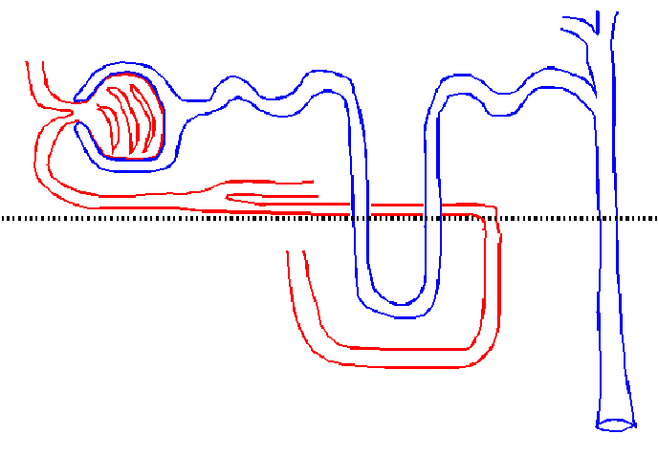
Actions of aldosterone
Acts mainly on the cells of the collecting ducts and distal tubules.
Na+
Increases Renal Tubular Reabsorption of Na⁺ and Secretion of K⁺ and H ⁺
Na+
_{K}+
1. Renal action:
Aldosterone causes sodium to be conserved in the ECF while increasing potassium excretion in the urine.
2. Circulatory Actions of Aldosterone:
Increases ECF volume and Arterial Pressure.
3. It also affects Na+ reabsorption by sweat, salivary and intestinal cells. (Stimulates synthesis of more Na/K-ATPase pumps)

Slide 18
Control of Aldosterone Secretion
increases aldosterone secretion.
K⁺ concentration in the ECF
Na⁺ concentration in the ECF
Increased activity of the renin- angiotensin system
(increased levels of angiotensin II)
Hypovolemia
Hypotention
ACTH:ACTH also stimulates aldosterone synthesis. However the ACTH stimulation is more transient than the other stimuli and is diminished within several days
stress, surgery,….

Slide 19
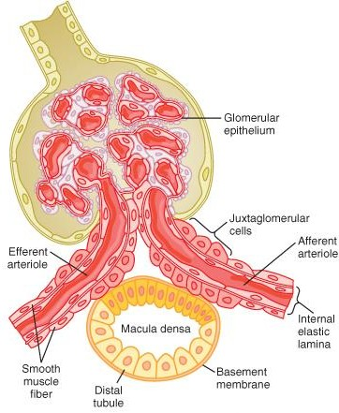
Control of Aldosterone Secretion
Renin :
is a enzyme released by the kidneys
when the arterial pressure falls.
Renin is synthesized and stored in in the juxtaglomerular cells (JG cells) of the kidneys.
The JG cells are modified smooth muscle cells located in the walls of the afferent arterioles immediately proximal to the glomeruli.
Renin acts on another plasma protein (angiotensinogen), to release angiotensin I which is converted to angiotensin II (in the lungs).

Slide 20
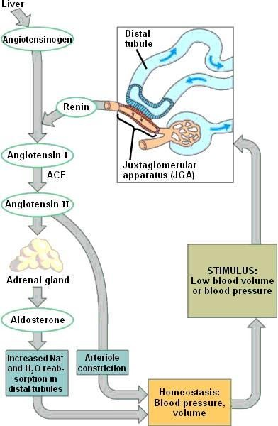
Angiotensin II increases the blood pressure through:
Control of Aldosterone Secretion
Vasoconstriction occurs intensely in the
arterioles & much less so in the veins.
Constriction of the arterioles increases the total peripheral resistance, thereby raising the arterial pressure.
decrease excretion of both salt and
water by the kidneys.
This slowly increases ECF volume, which then increases the arterial pressure during subsequent hours and days.
Angiotensin II acts on the zona glomerulosa to stimulate aldosterone synthesis.
Angiotensin II acts via increased intracellular cAMP to stimulate aldosterone synthesis.

Slide 21
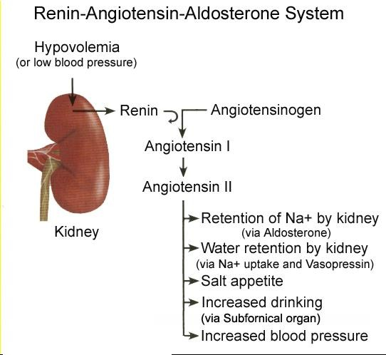

Slide 22
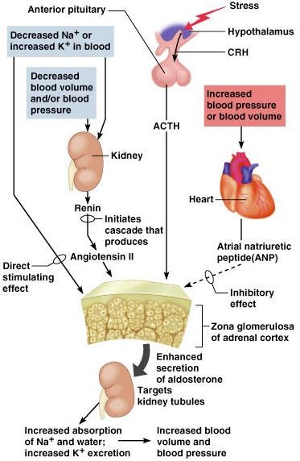
Regulation of Aldosterone secretion

Slide 23
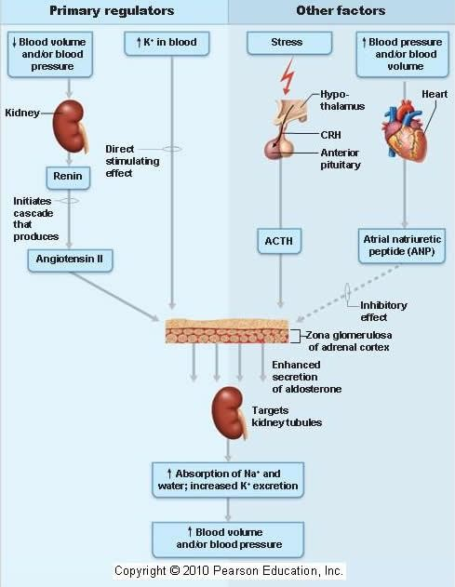
Regulation of Aldosterone secretion
It is essential for life

Slide 24
Hormones of adrenal cortex
 | production mg/day | concentr. ng/ml | activity MINERAL. | activity GLUCO.
aldosterone | 0.05-0.15 | 0.15 | 90%
deoxycorti- costerone | 0.6 | 0.15 | 1/15
corticoste- rone | 1-4 | 2-4 | 1/50 | 4%
cortisol | 8-25 | 40-180 | 1/400 | 95%
DHEA | 7-15 | 5

Slide 25
1- Cortisol is at concentrations
Notes:
Hormones of adrenal cortex
1000 fold higher than aldosterone
Corticosterone
Cortisol binds
>>>>aldosterone
well to the
mineralocorticoid receptor.

Slide 26
Abnormalities
Primary hyperaldosteronism
(increase secretion of mineralocorticoids)
Complete failure to secrete aldosterone
Dehydration
Low blood volume
Low blood pressure
Conn’s Syndrome
DEATH

Slide 27
Primary Aldosteronism (Conn's Syndrome)
Cause: tumor of the zona glomerulosa cells (adenoma) → secretes large
amounts of aldosterone.
Effects:
The most important effects are:
hypokalemia.
slight increase in ECF volume and blood volume.
very slight increase in plasma sodium concentration.
almost always, hypertension.
There are occasional periods of muscle paralysis
hypokalemia.
caused by the
decreased plasma renin concentration (from feedback suppression of renin secretion caused by the ↑ aldosterone) or by the excess ECF volume and arterial pressure.
Treatment:
usually surgical removal.
Spironolactone

Slide 28
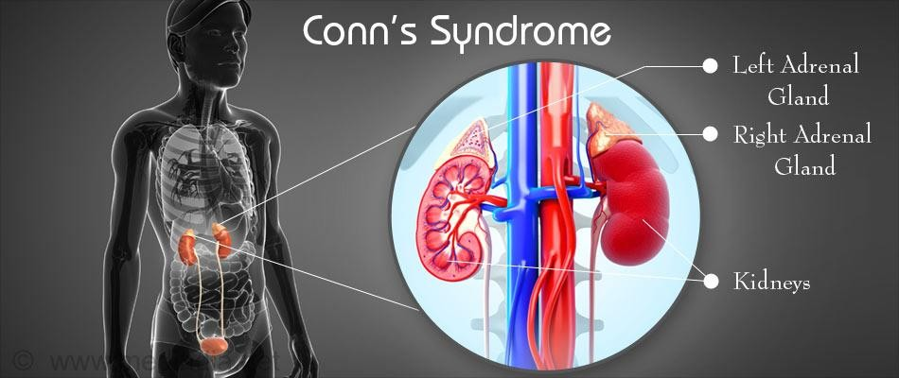
Primary Aldosteronism
Hypertension.
Hypokalemia and hypernatremia
Nocturnal polyuria & polydipsia
Increased tubular (intercalated cells) hydrogen ion secretion, with resultant mild alkalosis.
Neuromuscular manifestations
  weakness, paresthesia
  intermittent paralysis

Slide 29
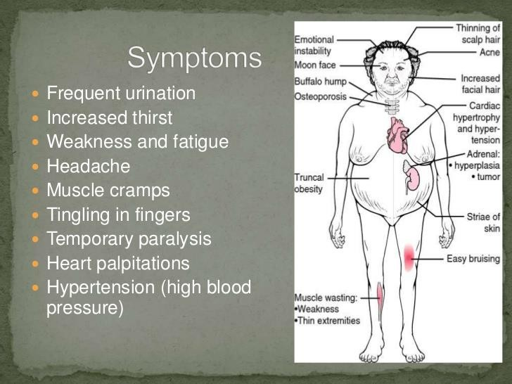
Conn’s Syndrome

Slide 30
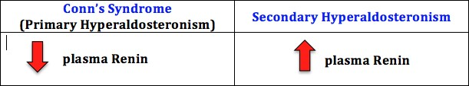

Slide 31



