Slide 1

ميحرلا نمحرلا الله مسب

Slide 2
The Adrenal Gland
ENDOCRINOLOGY
Glucocorticoids
Dr. Abeer Al-Ghumlas

Slide 3
Objectives
At the end of this lecture student should be able to:
Describe the metabolism and physiological effects of glucocorticoids.
Describe the mechanisms that regulate secretion of glucocorticoids
Describe the main features of the diseases caused by excess or deficiency of each of the hormones of the adrenal gland.

Slide 4

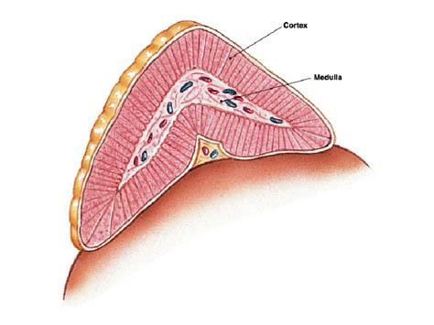
Cortisol

Slide 5
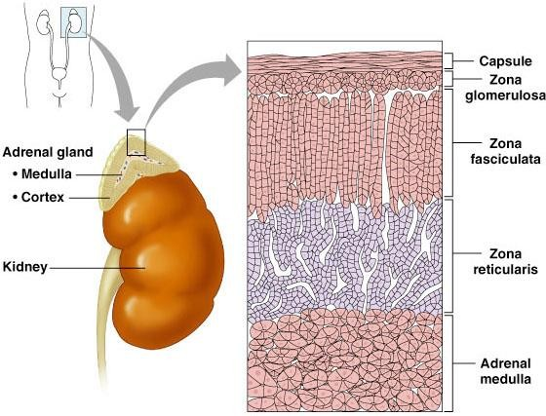
Adrenal Cortex
Cortisol

Slide 6
Glucocorticoids
Main glucocorticoids in humans:
Cortisol:
  very potent
  Account for 95% of glucocorticoid activity
Corticosterone:
  account for about 4% of total glucocorticoid
activity
  Less potent than cortisol
Cortisol:corticosterone produced in humans in a ratio of 10:1

Slide 7
Cortisol….Transport
Bound
90-95%
Mostly to transcortin
(Cortisol Binding Globulin)
 Albumin
Free
6%
Active
Half life =60-90 minutes
Metabolized in liver by reductases & conjugated to
glucuronides and excreted via kidney
Free cortisol is excreted into urine.

Slide 8
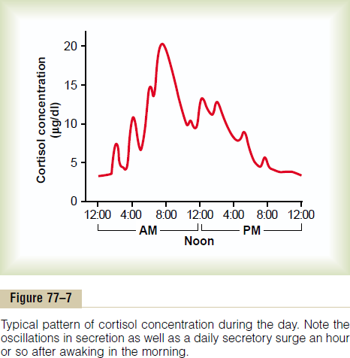
Circadian rhythm of cortisol secretion

Slide 9
Circadian rhythm of cortisol secretion
The secretory rates of CRF,ACTH, and cortisol:
high in the early morning:
the plasma cortisol level ranges between a high of about 20 µg/dl an hour before arising in the morning
low in the late evening:
low of about 5 µg/dl around midnight.
 This effect results from a 24-hour cyclical alteration in the signals from the hypothalamus that cause cortisol secretion.
 When a person changes daily sleeping habits, the cycle changes correspondingly. Therefore, measurements of blood cortisol levels are meaningful only when expressed in terms of the time in the cycle at which the measurements are made.

Slide 10

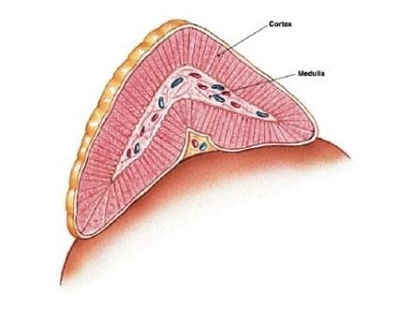
Physiological actions of cortisol
On protein metabolism:
Has a catabolic effect on proteins.
↓↓Protein stores in all
body (except the liver).
↑Liver and plasma proteins
a.a: - ↑↑ Amino acid level
in the blood.
-↓ a.a transport into
extra hepatic cells
- ↑a.a transport into hepatic cells
A. On metabolism
On carbohydrate metabolism:
↑↑Glucose level in the
blood:
Stimulates gluconeogenesis and glycogen synthesis by the liver.
↓↓Glucose utilization by
the cells.
“Adrenal Diabetes”.
On Fat metabolism
(lipolytic):
Mobilization of fatty acid
from adipose tissue
↑↑ The concentration of free fatty acids in the blood.
↑↑ Their utilization for energy.

Slide 11
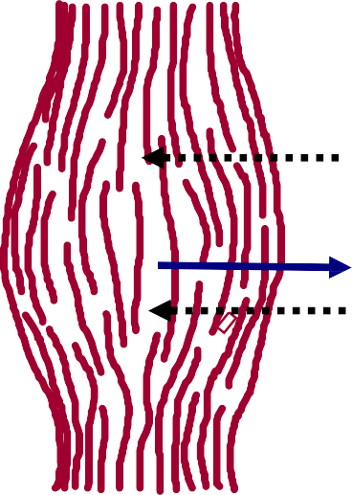
Glycogen
Glucose
Glucose-P
Glucose
Amino acids
Glucose
precursors
Free fatty acids
+
Glycerol
Protein
Liver
Muscle
Adipose
tissue
Plasma
Stimulate
Inhibit
↓
Glucose
Free fatty acids
Amino acids
↓
↓

Slide 12
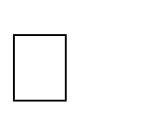
 On Stress:
2. Cortisol is important in resisting stress and
inflammation.
Stress include (trauma, infection, surgery, any
debilitating disease, increase heat or cold).
Cortisol causes rapid mobilization of amino acids and FFA from their cellular stores, making them immediately available both for energy & synthesis of other compounds, including glucose, needed by the different tissues in the body.
BP, glycogen, prevents stress induced reaction from becoming excessive.

Slide 13
Glucocorticoids and Stress:
Without Glucocorticoids , the body cannot cope
with even mild stressors
Fat & glucose metabolism (Redistribution of Fat, increase of
glucose)
Maintenance of the vascular response to norepinephrine
Effects on CNS

Slide 14

3. On inflammation
Damage to the tissues by trauma/infection almost
always leads to inflammation.
Inflammation can be more damaging than the
trauma or disease itself.
Cortisol has anti-inflammatory effects….How?
Cause stabilization of the intracellular lysozomal membranes → more difficult for these membranes to rupture → less release of proteolytic enzymes that cause inflammation.
Reduces all aspects of the inflammatory process.

Slide 15
3. On inflammation:
Anti-inflammatory:
Reduces all aspects of the inflammatory process.
(1)Block the early stages of the inflammation process before
inflammation even begin
(2) If inflammation begun: It cause rapid resolution of the inflammation and increase rapidity of healing
(3) Resolution of inflammation

Slide 16
Anti-inflammatory:
Stabilizes lysosomal membrane.
Reduces degree of vasodilatation.
Decreases permeability of capillaries.
Decreases migration of white blood cells.
Suppresses immune system.

Slide 17
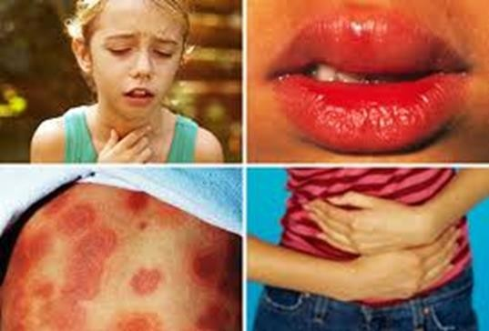
4. Cortisol blocks the inflammatory response to Allergic reactions
Anaphylactic shock
Cortisol prevent shock and death

Slide 18
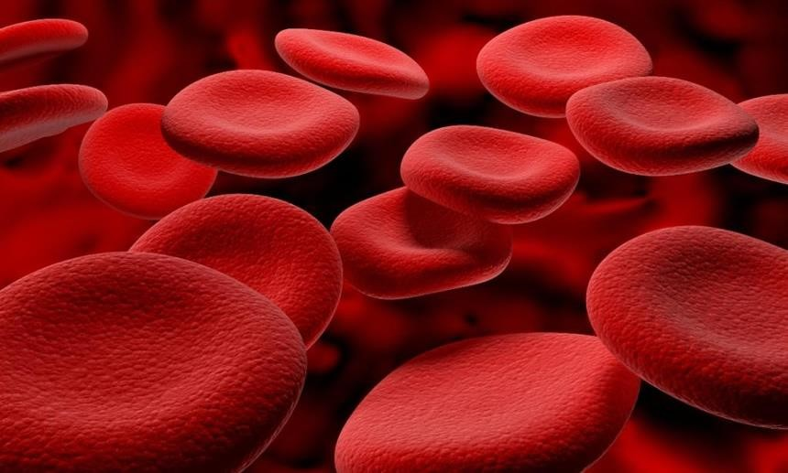
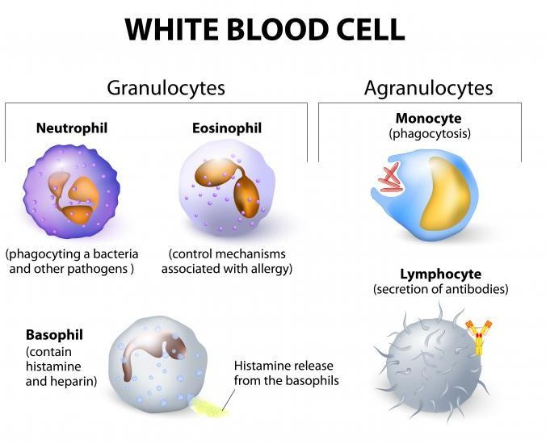
5. On blood cells:
 Increases RBC count,
platelets, neutrophils
 Decreases lymphocyte, eosinophils, basophils count
 Suppresses lymphoid tissue systemically therefore decrease T cell and antibody production decreasing immunity.
 This effect is useful in transplantation surgery in reducing organ rejection.

Slide 19
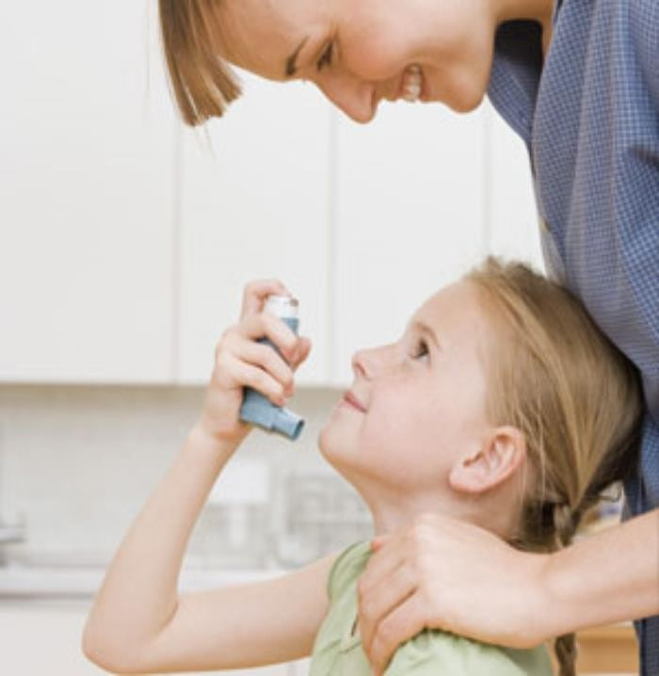
6. anti-allergic effects
(In pharmacological doses):
It decreases fibroblastic activity
and local swelling
phospholipase A2
Stabalizes lysosomal membrane
Inhibits collagenase from
breaking down proteins
Inhibits histamine release (anti-
allergic)

Slide 20
7. Effect on circulation
Excrete water load:
Cortisol levels vary with water intake
Mineral metabolism:
Cortisol has mineralcorticoid effect:
Na+ reabsorption and K+ secretion
Not as potent as aldosterone.
Maintains body fluid volumes & vascular integrity
BP regulation & cardiovascular function:
Sensitizes arterioles to action of noradrenaline (Permissive
effect).
Decreased capillary permeability
Maintains normal renal function

Slide 21
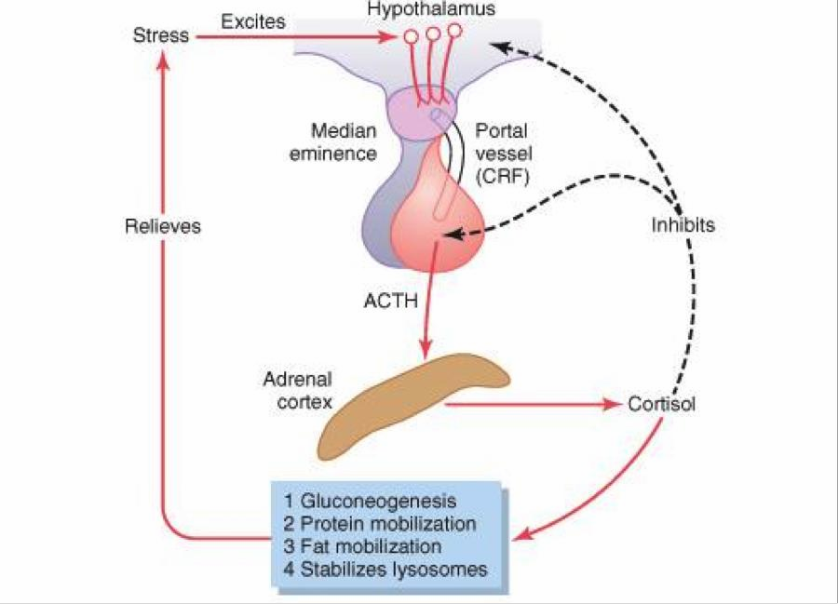


Regulation of Cortisol Secretion
Stress
 Stress stimulates CRH secretion by the hypothalamus.
 Cortisol has a direct negative feedback effect on both the hypothalamus and ant. pituitary.

Slide 22
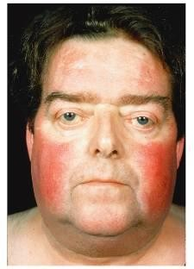
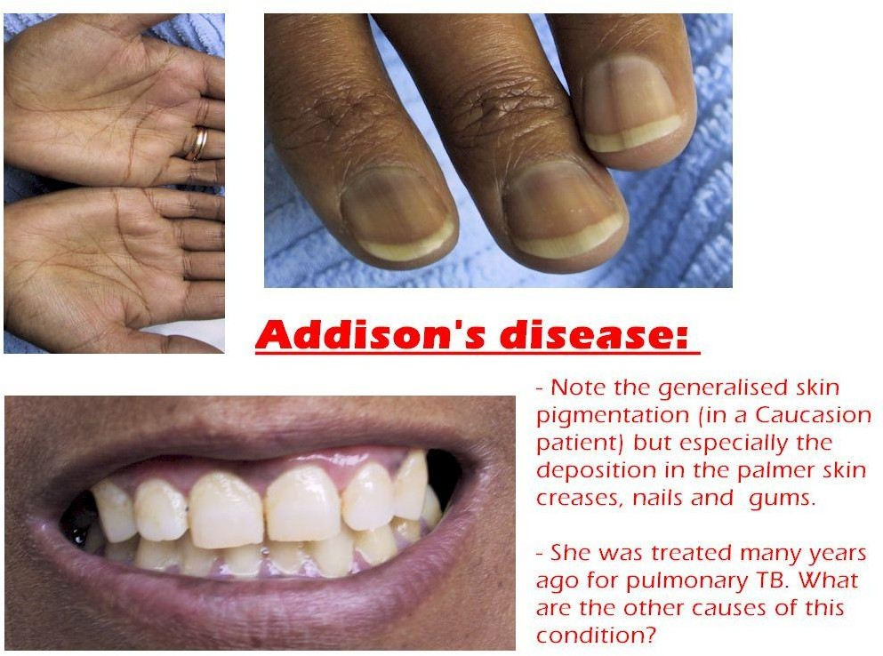
Abnormalities
(Increase secretion of corticosteroid)
(Decrease secretion of glucocorticoids
and mineralocorticoids)
Cushing’s Syndrome
(Addison's disease)

Slide 23

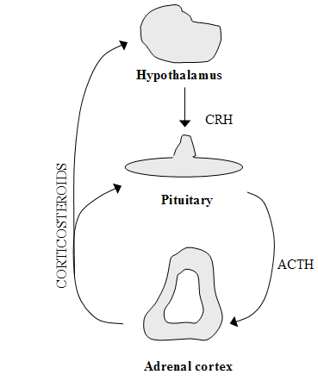
Cushing’s Syndrome
Cushing syndrome: (Hypercortisolism)
Causes and types:
adenomas of the anterior pituitary
→↑ ACTH.
abnormal function of the
hypothalamus →↑ CRH.
"ectopic secretion" of ACTH by a tumor elsewhere in the body, such as an abdominal carcinoma.
adenomas of the adrenal cortex.
When Cushing's syndrome is secondary to ↑ ACTH by the anterior pituitary = Cushing's disease.
2
1
4
3

Slide 24

(5) Cushing's syndrome may occur when large amounts of glucocorticoids are administered over prolonged periods for therapeutic purposes.
e.g. patients with chronic inflammation associated with diseases such as rheumatoid arthritis.

Slide 25
Cushing’s Syndrome
On carbohydrate
metabolism:
↑ blood glucose level (↑ gluconeogenesis and
↓ glucose utilization by
the tissues).
On protein metabolism:
↓ tissue proteins almost everywhere in the body (except liver).
Protein loss from the muscles in particular causes severe weakness.
protein collagen fibers in the s.c.(loss of CT)
Thining of the skin
severely ↓ protein
deposition in bones → severe osteoporosis.
suppressed immune
system.
Abnormal fat redistribution
mobilization of fat from the lower part of the body, with concomitant extra deposition of fat in the thoracic and upper abdominal regions, giving rise to a buffalo torso (truncal obesity).
The appearance of the face described as a "moon face"
80% of patients have hypertension (because of the mineralocorticoid effects of cortisol).

Slide 26
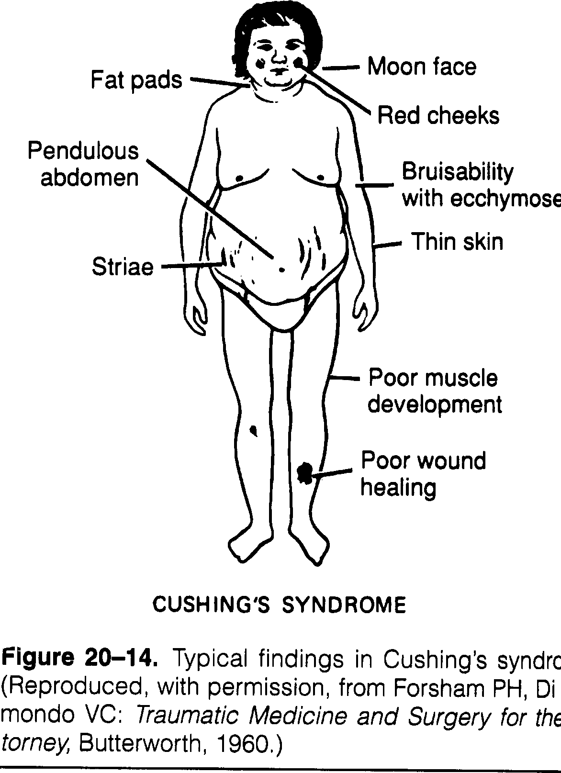
Cushing’ s Syndrome
Many people with excess cortisol secretion develop a peculiar type of obesity, with excess deposition of fat in the chest and head regions of the body, giving a buffalo-like torso and a rounded face, a “moon- face”.

Slide 27
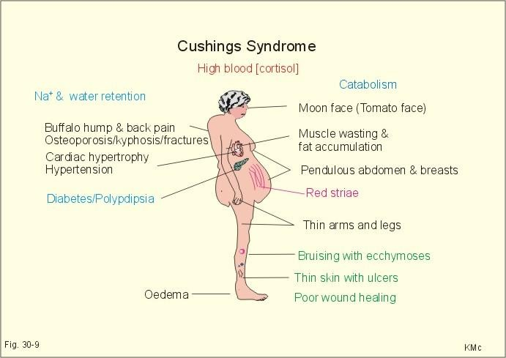
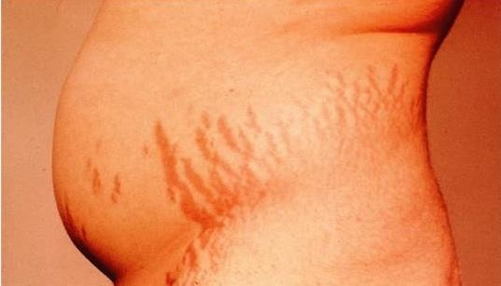
Features of Cushing’s Syndrome
striae

Slide 28

How to differentiate between ACTH-dependent and ACTH- Independent Cushing's syndrome?
By administrating large doses of cortisol (dexamethasone).
In patients with ↑ ACTH → no suppression of ACTH secretion.
patients with primary adrenal overproduction of cortisol
(ACTH-independent) → ↓ levels of
ACTH.

Slide 29
Abnormalities
(Increase secretion of corticosteroid)
(Decrease secretion of glucocorticoids
and mineralocorticoids)
Cushing’s Syndrome
(Addison's disease)

Slide 30
Adrenocortical insufficiency
primary causes, ie. Addison’s disease
  autoimmune disease, tumors, infection, hemorrhage, metabolic failure, ketoconazole (glucocorticoid antagonist activity)
secondary causes
  hypopituitarism, suppression by exogenous steroids

Slide 31
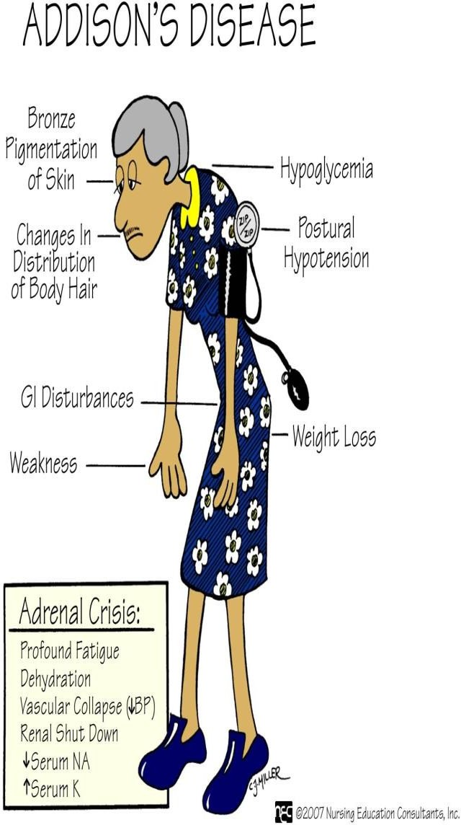
Adrenal insufficiency: (Addison's disease)
Increased excretion of sodium and water.
Reduction in ECF volume.
Tendency toward low blood pressure.
Complete absence of aldosterone, the
volume depletion may be severe.
Hypoglycemia
Skin pigmentation
The person is allowed to eat large amounts of salt and drink large amounts of water to balance the increased urine output of salt and water.

Slide 32
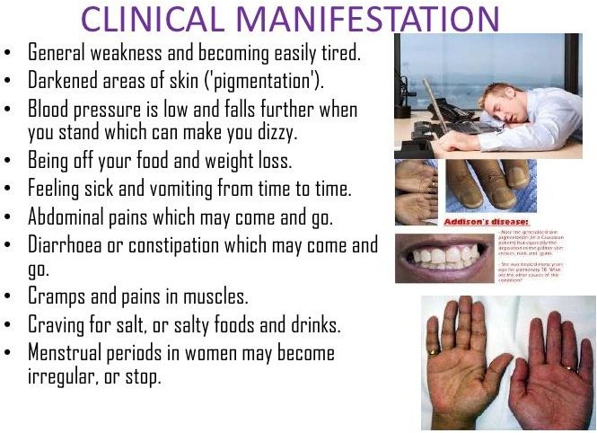

Slide 34
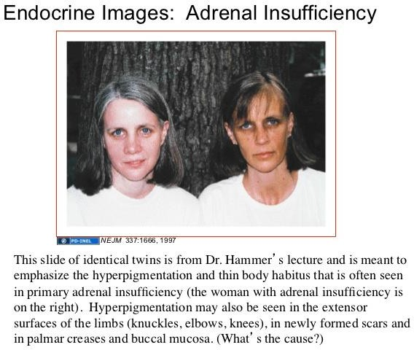

Slide 35
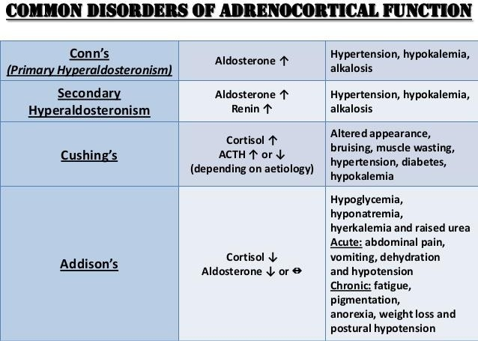

Slide 36
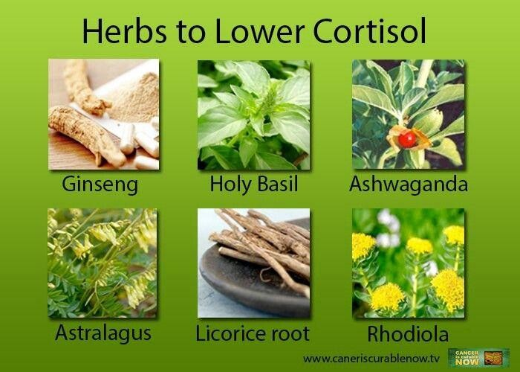

Slide 37



