Slide 1
Anterior Pituitary Disorders
MUHAMMAD MUJAMMAMI, MD, MSc, ECNU
Assistant Professor & Consultant
Endocrine & Metabolism Unit, Department of Medicine
King Saud University
Endocrine block 2018

Slide 2
Objectives
To understand basic pathophysiology and feedback for anterior pituitary hormones.
Know about clinical approach for common anterior pituitary gland disorders:
  Common clinical presentations.
  Main laboratory investigations.
  Radiological investigations
  Describe lines of management for each of these conditions.

Slide 3
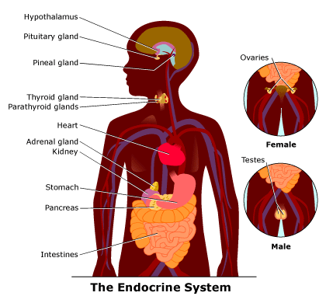
Endocrine system

Slide 4
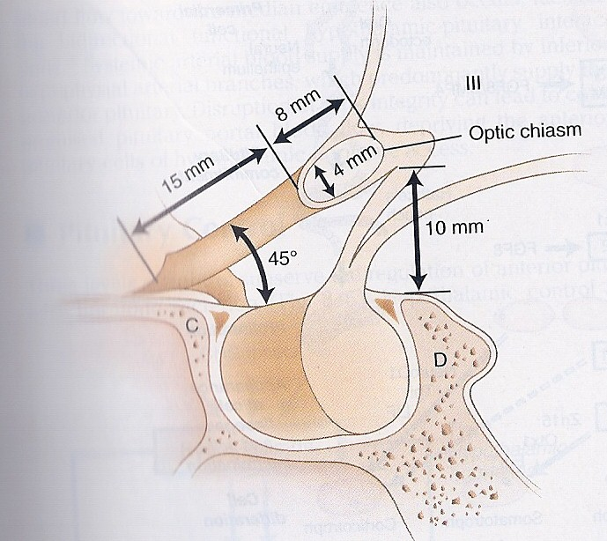
Pituitary Gland

Slide 5
Pituitary Development
Anterior pituitary
Posterior pituitary
(neurohypophysis)
Rathke’s pouch, Ectodermal evagination of oropharynx
Synthesis and secrete
  (GH,LH,FSH,PRL,TSH,ACTH)
recognizable by 4- 5th wk of gestation and full maturation by 20th wk
Portion of Rathke’s pouch →→ Intermediate lobe
Remnant of Rathke’s pouch cell in oral cavity →→ pharyngeal pituitary
neural cells as an outpouching from the floor of 3rd ventricle
Only storage:
  Oxyctocin,ADH (hypothalamic hormones)

Slide 6
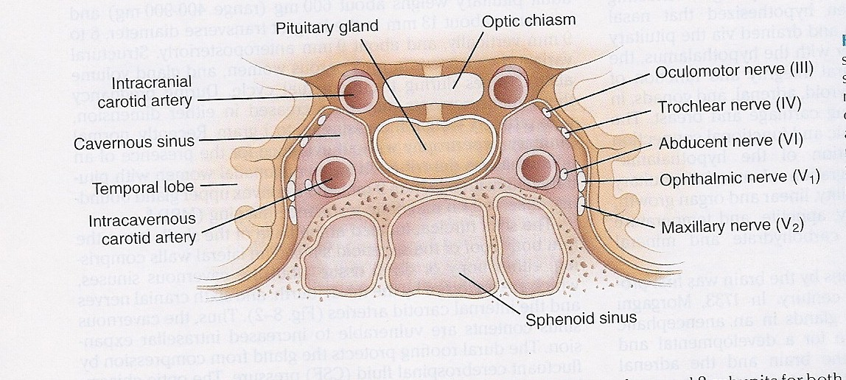
Sella turcica
Lies at the base of the skull
Roof : diaphragma sellae
  Pituitary stalk and its blood vessels pass through the diaphragm
Floor: Sphenoid sinus
Lateral walls: cavernous sinus
  containing III, IV, VI, V1, V2 cranial nerves and internal carotid artery with sympathetic fibers.
  Both adjacent to temporal lobes
Notes:
Diaphragma sella is formed by a reflection of dura matter preventing CSF from entering the sella turcica by this diaphragm

Slide 7
Pituitary Development
Pituitary stalk in midline joins the pituitary gland with hypothalamus that is below 3rd ventricle
Development of pituitary cells is controlled by a set of transcription growth factors like
  Pit-1, Prop-1, Pitx2
Notes:
Normal pituitary stalk length 5- 7 mm , 2-3 mm in diameter

Slide 8
Pituitary Development
Pituitary gland measures
  15 X 10 X 6 mm, weighs 500 mg but about 1 g in women
Optic chiasm
  lies 10 mm above the gland and anterior to the stalk
Blood supply :
  superior, middle, inferior hypophysial arteries ( internal carotid artery) running in median eminence from hypothalamus
Venous drainage:
  to superior and inferior petrosal sinsuses to jugular vein
Notes:
Height is 5-7 mm and 10 mm lateral dimension, height is 10. superior, middle supply ant. Pituitary. Inferior supply stalk and post pituitary artery

Slide 9
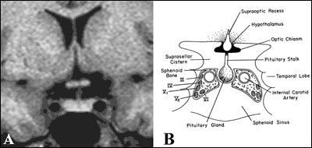
Normal Pituitary Anatomy
Modified from Lechan RM. Neuroendocrinology of Pituitary Hormone Regulation. Endocrinology and Metabolism Clinics 16:475-501, 1987

Slide 10
Pituitary Disorders
Anterior pituitary disorders
Posterior Pituitary disorders

Slide 11
Anterior Pituitary Disorders
  Function :
    Hypersecretion: (GH,LH,FSH,PRL,TSH,ACTH)
    Hyposecretion: hypopituitarism ( isolated, multiple, pan)
  Masses
    Functioning = Hypersecretion
    Non- Functioning
    With /without mass-effect:
      Space occupying lesion ( compression symptoms, hypopituitarism )

Slide 12
Posterior Pituitary disorders
  Diabetes insipidus

Slide 13
Anterior Pituitary Function
 | Somatotroph | Gonadotroph | Lactotroph | Thyrotroph | Corticotroph
Stimulators | GHRH GHS | GnRH E2 | -------- TRH, E2 | TRH | CRH AVP gp-130 cytokines
Inhibitors | IGF-1 Somatostatin Activins | Testosterone, E2 inhibin |  | T3, T4 Dopamine Somatostatin GH | Steroid
Hormone | GH | LH,FSH | PRL | TSH | ACTH,POMC
Target Gland | Liver & other tissues | Ovary, Testes | Breast & other tissues | Thyroid | Adrenals
Target Hormone | IGF-1 | Testosterone, E2 |  | T4 | cortisol
Trophic Effects | IGF-1 production, Growth induction, Insulin antagonism | Sex Steroid Follicular growth Germ Cell maturation | Milk Production | T4 synthesis and secretion | Steroid production Androgen

Slide 14
Pituitary Function
Anterior Pituitary Hormones
  Go Look For The Adenoma Please
  GH , LH, FSH, TSH, ACTH, Prolactin
  A compressive adenoma in pituitary will impair hormone production in this order
Posterior Pituitary Hormones
  Oxytocin
  ADH( vasopressin)
  Remember (storage not synthesis)

Slide 15
Etiology of Pituitary Masses

Slide 16
Anterior Pituitary Disorders
  Function :
    Hypersecretion: (GH,LH,FSH,PRL,TSH,ACTH)
    Hyposecretion: hypopituitarism ( isolated, multiple, pan)
  Masses
    Functioning = Hypersecretion
    Non- Functioning
    With /without mass-effect:
      Space occupying lesion ( compression symptoms, hypopituitarism )

Slide 17
Etiology of Pituitary-Hypothalamic Lesions
Non-Functioning Pituitary Adenomas
Endocrine active pituitary adenomas
  Prolactinoma ( PRL-oma)
  Somatotropinoma ( GH secreting adenoma, Acromegaly)
  Corticotropinoma ( ACTH secreting adenoma, Cushing’s disease )
  Thyrotropinoma (TSH-oma, rare )
  Other mixed endocrine active adenomas
Malignant pituitary tumors: Functional and non-functional pituitary carcinoma
Metastases in the pituitary (breast, lung, stomach, kidney)
Pituitary cysts: Rathke's cleft cyst, Mucocoeles, Others
Empty sella syndrome
Pituitary abscess
Lymphocytic hypophysitis
Carotid aneursym
\

Slide 18
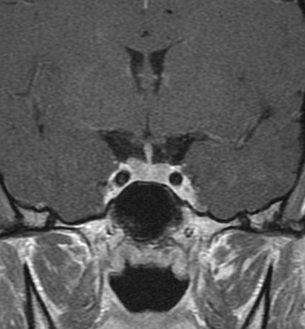
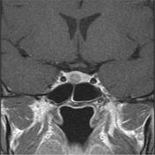
Notes:
Left side microadenoma post contract

Slide 19
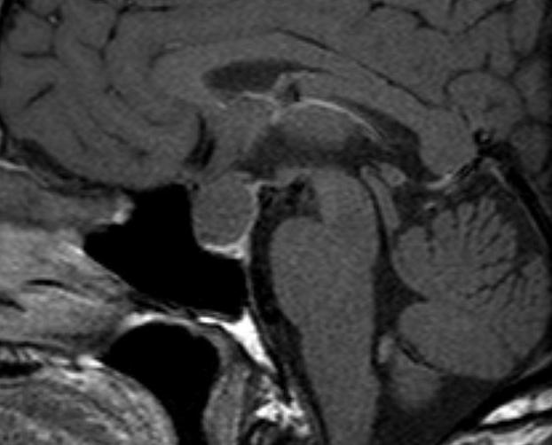
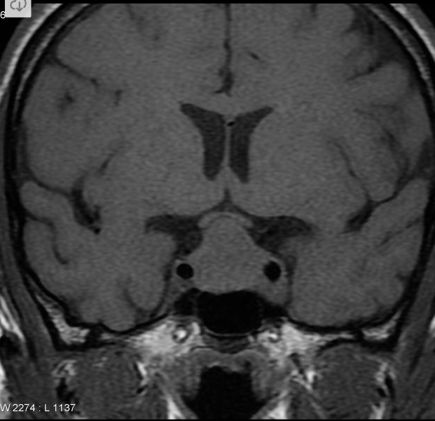
Notes:
Enhanced T1 MRI rathke’s cyst / non-enchanced T1 with large rathkes cyst compressing normal pituitary tissue and optic chiasm in the middle of stalk insertion sometimes go suprasellar

Slide 20
Anterior Pituitary Disorders
  Function :
    Hypersecretion: (GH,LH,FSH,PRL,TSH,ACTH)
    Hyposecretion: hypopituitarism ( isolated, multiple, pan)
  Masses
    Functioning = Hypersecretion
    Non- Functioning
    With /without mass-effect:
      Space occupying lesion ( compression symptoms, hypopituitarism )

Slide 21
Disorders of Pituitary Function
Hypopituitarism
  Central hypoadrenalism, hypogonadism, hypothyroidism or GH deficiency
  Panhypopituitarism
Hypersecretion of Pituitary Hormones
  Hyperprolactinemia
  Acromegaly
  Cushing’s Disease

Slide 22
Evaluation of Pituitary mass
Pituitary adenoma:
  10 % of all pituitary lesions
  Genetic-related
    MEN-1, Gs-alpha mutation, PTTG gene, FGF receptor-4
Pituitary incidentaloma:
  1.5 -31 % in autopsy ( prevalence)
  10 % by MRI most of them < 1 cm
Notes:
Guanine nucleatide stimulatory protein gene found in 40 % of somatotroph adenoma/ inactivation mutation in tumor supressing gene in men 1.

Slide 23
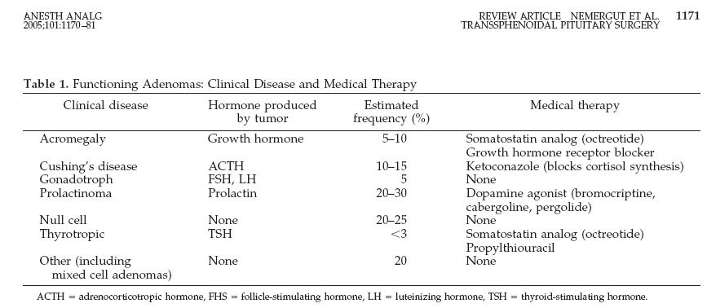
Evaluation of Pituitary lesion

Slide 24
Evaluation of Pituitary lesion
C: Clinical ( History and Examination)
  function ( oversection or hyposecretion )
  Mass ( headache, visual symptoms )
B: Biochemical
  Screen Test
  Confirmatory Test
A: Anatomical
  MRI of sella turcica
Then treatment:
  Surgical – Medical – Radiation
  Medical – Surgical – Radiation

Slide 25
Non- functional pituitary adenoma
C: Clinical | Asymptomtic , incidentaloma by imaging Mass-effect ( mechanical pressure, hypopituitarism, visual ( bitemproal hemianopia) Gonadal hypersecretion
B: Biochemical | GH,LH,FSH,TSH,ACTH: not high PRL : low ,high, normal
A: Anatomical | MRI
Treatment | Surgery if indicated Observation Adjunctive therapy: - Radiation therapy - Dopamine agonist - Somatostatin analogue

Slide 26
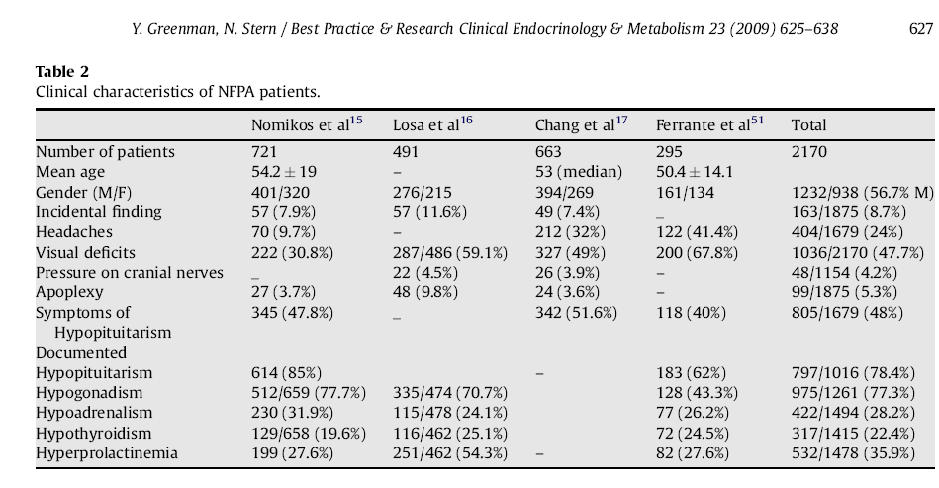
Non- functional pituitary adenoma

Slide 27
Functional pituitary mass

Slide 28
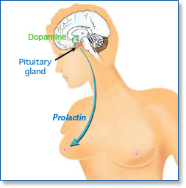
Prolactin

Slide 29
Prolactin - Low
No clinical significant if there is no mass invading the hypothalamus.
N.B. :
  PRL is the only pituitary hormone that is inhibited by hypothalamus.

Slide 30
Prolactinoma ( Mass + high level)

Slide 31
Prolactinomas
C: Clinical | oligomenorrhea, amenorrhea or infertility Galactorrhea Mass-effect ( mechanical pressure, hypopituitarism) Sexual dysfunction (in male) asleep, stress, pregnancy, lactation and chest wall stimulation or trauma, Renal failure, Liver failure medication O/E: Visual field defect ( Bitemporal hemianopia) Nipple discharge
B: Biochemical | GH,LH,FSH,TSH,ACTH: normal or low PRL : High TSH: R/O Hypothyroidism( primary) IGF-1: R/O acromegaly co-secrtion
A: Anatomical | MRI
Treatment | Medical – Medical – Medical ( Dopamine agonist) Surgical- Radiation

Slide 32
Prolactinomas
Most common of functional pituitary adenomas
25-30% of all pituitary adenomas
Some growth hormone (GH)–producing tumors also co-secrete PRL
Prolactinomas women:
  90% present with microprolactinomas
Prolactinomas in men :
  60% present with macroprolactinomas
http://www.emedicine.com/Med/topic1915.htm

Slide 33
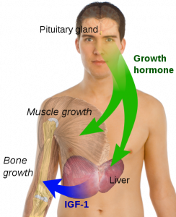
Growth hormone disorder

Slide 34
Growth hormone deficiency
Isolated, pan hypopituitarism
Pituitary tumor as mass effect →→ Growth hormone deficiency
Disease :
  Children: Short stature
  Adult: ??

Slide 35
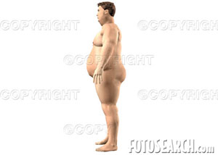
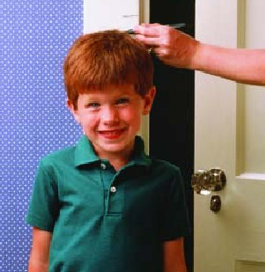
Growth hormone deficiency
Diagnosis in children and
adult

Slide 36
Growth hormone deficiency
C: Clinical | Function : Short stature Mass-effect ( mechanical pressure, hypopituitarism)
B: Biochemical | Pituitary Function (LH,FSH.PRL, TSH, ACTH, cortisol,testesterone, T4) Screen: IGF-1 Dynamic testing: clonidine stimulation test glucagon stimulation exercise testing, arginine-GHRH insulin tolerance testing
A: Anatomical | X-ray of hands: delayed bone age MRI
Treatment | GH replacement

Slide 37
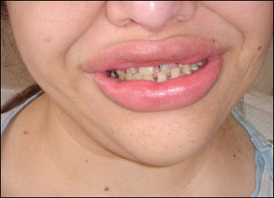
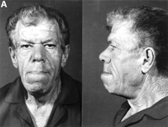
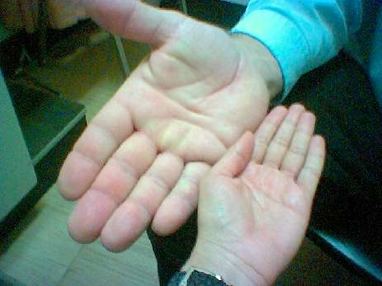
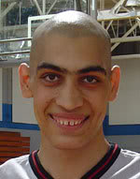
Acromegaly

Slide 38
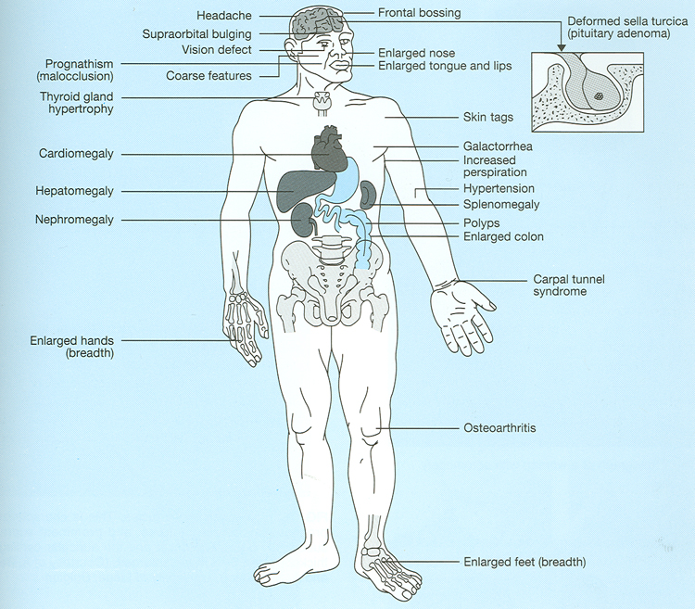
Growth hormone - Acromegaly

Slide 39
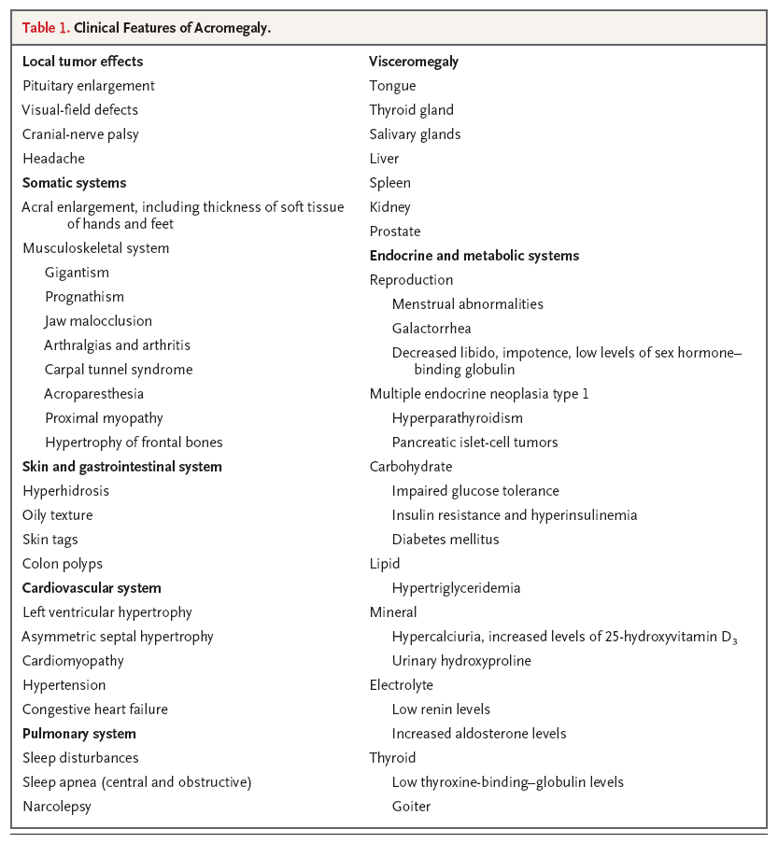
Growth hormone - Acromegaly

Slide 40
Acromegaly
C: Clinical | Function : Sweating, Enlargement (acral, face gross features, heart, tongue Jaw, gigantism in children , Galactorrhea Mass-effect ( mechanical pressure, hypopituitarism) HTN,CHF, OSA,constipation O/E: Visual field defect ( Bitemporal hemianopia) Gross features of Acromegaly
B: Biochemical | Pituitary Function (LH,FSH.PRL, TSH, ACTH, cortisol,testesterone, T4) Screen: IGF-1 Confirmatory Test : 75 g OGTT tolerance test for GH suppression Fasting and random blood sugar, HbA1c Lipid profile
A: Anatomical | MRI Echo: Cardiac disease is a major cause of morbidity and mortality 50 % died before age of 50 HTN in 40%, LVH in 50% , Diastolic dysfunction as an early sign of cardiomyopathy
Treatment | Surgical – Medical (Somatostatin analogue)- Radiation

Slide 41
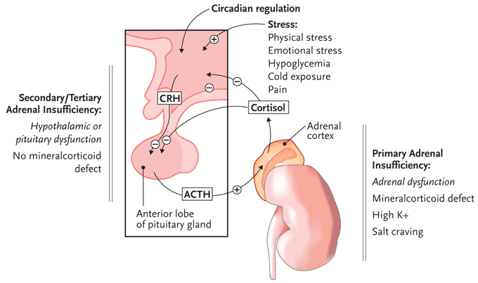
ACTH-disorders

Slide 42
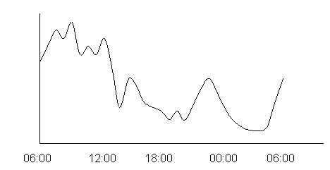
HPA-axis
Circadian rhythm of cortisol secretion
Early morning cortisol between 8-9 am

Slide 43
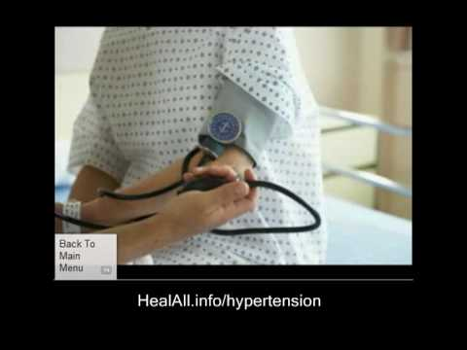
ACTH-disorders

Slide 44
Cortisol low (Hypoadrenalism)
Nausea, Vomiting, abdominal pain, Diarrhea
Dizziness and weakness, Tiredness, Muscle ache
Hypotension
Weight loss

Slide 45
Management of hypoadrenalism
Cortisol replacement

Slide 46
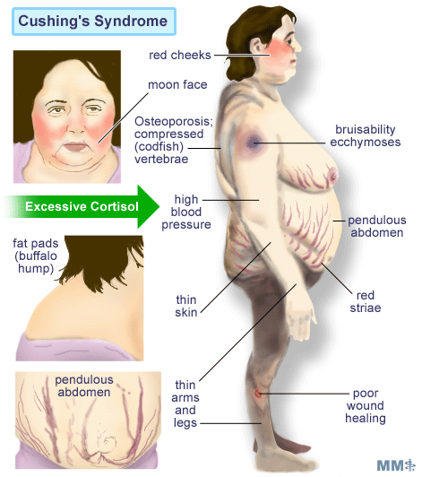
HPA-axis ( excessive cortisol)

Slide 47
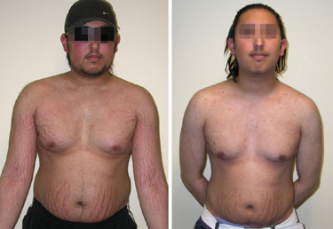
ACTH-Adenoma

Slide 48
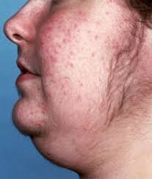
excessive cortisol (Cushing’s)
Hirsutism in women

Slide 49
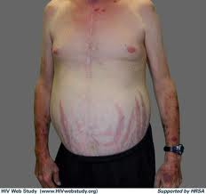
excessive cortisol (Cushing’s)
Stria (purple, wide >1cm)

Slide 50
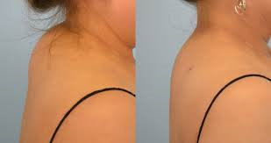
excessive cortisol (Cushing’s)

Slide 51
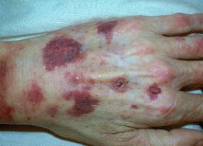
excessive cortisol (Cushing’s) ecchymosis

Slide 52
HPA-axis ( excessive cortisol)
80 % HTN
LVH
Diastolic dysfunction, intraventricular septal hypertrophy
ECG needed: high QRS voltage, inverted T-wave
Echocardiogram preop
OSA: 33% mild, 18% severe. Needs respiratory assessment and careful use of sedative during surgery
Glucose intolerance in 60%, control of hyperglycemia
Osteoporosis with vertebral fracture→→ positioning of patient in OR ( 50 %), 20 % with fracture
thin skin→→ difficult IV cannulation, poor wound healing

Slide 53
Cushing’s ( excessive cortisol)
C: Clinical | Function : Hirsutism, acne, easily bur DM,HTN, irregular period, proximal weakness, recurrent infections, depression O/E: hirsutism, acne, moon face, central obesity, stria, proximal weakness, supraclavicular fat pad,
B: Biochemical | High cortisol , high ACH 24hrs for UFC 1MG DST Midnight salivary cortisol
A: Anatomical | MRI
Treatment | Surgical – Medical - Radiation

Slide 54

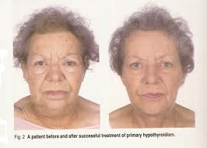
TSH-Hypothyroid

Slide 55
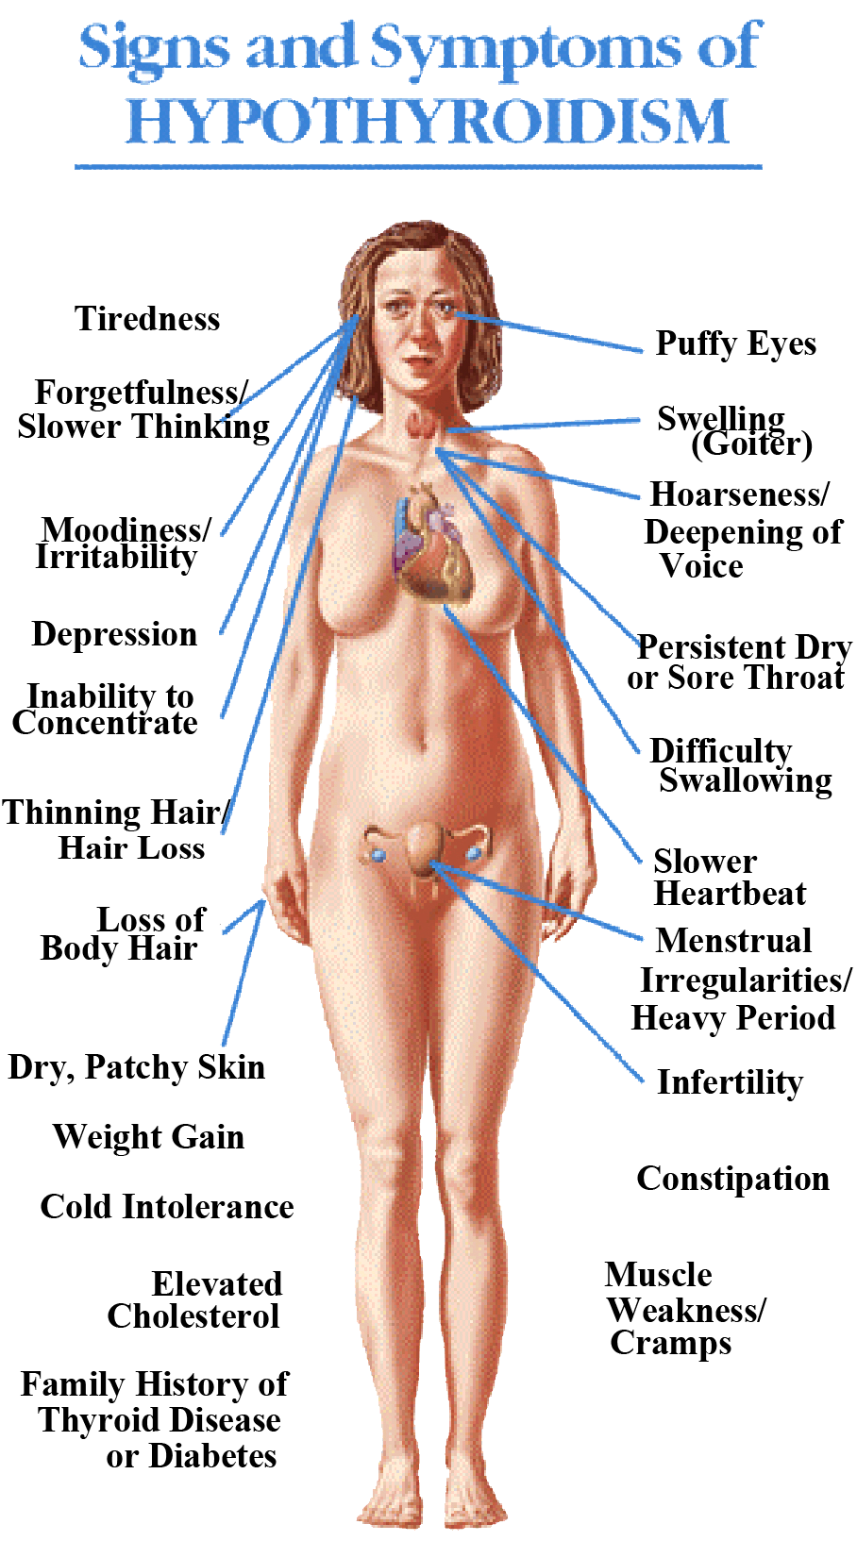
Central Hypothyroidism
Low TSH
Low free T4 and T3

Slide 56
Central Hypothyroidism
C: Clinical | Function : fatigue, weight gain, irregular menses, dry skin, depression, cold intolerance, increase sleep, slow thinking O/E: obesity, ? Depressed face, eye brow
B: Biochemical | Low T4 , Low TSH
A: Anatomical | MRI
Treatment | Thyroxine replacement Surgical removal of pituitary adenoma if large

Slide 57
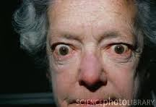
TSH-hyperthyroid

Slide 58
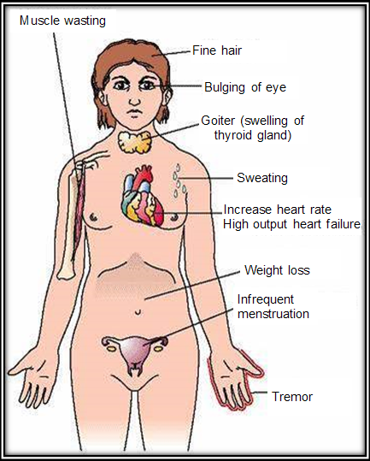

Slide 59
TSH-Producing adenoma
Very rare < 2.8 %
Signs of hyperthyroidism
High TSH, FT4, FT3
Treatment preop with anti-thyroid meds
Surgical resection of adenoma
Medical therapy: Somatostatin Analogue

Slide 60
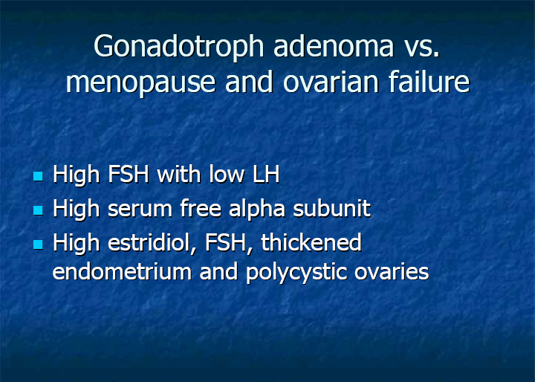

Slide 61
Gonadotroph Adenoma
Surgical resection if large
Radiation therapy

Slide 62
assessment of pituitary function
Baseline: TSH, FT4, FT3, LH, FSH, Prolactin, GH, IGF-I,Testosterone, Estradiol
MRI brain
Neuropthalmic evaluation of visual field
Cardiac and respiratory assessment
Anesthesiologist for airway and perioperative monitoring
Neurosurgeon
ENT for Endonasal evaluation for surgical approach
Preop hormonal replacement: all pituitary adenoma should be covered with stress dose of HC

