Slide 1
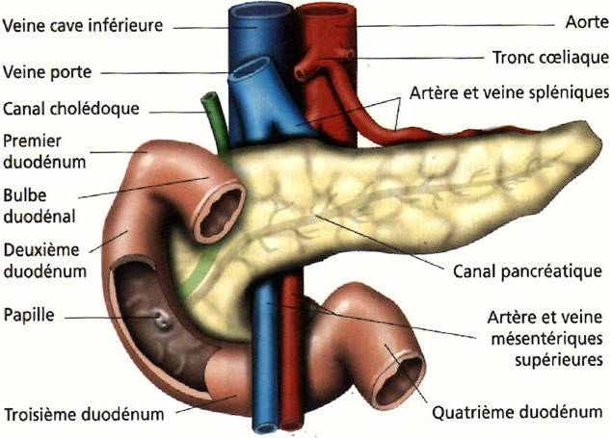
Endocrine Physiology Physiology of the pancreas and Insulin
Dr. Ahmed Alsabih

Slide 2
Pancreas
A triangular gland, which has both exocrine and endocrine cells, located behind the stomach
Strategic location
Acinar cells produce an enzyme-rich juice used for digestion (exocrine product)
Pancreatic islets (islets of Langerhans) produce hormones involved in regulating fuel storage and use.

Slide 3
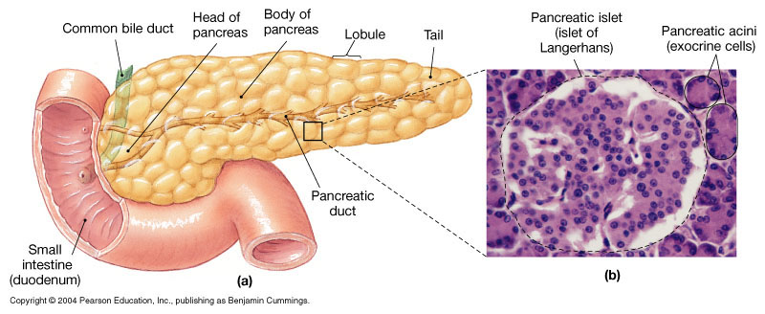
The Endocrine Pancreas

Slide 4
Islets of Langerhans
1-2 million islets
Beta (β) cells produce insulin (70%)
Alpha (α) cells produce glucagon (20%)
Delta (δ) cells produce somatostatin (5%)
F cells produce pancreatic polypeptide (5%)

Slide 5
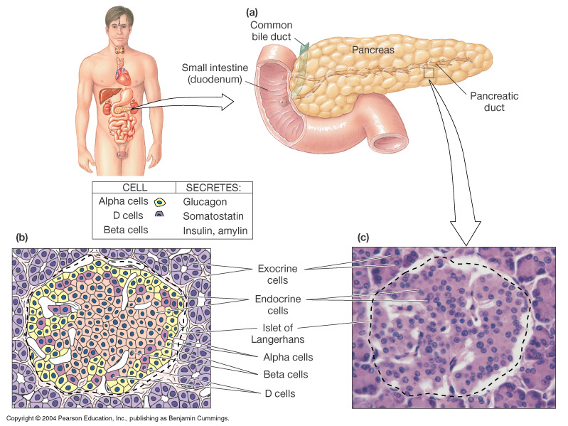
Islets of Langerhans

Slide 6
Insulin
Hormone of nutrient abundance
A protein hormone consisting of two amino acid chains linked by disulfide bonds
Synthesized as part of proinsulin (86 AA) and then excised by enzymes, releasing functional insulin (51 AA) and C peptide (29 AA).
Has a plasma half-life of 6 minutes.

Slide 7
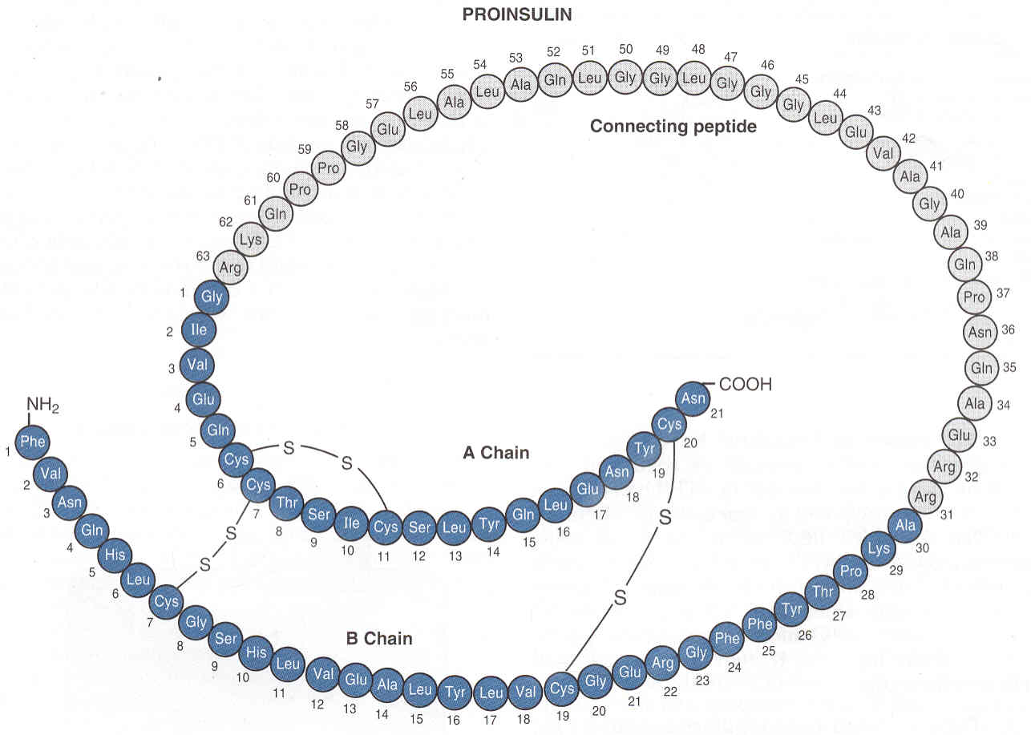
Insulin Structure

Slide 8
Insulin Synthesis
DNA (chromosome 11) in β cells
mRNA
Preproinsulin (signal peptide, A chain,
B chain, and peptide C)
proinsulin
insulin

Slide 9
Insulin Synthesis
Insulin synthesis is stimulated by glucose or feeding and decreased by fasting
Threshold of glucose-stimulated insulin secretion is 100 mg/dl.
Glucose rapidly increase the translation of the insulin mRNA and slowly increases transcription of the insulin gene

Slide 10
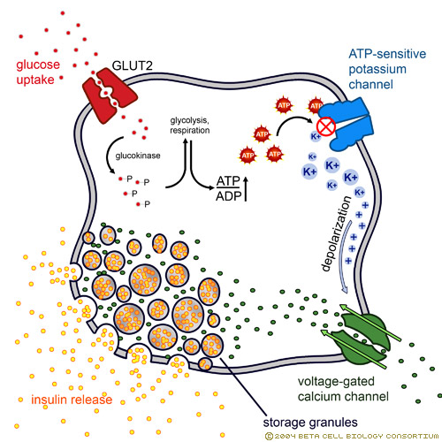
Glucose is the primary stimulator of insulin secretion

Slide 11
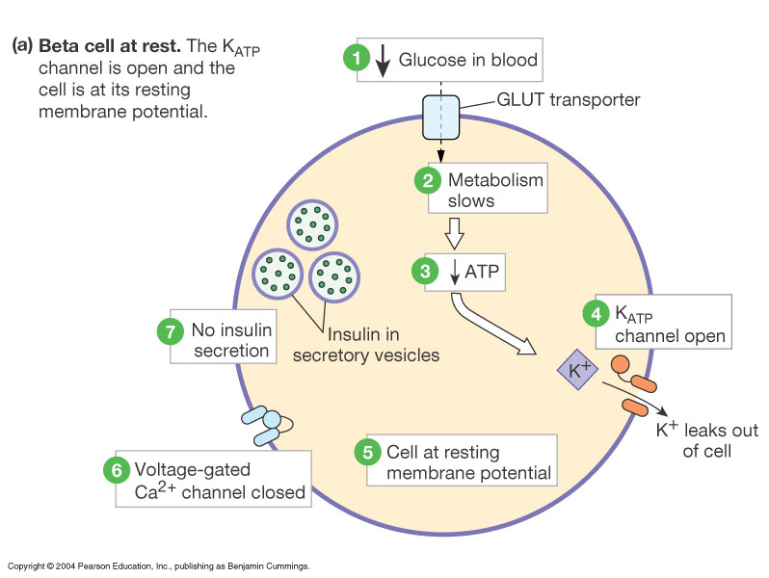

Slide 12
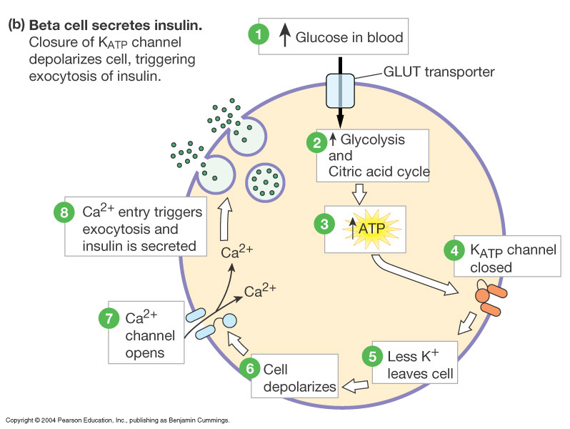

Slide 13
↑ Blood glucose concentration
↑ Gastrointestinal hormones
↓
↑ Blood amino acid conc.
↑
Major control
Food intake
↓
Parasympathetic stimulation
Islet β cells
Sympathetic stimulation
(and epinephrine)
↓
Insulin secretion
↓
Factors controlling insulin secretion
↓ Blood glucose
↓ Blood fatty acids
↓ Blood amino acid
↑ Protein synthesis
↑ Fuel storage

Slide 14
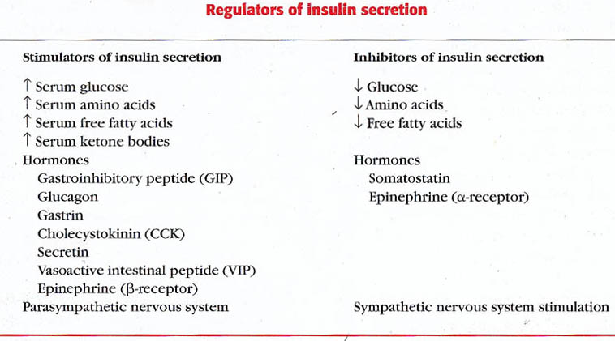
Regulation of Insulin Secretion

Slide 15
Insulin Receptor
the insulin receptor is a transmembrane receptor
belongs to the large class of tyrosine kinase receptors
Made of two alpha subunits and two beta subunits

Slide 17
Actions of insulin

Slide 18
Rapid (seconds)
(+) transport of glucose, amino acids, K+ into insulin-sensitive cells
Intermediate (minutes)
(+) protein synthesis
(-) protein degradation
(+) of glycolytic enzymes and glycogen synthase
(-) phosphorylase and gluconeogenic enzymes
Delayed (hours)
(+) mRNAs for lipogenic and other enzymes

Slide 19
Action of insulin on Adipose tissue
(+) glucose entry
(+) fatty acid synthesis
(+) glycerol phosphate synthesis
(+) triglyceride deposition
(+)lipoprotein lipase
(-) of hormone-sensitive lipase
(+) K uptake

Slide 20
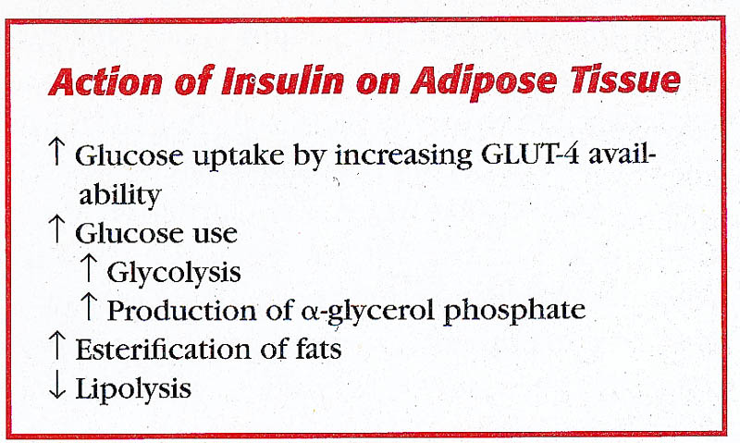
Action of insulin on Fat:

Slide 21
Action of insulin on Muscle:
(+) glucose entry
(+) glycogen synthesis
(+) amino acid uptake
(+) protein synthesis in ribosomes
(-) protein catabolism
(-) release of gluconeogenic aminco acids
(+) ketone uptake
(+) K uptake

Slide 22
Action of insulin on Muscle:

Slide 23
Action of insulin on Liver:
(-) ketogenesis
(+) protein synthesis
(+) lipid synthesis
(-)gluconogenesis, (+) glycogen synthesis, (+) glycolysis.
General:
(+) cell growth

Slide 24
Action of insulin on Liver:

Slide 25
Glucose regulation and metabolism terms
- Gluconeogenesis - Synthesis of glucose from noncarbohydrate precursors, Lactic acid, glycerol, amino acids, liver cells synthesis glucose when carbohydrates are depleted.
- Glycogenesis - Formation of glycogen, glucose stored in liver and skeletal muscle as glycogen, important energy reserve.
- Glycogenolysis – breakdown of glycogen (polysaccharide) into glucose molecules (monosaccharide)
- Glycolysis - the breakdown of glucose into pyruvate by cells for the production of ATP

Slide 26
Glucose transporter systems
TRANSPORTERS | PRESENT IN
GLUT-1 | Placenta, Blood brain barrier, RBCs, Kidneys and Colon.
GLUT-2 | β cells of Pancreas, Liver, Epithelial cells of small intestines and Kidneys.
GLUT-3 | Brain, Placenta and Kidneys.
GLUT-4 | Skeletal Muscles, Cardiac muscles and Adipose tissue.
GLUT-5 | Jejunum and sperm.

Slide 27
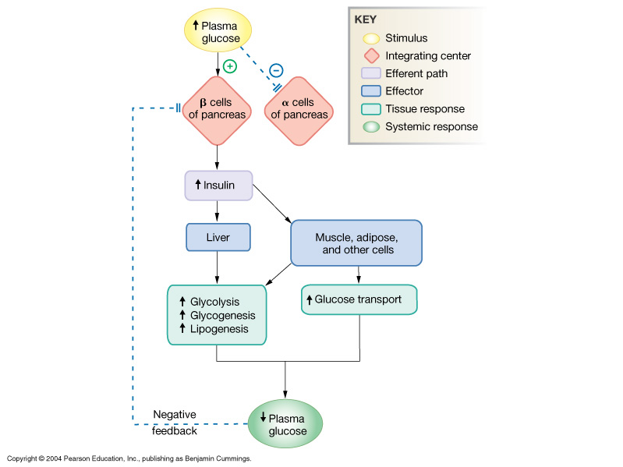
Insulin: Summary

Slide 28
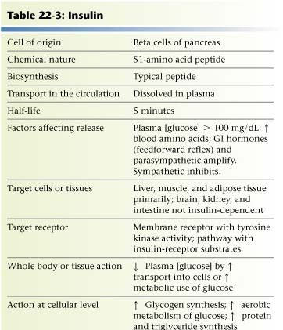

Slide 29
Glucagon
A 29-amino-acid polypeptide hormone that is a potent hyperglycemic agent
Produced by α cells in the pancreas

Slide 30
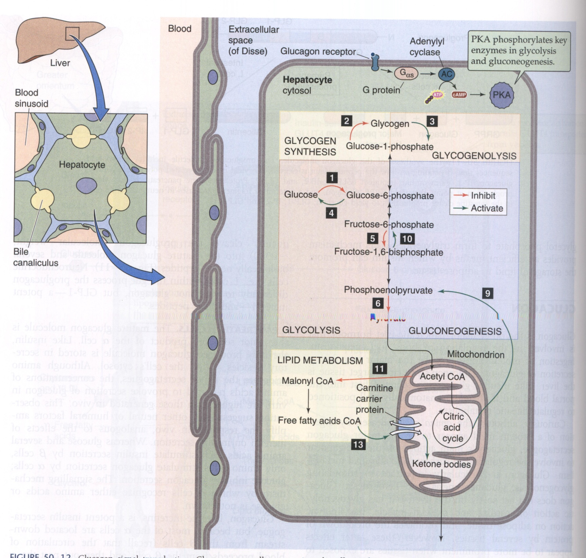
Glucagon Signaling

Slide 31
SYNTHESIS
DNA in α cells (chromosome 2)
mRNA
Preproglucagon
proglucagon
glucagon

Slide 32
Factors Affecting Glucagon Secretion:

Slide 33
Glucagon Actions
Its major target is liver:
Glycogenolysis
Gluconeogenesis
Lipid oxidation (fully to CO2 or partially to produce keto acids “ketone bodies”).
Release of glucose to the blood from liver cells

Slide 34
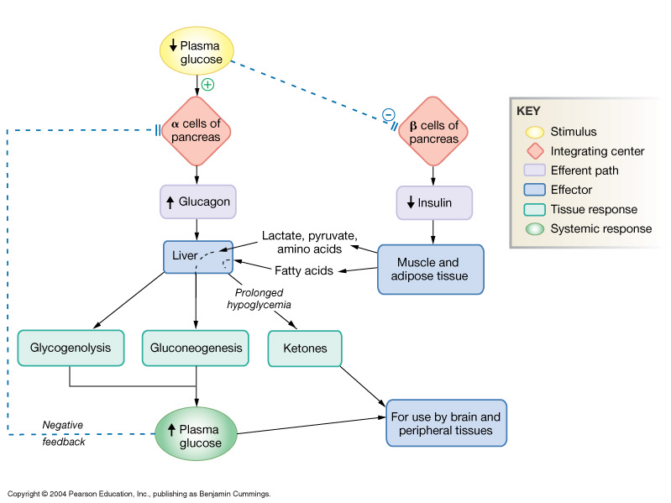
Glucagon Action on Cells:

Slide 35
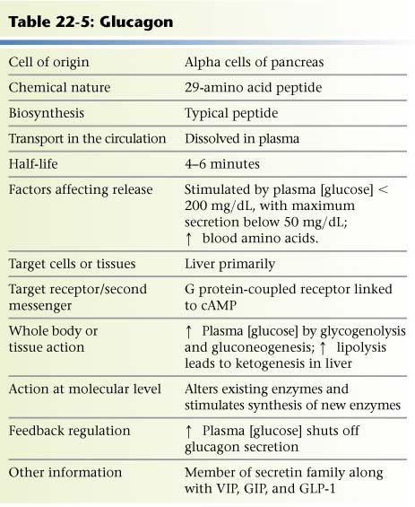

Slide 36
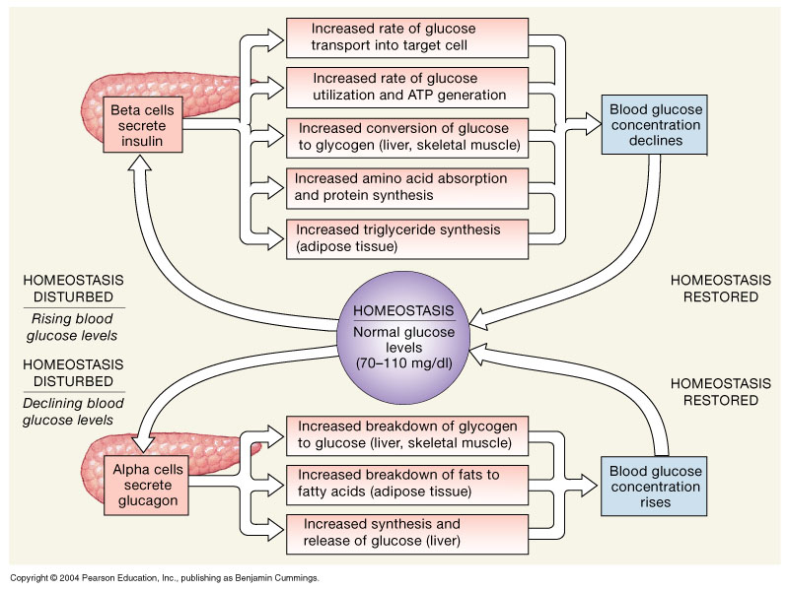
The Regulation of Blood Glucose Concentrations

Slide 37
Diabetes
Diabetes is probably the most important metabolic disease.
It affects every cell in the body and affects carbohydrate, lipid, and protein metabolism.
characterized by the polytriad:
Polyuria (excessive urination)
Polydypsia (excessive thirst)
Polyphagia (excessive hunger).

Slide 38
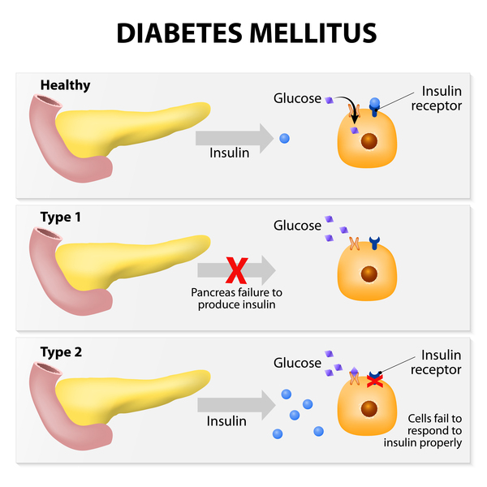

Slide 39
Type I Diabetes (autoimmune attack)
Juvenile onset
Hyposecretion of insulin
Insulin dependent
Gestational Diabetes (during pregnancy)
Type II Diabetes (about 85% )
Late onset
Resistance of body cells to insulin
manage by exercise and diet

Slide 40
Types of Diabetes
Type 1 Diabetes
Affects children
Cause: inadequate insulin secretion
Treatment : insulin injection
Type 2 diabetes
Affects adults
Cause defect in insulin action
Treatment :
diet or OHA (Oral Hypoglycaemic Agents)

Slide 41
Diabetes Mellitus
Inadequate secretion
of insulin
Defects in the action
of insulin
Cause
Metabolic disturbances (hyperglycemia and glycosuria)

Slide 42
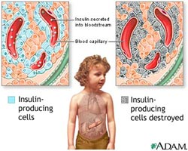
Type 1 diabetes

Slide 43
Diabetes Mellitus Type I
Caused by an immune-mediated selective destruction of β cells
β cells are destroyed while α cells are preserved:
No insulin :::: high glucagon high production of glucose and ketones by liver
glucose & ketones osmotic diuresis
keto acids diabetic ketoacidosis

Slide 44
Diabetes Mellitus: Type II
More common in some ethnic groups
Insulin resistance keeps blood glucose too high
Chronic complications: atherosclerosis, renal failure & blindness

Slide 45
Symptoms of Diabetes Mellitus

Slide 46
Glucose Tolerance Test
Both the FPG and OGTT tests require that the patient fast for at least 8 hours (ideally 12 hr) prior to the test.
The oral glucose tolerance test (OGTT):
FPG test
Blood is then taken 2 hours after drinking a special glucose solution

Slide 47
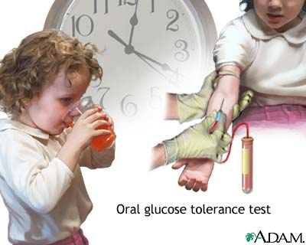

Slide 48
Glucose Tolerance Test (GTT)
Following the oral administration of a standard dose of glucose, the plasma glucose concentration normally rises but returns to the fasting level within 2 hours.
If insulin activity is reduced, the plasma glucose concentration takes longer than 2 hours to return to normal and often rises above 200 mg/dl.
Measurement of urine glucose allows determination of the renal threshold for glucose.

Slide 49
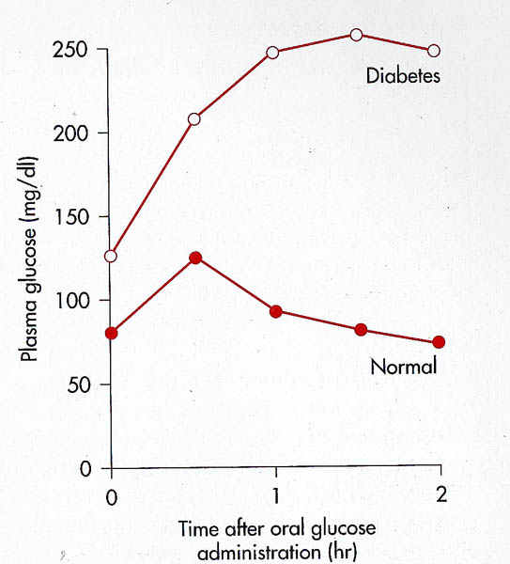
GTT

Slide 50
Glucose Tolerance Test
The following results suggest different conditions:
Normal values:
FPG <100 mg/dl
2hr PPG < 140 mg/dL
Impaired glucose tolerance
2hr PPG = 140 - 199 mg/dL
Diabetes
FPG ≥ 126 mg/dl
2hr PPG levels ≥200 mg/dL

Slide 51
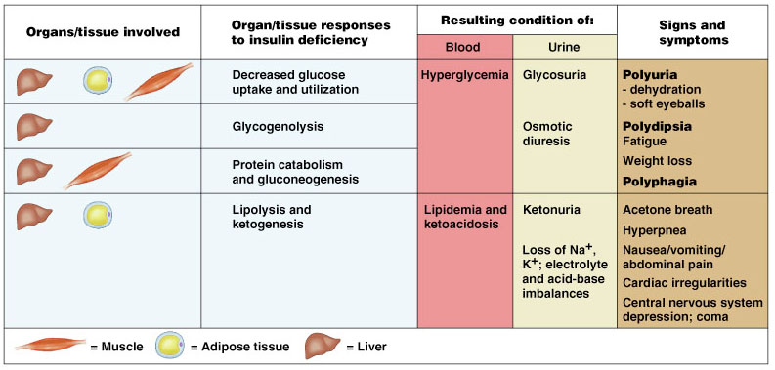
Diabetes Mellitus (DM)

